Slide 1
FDA Drug Adverse Effects Analysis
Domingo Salazar
24 April 2018

Slide 2
Summary
Discussion of the possible questions that would guide the analysis.
Limitations of the data, exploratory data analysis and question selection.
Question selection.
Country analysis based on adverse effects relative frequencies.
Country analysis based on co-occurrences of adverse effects.
How to make the analysis more robust.

Slide 3
Discussion of the possible questions that would guide the analysis.

Slide 4
Q1: Are different adverse events reported in different countries?
Two ways of approaching this question are explored:
Analysing differences in patterns of adverse event occurrences in different countries.
Analysing the relative proportions of adverse events occurring in different countries.
Should we include additional factors like sex, age, or severity in the analysis?

Slide 5
Q2: What are the different adverse events associated with different disease areas?
Like in the previous question, both patterns of adverse event occurrences and relative proportions could be used. This time the co-occurrences may be more likely to be informative.
We could perhaps explore whether the adverse effects are due to primary or secondary pharmacology?

Slide 6
Q3: What drugs tend to be taken together?
This question could perhaps be explored using a network analysis approach similar to what I have been developing together with my collaborators at Imperial College.
It is based in building a network from a correlations/co-occurrence matrix and identifying clusters through the network at difference levels of granularity.

Slide 7
Other Interesting Questions
What adverse effects co-occurred?
Identifying similar adverse effects and grouping them into “types” could make the previous analysis more robust.
What is two very different adverse effects co-occurred for a certain disease area or drug? This could be a hint about secondary pharmacology
Changes on adverse effects reported over time?
The FDA mentions ad hoc influences like media reports, etc.
This ad hoc influences, if they happen for a particular country or disease area, could bias the answers to the previous questions.

Slide 8
Limitations of the Data & Exploratory Data Analysis

Slide 9
Data Wrangling
I downloaded approximately 20 GiB of data from the OpenFDA website in the form of json files. I selected from them the desired field, filtered some errors and converting the resulting data frame into a combined CSV file.
The exploratory data analysis was based on this file, of approximately 856 MiB.

Slide 10
Limitations of the Data
Most of the data come from the US. This may present difficulties for Q1.
A few disease areas/indications are more common than others and there is a large proportion of reports that do not contain this information. This complicates Q2.
Some active principles are given together in the same medication. This complicates Q3.
Consequently, dose information may be less useful, unless combined with information about the actual product.
When information is missing in the main body of the report, sometimes is included in the OpenFDA field. Nevertheless, due to time constraints, I restricted myself to the information present in the main body of the report.
Some reports contain errors about patient ages (age > 122 years!).

Slide 11
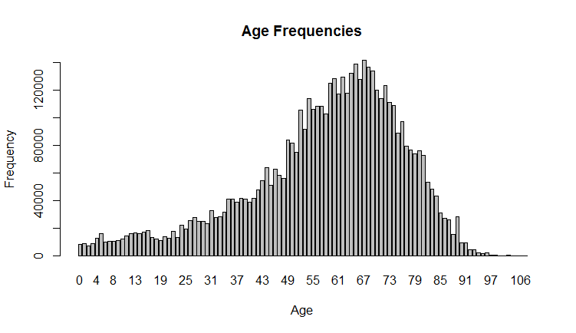
Exploratory Data Analysis (EDA)
For this analysis, I selected the fields: ReportID, Date, Country, patient age & sex, disease area, substance name and route.
As it turns out, again due to time constraints, I did not use all this information in the EDA. But when sub-setting countries and adverse effects (see below), I did check that I still have a good representation of sexes and ages.
In fact, I notice that 60% of the adverse effects were reported on female patients. This could merit further exploration in the context of some recent research.
On the other hand, the left-skewness of the Age distribution in this dataset was unsurprising.

Slide 12
Question Selection
I chose to answer Q1, mostly due to time constraints.
Q2 would required dealing with the large proportion of missing information about indication and the great diversity of indications and adverse effects.
Q3 would require more data wrangling to extract all the active principles taken by a patience and be complicated by lack of information about doses.

Slide 13
Country Analysis based on Adverse Effects Relative Frequencies

Slide 14
Countries & Adverse Event Selection
After some exploration, I felt that I have enough information to compare the top 21 countries that appeared more often in this dataset. The US is unsurprisingly number 1, with approximately 60% of the data.
It was harder to determined the number of adverse events to select. So I made 4 different cut-off values that produced a selection of the top 11, 21, 28 & 42 most common adverse effects in the dataset.
This allows for situation with more classes (countries) than features (adverse effects), with similar numbers and with the more features than countries.
Once I certain number of features is selected, a vector is computed for each country representing the proportion of occurrence of each selected feature in the reports from that country. Proportion for each feature set sum up to 1.
This is expected to compensate for the large differences in the number of reports coming from different countries.

Slide 15
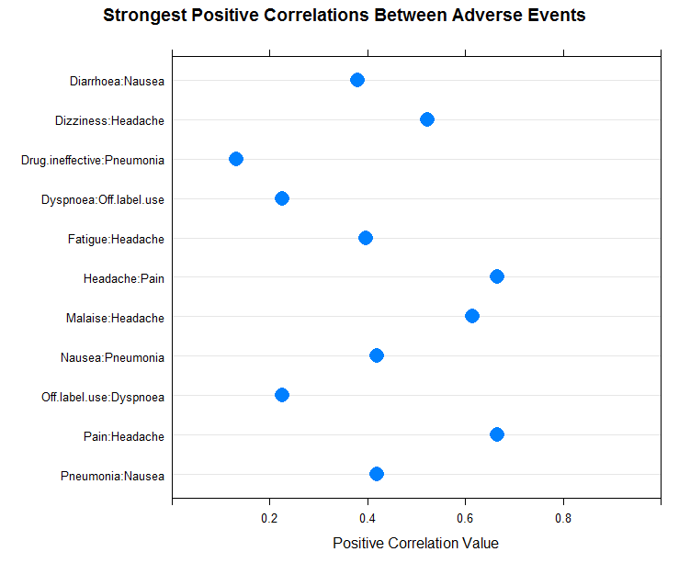
Positive Correlations between Adverse Effects

Slide 16
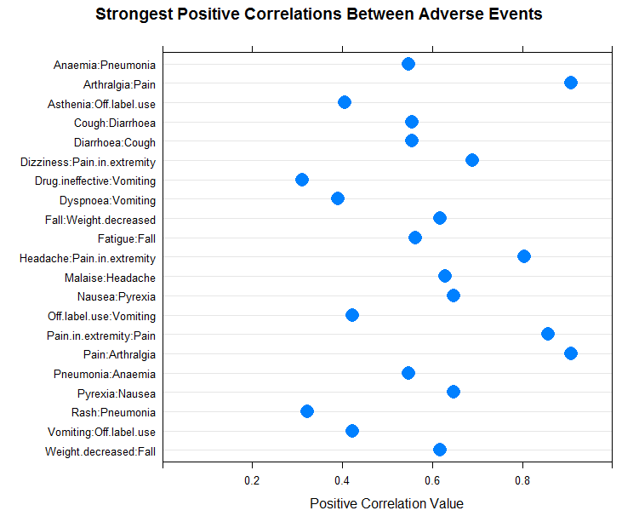

Slide 17
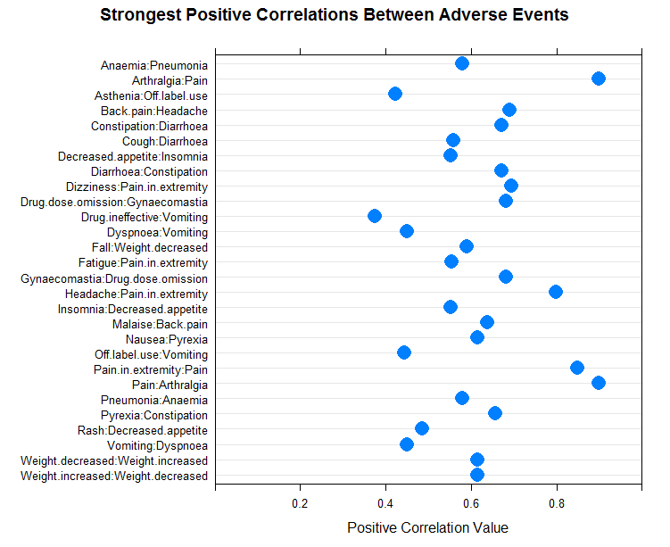

Slide 18
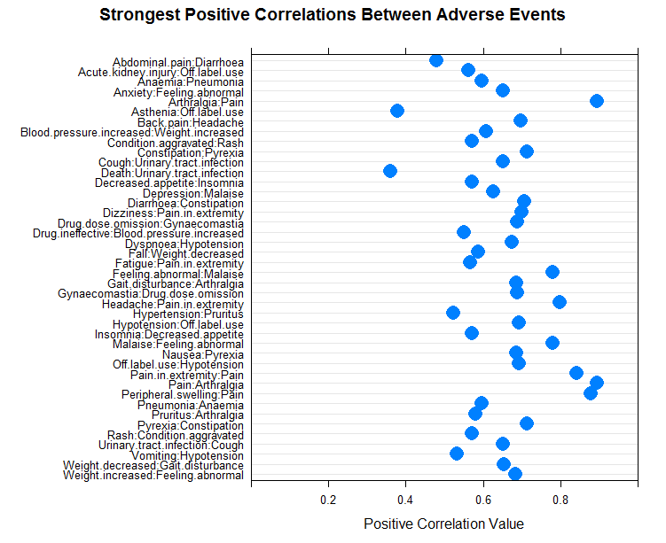

Slide 19
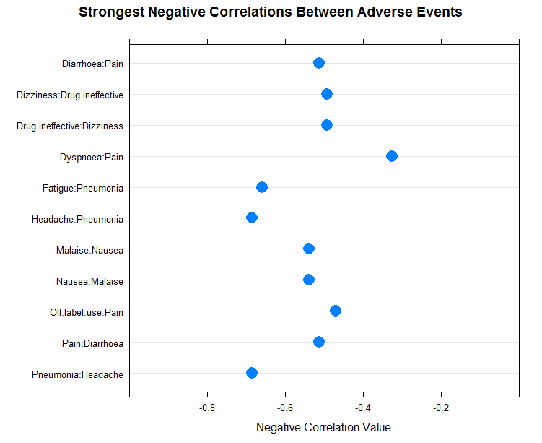
Negative Correlations between Adverse Effects

Slide 20
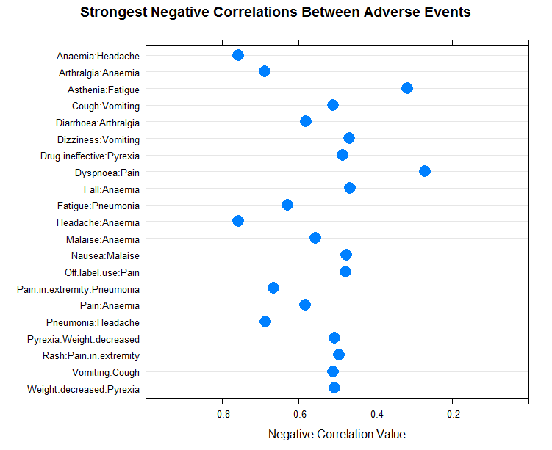

Slide 21
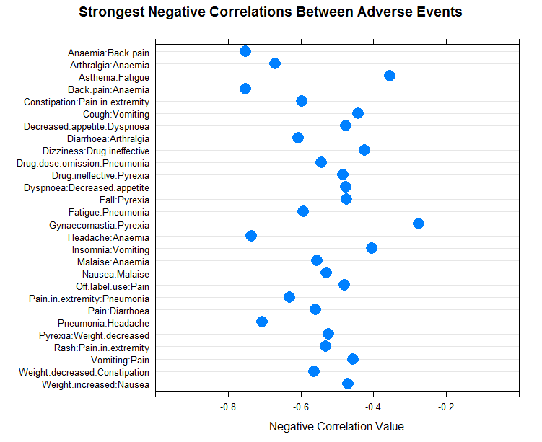

Slide 22
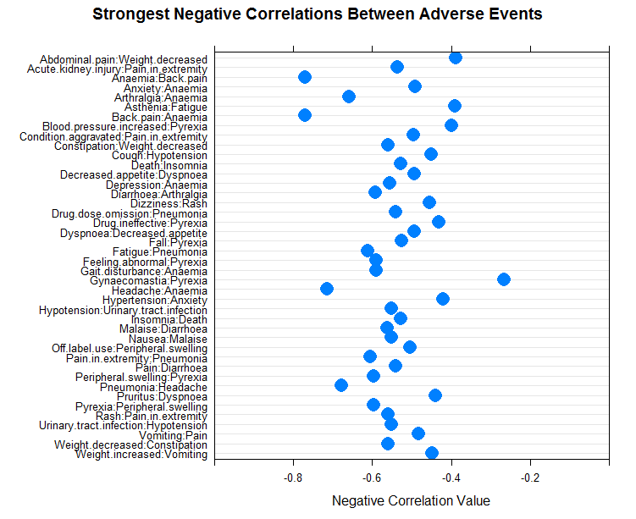

Slide 23
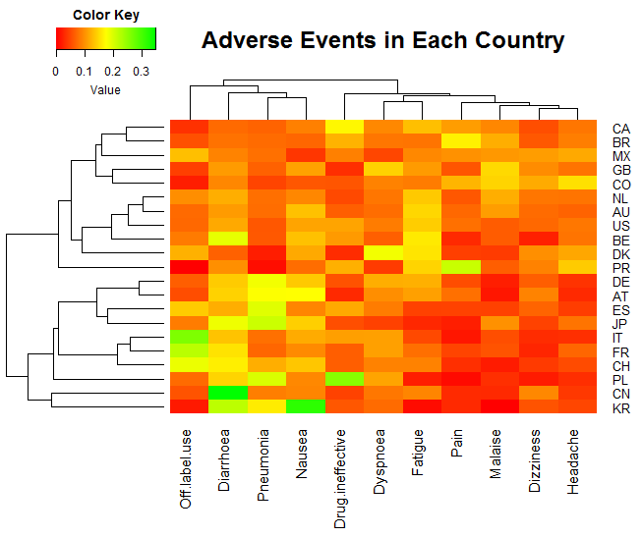
Heat Maps

Slide 24
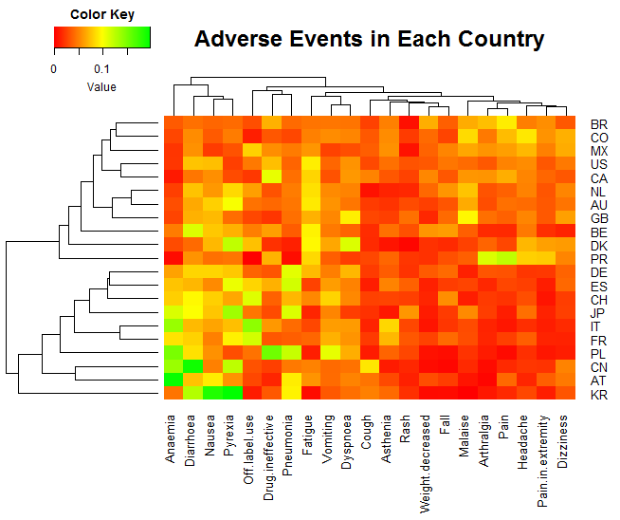

Slide 25
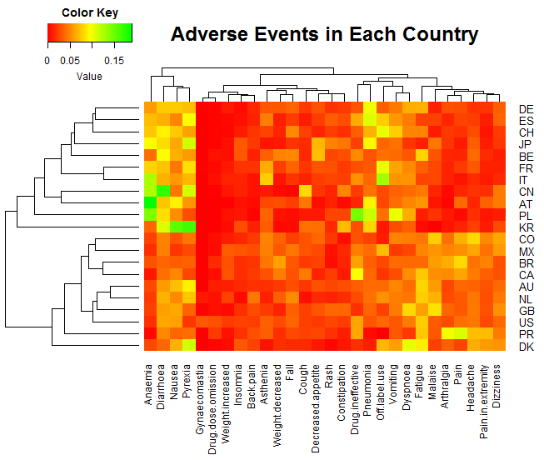

Slide 26
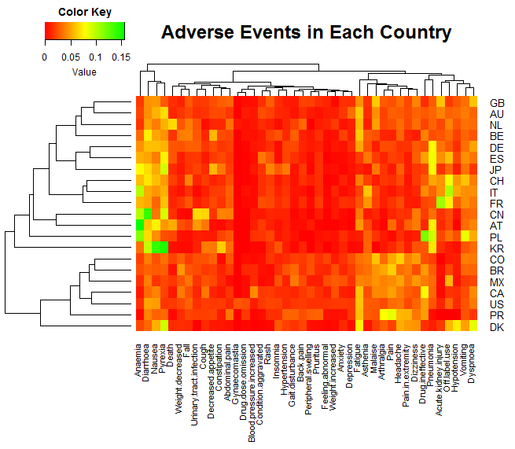

Slide 27
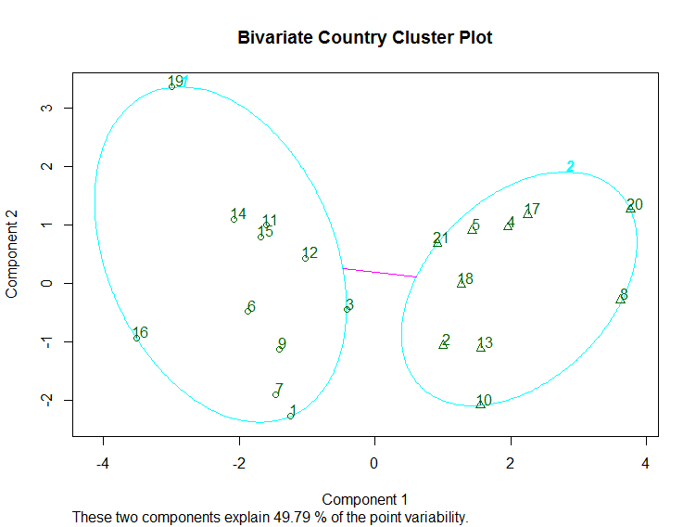
Additional Corroborative Evidence: Mediod Clustering

Slide 28
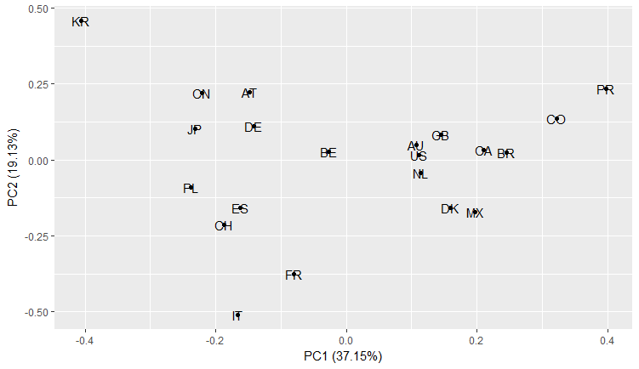
Principal Components (11, 21, 28 & 42 Adverse Effects)
11

Slide 29
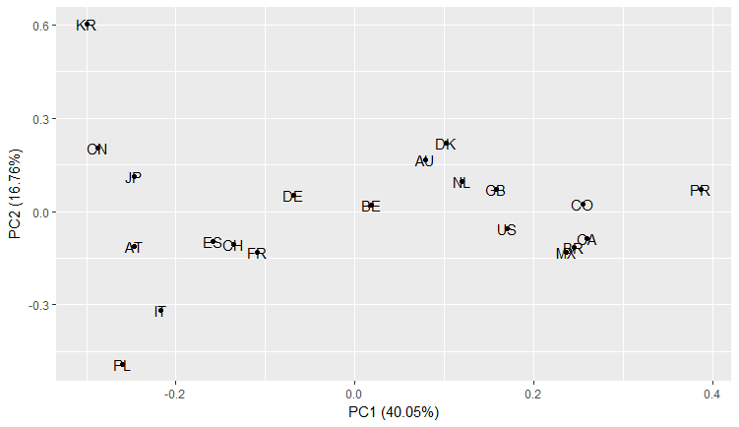
22

Slide 30
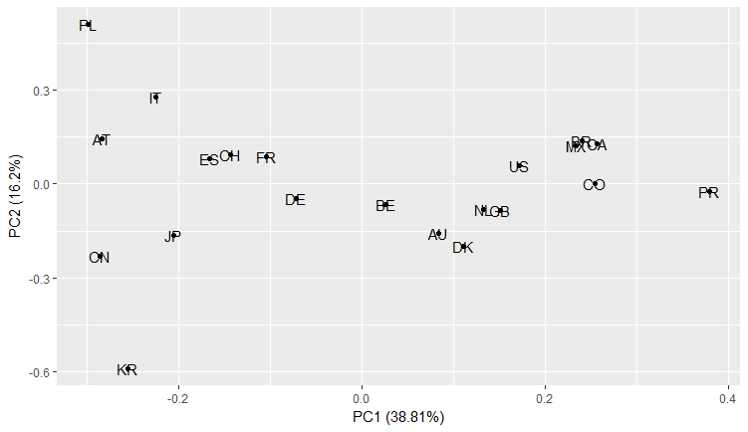
28

Slide 31
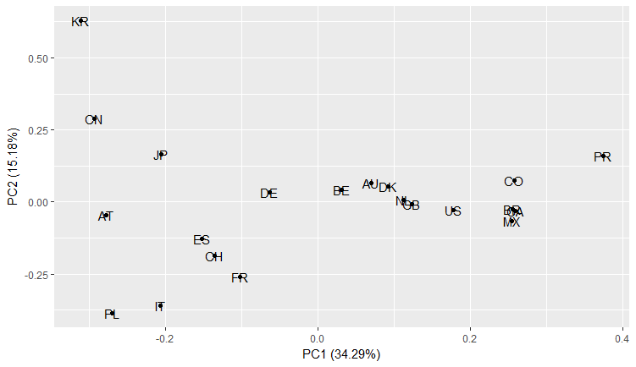
42

Slide 32
How to Make the Analysis more Robust.

Slide 33
Options
The simplest way is to include all the data in the analysis, not done now for time constraints.
Explore various ways of grouping adverse effects: perhaps by organ, type (cardiovascular, psychological, etc.).
In particular, consider separating procedural issues (“wrong dose administered”) from actual effects.
Add information about severity / outcome.
Create a country reporting index. How many reports per capita come from one country? This may be an additional feature that may help correct biased reporting.

