Slide 1
Suicide
An Analysis of Self Inflicted Deaths Between 2005-2015
A Presentation By: Anna, Diego, Hank, and Seth

Slide 2
Why we choose to analyze Death and in particular Suicide?
Discussion around Alzheimer’s led to seeking understanding the stats around Alzheimer’s deaths, which brought about additional discussion concerning other types of death.
Once we did exploratory analytics, we realized there was a story to tell around suicide.

Slide 3
What Questions did we ask the Data?
Is the rate of suicides increasing?
Is the rate of suicides increasing with age?
Does education play a factor in suicide?
Do most suicides involve firearms?
Is suicide more prevalent in one age group over others?
Marital status & suicide: a distinguishable relationship?
Notes:
OWNER: DIEGO

Slide 4
The Data
Where did we find our data?
Kaggle
Main Source
CMS.gov
Health Code txt files
CDC.gov
Quick Code Reference
What issues did we have with our data?
The files were massive and initially hard to explore.
The medical codes were complex, ever changing, and abundant (over 68k.)
The data was very light on detailed or geographical information.
Notes:
OWNER: SETH

Slide 5
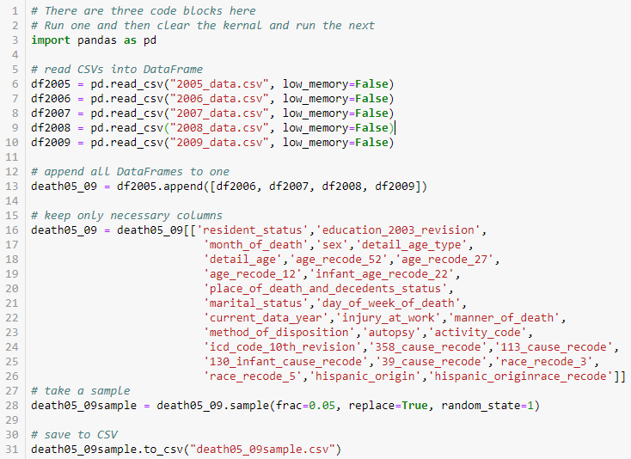
Preparing the Data
The data came in a zipped folder containing 11 CSV files. Each was millions of rows by 77 columns, which took up a lot of memory.
Process:
Read a batch of CSVs to dataframes
Append all to one dataframe
Keep pertinent columns
Take a sample of the dataframe
Save the sample to CSV
Repeat
Append sample CSVs
Sample resemblance: -.02% to .04%
Notes:
OWNER: SETH

Slide 6
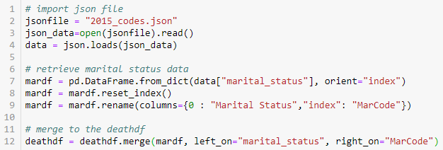
Preparing the Data
Each CSV also came with a json file containing medical codes for that year.
Json files are able to be read into a dataframe similarly to how it would be done using an API.
Notes:
OWNER: SETH

Slide 7
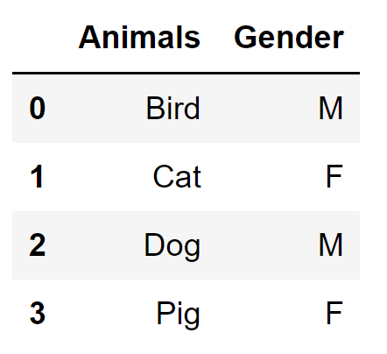
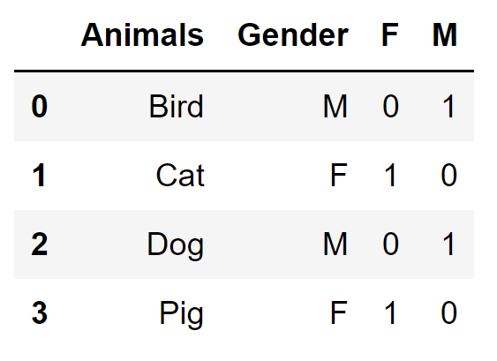
Preparing the Data
We used many methods and a few functions to manipulate our data. But there were two that stood out.
pd.get_dummies()
The ability to change any column into multiple binary columns made it very easy to slice, aggregate, and manipulate our dataset.
Notes:
OWNER: SETH

Slide 8
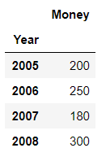
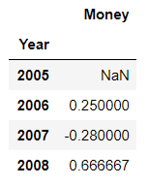

Preparing the Data
The percent change method allowed us to easily put a real number to our analysis.
DataFrame.pct_change()
Notes:
OWNER: SETH

Slide 9
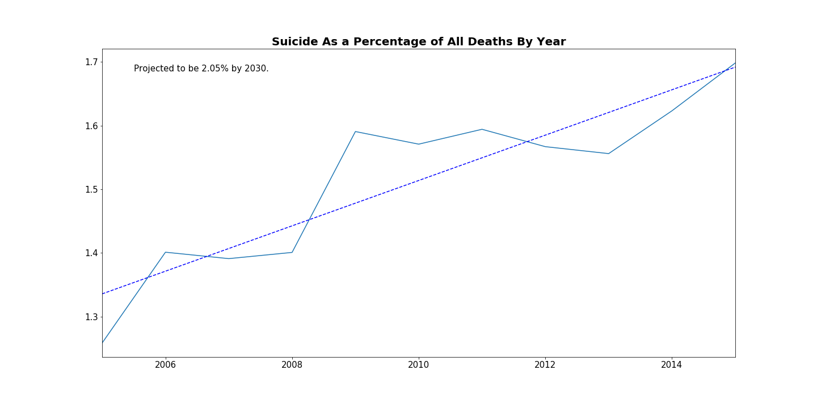
What is the Current and Future Rate of Suicide in the United States
We saw a steady increase in the amount of suicides per year.
Based on our dataset the suicide rate is projected to pass 2% by 2030.
We saw the sharpest increase in suicides between 2008 and 2009. Possible correlation to the financial crisis.
Notes:
OWNER: DIEGO

Slide 10
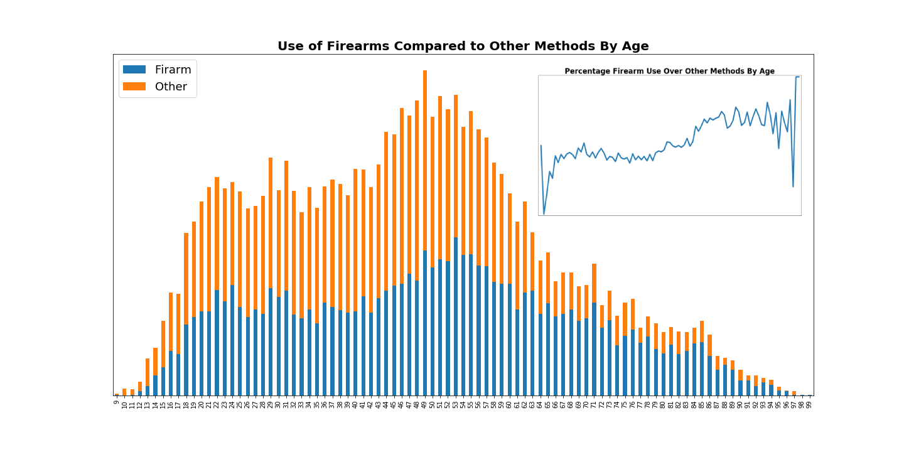
Does Age play a Factor in how one commits suicide?
Firearms account for 42% of suicides under the age of 50.
After the age of 50, usage increases to 58.4%.
Notes:
OWNER: DIEGO
Using the "Cause of Death" code in our dataset we were able to analyse a change in the preferred method overtime. Firearms were the largest proportion of suicide method in our dataset, so they were contrasted against everything else. The graph above charts the age at time of death on the x axis and number of deaths on the y axis. The smaller graph shows the same thing as a percentage.
While the number of suicides starts to taper off around the mid 50's, firearms starts to become the preferred method at about the same time. In the smaller accompanying graph we see the percentage of use almost flip across the age range.

Slide 11
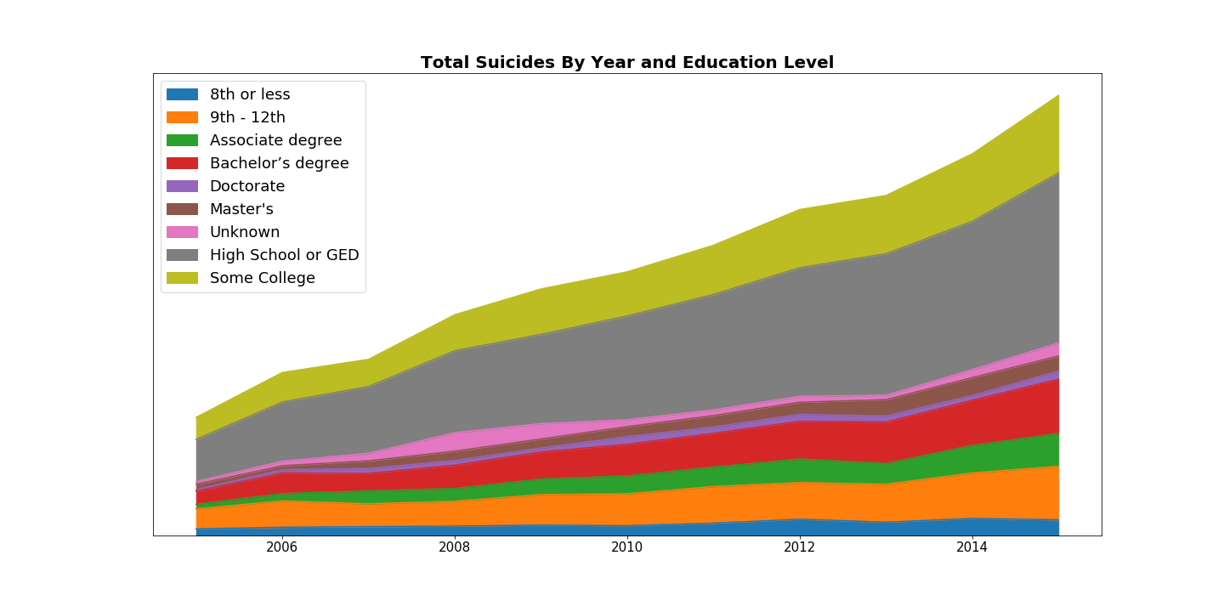
How does Education play a hand in suicide?
Educational Demographic is one of the main contributors to economic hardship which in turn is a contributing factor for some people facing the issue. Initially we looked at the number of suicides a year by educational group. The graph shows number of suicides by year.
Notes:
Side note: This is a good example where using a plt.stackplot line chart vs. a conventional plt.plot line chart is very helpful. Using a plt.plot produces 9 separate lines, the majority of which are close together and it’s very difficult to differentiate and make determinations. In this case, the stockplot makes a great deal of sense, showing the relative percentage of the parts vs. the whole, in this case suicide deaths by education category. You can see that the grey area (HS or GED) is the largest contributor to an increasing number of suicides, followed by the ‘some college’ category, and ‘bachelor’s’ and ‘9th - 12th’ are not too far behind. However, note that this is a sub-set of our df, filtering on deaths by suicide. So is HS-GED really the top of the heap? Can anyone think of why the results displayed above might be misleading? You’ll see on the next slide….

Slide 12
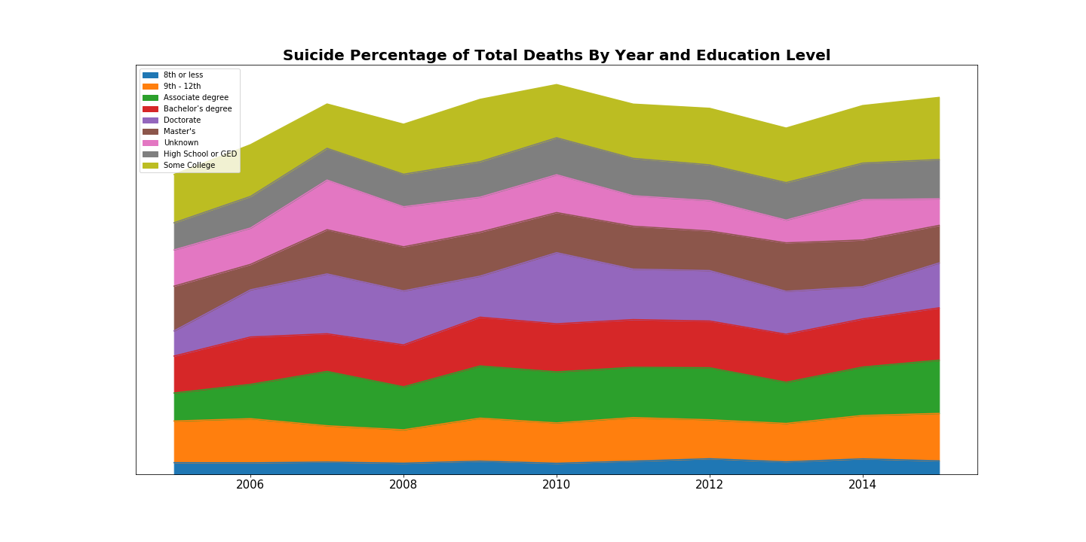
How does Education play a hand in suicide?
Notes:
The last slide showed that the "HS or GED" category has the highest NUMBER of suicides, but this is misleading. As the population grows the amount of deaths per year will also grow. As for education level, it is reported that 90% of the population 25 and older have earned a High School Degree. While only 28% over the age of 27 have college degrees. This means that the pool of "High School level education or GED" will be much larger than most, if not all, other education groups (it was by far in our data set: 400K/41% vs. 123k/13% ‘8th gr or less’). It is more appropriate to analyse this by percentage. The graph shows suicide deaths as a percentage of total deaths by year per education group. A bit more difficult to see above, but the ‘Associates’ cat about doubled from 2005 to %2015(1%-2%)...which you’ll see on the next slide.

Slide 13
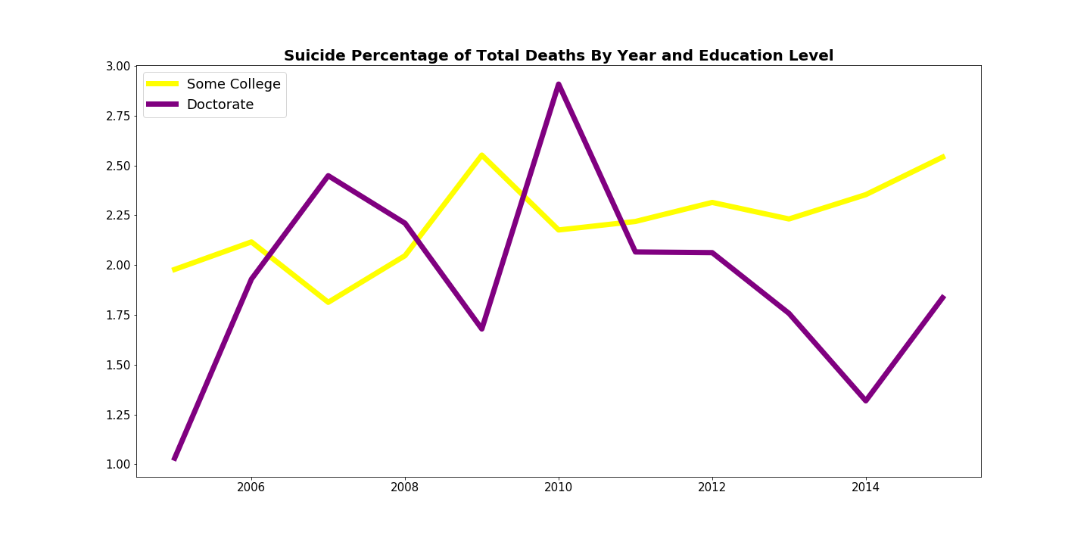
Some College vs Doctorate
Notes:
The previous graph shows us that the suicide rate across education groups fluctuates a little but remains pretty constant across all groups. However, two that are interesting are the "Some College" and "Doctorate" groups.
Without much more in terms of supporting data a clear correlation can not be determined. But it is interesting that when other groups started to experience a higher rate of suicide, "Doctorate" saw a decrease in 2008-09 and a spike in 2010. The "Some College" group is interesting because it has seen a slow and steady increase in the latter years of our dataset.
focuses on the steady trend of "some college", only 2 years below 2%, in 2005 and 2007
doctorate had a few volatile years: 2005: 1%, 2006: ~2%, 2007: 2.4%, 2008: 2.2%, 2009: 1.7%, 2010: ~3%, before dropping off and steadying

Slide 14
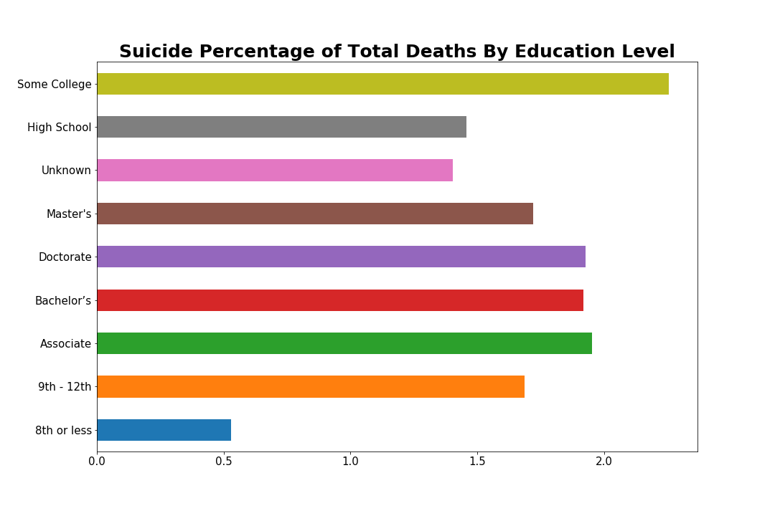
How do educational groups stack against each other as a whole?
Notes:
Overall "Some College" is the educational group with the highest percentage suicides of total deaths. Counter-intuitively, the highest suicide rates were all higher education levels: Some college: 2.26%, Associates: 1.95%, Doctorate: 1.93%, Bachelor's: 1.92%, Master's: 1.72%. In line with this relationship, the lowest level of education completed expressed in numbers and percentage of whole, was 8th grade or less.

Slide 15
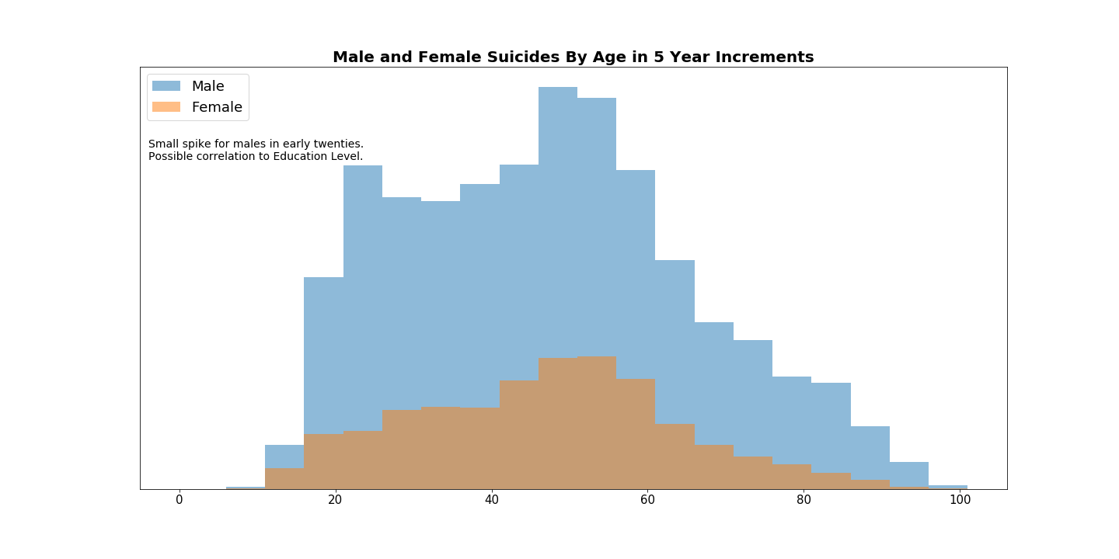
Does Suicide differ depending on Sex?
Gender paradox in suicide:
Women have more suicidal thoughts*
Men die by suicide more frequently
*Source: Self-Directed Violence report by World Health Organization
Notes:
- Even without showing the number of suicides it's easy to see that suicides of males is double that of females >> for the age range 10-15: female suicides are 45% of the male total.
- Male suicide skyrockets 241% from 11-15 age group to 16-20 age group and jumps another 28.61% for 21-25
- By comparison, female suicides jump 111.24% from 11-15 age group to 16-20, which again is around ½
- They both seem to have a similar pattern, except for men in their early twenties; as mentioned by Hank this may have a possible correlation to education level
- Now what if we dig deeper and explore marital status? [Go to Next Slide]

Slide 16
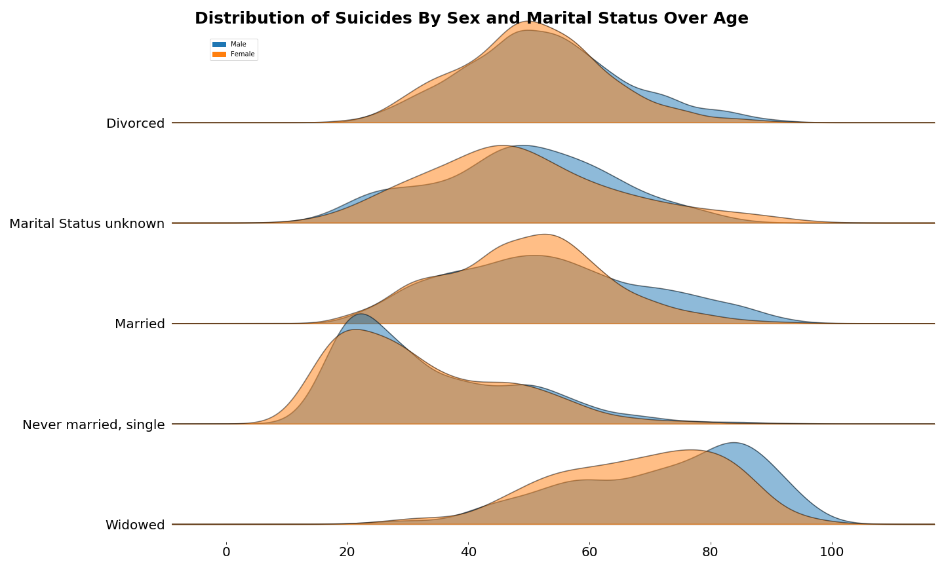
Marital Status & Suicide: A Distinguishable Relationship?
Notes:
- The two groups that don't seem to have a normal distribution are never married and widowed; this doesn’t come as a huge surprise. We can safely assume the two groups follow suit with their typical age distribution...usually there are more never married individuals in their 20-30s then 60s and over and the reverse for widowed. It would be interesting to do further investigation to see how long the individual was a widow before passing away.
- The other groups have a fairly normal distribution and the peak seems to fall around the mid-life crisis time frame.
- Recalling from our last chart, we saw there was a spike for the number of men in their 20s; it seems the majority of these men were never married.
- When it comes to suicide there are rate differences depending on demographic characteristics such as age, gender, marital status, education, and numerous others. Nonetheless, suicide occurs in all demographic groups. [Go to Next Slide]

Slide 17
Conclusion
100% of people will die, . BUT not all will die from suicide
“Suicide is a permanent solution to a temporary problem.”
“When it is darkest, We can see the stars.” - Ralph Waldo Emerson
“This life. This night. Your Story. Your Pain. Your Hope. It matters. All of it matters.” - Jamie Tworkowski
TALK TO SOMEONE NOW
If you’re thinking about suicide, are worried about a friend or loved one, or would like emotional support, the Lifeline network is available 24/7 across the United States.
https://suicidepreventionlifeline.org/
1-800-273-8255

