Slide 1

JSON
A day without new knowledge is a lost day.
https://javascript.info/
infoway

Slide 2
Class Room
Session 1

Slide 3
It’s an alternative to XML.
JSON
There is a difference in JSON - The JSON standard specifies that all key, value pairs should be in double quotes.

Slide 4
What is JSON?
JSON (JavaScript Object Notation) is a lightweight data-interchange format. It is easy for humans to read and write.
JSON provides an easy way to create and store data within JavaScript.
The JSON object can be easily parsed and manipulated with JavaScript and other languages.

Slide 5
JSON Structure
JSON is built on two structures.
A collection of name/value pairs: In various languages, this is realized as an object, record, struct, dictionary, hash table, keyed list, or associative array.
An ordered list of values: In most languages, this is realized as an array, vector, list, or sequence.
“.json” is the extension for external JSON files.

Slide 6
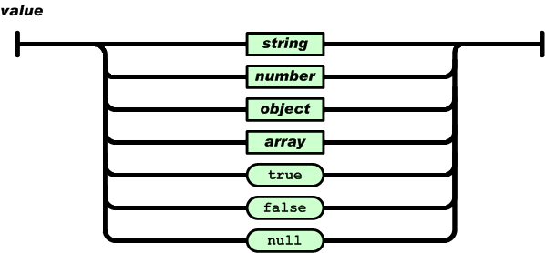
JSON Value
The type of value which is stored.
syntax
A value can be a string in double quotes, or a number, or true or false or null, or an object or an array. These structures can be nested.

Slide 7
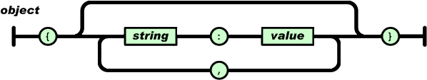
JSON Object
An object is an unordered set of name/value pairs.
syntax
An object begins with { (left brace) and ends with } (right brace). Each name is followed by : (colon) and the name/value pairs are separated by , (comma).

Slide 8
JSON Object
syntax
{ "name1":"value1", "name2":"value2",… }
var book = {
"id":"1001",
"language": "Java",
"edition": "fourth",
"year": 2014,
"author": "Herbert Schildt"
}
var book = {};
book.id = 1001;
book.language = 'Java';
book.edition = "third"
book.year = 2017;
book.author = 'Herbert Schildt';
var book = new Object();
book.id = 1001;
book.language = 'Java';
book.edition = "third"
book.year = 2017;
book.author = 'Herbert Schildt';

Slide 9
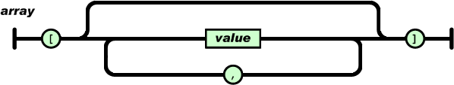
JSON Array
An array is an ordered collection of values.
syntax
An array begins with [ (left bracket) and ends with ] (right bracket). Values are separated by , (comma).

Slide 10
JSON Array
syntax
{ "name":["value1", "value2"", "value3",…] }
var book = {
"id":"01",
"language": "Java",
"edition": "third",
"year": 2017,
"author": "Herbert Schildt",
"price": {"currency": "Rs.", "amount": "1234"},
"mobile": [9850884228, 9850884229]
}
var book = {};
var price = {};
book.id = 1001;
book.language = 'Java';
book.edition = 2017;
book.author = 'Herbert Schildt';
book.price = price;
book.price.currency = 'RS.';
book.price.amount = 12345;
book.mobile = [9850884228, 9850884229];
var book = new Object();
var price = new Object();
book.id = 1001;
book.language = 'Java';
book.edition = 2017;
book.author = 'Herbert Schildt';
book.price = price;
book.price.currency = 'RS.';
book.price.amount = 12345;
book.mobile = [9850884228, 9850884229];

Slide 11
JSON Array
syntax
{ "name":["value1", "value2",… }
var book = new Object();
var price = new Object();
book.id = 1001;
book.language = 'Java';
book.edition = 2017;
book.author = 'Herbert Schildt';
book.price = price;
book.price.currency = 'RS.';
book.price.amount = 12345;
book.mobile = [9850884228, 9850884229];

Slide 12
Parsing JSON
The JSON.parse() method parses a JSON string, constructing the JavaScript value or object described by the string.
syntax
JSON.parse(text[, reviver])
The JSON.stringify() method converts a JavaScript value to a JSON string.
syntax
JSON.stringify(value[, replacer[, space]])
The delete operator removes a property from an object.
delete expression
delete object.property
delete object['property']

Slide 13
JSON.parse()
The JSON.parse() method parses a JSON string, constructing the JavaScript value or object described by the string.
syntax
JSON.parse(text[, reviver])
<script type="text/javascript">
var x = '{"code":"1","ename":"saleel"}';
var y = JSON.parse(x);
console.log(y.code, y.ename);
</script>
<script type="text/javascript">
var x = '[{"code":"1","ename":"saleel"},
{"code":"2","ename":"sharmin"}]';
var y = JSON.parse(x);
for (var i in y) {
console.log(y[i].code, y[i].ename);
}
</script>

Slide 14
JSON.stringify()
The JSON.stringify() method converts a JavaScript value to a JSON string.
syntax
JSON.stringify(value[, replacer[, space]])
<script type="text/javascript">
var x = [{"code":"1","ename":"saleel"},
{"code":"2","ename":"sharmin"}];
var y = JSON.stringify(x);
console.log(y);
</script>

Slide 15

"Live as if you were to die tomorrow.
Learn as if you were to live forever"

