Slide 1
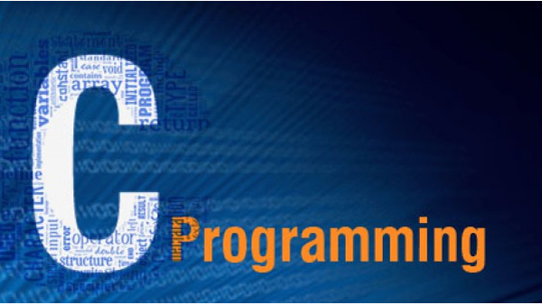
Harshita

Slide 2
Introduction to Programming

Slide 3
Programming Language
A Programming language is a set of rules that provides a way of telling a computer what operations to perform.
A programming language is a notational system for describing computation in a machine-readable and human readable form.

Slide 4
Learning programming language is quite similar to learn English (natural language)-
Steps in learning English language –
Steps in learning Programming language-
Alphabets
Words
Sentences
Paragraph
Alphabets
Digits
Special Symbols
Constants
Keywords
Variables
Instructions
Program

Slide 5
Types of programming language
Low-level programming language – Machine dependent.
i. Machine language
ii. Assembly language
High-level programming language - designed for developing user-friendly software programs and websites.
i. Procedural Oriented programming language
ii. Object-Oriented Programming language
iii. Natural language
Middle-level programming language - lies between the low-level programming language and high-level programming language.

Slide 6
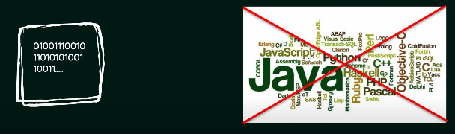
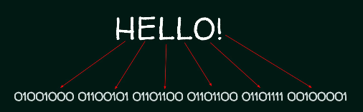
History of Computing
Machine Language -

Slide 7
Assembly Language
For example – Add two numbers
Mov b1, 2
Mov c1, 3
ADD b1, c1
Mov Result, b1

Slide 8
Why C?
In 1969 -UNIX Operating system was developed in assembly language but there is one problem –
Portability
ability to run your code anywhere you want.
Less Line of Code
Procedural Programming
Middle Level Language
Direct access to memory through pointers
Bit manipulation using bitwise operators
Writing assembly code within C Code
Wide variety of built in functions, Standard libraries and header files
stdio.h, math.h, string.h, scanf, printf stc.

Slide 9
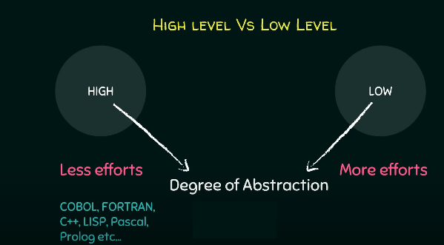

Slide 10
More Features
Simple
structured programming language
Memory Management
Fast Speed
Pointers
Recursion
Extensible

Slide 11
‘C’ was designed and developed by Brian Kernighan and Dennis Ritchie in bell labs in 1972.
It was developed to overcome the problems of previous languages such as B, BCPL (Basic Combined programming Language), etc.
UNIX Operating system was developed in C language in 1972.
ANSI C is the standards for ‘C’ defined by American National Standards Institute(ANSI)

Slide 12
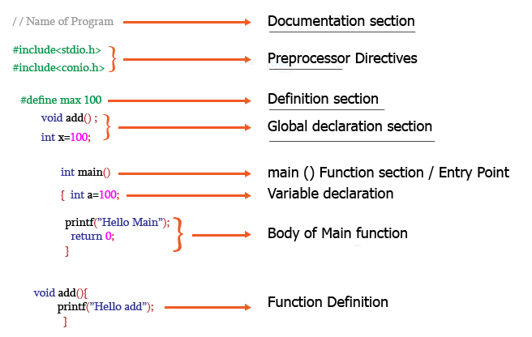
Structure of C Program

Slide 13
First Program
#include <stdio.h>
int main()
{
printf("Hello World");
return 0;
}

Slide 14
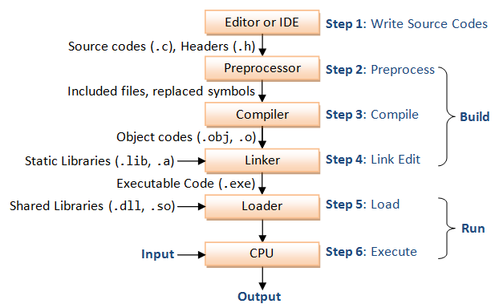
Compiling and executing the Programs

Slide 15
printf() and scanf()
The printf() function is used for output. It prints the given statement to the console.
Syntax:
printf("format string",argument_list)
The format string can be %d (integer), %c (character), %s (string), %f (float) etc.
The scanf() function is used for input. It reads the input data from the console.
Syntax:
scanf("format string",argument_list);

Slide 16
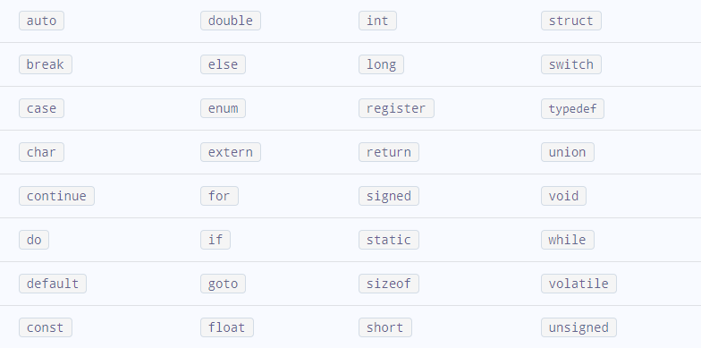
Keywords
Keywords are predefined, reserved words used in programming that have special meanings to the compiler.
A list of 32 keywords in the c language is given below:

Slide 17
Identifiers
Identifier refers to name given to entities such as variables, functions, structures etc.
Identifiers must be unique. They are created to give a unique name to an entity to identify it.
Rules for naming identifiers
A valid identifier can have letters (both uppercase and lowercase letters), digits and underscores.
The first letter of an identifier should be either a letter or an underscore.
You cannot use keywords as identifiers.
There is no rule on how long an identifier can be. However, you may run into problems in some compilers if the identifier is longer than 31 characters.

Slide 18
Variables
C is a strongly typed language
In programming, a variable is a container (storage area) to hold data.
To indicate the storage area, each variable should be given a unique name.
Variable names are just the symbolic representation of a memory location.
For example:
Int marks = 95;
Here, marks is a variable of int type. Here, the variable is assigned an integer value 95.

Slide 19
Constants
constants are fixed values it cannot be changed during the execution of the program. These fixed values are also called literals. It can be any kind of data type.
Using #define pre-processor directive-
This directive is used to declare an alias name for existing variable or any value. We can use this to declare a constant as shown below:
#define identifierName value
Ex- #define PI 3.14
identifierName: It is the name given to constant.
value: This refers to any value assigned to identifierName.
Notes:
Example:
23,160,-205,+78,9978….etc
Float/Real constants
These are refer as floating point/fractional parts.
Rules for creating Float/Real constants
It must have at least one digit.
It must have decimal/floating point.
It can be either positive/negative.
If it does not begins with sign it will be considered as positive.
Commas and blanks are allowed here.
Example:
85.2,6.3,563.9…..etc.
Character & String constants
Character constant is a single character/alphabet/digit/symbol enclosed within a single quote (‘‘).
String constants are enclosed within a double quote (“”).

Slide 20
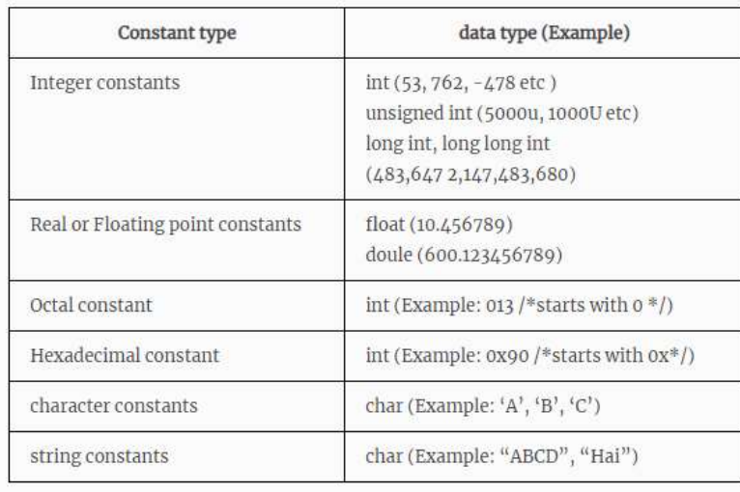
Types of Constant
Notes:
Two ways using const keyword in C
const keyword
#define preprocessor
Const keyword
It can be start with const keyword to declare constants.
Syntax:
const VARIABLE_NAME=VALUE;
Note:-it will be better by naming constant in capitals.
Example

Slide 21
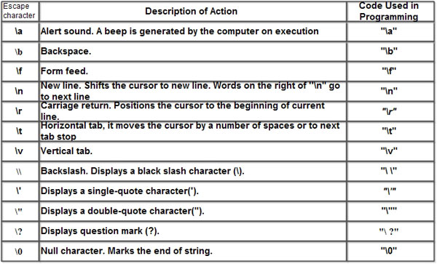
Escape Character

Slide 22
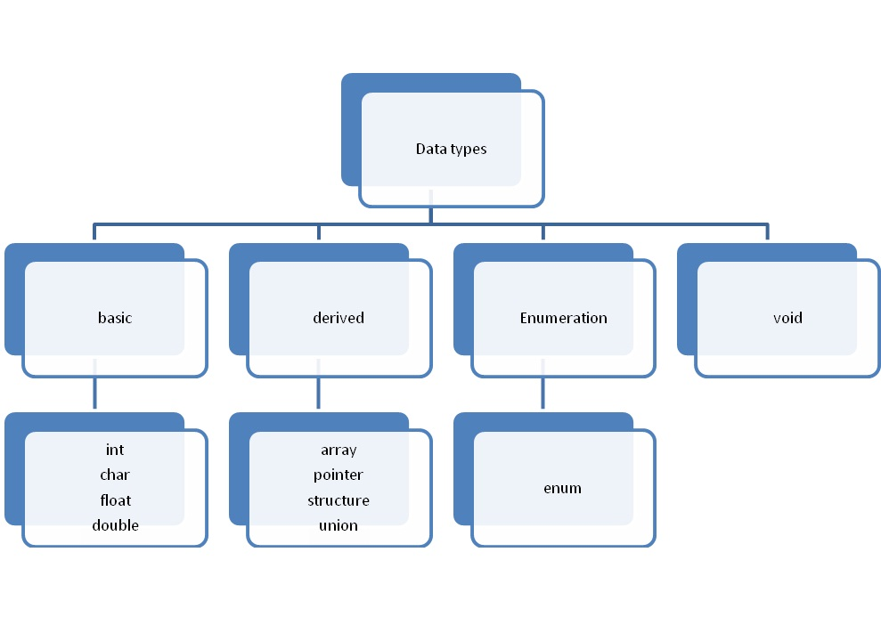
Data types
Data types are declarations for variables.

Slide 23
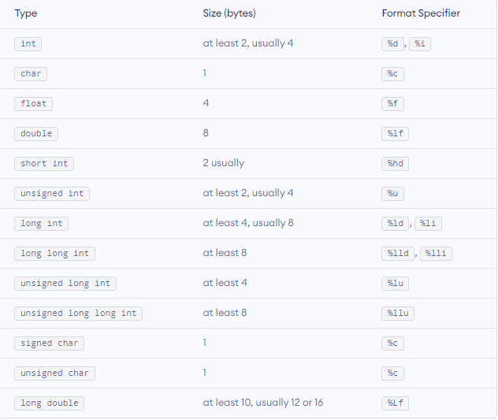
Basic Data Types

Slide 24
Operators

Slide 25
Operators
Operators are symbols that is used to perform some mathematical or logical operations.
Types of operators
Arithmetic operators
Assignment operators
Relational operators
Logical operators
Bitwise operators
Conditional/Ternary operators
Increment& Decrement operators
Misc/Special operators

Slide 26
Operator | Type
++, - - | Increment/Decrement Operator
+, -, *, /, % | Arithmetic Operator
<, <=, >, >=, ==, != | Relational Operator
&&, ||, ! | Logical Operator
&,|, <<, >>, ~, ^ | Bitwise Operator
=, +=, -=, *=, /=, %= | Assignment Operator
?: | Ternary Operator or Conditional Operator
&, *, sizeof( ) | Special operators
Unary Operator
Binary Operator
Ternary
Operator

Slide 27
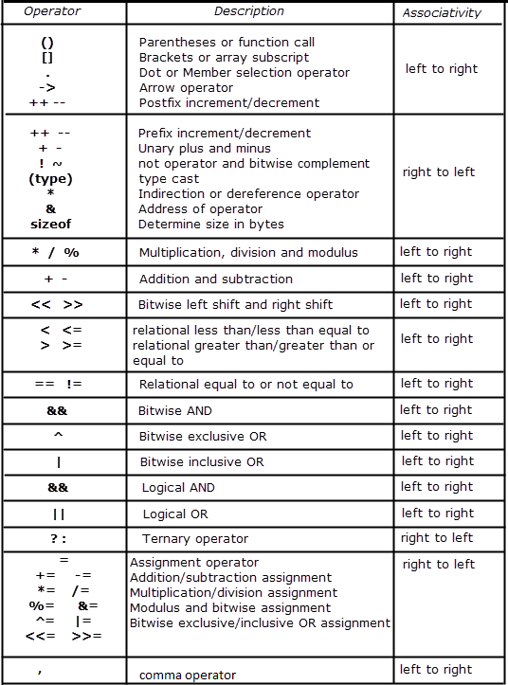
Operator Precedence And Associativity

Slide 28
Algorithms and Flow Chart

Slide 29
Algorithm:- It is a step by step procedure, which defined a set of instructions to be executed in a certain order to get the desired output.
Flow Chart:- It is a graphical representation of an algorithm. It makes use of symbols which are connected among them to indicate the flow of information and processing.

Slide 30
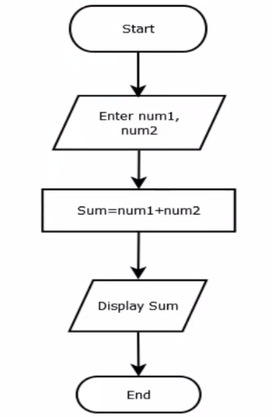
Q: Write an algorithm and draw flowchart for addition of 2 number
Algorithm:-
Step1: Start
Step2: Accept 2 numbers from user
Step3: Add the accepted numbers
Step4: Display the result
Step5: Stop/End

Slide 31
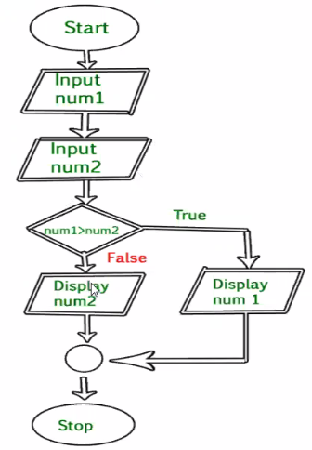

Slide 32
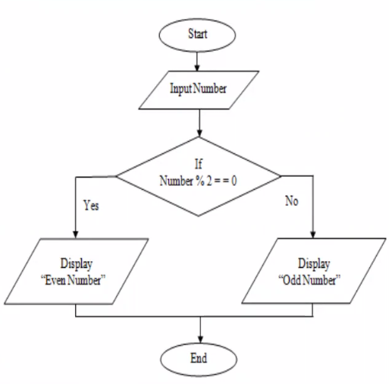

Slide 33
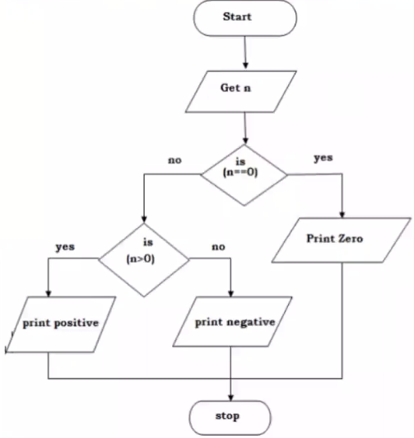

Slide 34
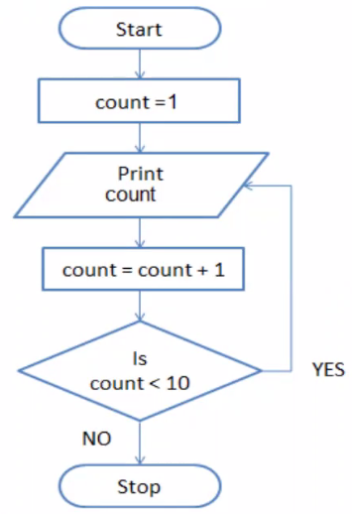

Slide 35
Problem statements
Accept radius from user and display area of circle
Accept age from user and check if eligible to vote or not
Accept number from user until user enters 0 and lastly display sum of all numbers
Accept number from user and calculate factorial.
Display even numbers from 1 to 100.
Check if user entered number is prime or not.

Slide 36
Decision control statements

Slide 37
Decision making statements
Decision making statements are used to perform operation on some condition.
It is used to identify the condition of the operation is true or false.
These statements are also called decision controlled statements.
Here we have listed the decision making statements as follows:
Simple if
if else
Else if ladder
Nested if

Slide 38
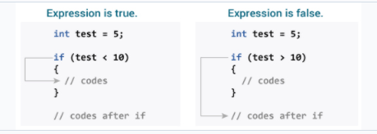
If statement
Syntax for simple if
if(condition)
{
Statements;
}
#include<stdio.h>
int main()
{
int num;
printf(“\nEnter number“);
scand(“%d”,&num);
if(num>0)
printf(“\nIt is positive number”);
return 0;
}

Slide 39
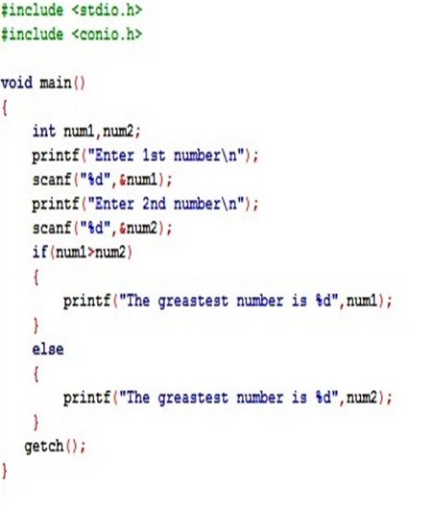
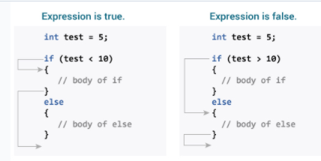
If…else Statement

Slide 40
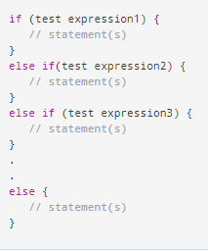
if...else Ladder
The if...else statement executes two different codes depending upon whether the test expression is true or false. Sometimes, a choice has to be made from more than 2 possibilities.
The if...else ladder allows you to check between multiple test expressions and execute different statements.
Syntax:

Slide 41
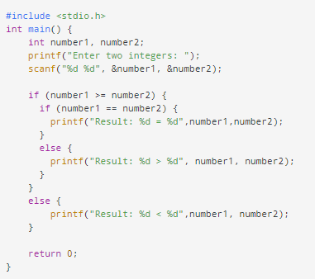
Nested if...else
It is possible to include an if...else statement inside the body of another if...else statement.
Syntax: if(condition)
statement;
else
{
if(condition)
statement;
else
{
if(statement)
statement;
…..
…..
}

Slide 42
Loops
Loop is a block of statement that performs set of instructions.
In loops Repeating particular portion of the program either a specified number of time or until a particular no of condition is being satisfied.
There are three types of loops in c
1.While loop
2.do while loop
3.for loop

Slide 43
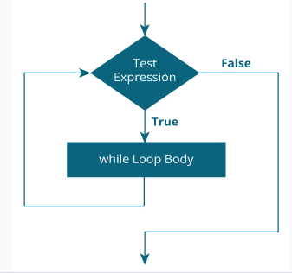
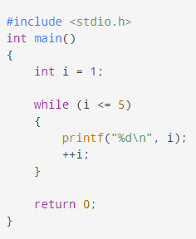
While Loop
The syntax of the while loop is:
while(condition)
{
Body of the loop;
}
For Ex-

Slide 44
do...while loop
The do..while loop is similar to the while loop with one important difference. The body of do...while loop is executed at least once. Only then, the test expression is evaluated.
The syntax of the do...while loop is:
do
{
Body of the loop;
}while(condition);

Slide 45
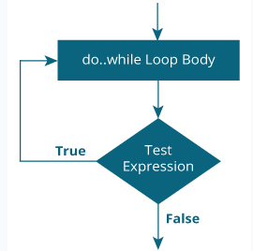
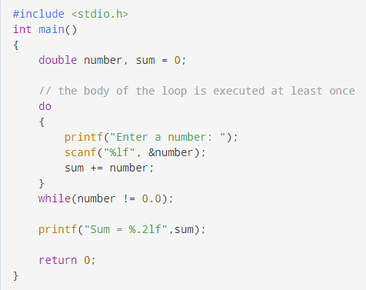
do...while loop

Slide 46
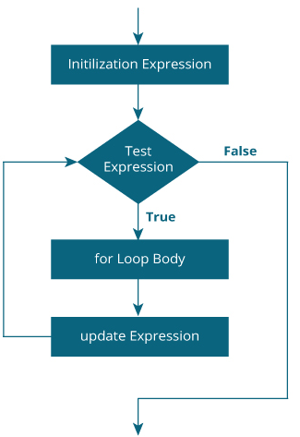
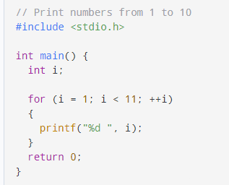
For Loop
The syntax of the for loop is:
for (initializationStatement; testExpression; updateStatement)
{
// statements inside the body of loop
}

Slide 47
Nested while loops
Syntax: intialization
while(condition)
{
intialization
while(condition)
{
…..
increament/decrement
}
increment/ decrement
}

Slide 48
Nested for loops
Syntax: for(initialization;condition;increment/decrement)
{
for(initialization;condition;increment/decrement)
{
statements …
}
statements …..
}

Slide 49
Nested do…while loops
Syntax: do
{
statements
do
{
statements …
}while(condition);
}while(condition);

Slide 50
Jumping statements
Jump statements are used to transfer the control of the program unconditionally.
break
continue
goto

Slide 51
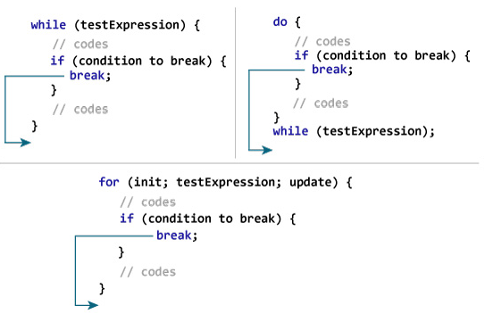
break
The break statement ends the loop immediately when it is encountered.
How break statement works-

Slide 52
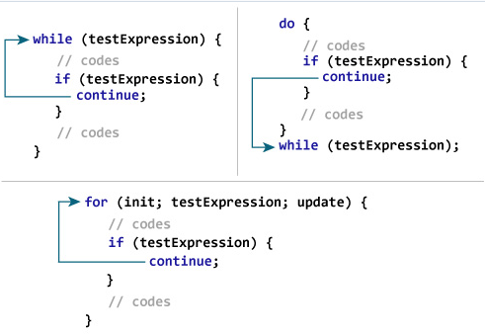
continue
The continue statement skips the current iteration of the loop and continues with the next iteration.
How continue statement works-

Slide 53
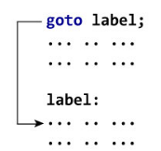
goto
The goto statement allows us to transfer control of the program to the specified label.
Syntax of goto Statement
goto label; ... .. ... ... .. ... label: statement;
The label is an identifier. When the goto statement is encountered, the control of the program jumps to label: and starts executing the code.

Slide 54
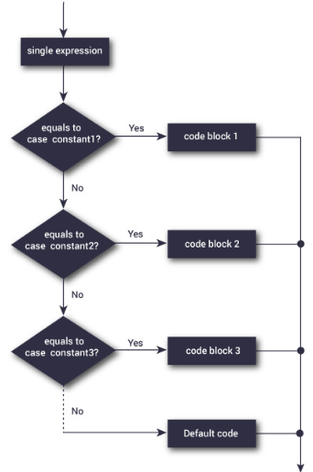
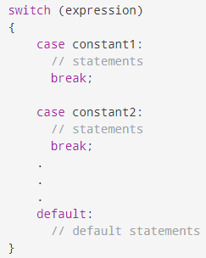
Switch statement
The switch statement allows us to execute one code block among many alternatives.
Syntax of switch...case

Slide 55
Array

Slide 56
Array
Array is a collection of finite set of elements stored at contiguous memory locations.
An array is stored so that position of each element can be evaluated by the index. Arrays are used to implement the data structure.
If you want to store 50 employee details, for that we allocate 50 variables to the store data, this will more difficult to process the data and then length of code will be too long. So by using array we can overcome from that problem. array.
Whatever size may be define at the declaration of array, we can’t exceed the limit of size what we declared. Dynamically it doesn’t change the size.

Slide 57
Uses of Arrays
Less code will be use to access the array data.
We can retrieve the elements of an array easily.
It is easy to sort the array elements.
Types of Arrays:
There are 2 types of array available in C.
One dimensional array
Multi dimensional array

Slide 58

One dimensional array
How to declare an array?
dataType arrayName[arraySize];
For example: int mark[5];
Access Array Elements:
How to initialize an array?
It is possible to initialize an array during declaration.
For example,
int mark[5] = {19, 10, 8, 17, 9};
OR
int mark[] = {19, 10, 8, 17, 9};

Slide 59
Int arr[10];
Index
0
1
2
3
4
5
6
7
8
9
56 | 76 | 64 | 45 | 67 | 87 | 98 | 38 | 73 | 49
100
104
108
112
116
120
124
128
132
136
Address
(arr+0 )= &arr[0] *(arr+0)=arr[0]
If you write
(arr+3)-Arr is nothing but base address.
100+3*(No of byte as per datatype)
100+3*4=112 now to get value at 112 *(arr+3)

Slide 60
Example
#include<stdio.h>
int main()
{
int arr[5],sum=0,i;
printf(“\nEnter array elements ”);
for(i=0;i<=4;i++)
{
scanf(“%d”,&arr[i]); //i.e (arr+i)
}
for(i=0;i<=4;i++)
{
sum=sum+arr[i];
}
printf(“\nSum of array elements are :%d”,sum);
return 0;
}

Slide 61
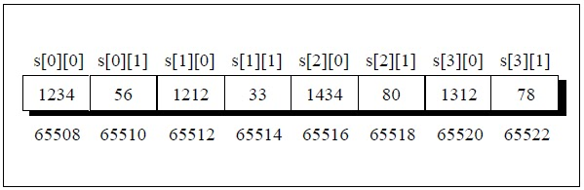
Two dimensional array
Syntax:
Data_type array_name[size][size];
Int arr[3][3]; ->here row size is 3 and column size 3.
How to initialize Array elements.
Int arr[3][3]={1,2,3,4,5,6,7,8,9};
Int arr[][3]={
{10,20,30},
{40,50,60},
{70,80,90}
};
int s[2][4];

Slide 62
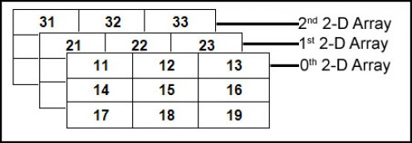
Multi dimensional array

Slide 63
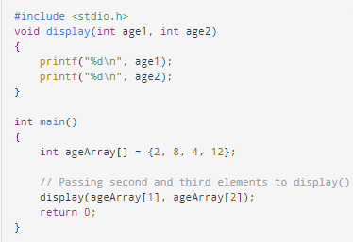
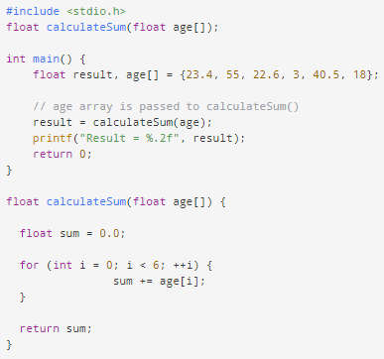
Passing arrays to functions

Slide 64
Function

Slide 65
Function
A function is a block of code that performs a specific task.
Types of function:
Standard library functions
User-defined functions
Three program elements involved in using a user-defined function
1)Function prototype/Function declaration.
2)Function definition
3)Call to the function

Slide 66
Function Example
void printMsg(); //Function Declaration
Void printMsg() //function definitions
{
printf(“\n Predac batch –is ongoing”);
}
int main()
{
printMsg(); }

Slide 67
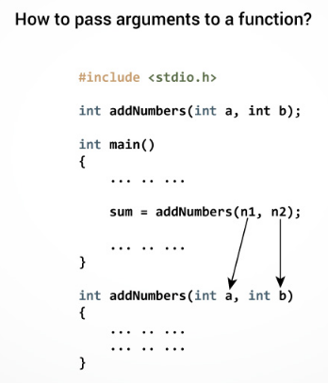
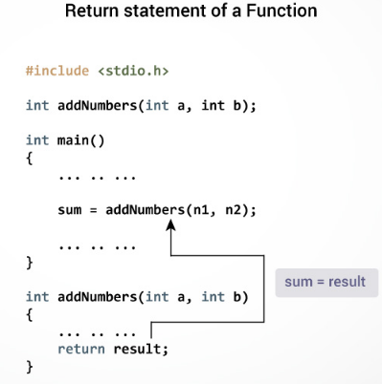

Slide 68
Types of User-defined Functions
No arguments passed and no return value
No arguments passed but a return value
Argument passed but no return value
Argument passed and a return value

Slide 69
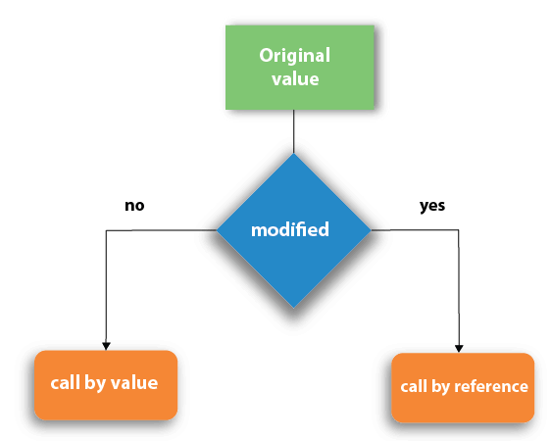
Call by value and Call by reference

Slide 70
Call by value
In this method value passed to the function locally stored to the parameter/ argument in stack. In other words it copies the value of an argument into the formal parameter of the function.
Memory is differing from both actual and formal parameters. Because it copy the value of actual parameter to formal parameter.
The value of actual parameter cannot be changed by the formal parameter. such that original value is not modified.
Note: - By default C uses the call by value method to pass the arguments.
Actual parameter: It is used in function call.
Formal parameter: It is used in function definition

Slide 71
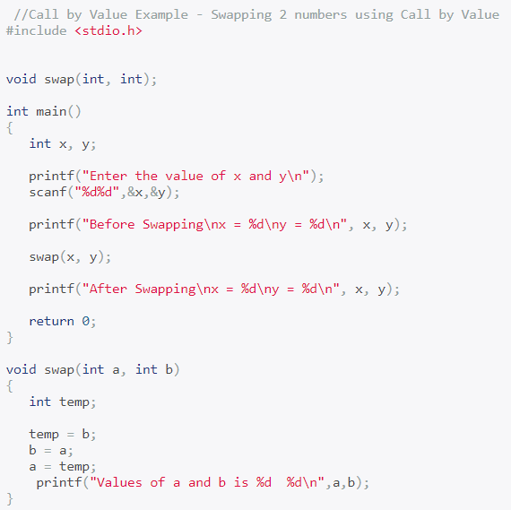

Slide 72
Call by reference
In call by reference it will pass the address of the (variable) actual parameter.
So it will affect original value that means it can be modified by the formal parameter.
Thus it will change the value; it can affect inside the function as well outside the function values.
Address operator (&) is used in actual parameter to call the function.
Address is used for both formal and actual parameter. Same memory is used for actual and formal parameter. This address is used to access and change the value of the variable.

Slide 73
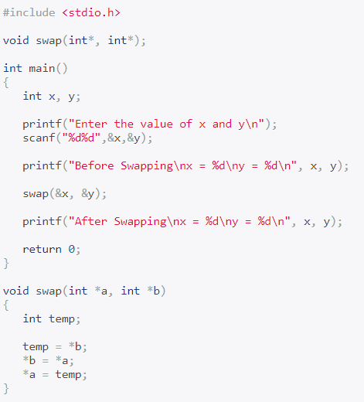

Slide 74
Recursion
Functions call itself is called as recursive function.
It is also known as recursion. It repeatedly performs the process. Just like looping statement it repeats same code. Without using iteration statements (while, for) this kind of process will be more helpful for us.
When we using recursive function, we have to define some exit condition from the function to prevent infinite function call.

Slide 75
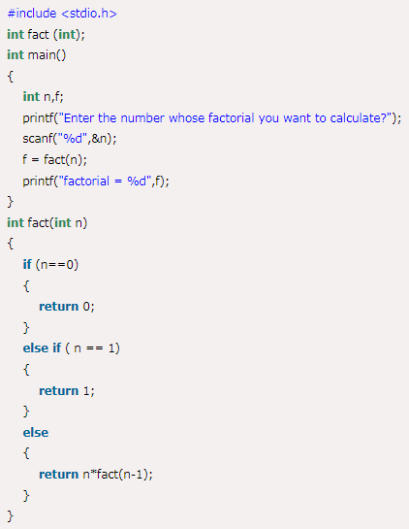
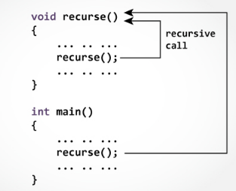

Slide 76
Storage Classes

Slide 77
Storage Class
Every variable in C programming has two properties: type and storage class.
Type refers to the data type of a variable. And, storage class determines the scope, visibility and lifetime of a variable.
There are 4 types of storage class:
automatic
external
static
register

Slide 78
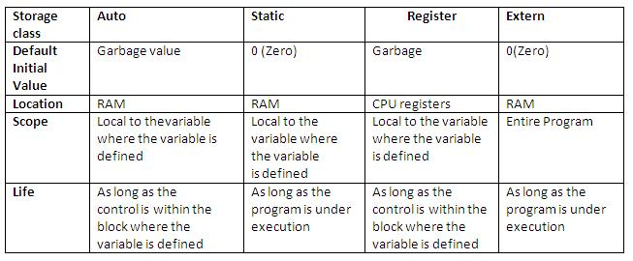

Slide 79
Auto storage class
By default auto storage class is used for all local variables. It is also known as automatic variables.
Example:
#include<stdio.h>
void main()
{
{ auto int i=14;
printf("\ninside the block i=%d",i);
}
//printf("\noutside the block i=%d",i);// i value cannot be accessed outside the block
}

Slide 80
Extern storage class
A variable that declared outside the function is called external variables or global variables.
It can be accessed anywhere in the program. It is used if one or more files share same variable names.
Default storage class for all global variable is extern.

Slide 81
Extern storage class
Example:
#include<stdio.h>
int x = 20 ; //global variable
void main( )
{
int x=23; //local variable
void show();
printf(" %d ",x); //here local variable value is taken
show();
getch();
}
void show()
{
printf("\n%d",x); //here global variable
} value is taken

Slide 82
static storage class
static variables are initialized only once at time of program creation.
It exists at end of the program. It maintains the value between multiple function calls.
There are two types of static variables available in C.
Local/internal static variables
Global/external static variables

Slide 83
static storage class Example
Example:
#include <stdio.h>
void fun() {
static int i=0;//local static variable
int j=0; //local variable
i++;
j++;
printf("i= %d j= %d\n", i, j);
}
void main() {
printf("global static variable value=%d",i);
fun();
fun();
fun();
}

Slide 84
Register storage class Example
register variables allocates the memory in register space. It is used to access the variables very fast than the other variables.
We can’t get the address of the register variable. It is mostly used in counter variable.
Register variables also declared as global and local.
Example:
#include<stdio.h>
void main(){
register int i=12;
{
register int i=45;
printf("\n%d",i);
}
printf("\n%d",i);
}

Slide 85
Strings

Slide 86

String
A string is a sequence of characters terminated with a null character \0.
For example: char c[] = "c string";
When the compiler encounters a sequence of characters enclosed in the double quotation marks, it appends a null character \0 at the end by default.
Two ways of string declaration:
(1) By using character array (2) By using string literal
Example for declaring string :
char c[6]={‘H’,’e’,’l’,’l’,’o’,’\0’}; char c[]={‘H’,’e’,’l’,’l’,’o’,’\0’};
char s[10]=”trust god”; char s1[]=”be good”;

Slide 87
String Manipulations
int strlen(string_variable )- it is used to calculate the string length. Return type is int.
char *strcpy( destination_variable, source_variable)- It copies one content into other string. Return type is string
char * strcat(string1_variable,string2_variable )-It joins/concatenates the two strings. The result of the string stored in first string. Return type is string.
int strcmp(string1_variable,string2_variable)- It compares the two strings. Return type is int.
If it returns 0 both strings are equal.
If it returns negative value then it less than the second string.
If it returns positive value then it greater than the second string.
char *strrev(string_variable)- It used to reverse the string. Return type is string.

Slide 88
Example for calculate the string length
#include<stdio.h>
#include<string.h>
void main()
{
char str[20];
printf("enter string:");
scanf("%s",&str);
printf("length of given string:%d",strlen(str));
}

Slide 89
Strcpy() function
#include<stdio.h>
#include<string.h>
void main()
{
char s1[]="hello";
char s2[10];
strcpy(s2,s1);
printf("s1=%s\ns2=%s\n",s1,s2);
}
output
s1=hello
s2=hello

Slide 90
Strcat() function
#include<stdio.h>
#include<string.h>
void main()
{
char s1[]="abdul";
char s2[]="kalam";
strcat(s1,s2);
printf("concatenated string is=%s",s1);
}

Slide 91
Strcmp() function
#include<string.h>
#include<stdio.h>
void main(){
char s1[15],s2[15];
int i;
printf("enter 1st string:");
gets(s1);
printf("enter 2nd string:");
gets(s2);
printf("size of %s is %d\n",s1,strlen(s1));
printf("size of %s is %d\n",s2,strlen(s2));
i=strcmp(s1,s2);
if(i==0) printf("strings are equal");
else if(i<0) printf("%s is less than %s",s1,s2);
else
printf("%s is greater than %s",s1,s2);
}

Slide 92
Strrev() function
#include<string.h>
#include<stdio.h>
void main()
{
char s1[15];
printf("enter string to reverse:");
gets(s1);
printf("reverse of given string is=%s",strrev(s1));
}

Slide 93
Pointers

Slide 94
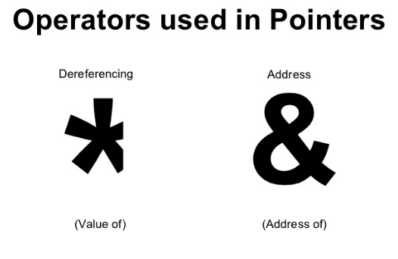
Pointer
Pointers (pointer variables) are special variables that are used to store addresses rather than values.

Slide 95
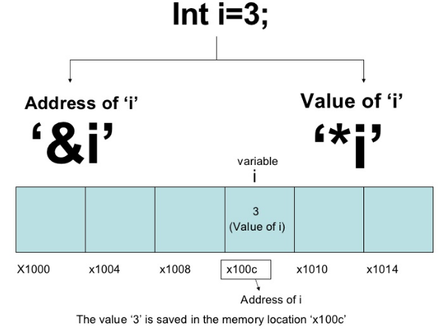

Slide 96
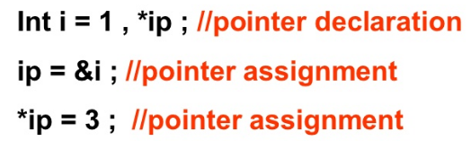
Syntax: type *var-name;
int *ip; /* pointer to an integer */
double *dp; /* pointer to a double */
float *fp; /* pointer to a float */
char *ch /* pointer to a character */

Slide 97
NULL Pointers
It is always a good practice to assign a NULL value to a pointer variable in case you do not have an exact address to be assigned. This is done at the time of variable declaration. A pointer that is assigned NULL is called a null pointer.
The NULL pointer is a constant with a value of zero defined in several standard libraries.
#include <stdio.h>
int main ()
{
int *ptr = NULL;
printf("The value of ptr is : %x\n", ptr );
return 0;
}

Slide 98

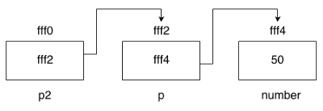
Pointer to Pointer (Double Pointer)
we can also define a pointer to store the address of another pointer.
Syntax: int **p;

Slide 99
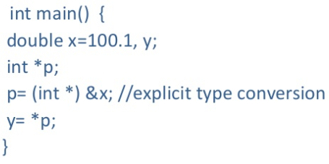
Pointer Conversions
One type of pointer can be converted to another type of pointer.

Slide 100

Pointer Arithmetic
There are only two arithmetic operations that can be used on pointers
– Addition
– Subtraction

Slide 101
Arithmetic Rules
• You cannot multiply or divide pointers.
• You cannot add or subtract two pointers.
• You cannot apply bitwise operators to them.
• You cannot add or subtract type float or double to or from pointers.

Slide 102

Pointer Comparison

Slide 103
Generic Pointer
void * pointer is called as generic pointer.
Can’t convert void *pointer to another pointer and vice-versa.
void *pointer can be assigned to any other type of pointer.
void * is used to specify a pointer whose base type is unknown.
It is capable of receiving any type of pointer argument without reporting any type of mismatch.

Slide 104
Preprocessor Directives
Preprocessor directives in C
Preprocessor is a text alternate tool and it instructs the compiler to do specified pre-processing before the compilation.
In other words, it is micro processor that is used by the compiler to transfer your code before compilation. It is known as micro preprocessor because it can be add macros.
All preprocessor commands must start with hash symbol(#).
Here we list out the preprocessors available in C as follows.

Slide 105

Preprocessor Directives

Slide 106
Macros
Macros in C
It is a part of code which is replaced by the value of macro that can be defined by #define directive.
There are 2 types of macros available in c as follows.
1.Simple macro.
2.Function like macro

Slide 107
Simple Macro Example
Example
#include<stdio.h>
#define pi 3.14
#define p printf
#define s scanf
void main()
{
int r;
float c;
p("enter r value");
s("%d",&r);
c=2*pi*r;
p("area of circle is=%f",c);
}

Slide 108
Function Macro Example
Example
#include<stdio.h>
#define min(a,b) (a*b)
void main()
{
printf("mul value of a*b=%d",min(12,10));
getch();
}

Slide 109
Undef and ifdef #else examples
Example for #ifdef, #else and #endif
Example for - #undef
#include<stdio.h>
#define id 123
/*int i=id;//if we give then it will display
id value because we assign before #undef*/
#undef id
void main(){
printf("id=%d",id); // it shows error like id is undefined symbol
}
#include<stdio.h>
#define noval
void main()
{
int n; #ifdef noval
n=2;
#else
printf("enter n value:");
scanf("%d",&n);
#endif
printf("valu of n:%d",n);
}

Slide 110
Ifndef exampls
Example
#include<stdio.h>
#define noval
void main()
{
int n;
#ifndef noval
n=2;
#else
printf("enter n value:");
scanf("%d",&n);
#endif
printf("value of n:%d",n);
}
#ifndef
It is used to undefine the defined preprocessor directive.
Syntax:
#ifndef macro_name

Slide 111
#if and #else example
Example for #if, #else and #endif
#include<stdio.h>
#define n -2
void main()
{
#if(n<0)
printf("n is negative..");
#else
printf("n is positive");
#endif
printf("\nvalue of n=%d",n);
}

Slide 112
Structures in C
Structure is a collection of different data type variables are grouped together under a single name. It is user defined data type.
Each element/variable declared inside the structure is called member/ members of structure.
Keyword struct is used to declare the structure in C.
We can declare many variables in same structure. Memory will be allocated separately.
It is mostly used to store student information, book information, employee information and patient information, etc.
Uses of structure
Structures are use to store large amount of data. It can be act like data base.
By using structure we can send data to the printer.
It can be interact with keyboard and mouse to store the data.
It used to check the memory size of the computer.
It is used to clear the output screen contents.

Slide 113
Structures in C
Syntax
struct structure_name
{
Data type variable_name1;
Data type variable_name2;
.
.
.
Data type variable_nameN;
}structure reference_name;
Note: - structure must ends with semicolon (;).
Structure member accessing
. (Dot/member operator for normal variable) it is also called period operator.
-> (structure pointer operator)
Syntax:
Structure_variable_name.member;

Slide 114
Structures in C
#include<stdio.h>
struct info
{
char name[50];
int regno[20];
char city[30];
}infostr; //infostr is structure
void main(){
//infostr.name=”divya
printf("enter your name:");
gets(infostr.name);
printf("enter regno:");
scanf("%d",&infostr.regno);
printf("enter your city:");
scanf("%s",&infostr.city);
printf("Name=%s\nRegno=%d\ncity=%s\n” nfostr.name,infostr.regno,infostr.city);}

Slide 115
Array of Structures in C
It is used to store huge information of different data types. This is also called collection of structures or structure array.
Example:
#include<stdio.h>
struct book
{
int bid;
char bname[20];
};
void main(){
struct book b1[5];//here also we can declare structure reference name
int i;
printf("enter 5 books details\n");
for(i=0;i<5;i++){
printf("enter book id:");
scanf("%d",&b1[i].bid);
printf("enter book name:");
scanf("%s",&b1[i].bname);
}
printf("\n 5 book details are");
for(i=0;i<5;i++){
printf("\nbook id:%d",b1[i].bid);
printf("\nbook name:%s",b1[i].bname);}
}

Slide 116
Passing structure to function
#include<stdio.h>
#include<string.h>
struct empinfo
{
int empid;
char ename[15];
}e;
void empdetails(struct empinfo e);
main(){
e.empid=452;
strcpy(e.ename,"divya");
empdetails(e); }
void empdetails(struct empinfo e)
{
printf("emp id=%d\n",e.empid);
printf("emp name=%s",e.ename);
}

Slide 117
Structure using pointers
We can use pointers in structure. By accessing members we use -> operator.
Syntax:
Structure reference_name->member;
Example:
#include<stdio.h>
struct stud{
int id;
char *name;
char *addr;
}
struct stud s,*stptr;
void main(){
stptr=&s;
stptr->id=235;
stptr->name="sarjuna";
stptr->addr="kknagar";
printf("student details\n");
printf("id=%d\n name=%s\n address=%s\n",stptr->id,stptr->name,stptr >addr);
}

Slide 118
Nested Structure
Structure with in a structure
One structure declared inside the another structure is called nested structure. We can access normal variables as well pointer variables.
Syntax
struct out
{
Members of outer structure;
Struct in
{
Members of inner structure;
}inref;
}outref;

Slide 119
Nested Structure Example
struct Employee
{
int id;
char name[20];
struct Date
{
int dd;
int mm;
int yyyy;
}doj;
}e1;
void main( ) {
//storing employee information
e1.id=101;
strcpy(e1.name, "indra");//copying string into char array

Slide 120
Nested Structure Example cont..
e1.doj.dd=10;
e1.doj.mm=11;
e1.doj.yyyy=2014;
// printing first employee information
printf( "employee id : %d\n", e1.id);
printf( "employee name : %s\n", e1.name);
printf( "employee date of joining (dd/mm/yyyy) : %d/%d/%d\n", e1.doj.dd,e1.doj.mm,e1.doj.yyyy);
}

Slide 121
Union in C
It is collection of different data type which are grouped together. It is also like structure. Each element in union is called member.
You can define many members in union, but only one member can have the value at any given time. Union uses the same memory location to store the data.
Union holds value for one data type which requires large storage among their member.
union keyword can be used to declare the union.
Syntax
union union_name{
Data type variable_name1;
……
Data type variable_nameN;
}union_reference_name;

Slide 122
Union in C Example
#include<stdio.h>
union tech{
int id;
char name[15];
}tr;
void main(){
printf("enter developer id:");
scanf("%d",&tr.id);
printf("enter developer name:");
scanf("%s",&tr.name);
printf("developer details are\n");
printf("id=%d",tr.id);
printf("name=%s",tr.name);
}

Slide 123
Enum
Enum is user defined datatype which consists of a set of named integer constants.
enum accType{SAVING,FIXED,RECURRING};
Each member starts with 0 by default and is incremented by 1 for each next member.
enum accType at;
at=SAVING;
printf(“%d”,at); //which prints 0

Slide 124
Dynamic Memory Allocation
There are 2 types memory allocation available in C.
1. Static memory allocation
2. Dynamic memory allocation
Static memory allocation
It is used to allocate the memory at compile time. Size is fixed when program is created. We can change the memory size while run time. It is used to implement the data segments.
It can be allocate the memory faster than the dynamic allocation. More memory space is required.
Dynamic memory allocation
It is used to allocate the memory at runtime. It can used to release the unwanted memory space during the program execution.
It is used to modify the size of the previously allotted memory space.It allots memory space to array of elements and initialized to them 0.
Less memory space is required. Slower than the static allocation.

Slide 125
Dynamic Memory Allocation Functions
It has 4 functions of stdlib.h header file as follows.
malloc( )
calloc( )
realloc( )
free( )
malloc()
The malloc( ) is used for memory allocation. It allocated memory of specified size of the bytes.
It doesn’t not initialize memory at compile time. So by default it has garbage value.
It returns the null pointer if it doesn’t have specified amount of memory.
Syntax
ptr_variable=(type cast*)malloc(number*sizeof(bytes));
free( )
It is used to releasing the memory allocated by the malloc( ) , calloc( ) and realloc( ) functions. It returns the memory to the system.
Syntax:
free(variable_name);

Slide 126
Dynamic Memory Allocation Example
#include<stdio.h>
void main(){
int *ptr,i;
ptr=(int*)malloc(sizeof(int)*5);//memory allocation
printf("enter ptr value:");
for(i=0;i<5;i++)
scanf("%d",&ptr[i]);
printf("value of i=%d",*i);
free(i); //releasing memory
}

Slide 127
Calloc() function
calloc( ) used for contiguous allocation.It allocates multiple of blocks specified memory.
It initializes the allocate memory to 0.
It returns NULL if memory is not enough.
Syntax:
Ptr_variable=(cast type)*calloc(n,sizeof(bytes));
Example:
#include<stdio.h>
#include<string.h>
void main(){
char *s;
s=(char*)calloc(10,10*sizeof(char));//memory allocation
strcpy(s,"program");
printf("s=%s",s);
free(s);//releasing memory
}

Slide 128
realloc() function
realloc( ) It is used to modify the size of allocated memory.
If memory is not enough for malloc( ) and calloc( ), then use the realloc( ) function for the change memory size.
Syntax:
ptr_variable=realloc(ptr_variable,new size);

Slide 129
realloc() function Example
#include<stdio.h>
void main(){
char *pt;
pt=(char*)malloc(6);//memory allocation
strcpy(pt,"MADRAS");
printf("memory contains:%s\n",pt);
pt=(char*)realloc(pt,7); //memory reallocation
strcpy(pt,"CHENNAI");
printf("memory now contains:%s",pt);
free(pt);//releasing memory
}

Slide 130
FILE Handling
File It is a place on the disk where the related data’s are stored.
It represents the collection of bytes. It can be text file or binary file.
It is used to read, write, and search/close file operations in C.
Normally we use array to store the data but it will lost the data after program exit. But in file it will not lost the data after program exit.
Arrays are not store the data permanently. Whereas files are stored permanently.
Types of files
There are 2 types of files are as follows.
Text file/System oriented file
Binary file/Stream oriented file

Slide 131
Types of Files
Text file
Text files are normal .txt file than we can easily create using notepad or some text editors. It contains ASCII codes of digits, alphabetic and symbols.
We can see all the contents within the file as plain text. we can easily edit and delete the contents. It takes more storage space. It is also called as system oriented file.
Binary file
Binary files are .bin files in our computer. It contains the collection bytes (0’s and 1’s). Binary files are compiled version of text files. It can take large amount of data. We cannot easily read these files.
More secure than the text files. It is also called as stream oriented file.
File operations
Opening/creating a file- It define how to open a file
Reading a file - It define the process of how to read a file
Writing a file- It define the process of how to write a file
Appending a file- It define the process of how to append a file
Closing a file- It define how to close a file

Slide 132

Types of File functions and Modes

Slide 133

Types of File functions and Modes

Slide 134
Examples of File handling Funtions
void main(){
FILE *fptr;
int id;
char name[30] ,
ar[50];
float percent;
fptr = fopen("stud.txt", "w");/* open for writing */
if (fptr == NULL) {
printf("File does not exists \n");
getch();
}
printf("Enter the id\n");
scanf("%d", &id);
fprintf(fptr, "Id= %d\n", id);
printf("Enter the name \n");
scanf("%s", name);
fprintf(fptr, "Name= %s\n", name);
printf("Enter the percentage\n");
scanf("%f", &percent);
fprintf(fptr, "Percentage= %f\n", percent);
printf("file written successfully...\n");
printf("file content is \n");
fclose(fptr);
fopen("stud.txt","r");//open for reading a file
while(fscanf(fptr,"%s",ar)!=EOF){
printf("%s",ar);
}
fclose(fptr);
}

Slide 135
Examples of File handling Funtions
#include<stdio.h>
#include<conio.h>
void main()
{
FILE *fs,*ft;
char s[25],t[25],ch;
printf("enter source file name:");
scanf("%s",&s);
fs=fopen(s,"r");
if(fs=NULL)
{
printf("\n file doesn't exist");
getch();
}
printf("enter target file name:");
scanf("%s",&t);
ft=fopen(t,"w");
while((ch=fgetc(fs))!=EOF)// reading a file
fputc(ch,ft); //writing a file
fclose(fs);
fclose(ft);
printf("file copied successfully...");
}

Slide 136
Fseek() functions
#include <stdio.h>
#include<conio.h>
void main(){
FILE *fp;
int l;
clrscr();
fp = fopen("f1.txt","w");
fputs("This is program", fp);
fseek( fp, 7, SEEK_CUR);
printf(“file moved…”);
fputs("sample", fp);
fseek( fp, 7, SEEK_CUR);
printf(“file moved…”);
fputs("sample", fp);
l=ftell(fp);
printf(“\nsize of file:%d”,l);
fclose(fp);
}

Slide 137
Rewind() function
rewind( )
It is used to set the file pointer at the beginning of the stream.
Syntax:
rewind(file_ptr_variable);
Example:
#include<stdio.h>
#include<conio.h>
void main(){
FILE *fp;
char c;
clrscr();
fp=fopen("f1.txt","r");
while((c=fgetc(fp))!=EOF){
printf("%c",c);
}
rewind(fp);//moves the file pointer at beginning of the file
while((c=fgetc(fp))!=EOF){
printf("%c",c);
}
fclose(fp);
getch();
}

Slide 138
Thank You

