Slide 1

Data Analytics for Optimizing 3D Printing of UAV Parts

Slide 2
Project Overview
This project demonstrates how data analytics techniques were applied to optimize 3D printing parameters for UAV parts.
Data generated and collected in-house using designed experiments.
Regression models built with Response Surface Methodology (RSM).
Multi-objective optimization performed using NSGA-II and Minitab’s Response Optimizer.
Trade-off analysis between mass and tensile strength visualized with Pareto fronts.

Slide 3
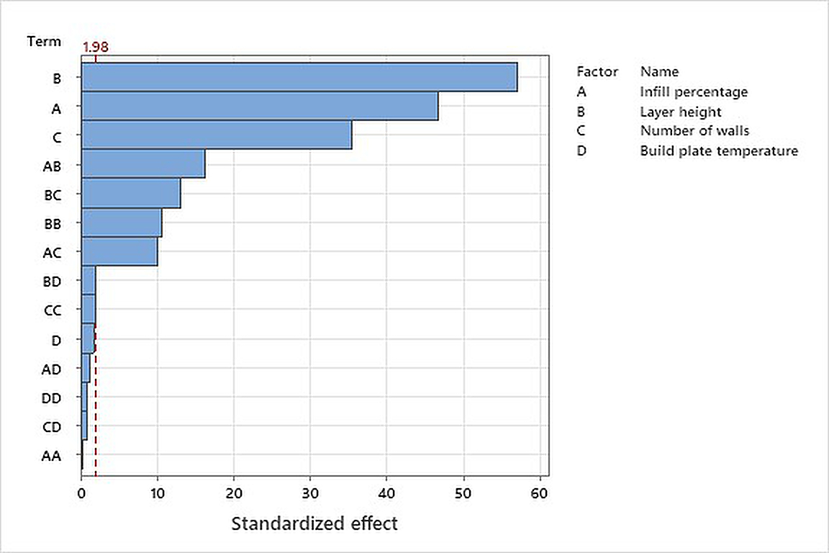
Pareto chart of standardized effects for mass-ANOVA Results.
This Pareto chart shows which factors most significantly influenced the mass of printed UAV parts. Infill percentage, layer height, and number of walls had the strongest effects, while build plate temperature had negligible impact.

Slide 4
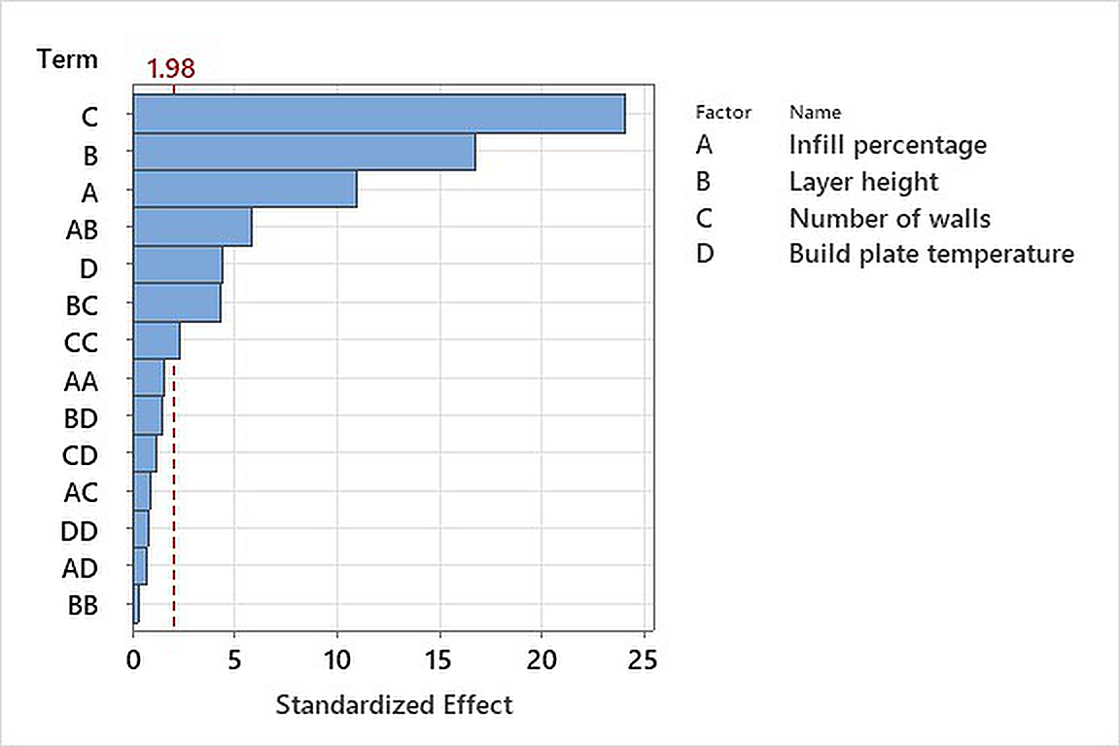
Pareto chart of standardized effects for tensile strength-ANOVA Results
This chart illustrates the key factors affecting tensile strength. Layer height and number of walls had the largest influence, with strong interactions also observed between variables.

Slide 5
Regression Equations
Mass (g):
Mass = 0.679909 + 0.00999339·IP + 0.654401·LH + 0.209838·NW - 0.00244999·BT - 2.72×10⁻⁶·IP² + 7.62339·LH² - 0.00814842·NW² + 3.59×10⁻⁵·BT² - 0.0176952·(IP×LH) - 8.19231×10⁻⁴·(IP×NW) - 9.54812×10⁻⁶·(IP×BT) - 0.283995·(LH×NW) - 0.00441283·(LH×BT) - 1.41288×10⁻⁴·(NW×BT)
Tensile Strength (MPa):
TS = -0.830244 + 0.356997·IP + 104.608·LH + 11.9154·NW - 0.184526·BT - 0.00150299·IP² + 20.6051·LH² - 0.901996·NW² + 0.00294304·BT² - 0.602183·(IP×LH) - 0.00695·(IP×NW) + 0.000542375·(IP×BT) - 8.912·(LH×NW) - 0.299033·(LH×BT) - 0.01849·(NW×BT)

Slide 6
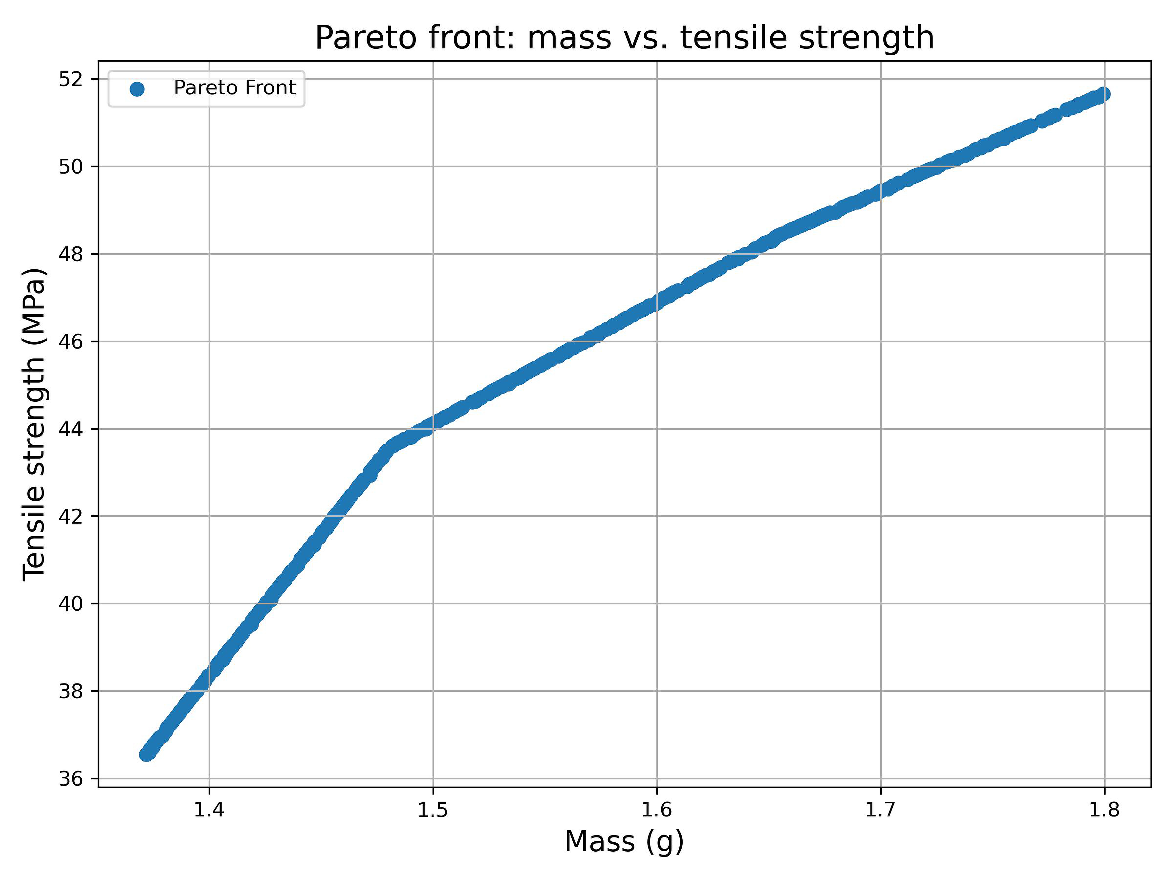
Pareto front (NSG-II) - analysis of mass vs. tensile strength
The Pareto front reveals the trade-off between minimizing mass and maximizing tensile strength. Each point represents an optimal compromise; the 'knee' of the curve indicates the best balance for UAV design.

Slide 7
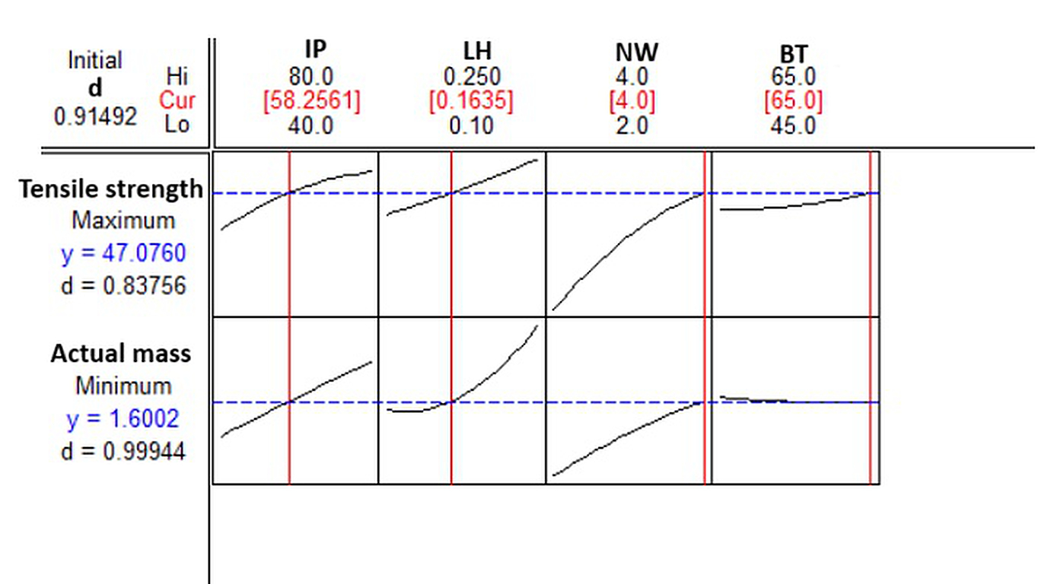
Response optimizer plot.
The response optimizer combines regression models and optimization to recommend ideal parameter settings: ~58% infill, 0.1635 mm layer height, 4 walls, and 65°C build plate temperature. This achieved 47.08 MPa tensile strength with 1.60 g mass.

Slide 8
Conclusion
This study demonstrates the power of data analytics in manufacturing optimization:
Collected in-house data, modeled with response surface method of DOE and analyzed regression and ANOVA.
Applied optimization to balance lightweight design with tensile strength via NSG-II.
Delivered actionable recommendations for UAV applications.

