Slide 1
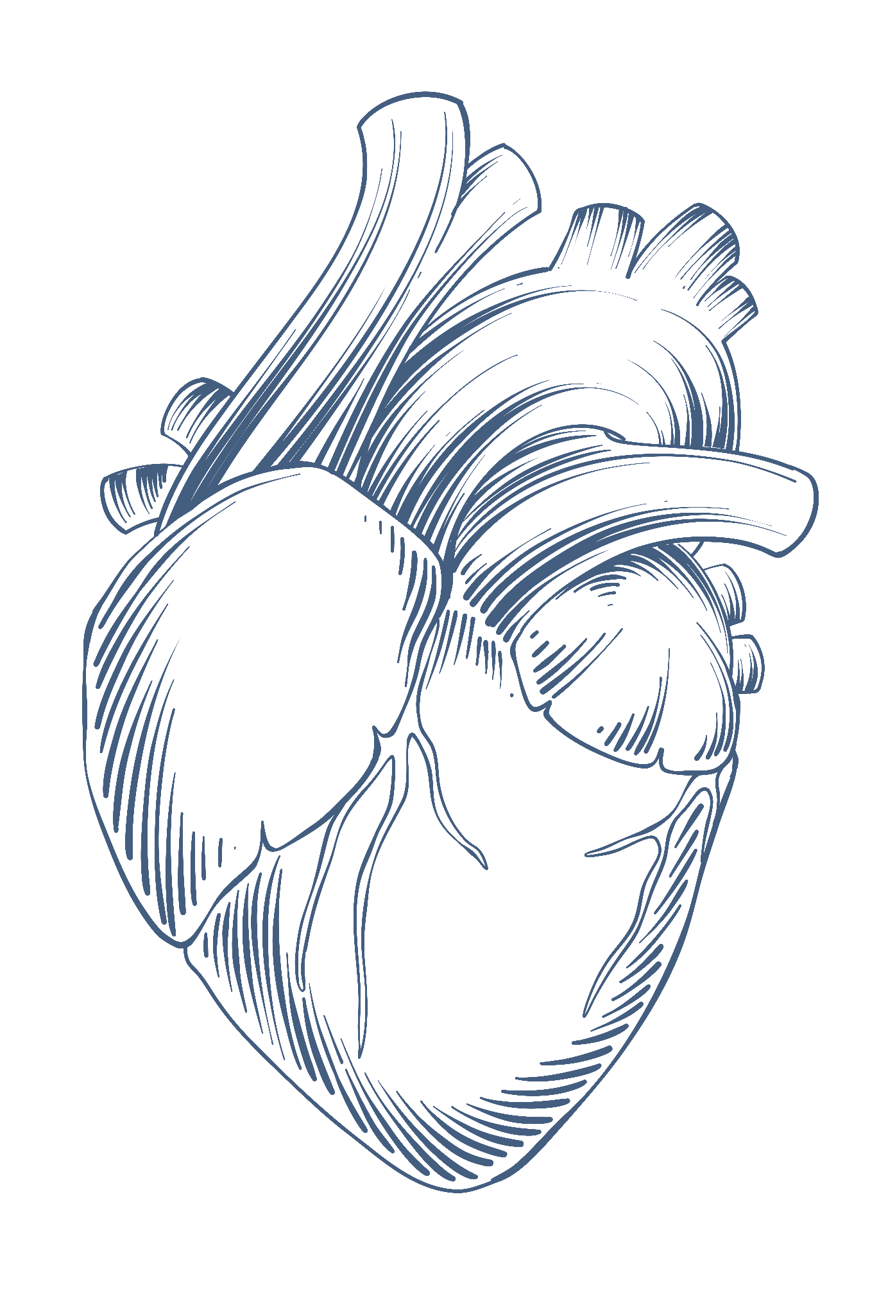
Heart Failure Prediction
Dataset by: Fedesoriano (Data scientist at Kaggle)
Saleem Naseer

Slide 2
Overview
>Heart disease prediction using patient data > Contains 14 features. E.g: Cholesterol levels & Chest pain types >Target Variable is HeartDisease 0= absent, 1 = present >Dataset contained 0 values instead of null. - 0 values changed to null - Used mean and median to calculate the most repeated element for numerical and categorical data respectively.

Slide 3
Result
A program which predicts heart failure based on user input.

