Slide 1
Data Extraction using Web Scraping
Mustafa Riaz
Saleem Malik

Slide 2
Points to cover
What is Web Scraping
About the task
Screenshot of scrapdata
Feature works

Slide 3
What is Web Scraping
Web Scraping (also called Web Data Extraction, Web Harvesting etc.) is a data extraction technique employed to extract large amounts of data from webpages (websites) and saved to your local machine.

Slide 4
About the task
Problem statement: To extract Sports, food ,disease and symptom product data from different website
For sports
pak-cricket, Sport Sense , Active Gear
For food Zomato , foodpanda, foodforyou
Disease and Symptom
WebMD ,mayo clinic ,Medlinepluse

Slide 5
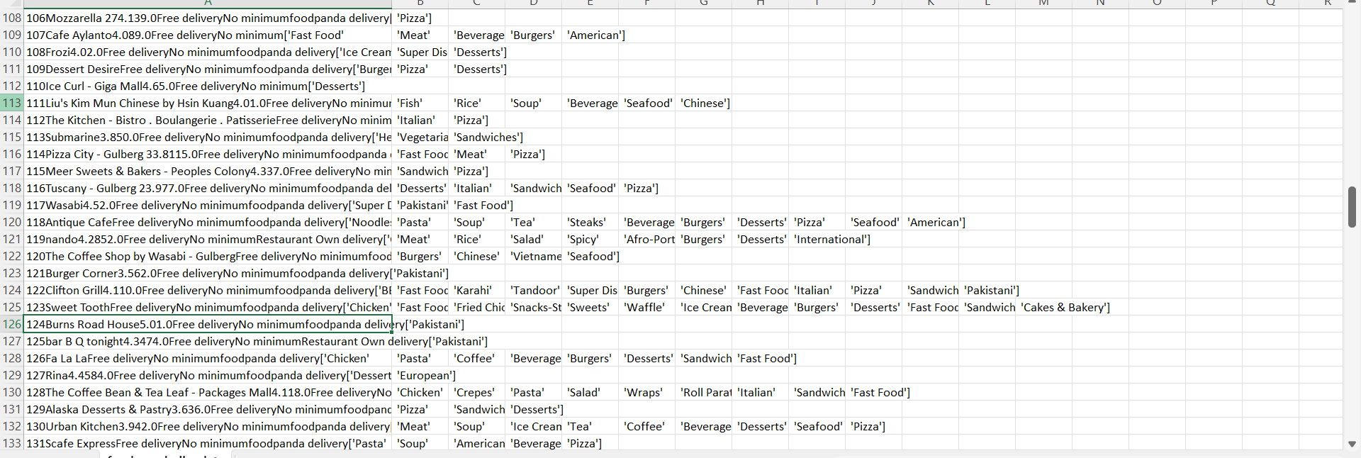
Scrapped data

Slide 6
Scrapped data

