Slide 1

1
CUHK DATA HACK 2026
Beyond
the Bin
Hong Kong's
Recycling
Stream Desert
The Green Loop Challenge
SDG 11 · SDG 12 · March 2026
5 Datasets
8,858 Points

Slide 2
The Surface Story
2
At first glance, Hong Kong's recycling coverage looks comprehensive.
8,858
18
16
7
Collection
Points
Districts
Covered
Waste
Streams
Facility
Types
But what happens when you look at WHAT each point accepts, and WHO can access it?
Data: ① Recyclable Collection Points (data.gov.hk) — 8,858 points with waste_type and accessibilty_notes

Slide 3
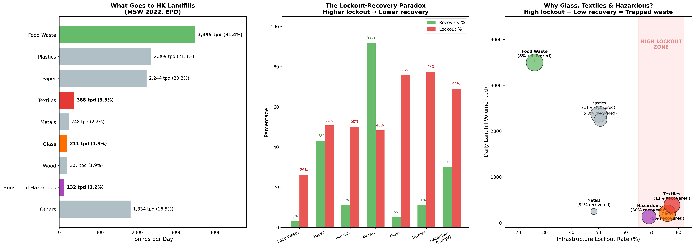
The Double Trap
3
Higher lockout → Lower recovery → More waste to landfill
Datasets: ① Recyclable Collection Points (8,858 pts, waste_type + access) ② EPD Waste Statistics 2022 (MSW composition, recovery rates)

Slide 4
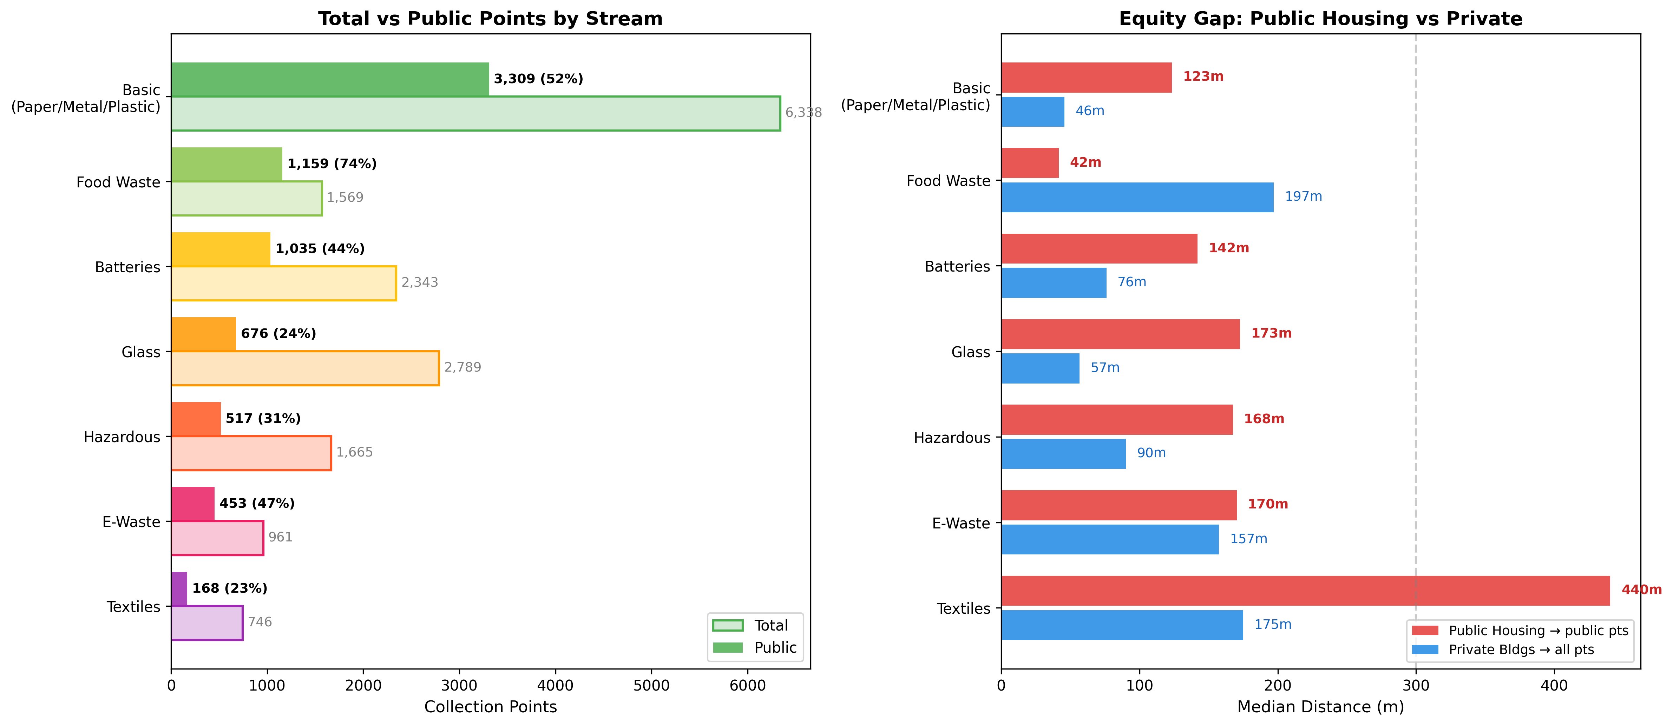
The Complexity Lockout
4
Datasets: ① Recyclable Collection Points ② Public Housing Estates (241 estates, population proxy) ③ Database of Private Buildings (765 — equity comparison)

Slide 5
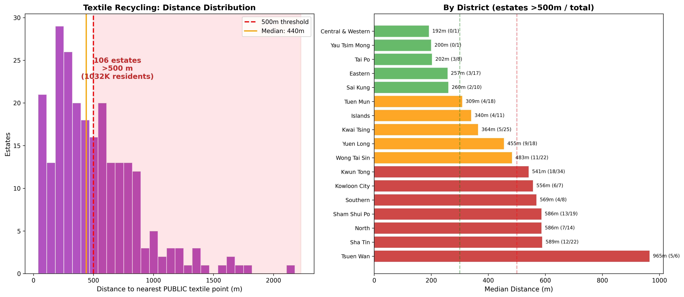
Worst Case: Textile Recycling
5
78%
106
2.5×
locked behind
private estates
estates beyond
500m
farther walk for
public housing
Datasets: ① Recyclable Collection Points (746 textile pts, 168 public) ② Public Housing Estates (241 estates, lat/lon + flat count population proxy)

Slide 6




Our Solution
6
10 Multi-Stream Micro-Hubs — placed by greedy max-coverage algorithm
# | Estate | District | Pop 800m
1 | Po Tat Estate | Kwun Tong | 100,980
2 | Cheung Shan Estate | Tsuen Wan | 50,220
3 | Wing Cheong Estate | Sham Shui Po | 58,590
4 | Wah Fu (I) Estate | Southern | 26,730
5 | Wang Tau Hom Estate | Wong Tai Sin | 73,980
6 | Queens Hill Estate | North | 24,030
7 | Ying Tung Estate | Islands | 22,680
8 | Wo Che Estate | Sha Tin | 29,970
9 | Wan Tau Tong Estate | Tai Po | 18,900
10 | Tak Long Estate | Kowloon City | 80,190
Analyze
Score every estate by composite gap across 5 streams, weighted by landfill tonnage
Optimize
Greedy algorithm iteratively picks location maximizing pop-weighted coverage
Deploy
Each hub: glass, textiles, batteries, fluorescent lamps, e-waste — 800m catchment
Total catchment: 486,270 residents across 10 districts
Datasets: ① Collection Points ② Public Housing Estates ③ Waste Management Facilities (24 — RTS logistics matching)

Slide 7
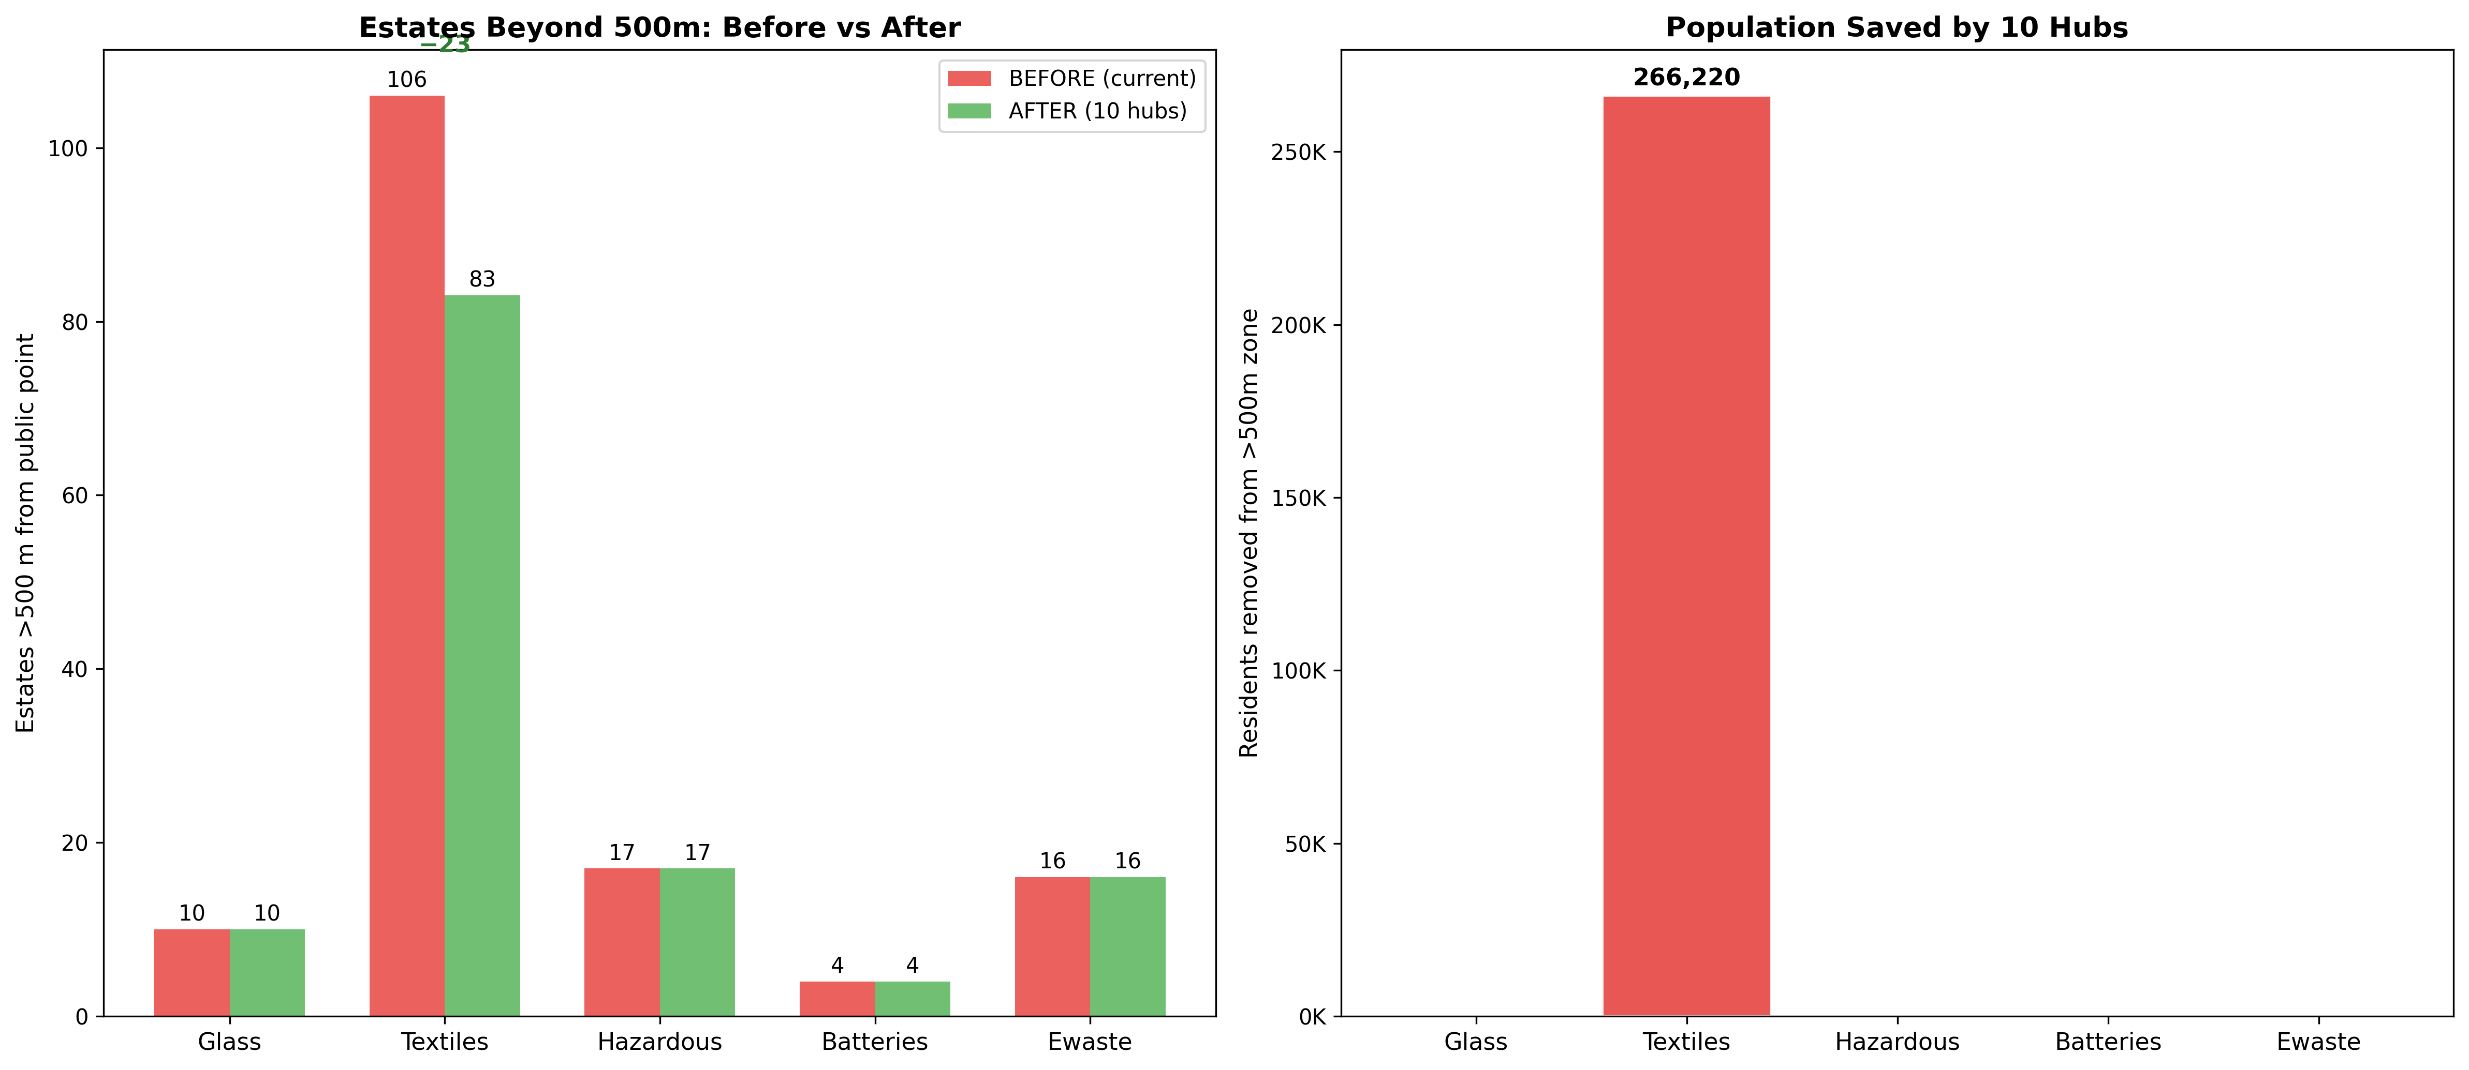
Measured Impact
7
Cost-Benefit: HK$20–50M total (vs HK$20–30M for 1 GREEN@ station) · 13,300–26,700 tonnes/year diverted · HK$4.9–9.7M/year savings · Payback: 2–10 yrs
Datasets: All 5 — Collection Points, Public Housing, Private Buildings, Recycling Stations, Waste Management Facilities

Slide 8

Multi-Stream Desert Map
8
Interactive map — 241 estates × 5 waste streams × 10 proposed hubs
0 streams >500m (well-served)
Toggleable Layers:
1 stream >500m
Public Glass collection points
Public Textile collection points
Public Hazardous waste points
Public Battery collection points
Public E-Waste collection points
GREEN@ Stations (12)
Waste Management Facilities (24)
Proposed Hubs + 800m rings
2 streams >500m
3+ streams >500m (desert)
Proposed multi-stream hub (800m)
GREEN@ premium station
→ Live demo: visualizations/05_interactive_map.html
Datasets: All 5 — Collection Points, Public Housing, Private Buildings, Recycling Stations (12 GREEN@), Waste Mgmt Facilities (24 incl. 13 RTS)

Slide 9
9
Closing the Loop
731
tpd
of glass, textiles & hazardous waste trapped behind private gates
106
estates
where 1M+ residents are >500m from public textile recycling
10
hubs
data-optimized placements across 10 districts, 486K catchment
2–10
yr payback
at HK$20–50M total — the cost of a single GREEN@ station
5 Datasets · 8,858 Points · 241 Estates · 16 Waste Streams · 1 Data-Driven Solution

