Slide 1
Statistical signal processing through applications
Adaptive filtering

Slide 2
Problem description:
Noisy signal (bass signal + talking noise)
Recorded noise (External talking noise)
Want to clean the signal to not hear the talking noise.
Difficulty: Reverb effect affects the recorded noise. Situation may not be static.

Slide 3
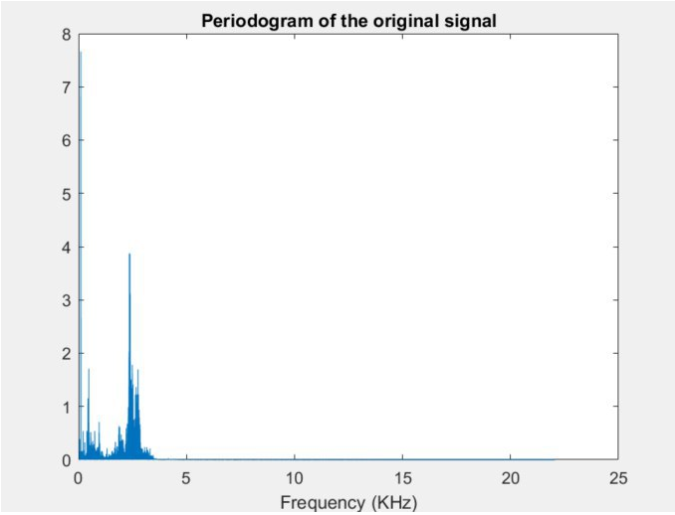
Starting point:
Bass + talking noise:
Recorded talking noise:
Sampling Frequency: 44.1kHz

Slide 4
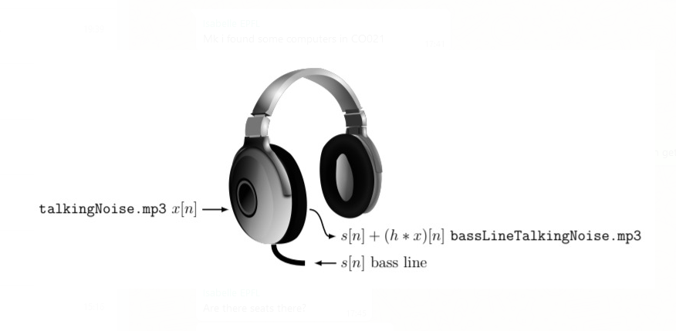
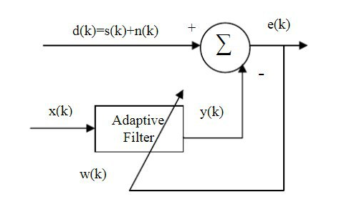
Methods
Estimate adaptive filter coefficients w(k) in order to be able to clean the bass signal e(k)
To deal with non-static situation, adaptive solutions:
LMS
NLMS
RLS

Slide 5
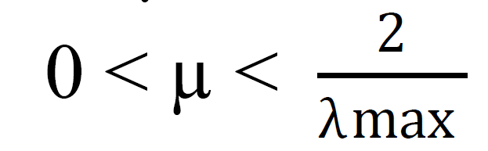
LMS algorithm summary
Parameters
Initialization
Computation
P = filter order = 800 (18 ms as fs = 44.1k)
µ = step size = 0.0003
  λmax =
ĥ (0) = 0 or random
Computation: For n = 0, 1, 2...

Slide 6
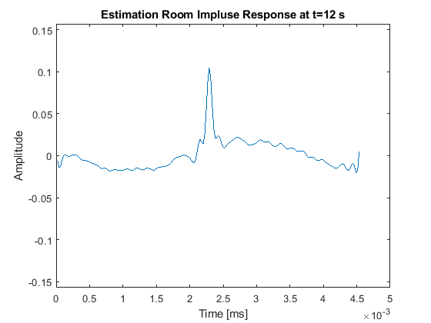
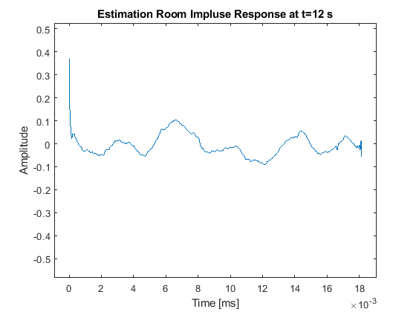
LMS results
Estimated Impulse Response
Offline
On the fly

Slide 7
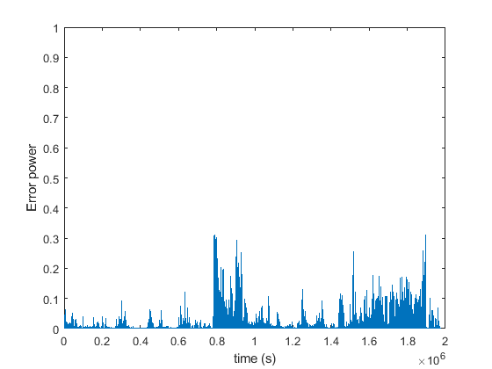
LMS results
Mean square error
Mean square error
On the fly
Offline

Slide 8

NLMS algorithm summary
Parameters
Initialization
Computation
P = filter order = 800 (18 ms as fs = 44.1k)
µ = step size = 0.003*Nf*mean(x.^2)
ĥ (0) = 0 or random
Computation: For n = 0, 1, 2...
Convergence condition

Slide 9
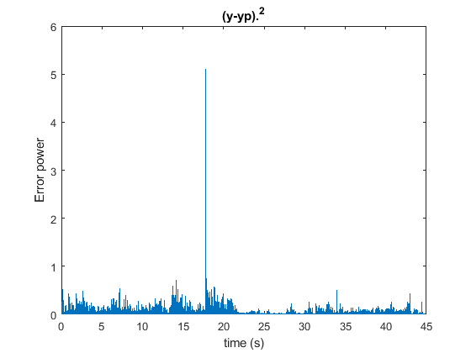
NLMS results
NLMS
graphs
Play sound

Slide 10
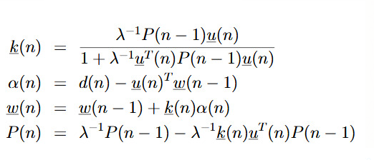
RLS Algorithm Summary
Parameters
Initialization
Computation
P = 300 samples,
Signal downsampled to 11kHz
λ = forgetting factor= 0.999
ĥ (0) = random (cannot be zero)
P is correlation matrix
Batch is the u vector

Slide 11
RLS results
RLS
graphs
Play sound

Slide 12
Comparison
 | Filter order | Mse using only past samples | Mse using past&future samples
Noisy signal |  | 0,0568
LMS | 800 (offline 200) | 0,0338 | 0.004
NLMS | 800 | 0,0435
RLS | 300 | 0.0022

Slide 13
Thank you, any questions?

