Slide 1

Robotics
Student:
Saleh Ahmed Alheeh
University ID:
201614721
Teacher:
Eissa Alreshidi
Course:
Principals of Artificial Intelligence

Slide 2

Outline
Introduction
The definition of robot
History of the robot
Robot components
Types of robots
Robot uses
Programming languages ​​used to program robots
Robot vision
Robot and Reinforcement learning (RL)
Advantages of robotics and intelligent algorithms
Conclusion

Slide 3

Introduction
The definition of robot
A robot is a machine especially one programmable by a computer capable of carrying out a complex series of actions automatically.
One of the reasons for the development of the robot is the artificial intelligence that added its touch by expanding the fields of the robot and get the benefit from it in these fields.
Artificial intelligence is a branch of computer science that creates machines that are capable of problem-solving and learning similarly to humans.
AI is the brain and robotics is the body. While there continues to be confusion about the terms artificial intelligence (AI) and robotics, they are two separate fields of technology and engineering

Slide 4
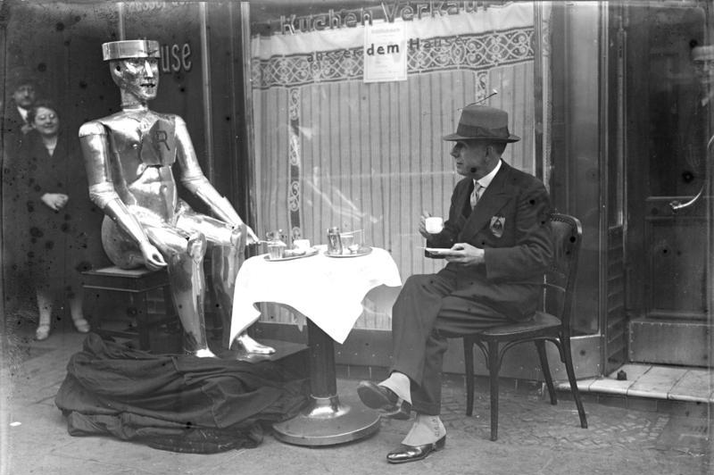
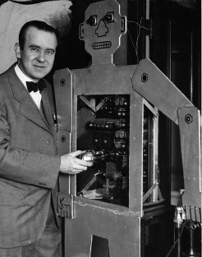
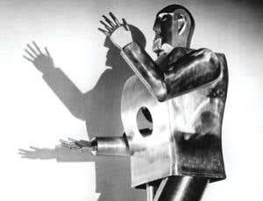
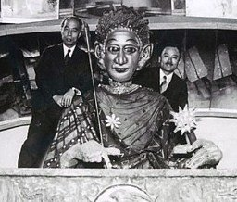
Introduction
B. History of the robot
The first appearance of robots
In 1928, one of the first humanoid robots, Eric[1.fig], was exhibited at the annual exhibition of the Model Engineers Society in London, where it delivered a speech.
Westinghouse Electric Corporation built Televox[2.fig] in 1926; it was a cardboard cutout connected to various devices which users could turn on and off.
In 1939, the humanoid robot known as Elektro[3.fig] was debuted at the 1939 New York World's Fair.
In 1928, Japan's first robot, Gakutensoku[4.fig], was designed and constructed by biologist Makoto Nishimura
Eric[1.fig]
Televox[2.fig]
Elektro[3.fig]
Gakutensoku[4.fig]

Slide 5
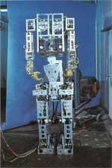
The first robot with artificial intelligence
WABOT-1[5.fig], the first ‘intelligent’ humanoid robot, was built in Japan. It consisted of a limb-control system, a vision system and a conversation system. The WABOT-1 was able to communicate-with a person in Japanese and to measure distances and directions to the objects using external receptors, artificial ears and eyes, and an artificial mouth. The WABOT-1 walked with his lower limbs and was able to grip and transport objects with hands that used tactile-sensors. It was estimated that the WABOT-1 has the mental faculty of a one-and-half-year-old child. WABOT-1 consisted of the WAM-4 (as its artificial hands) and the WL-5 (Its artificial legs).
WABOT-1[5.fig]

Slide 6
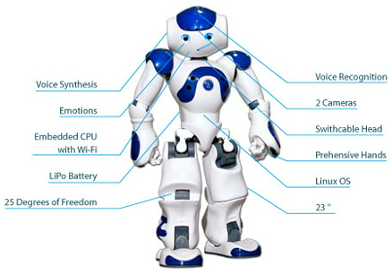
B . Robot components
Robots are composed of various types of main parts and components:
1-Sensors
Also known as receptors, they help robots collect information about the surrounding environment, as this information helps him determine his behavior.
2- control system
The brain: or the control system, which is the main part that is divided into two types.
3-Effectors
Response devices: These are also called Effectors, which are the parts concerned with doing business and performing tasks, as they program the entire infectious robot from a computer, and it also performs a specific ironing.

Slide 7
2. Type of Robots
Mechanical bots come in all shapes and sizes to efficiently carry out the task for which they are designed.
Pre-Programmed Robots
Pre-programmed robots operate in a controlled environment where they do simple, monotonous tasks. An example of a pre-programmed robot would be a mechanical arm on an automotive assembly line.
Humanoid Robots
Humanoid robots are robots that look like and/or mimic human behavior. These robots usually perform human-like activities (like running, jumping and carrying objects), and are sometimes designed to look like us, even having human faces and expressions
.
Autonomous Robots
Autonomous robots operate independently of human operators. These robots are usually designed to carry out tasks in open environments that do not require human supervision.
Teleoperated Robots
Teleoperated robots are mechanical bots controlled by humans. These robots usually work in extreme geographical conditions, weather, circumstances, etc.
Augmenting Robots
Augmenting robots either enhance current human capabilities or replace the capabilities a human may have lost.

Slide 8
3.Robot uses
Robots can be used and are being used in many different fields. Their applications are numerous:
Industrial applications
Medical applications
Bionics
Military
4.Programming languages ​​used to program robots
Assembly
C/C++
Java
NET/C#:
Processing (Arduino)
Python

Slide 9
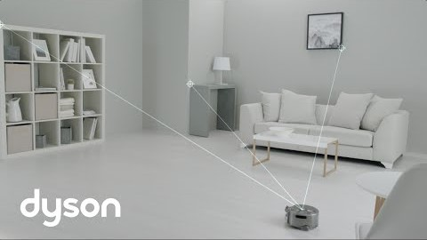
5.Robot vision
Robotic vision is similar to human vision - it provides valuable information that the robot can use to interact with the world around it.
This is the robot's vision and how to recognize things

Slide 10
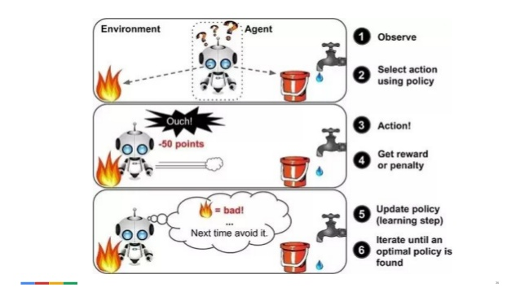
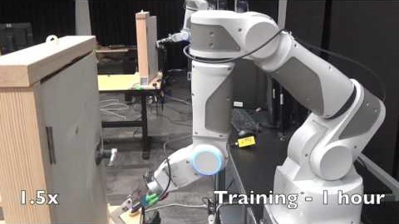
6.Robot and Reinforcement learning (RL)
Reinforcement learning (RL): This is the process of learning from trial-and-error , by exploring the environment and the robot’s own body.
The main motivation for using reinforcement learning to teach robots new skills is that it offers three previously missing abilities:
to learn new tasks which even the human teacher cannot physically demonstrate or cannot directly program
to learn to achieve optimization goals of difficult problems that have no analytic formulation or no known closed form solution.
to learn to adapt a skill to a new, previously unseen version of a task learning to walk from flat ground to a slope.

Slide 11
Conclusion As a result, finally, we have talked about History of the robot AI robot, Robotics, and comparison between AI vs Robotics. Also, learned robotics components and different applications of robotics and Robot and Reinforcement learning (RL).

