Slide 1
Intelligent Traffic Incident Analysis System
Predicting incident severity, identifying high-risk locations and detecting abnormal traffic behaviour with supervised and unsupervised machine learning
IT7009 Artificial Intelligence — Group Project (Brief 1)
Academic Year 2026–2027, Semester A
[Group Number] | [Student names and IDs]

Slide 2
Problem, Objectives and Motivation
Why automated traffic-incident analysis matters
• The problem:
  – Urban traffic is growing in volume and complexity; manual monitoring cannot keep pace.
  – Incidents detected late or misjudged delay emergency response, prolong congestion and raise the risk of secondary collisions.
• Objectives:
  – Predict the severity of an incident (4 classes) from conditions observed at report time.
  – Identify high-risk locations and traffic environments without relying on labels.
  – Detect abnormal traffic behaviour that a classifier alone cannot see.
• Motivation and practical value:
  – Automated triage of limited response resources; proactive rather than reactive management; evidence for infrastructure policy.
  – Road traffic injuries remain a leading cause of death worldwide (WHO, 2023).

Slide 3
Dataset
50,010 incidents x 72 attributes (synthetic, educational)
• Attribute groups: traffic flow, road characteristics, environmental conditions, temporal attributes, infrastructure and control features, location attributes and derived metrics.
• Target: Severity 1 (minor) to Severity 4 (critical).
• Class imbalance is severe:
  – Severity 1 = 1.57%, Severity 2 = 6.96%, Severity 3 = 36.31%, Severity 4 = 55.17% (35:1).
  – A majority-class model already scores 55.17% accuracy — accuracy alone is meaningless.
• Key early signal: most environmental and infrastructure variables are almost uncorrelated with severity; a small number of traffic-intensity variables carry the real signal.

Slide 4
Data Quality: What We Found
Audited before any modelling — every finding has a documented treatment
• 14 exact duplicate records (and duplicate Incident_IDs).
• Inconsistent categorical labels: 'collision ', 'DRY', 'RAIN', 'car', 'Truck ', 'day light', 'police', 'monday', 'Fri'.
• Wrong data types: Temperature, Average_Speed, Vehicle_Count, Road_Width stored as text.
• Impossible values: latitude 95, longitude -200, humidity 150 and -10, visibility -5.
• Temporal issues: 8 unparsable datetimes; 1 record with End_Time before Start_Time.
• Outliers: 336 Dew_Point and 176 Precipitation values by the 1.5 x IQR rule.
• Near-unique identifiers: Postal_Code (38,347 unique), Road_Name (39,388 unique).

Slide 5
Data Cleaning and Preprocessing
Issue -> treatment -> justification
• Duplicates removed; the 7 rows with a missing target dropped (a label cannot be imputed).
• Missing features imputed: median (numeric), mode (categorical) — missingness is only ~0.01%.
• Text-stored numbers coerced with pd.to_numeric().
• Categorical labels stripped and title-cased so one real category = one encoded level.
• Impossible values set to NaN via explicit domain rules, then imputed.
• The record with End_Time before Start_Time was dropped.
• Identifiers and near-unique keys removed.
• Stratified 80/20 split; imputation + scaling + one-hot encoding all inside a Pipeline fitted on the training fold only (no leakage).
• Class imbalance addressed with class_weight='balanced'.

Slide 6
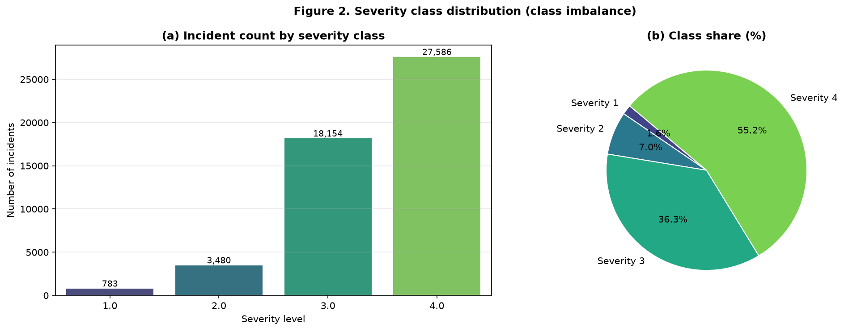
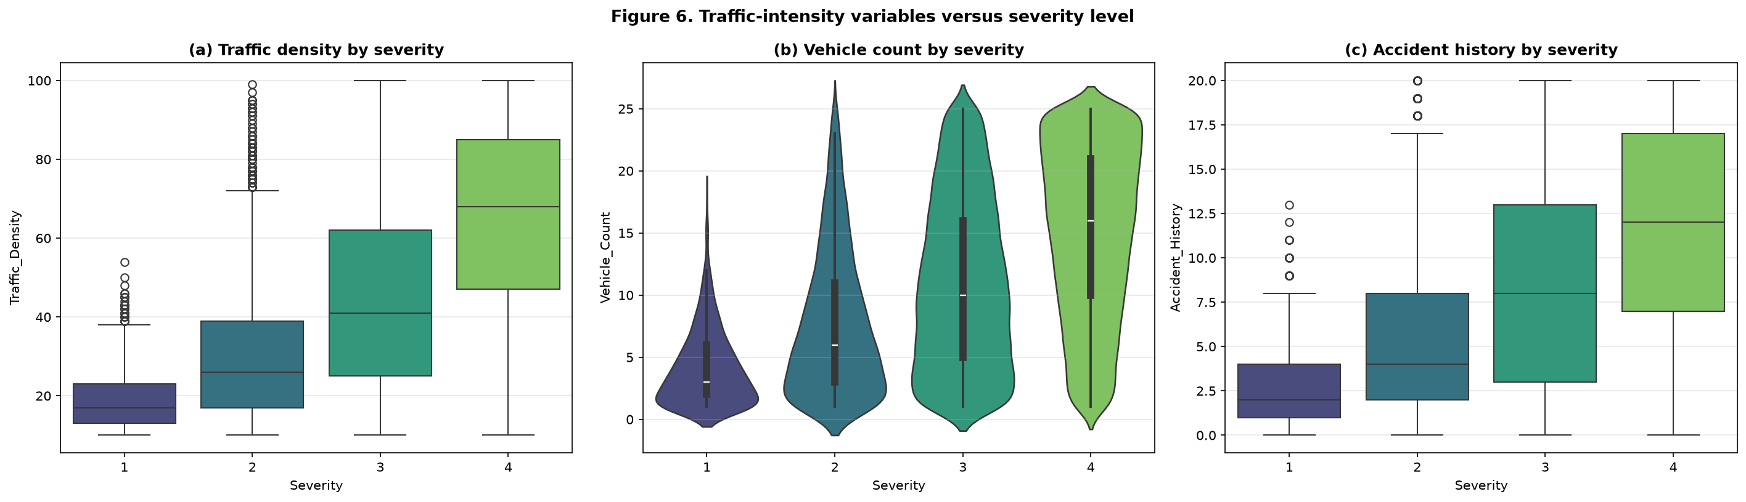
Exploratory Analysis
What the data actually looks like
Left: the severity class imbalance. Right: traffic density, vehicle count and accident history all rise monotonically with severity.

Slide 7
Data Leakage — The Most Important Decision
Two variables would have produced a fake 0.98 macro-F1
• Risk_Score: correlation 0.88 with Severity, with class means rising strictly monotonically (37.8 -> 72.5 -> 107.8 -> 147.3).
• Emergency_Response_Time: correlation 0.37, measured only AFTER the incident is reported.
• Also removed: Response_Team, End_Time, the derived incident duration, Incident_ID, Postal_Code and Road_Name.
• The effect was measured, not assumed:
  – With leakage included: macro-F1 = 0.984 (accuracy 0.987)
  – Leakage-free model: macro-F1 = 0.701
• Reporting the leaky score would have been meaningless — those values do not exist at the moment a prediction must be made.

Slide 8
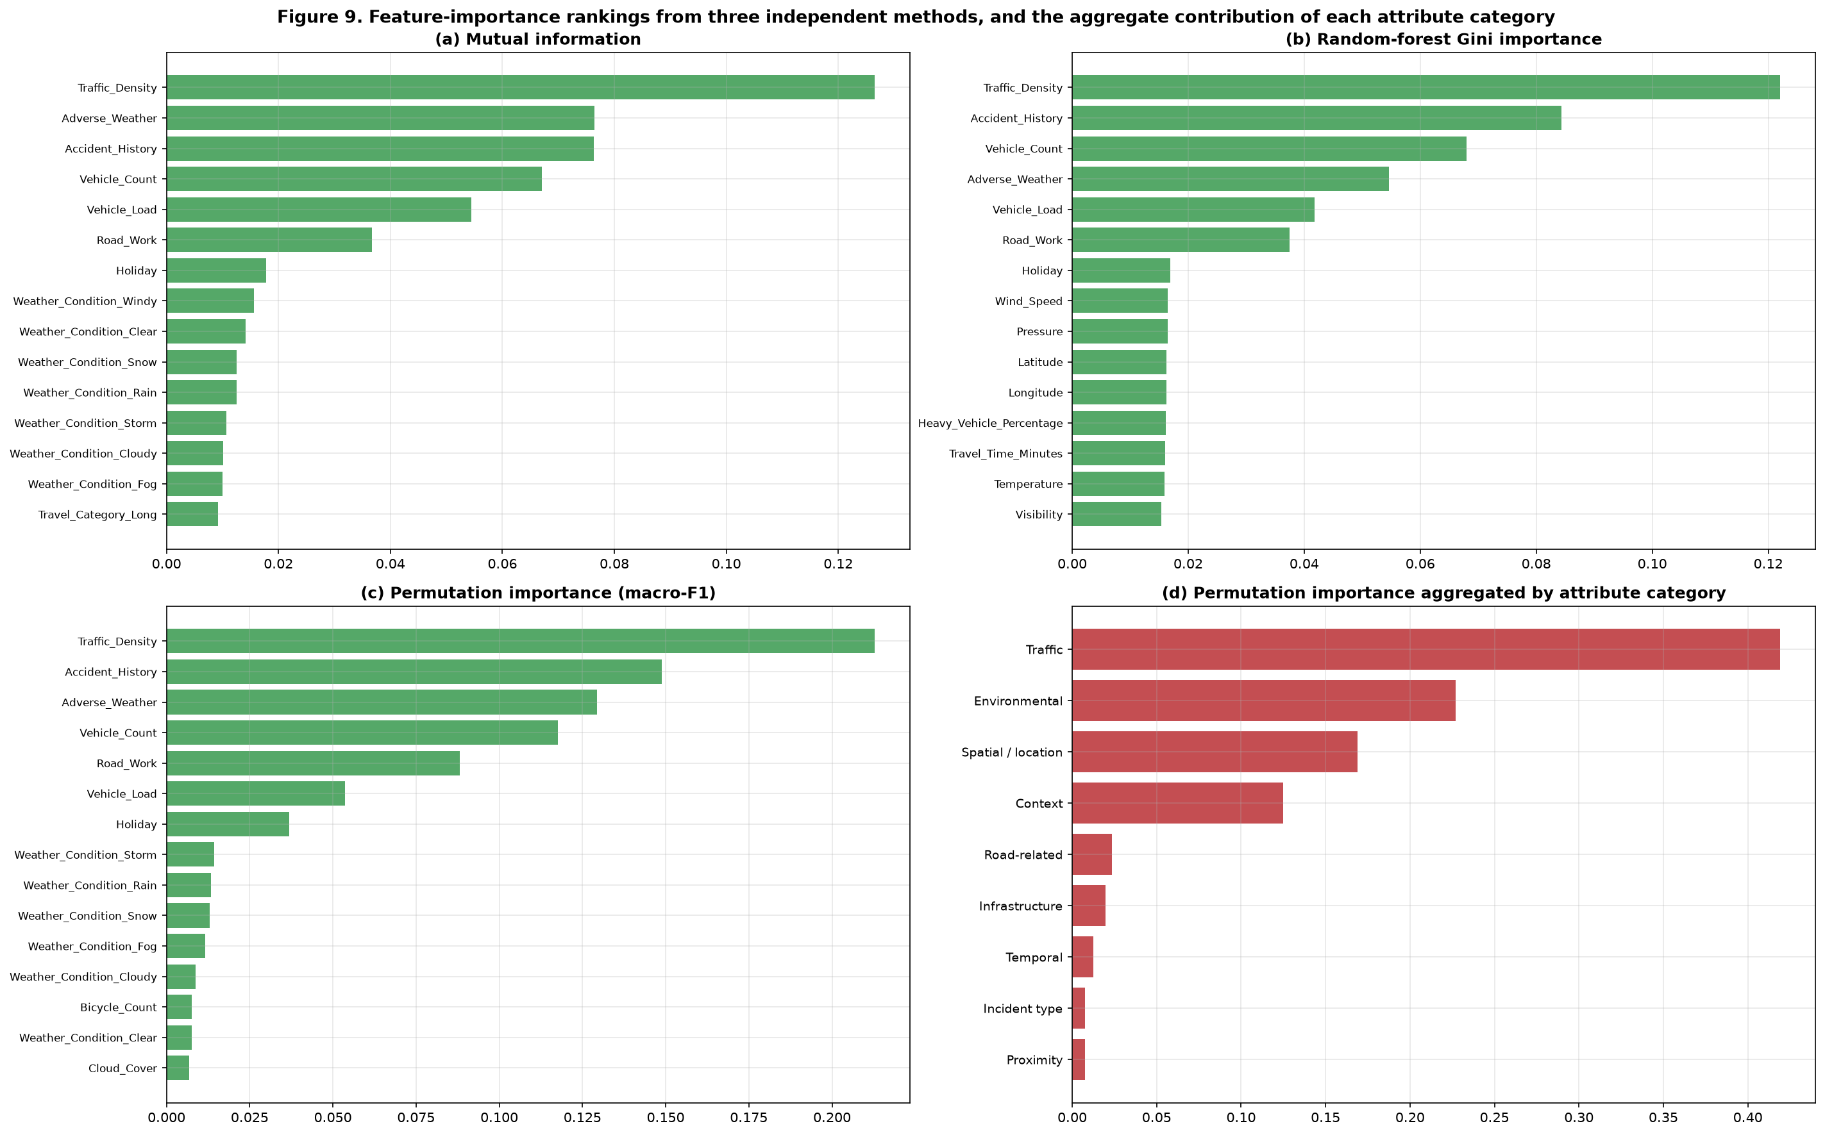
Feature Analysis and Selection
Three independent importance methods, plus aggregation by category
Traffic_Density, Accident_History and Vehicle_Count rank highest under all three methods; environmental, spatial and road-related variables contribute smaller but non-zero shares.

Slide 9
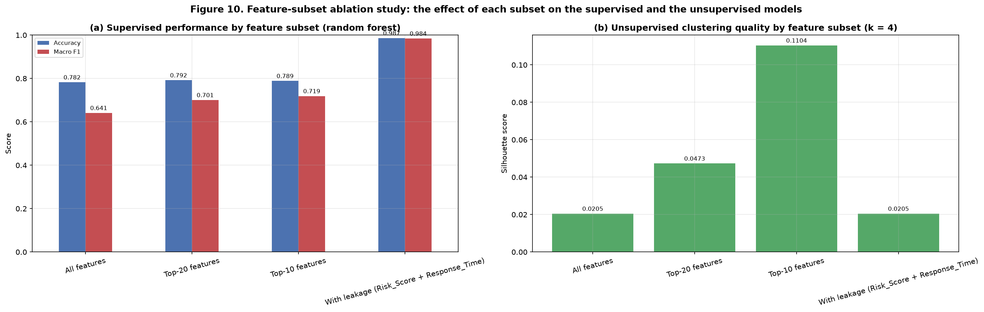
Feature-Subset Ablation Study
Assessed on BOTH the supervised and the unsupervised model, as the brief requires
Top-20 matches the full feature set on macro-F1; the leakage subset scores an implausible 0.984. Clustering quality rises from 0.0205 (all features) to 0.1104 (Top-10) — feature selection helps the unsupervised model too.

Slide 10
Supervised Modelling — Design
Four algorithms, stratified pipeline, tuned on macro-F1
• Logistic Regression — linear, interpretable baseline; coefficients show the direction of each effect; balanced class weights.
• Random Forest — bagged trees; captures non-linearity and interactions; provides Gini importance.
• Hist Gradient Boosting — boosted trees; usually the strongest tabular performer.
• k-Nearest Neighbours — instance-based contrast; tests whether the classes are locally separable.
• Pipeline: median imputation + standardisation (numeric), most-frequent imputation + one-hot encoding (categorical), all fitted on the training fold only.
• Tuning: GridSearchCV, 3-fold stratified cross-validation, macro-F1 objective.

Slide 11
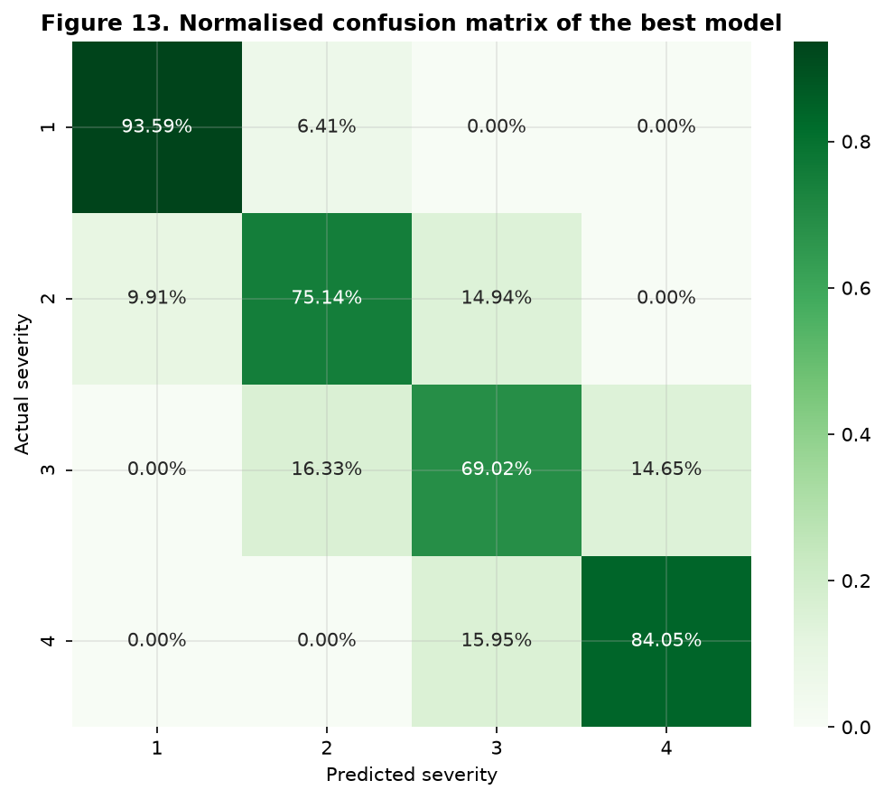
Supervised Results and Comparison
Best model: Logistic Regression — selected on macro-F1
Model | Accuracy | Precision (macro) | Recall (macro) | Macro F1
Logistic Regression | 0.7812 | 0.6897 | 0.8045 | 0.7332
Hist Gradient Boosting | 0.7864 | 0.7111 | 0.7634 | 0.7323
Random Forest | 0.7832 | 0.7133 | 0.7060 | 0.7090
Majority-class baseline | 0.5517 | — | — | 0.1778
Errors fall almost entirely between ADJACENT severity levels; Severity 1 recall is 0.936 and Severity 4 precision is 0.897 — the two decisions that matter most.

Slide 12
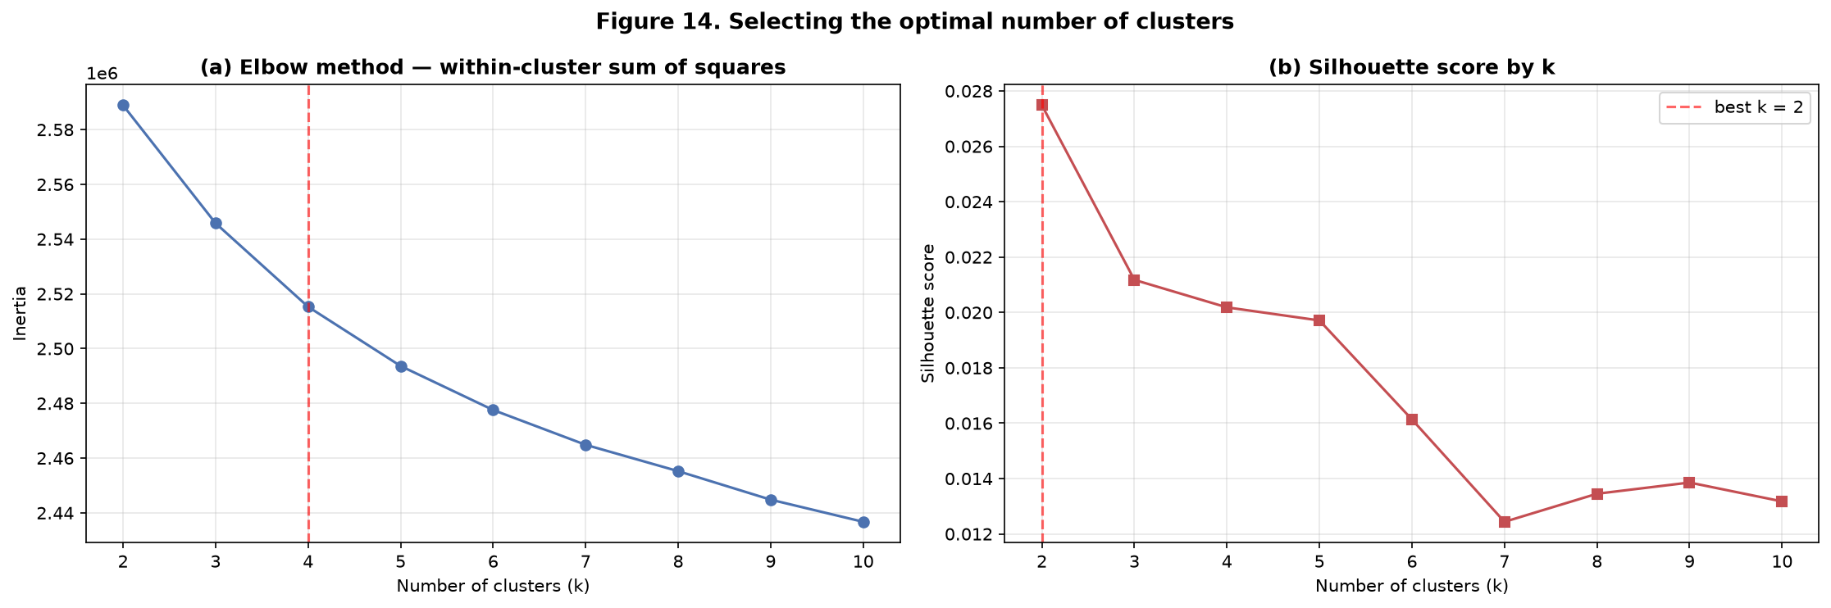
Unsupervised Learning — Choosing k
Elbow method and silhouette score, as the brief requires
• k tested from 2 to 10; silhouette computed on a 10,000-record sample (O(n^2)).
• Silhouette is maximised at k = 2 but every value is below 0.03 —
  – the clusters overlap heavily; there is no strongly separated structure.
• The elbow bends at k = 4, after which the inertia curve flattens.
• Decision: k = 4, justified by the elbow plus interpretability, with the low silhouette reported openly as a limitation.

Slide 13
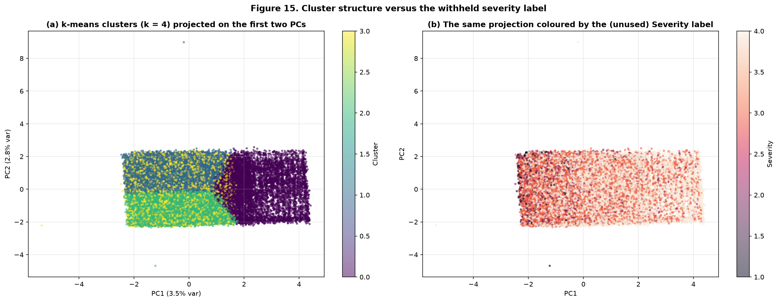
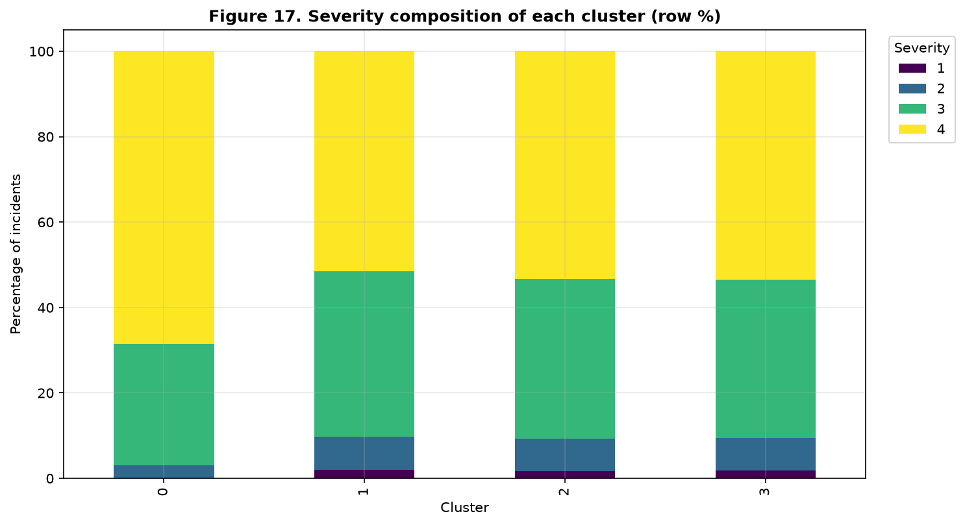
Unsupervised Learning — Clusters and Profiles
Structure recovered WITHOUT using the severity label
The clusters separate on the same traffic-intensity variables the supervised model found important, and their severity composition differs systematically — independent agreement between the two analyses.

Slide 14
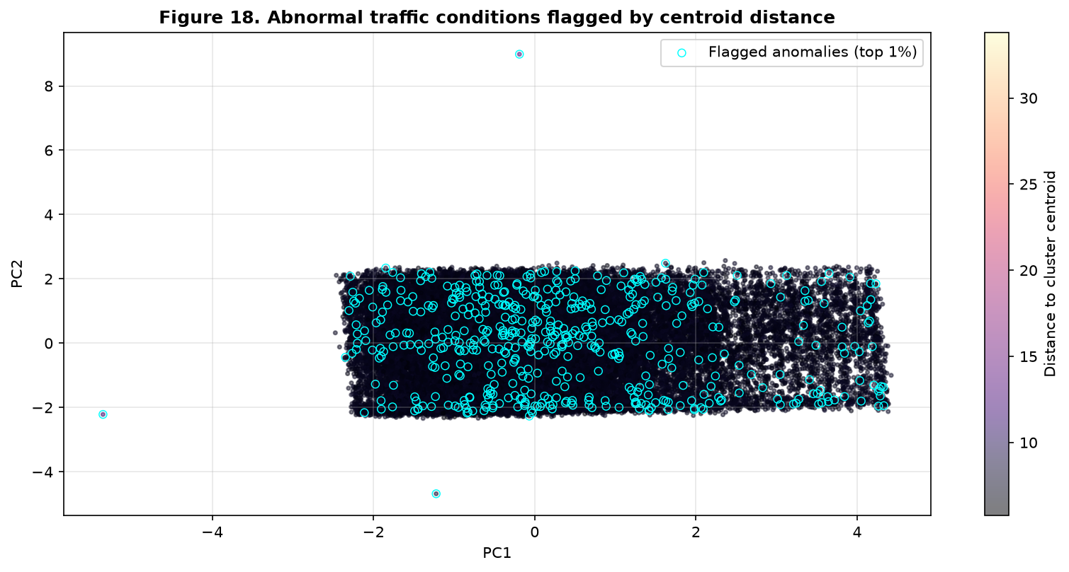
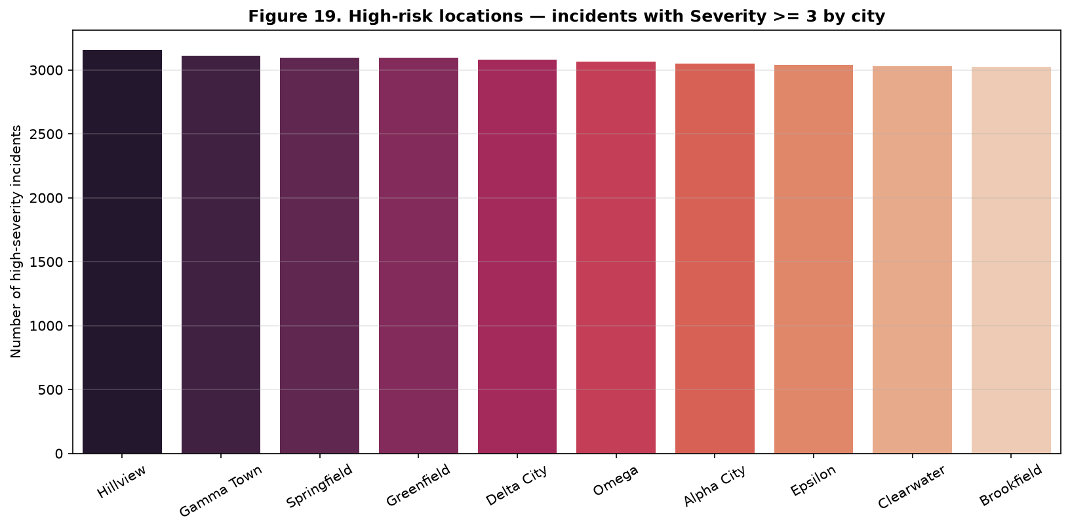
Abnormal Behaviour and High-Risk Locations
Capabilities the classifier cannot provide on its own
Left: the 500 incidents (top 1%) furthest from any cluster centroid — the unusual events that deserve human attention. Right: cities ranked by high-severity incident count.

Slide 15
Key Findings and Practical Implications
What the analysis shows
• Traffic_Density, Accident_History and Vehicle_Count are the dominant predictors — and the same variables define the unsupervised clusters, so two independent analyses agree.
• Adverse weather (fog, rain, storm, snow) is associated with markedly higher severity.
• A compact 20-feature subset matches or beats the full feature set, so most of the value comes from a small number of traffic and location sensors.
• Remaining classification errors fall almost entirely between adjacent severity levels.
• Practical implications:
  – Automated triage — prioritise critical incidents and cut response time.
  – Proactive management — pre-position resources in high-risk environments.
  – Attention management — route anomalous events to human operators.
  – Infrastructure policy — target lighting, signage and speed management where severity is highest.

Slide 16
Limitations and Improvements
Reported openly and honestly
• Limitations:
  – The dataset is synthetic and the relationships are weak — macro-F1 is capped at roughly 0.73.
  – The clustering structure is diffuse: every silhouette score is below 0.03.
  – Severity 2 remains the hardest class (fewest distinguishing features).
  – Validation is a random split, not chronological — drift is not yet measured.
  – The severity classes are ordinal but modelled as nominal.
• Improvements:
  – Enrich the data with real sensor feeds, road geometry and signal timing.
  – Model severity ordinally or with a cost-sensitive loss.
  – Apply SMOTE inside the CV folds and tune the rare-class decision threshold.
  – Add SHAP explanations so an operator can see why an incident was rated critical.
  – Add DBSCAN spatial clustering and a time-series occurrence forecast.

Slide 17
Conclusion
An end-to-end, leakage-free, reproducible pipeline
• Cleaning and preprocessing addressed every quality problem the brief names, each with a documented justification.
• The leakage audit prevented a false 0.984 macro-F1 and delivered an honest 0.701 instead.
• Four classifiers were implemented, tuned and compared; Logistic Regression was selected on macro-F1 and on interpretability.
• The unsupervised analysis recovered traffic-condition groups that agree with the supervised findings, and added an anomaly-detection capability.
• Everything is reproducible from a single notebook with a fixed random seed.
• Thank you — we are happy to take questions.

