Slide 1
Automated Water Pump
Presented By
(190104130)
(190104138)
(190104139)
(190104150)

Slide 2
OBJECTIVE
01
04
To avoid wastage of water and electricity
02
05
To control water inadequacy in such reservoir
03
06
Pump shut down automatically when the water reservior is filled up also turn on when the reservior is nearly empty
To prevent over labor of the pumping machine and prevent it from getting bad
Measure the quality of the water
To incorporate an interactive medium between the end user and the machine
2

Slide 3
SOCIAL VALUES
Save Power
Save Time
Cost Effective (Save money)
Minimal Maintenance (No need to manually check the water level)
Reduce Wastage of Water
Ensure Safe Water
3

Slide 4
REQUIRED COMPONENTS
Arduino MEGA
01
07
5v Relay Module
02
08
16 x 2 LCD Display
Push Button
03
09
Ultrasonic Sensor
SPST Switch
04
10
Breadboard
Gravity analog pH Sensor
05
11
Resistor 1k ohm
Buzzer
06
12
Connecting wires
Power Supply
4

Slide 5
WORKING PROCEDURE
INPUT
Output
System can be operated automatically or manually
When the water level of reservoir is below 20 percent then the switch will turn on
When the water level of reservoir is above 80 percent then the switch will turn off
Measuring the pH level of water
Buzzer will inform if the pH level of the water is unusual
LCD Display will show every result of this system
Ultrasonic sensor.
pH sensor
LCD Display
Buzzer
LED
5

Slide 6
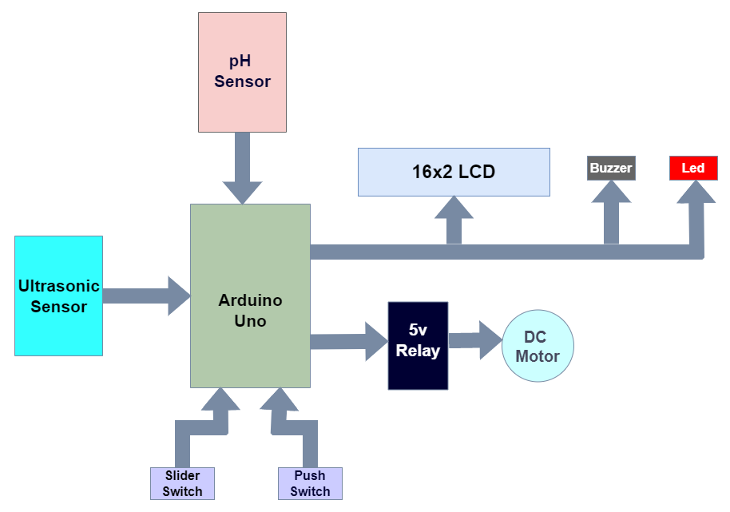
WORKING PROCEDURE
Block Diagram
5

Slide 7
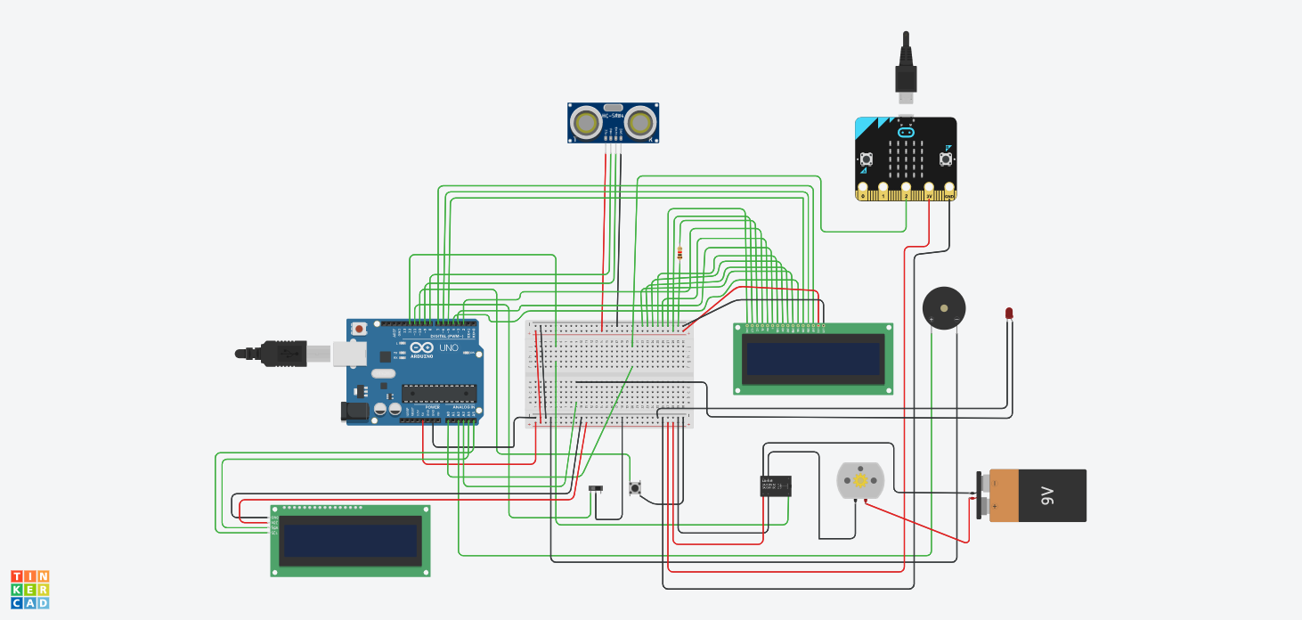
WORKING PROCEDURE
Circuit Diagram
5

Slide 8
BUDGET
Equipment | Quantity | Estimated Budget (BDT)
Arduino MEGA | 1 | 1650
16x2 LCD Display | 1 | 250
Keypad | 1 | 75
Ultrasonic Sensor | 1 | 90
Breadboard | 2 | 300
Resistor 1k ohm | As needed | 15
Tactile Switch | 1 | 10
Slide Switch | 1 | 10
Connecting Wires | As needed | 90
Gravity Analog pH sensor | 1 | 2500
5v Relay Module | 1 | 100
Buzzer | 1 | 15
6

Slide 9
BUDGET
Equipment | Quantity | Estimated Budget | Budget
Arduino MEGA | 1 | 1650 | 1200
16x2 LCD Display | 1 | 250 | 120
Keypad | 1 | 75
Ultrasonic Sensor | 1 | 90 | 90
Breadboard | 2 | 300 | 400
Resistor 1k ohm | As needed | 15 | 5
Tactile Switch | 1 | 10 | 10
Slide Switch | 1 | 10 | 15
Connecting Wires | As needed | 90 | 120
Gravity Analog pH sensor | 1 | 2500 | 2700
5v Relay Module | 1 | 100 | 90
Buzzer | 1 | 15 | 10
6

Slide 10
BUDGET
Total Estimated Budget = 5105 Taka (BDT)
Total Budget = 5160 Taka (BDT)
6

Slide 11
CONTRIBUTION
Md. Shahid Hasan 190104130 25%
Saleh Ahmed Shafin 190104138 25%
Nirjoy Debnath 190104139 25%
Dewan Mubinul Haque 190104150 25%
7

Slide 12
Challenges of the project
handling of two sensors
difficult to measure accurate distance
problem in working with the pH sensor
Setting up the circuit on bread board
After connecting the pump to the circuit, it starts misbehaving
7

Slide 13
CONCLUSION
01
Reduce the human interference
Unwanted overflow can be controlled
Helps to measure the acidity or alkalinity of the water
Can be used in different types of sectors
02
03
04
7

Slide 14
REFERENCES
Project Hub- https://create.arduino.cc/projecthub/blackpanda856/automatic-water-pump-controller-using-arduino-uno-fd902b
Circuit Digest- https://circuitdigest.com/microcontroller-projects/arduino-ph-meter
researchClue.com- https://nairaproject.com/projects/1387.html#:~:text=Aim%20and%20Objectives&text=To%20pump%20water%20automatically%20from,or%20source%20of%20water%20supply.
HyClassProject- https://hyclassproject.com/design-and-construction-of-an-automatic-water-pump-controller.html
How To Electronics- https://how2electronics.com/ph-meter-using-ph-sensor-arduino-oled/
ResearchGate- https://www.researchgate.net/publication/322918493_Flexible_Automatic_Water_Level_Controller_and_Indicator
Uni Assignment- https://www.uniassignment.com/essay-samples/engineering/automatic-water-tank-level-controller-engineering-essay.php
Daraz- https://www.daraz.com.bd/products/mega-2560-pro-mini-5vembed-ch340g-atmega2560-16au-with-male-pinheaders-development-board-for-arduino-mega-i184125653.html
8

Slide 15
THANK YOU
ANY QUERIES

