Slide 1
FINAL PROJECT TEMPLATE

Slide 2
THREAT SUMMARY
Summary of Situation: 3 Hospitals (“A”,”B”, ”C”) have been attacked by Ransomware by forcing them to pay in bitcoin raising by a timer, the incident occurs when the IT Department open an E-mail attachment resource.
Asset: Windows systems that contain centralized log files and backups
Impact: the impact was on the all 3 element of CIA trade.
Threat Actor: Group called FIN4 Bit Cryptor as an External threat, and an unintentionally the user from tech department as an internal threat.
Threat Actor Motivation: Motivated by financial gain and criminal activity.
Common Threat Actor Techniques: the attack occurred in spear phishing technique.

Slide 3
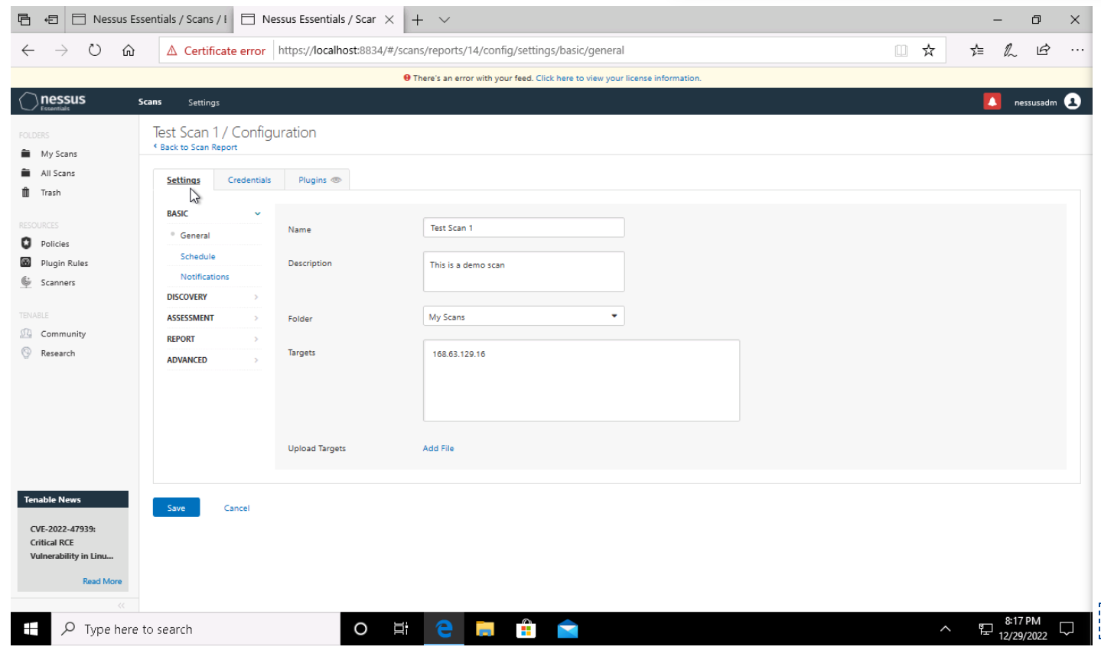
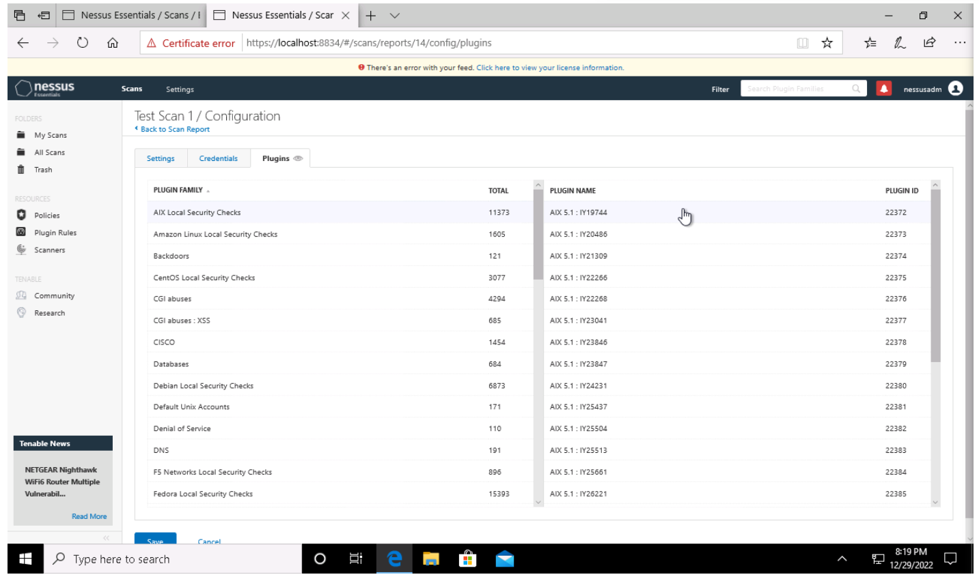
VULNERABILITY SCANNING TARGETS
Summary of scan targets:
Number of devices scanned: one
Device type: Windows
Primary purpose of device: general purpose computer ~ able to carry out many different tasks.
(insert 2 screenshots from scan configuration window – one of the settings tab and one of the plugins tab)

Slide 4
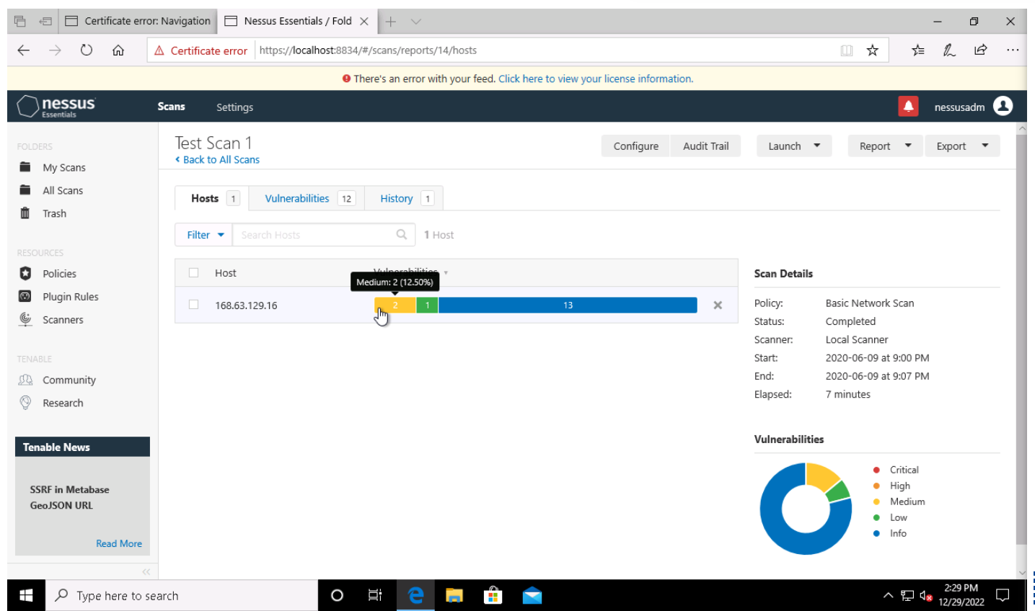
VULNERABILITY SCAN RESULTS
Summary of findings:
Total number of actionable findings: 12 Vulnerabilities
Critical: zero
High: zero
Medium: 2 Vulnerabilities
Low: one vulnerability
(insert screenshot from scan results dashboard)

Slide 5
REMEDIATION RECOMMENDATION
Fix within 7 days
Finding | Severity Rating | Recommended Fix
null
Fix within 30 days
Finding | Severity Rating | Recommended Fix
DNS Server spoofed Request Amplification DDoS | MEDIUM | Restrict access to your DNS server from public network of reconfigure it to reject such queries
DNS Server Recursive Query cache Poisoning weakness | MEDIUM | Restrict recursive queries to the hosts that should use this name server
Fix within 60 days
Finding | Severity Rating | Recommended Fix
DHCP Server Detection | LOW | Apply filtering to keep this information off the network and remove any options that are not in use

Slide 6
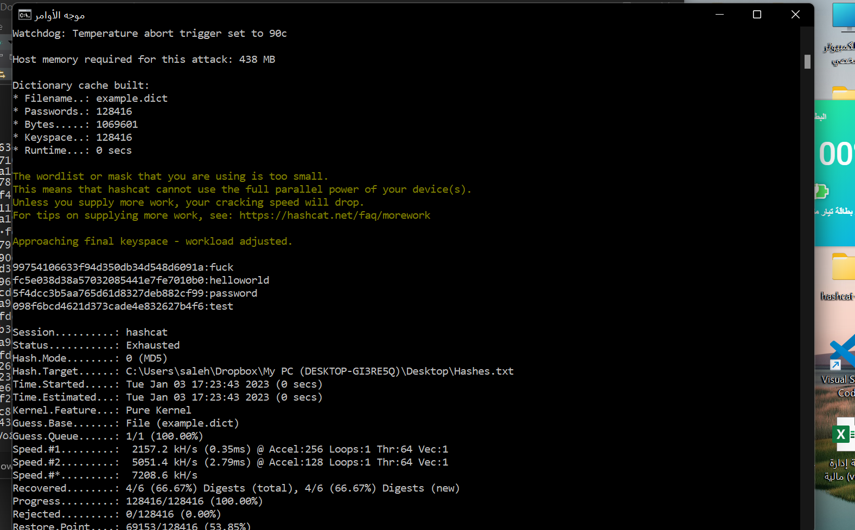
PASSWORD PENETRATION TEST OUTCOME
Methodology: To start I downloaded the hashed password as a txt file then I used at cmd the code: hashcat -m 0 -a 0 target_hashes.txt example.dict to test cracking and the –m 0 represents the hash type MD5
The –a 0 represents dictionary attack
The target_hashes represents our file that want to crack
Number of passwords tested: 6
Number of passwords cracked: 4
Evidence of weak passwords:
Recommended steps to improve passwords security:
Use Employ a CAPTCHA and two-factor authentication.
Monitor IP addresses.
Use Web Application Firewalls (WAFs)

Slide 7
INCIDENT RESPONSE PRELIMINARY ASSESSMENT
Summarize ongoing incident:
The administrative staff and several of medical staff have noted that they are being asked to pay 1 million dollar in bitcoin to give them access to the system
The monitor patient stats system has lost the control and the doctors unable to render treatments without patient stats.
Document actions or notes from the following steps of the initial incident response checklist
Step 1: Helpdesk, end users
Step 2:
the System is down
the users cannot access the patient stats
The control systems used to monitor patient stats , Microsoft Windows 10 , 168.63.129.16
Step 3: yes it’s confirmed, and it still in progress, also it’s urgent, and we mustn’t respond to the attacker, we are talking about ransomware attack.
Step 4: yes because there is no treatments without patient stats.
Step 6: Category one - A threat to public safety or life; because there is patients have no treatments.

Slide 8
INCIDENT RESPONSE RECOMMENDED ACTION
Summarize recommendation to contain, eradicate, and recover:
The first step is making sure the system is isolated from another network
Then the next step is clearing any parts of viruses remains
And the final step is restoring the backup and update the system to prevent any future incidents
Documented actions and notes from the IR checklist
Step 7: Malware response procedure
Step 8: We are unable to check the logs so we can copy the logs from this system to the center location
Step 9: we must ensure the system is fully patched
Step 12: We must add more efficient technologies like firewall or SSH network protocol and make sure to improve and train the employees for future incident.

