Slide 1
Human Action Recognition Using Image Processing through Matlab
Submitted By
GROUP 8
- MD. Akif Zaman (ASH1701041M)
- Md. Saleh Zohur Bhuiyan (ASH1701047M)
- Mazharul islam (ASh1701054m)
- Rabea Boshri (muh1701057f)
MD. Shariar Hossain (ash1601035m)
Kamruzzaman (ash1701045m)
Asif Hossen (ash1701052m)
Md. Kamrul Hasan Tuhin (ash1701002m)
Submitted To
A.R.M Mahamudul Hasan Rana
Assistant Professor
Department of Computer Science & Telecommunication Engineering
Noakhali Science & Technology University

Slide 2
Human Action Recognition
Introduction
The goal of Human Action Recognition (HAR) is to analyze human behavior and give each action a label.
It has a wide range of applications, and as a result, it is gaining popularity in the field of computer vision.
Human actions can be represented using various data modalities, such as RGB, skeleton, event stream, audio, acceleration, etc.
Objective
In this project we will use still images to recognize human actions. By taking advantage of pre-trained CNNs, we employ the transfer learning technique to tackle the lack of massive labeled action recognition datasets.

Slide 3
Dataset
We developed a dataset of 12 different human actions images which are collected from various photographing websites and existing datasets. All images are in RGB color space with jpeg format. Included human actions are listed below,
i) Walking
ii) Running
iii) Eating
iv) Driving
v) Swimming
vi) Bike riding
vii) Horse riding
viii) Kayaking
ix) Photographing
x) Playing music
xi) Push ups
xii) Using computer

Slide 4
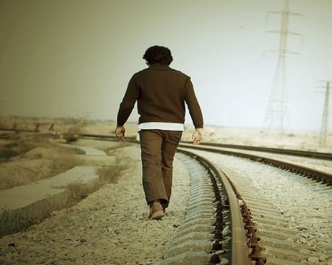
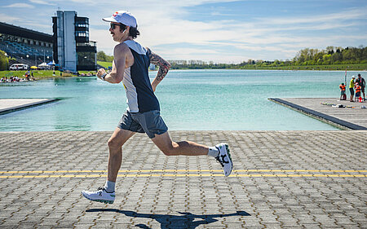
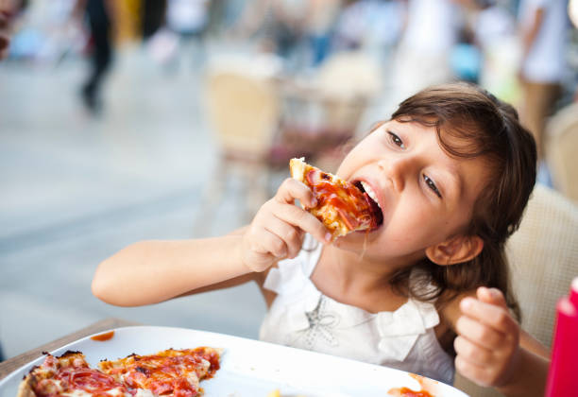
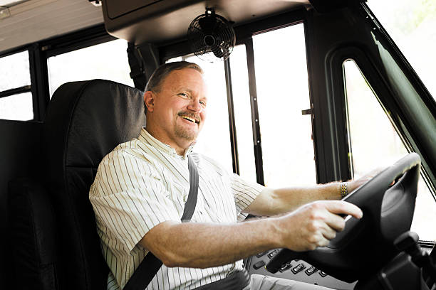
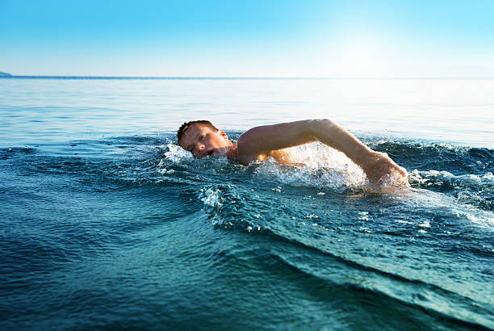
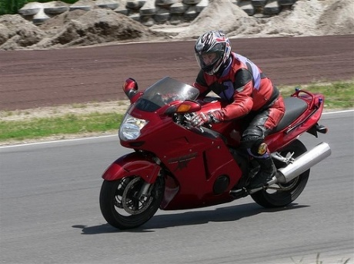
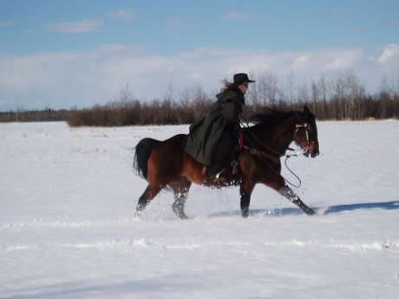
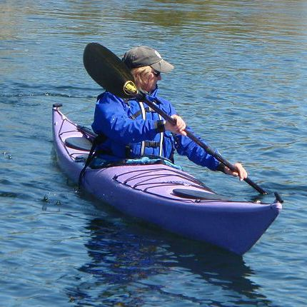
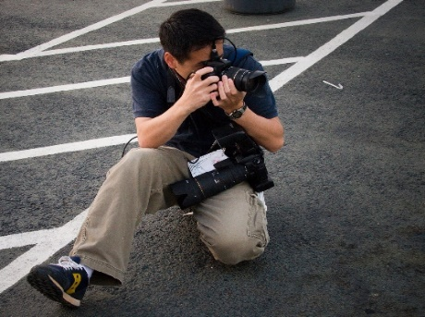
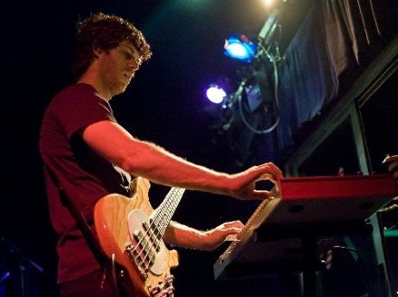
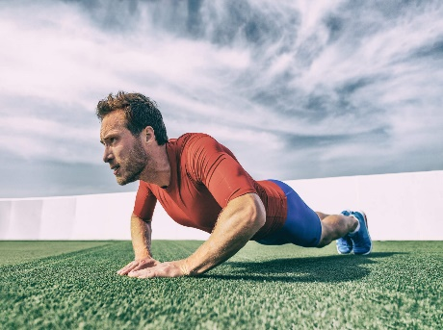
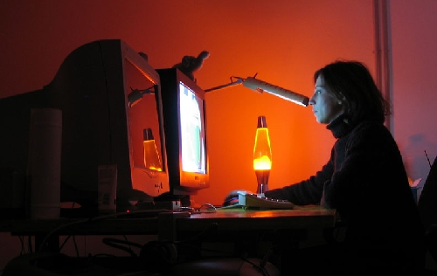
Sample images from each class
walking
running
eating
driving
swimming
bike riding
horse riding
kayaking
photographing
playing music
push ups
using computer

Slide 5
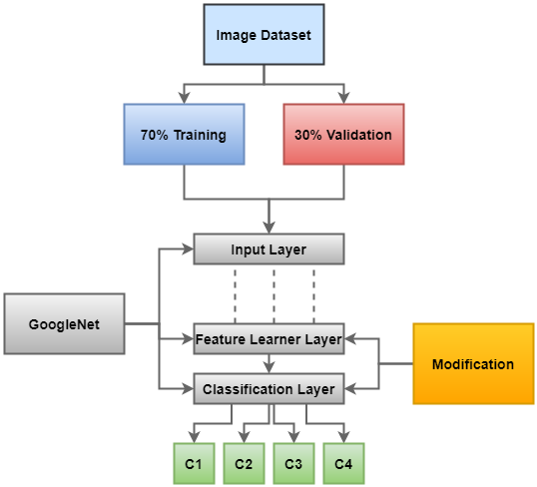

Methodology
We started by resizing our image dataset to 224x224 pixels so that all of the photos in the dataset are the same size, which our model can take. Then we split the dataset into training and validation set with 70% for training and 30% for validation. To perform the task of Human Action Recognition we used pretrained googlenet model which is based on convolutional neural network architecture. The model contains 144 layers of computations. We modified the built in model to classify 12 human actions by replacing layer 142(feature learner layer) and layer 144(output classification layer) with our defined layers. Then the modified model is trained using training data.
…
c12
Figure: working flowchart

Slide 6
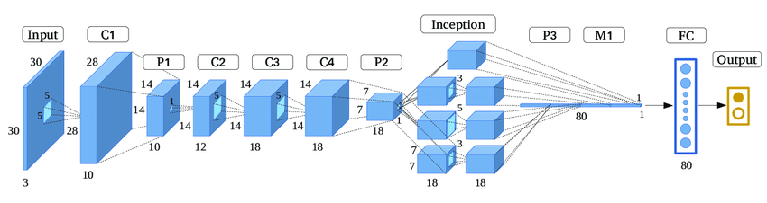

Model structure
This is the simplified architecture of googlenet. The original model contains 144 layers and there are some inception blocks in the model.
224
224

Slide 7
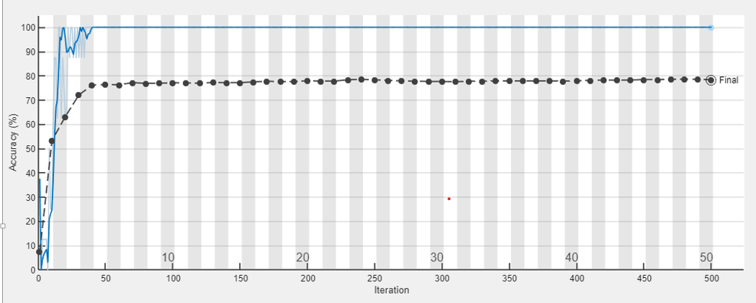

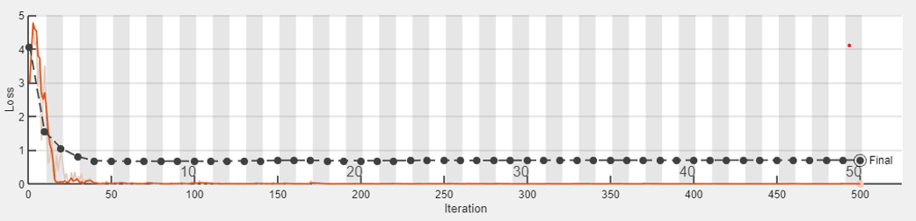

Results
Using modified googlenet we obtained around 80% classification accuracy on our validation set.
(a) Accuracy
(a) Loss

