Slide 1
Smart Lost & Found System
Saleha Tariq

Slide 2
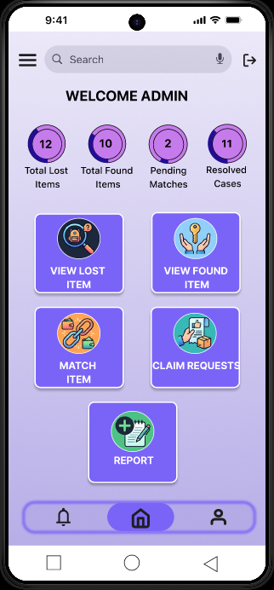
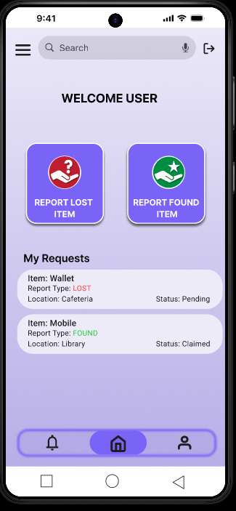
Project overview
The product:
The Smart Lost & Found System is a web-based application that helps users report lost and found items and recover them efficiently. It connects users with administrators through a centralized platform that manages item tracking, matching, and claim verification.
.
Project duration:
27 April 2026 – 18 May 2026

Slide 3
Project overview
The problem:
Many people lose personal belongings in public places like universities, offices, and transport areas. There is no centralized system to report or find these items, which leads to loss, confusion, and wasted time.
The goal:
To design a system that allows users to easily report lost/found items, search for items, and recover them through a secure and verified claim process managed by an admin.

Slide 4
Project overview
My role:
UX Designer / UX Research Contributor
Responsibilities:
Designed high-fidelity UI screens.
Conducted user research activities.
Assisted in usability testing sessions.
Improved UI based on user feedback and testing results.

Slide 5
User research
Personas
Problem statements
User journey maps
Understanding
the user

Slide 6
User research: summary
User research was conducted through informal interviews and observations. Initially, it was assumed that users mainly struggle with reporting lost items. However, research revealed that users also face difficulty in tracking item status and verifying ownership. This led to adding features like notifications and claim verification.

Slide 7
User research: pain points
1
2
3
4
Time-Consuming Manual Search
Difficulty Finding Matching Items
Delayed Verification Process
Fake Claim Requests
People often spend a lot of time physically searching different locations or asking others about lost belongings.
Some users may falsely claim ownership of found items, creating trust and security issues.
Users struggle to identify whether a found item matches their lost item because of incomplete information.
Manual verification by administrators can delay the return of items to their rightful owners.

Slide 8
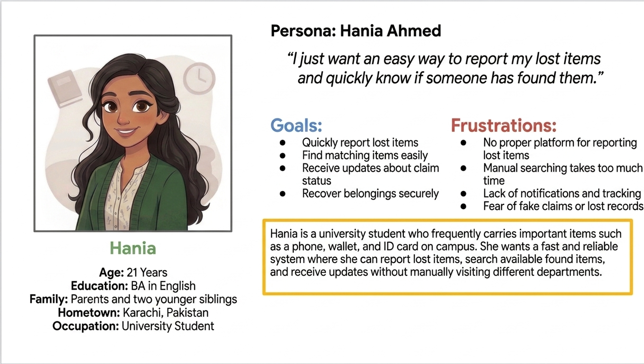
Persona: Hania Ahmed
Problem statement:
Hania is a busy university student who needs a simple and secure way to report and recover lost items because traditional lost-and-found methods are slow, unorganized, and unreliable.

Slide 9
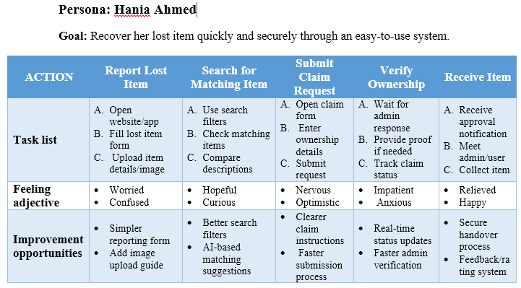
User journey map
[Hania wants a fast and reliable way to recover her lost belongings without wasting time searching manually. She expects the system to be simple, secure, and easy to navigate. During the journey, her emotions change from stress and confusion to relief after successful verification and item recovery. The design focuses on improving trust, reducing delays, and making communication between users and admins smoother.]
Image of user journey map

Slide 10
Paper wireframes
Digital wireframes
Low-fidelity prototype
Usability studies
Starting
the design

Slide 11
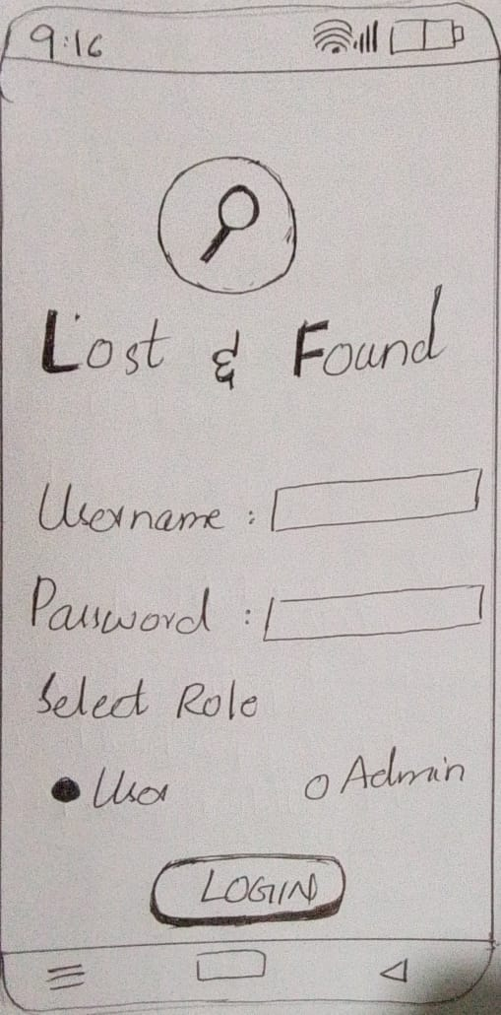
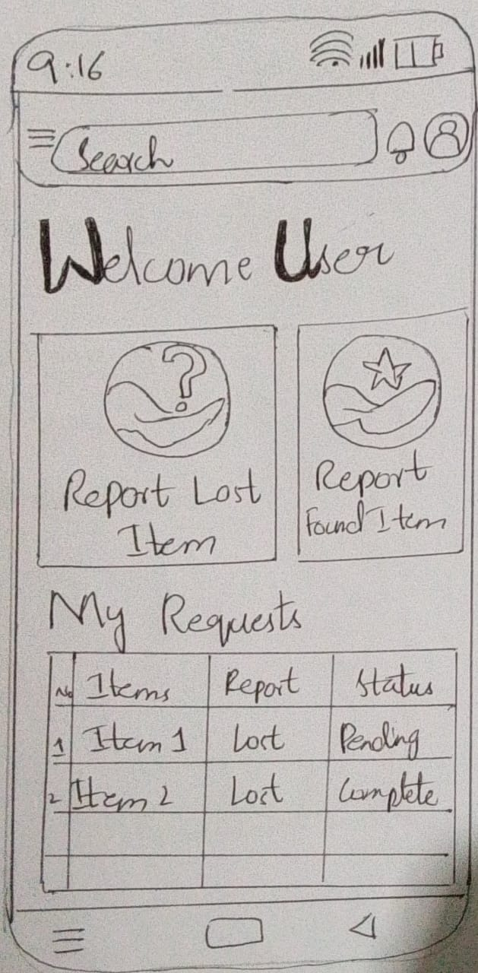
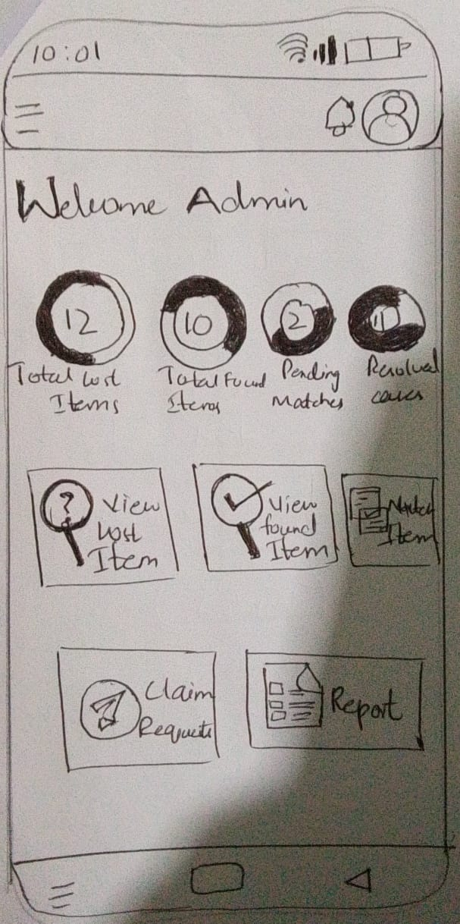
Paper wireframes
Paper wireframes were created to quickly explore different layout ideas for the application. The focus was on simple navigation, easy item reporting, and quick access to search functionality. Multiple layout variations were tested before selecting the most user-friendly design.

Slide 12
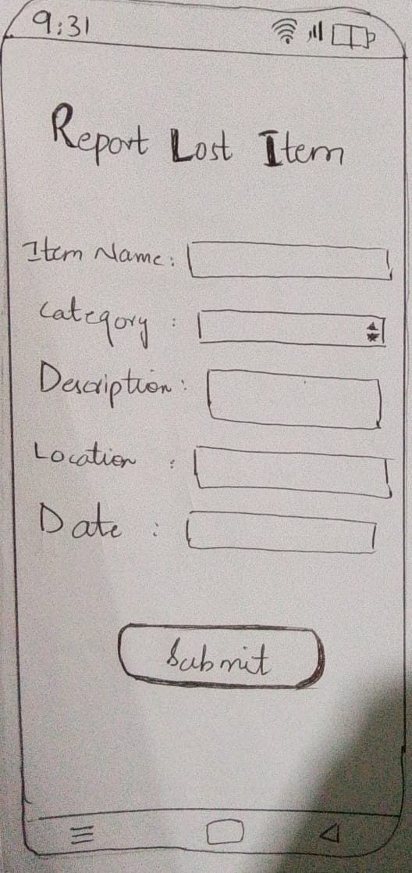
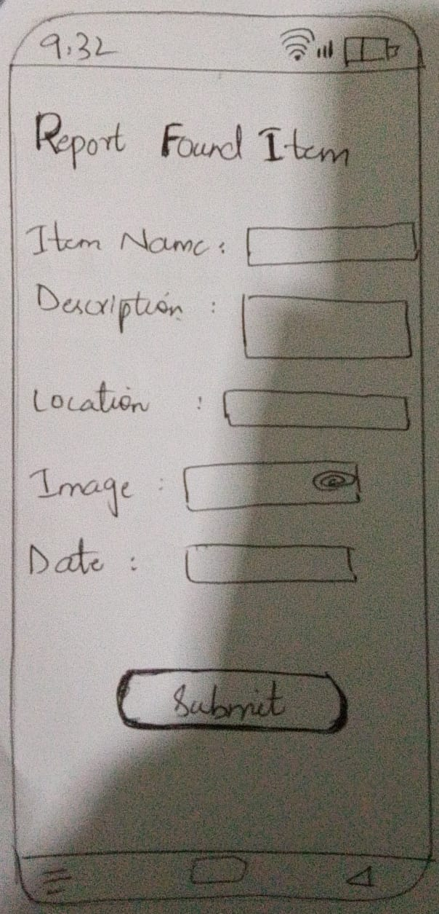
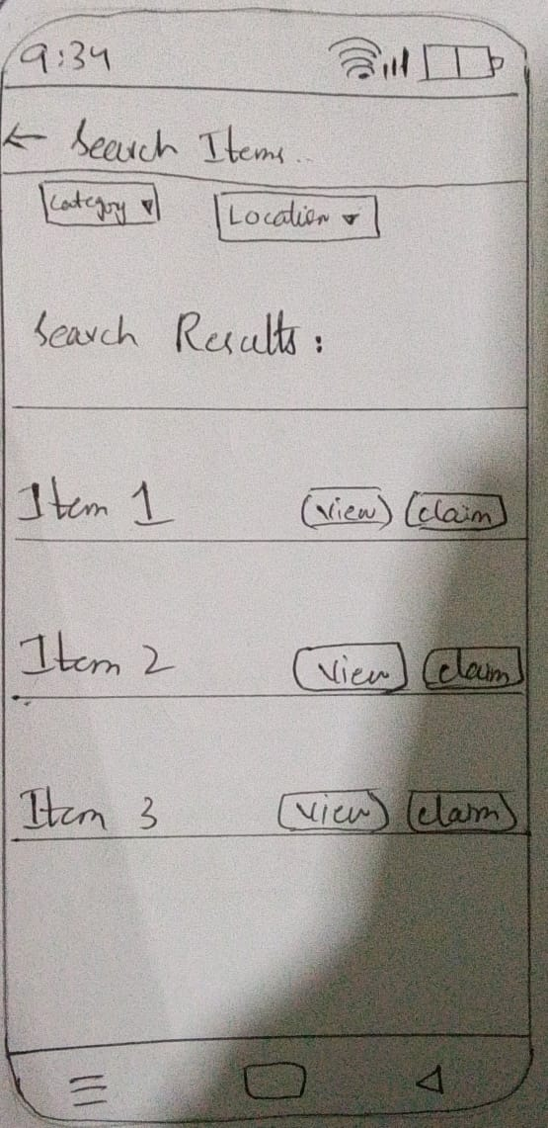
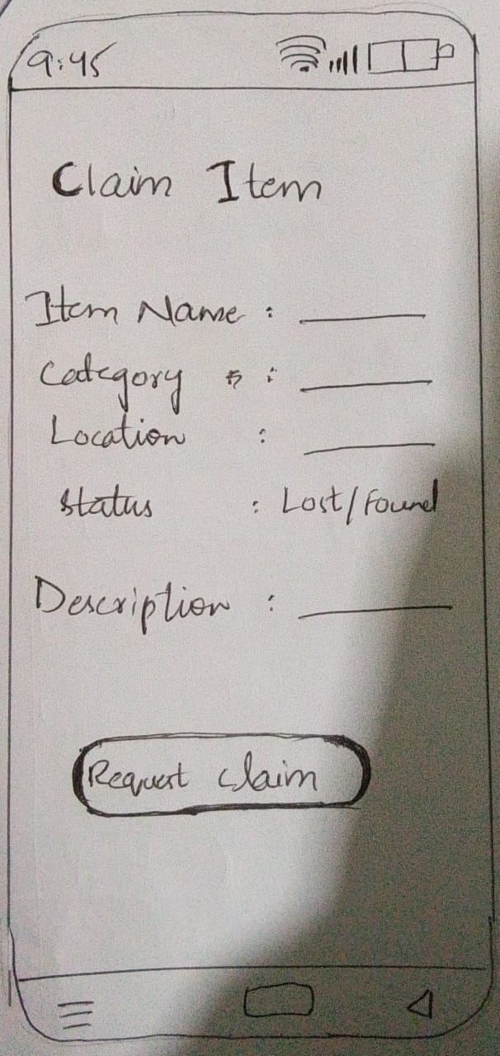

Slide 13
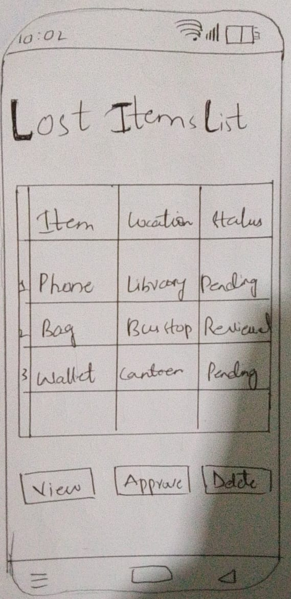
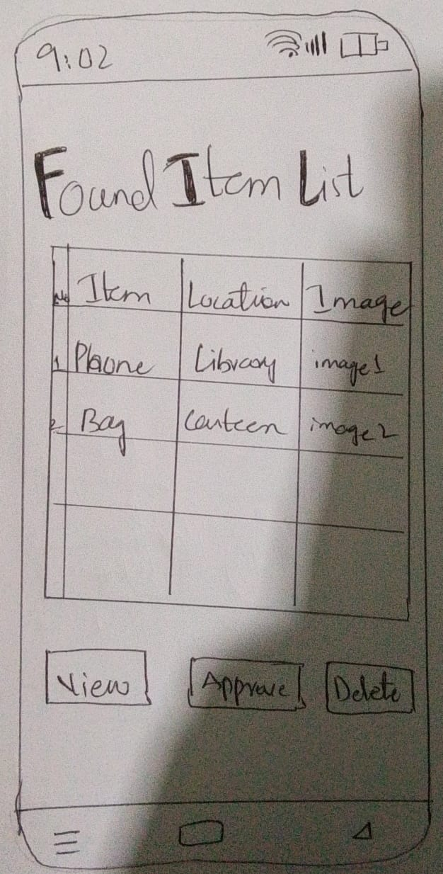
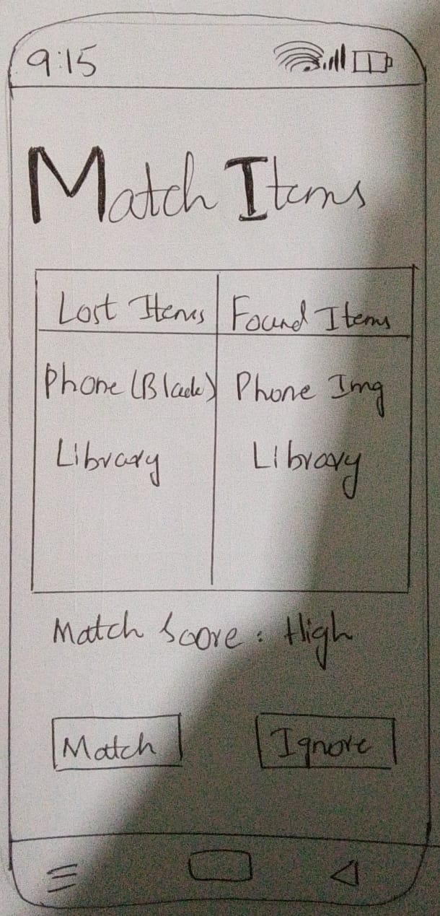
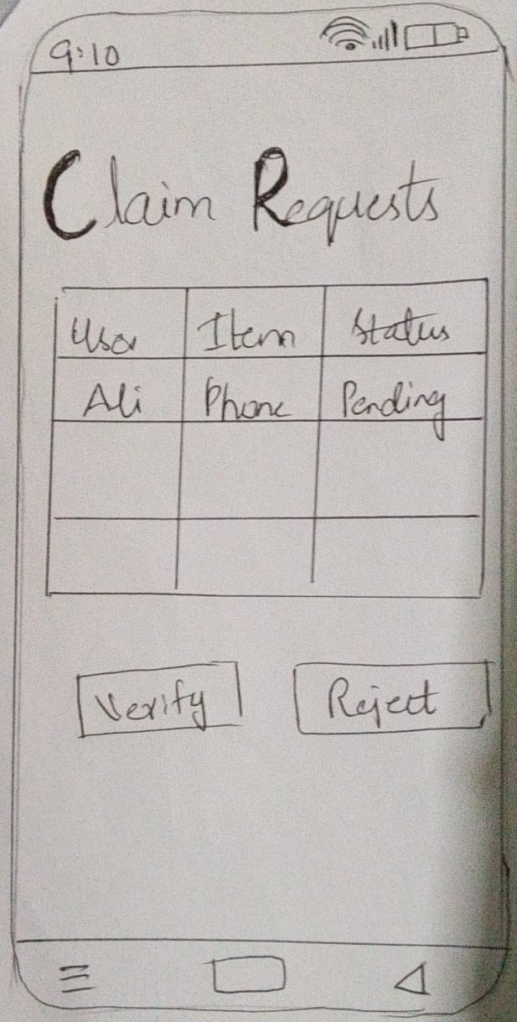

Slide 14
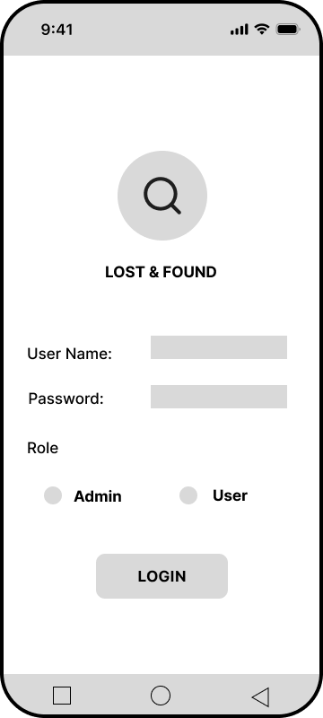
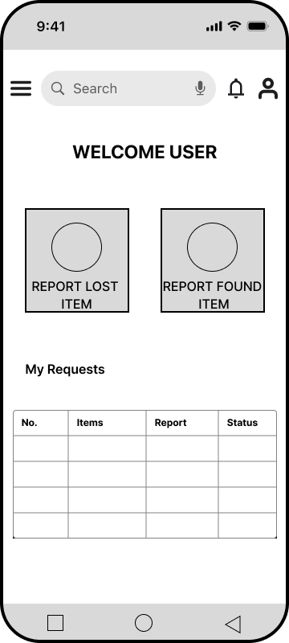
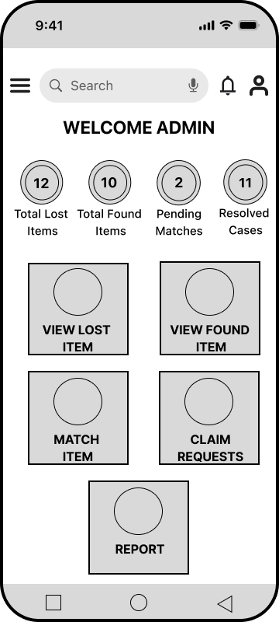
Low-fidelity prototype
[Link: https://www.figma.com/design/1cwamnj4WCgFwjFPlwiT9p/HCI_Assigmnet05?node-id=0-1&t=GdCGOHp1o8c2Xxuj-1 ]

Slide 15
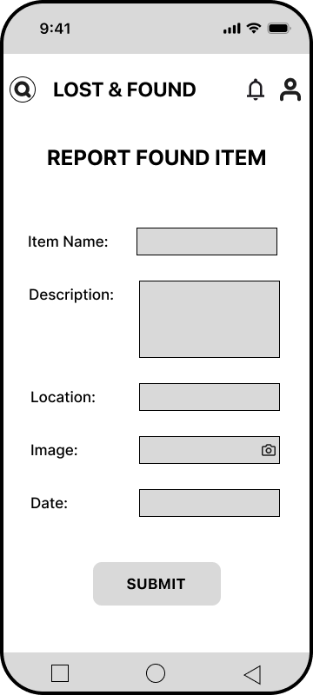
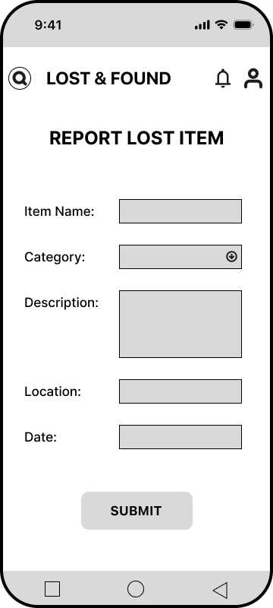
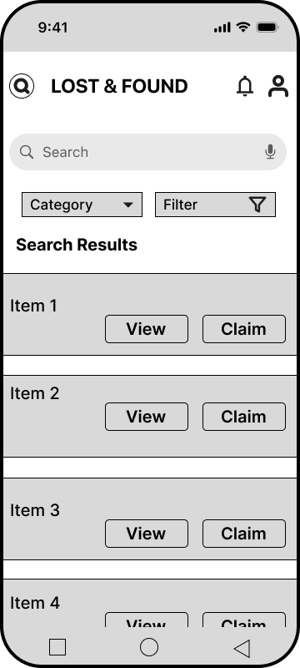
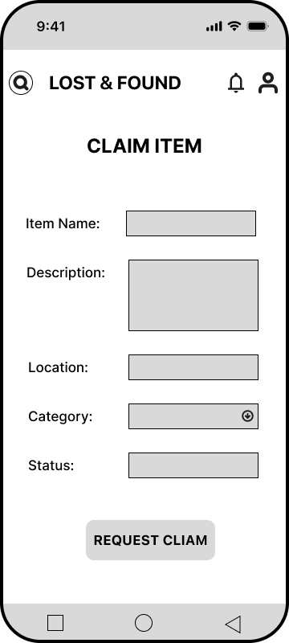

Slide 16
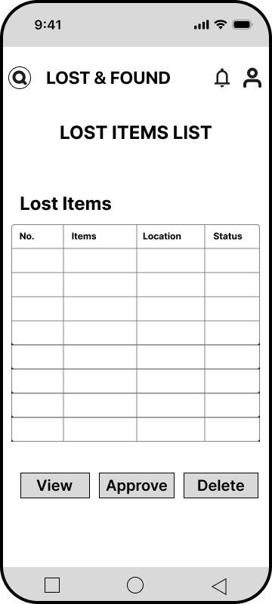
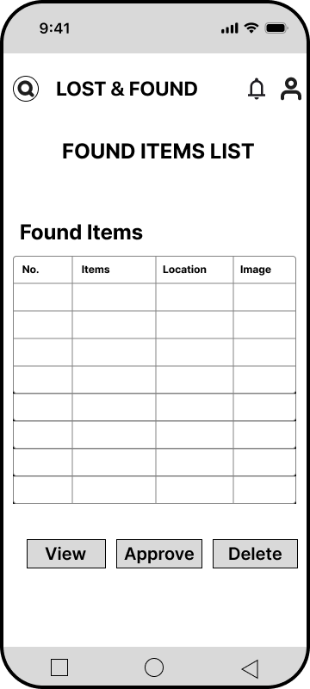
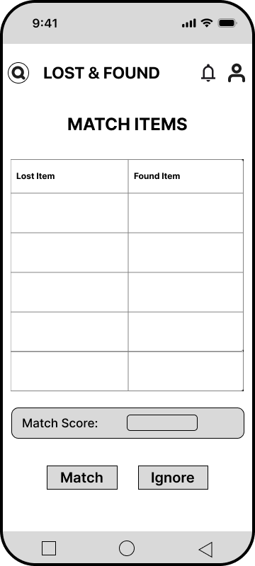
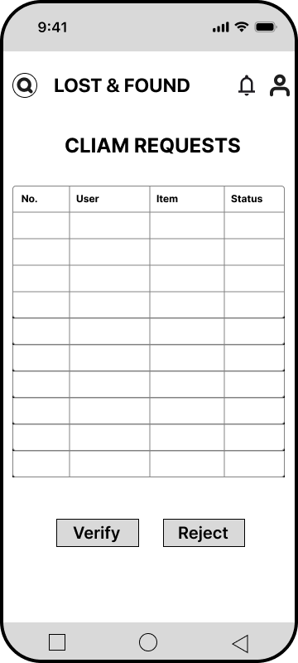

Slide 17
Usability study: findings
Two rounds of usability studies were conducted with regular users to evaluate the ease of reporting items, searching for lost belongings, and understanding the claim process. Feedback from participants helped improve navigation, simplify forms, and make important features more visible.
Round 1 findings
Round 2 findings
1
Logout button was hard to find.
1
Navigation bar was added.
2
No navigation bar for easy movement.
2
Logout button placement was improved.
3
Some users were confused about the item claim verification process.
3
Interface became more user-friendly.

Slide 18
Refining
the design
Mockups
High-fidelity prototype
Accessibility

Slide 19
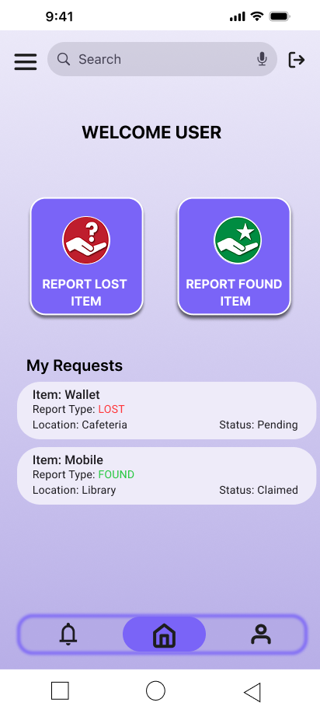
Mockups
Before usability study
After usability study
Before Usability Study
No navigation bar for switching pages.
Logout option not easily visible.
Overall layout looked cluttered.
After Usability Study
Navigation bar added for easy page switching
Logout button made visible and accessible
Cleaner and more structured dashboard layout.
Image of selected screen before usability study
Image of selected screen after usability study

Slide 20
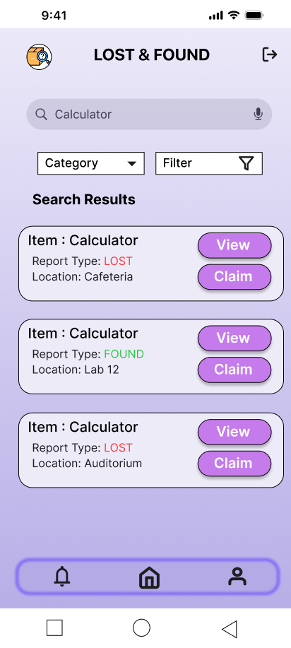
Mockups
Before usability study
After usability study
Before Usability Study
Form fields were overcrowded and not properly structured.
Only item name was visible, making it hard to understand full details.
Poor spacing caused layout to look cluttered and confusing.
After Usability Study
Form layout improved with better spacing and alignment.
Key details like item type and location are now visible along with item name.
Improved readability and clearer presentation of reported items.

Slide 21
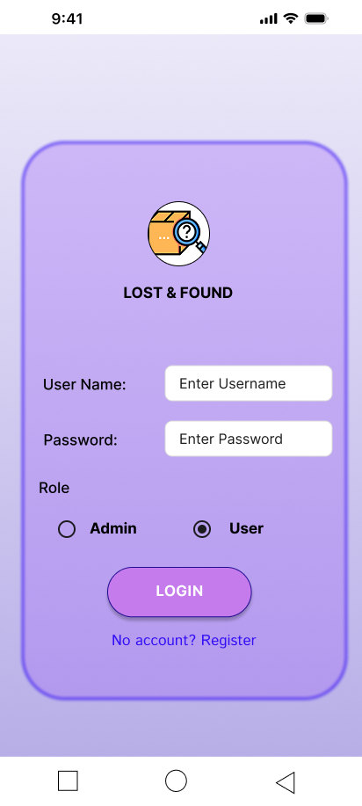
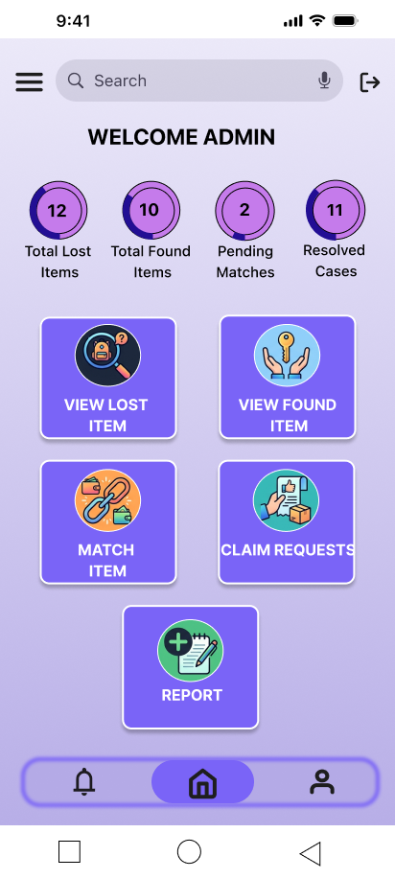
High-fidelity prototype
[Link: https://www.figma.com/design/1cwamnj4WCgFwjFPlwiT9p/HCI_Assigmnet05?node-id=54637-402&t=GdCGOHp1o8c2Xxuj-1 ]

Slide 22
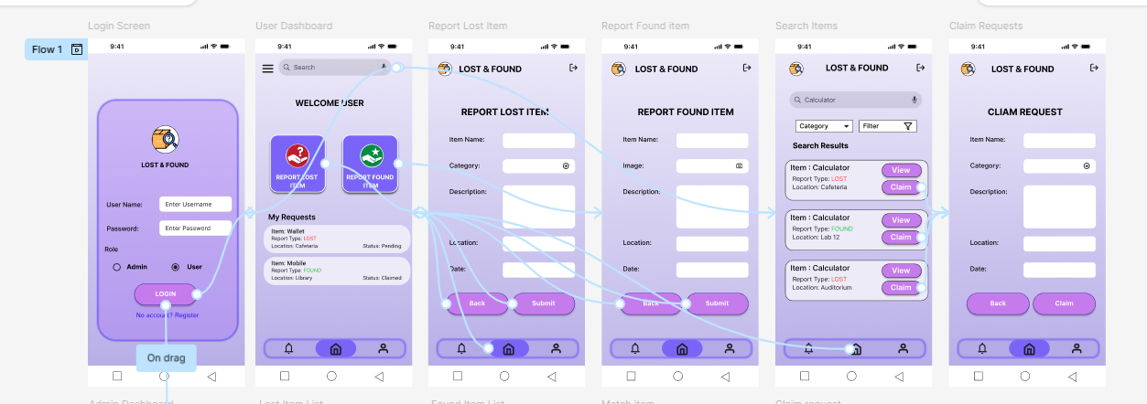

Slide 23
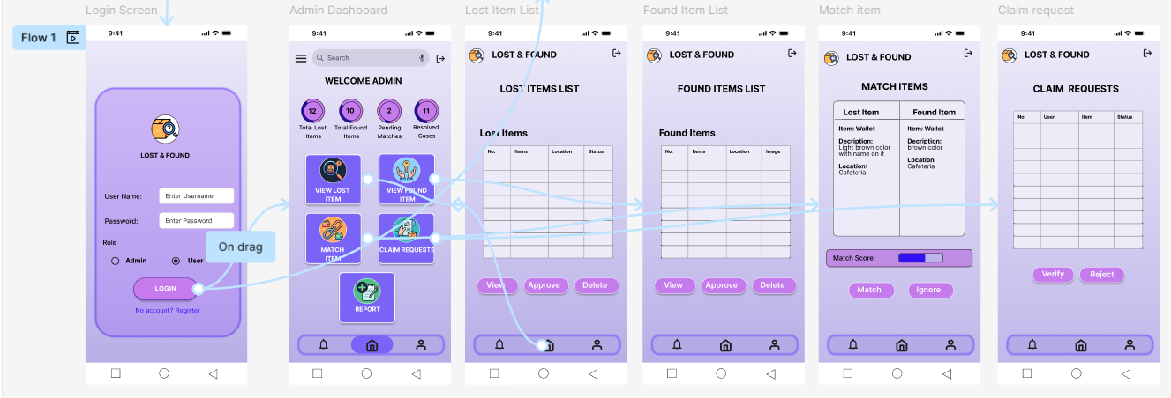

Slide 24
Accessibility considerations
1
2
3
High-contrast colors and readable fonts were used to improve visibility for users with visual impairments.
Buttons and navigation elements were designed with clear labels and sufficient spacing for easier interaction.
Simple language and organized layouts were used to make the system understandable for users with different technical skill levels.

Slide 25
Going forward
Takeaways
Next steps

Slide 26
Takeaways
Impact:
The Smart Lost & Found System provides users with a faster and more organized way to report and recover lost items. Feedback from users showed that the platform made the process easier, reduced confusion, and improved trust through secure claim verification.
What I learned:
Throughout this project, I learned the importance of user-centered design and continuous testing. Conducting usability studies helped me understand real user problems and improve the interface based on practical feedback. This also improved my skills in wireframing, prototyping, and designing accessible interfaces.

Slide 27
Next steps
1
2
3
Add AI-based item matching to automatically suggest similar lost and found items.
Implement email and SMS notifications to keep users updated about item status and verification.
Introduce a feedback and rating system for verified claims to improve trust and transparency.

Slide 28
Insert a few sentences summarizing the next steps you would take with this project and why. Feel free to organize next steps in a bullet point list.
Let’s connect!
Thank you for reviewing our project portfolio. This project was developed as part of a team effort, and I am grateful for the opportunity to collaborate, learn, and contribute to building a user-focused solution.
Email: salehat2047@gmail.com

