Slide 1
NLP Chatbot Development using Dialogflow
Name: Saleha Shaukat
Group ID: F24PROJECT38A67 (BC230424569)

Slide 2
GitHub link: https://github.com/Saleha786-collab/Prototype-Assignment--Saleha-Shaukat_BC230424569-.git
Supervisor: Abdullah Qamar

Slide 3
Slide 1: Introduction
This project is a smart, AI-powered Hotel and Restaurant Chatbot System developed using Dialogflow, Flask (Python), and a responsive HTML/CSS/JavaScript front-end. The system is designed to handle both hotel-related services and restaurant-related queries, providing a seamless and interactive experience for users.
On the hotel side, users can check room availability, make reservations, modify or cancel bookings, and get pricing details through natural conversation. For the restaurant, the chatbot assists with menu inquiries, table reservations, taking orders and general customer support.
Dialogflow powers the Natural Language Processing (NLP) to understand user intents, while Flask acts as the backend framework managing logic, database access, and integrations. The system uses SQLAlchemy for database operations and supports user login and account features.
This project enhances operational efficiency by reducing manual workload for hotel and restaurant staff, ensuring 24/7 customer support, and offering a modern, user-friendly solution to hospitality service automation.

Slide 4
Slide 2: Scope
This chatbot handles hotel and restaurant services. Users can:
Check room availability
Make a reservation
Modify or cancel a booking
Check room prices
Ask restaurant-related questions
Place orders

Slide 5
Get help through general FAQs
Manage their profile (login, register, update info)
It is designed to automate these tasks using AI and NLP, saving time for both staff and customers.

Slide 6
Slide 3: Objective
To develop an AI-based chatbot that can handle hotel and restaurant queries automatically.
To allow users to check room availability, make, modify, or cancel bookings through natural conversation.
To assist restaurant customers in viewing the menu, placing orders, and getting quick responses to common questions.
To reduce staff workload and provide 24/7 customer support through automation.

Slide 7
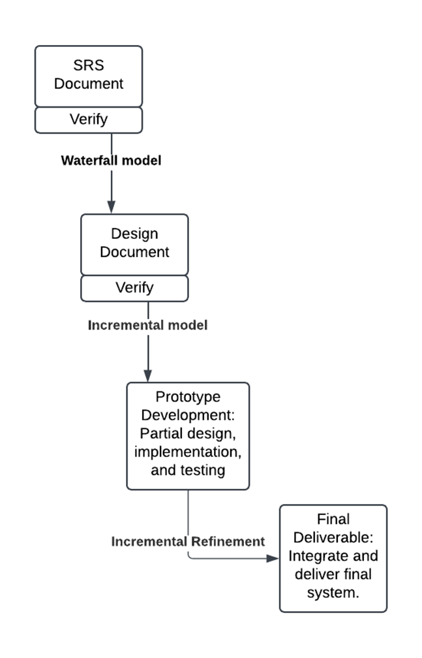
Adopted Methodology
This hybrid model allowed us to first complete formal documentation and design using the Waterfall approach, and then build and refine the system iteratively using the Incremental model.

Slide 8
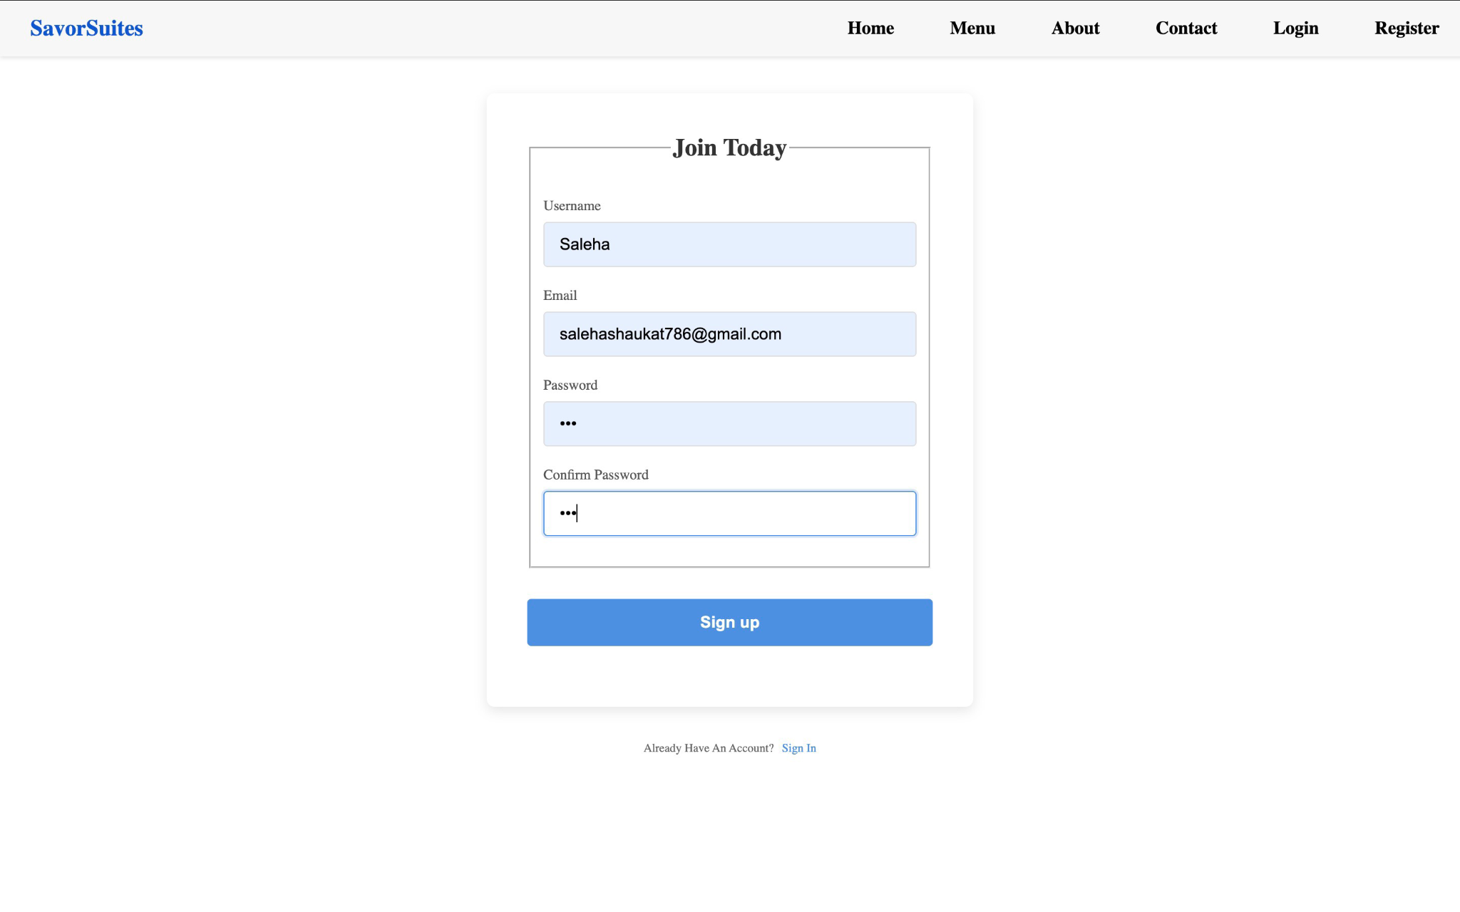
Functional Requirement 1: User Registration
Description:
Users can register an account by
providing their username, email, and
password.
Purpose:
To allow personalized bookings and track
user-specific reservations.

Slide 9
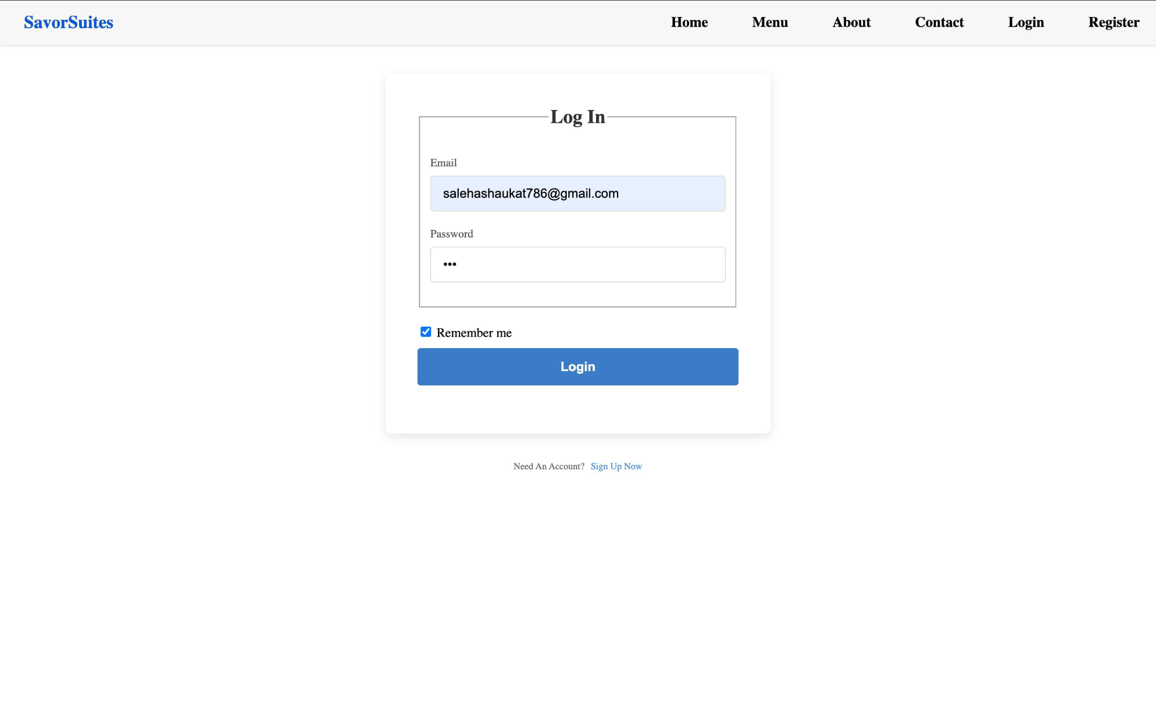
Functional Requirement 2: User Login
Description:
Registered users can log in securely
using email and password.
Purpose:
To authenticate the user before allowing any
reservation, modification, or chatbot interaction.
Only logged-in users can access the
chatbot, ensuring secure and personalized
services.

Slide 10
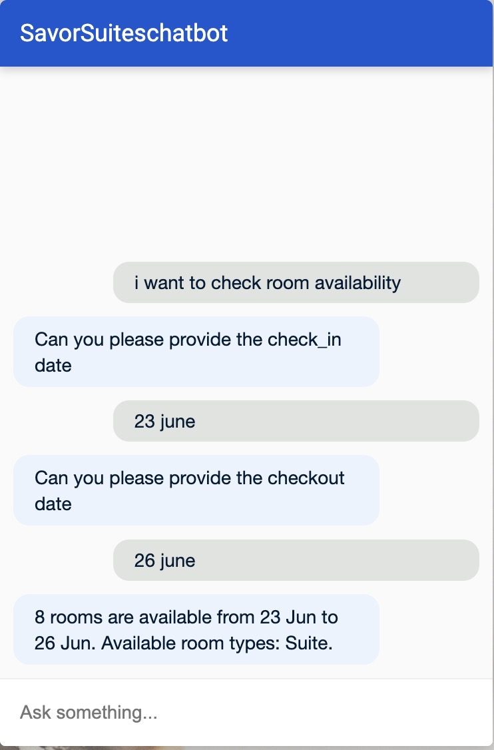
Functional Requirement 3: Check Room Availability
Description:
The chatbot can check availability of rooms based on user’s
check-in, check-out dates, and room type.
Purpose:
To help users know if rooms are available before booking.

Slide 11
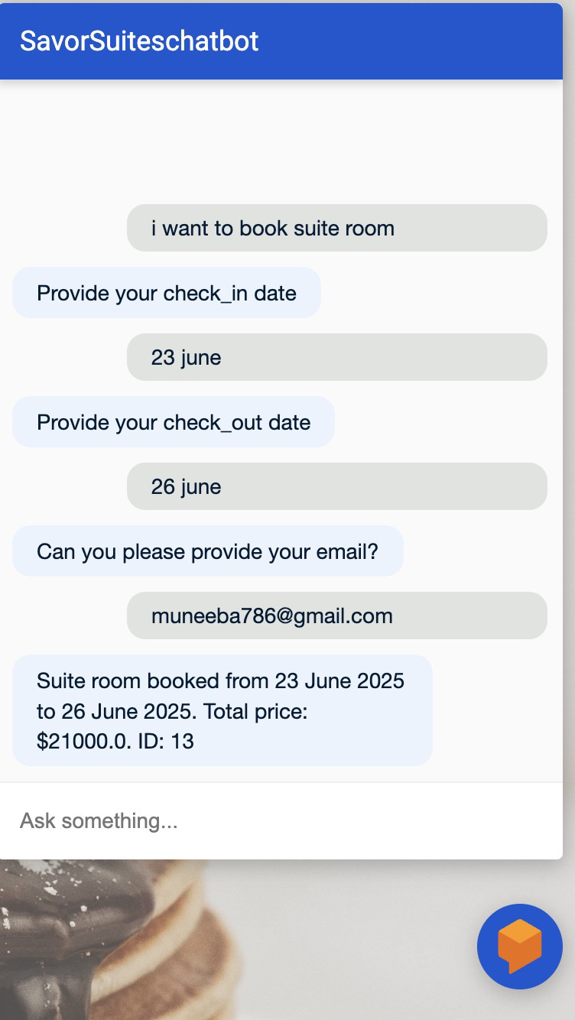
Functional Requirement 4: Book a Room
Description:
Users can book a room by providing check-in/out dates,
room type, and email.
Purpose:
To complete a hotel reservation.

Slide 12
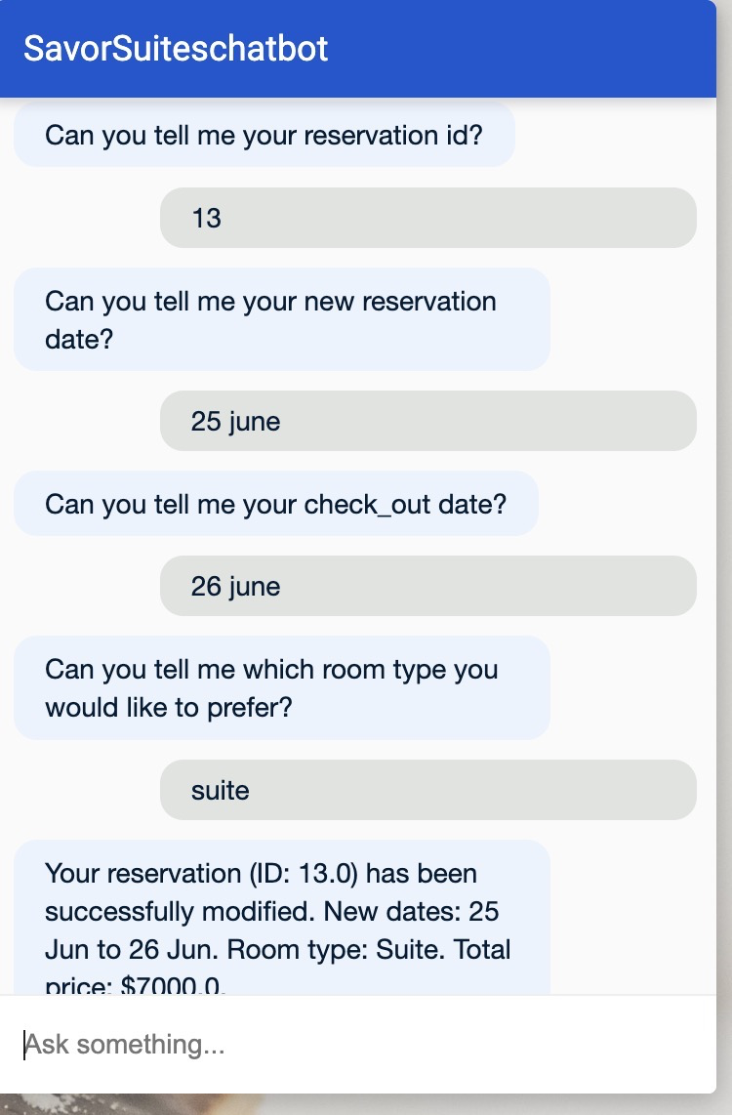
Functional Requirement 5: Modify Room Reservation
Description:
Users can modify their booking by changing the dates
or room type using the reservation ID.
Purpose:
To give flexibility in changing plans after booking.

Slide 13
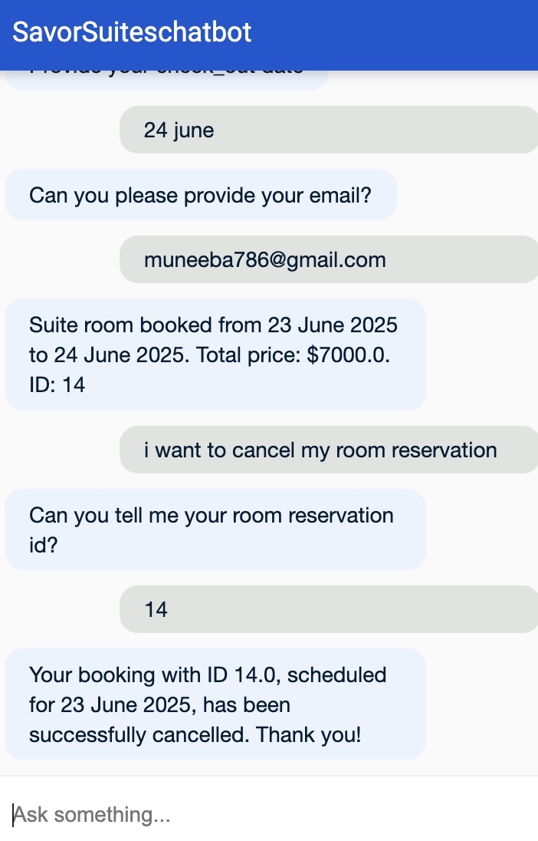
Functional Requirement 6: Cancel Reservation
Description:
Users can cancel an existing room reservation using
their reservation ID.
Purpose:
To release the booking and update room availability.

Slide 14
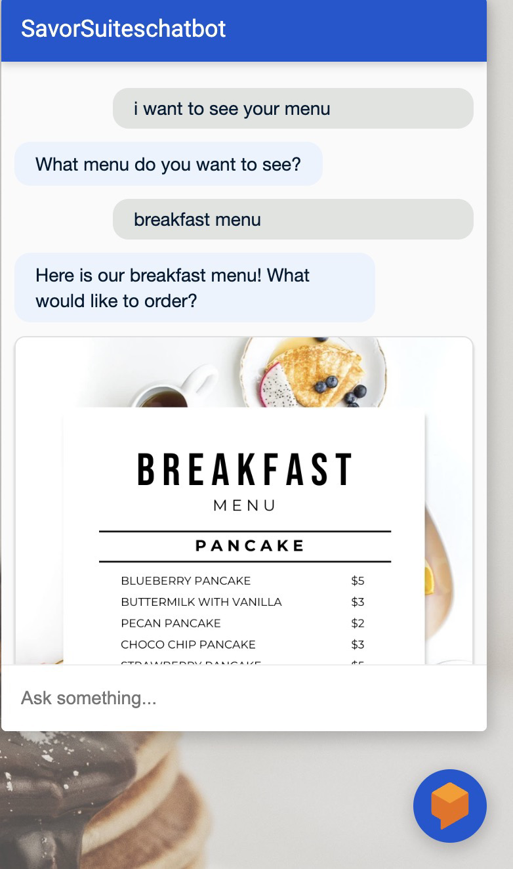
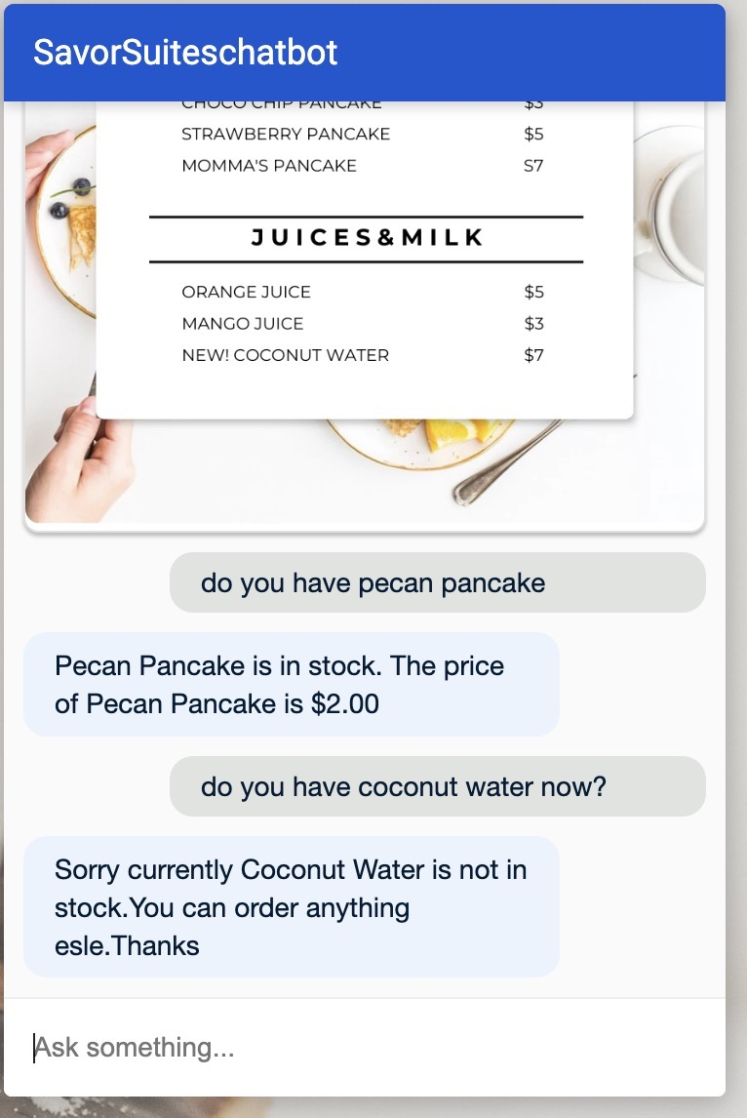
Functional Requirement 7: See Menu
Description:
The chatbot displays the restaurant's food menu when
the user asks for it, allowing them to browse available dishes.
Purpose:
To provide customers with an up-to-date list of available food items,
making it easy for them to choose before placing an order.

Slide 15
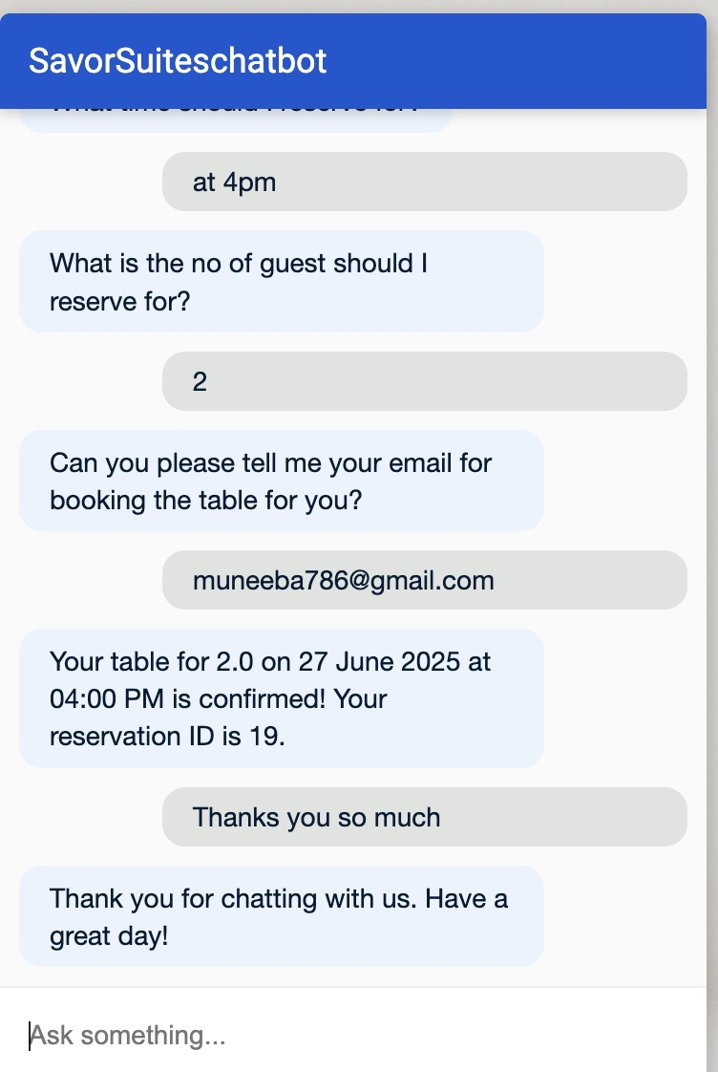
Functional Requirement 8: Chatbot Greetings & Farewell
Description:
Chatbot gives greetings and says goodbye based on user interactions.
Purpose:
To create a friendly, human-like interaction.

Slide 16
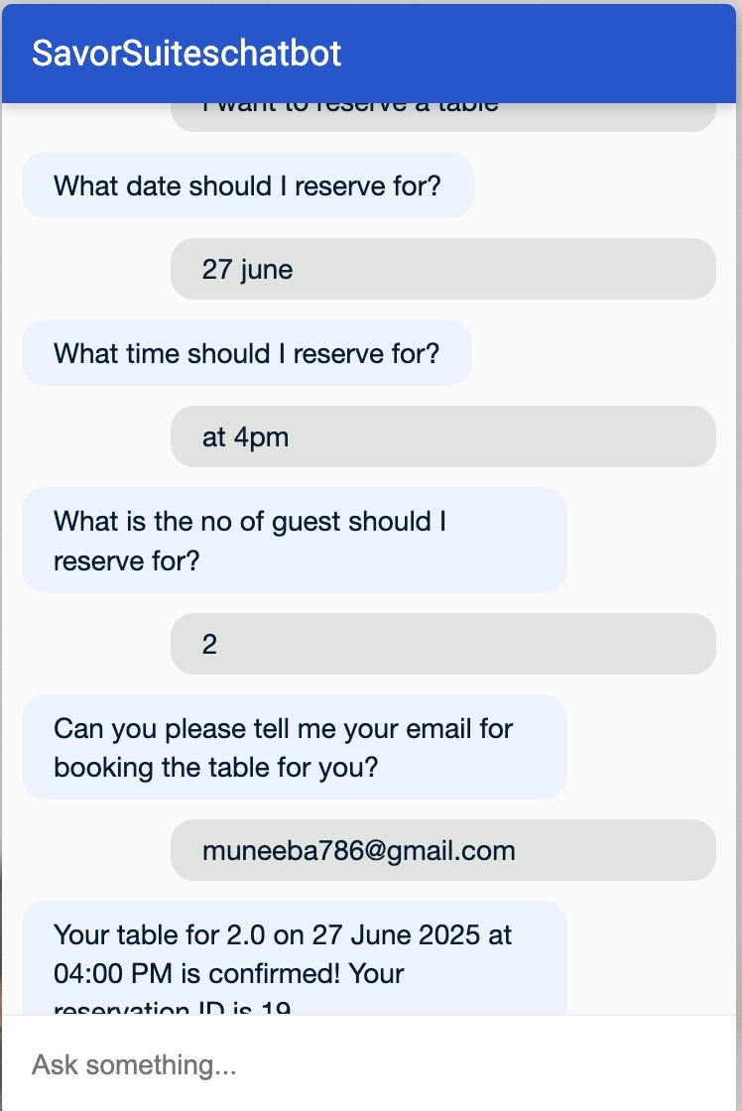
Functional Requirement 9: Table Reservation (Restaurant)
Description:
Users can reserve a restaurant table through the chatbot.
Purpose:
To book the table for the user.

Slide 17
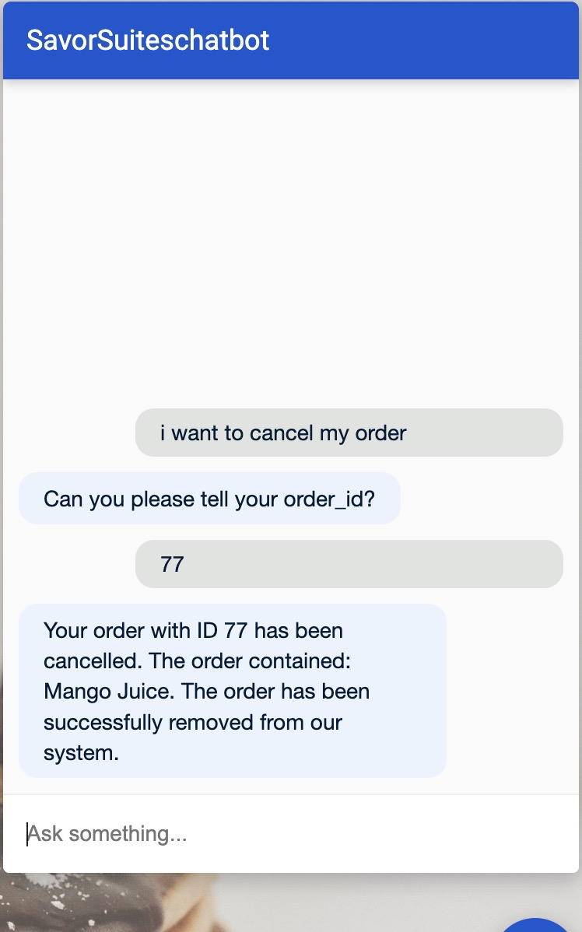
Functional Requirement 10: Cancel Order
Description:
Users can cancel their existing hotel or food order by providing the
reservation/order ID.
Purpose:
To give customers the flexibility to cancel bookings easily without
staff involvement.

Slide 18
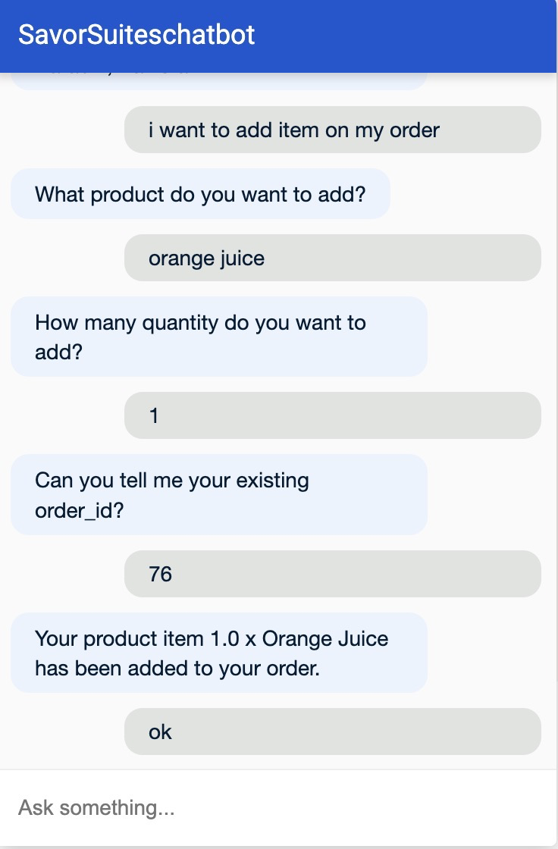
Functional Requirement 11: Add Item to Existing Order
Description:
Allows users to add more items to their existing food order through
the chatbot.
Purpose:
To provide flexibility so users can update their order before it's
finalized.

Slide 19
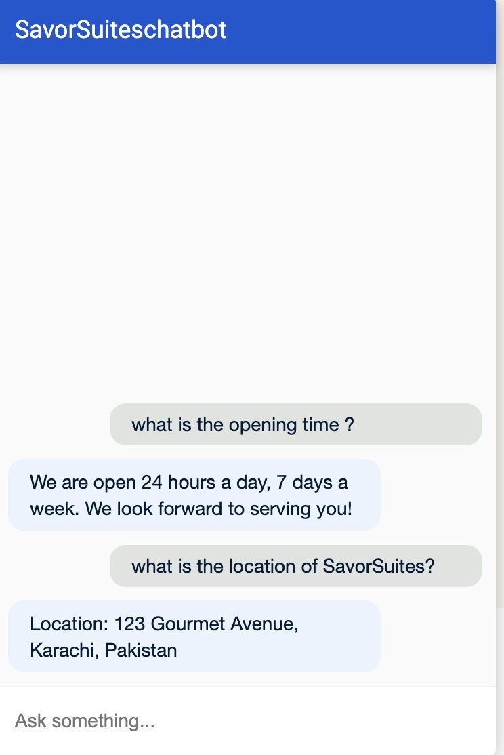
Functional Requirement 12: FAQs Handling
Description:
The chatbot answers frequently asked questions like pricing, location,
timings, menu items, etc.
Purpose:
To save time for both users and staff by automatically answering
common queries.

Slide 20
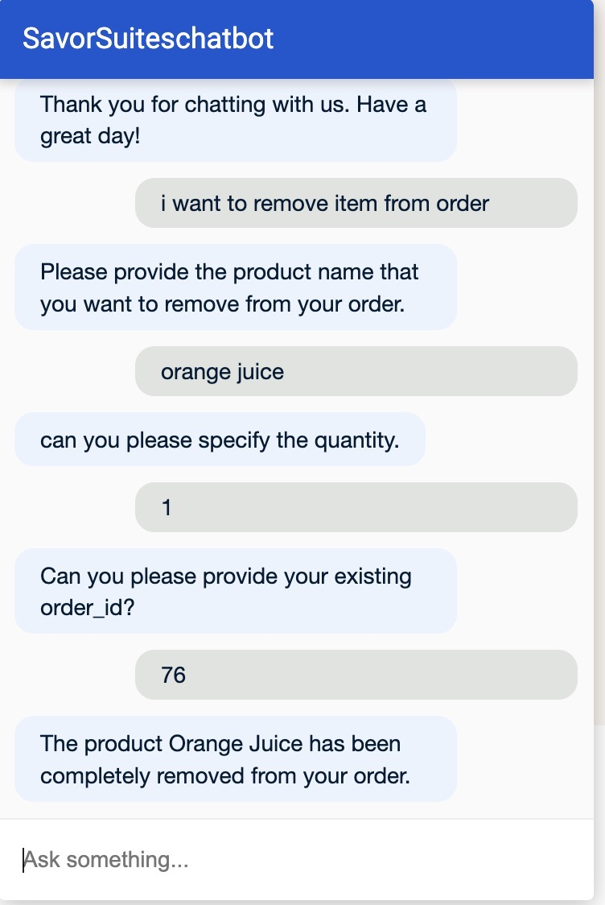
Functional Requirement 13: Remove Item from Existing Order
Description:
Enables users to remove specific items from their existing order via
natural language.
Purpose:
To give customers the ability to correct or change their order without
starting over.

Slide 21
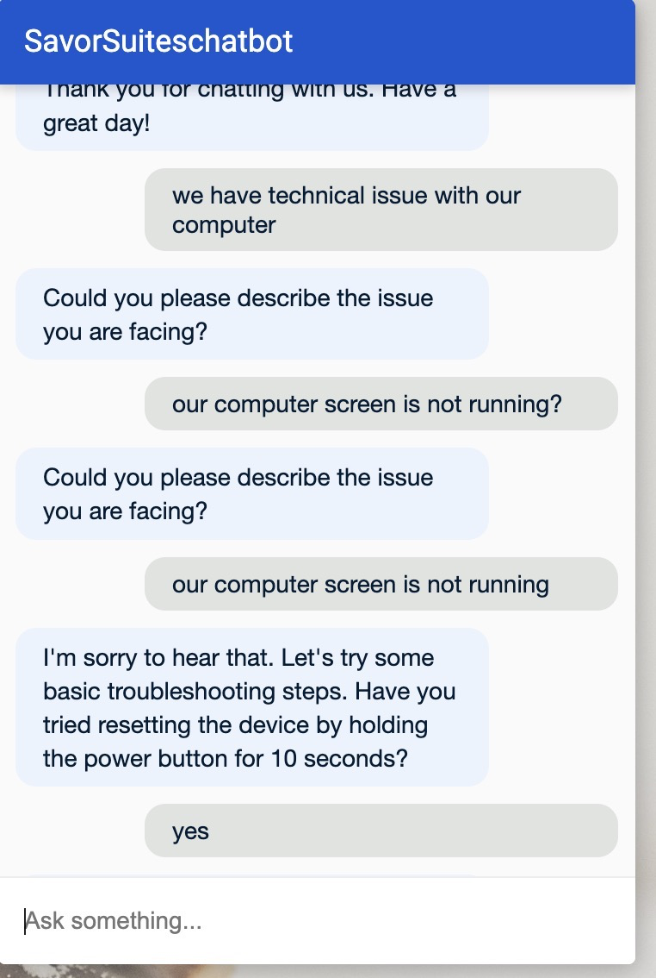
Functional Requirement 14:
Technical Support Flow
User Possible Inputs:
“My device is not working.” “I need help with my account.” “I have a technical issue.”
Bot Gathers Issue Details
Bot: "Could you please describe the issue you're facing?"
User Describes the Issue
User: "My device won’t turn on."
Bot Troubleshoots or Escalates
Bot: "I’m sorry to hear that. Let’s try some basic troubleshooting steps. Have you tried resetting the device by holding the power button for 10 seconds?"

Slide 22
User Response
If Resolved:
User: "Thanks, it works now!"
Bot: "Glad to hear! Anything else I can help with?" → Return to Main Menu or end conversation.
Bot: "Glad to hear! Anything else I can help with?" → Return to Main Menu or end conversation.
If Not Resolved:
User: "Still not working."
Bot: "I’ll create a support ticket for further assistance. Can you confirm your email address and preferred contact method?"
Bot Confirms Ticket Creation
Bot: "Your ticket has been created. Our support team will reach out within 24 hours. Is there anything else you need?" → Return to Main Menu or end conversation.

Slide 23
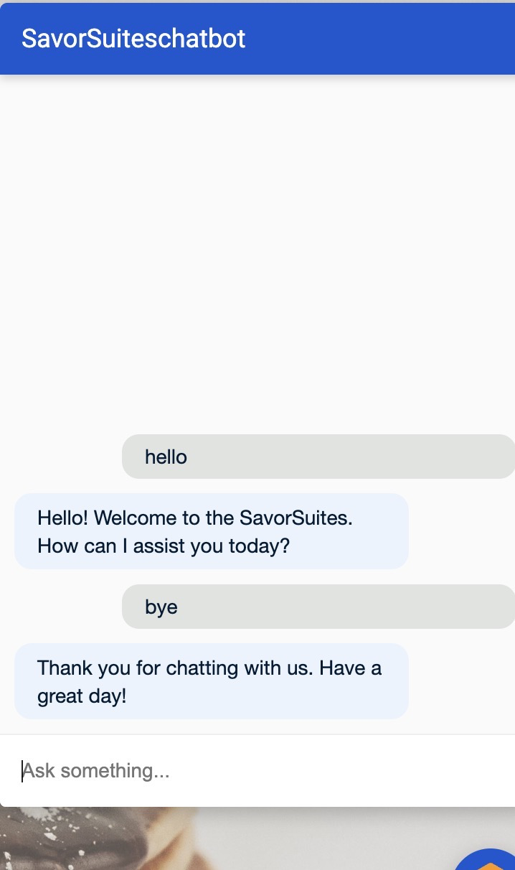
Functional Requirement 15: Closing Conversation Flow
User Possible Inputs:
"Bye"
"No, thank you"
"That’s all"
Chatbot Response:
"Thank you for chatting with us today! Have a great day!"
Logic/Condition:
If the user explicitly says goodbye or indicates no further questions, the chatbot will end the conversation gracefully.

Slide 24
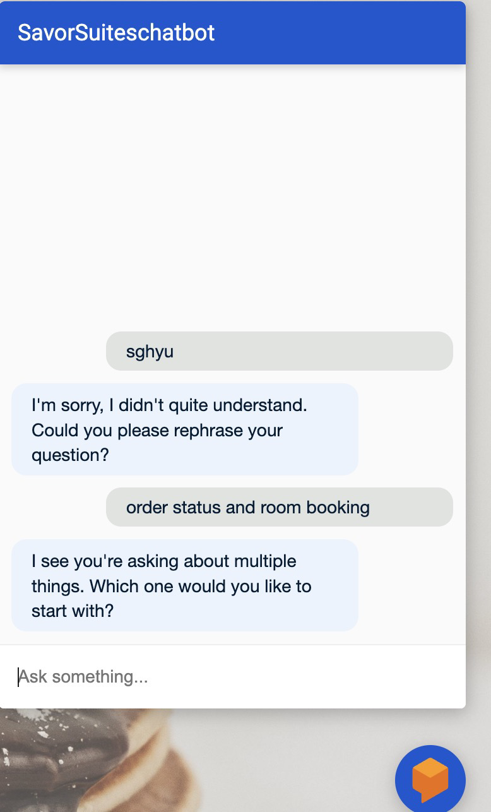
Functional Requirement 16: Error Handling & Fallbacks
Unrecognized Input: “Sorry, I didn’t understand. Could you rephrase?”
Multiple Intents Detected: Clarify which question to address first.
Invalid Input: Handle misformatted data (e.g., invalid order ID).

Slide 25
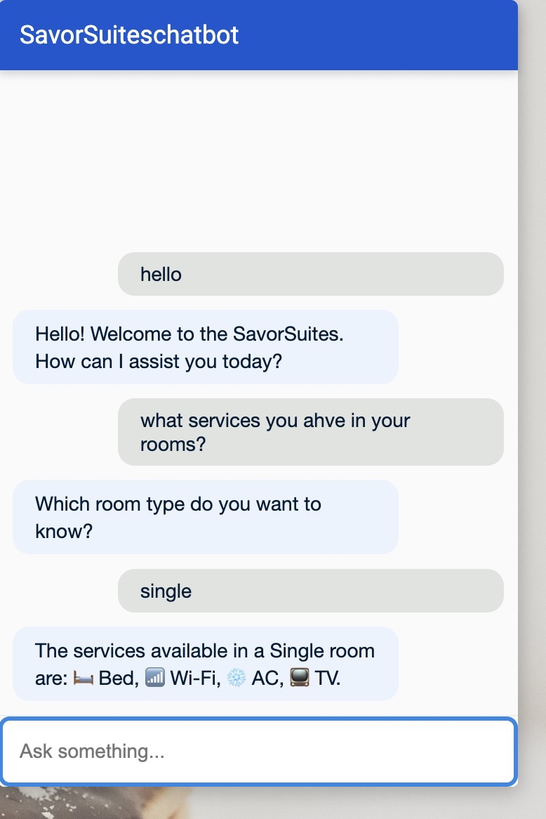
Functional Requirement 17: Room Services
Points:
Single: Bed, Wi-Fi, AC, TV
Double: Two Beds, Wi-Fi, AC, TV, Kettle
Suite: King Bed, Wi-Fi, AC, TV, Kettle, Mini Bar, Bathtub
Example Flow: User: "What is included in a suite?" Bot: "Suite includes King Bed, Wi-Fi, AC, TV, Mini Bar, Bathtub."

Slide 26
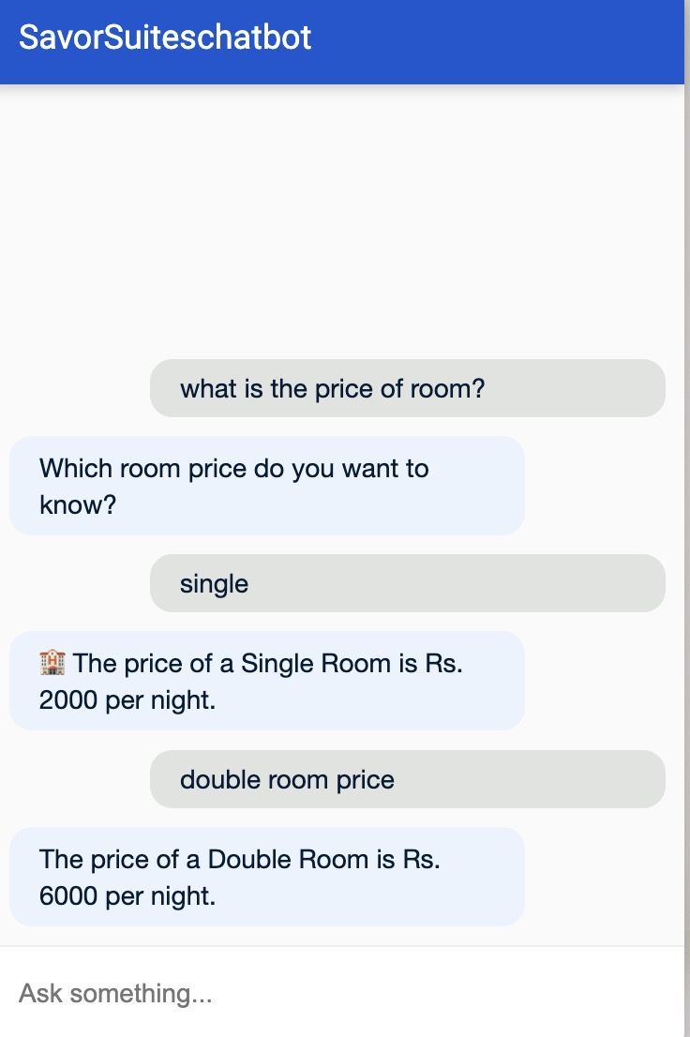
Functional Requirement 18: Room Prices
Points:
Single Room: Rs. 2000
Double Room: Rs. 6000
Suite Room: Rs. 7000
Dialogflow Flow Example: User: "What is the price of Double room?" Bot: "The price for a Double room is Rs. 6000 per night."
Note: Static reply based on intent logic (no database used).

Slide 27
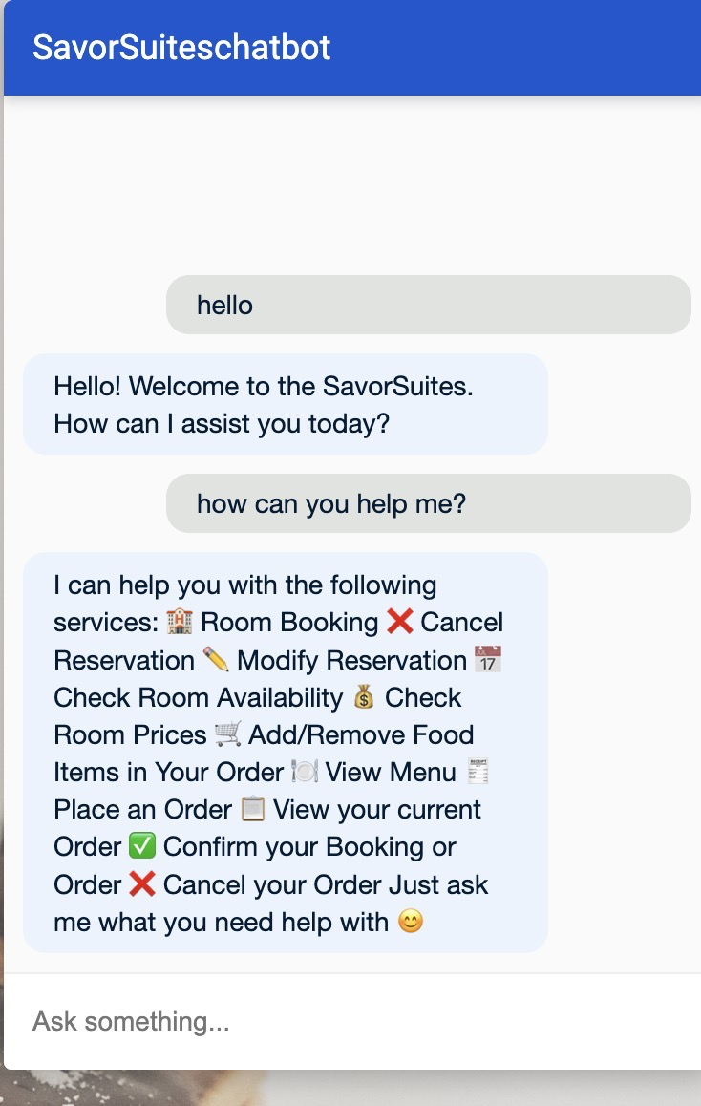
Functional Requirement 19: Chatbot functions
Points:
Book a room 🏨
Check room availability 📅
Cancel or modify reservations ❌✏️
Add or remove items from an order 🍔
Answer FAQs like prices and services 💬
Dialogflow Intent Example: User says: "What can you do?" Bot replies: "I can help you book rooms, check availability, modify or cancel your bookings, and answer questions about our hotel."

Slide 28
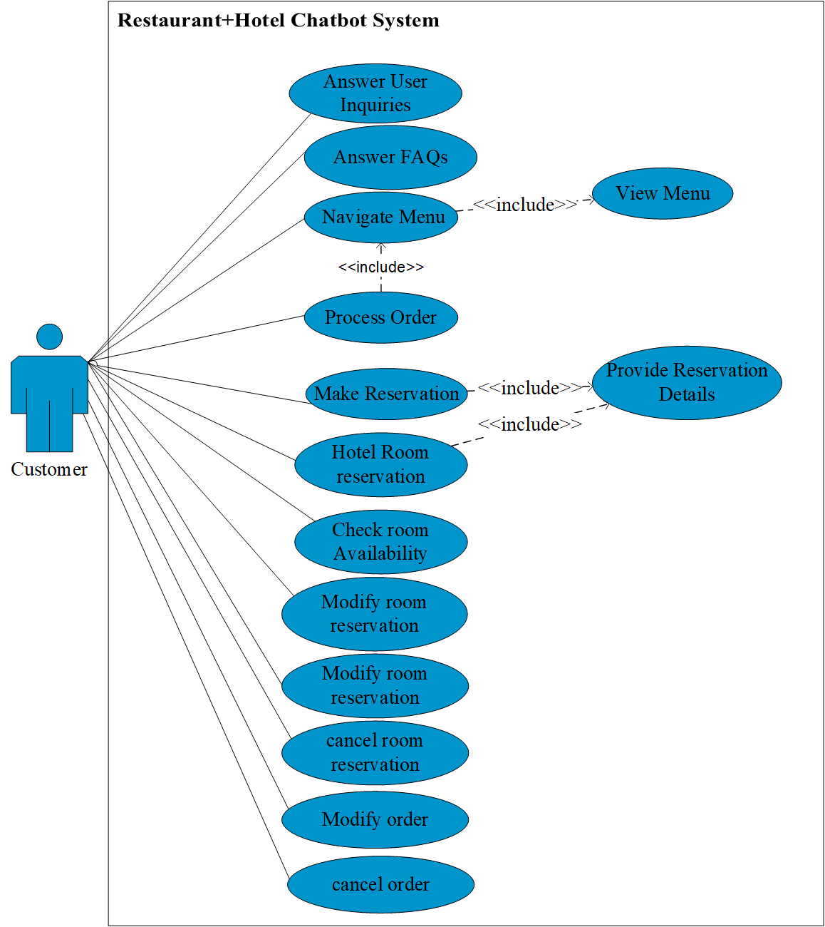
Use case diagram

Slide 29
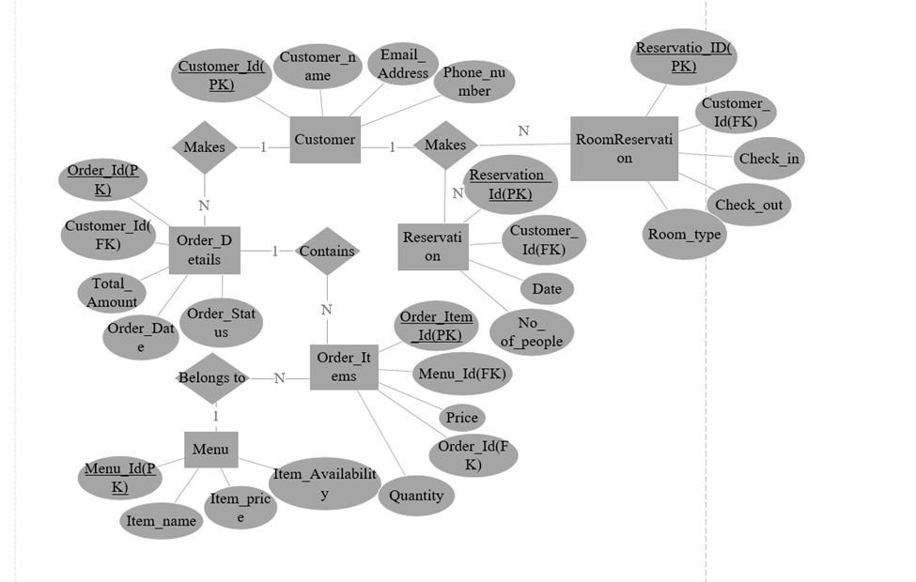
Entity Relationship Diagram

Slide 30
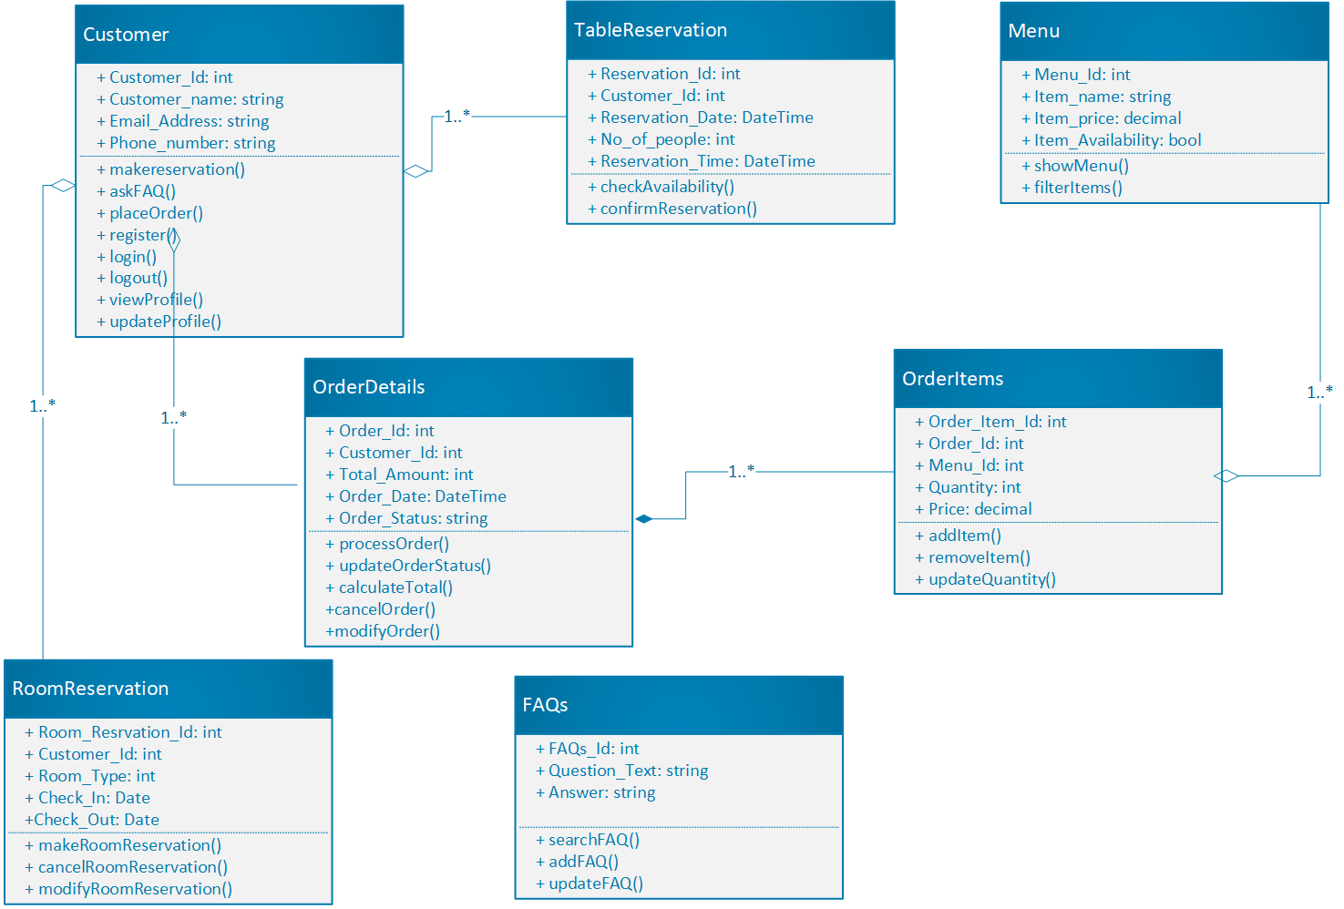
Class Diagram

Slide 31
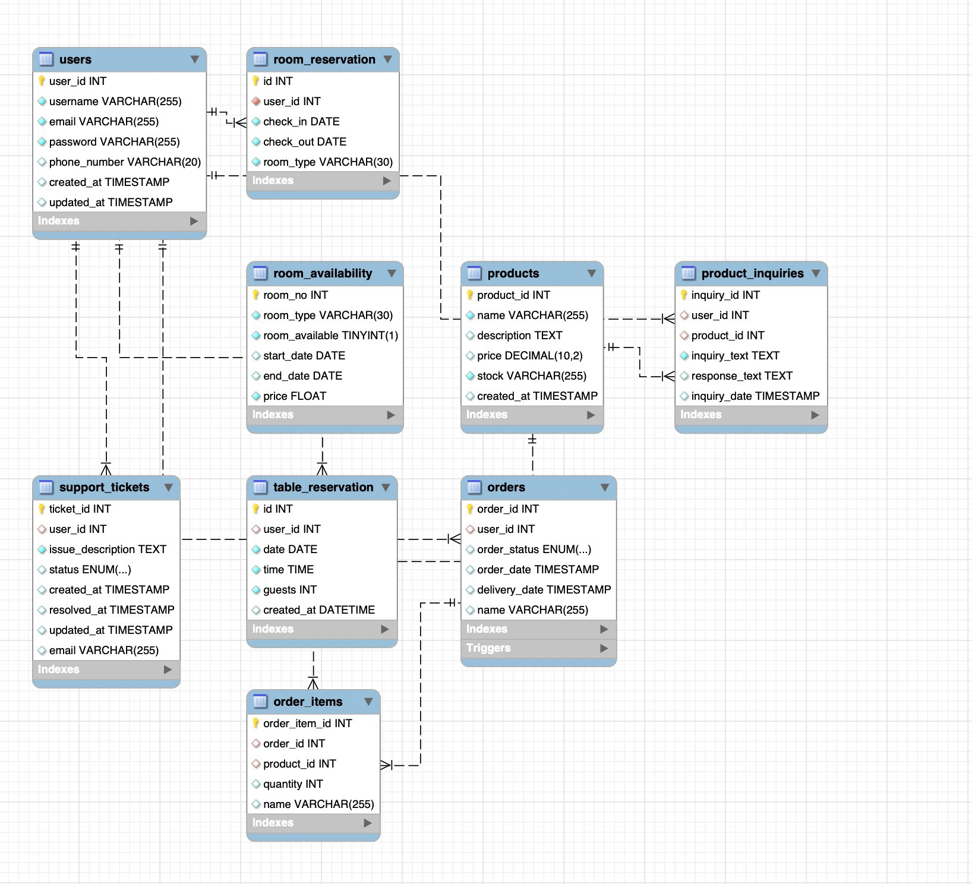
Database Diagram

Slide 32
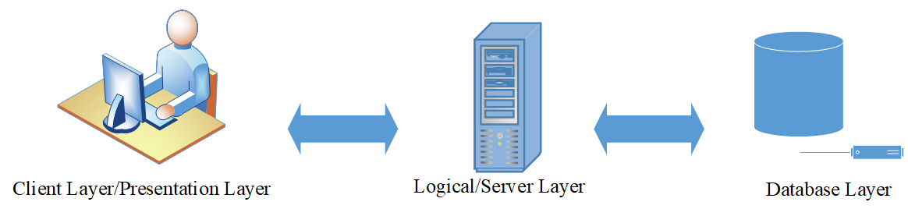
Architecture Diagram

Slide 33
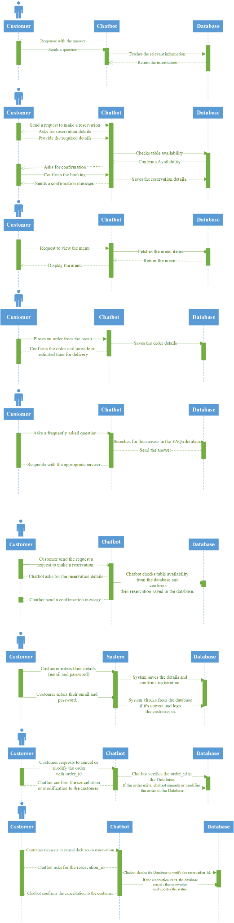
Sequence Diagram

Slide 34
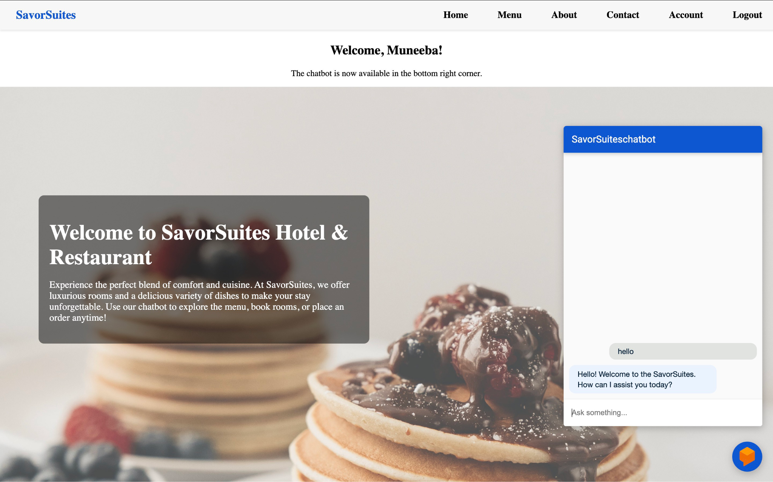
User Interface:

Slide 35
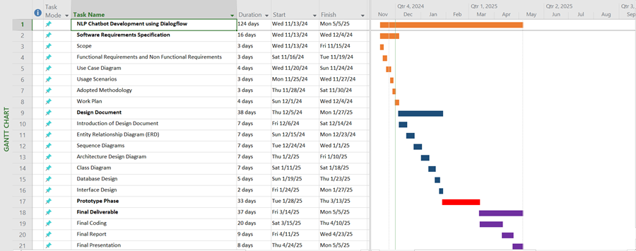
Gantt chart:

Slide 36
Tools and Technology:
Development Tools & Frameworks
Flask (Python) – Backend web framework used to build APIs and handle routing.
Dialogflow – Google's NLP platform to handle natural language queries and intents.
SQLAlchemy – ORM (Object Relational Mapper) used for database operations in Python.
Jinja2 – Used for rendering dynamic HTML templates with Flask.
PyMySQL – Python library used to connect Flask app to MySQL database.
AI & NLP
Dialogflow ES – For intent detection, entity extraction, and context management.
Database
MySQL – Relational database to store user data, reservations, room info, etc.

Slide 37
Tools and Technology:
Other Libraries
Bcrypt – Used for secure password hashing during user registration and login.
Flask-Login – Manages user sessions and authentication.
Frontend
HTML, CSS, JavaScript – For building user-friendly web pages.

