Slide 1
Predicting Air Quality Index (AQI) with Machine Learning
Students: Saleh Abdul Rahman Saleh Al-Zahrani(444006497), Bandar Faisal Muataq Al-Harbi (444005766) Course: Principles and Techniques of Artificial Intelligence (AI2360-4) Instructor: Dr. Tarik Alafif Date: 31/1/2025

Slide 2
Abstract
Predicting AQI category using pollutant levels.
K-Nearest Neighbors (KNN) model with 79.87% accuracy.
Developed a user-friendly GUI for predictions.

Slide 3
Introduction
Air quality affects health and the environment.
AQI categorizes pollution levels for public awareness.
Machine learning used to automate AQI predictions.

Slide 4
Methodology
Data Preprocessing - Cleaning and handling missing values.
AQI Categorization - Five levels: Good, Moderate, Unhealthy, Very Unhealthy, Hazardous.
Feature Engineering - Converting data into numeric format.
Model Training - Using KNN with k=5.
GUI Development - Easy input and AQI prediction.

Slide 5
Algorithm
Compute distances between input and training data.
Identify k nearest neighbors.
Predict the most common AQI category.

Slide 6

Results & Evaluation

Slide 7
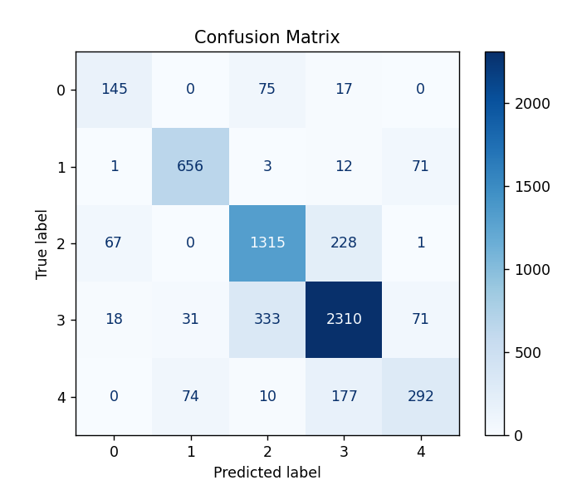
Results & Evaluation
Confusion matrix shows strong predictions for "Good" & "Moderate," challenges with "Unhealthy" & "Very Unhealthy."

Slide 8
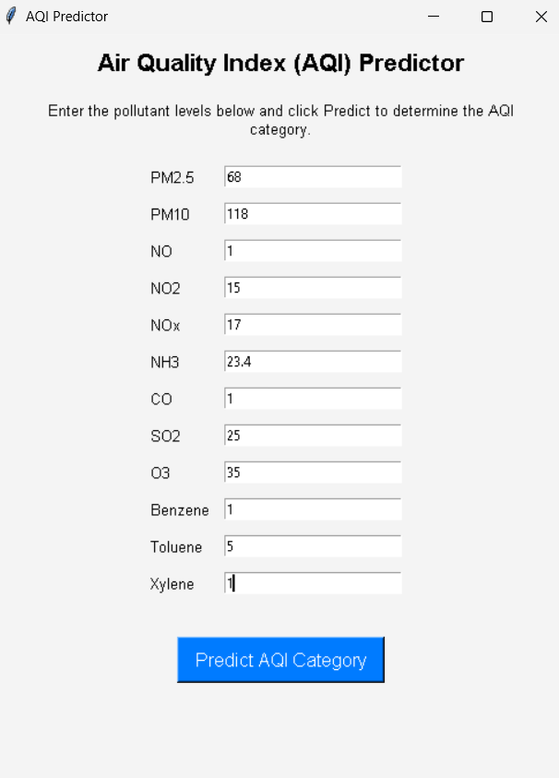
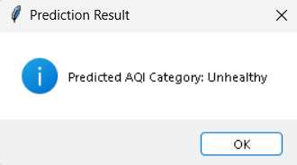
Demo

Slide 9
Conclusion
Successfully implemented KNN for AQI prediction.
GUI enhances accessibility and usability.
Potential improvements for higher accuracy in future work.

Slide 10
Thank You

