Slide 1
SecureVibes
You vibe-coded it.
Is it secure?
Secure Vibes: see what attackers see in 60 seconds
For founders shipping with Cursor · Lovable · Bolt · Replit · Claude Code

Slide 2
SecureVibes
You shipped fast. Attackers scan faster.
Bots find and scan every new site within hours of launch. No one is "too small".
Open ports
AI scaffolds leave SSH, FTP and databases reachable from the internet.
Missing headers
No CSP, no HSTS: one bad script and your users' data walks out.
Leaked .env files
API keys and DB passwords one URL away from anyone.
No email protection
Without SPF/DMARC, anyone can email your customers as you.

Slide 3
SecureVibes
How bad can it go?
Real outcomes we see when vibe-coded apps hit production.
Leaked API keys
→ a surprise $10k cloud or OpenAI bill by Monday.
Spoofed email from your domain
→ your customers get phished in your name.
Exposed database
→ a data-breach headline instead of a launch headline.
Site blocklisted
→ browsers block you. Traffic drops to zero.

Slide 4
SecureVibes
Paste your URL. Get the truth.
11 passive checks in ~15 seconds. Read-only, with the owner's consent.
✓ Encryption certificate
✓ Outdated TLS (1.0/1.1)
✓ HTTP → HTTPS redirect
✓ Security headers
✓ Email spoofing (SPF / DMARC)
✓ Threat-intel blocklists (4)
✓ 15 risky ports
✓ Leaked files (.git / .env)
✓ Outdated libraries
✓ Domain health
✓ Attack surface & subdomains
→ a plain-English report, not a wall of CVEs

Slide 5
SecureVibes
We don't just scare you. We tell you how to fix it.
Gemma 4 (google/gemma-4-31b-it via OpenRouter) turns raw findings into your brief.
Our website has several open doors that hackers could exploit.
Attackers could use open admin ports and leaked usernames to hijack our site or steal data. This risks significant reputational damage and potential financial loss from a service outage. These gaps are common and can be closed quickly with standard security updates.
Top 3 fixes
1. Close open FTP and SSH admin ports immediately
2. Hide WordPress usernames and disable XML-RPC
3. Update email security settings to block spoofing
For your investors
"We have identified a few security gaps and are implementing fixes to harden our digital perimeter."

Slide 6
SecureVibes
Sample scan: MyAwesomeVibeCodedWebsite.com · 36/100 exposure
A typical vibe-coded site · 7 issues found from the outside, zero access needed.
HIGH · FTP (file transfer) reachable from the internet (port 21)
Fix: Close the port in your firewall or restrict it to a VPN / allow-list.
MEDIUM · DMARC is in monitor-only mode (p=none)
Fix: Move to p=quarantine, then p=reject.
MEDIUM · SSH (remote admin) reachable from the internet (port 22)
Fix: Close the port in your firewall or restrict it to a VPN / allow-list.
MEDIUM · Publicly downloadable: WordPress user list (usernames for login attacks)
Fix: Block access to this path on your web server.

Slide 7
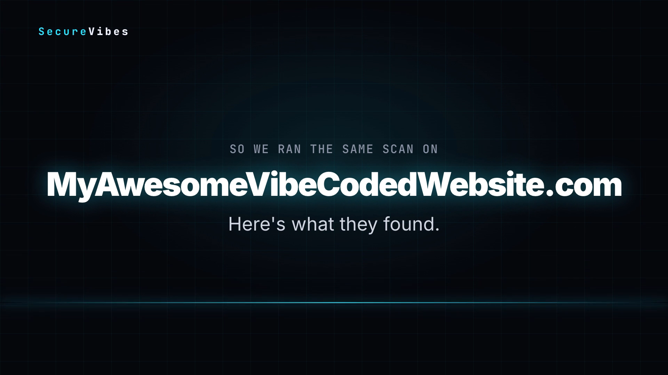
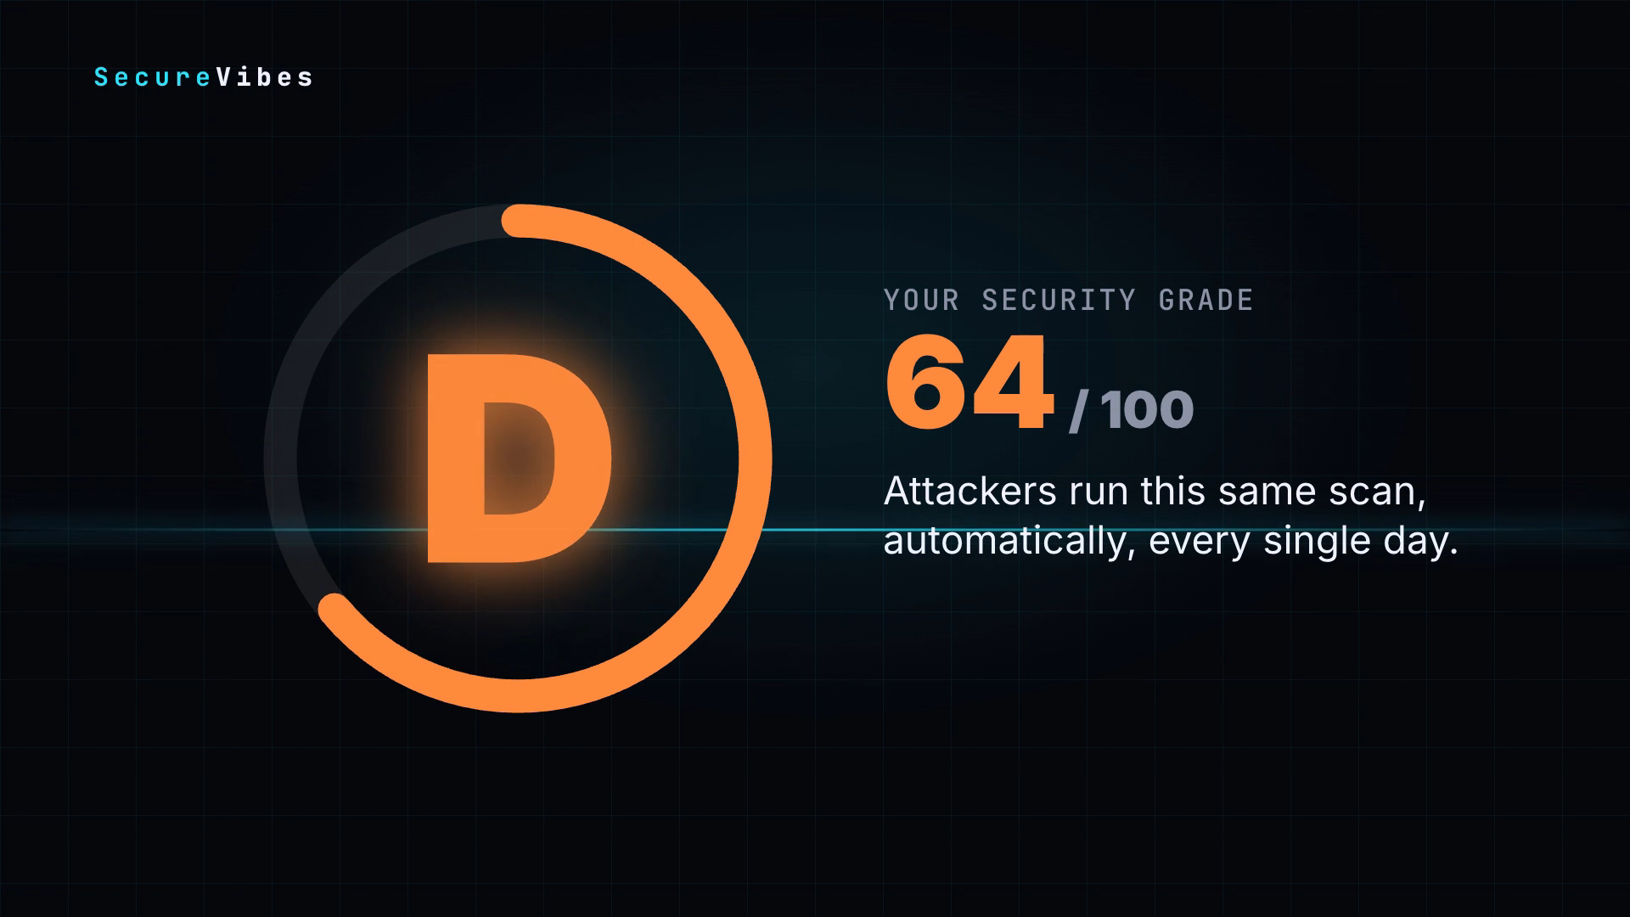
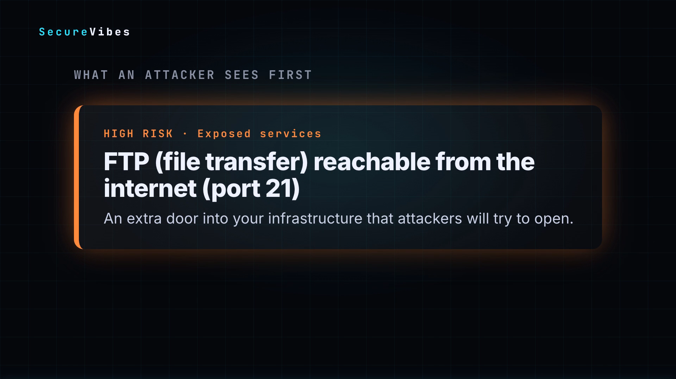
SecureVibes
Your personal security video
Every scan renders a 32-second briefing you can share with your co-founder or investors.
Hook → Issues found → Grade → Top risks → Attack surface → Call to action

Slide 8
SecureVibes
Built with
Open source all the way down.
Scanner
Checks modelled on web-check (MIT). Node.js, ~15 s per scan.
AI brief
Gemma 4 via OpenRouter writes the CEO-friendly summary and fixes.
Video
HyperFrames renders HTML + GSAP to MP4. ~30 s per video.
Web app
Node / Express, live progress over Server-Sent Events.

Slide 9
SecureVibes
Scan your vibe today.
Free scan → fix list → Secure Vibes monthly
Continuous monitoring + fixes you can paste straight into your AI coding tool.
github.com/Salem-1/Secure-vibes

