Slide 1

 | ULFS2
 | Lebanese University - Faculty of Science - Section II
Arabic sentiment analysis model
DEPARTMENT OF COMPUTER SCIENCE
Author: Charbel SALEM
Supervisor: Mohamed EL MESAWY

Slide 2

TABLE OF CONTENT
Preparing the Dataset
Data Preprocessing
Multinomial Naive Bayes
Model Training
Model Evaluation
Exporting the Model
Introduction

Slide 3
Introduction
Sentiment analysis is the automated process of identifying and extracting subjective information from text, including opinions, emotions, and attitudes.
This technology has become increasingly important in recent years, as businesses strive to better understand the sentiment of their customers towards products, services, and events.
When it comes to Arabic sentiment analysis, it presents unique challenges due to the complexity of the Arabic language, including variations in dialects, syntax, and grammar. However, with advancements in machine learning and natural language processing, sentiment analysis for Arabic language has become more accurate and reliable.
In this presentation, we will discuss our AI sentiment analysis project focused on the Arabic language. Our objective is to build a machine learning model that can predict the sentiment of Arabic text with high accuracy. Additionally, we will develop a web application using Flask that demonstrates the model's capabilities.

Slide 4

What is sentiment analysis?
Sentiment analysis is used in a wide range of industries, such as:
Marketing and advertising
Customer service
Politics and public opinion research
Finance and stock market analysis
Some examples of sentiment analysis in action include:
Analyzing customer feedback on social media to improve customer experience
Monitoring online reviews to manage brand reputation
Analyzing public opinion on social media during election campaigns
Analyzing news articles to predict stock market trends.

Slide 5

PREPARING THE DATASET
The first step is to prepare the dataset that we will use to train our model.
Ideally, the dataset should contain a balanced number of positive and negative reviews.
Data diversity: The dataset should represent a diverse range of topics, domains, and sources to ensure that the model is robust and can handle different types of text.
Data size: The dataset should be large enough to provide enough variation and generalize well.
Data quality: The dataset should be clean, free of noise, and accurately labeled.

Slide 6
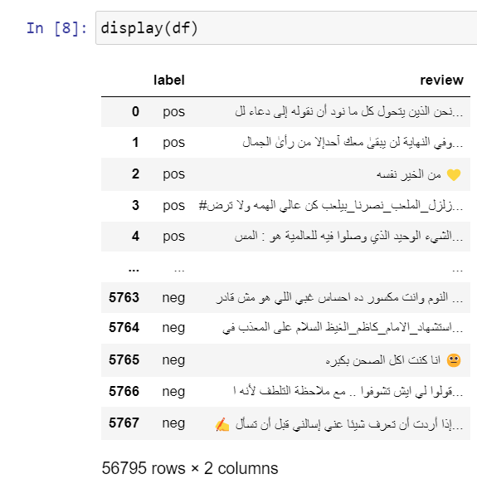
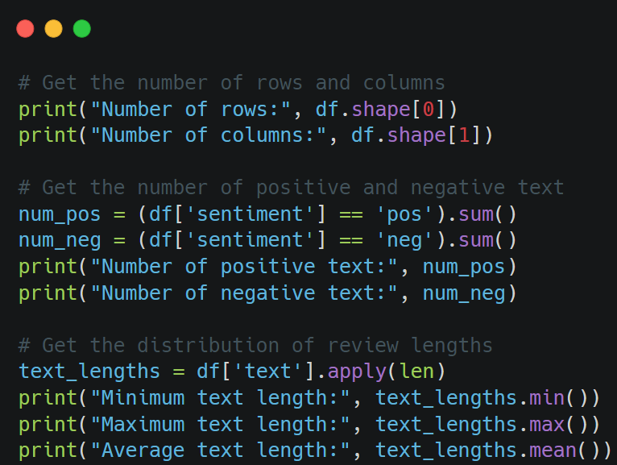


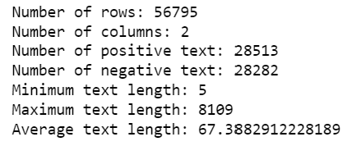
ABOUT THE DATASET
Most used word in the positive set
Most used word in the negative set

Slide 7
DATA PREPROCESSING
Data preprocessing is a critical step in any machine learning task, and it plays a crucial role in the accuracy and performance of the model. This is especially true in sentiment analysis tasks, where the quality of the data and the accuracy of the sentiment labels are critical for the model's success.
When working with Arabic text, there are several challenges that need to be addressed during data preprocessing. Arabic is a morphologically rich language, with many variations in word forms and sentence structures. Additionally, the absence of vowels in the Arabic script can make it difficult to tokenize and normalize text accurately.

Slide 8
WHY ARABIC IS HARD TO TOKENIZE?
Arabic language is written in a script that is written from right to left, which makes it difficult for some tools and algorithms to process, example:
أنا ذهبت إلى المدرسة. -
أحب السفر. -
Arabic language has a rich set of diacritics and vocalization marks that represent the different sounds and letters, and these marks can change the meaning of the word or even its pronunciation. For example, the word "كتاب" without any diacritics could mean "book", but with the diacritics "كِتَابٌ" it could mean "a letter" or "an epistle".
In the Arabic language, the letter و" “ (waw) is a unique letter that can act as a conjunction and a letter in a word.
Arabic language has a complex morphology where a single word can have many forms and meanings:
"مدرسة" can mean "school", "teacher“
"طالب" can mean "student", "seeker", or "applicant“
"مكتب" can mean "office", "desk", "agency"
Arabic word | Pronunciation | Meaning 1 | Meaning 2
وزن | wazn | weight | measure
ورد | ward | rose | respond
وعد | wa'ada | he promised | he counted

Slide 9
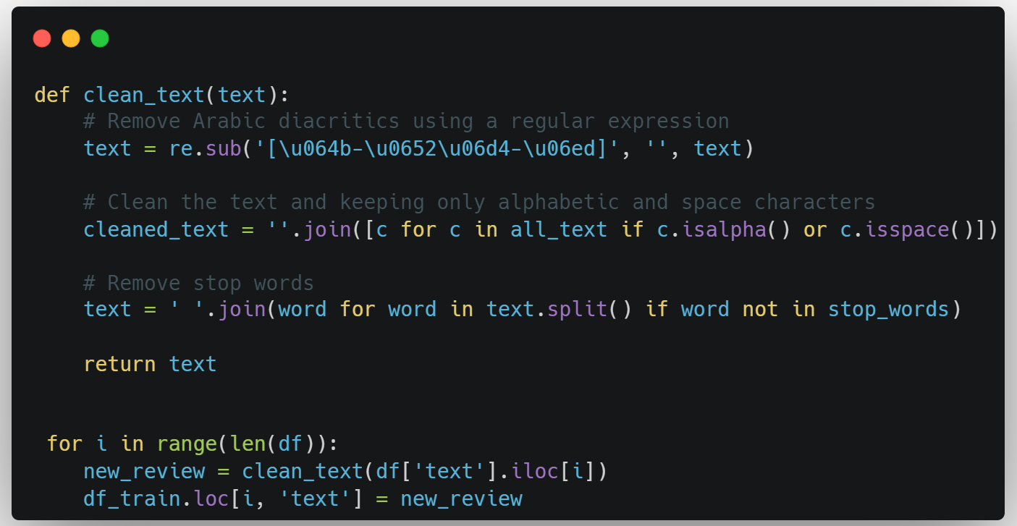
PREPROCESSING IMPLEMENTATION
This code removes non-alphabetic characters and stop words from the text, and keeps only the meaningful words. It applies this cleaning process to all the texts in a given dataset, and saves the cleaned texts back to the same dataset.

Slide 10
Multinominal Naive Bayes
For example, the algorithm may learn that the word "love" is strongly associated with a positive sentiment, while the word "hate" is strongly associated with a negative sentiment.
Multinomial Naive Bayes algorithm can be used for sentiment analysis:
Text | Sentiment
"I love this product" | Positive
"This is a great movie" | Positive
"I hate this phone" | Negative
"The service was terrible" | Negative
"The food was okay" | Neutral
For example, if the algorithm was given the text "This phone is great", it might calculate the following probabilities:
Sentiment | Probability
Positive | 0.9
Negative | 0.1
Neutral | 0.05
Using the above training data, the Multinomial Naive Bayes algorithm can learn the probabilities of each word in the text belonging to each sentiment category.

Slide 11
Advantages of Multinomial Naive Bayes for Handling Unstructured Text Data
Arabic language has a complex grammar structure with intricate rules, making it difficult to accurately tokenize and classify using traditional methods. Multinomial Naive Bayes, on the other hand, can handle the complexities of Arabic language without the need for extensive preprocessing and tokenization. For example, when classifying sentiment in Arabic social media posts, Multinomial Naive Bayes can accurately capture the meaning of the post even with variations in grammar and spelling, making it a more effective method for Arabic sentiment analysis.
In addition, Multinomial Naive Bayes does not require tokenization, which is the process of breaking text into words or other meaningful units.
This is because it uses a bag-of-words representation, which treats each document as a collection of words without any specific order or structure.
This makes it easy to handle different types of text data, including unstructured text, social media posts, and short-form content like tweets.

Slide 12
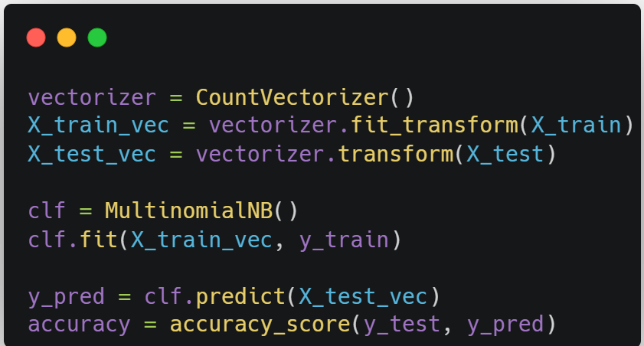
IMPLEMENTATION OF NATIVE BAYES (1)
CountVectorizer: A class that transforms the text into a numerical representation
Suppose we have the following two sentences as our training data:
"John likes to watch movies. Mary likes movies too."
"John also likes to watch football games."
 | Also | Football | Games | John | Likes | Mary | movies | To | Too
Doc1 | 0 | 0 | 0 | 1 | 2 | 1 | 2 | 1 | 1
Doc2 | 1 | 1 | 1 | 1 | 1 | 0

Slide 13
IMPLEMENTATION OF NATIVE BAYES (2)
Word | Positive | Negative
Great | 0.023 | 0.010
Bad | 0.004 | 0.018
Love | 0.017 | 0.009
Hate | 0.005 | 0.015
Happy | 0.012 | 0.008
Sad | 0.008 | 0.011
Fit and transform: The fit_transform() method fits the CountVectorizer model to the training data and then transforms the training data into a numerical representation.
Tranform: The transform() method transforms the test data into a numerical representation using the same vocabulary learned from the training data.
Fit: The fit() method fits the model to the training data by estimating the probability distribution of each word in each class.

Slide 14
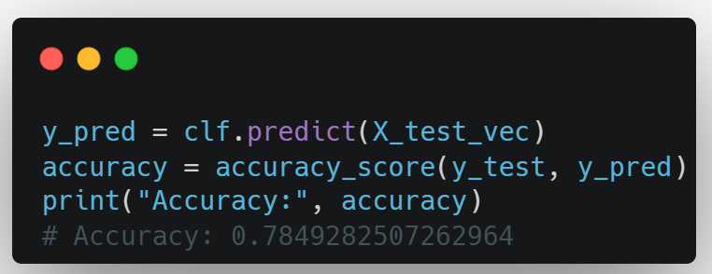
DATA TRAINING AND MODEL EVALUATION
To improve the accuracy of the model, we can try different preprocessing techniques such as stemming, lemmatization, or using different types of vectorization techniques. We can also try different models like Support Vector Machines (SVM) or Random Forests and tune the hyperparameters to find the optimal values. Additionally, we can try using more advanced techniques such as deep learning models like Convolutional Neural Networks (CNNs) or Recurrent Neural Networks (RNNs) to further improve the accuracy.

Slide 15
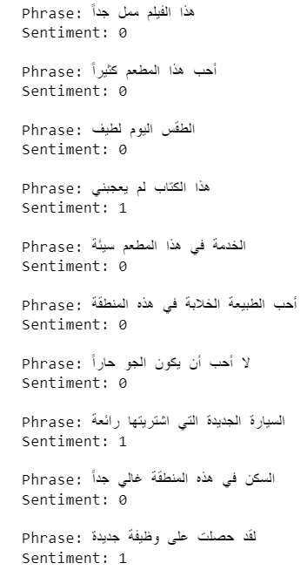
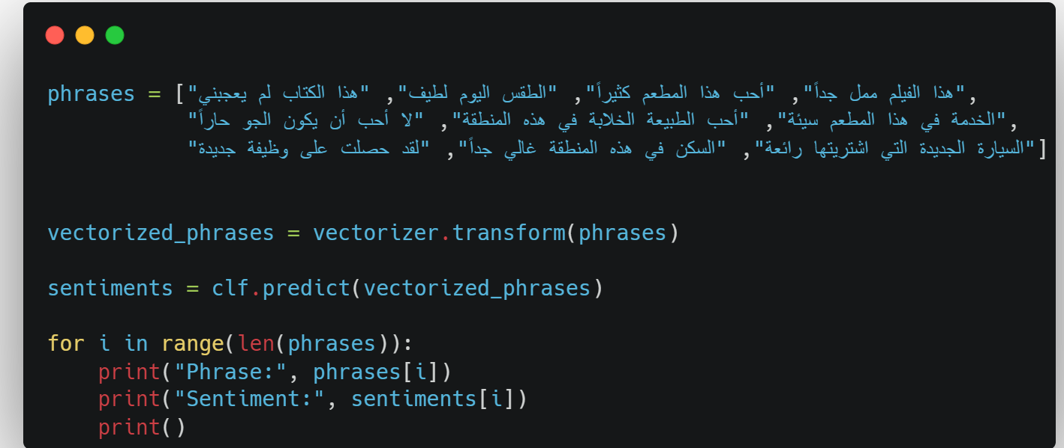
RESULTS

Slide 16
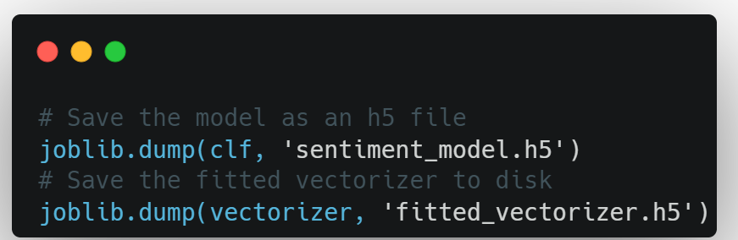
EXPORTING THE MODEL
By saving the model and vectorizer separately, we can load them independently and use them together to predict the sentiment of new text data. This also allows us to share the model and vectorizer with others who may need to use them.

Slide 17
THANK YOU FOR YOUR ATTENTION
CHARBEL SALEM

