Slide 1
🌱
Green Software
Engineering
Building software that doesn't cost the planet
GreenDev AI • Carbon-Aware Development • SCI Metric

Slide 2
Why Does Software Harm the Planet?
Software doesn't use energy directly — but it drives hardware that does.
3%
3.9%
76×
of global electricity
consumed by data centers
of global greenhouse
gas emissions from ICT
more energy Python
uses vs C for same task
Most developers write code without ever seeing its energy cost.
Green Software Engineering is the discipline that fixes this — by making carbon a measurable, trackable part of development.

Slide 3
What is Green Software Engineering?
A discipline of best practices to build applications that reduce carbon emissions across their full lifecycle.
⚡ Energy Efficiency
🌍 Carbon Efficiency
Use the least energy possible. Optimize algorithms, idle hardware off, stop wasteful loops.
Emit the least CO₂. Choose greener regions, time workloads for clean energy windows.
🔋 Hardware Efficiency
📊 Measurement First
Consider embodied carbon — the CO₂ cost of manufacturing hardware, not just using it.
What you cannot measure, you cannot improve. Track carbon as a first-class metric.
☁️ Carbon Awareness
📋 Climate Commitments
Electricity grid carbon intensity changes by time and location. Schedule smartly.
Real reductions only. Offsets do not improve your SCI score — only genuine efficiency does.
Source: Green Software Foundation — ISO/IEC 21031:2024

Slide 4
The Four Core Tools & Standards
These four components form the technical backbone of any serious green software measurement system.
CodeCarbon
Intel RAPL
Python Library
Hardware Interface
Wraps your code and tracks CO₂ in real time. When RAPL is unavailable, falls back to TDP-based CPU estimation automatically.
Running Average Power Limit — reads actual CPU/RAM energy registers directly from the hardware at millisecond resolution.
pip install codecarbon → 3 lines → CO₂ measured
Requires Skylake (2015+) Intel CPU, Linux powercap sysfs
SCI Metric
Energy-Languages Dataset
ISO/IEC 21031:2024
GitHub Research Dataset
Software Carbon Intensity formula: (E × I + M) / R. The only ISO-standardized carbon score for software. Offsets cannot improve it.
28 programming languages benchmarked across 10 tasks using real Intel RAPL. Proves Python uses 76× more energy than C.
E=energy, I=intensity, M=hardware, R=functional unit
github.com/greensoftwarelab/Energy-Languages

Slide 5
What Research Says — And What's Still Missing
✅ What Exists
❌ Key Gaps
• Green Software Foundation — 6 formal principles
• No legal enforcement — only 1/5 companies monitor energy
• SCI Metric — ISO 21031:2024 standard formula
• RAPL only works on Skylake (2015+) Intel CPUs
• CodeCarbon — live CO₂ tracking for Python
• AI training energy (Red AI) growing fast, barely regulated
• Energy-Languages dataset — real RAPL measurements across 28 languages
• Open-source software has zero carbon accountability
• ACM 2025 paper — field-wide review + 2030 roadmap
• Green practices still not embedded in SDLC education
Sources: Ibrahim et al. (2022) • Mohankumar et al. (2016) • ACM TOSEM 2025 • Green Software Foundation

Slide 6
Introducing GreenDev AI
GreenDev AI
What if your IDE could tell you the carbon cost of your code — before it ships?
Sustainability
Solution for
Developers
📤 Upload any Python file or code snippet
⚡ Live energy measurement via CodeCarbon (TDP mode)
🔬 Real RAPL reference values from Energy-Languages dataset
🌱
📊 SCI score calculated from both sources — estimated vs real
🤖 Gemini AI explains why your code is inefficient and how to fix it
Not just "Energy = 13J" — evidence-based AI recommendations grounded in real measurements.

Slide 7
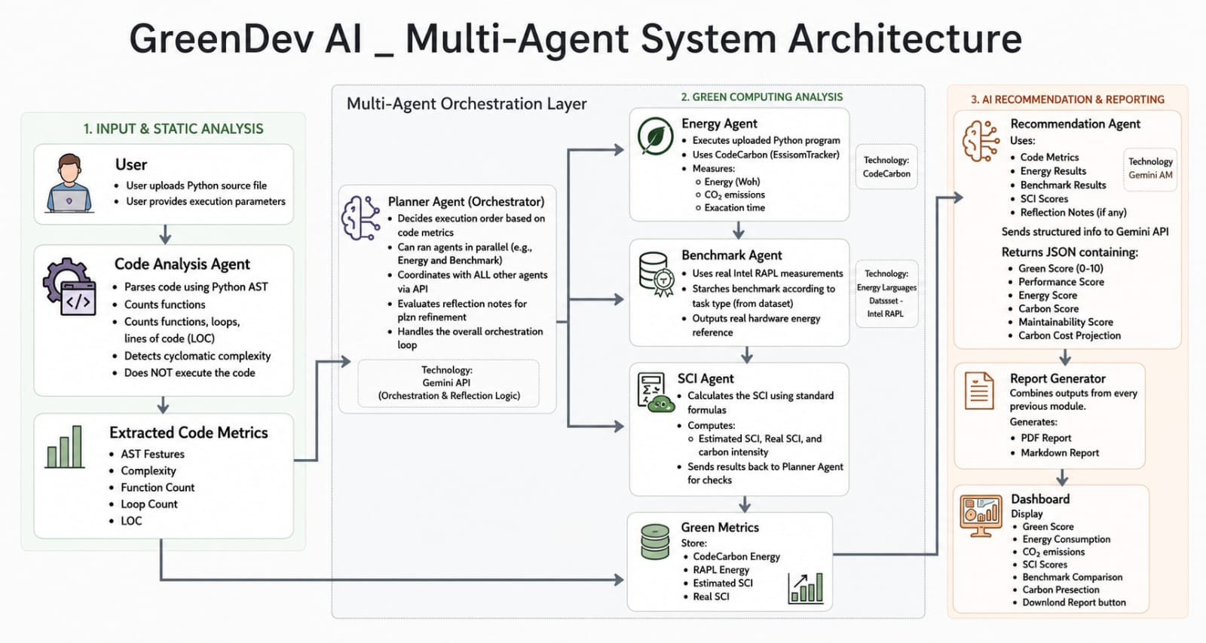
System Architecture — Five Agents

Slide 8
The code we write today
shapes the planet tomorrow.
GreenDev AI makes the invisible visible — turning carbon from a side-effect into a trackable metric every developer can act on.
✦ CodeCarbon — live measurement
✦ SCI Metric — ISO standard formula
✦ Intel RAPL — real hardware reference
✦ Energy-Languages — RAPL ground truth
🌱 GreenDev AI — Build Greener Code

