Slide 1
Proof Of Concept For Opportunistic Security in MPLS Network
Dissertation
CS7CS5
Student:
Salil Ajgaonkar
Supervisor:
Prof. Stephen Farrell
Date 20/08/2018

Slide 2
What is MPLS
MPLS – Multi-Protocol Label Switching
Data Carrying Technology for High Speed Core Networks
Routes packets using Special Labels
Labels decide the virtual path in the network

Slide 3
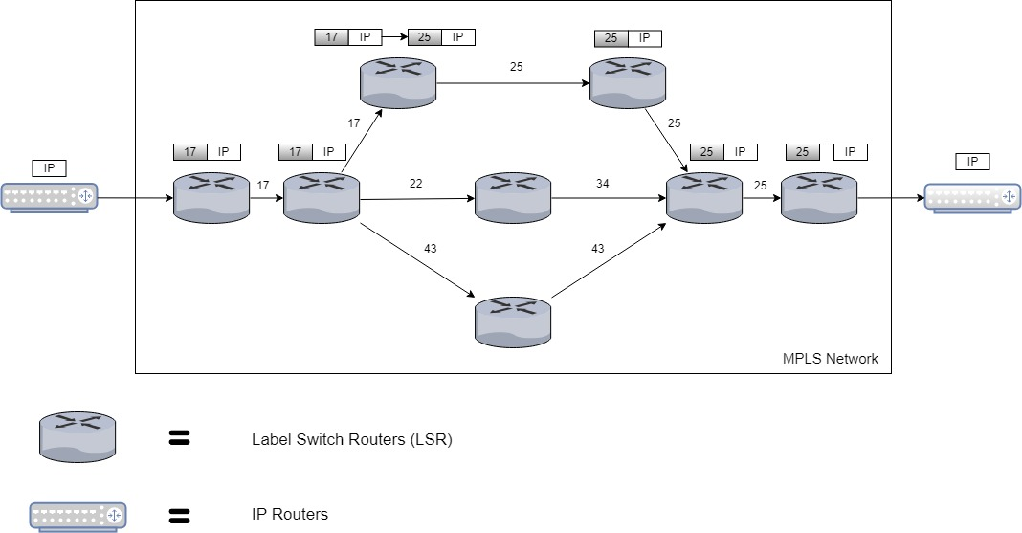
MPLS working

Slide 4
Security issues in MPLS
Government, Corporations and Service Providers heavily rely on MPLS
Attacks ranging from sensitive data sniffing, DOS, replication can impact vital operations

Slide 5
Existing Security Tools
Physical isolation of the network
Transport Layer Security (TLS)
IP Security (IPSec)
MAC Security (MACSec)
Pseudowire Encryption

Slide 6
Shortcoming of these Security Tools
Network taps can be easily implemented
TLS leaves metadata like IP destination
IPSec only supports security for IP, MPLS is multi-protocol data carrying technology
MACSec needs to be implemented hop-by-hop , relies on chain of trust
Pseudowire Encryption only works on Ethernet and not other protocols like TDM

Slide 7
What is Opportunistic Security (OS)
Opportunistic security is a protocol design pattern
Aims to implement encryption with key exchange without relying on manual configuration of keys or Public Key Infrastructure (PKI)
Using Diffie-Hellman Key exchange between LSR for Key Exchange
AES-GCM Encryption for Data Integrity, Confidentiality and Authentication

Slide 8
Proof Of Concept
Preliminary theoretical research already conducted by Professor Stephen Farrell and Adrian Farrell from Juniper Networks
Research published in ietf internet draft titled:
“Opportunistic Security in MPLS Networks draft-ietf-mpls-opportunistic-encrypt-03”

Slide 9
Aim of the Dissertation
Implement the proposed idea in an experimental environment
Measure the network performance metrics, once without the OS and then with the OS
Compare the metrics to evaluate the feasibility of the OS implementation and any other remarks which could be inferred

Slide 10
Implementation
Create a Virtual Network Environment (Mininet)
Setup Virtual Switches (OpenVSwitch) in the said Virtual Network Environment
Configure the Virtual Switches with MPLS Flows (OpenFlow)
Implement the OS functionality in the OpenVSwitch
Run the System without the OS collect metrics
Run the System with the OS collect metrics
Compare the Metrics and Evaluate

Slide 11
Mininet
Virtual network creation technology
Creates platform to mimic real network scenario
Runs real kernel switches and application code
Close collaboration with OpenVSwitch
Actively developed and supported, and is released under a permissive BSD Open Source license

Slide 12
OpenVSwitch
Multilayer Virtual Switch Technology
Aims to automate Networking using programming extensions (Software Defined Networks)
Network configurations and Settings can be exported to other devices
Licensed under Apache 2.0

Slide 13
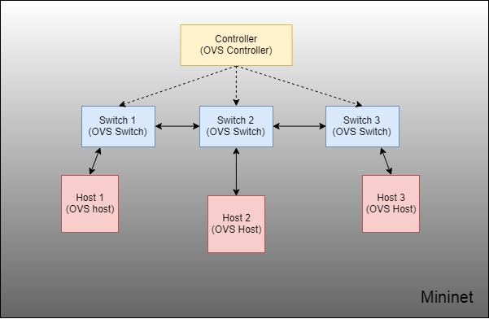
Topology Design

Slide 14
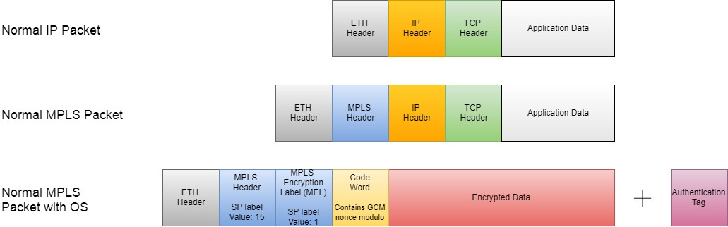
OS Implementation

Slide 15
Advanced Encryption Standard – Galois Counter Mode (AES-GCM)
Inputs:
Key - 16 Bytes
Initialization Vector (IV Counter) – 12 Bytes
(Modulo is passed into the Code Word)
Plain text – Data
Output:
Cipher text – Encrypted Data
Authentication Tag – 16 Bytes
(Used for Authentication during Decryption)

Slide 16
Metrics
Bandwidth – Max Amount of data that can be transferred between two points on a network in a given period of time.
Throughput – Practical amount of data that can be transferred between two points on a network in a given period of time
Latency – Amount of time for data to travel from A to B
CPU Utilization
Memory Usage

Slide 17
Progress
Implemented the whole network system
Set up the Switches to perform MPLS Switching
Implemented the new OS encryption functionality in the OVS codebase
Successfully tested the MPLS with OS flow
Currently deploying the system on a linux server to gather metrics
Unable to implement Key exchange due to lack of time

Slide 18
Demo

Slide 19
Questions?

