Slide 1
Clean Code Assignment
By – Salil Kumar Verma

Slide 2
Code Snapshot

Slide 3
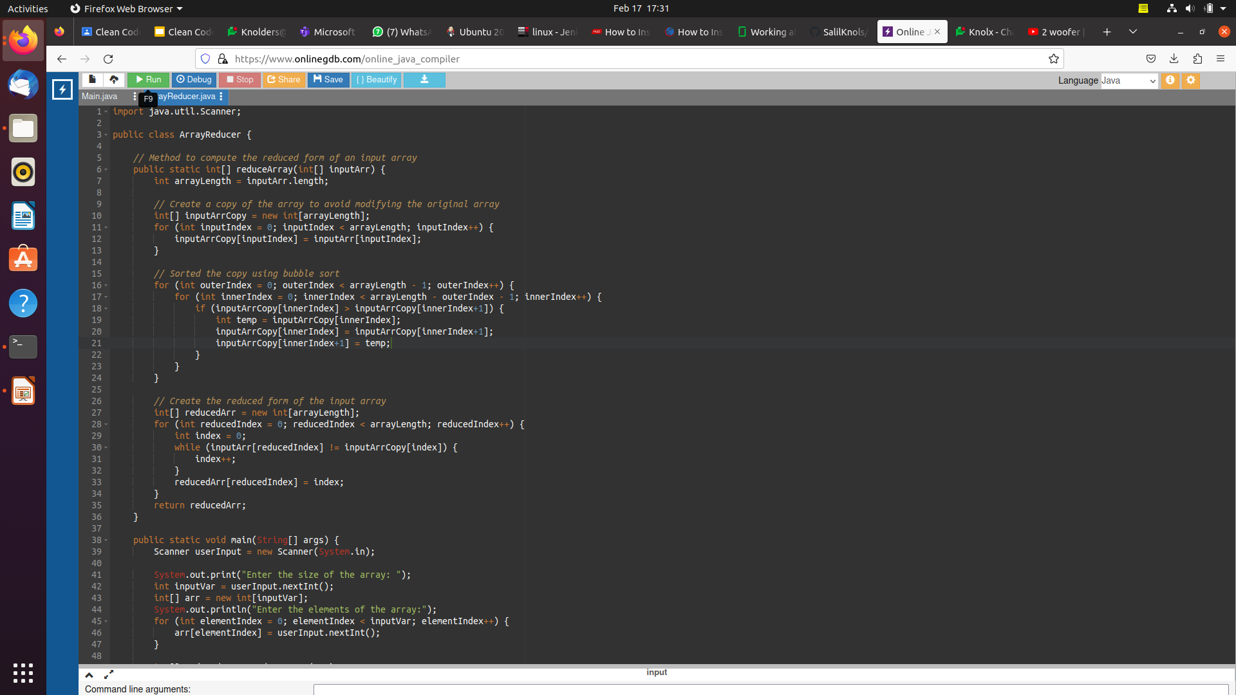

Slide 4
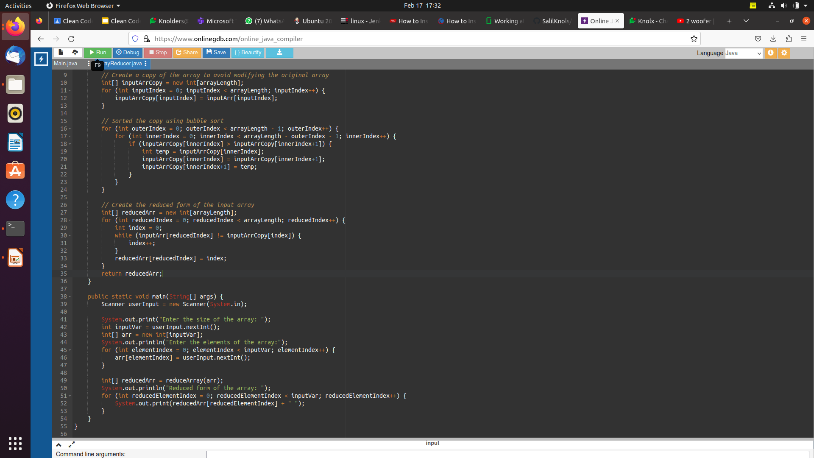

Slide 5
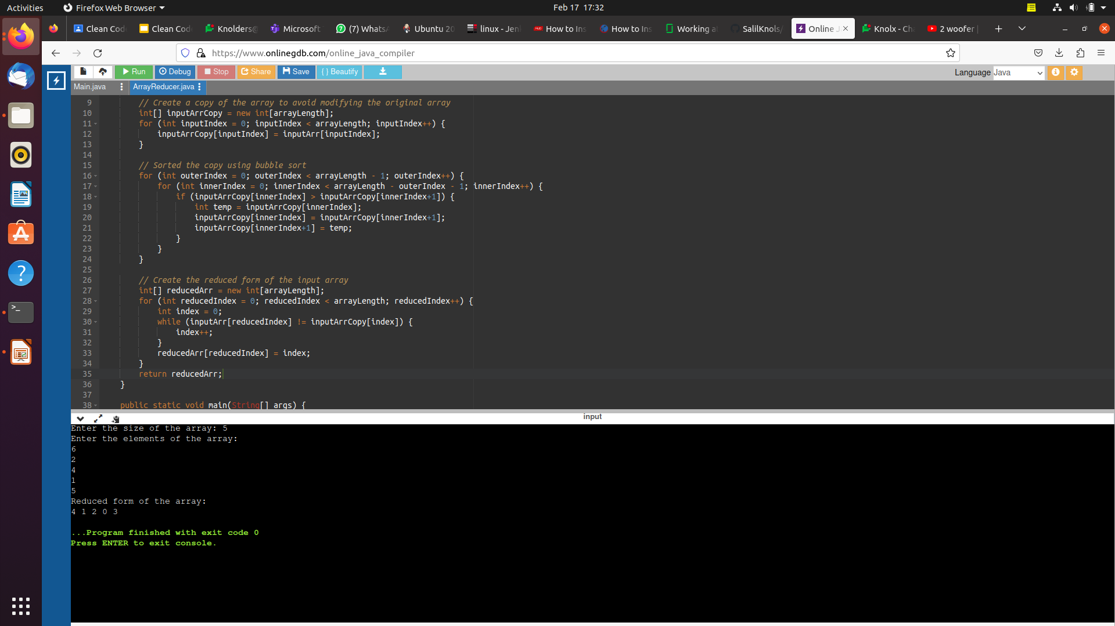

Slide 6
Thank You

