Slide 1
SOLID PRINCIPLES
By – Salil Kumar Verma

Slide 2
Code Screenshots !!!

Slide 3
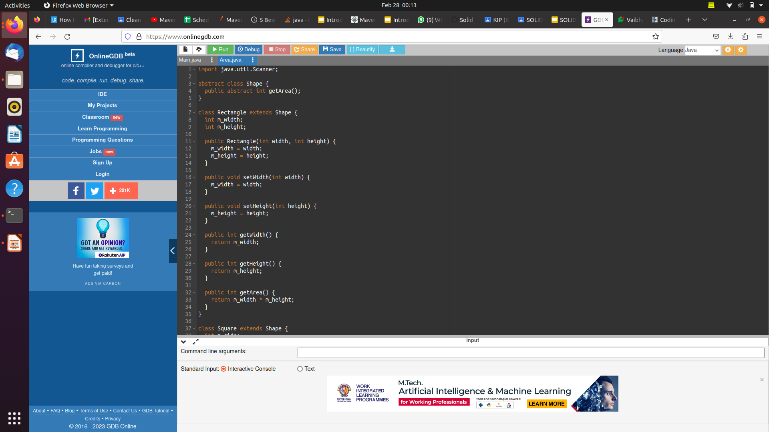

Slide 4
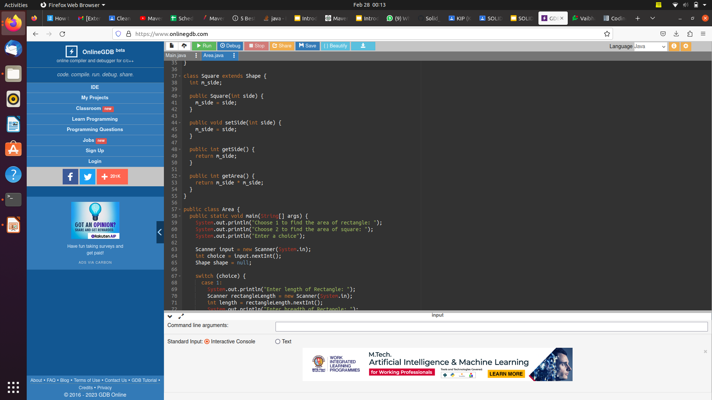

Slide 5
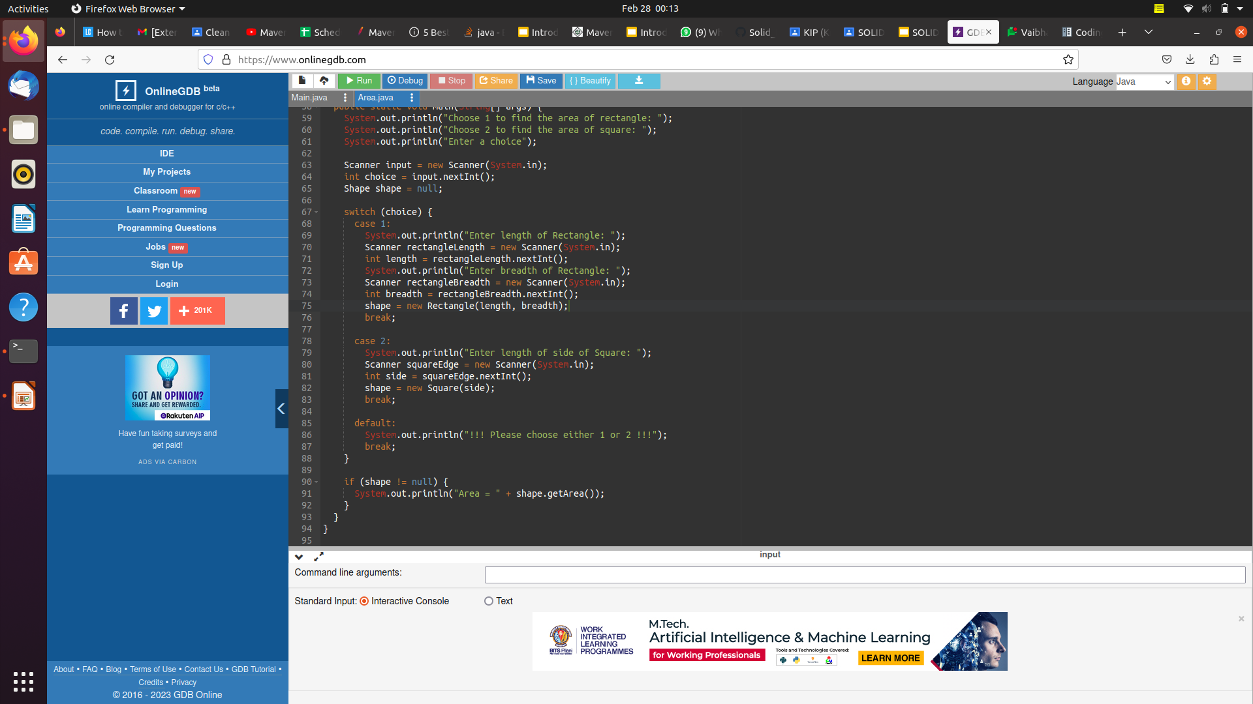

Slide 6
Output Screenshots !!!

Slide 7
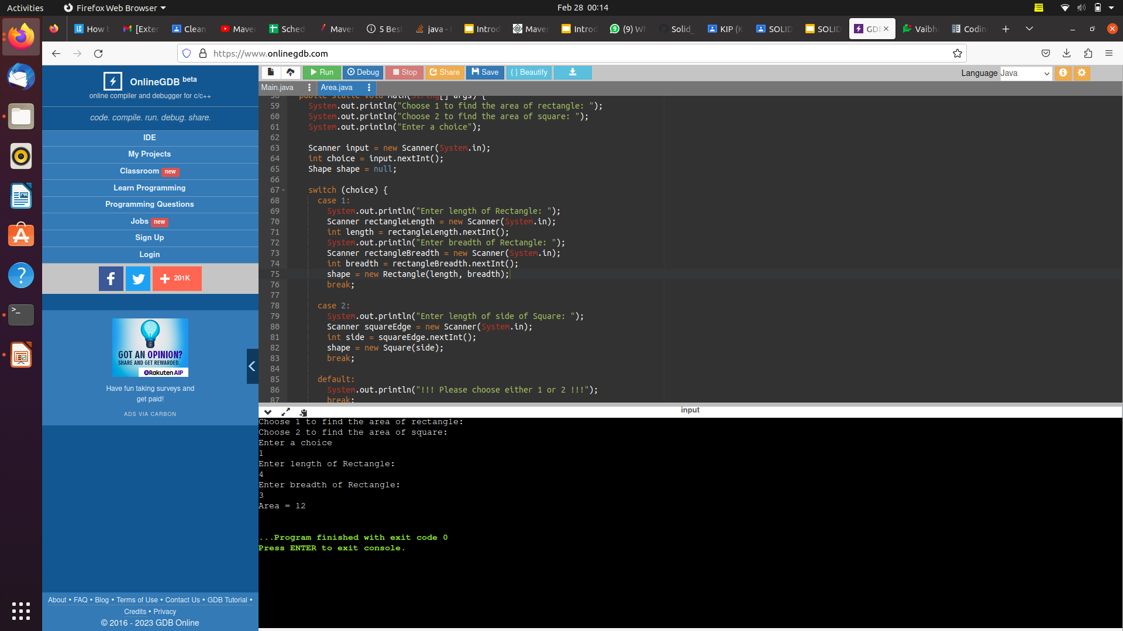

Slide 8


Slide 9
Explaination!!!
As a basis class for both the Rectangle and Square classes, we have added an abstract Shape class. The concrete subclasses of the Shape class implement the abstract getArea() function. As needed by the Liskov substitution principle, this guarantees the changability of any classes descended from the Shape class.
Also, since it is no longer necessary, we have eliminated the calculateArea() method and replaced it with a straightforward if statement to determine the area of the selected shape.

Slide 10
Thank You !

