Slide 1

Final Presentation
ADP1071-1EVALZ
רים בדוי וסלים בשארה
הצגה בתאריך 25/01/2026

Slide 2
What is the ADP1071-1EVALZ?

Slide 3
Our Project

Slide 4
Our Progress
Datasheet
measurements
Contrast

Slide 5
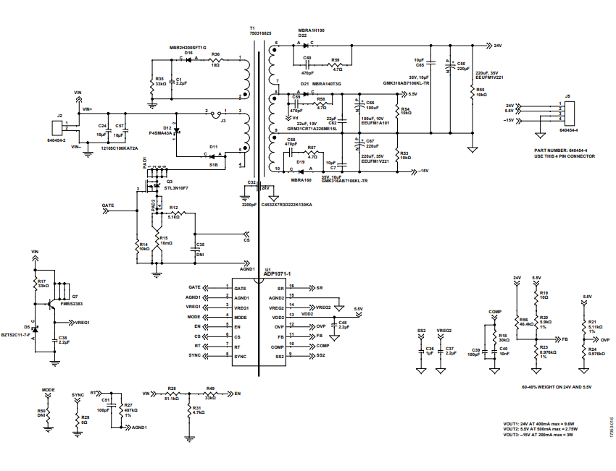
Device
circuit

Slide 6
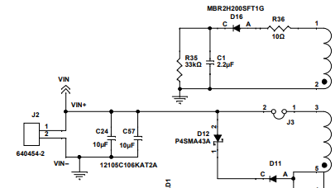
Primary Side

Slide 7
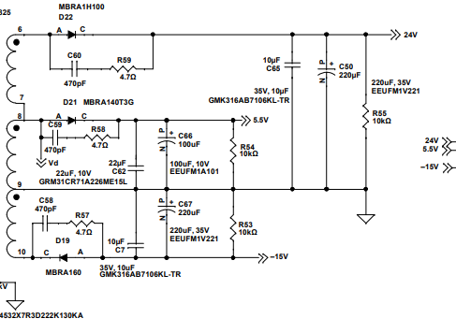
Secondary Side

Slide 8
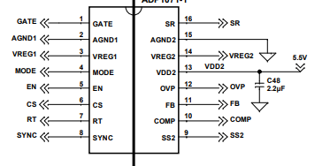
Controller

Slide 9
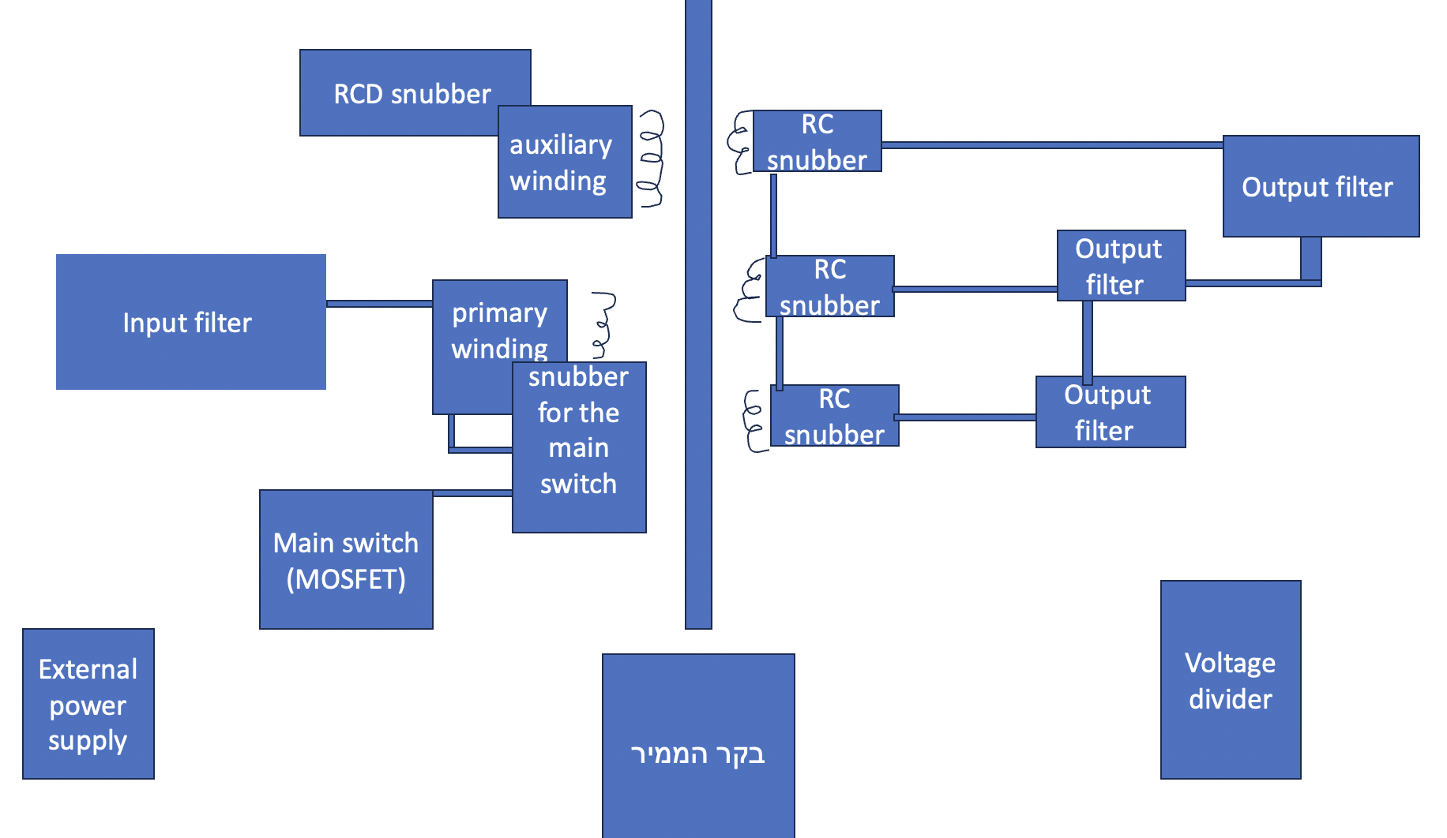

Slide 10
Measurements

Slide 11
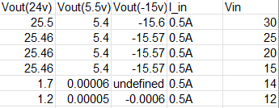
Vout(Vin) - no load

Slide 12
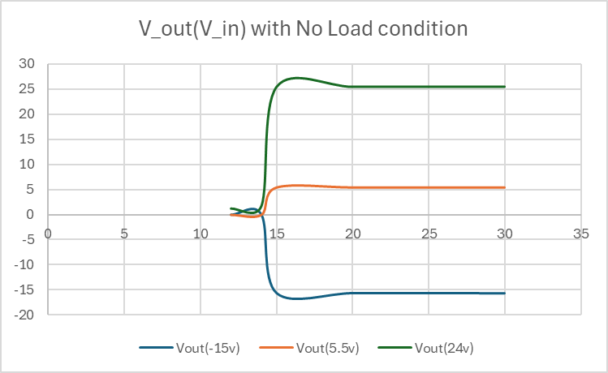
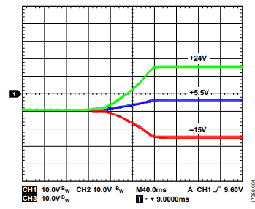

Slide 13

V24(Load)

Slide 14
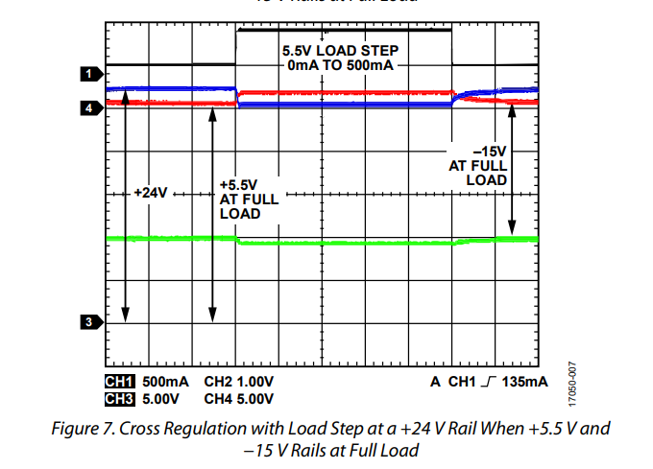

Slide 15
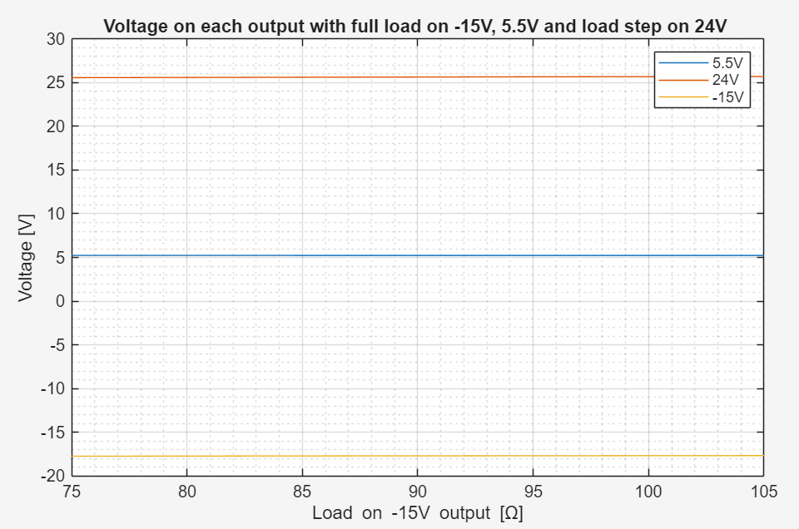

Slide 16
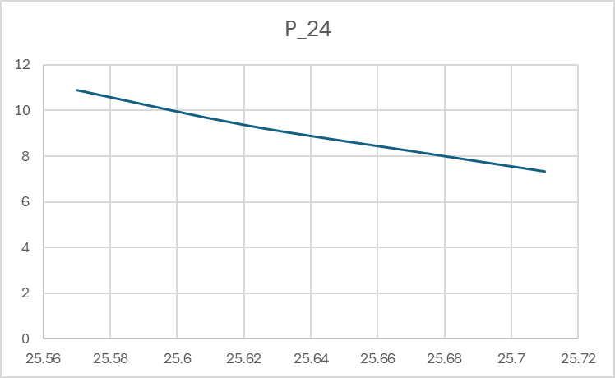
Power graph for V24(Load)

Slide 17

V5.5(Load)

Slide 18
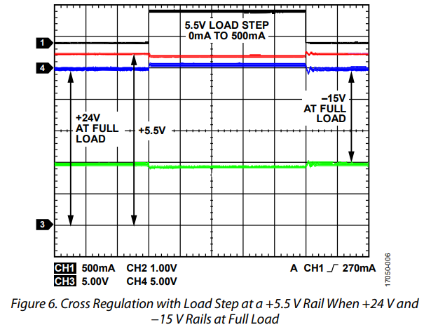

Slide 19
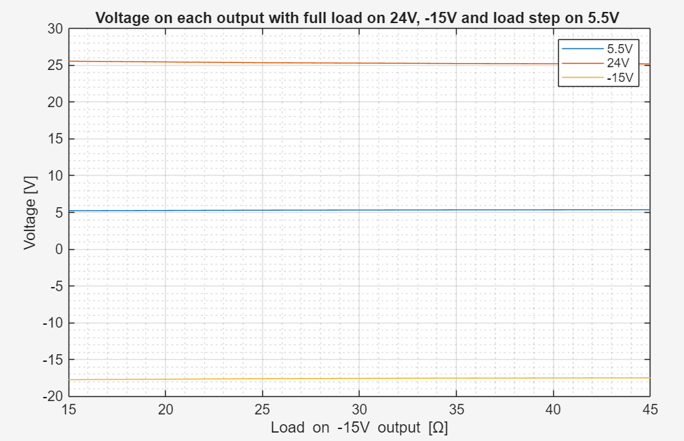

Slide 20
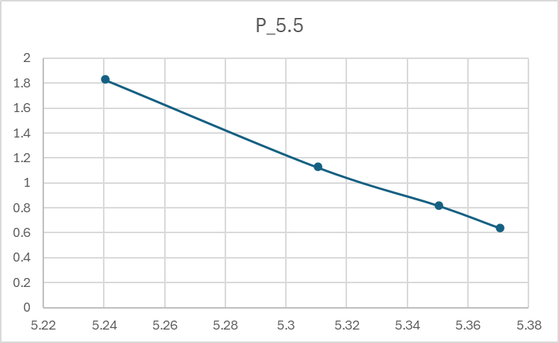
Power graph for V5.5(Load)

Slide 21

V-15(Load)

Slide 22
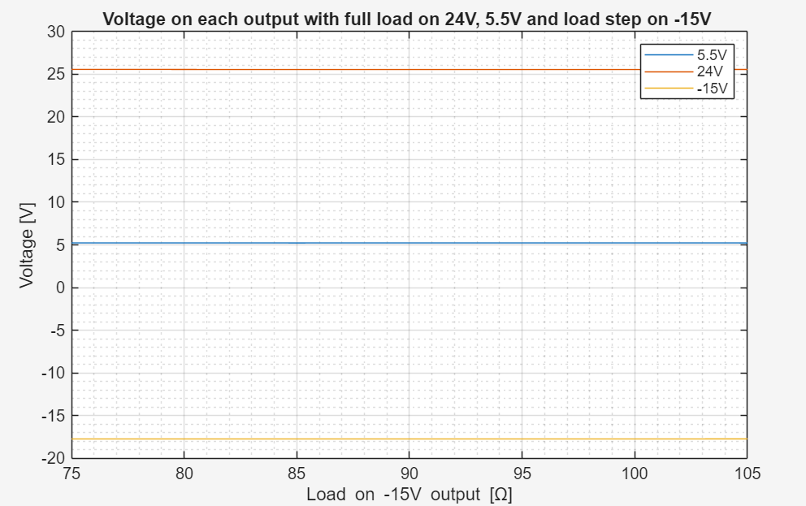

Slide 23
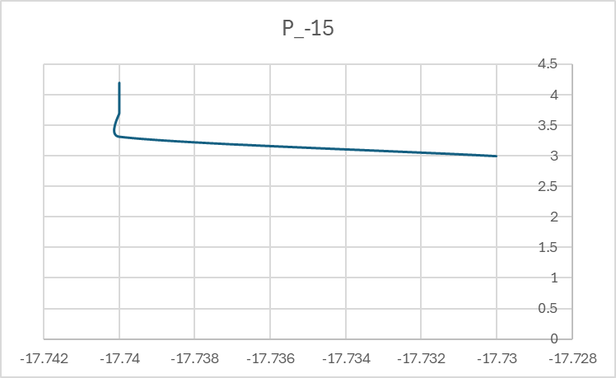

Slide 24

To summarize the results

Slide 25
Next phase
Notes:
نشرح عن شو بدنا نساوي بالרכיב مع المايكرو كونترولر

Slide 26
Understanding the circuit

Slide 27
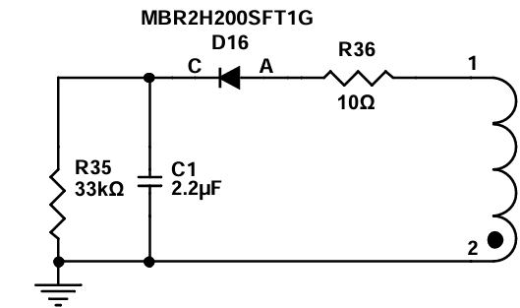
Auxiliary Winding

Slide 28
Spice Simulation

Slide 29
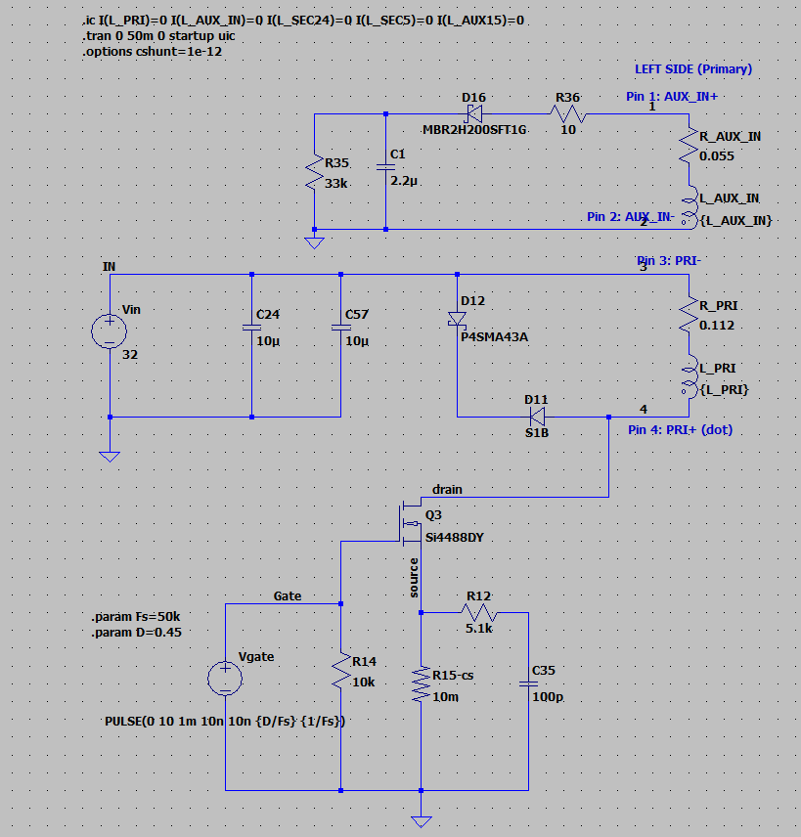

Slide 30
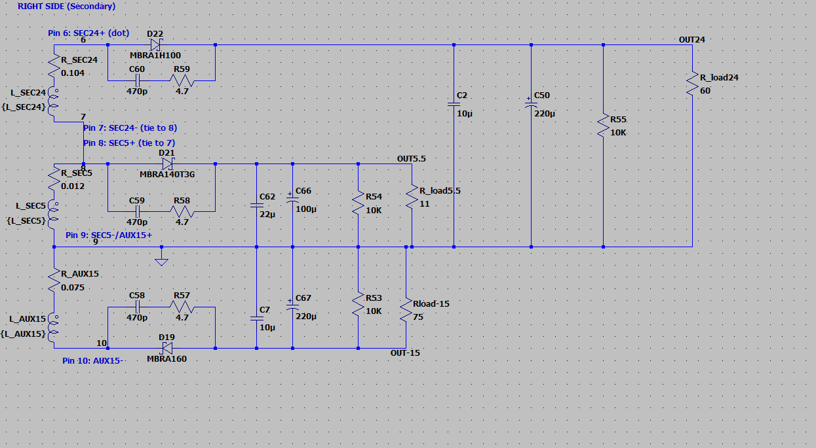

Slide 31
Verifying the schematic

Slide 32
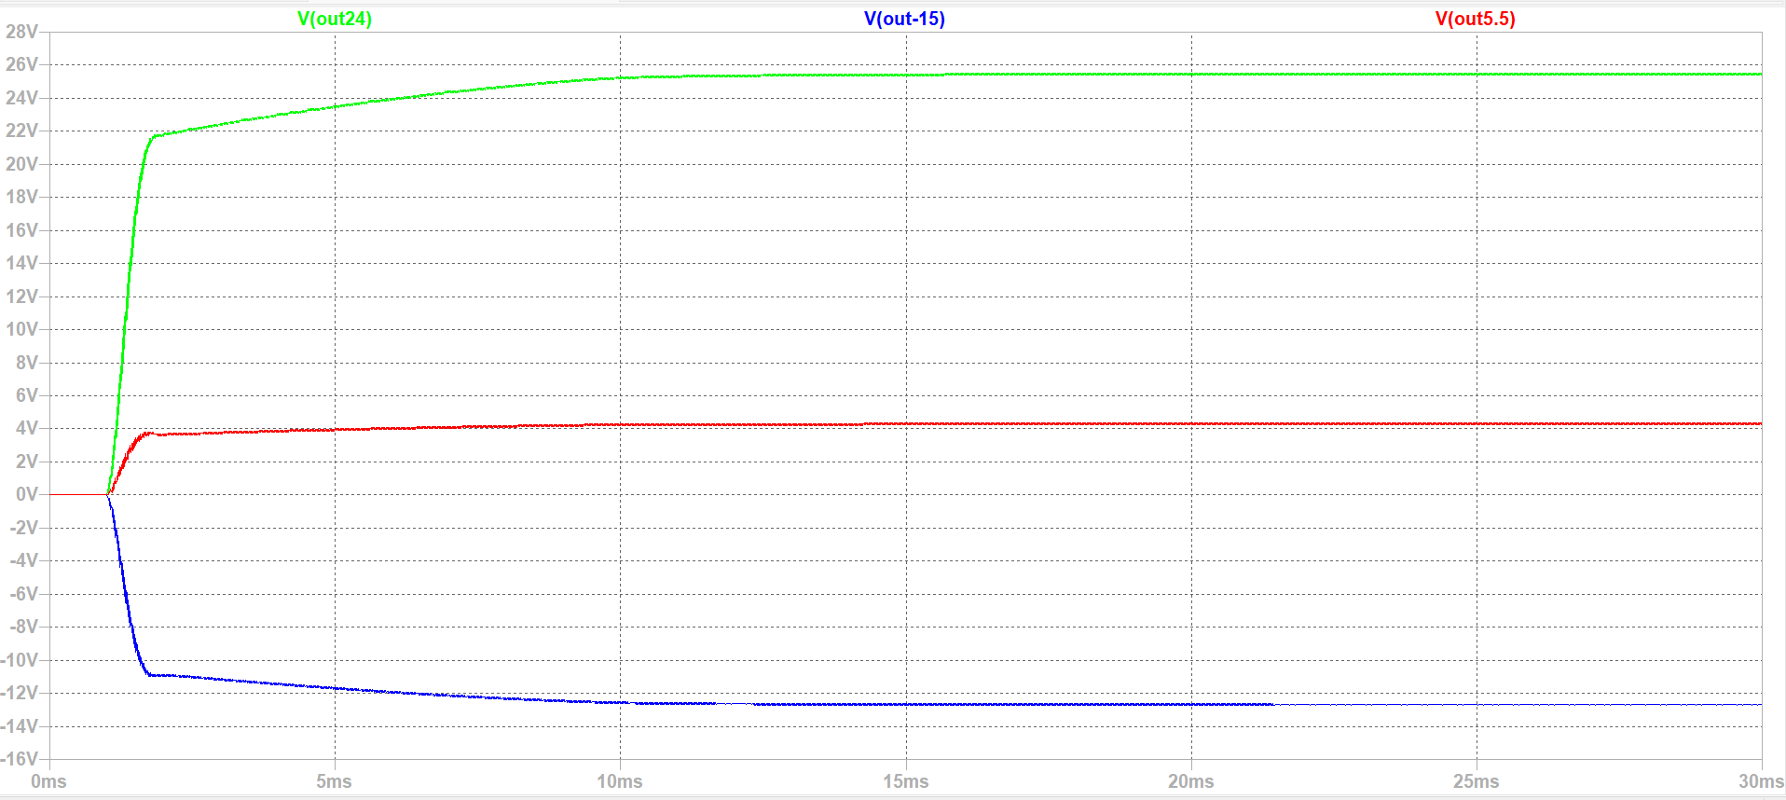

Slide 33
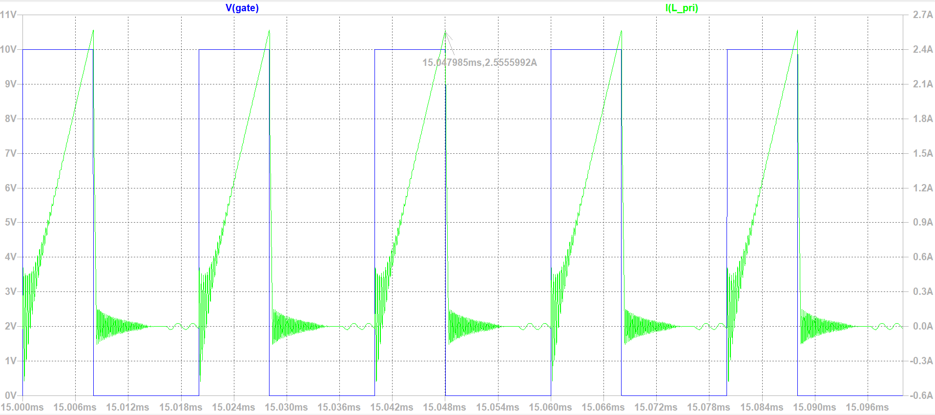
Primary current

Slide 34
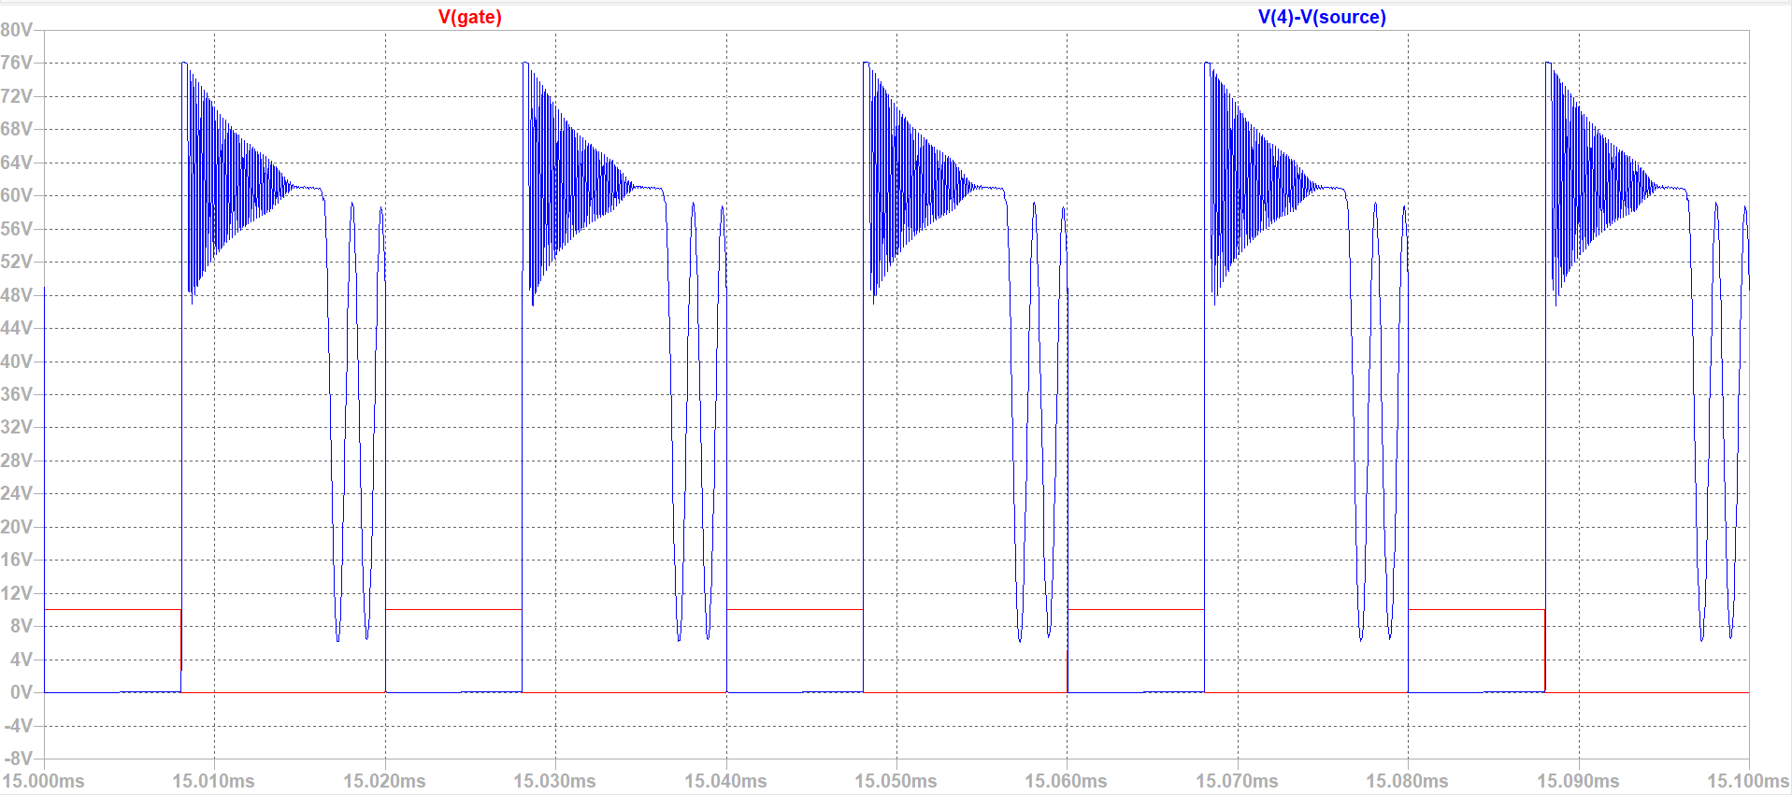
V_{ds}

Slide 35
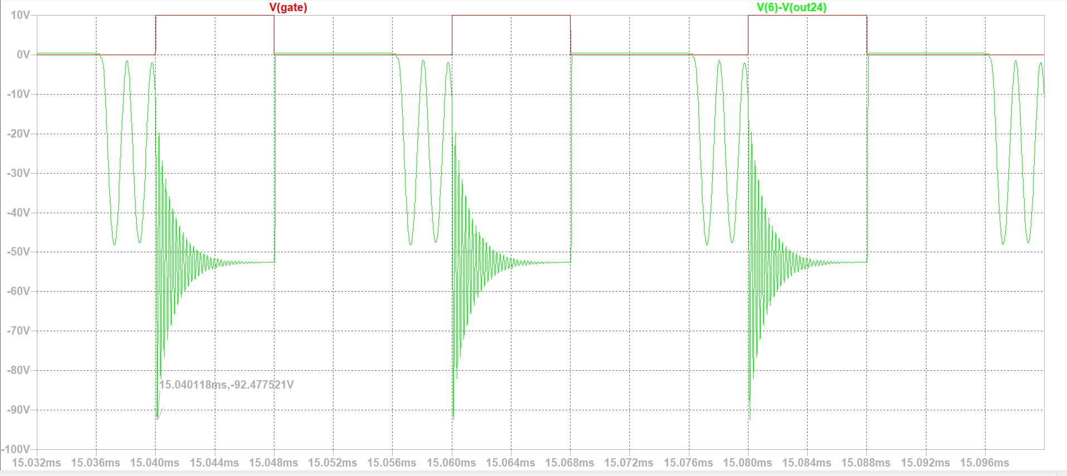
Diode voltage on the 24V output

Slide 36
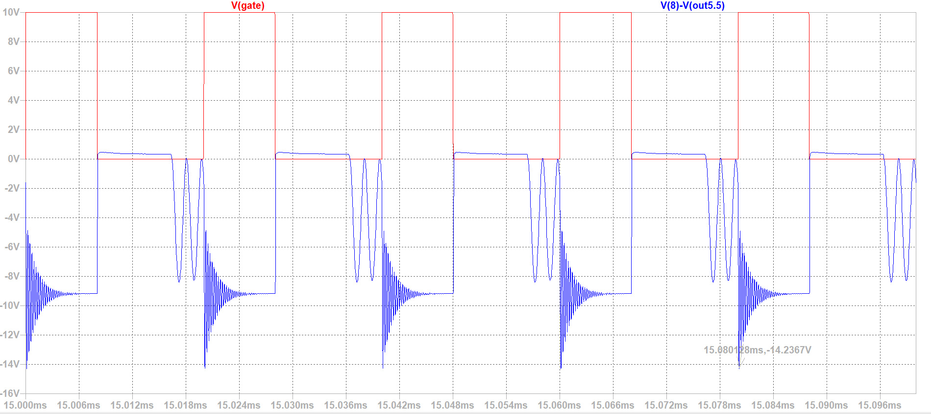
Diode voltage on the 5.5V output

Slide 37
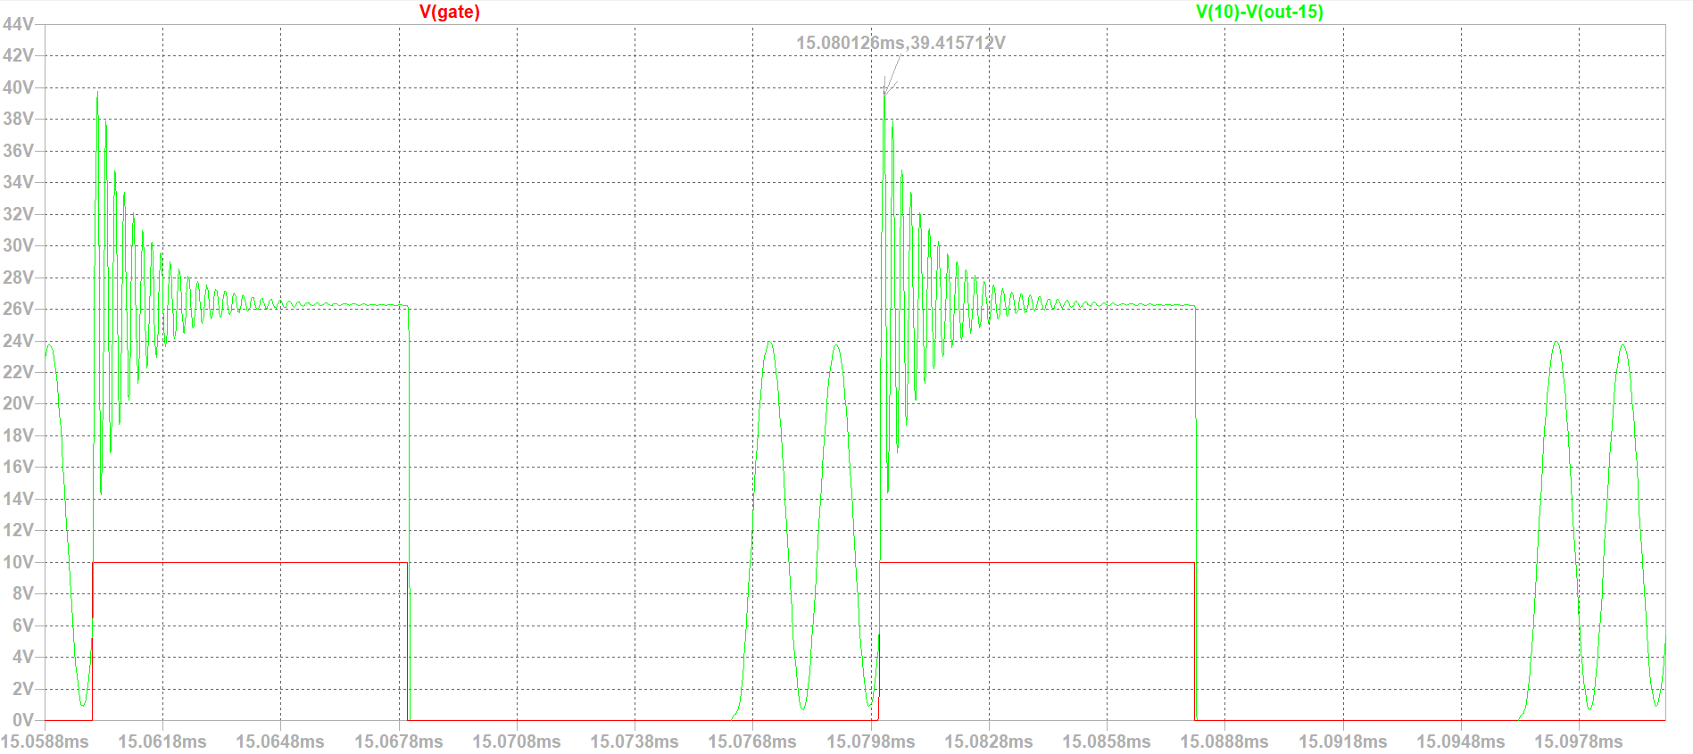
Diode voltage on the -15V output

Slide 38
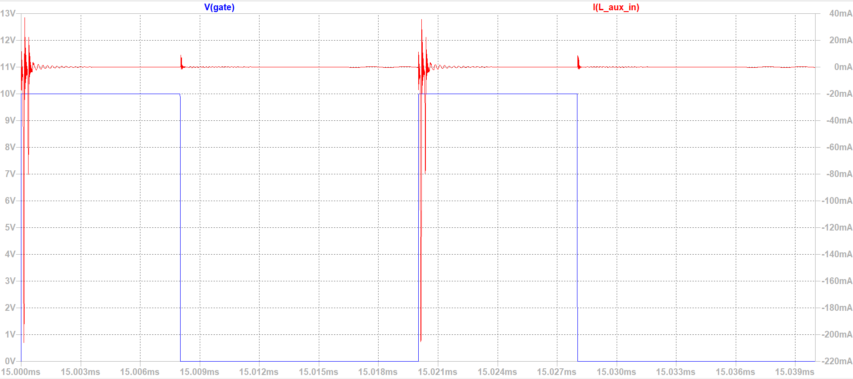
Auxiliary winding current

Slide 39
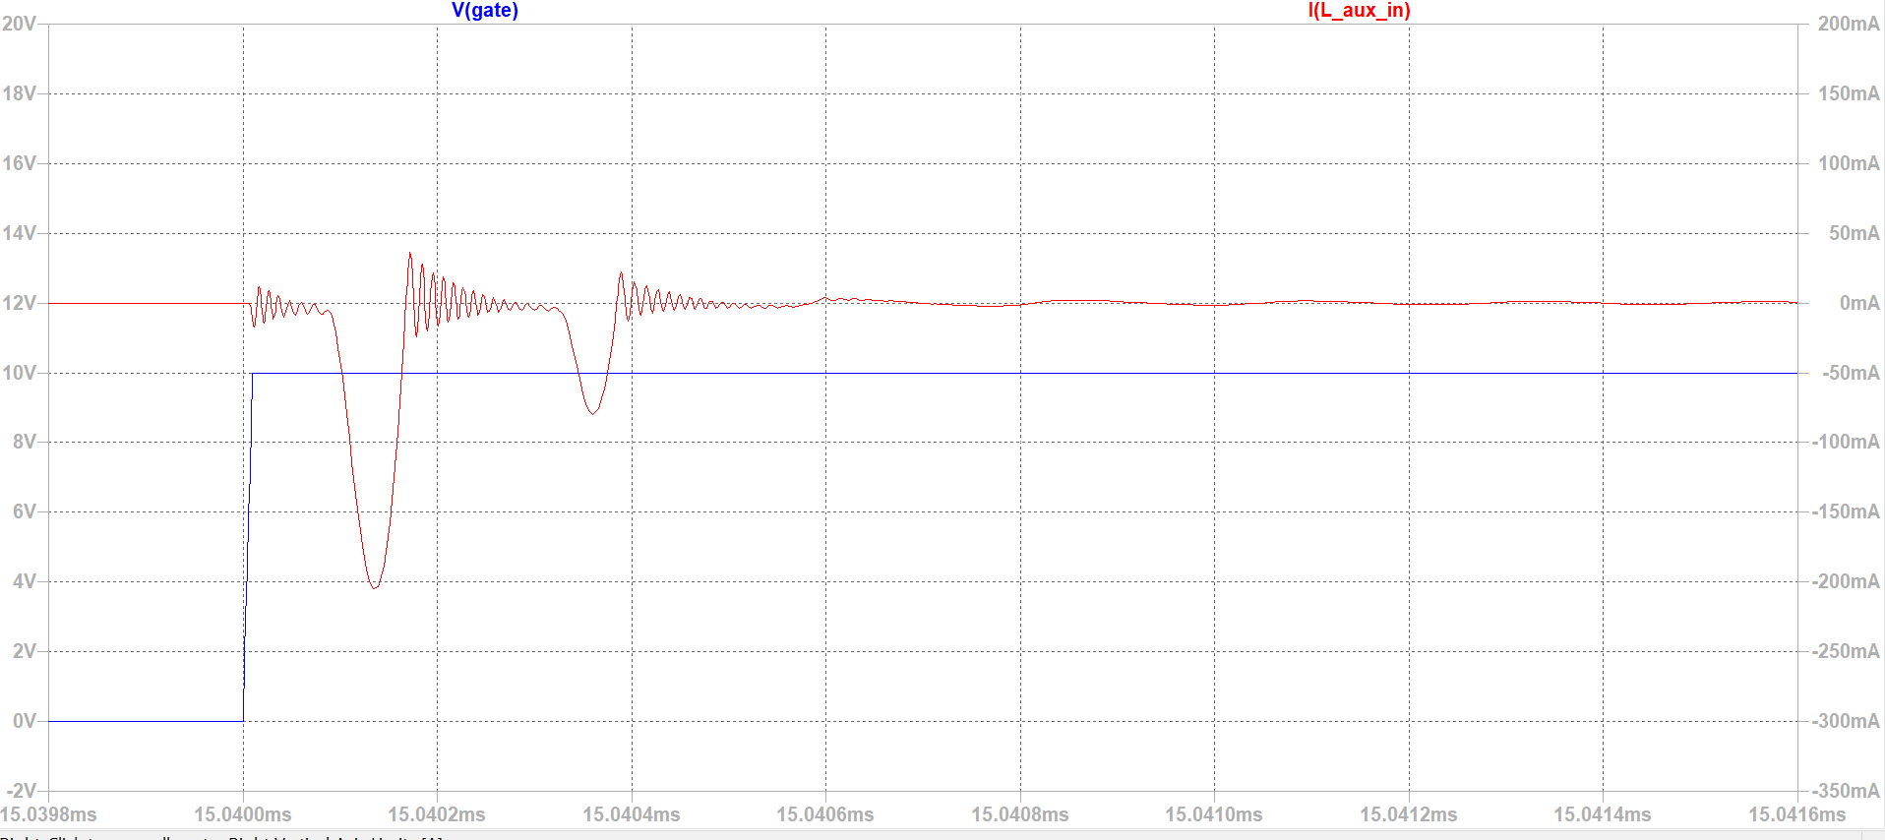

Slide 40
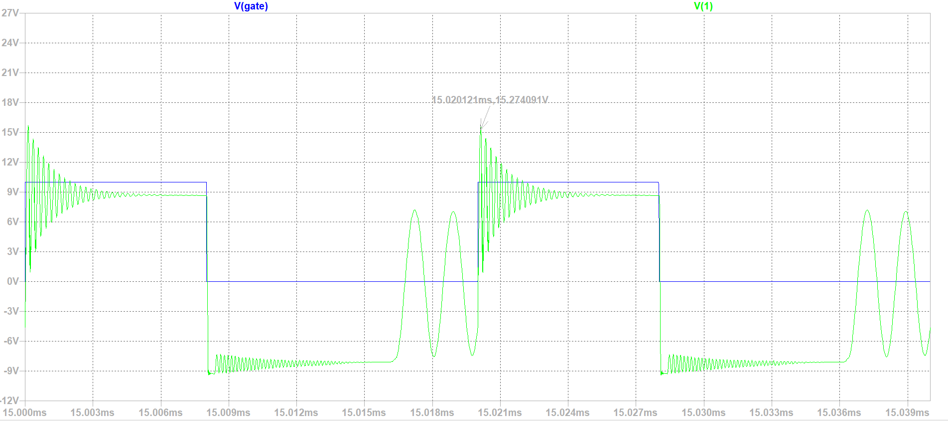
Auxiliary winding voltage

Slide 41
Removing the auxiliary winding

Slide 42
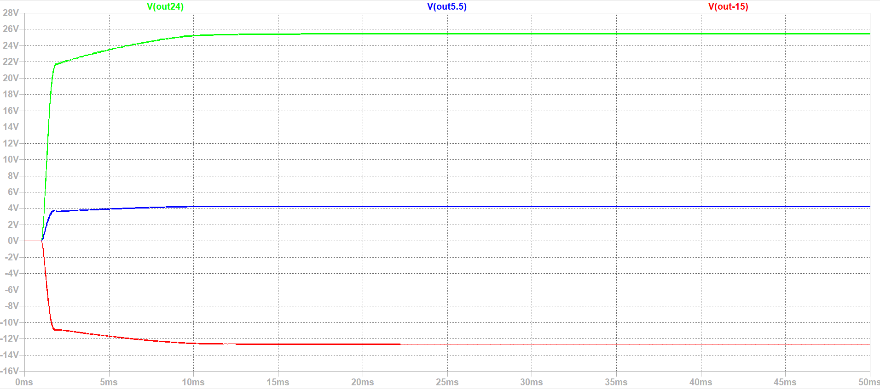
Output Voltages

Slide 43
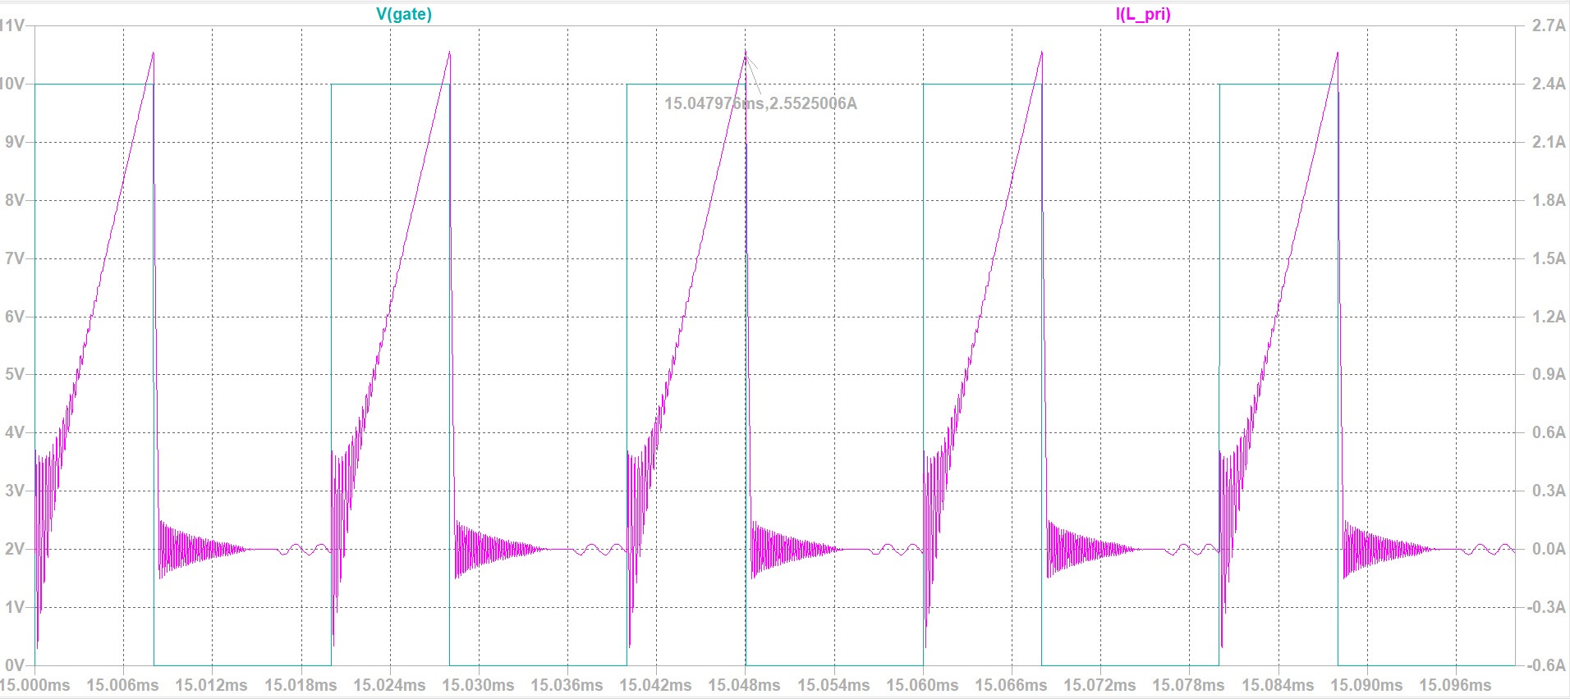
Primary current

Slide 44
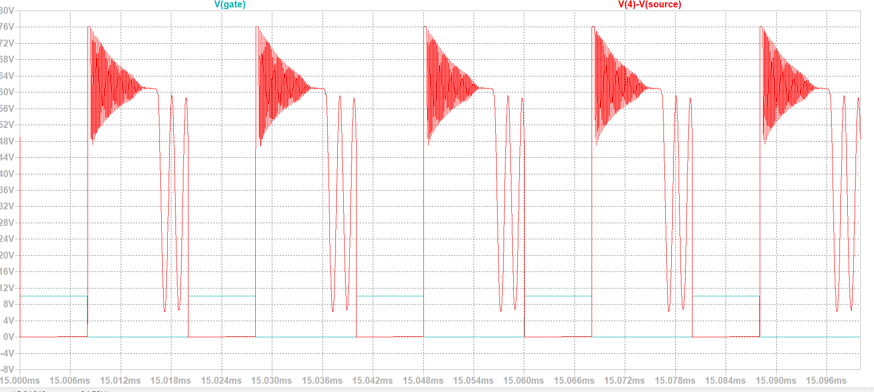
V_{ds}

Slide 45
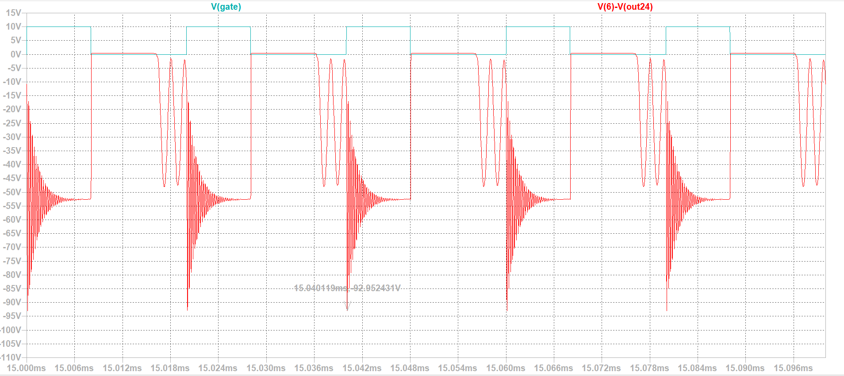
Diode voltage on the 24V output

Slide 46
Conclusion

