Slide 1
🌲 Smart Waste Management
System
MINHAZ AHMED AYON 20-41859-1
MD AL-AMIN 20-42481-1
MD. SAJIDUL HAQUE SHOHAN 20-42022-1
SALIMA FARHA 20-42497-1

Slide 2

OUTLINE
Over-view
Use-case Diagram
UI - Design
User Story Card
CRC Card
Activity Diagram
Class Compartment
Class Diagram
JIRA
GIT
Timeline-Chart
Constructive Cost Model
01

Slide 3
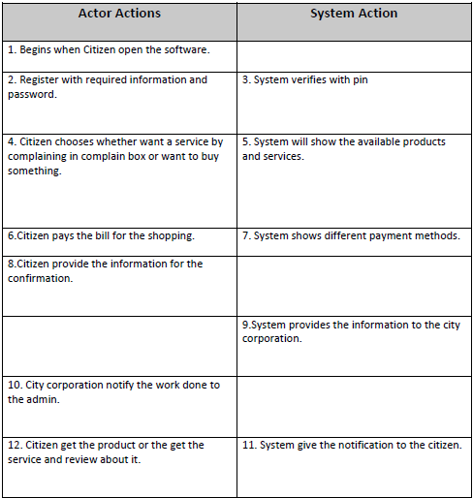
Overview
Waste are making our environment and unsustainable for living. In our Smart waste management system, a citizen will get two different types of platform: A Complaint Box where anyone can give a complain about wastes which are not cleaned by the authorities, A small market place where citizen can buy their desire organic or inorganic products which will not create any on our environment.
Normal flow of events:
02

Slide 4
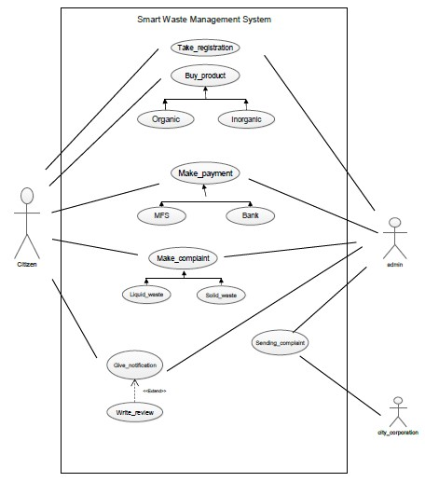
Use Case Diagram:
Actors:
User,
Admin,
City Corporation
03

Slide 5
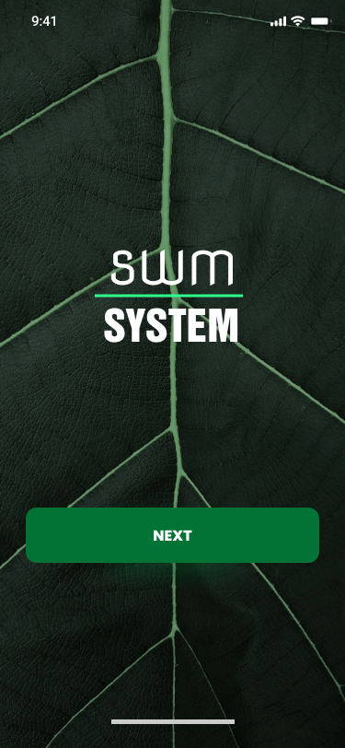
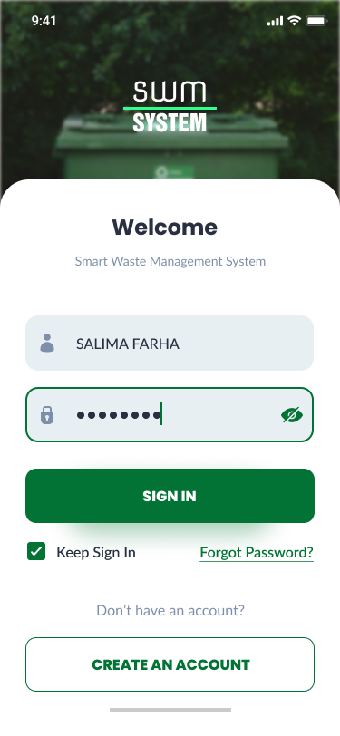
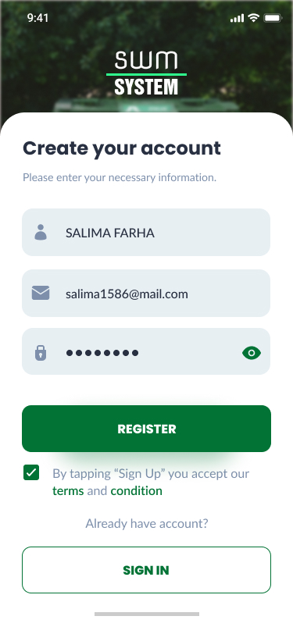
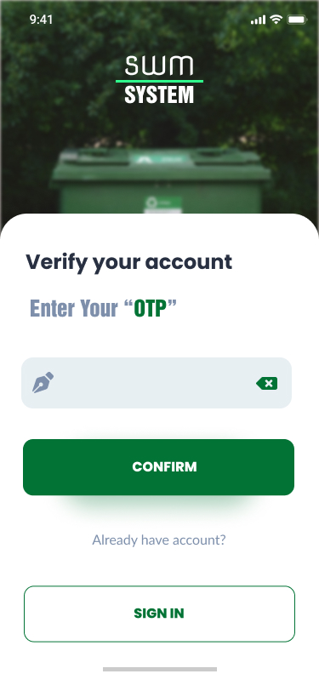
UI-Design
04

Slide 6
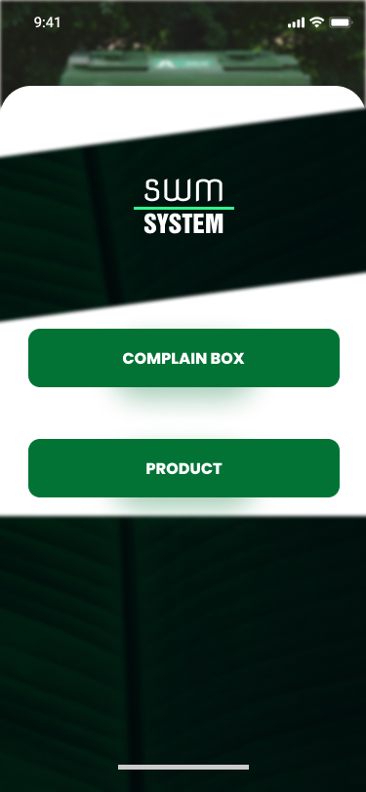
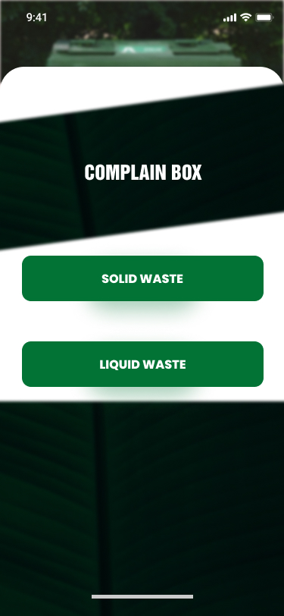
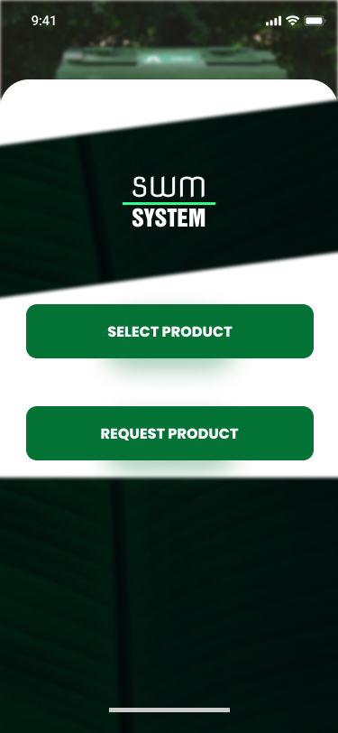
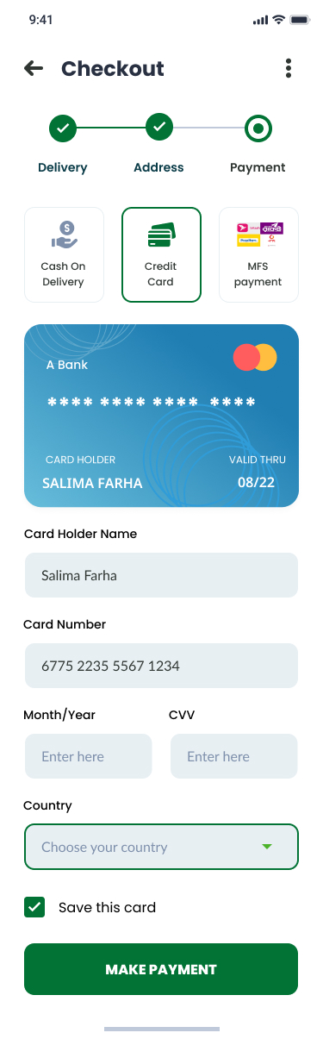
UI-Design
05

Slide 7
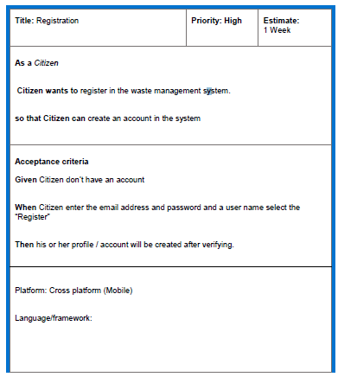
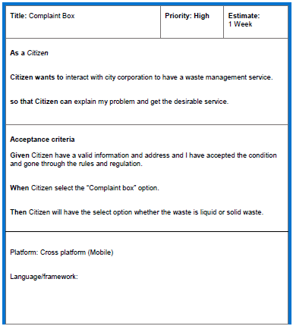
User Story Template
06

Slide 8
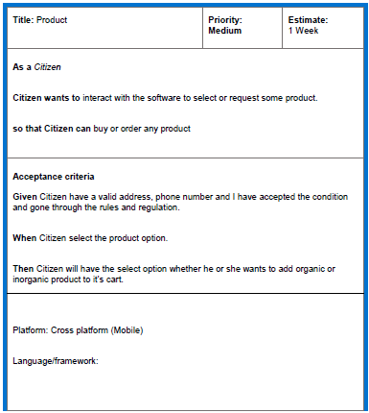
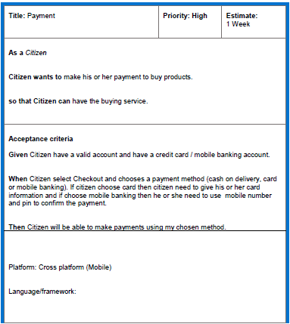
User Story Template
07

Slide 9
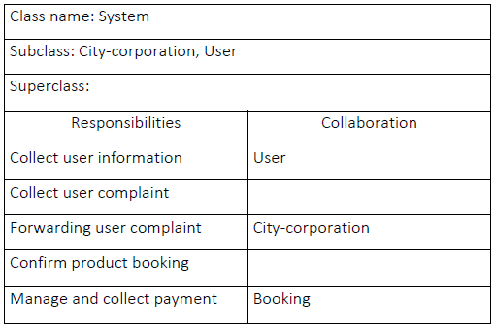
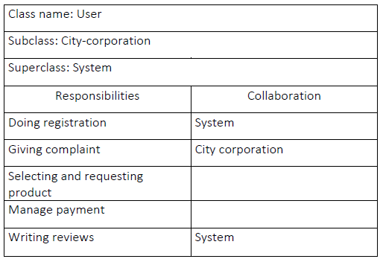
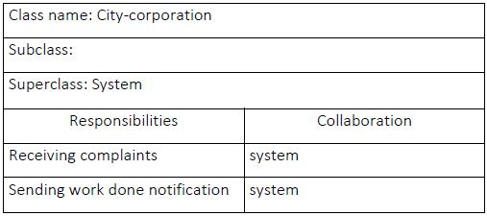
CRC Card
02
01
08
03

Slide 10
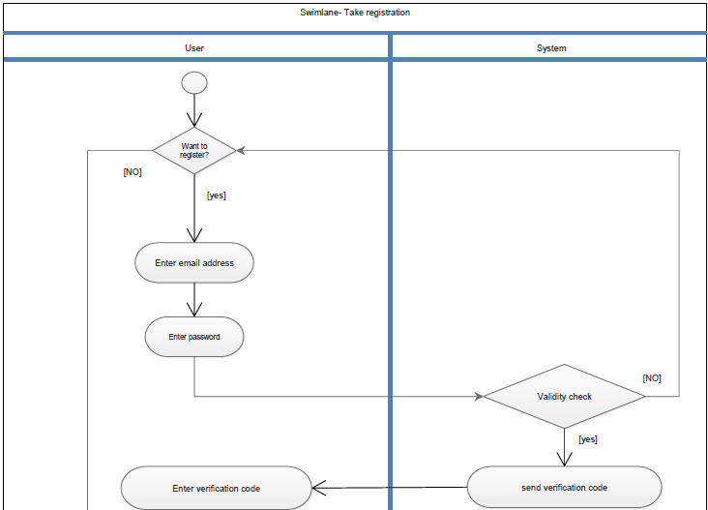
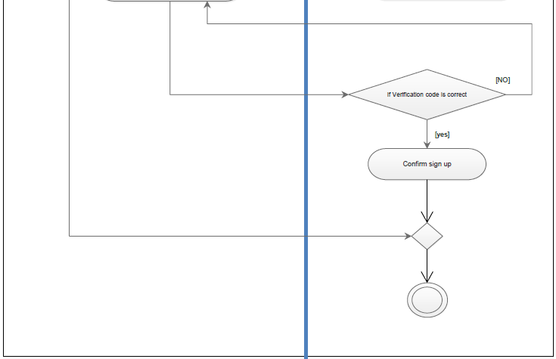
Activity Diagram
Take registration
9

Slide 11
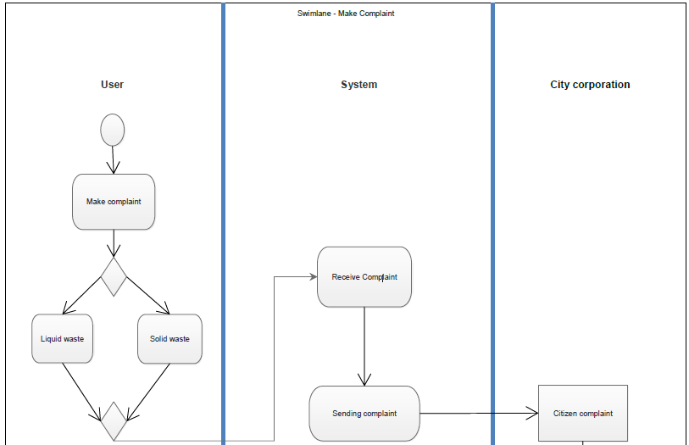
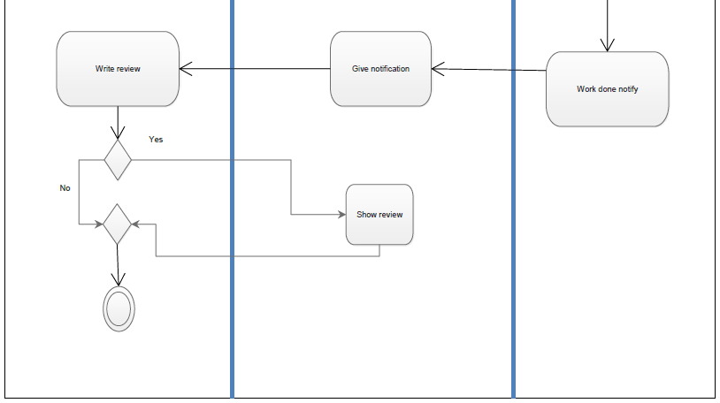
Activity Diagram
Make Complaint
10

Slide 12
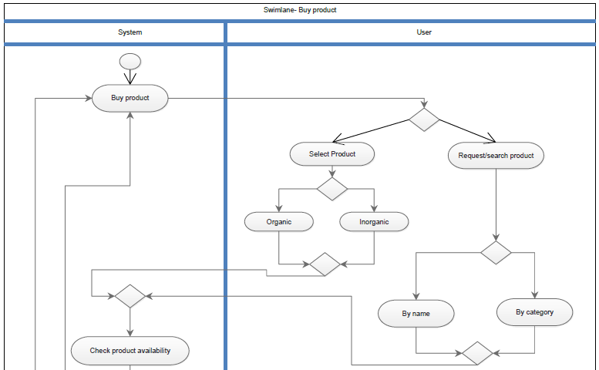
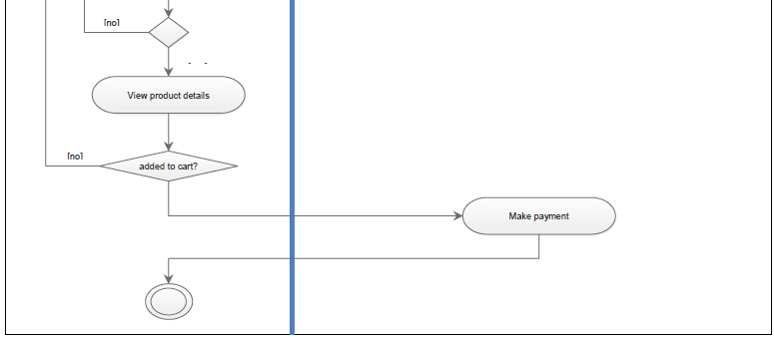
Activity Diagram
Buy Product
11

Slide 13
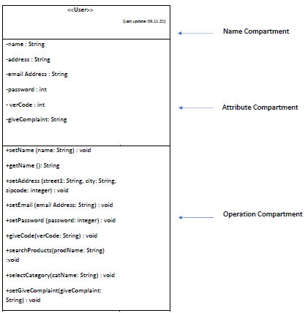
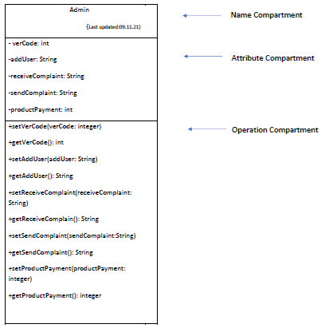
Class Compartment
12

Slide 14
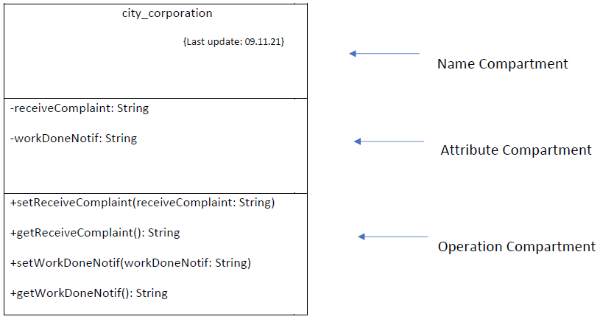
Class Compartment
13

Slide 15
Class Diagram
14

Slide 16
JIRA
15

Slide 17
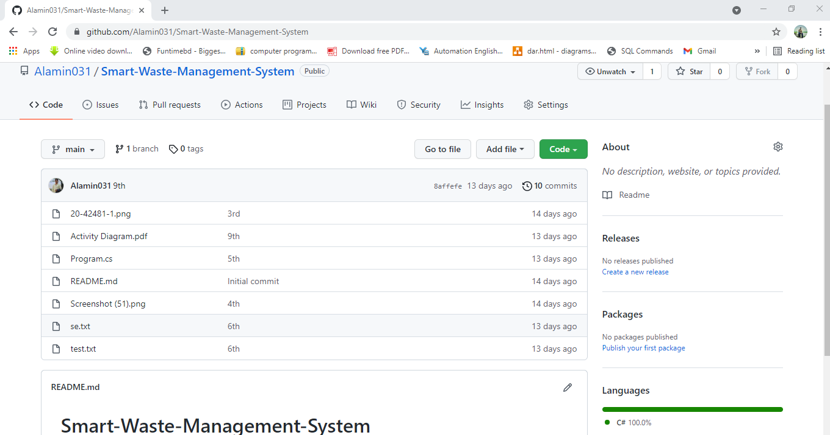
GIT
16

Slide 18
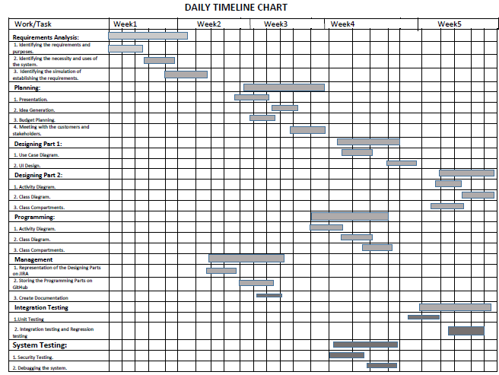
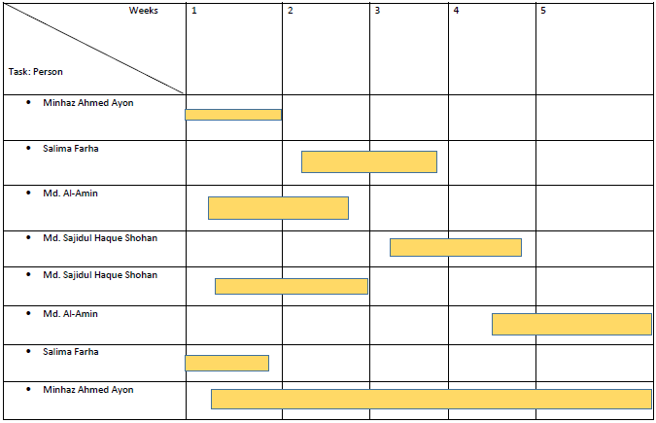
Timeline-Chart
17

Slide 19
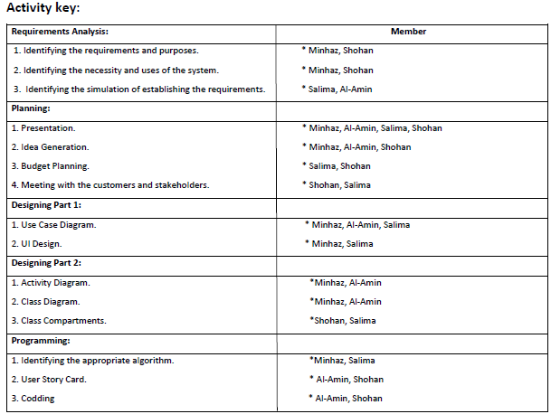
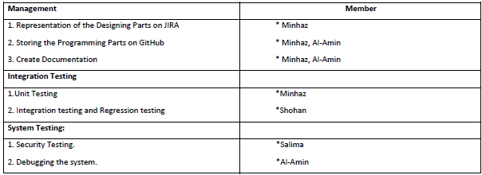
Timeline-Chart
18

Slide 20
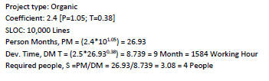
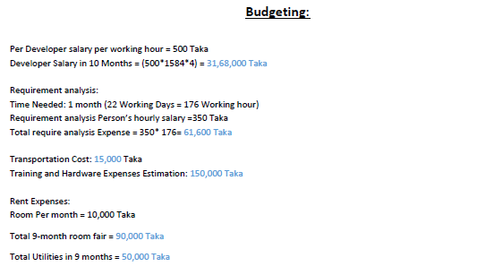
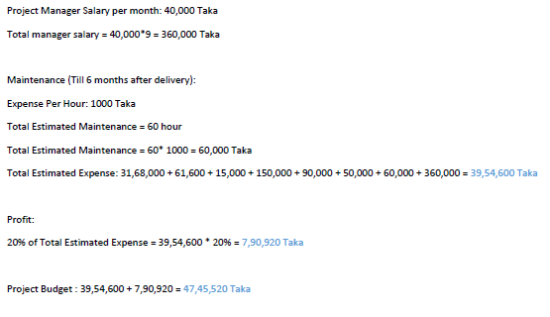
Constructive Cost Model
19

Slide 21
THANK’S

