Slide 1
🌲 Smart Waste Management
System

Slide 2

OUTLINE
Over-view
Use-case Diagram
UI - Design
User Story Card
CRC Card
Activity Diagram
Class Compartment
Class Diagram
JIRA
GIT
Timeline-Chart
Constructive Cost Model
01

Slide 3
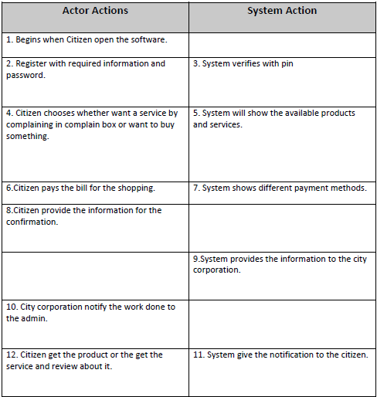
Overview
Waste are making our environment and unsustainable for living. In our Smart waste management system, a citizen will get two different types of platform: A Complaint Box where anyone can give a complain about wastes which are not cleaned by the authorities, A small market place where citizen can buy their desire organic or inorganic products which will not create any on our environment.
Normal flow of events:
02

Slide 4
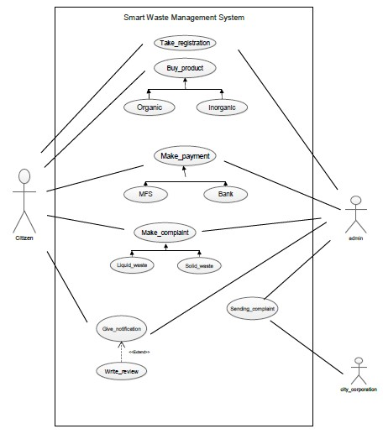
Use Case Diagram:
Actors:
User,
Admin,
City Corporation
03

Slide 5
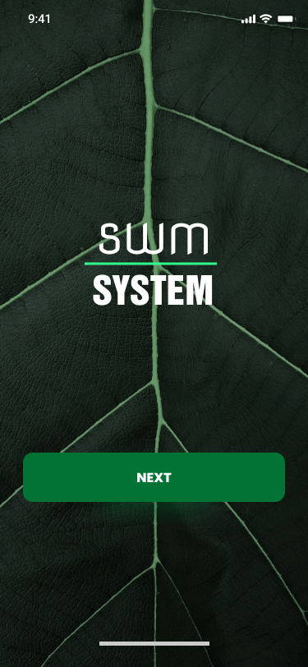
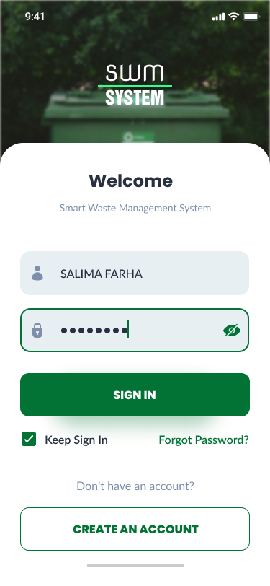
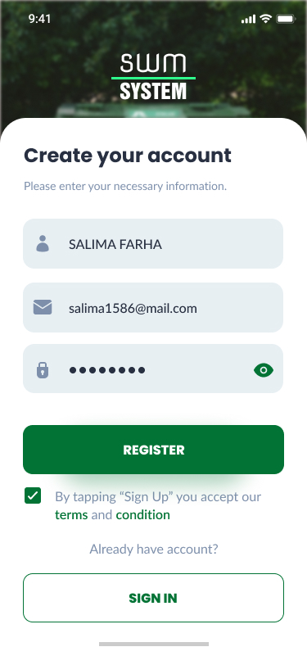
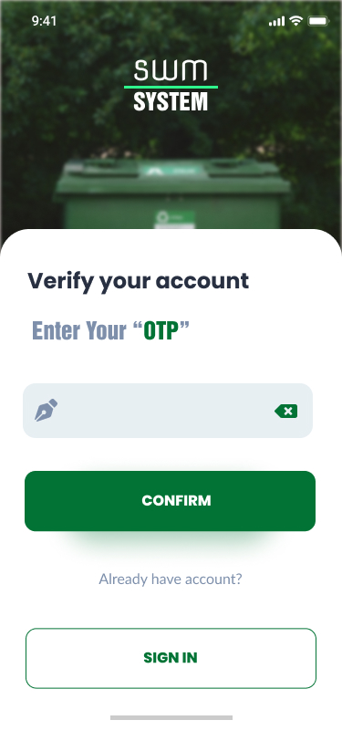
UI-Design
04

Slide 6
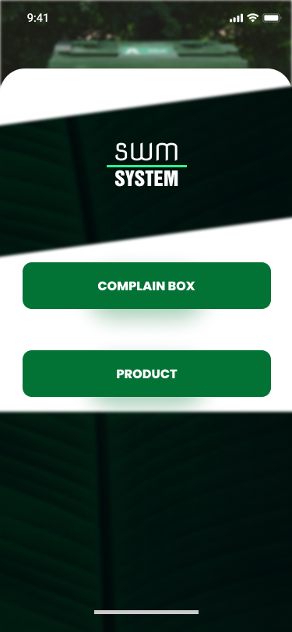
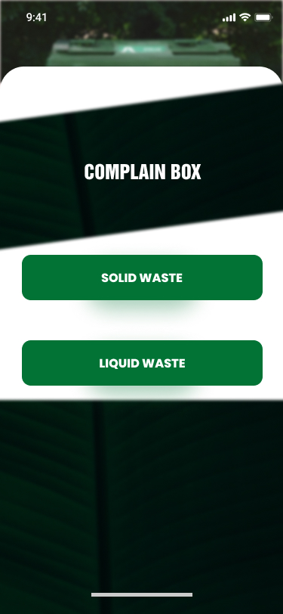
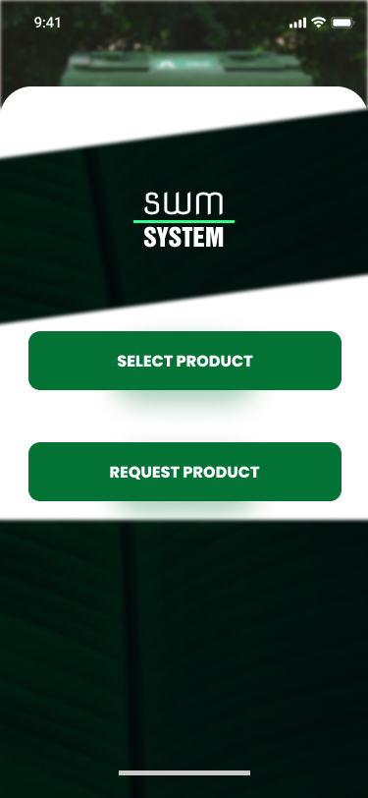
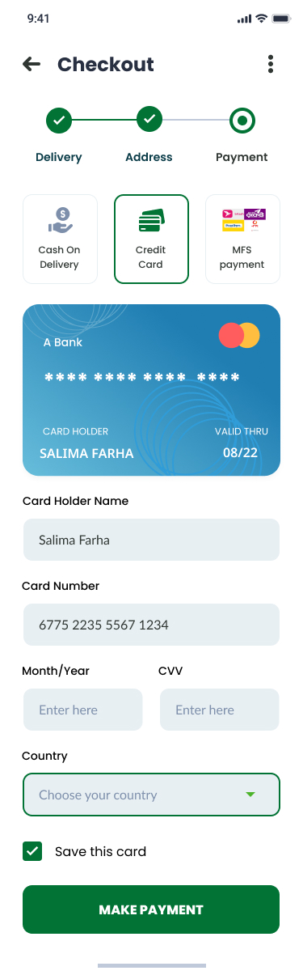
UI-Design
05

Slide 7
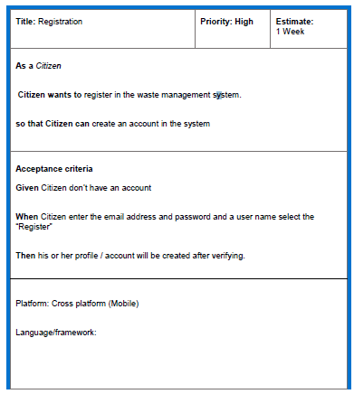
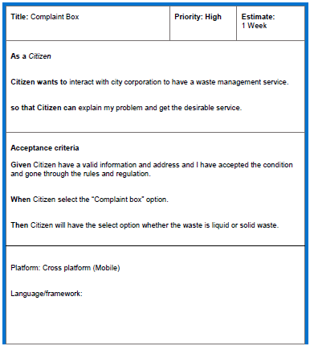
User Story Template
06

Slide 8
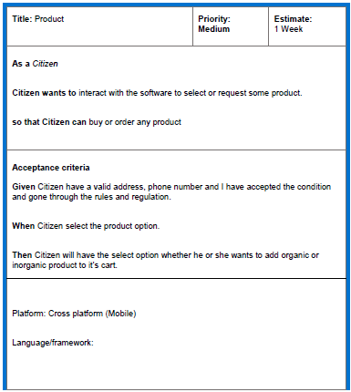
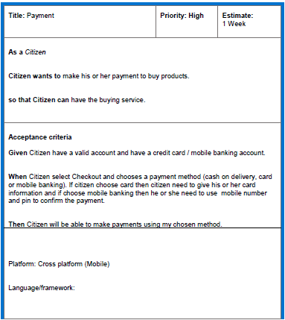
User Story Template
07

Slide 9
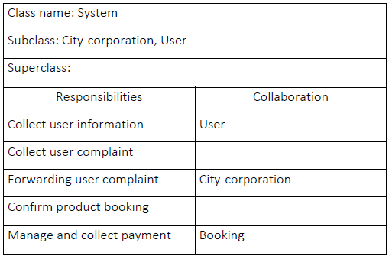
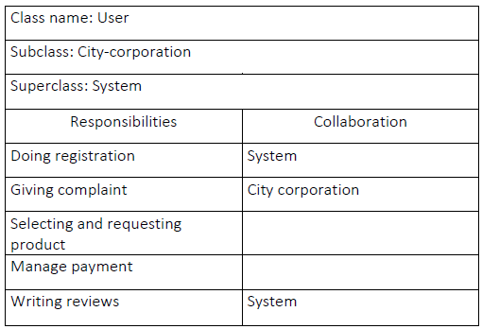
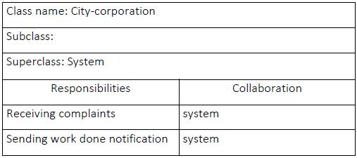
CRC Card
02
01
08
03

Slide 10
CRC Card
02
01
09
03

Slide 11
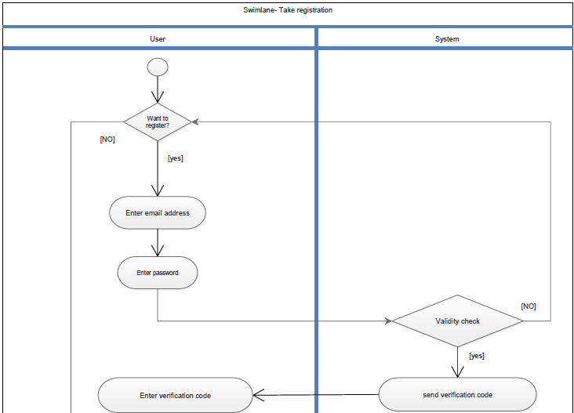
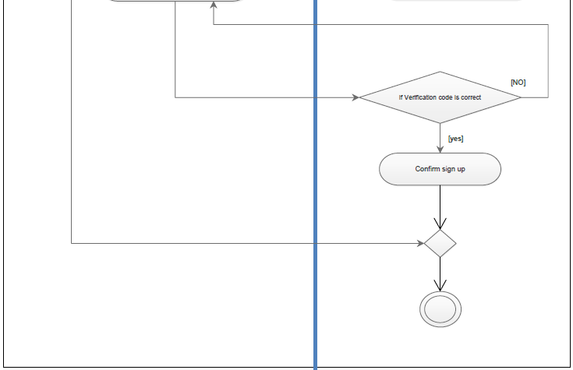
Activity Diagram
Take registration
10

Slide 12
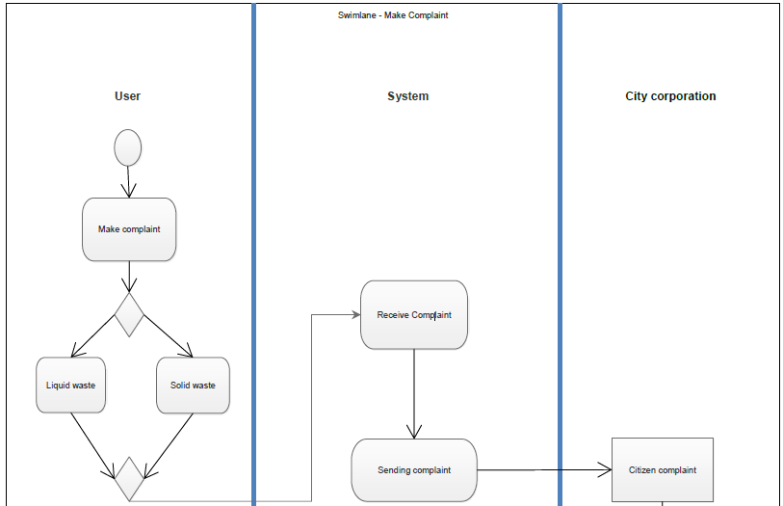
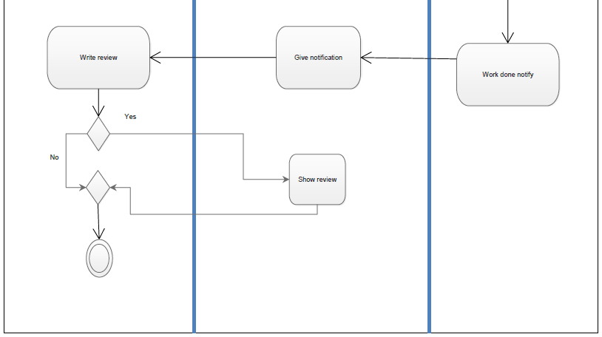
Activity Diagram
Make Complaint
11

Slide 13
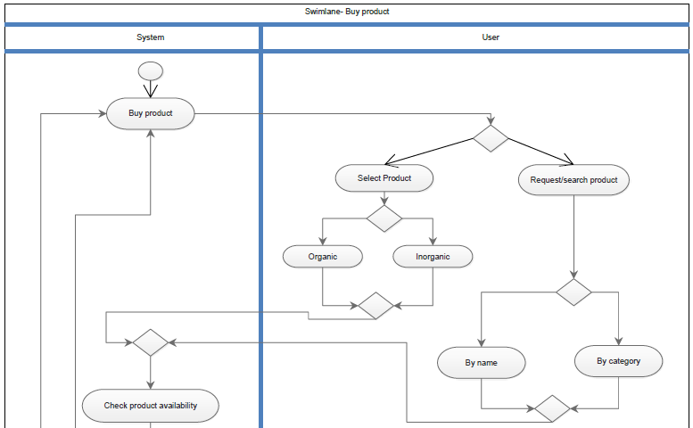
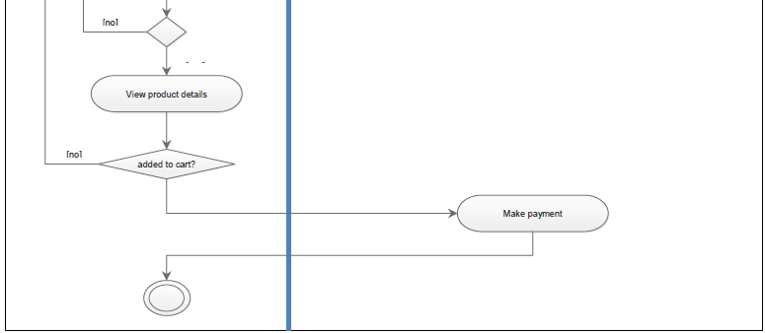
Activity Diagram
Buy Product
12

Slide 14
Activity Diagram
Buy Product
13

Slide 15
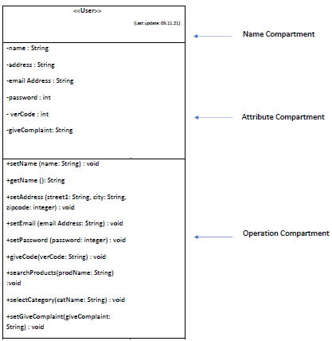
Class Compartment
14

Slide 16
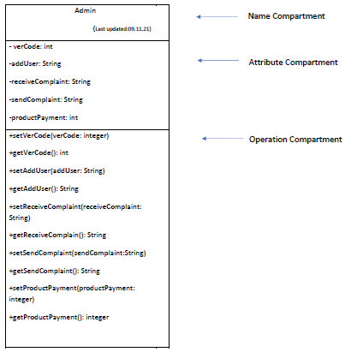
Class Compartment
15

Slide 17
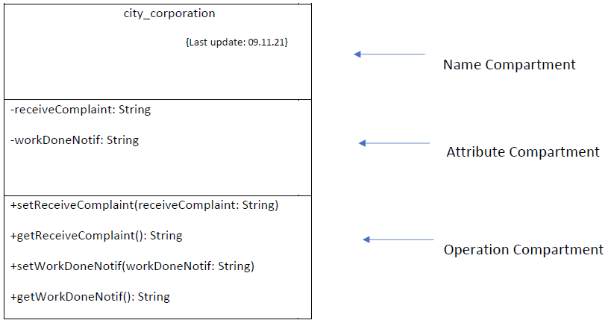
Class Compartment
16

Slide 18
Class Diagram
17

Slide 19
JIRA
18

Slide 20
JIRA
19

Slide 21
JIRA
20

Slide 22
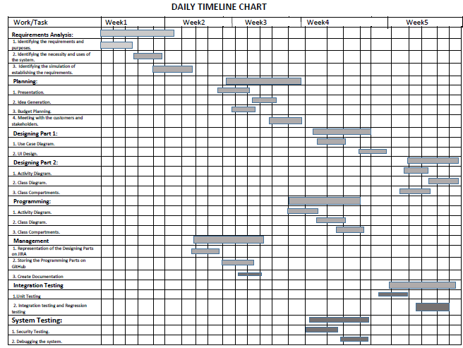
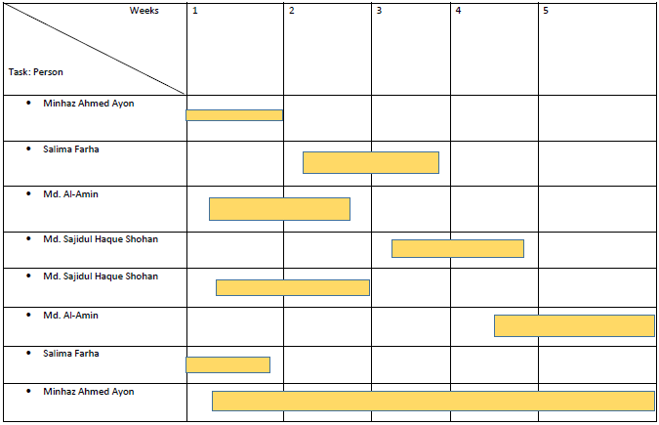
Timeline-Chart
21

Slide 23
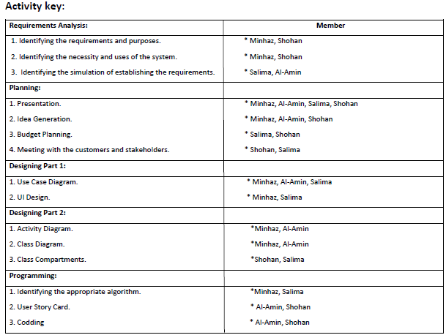
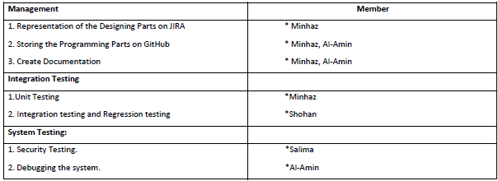
Timeline-Chart
22

Slide 24
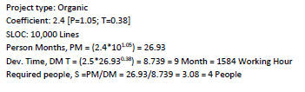
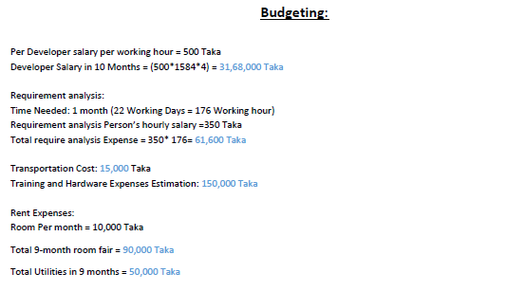
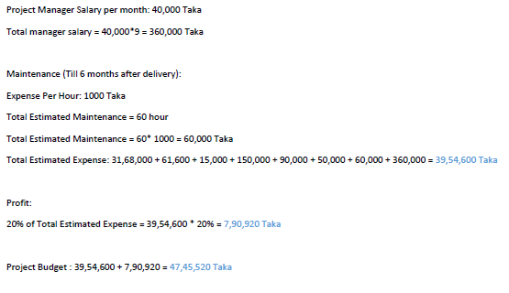
Constructive Cost Model
22

Slide 25
THANK’S

