Slide 1



CAPSTONE PROJECT
E-Commerce Sales Analysis
Presented By
SHAIK SALIMA
Tirumala Engineering College
Computer Science and engineering
Email ID: shaiksalima512@gmail.com

Slide 2
OUTLINE:
Problem Statement
Proposed System/Solution
System Development Approach
Algorithm & Deployment
Result
Conclusion
Future Scope
References

Slide 3
Problem Statement:
E-commerce companies generate a huge amount of transactional data from various products, customers, locations, and time periods. Analyzing this data manually can be difficult due to its large volume and complexity. Without proper data analysis and visualization tools, it becomes challenging for businesses to identify sales trends, understand customer purchasing behavior, and determine which products or categories perform the best. Additionally, businesses may struggle to track revenue, monitor order performance, and analyze regional sales distribution. This lack of clear insights can limit the ability of organizations to make data-driven decisions, optimize product strategies, and improve overall business performance.

Slide 4
Proposed Solution:
The proposed system aims to analyze e-commerce sales data to identify patterns, trends, and performance across different products, categories, customers, and locations. By using data analytics and visualization techniques, the system helps transform raw sales data into meaningful insights that support better business decision-making.
The solution will consist of the following components:
Data Collection: Historical e-commerce transaction data is collected, including details such as Order ID, Product Name, Category, Quantity, Price, City, Payment Method, Order Status, and Order Date.
Data Preprocessing: The dataset is prepared for analysis by cleaning the data, handling missing values, removing duplicate records, and ensuring correct data types for columns such as date, price, and quantity.
Data Analysis: The sales data is analyzed using Power BI and DAX measures to identify key business insights such as total revenue, total orders, top-selling products, category performance, and sales trends over time.
Data Visualization: Various charts and visualizations such as bar charts, line charts, pie charts, and maps are used to present sales insights clearly and effectively.
Dashboard Development: An interactive Power BI dashboard is developed that displays key performance indicators (KPIs) like total revenue, total orders, total quantity sold, and average order value. The dashboard allows users to filter data by category, location, and time period to gain deeper insights into sales performance.

Slide 5
System Approach:
The System Approach describes the overall method used to analyse sales data and generate meaningful insights.
System Requirements :
Hardware Requirements
Computer or Laptop ,
Minimum 8 GB RAM ,
Internet connection
Software Requirements
Microsoft Power BI Desktop
Microsoft Excel / CSV files (for dataset storage)
Windows Operating System
Tools and Technologies Used
Power BI Desktop – Used for data visualization, dashboard development, and interactive reporting.
DAX (Data Analysis Expressions) – Used to create calculated measures such as:
Total Revenue
Total Orders
Total Quantity
Average Order Value
Power Query – Used for data cleaning, preprocessing, and transformation

Slide 6
Algorithm & Deployment:
Step 1: Data Collection
Collect historical e-commerce sales data.
Dataset includes Order ID, Product Name, Category, Price, Quantity, City, Payment Method, and Order Date.
Step 2: Data Preprocessing
Clean the dataset by removing duplicate records.
Handle missing values and correct data formats.
Convert date, numeric, and categorical fields appropriately.
Step 3: Data Transformation
Create calculated columns such as Month and Year.
Use DAX measures like Total Revenue, Total Orders, and Total Quantity.
Step 4: Data Analysis
Analyze sales patterns and trends.
Identify top-selling products, category performance, and regional sales distribution.
Step 5: Data Visualization
Use charts such as bar charts, line charts, pie charts, and maps. Deployment of the Dashboard

Slide 7
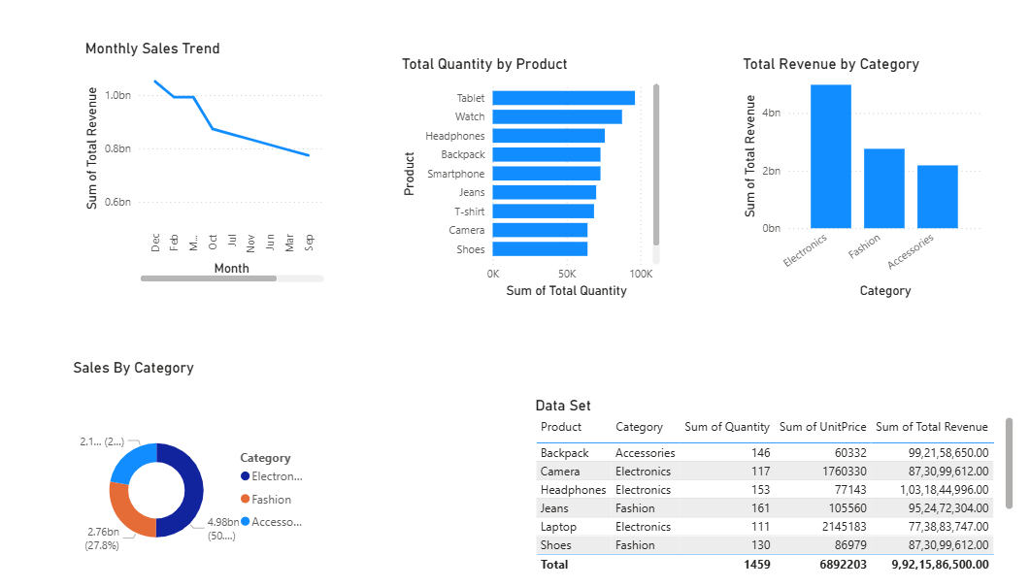
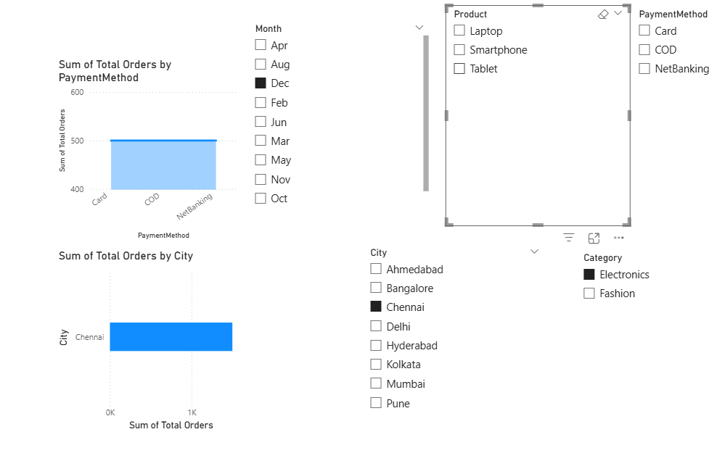
Result:
The e-commerce sales analysis successfully identified important trends and patterns in the dataset. The Power BI dashboard provides clear insights into sales performance across different products, categories, and locations. The analysis highlights key metrics such as total revenue, total orders, and total quantity sold. It also identifies top-performing products and shows sales trends over different time periods.
Various visualizations such as bar charts, line charts, pie charts, and maps help in clearly understanding business performance and sales distribution. The interactive dashboard allows users to explore the data using filters and gain deeper insights into product performance, regional sales, and customer purchasing behavior. Overall, the analysis helps businesses make better data-driven decisions.

Slide 8
Conclusion:
The e-commerce sales analysis successfully identified important trends and patterns in the dataset. The Power BI dashboard provides clear insights into sales performance across different products, categories, and locations. The analysis highlights key metrics such as total revenue, total orders, and total quantity sold. It also identifies top-performing products and shows sales trends over different time periods.

Slide 9
Future scope:
The current project provides useful insights into e-commerce sales performance using Power BI dashboards. In the future, the system can be enhanced with additional features to provide deeper analysis and better decision-making support.
Integrate real-time sales data to monitor business performance continuously.
Apply machine learning techniques to predict future sales trends and product demand.
Include customer behavior analysis to understand purchasing patterns and preferences.
Expand the dashboard to analyze profit margins, discounts, and inventory performance.
Deploy the dashboard on Power BI Service for easy access and sharing within organizations.

Slide 10
References:
Data Science and Predictive Analytics – Ivo D. Dinov, Springer Publications
Research articles on sales data analysis and forecasting techniques.
Online tutorials and learning platforms.
Data Analysis and Visualization Concepts
https://powerbi.microsoft.com
GitHub Link: Link

Slide 11
Thank You

