Slide 1
SPYDER

Slide 2
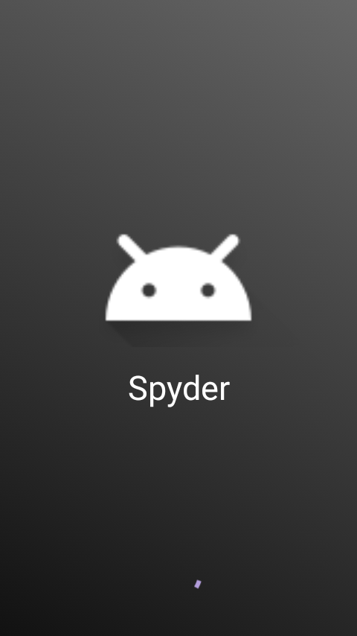
Splash screen of application.

Slide 3
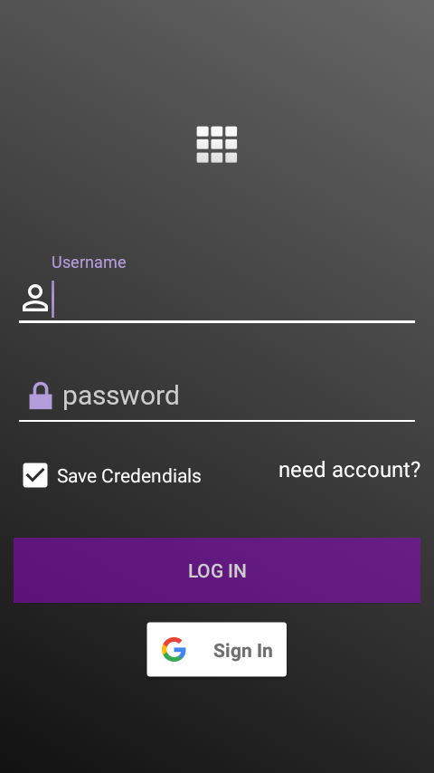
User sign-in screen.
He/she can login using email-password or use simple googleplus sign-in
Save credentials is provided so that user need not to enter credentials every time he opens the app
If the user don’t have account he can click on need account? and get an account to login

Slide 4
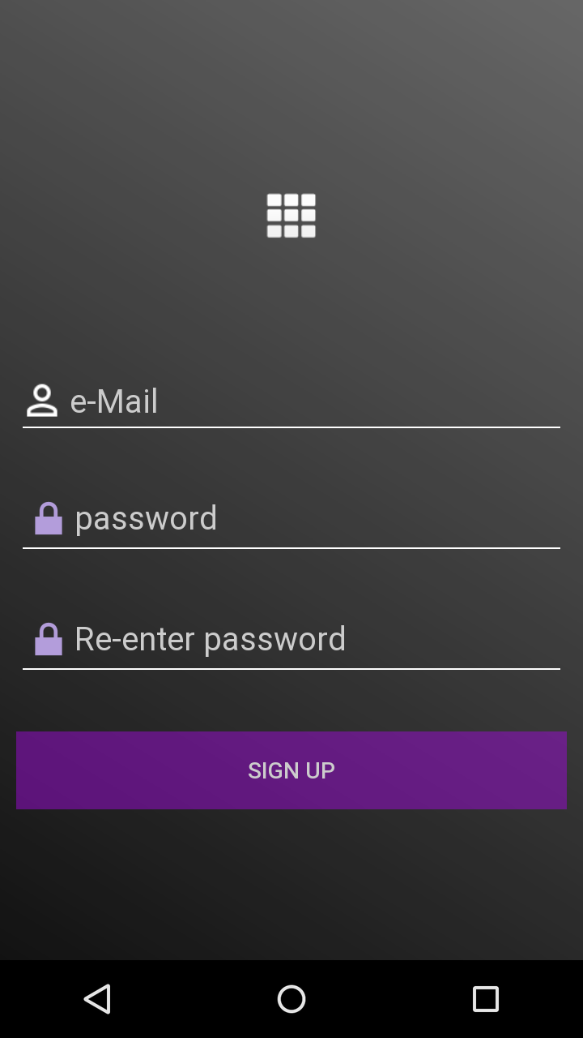
Enter a mail id and password and get an account to login

Slide 5
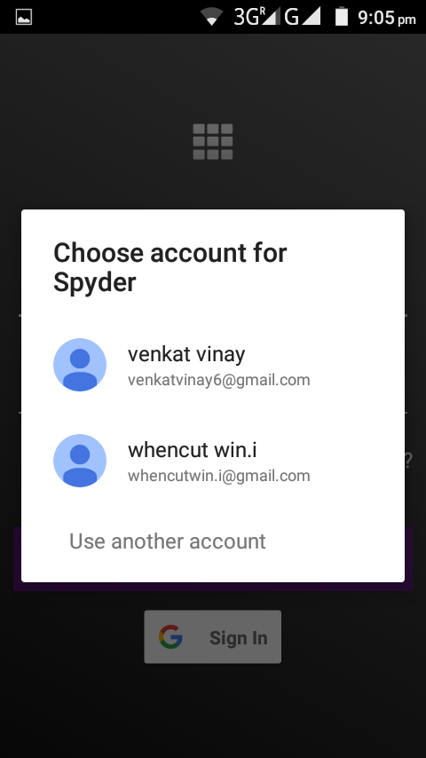
Using google-plus signIn

Slide 6
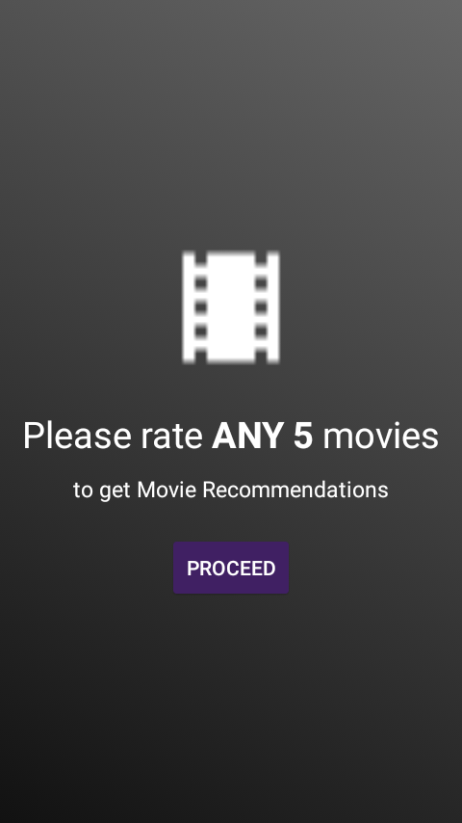
Next you will be asked to rate any 5 movies to get
recomendations

Slide 7
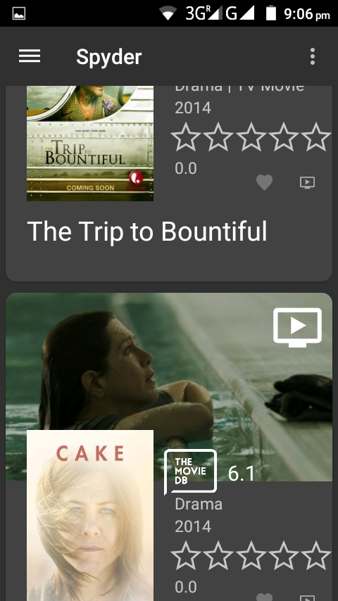
User can add a movie to favourites or watch later using the buttons provided
You can rate any 5 movies
from the list of provided movies. You can also swipe to refresh the list
Click on the trailer icon
to watch trailer

Slide 8
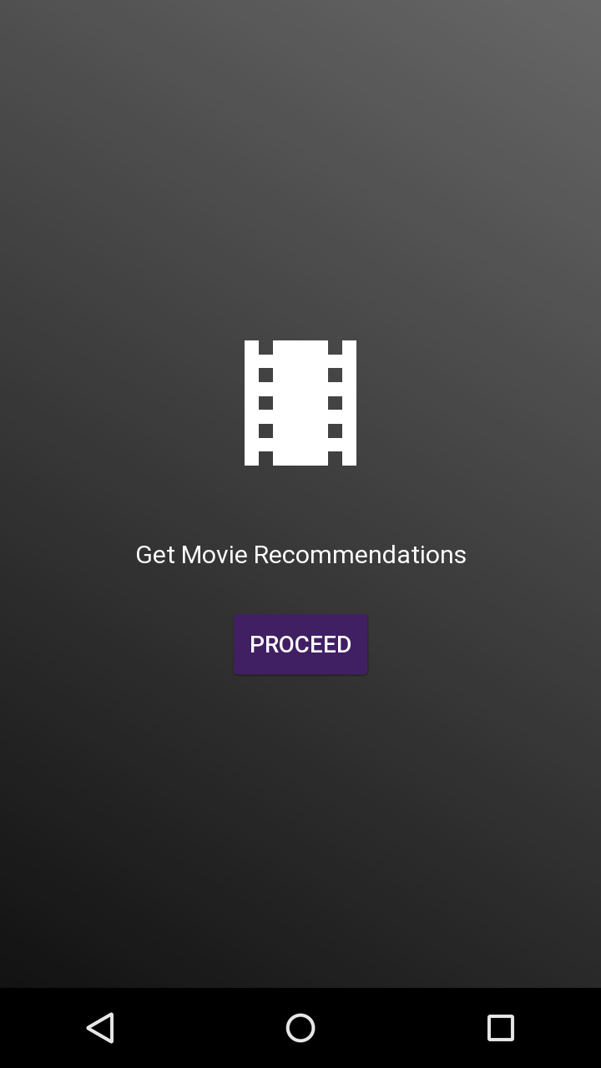
After the user provides 5 movie ratings he will be asked to get the recommended movies

Slide 9
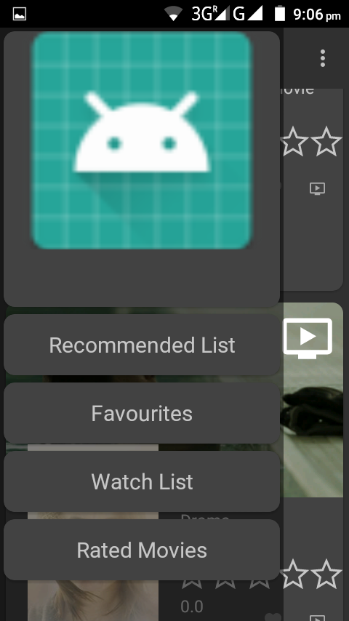
Use the drawer to switch between lists.

Slide 10
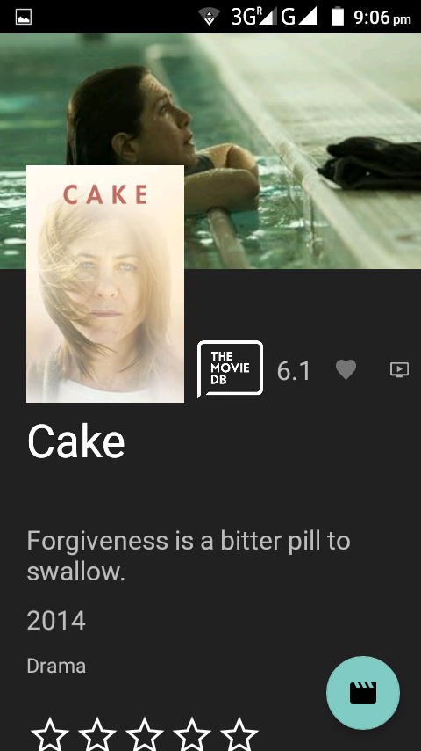
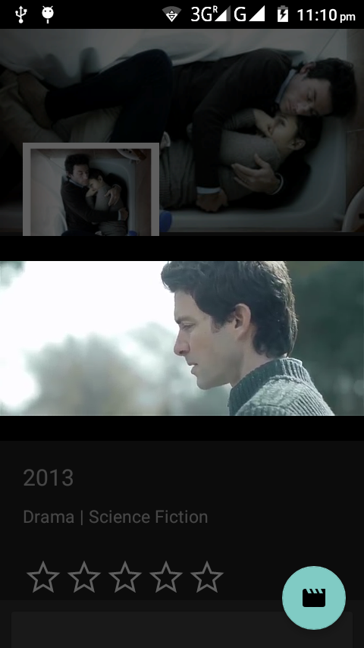

Slide 11
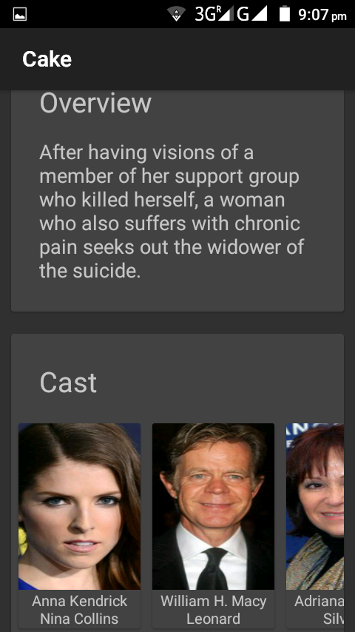
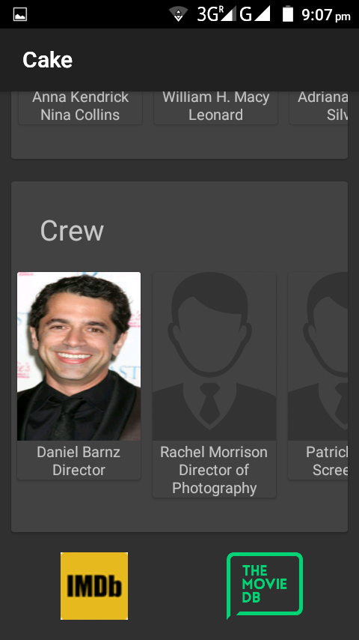
To view a particular cast details click on the image
User can also view movie on external sites like Imdb and Tmdb

Slide 12
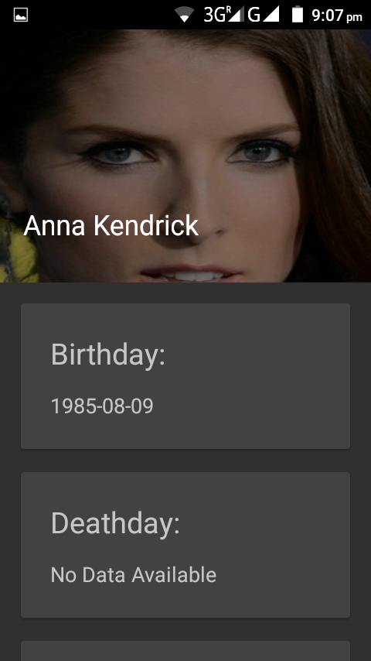
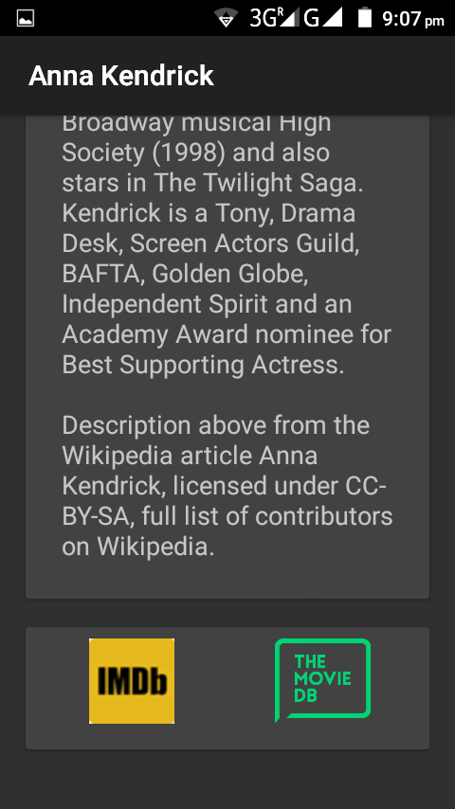

Slide 13
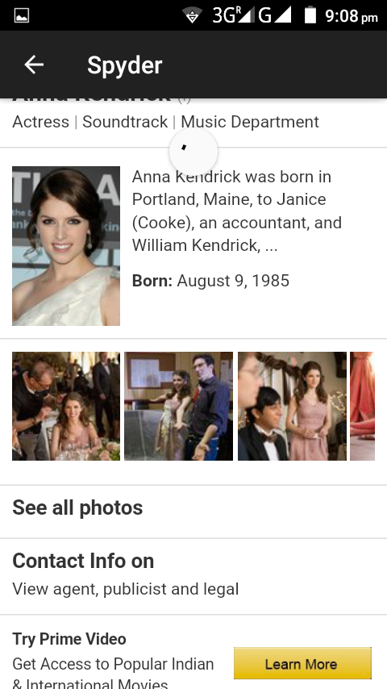
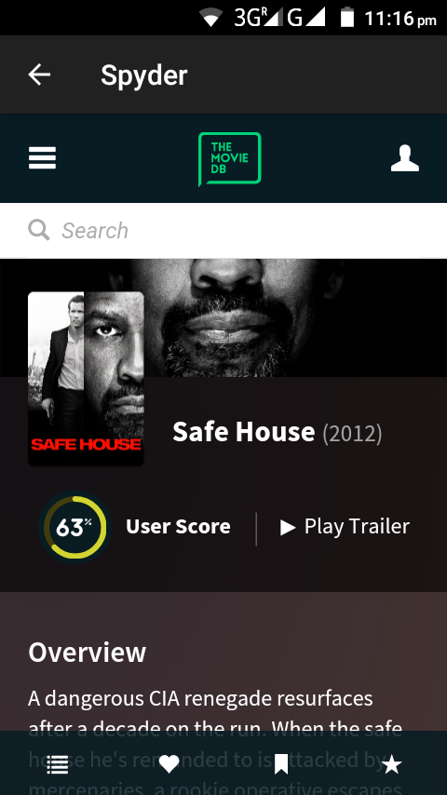

Slide 14
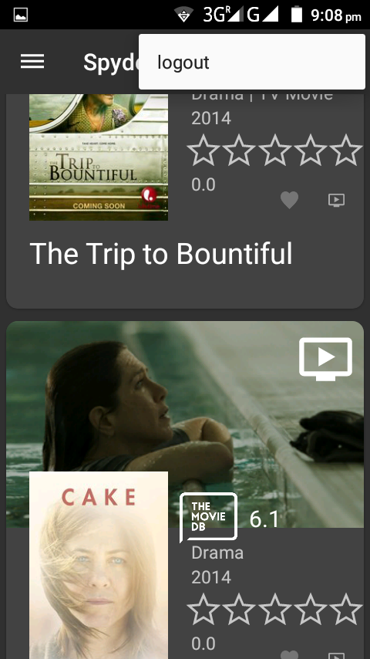
User can log out using the
Logout option provided in menu options.

