Slide 1

SALIM ABDULKAREEM
ABOUT ME

Slide 2


WORK EXPERIENCES
IT Support
Junior Network Engineer
IT Technicians
Service Desk Analyst

Slide 3


EDUCATION
  Masters in Computer Networking
  Administration and Management
  Computer Sciences Engineering
  Amazon Sysops Certified

Slide 4


SKILLS AND TOOLS
  VPC
  Cloud Formation
  IAM
  S3
  Terraform
  Active Directory
  Remote Support
  TCP,DNS and DHCP
  Route 53
  Monitoring

Slide 5

Skills I Gained from Work Experiences
Team player
Troubleshooting Skills
Good Interpersonal Skills
Flexible
Reliable
Hardworking
Used to stressful Environment
Remain Calm Under Pressure
Communicate Effectively
Fast Learner

Slide 6
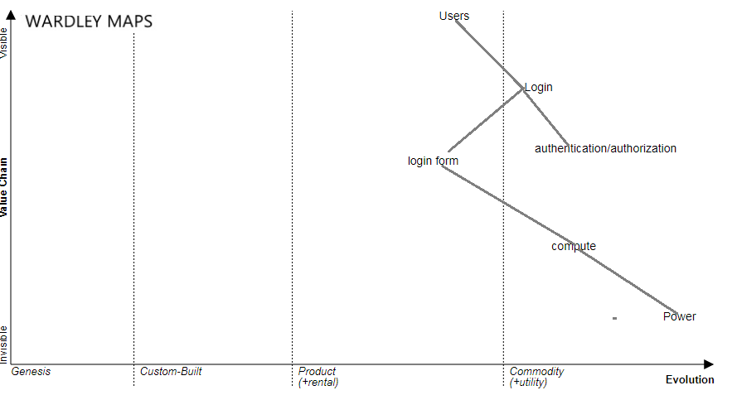
WARDLEY MAP

Slide 7

Contact Info
Email Address
salimabdulkareem@Hotmail.co.uk
Telephone Number
07722227688
LinkedIn
https://www.linkedin.com/in/salim-abdulkareem-293a10b5/

