Slide 1
Identifying Student Learning Patterns in Mathematics E-Learning Platform
A Data Mining Approach
EC 9560-DATA MINING
PROJECT BY :
HULANGAMUWA R.R.W.G.B.S.C
2020E054
11th NOV 2024

Slide 2
Introduction
Analyze student performance and answering patterns in mathematics.
Identify distinct learning behaviors through clustering analysis.
Utilize a dataset of 9,546 student responses to various mathematical questions.
Uncover student groups that may need additional support or tailored instructional strategies.
Provide insights to enhance teaching methods and improve educational outcomes in mathematics.

Slide 3
Project Objective
Identify distinct groups of students based on their performance and answering patterns in mathematics topics for understanding different learning behaviors and identifying groups that may need additional support or different instructional strategies.

Slide 4
Methodology
Data Selection
Data Integration
Data Preprocessing
Feature Selection
Data Clustering
Cluster Interpretation
Validation & Visualization

Slide 5
Dataset Characteristics
9,546 Student Records
8 Key Features
Multiple Learning Indicators
Variable Name | Role | Type | Description | Units | Missing Values
Student ID | Feature | Integer |  |  | no
Student Country | Feature | Categorical |  |  | no
Question ID | Feature | Integer |  |  | no
Type of Answer | Feature | Binary |  |  | no
Question Level | Feature | Categorical |  |  | no
Topic | Feature | Categorical |  |  | no
Subtopic | Feature | Categorical |  |  | no
Keywords | Feature | Categorical |  |  | no

Slide 6
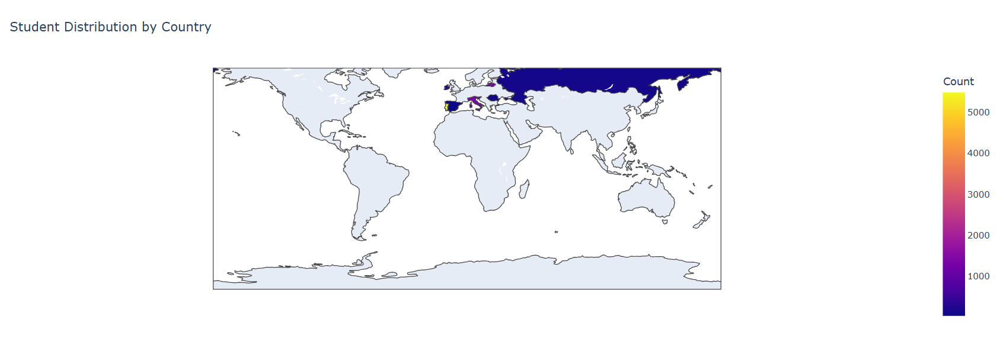
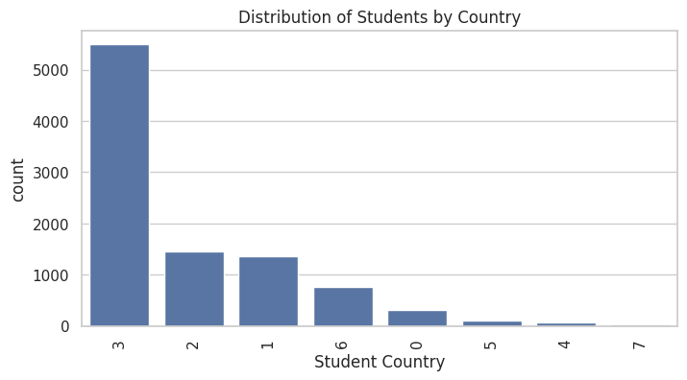
Data Visualization
Visualize the distribution of students by country

Slide 7
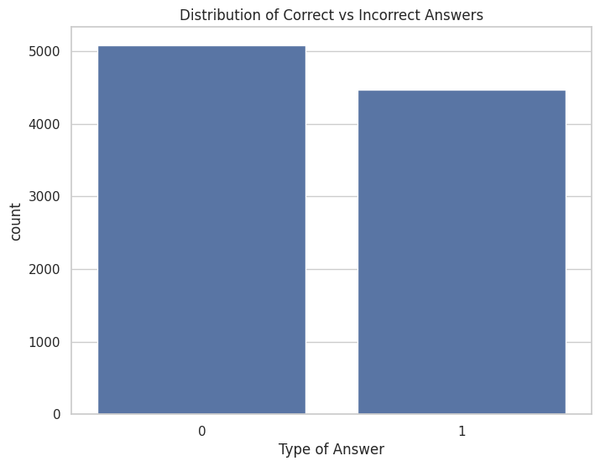
Data Visualization
Visualize the distribution of Correct vs Incorrect Answers

Slide 8
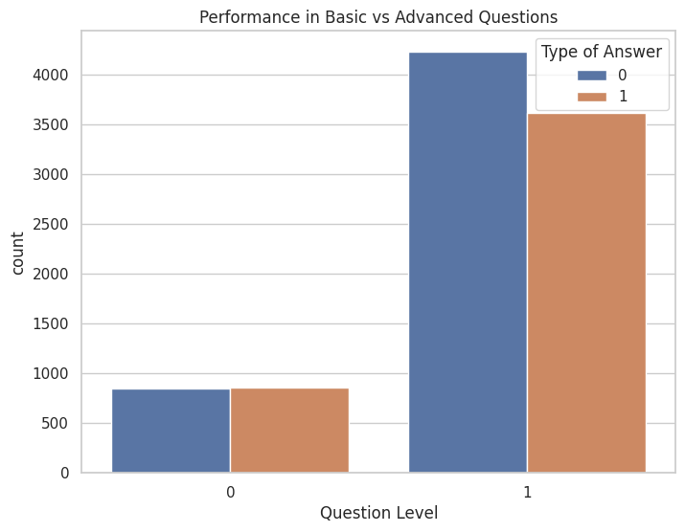
Data Visualization
Visualize the Performance in Basic vs Advanced Questions

Slide 9
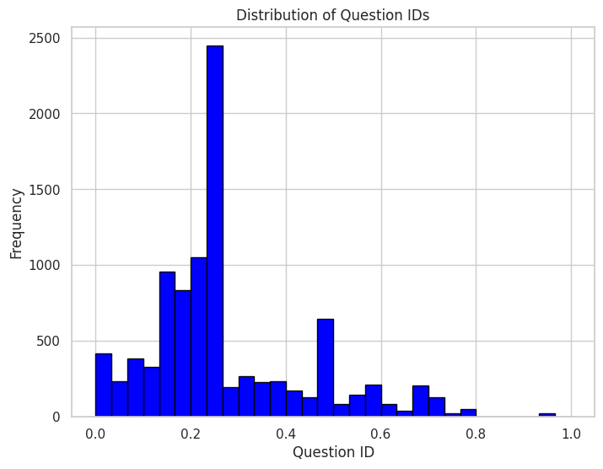
Distribution Analysis
Distribution of Question IDs

Slide 10
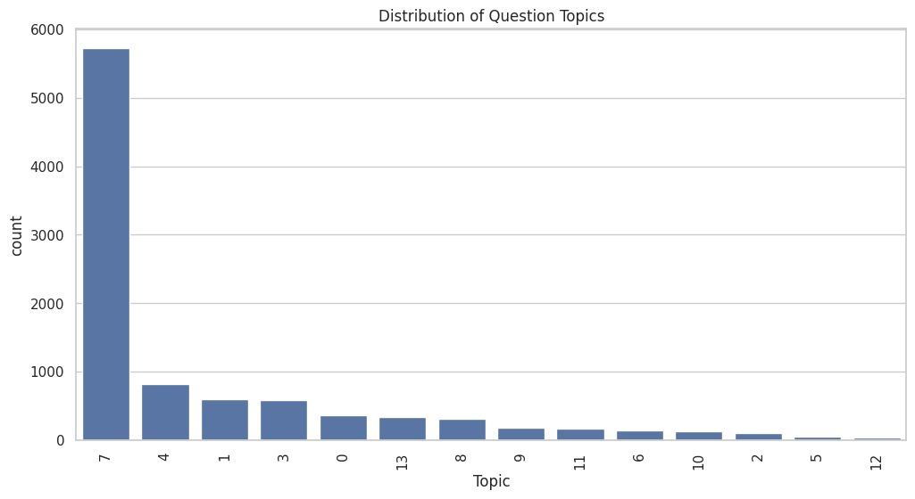
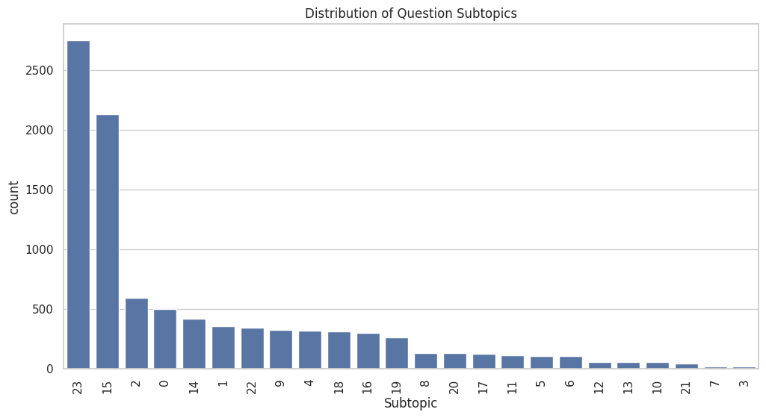
Distribution Analysis
Distribution of Question Topics and Subtopics

Slide 11
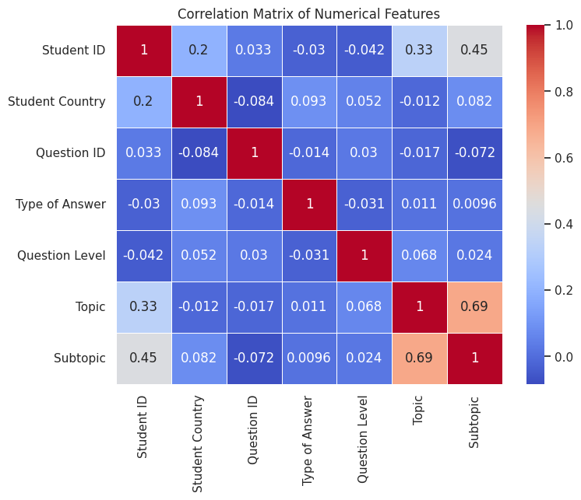
Correlation Analysis
Correlation Matrix of Numerical Features

Slide 12
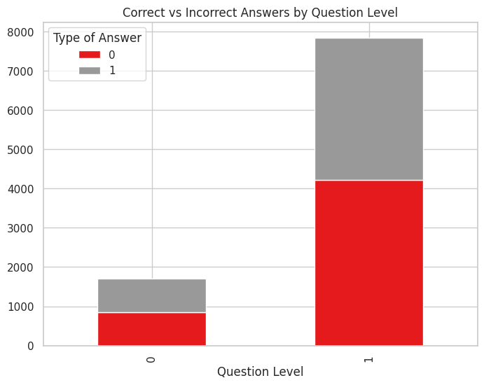

Correlation Analysis
Correct vs Incorrect Answers by Question Level

Slide 13
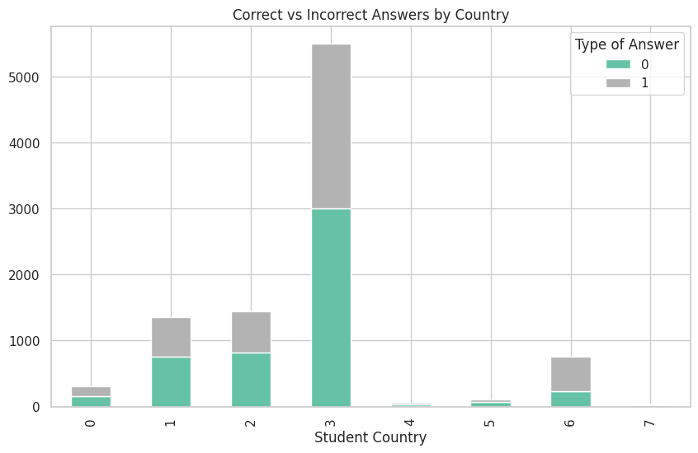
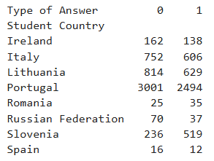
Correlation Analysis
Correct vs Incorrect Answers by Country

Slide 14
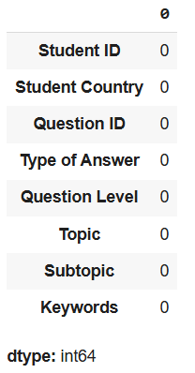
Data Preprocessing
Handling Missing Values: Remove duplicates

Slide 15
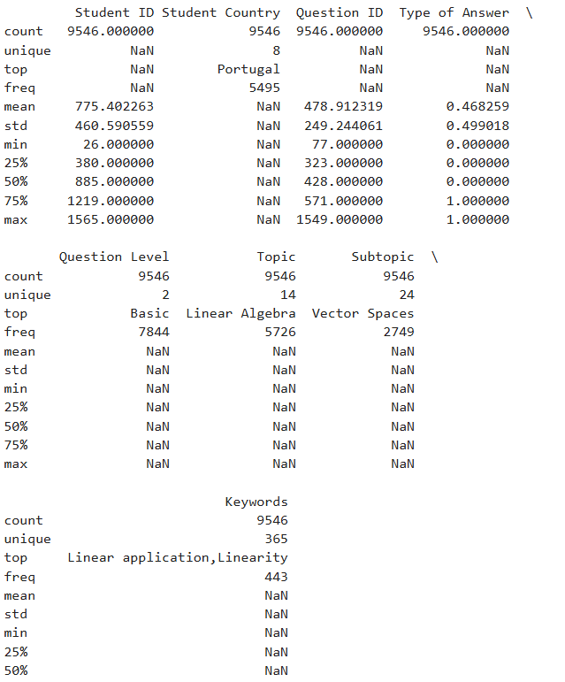
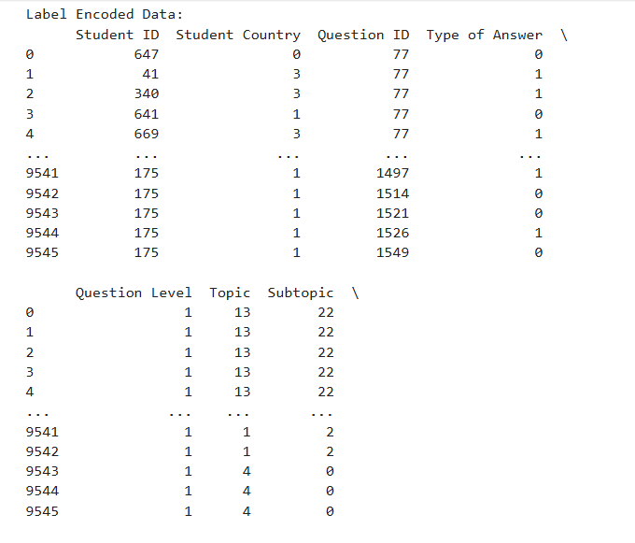
Data Preprocessing
Encoding: Convert categorical data into numerical format.

Slide 16
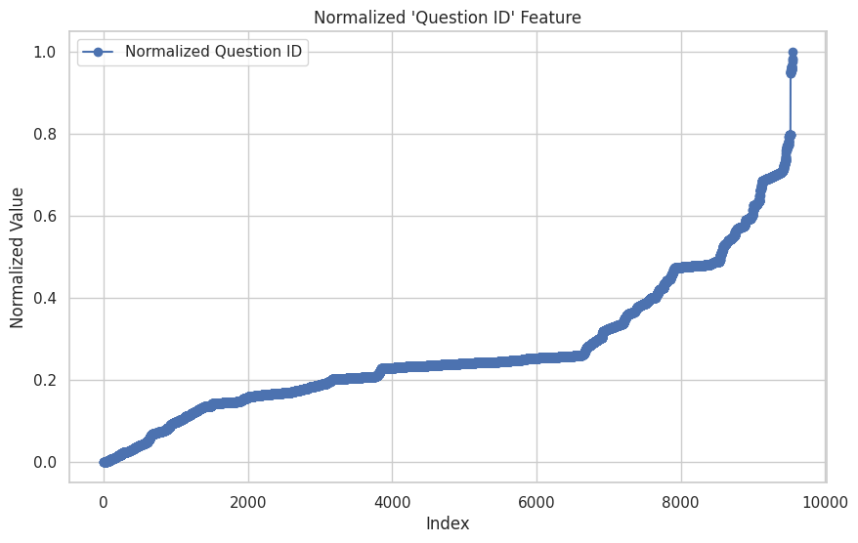
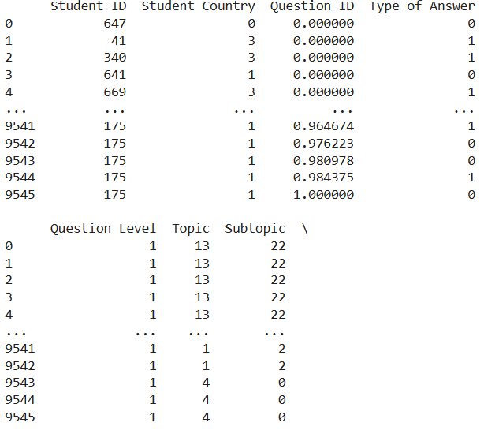
Data Preprocessing
Normalization : Scale data for consistent analysis

Slide 17
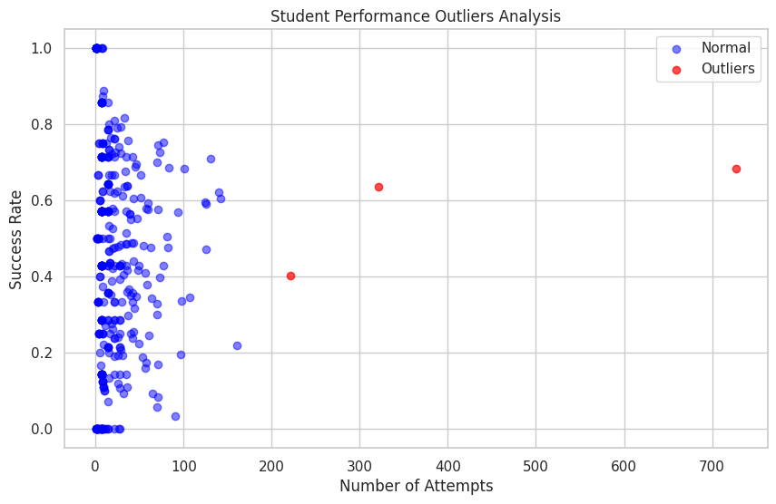
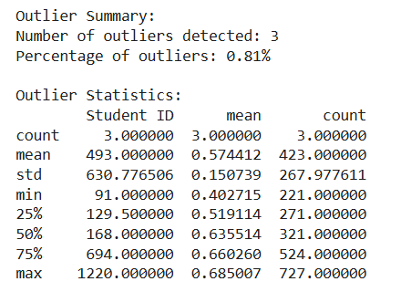
Data Preprocessing
Handle Outliers : Identifying noise data

Slide 18
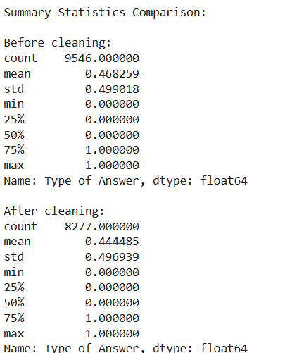
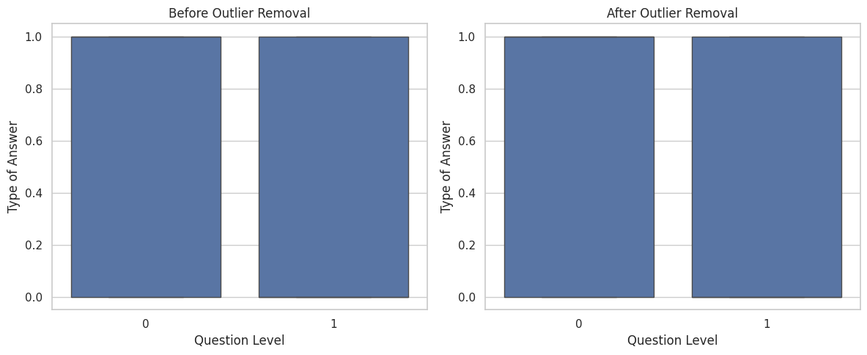
Data Preprocessing

Slide 19
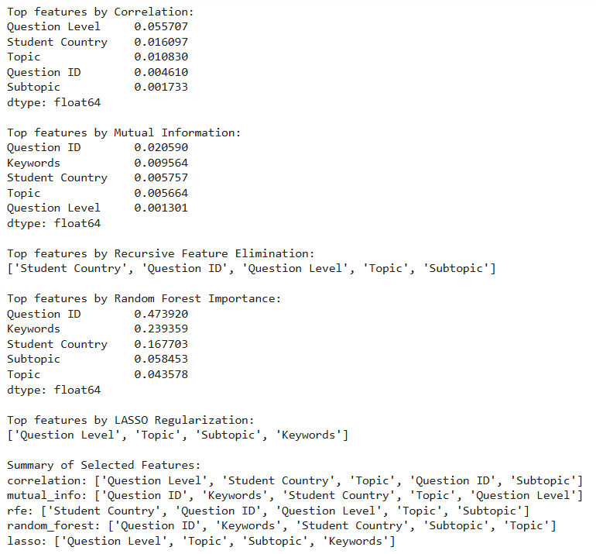
Feature Selection and Test

Slide 20
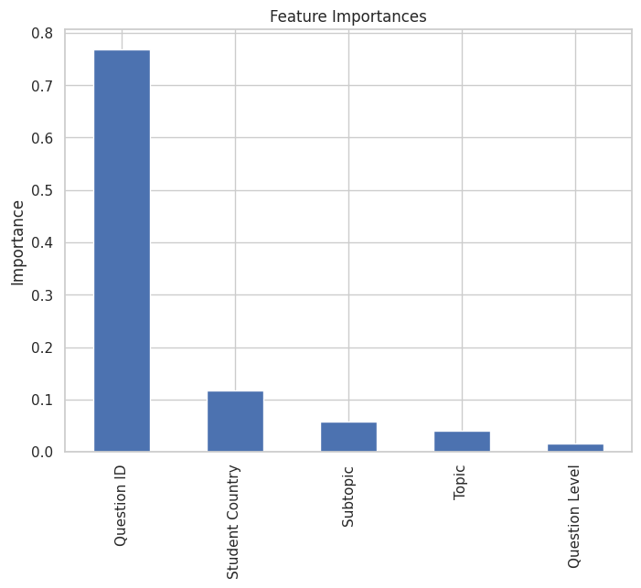
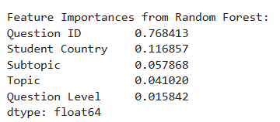
Feature Importance

Slide 21
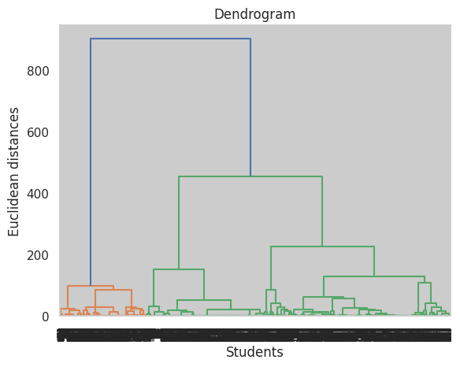
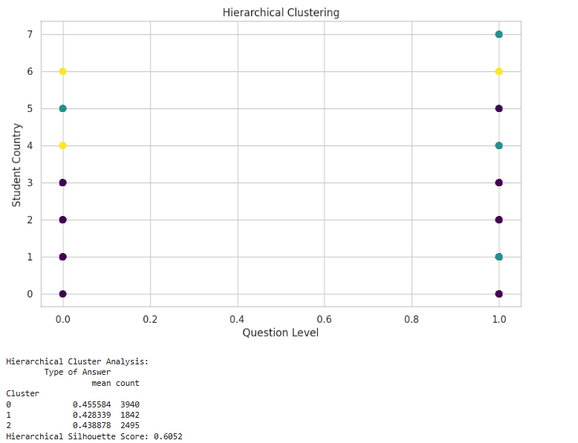
Hierarchical Clustering

Slide 22
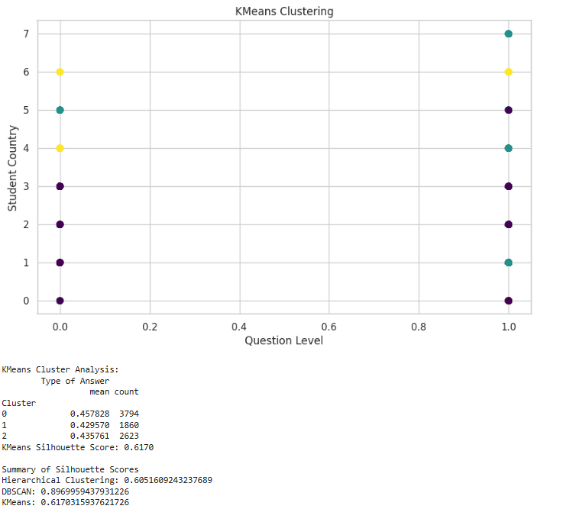
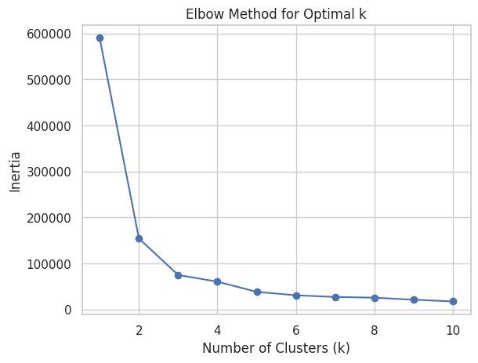
K Means Clustering

Slide 23
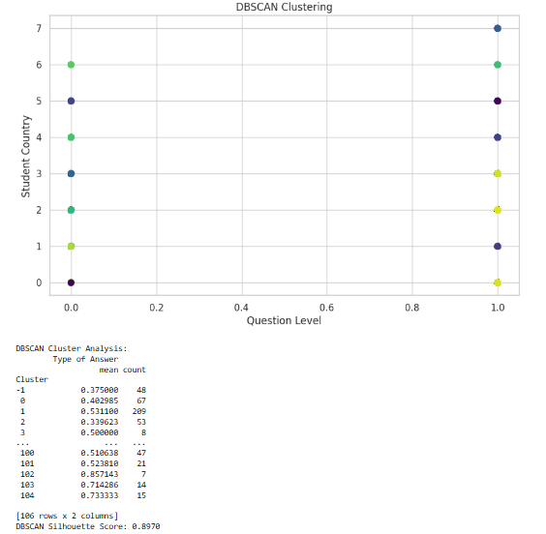
DBSCAN Clustering

Slide 24
The Best Model
Based on the Silhouette Scores, which measure how well-separated and cohesive the clusters are, the DBSCAN model performs the best with a score of 0.897, indicating well-separated and distinct clusters. In comparison, KMeans (0.617) and Hierarchical Clustering (0.605) show lower scores, suggesting that the clusters formed by these models are less distinct. Therefore, DBSCAN is the preferred model for clustering in this case.

Slide 25
Conclusion
This project has demonstrated the power of data mining in uncovering valuable insights into student learning patterns on a mathematics e-learning platform. These findings can guide more effective instructional strategies and provide targeted support, making learning experiences more personalized and impactful.

