Slide 1


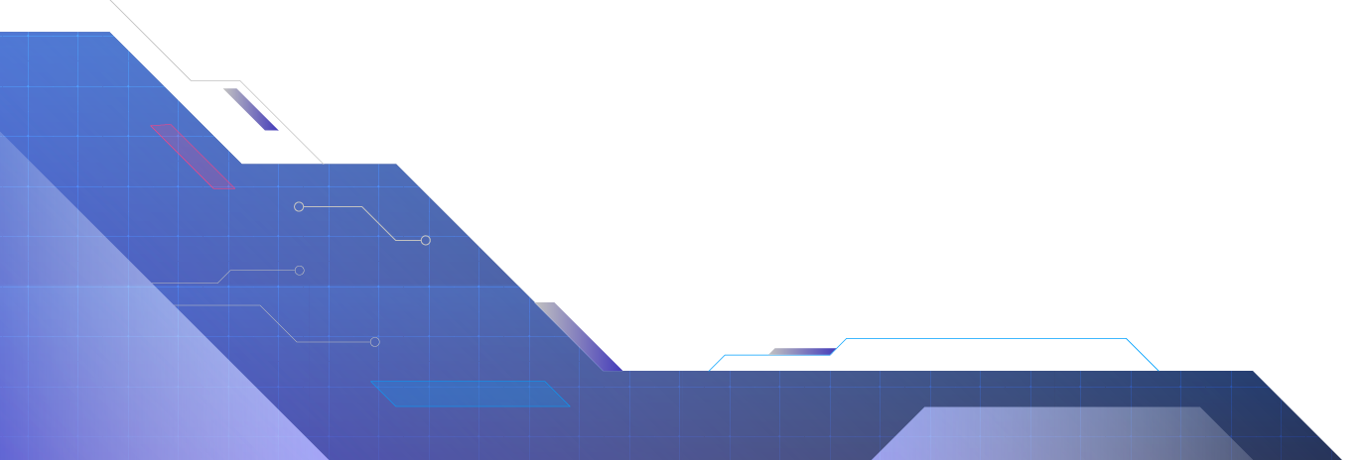
UNDERACTUATED MOTION PLANNING AND CONTROL FOR JUMPING WITH
WHEELED-BIPEDAL ROBOT
Bassam ElSaadani 222440
Salma Farid 197607
Islam Ibrahim 223475

Slide 2
INHALTSVERZEICHNIS
01
03
INTRODUCTION AND BACKGROUND
MATHEMATICAL MOTION PLANNING
05
SIMULATION, ANALYSIS, AND CONCLUSION
02
04
TRACKING CONTROL AND ROBUSTNESS
STANCE AND FLIGHT PLANNING

Slide 3
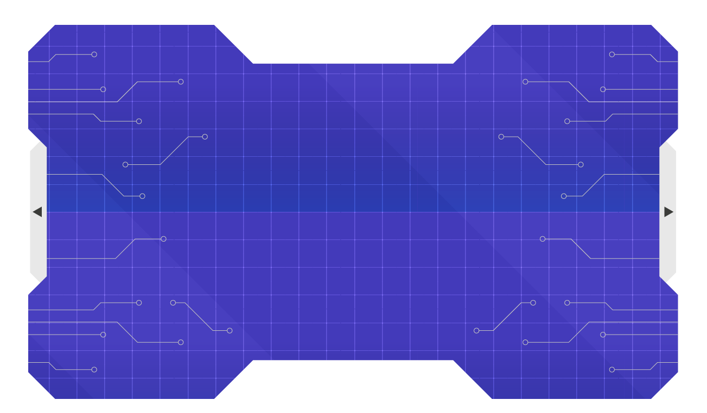
01
INTRODUCTION AND BACKGROUND

Slide 4
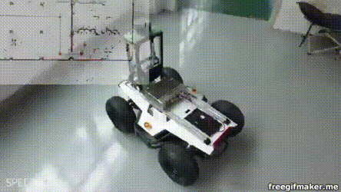
Introduction
In the field of robotics, the most common form of locomotion is through wheeled robots. Using motorized wheels, they offer:
Efficient
High-speed movement
High payload-to-weight capacity.
However, they are extremely constrained by the terrain, gaps or obstacles larger than the wheel radius can completely halt the robot’s movement

Slide 5
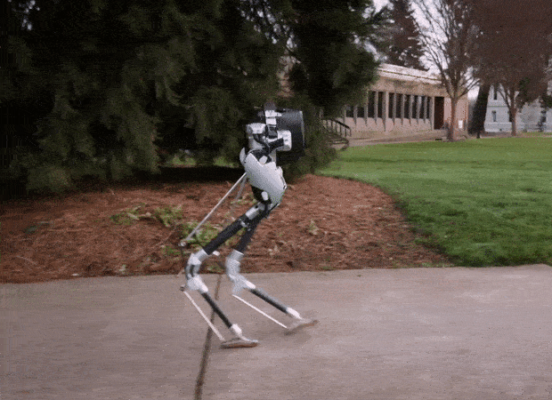
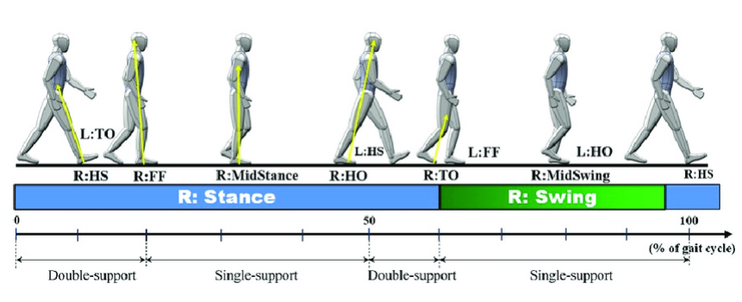
Introduction
Another form of locomotion is using bipedal robots. They are robots designed to move on two legs, mimicking human motion which offers the ability of dealing with sophisticated and complex terrains.
Despite their promises, they come with drawbacks such as:
Slow rugged movement
Extremely high energy consumption

Slide 6
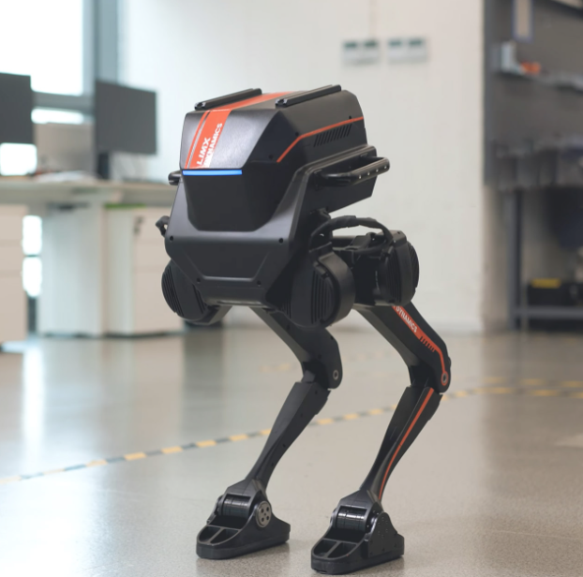

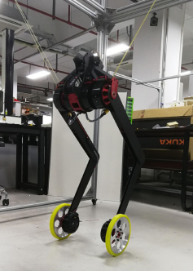

Wheeled-Bipedal
Bipedal Robots
Wheeled Robots
Wheeled-Bipedal
Strengths: Highly agile, negotiates rough terrain and stairs.
Weaknesses: Low energy efficiency, computationally expensive to balance.
Strengths: High energy efficiency, fast on flat terrain.
Weaknesses: Completely blocked by obstacles larger than the wheel radius.
The Promise: Unifies bipedal agility with wheeled efficiency. Capable of jumping over massive gaps and obstacles.
The Dilemma: Severe control complexity. The system is inherently unstable and heavily underactuated.

Slide 7
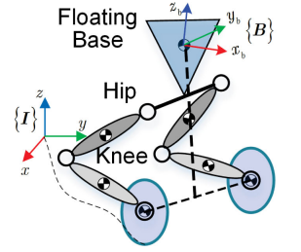
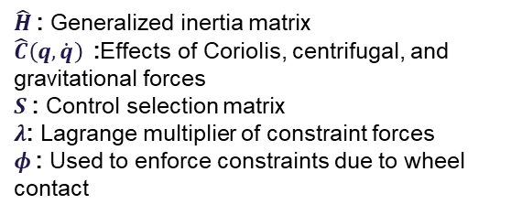

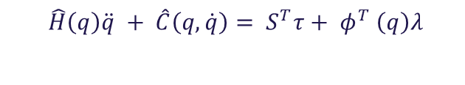
The Challenge of Jumping
The research focuses on jumping with wheeled-bipedal robots. A motion that fully exploits the hybrid design allowing to overcome challenging terrains while maintaining energy efficiency.
The Issue:
Complex Mathematical Model due to sudden transitions between different dynamics when jumping
The robot is underactuated, leading to unstable stance dynamics
Nonlinearity of stance phase dynamics
$$\hat{H}\left(q\right)\ddot{q} + \hat{C}\left(q, \dot{q}\right)= S^{T}τ+ φ^{T} \left(q\right)λ$$
$$φ(q)\ddot{q} = 0$$
$\hat{H}$: Generalized inertia matrix
$\hat{C}\left(q, \dot{q}\right)$:Effects of Coriolis, centrifugal, and gravitational forces
$S$: Control selection matrix
$λ$: Lagrange multiplier of constraint forces
$φ$: Used to enforce constraints due to wheel contact

Slide 8
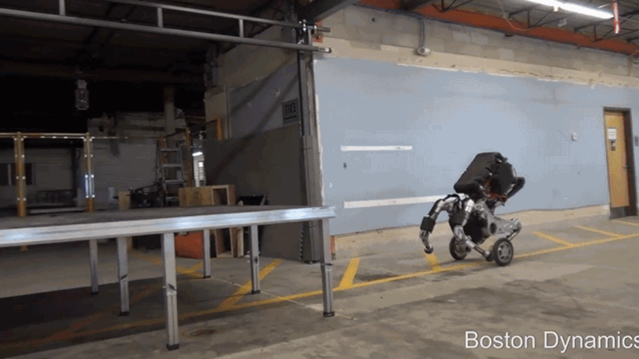
The Challenge of Jumping
To solve this challenge, hierarchical planning and control framework is proposed
Consisting of four main parts:
Stance phase planning
Flight phase planning
Stance phase control
Flight phase control
For both planning phases, a Wheeled-Spring-Loaded-Inverted-Pendulum (WSLIP) model is adopted. It adds a wheel with mass to the standard SLIP template, allowing the math to account for the unique way wheels affect balance during a jump.

Slide 9
Terminology used
T-WIP Model (two-wheeled inverted pendulum)
SLIP Model (Spring-Loaded Inverted Pendulum)
It describes a robot with a central body balanced atop two wheels on a single axis. It is an underactuated system: the robot must constantly roll its wheels forward or backward just to stay upright, essentially using movement to fight gravity.
A classic mathematical template that represents a legged robot as a single point of mass sitting on top of a spring. It is the foundation for almost all legged jumping research.
W-SLIP Model (Wheeled-SLIP)
A "novel" model created for this research. It adds a wheel with mass to the standard SLIP template, allowing the math to account for the unique way wheels affect balance during a jump.

Slide 10
Background Mathematical concepts
Differential Flatness
Linear Quadratic Regulator (LQR)
A mathematical property where a complex, complex, non-linear set of equations can be simplified into a linear form.
A classic control algorithm used to keep systems stable, such as maintaining the upright balance of a wheeled robot.
Quadratic Programming (QP)
Disturbance Observer (DOB)
A type of mathematical optimization used to find the optimal trajectory for a robot while respecting physical limits (like motor strength).
Mathematically compares how a robot is supposed to move with how it moves. It estimates external forces, like a push or friction, and tells the motors to cancel them out.

Slide 11
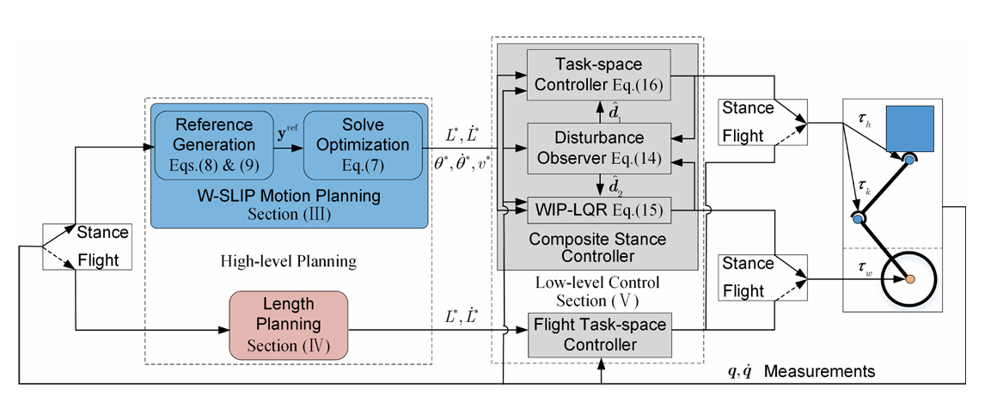
Planning and control architecture
High-Level Planning:
Operates at 25 Hz to calculate the optimal mathematical trajectory for the jump.
Abstracts the robot into simplified template models.
Calculates broad reference trajectories for Stance and Flight.
Calculates Ideal angles and velocities.
Low-Level Control:
Operates at 500Hz to command the physical actuators and react to disturbances.
Receives ideal trajectories.
Uses composite whole-body models to react to physical forces.
Calculates motor torques required.

Slide 12
02
STANCE AND FLIGHT PLANNING

Slide 13
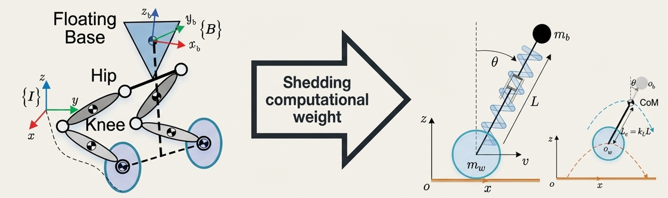
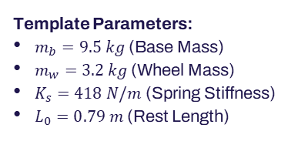
The W-Slip Model
Abstraction:
SLIP Foundation: Leverages the classic Spring-Loaded Inverted Pendulum used to model human and bipedal running.
The Novel Addition: Attaching a wheel with non-zero mass to the base of the pendulum. This captures the essential underactuated jumping dynamics while drastically reducing the variables the 25Hz planner must process.
Template Parameters:
$m_{b}=9.5 kg$ (Base Mass)
$m_{w}=3.2 kg$ (Wheel Mass)
$K_{s}=418 N/m$ (Spring Stiffness)
$L_{0}=0.79 m$ (Rest Length)

Slide 14
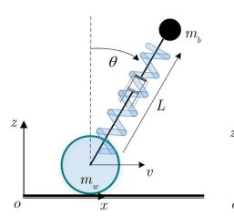
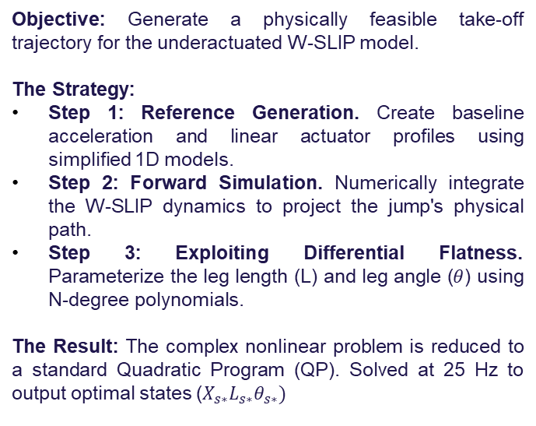
Stance Phase Planning
Objective: Generate a physically feasible take-off trajectory for the underactuated W-SLIP model.
The Strategy:
Step 1: Reference Generation. Create baseline acceleration and linear actuator profiles using simplified 1D models.
Step 2: Forward Simulation. Numerically integrate the W-SLIP dynamics to project the jump's physical path.
Step 3: Exploiting Differential Flatness. Parameterize the leg length (L) and leg angle ($θ$) using N-degree polynomials.
The Result: The complex nonlinear problem is reduced to a standard Quadratic Program (QP). Solved at 25 Hz to output optimal states ($X_{s∗}L_{s∗}θ_{s∗})$

Slide 15

Stance Phase Planning
Integrates the non-linear dynamics using the generated inputs
Projects the physical path of the impending jump
Fits the resulting trajectory with n-degree polynomial
Solves using quadratic programming to output the optimal flat variables
Reference Generation
Forward Simulation
Polynomial fitting
Generates forward acceleration using a double integration model.
Generates linear actuator displacement using a 1D spring-mass model
System Output:
$$X_{s∗}L_{s∗}θ_{s∗}$$

Slide 16
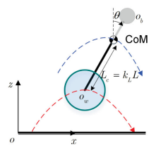
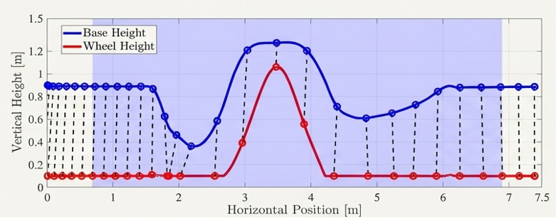
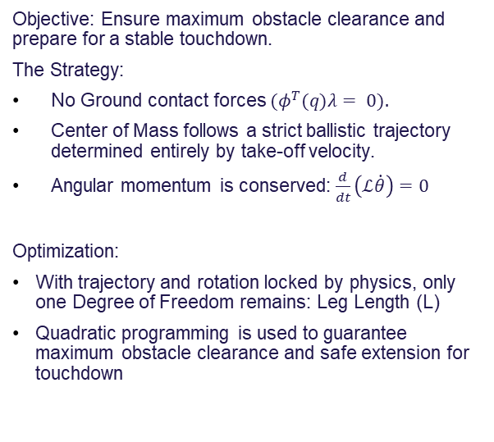
Flight Phase Planning
Objective: Ensure maximum obstacle clearance and prepare for a stable touchdown.
The Strategy:
No Ground contact forces $(φ^{T}(q)λ= 0).$
Center of Mass follows a strict ballistic trajectory determined entirely by take-off velocity.
Angular momentum is conserved: $\frac{d}{dt}\left(ℒ\dot{θ}\right)=0$
Optimization:
With trajectory and rotation locked by physics, only one Degree of Freedom remains: Leg Length (L)
Quadratic programming is used to guarantee maximum obstacle clearance and safe extension for touchdown

Slide 17
03
MATHEMATICAL MOTION PLANNING

Slide 18
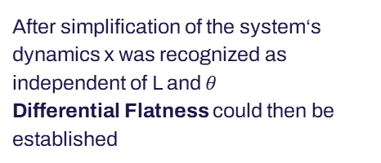
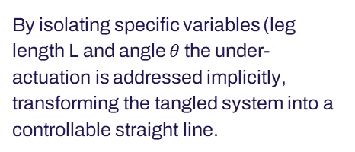
Underactuated W-SLIP Model
01
02
03
Main Problem
Solution
Differential Flatness
Dynamics are non-linear and complex, resulting in a computationally heavy number of variables
After simplification of the system‘s dynamics x was recognized as independent of L and $θ$
Differential Flatness could then be established
By isolating specific variables (leg length L and angle $θ$the under-actuation is addressed implicitly, transforming the tangled system into a controllable straight line.

Slide 19
Motion Planning
Numerical Integration
Optimization
Inputs like acceleration and linear actuator displacement are fed into numerical integration to create reference trajectories
A Quadratic Programming (QP) solver generates the final optimal trajectory by solving a problem with only ~30 variables
Efficiency
This reduces the complex problem enough to be solved efficiently online at 25Hz

Slide 20
04
TRACKING CONTROL AND ROBUSTNESS

Slide 21
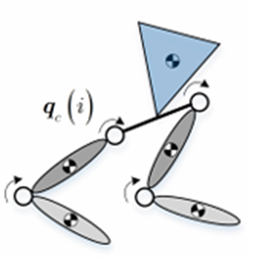
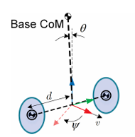
Composite Tracking Controller
Strategy
Physically decouple the mathematical model of the body to handle underactuated wheels
Upper Body | Lower Body
A Task-Space (PD) Controller drives the fully actuated hips and knees | A Time-Varying Linear Quadratic Regulator (TV-LQR) handles the unstable wheels

Slide 22
Handling the Unknown with Disturbance Observers (DOB)
The issue with composite controllers
The solution
Splitting the controllers creates unmodeled "coupling forces" between the upper and lower body
Instead of perfectly modeling these complex connections, Disturbance Observers (DOB) estimate them in real-time and inject corrective torque to cancel them out.

Slide 23
05
VALIDATION, SIMULATION, AND ANALYSIS

Slide 24
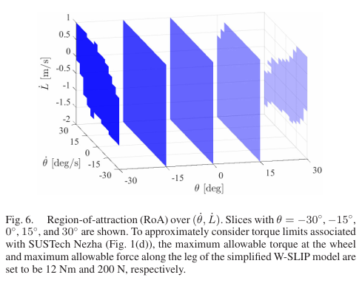
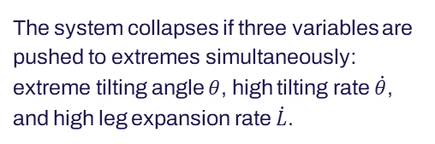
The Region of Attraction
Robustness
The planner is robust across a wide state space but limited by hardware constraints like a 12 Nm wheel torque and 200 N leg force.
Failure Conditions
The system collapses if three variables are pushed to extremes simultaneously: extreme tilting angle $θ$, high tilting rate $\dot{θ}$, and high leg expansion rate $\dot{L}$.

Slide 25
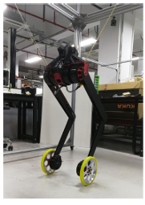
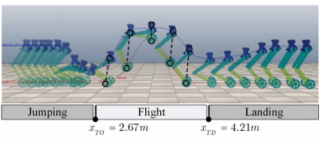
Validation in Simulation
V-REP simulation utilizing the 12.7 kg SUSTech Nezha prototype.
Capabilities Demonstrated:
Varied apex heights (0.8m to 1.4m).
Forward velocities (0.5m/s to 1.5m/s).
Landing on slopes with up to 5° inclination.

Slide 26
Critical Analysis
Strengths | Limitations
Strategic simplification via W-SLIP | The model is purely 2D (sagittal plane) and ignores 3D lateral stability
Effective controller decoupling | Simulations ignore energy absorption from soft or uneven real-world terrain
Error reduction using DOBs

Slide 27
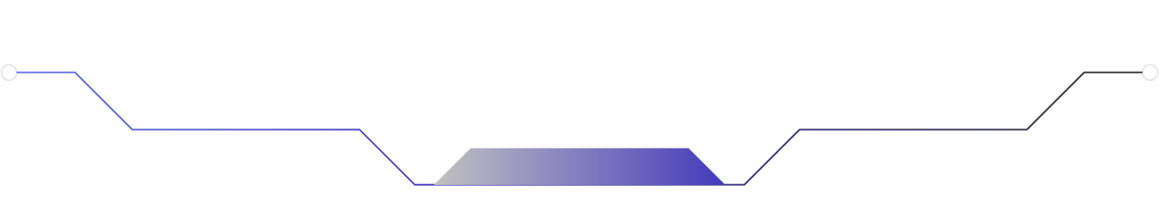


Conclusion
By abstracting hardware into a template, untangling the math, and treating reality as a disturbance, the authors provide a robust blueprint for the future of agile wheeled-bipedal robotics.

Slide 28
Thank You!

