Slide 1

ANJUMAN INSTITUTE OF TECHNOLOGY AND MANAGEMENT
Basic Electronics (BBEE203)
Mini Project Seminar on
ULTRA-SONIC WATER LEVEL SENSOR AND CONTROLLER
Presented by
Salsabeel Kobattey
Shayan Ahmed
Nawwaf Peshmam
Ruwaif Fakardey
Under the Guidance of
Prof. Shrishail Bhat
Assitant Professor, Dept. of ECE, AITM

Slide 2
CONTENTS
Introduction
Objectives
Methodology
Components Details
Implementation
Results and Discussion
Conclusion
Scope for Future Work

Slide 3
INTRODUCTION

Slide 4
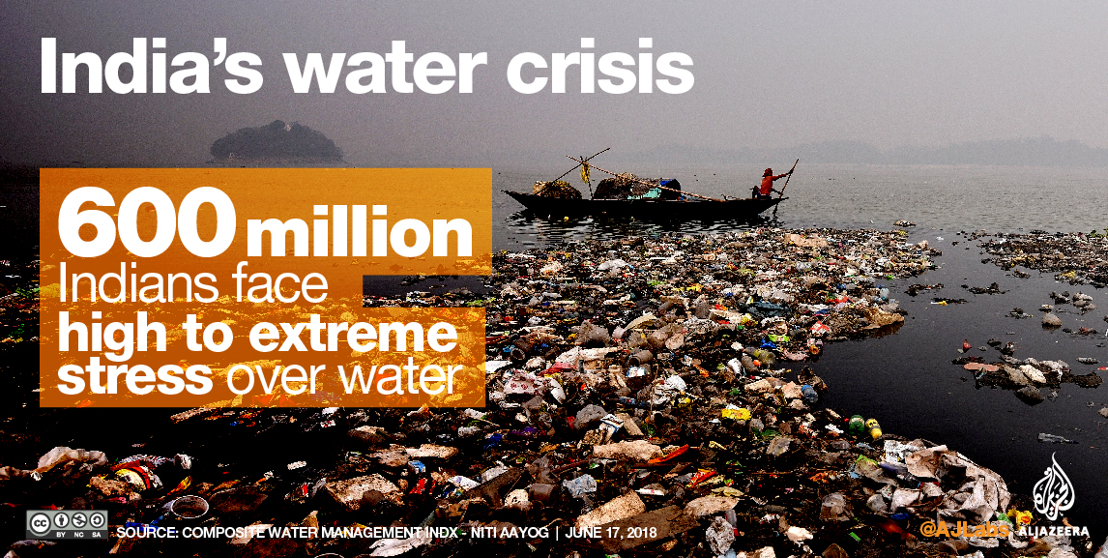
INTRODUCTION
Water is a fundamental resource vital to human survival, agricultural productivity, industrial activities, and the health of ecosystems. However, water scarcity is an escalating global issue exacerbated by rapid population growth, urbanization, climate change, and inefficient water management practices. The need for effective water conservation and management strategies has never been more critical.

Slide 5
In India, significant water loss occurs daily due to overflows from storage tanks and reservoirs, inefficient irrigation systems, and a general lack of real-time water level monitoring. According to estimates, approximately 45 million cubic meters of water are wasted every day in urban areas due to these inefficiencies. On a global scale, it is reported that about 30% of the world's water supply is wasted annually because of inefficient usage and inadequate monitoring systems. These alarming statistics underscore the urgent need for innovative solutions to address water wastage.
This project, the Ultrasonic Sensor-Based Water Level Measurement System, is designed to tackle these issues by offering a precise, real-time method for monitoring and managing water levels in various storage systems, such as tanks and reservoirs. By employing an HC-SR04 ultrasonic sensor, the system can accurately measure water levels and display this data on an LCD screen, providing users with immediate and actionable information

Slide 6
OBJECTIVES

Slide 7
OBJECTIVES
Accurate Measurement: To achieve precise measurement of water levels in storage containers using the HC-SR04 ultrasonic sensor, ensuring reliable data for effective water management.
Real-Time Monitoring: To facilitate real-time water level monitoring by displaying up-to-date information on an LCD screen, enabling users to make timely decisions.
Cost-Effectiveness: To develop a low-cost solution that can be easily adopted in both domestic and industrial settings, making advanced water monitoring accessible to a broader audience.
User-Friendly Design: To create a system that is easy to set up, operate, and maintain, requiring minimal technical expertise from the user.

Slide 8
METHODOLOGY

Slide 9
METHODOLOGY
The Ultrasonic Sensor-Based Water Level Measurement System is designed to provide accurate and real-time water level measurements using an ultrasonic sensor and an LCD display. The methodology involves the integration of various hardware components, programming the Arduino microcontroller, and ensuring seamless communication between the sensor and the display. The process can be divided into three main parts: the working principle, the implementation, and testing and calibration.

Slide 10
METHODOLOGY
COMPONENTS DETAILS
Working Principle:
Ultrasonic Sensing: The HC-SR04 ultrasonic sensor emits a high-frequency sound wave (ultrasonic pulse) when triggered by the Arduino. This pulse travels through the air and reflects off the surface of the water. The sensor then detects the reflected pulse (echo) and measures the time it takes for the pulse to return.
Distance Calculation: The Arduino calculates the distance between the sensor and the water surface using the time it took for the echo to return. The formula used is:
Distance=Time × Speed of Sound / 2
Data Display: The calculated distance is then displayed on the LiquidCrystal_I2C LCD. If the distance is below a certain threshold, the system can also display additional information such as a warning message or a calculated difference (reset distance).

Slide 11
1. Microcontroller : Arduino UNO 2. Operating Voltage(logic level) : 5 V 3. Input Voltage(recommended) : 12 V 4. Input Voltage(limits) : 12 V

Slide 12
METHODOLOGY
IMPLEMENTATION
Hardware Setup :
Connecting the Ultrasonic Sensor: Connect the VCC and GND pins of the HC-SR04 sensor to the 5V and GND pins of the Arduino, respectively. Connect the Trig pin to a digital output pin (e.g., pin 12) and the Echo pin to a digital input pin (e.g., pin 10).
Connecting the LCD Display: Connect the I2C pins of the LCD (SDA and SCL) to the corresponding I2C pins on the Arduino (A4 and A5 on the Uno). Also, connect the VCC and GND pins of the LCD to the 5V and GND pins on the Arduino.
Power Supply: Ensure the Arduino is powered by external power source connected to the pump via motor driver.

Slide 13
METHODOLOGY
IMPLEMENTATION
Programming the Arduino:
Libraries: Include the necessary libraries (Wire.h, LiquidCrystal_I2C.h, HCSR04.h) for handling I2C communication, LCD display, and ultrasonic sensor operations.
Initialization: Initialize the LCD and sensor in the setup() function. Set the pin modes for the ultrasonic sensor.
Loop Function: In the loop() function, trigger the ultrasonic sensor, measure the echo time, calculate the distance, and display the result on the LCD. Implement additional logic for threshold detection and reset distance calculation if needed.

Slide 14

BLOCK DIAGRAM
ARDUINO
UNO
LCD UNIT
POWER SUPPLY
ULTRA-SONIC
SENSOR
MOTOR DRIVER
PUMP
BUTTON
SWITCH

Slide 15
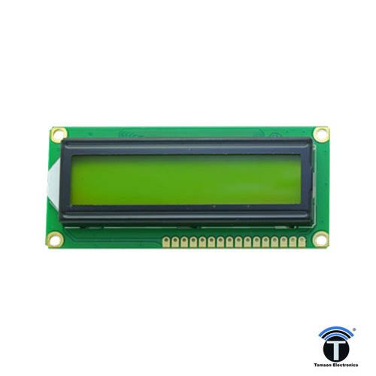
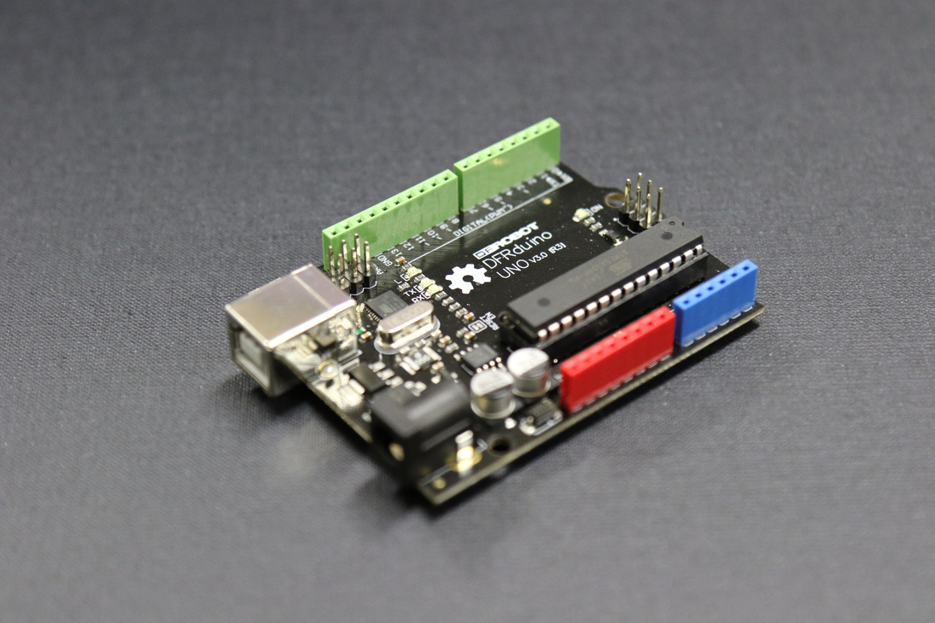
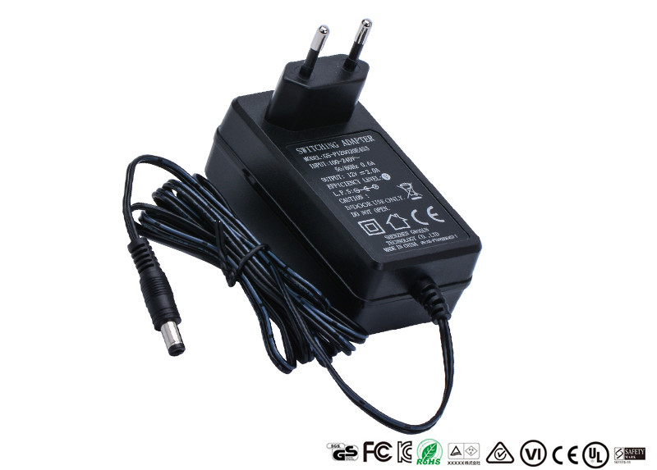
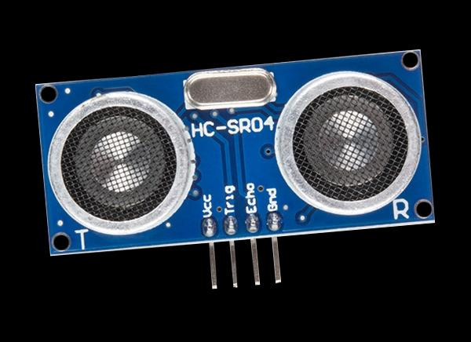
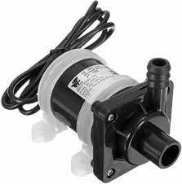
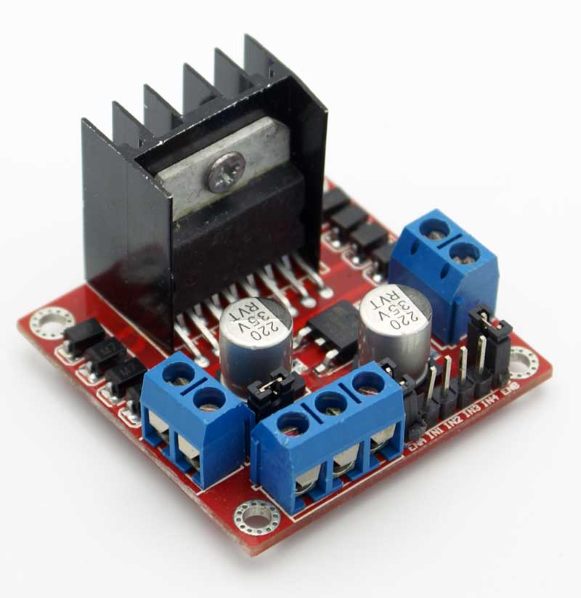
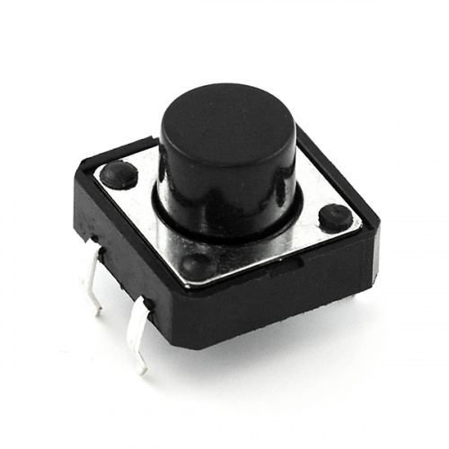
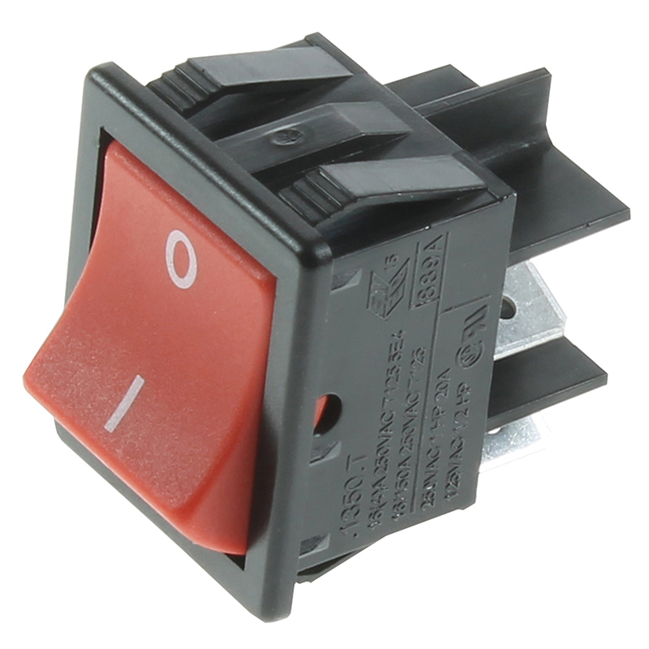

Slide 16
RESULTS & DISCUSSION

Slide 17
RESULTS AND DISCUSSION
Water Conservation
Accurate and Reliable
Scalable
Energy Efficient
Good User Interface

Slide 18
CONCLUSION

Slide 19
CONCLUSION
The Ultrasonic Sensor-Based Water Level Measurement System effectively addresses the critical issue of water conservation by providing a reliable, real-time method for monitoring water levels in various storage systems. This project combines the use of an HC-SR04 ultrasonic sensor, Arduino microcontroller, and an LCD display to deliver accurate measurements and user-friendly data visualization. The system’s ability to prevent water wastage in urban and agricultural settings underscores its importance in addressing water scarcity and promoting sustainable water management practices. By implementing such innovative solutions, we can contribute significantly to conserving one of the planet’s most vital resources, ensuring its availability for future generations. This project not only demonstrates the practical application of electronics and programming in solving real-world problems but also highlights the importance of technological advancements in resource management and environmental conservation.

Slide 20
SCOPE FOR FUTURE WORK

Slide 21
SOCIETAL RELEVANCE
The Ultrasonic Sensor-Based Water Level Measurement System holds significant societal relevance, particularly in the context of water conservation. In urban areas, water loss due to overflows from tanks and reservoirs is a major issue. This system helps prevent such overflows by providing timely alerts when water levels reach critical points. In rural and agricultural settings, where water is a vital resource for irrigation, this system ensures that water is used efficiently, preventing both over-irrigation and under-irrigation.
In India, approximately 45 million cubic meters of water are wasted daily in urban areas due to inefficiencies in water management. Globally, about 30% of the world's water supply is wasted annually because of inefficient usage and lack of proper monitoring systems. By implementing this system, significant water savings can be achieved, contributing to the conservation of natural water bodies, maintaining ecological balance, and supporting biodiversity.

Slide 22
Future Enhancements:
Implementing wireless communication (e.g., Wi-Fi or Bluetooth) to monitor and control the system remotely via a smartphone app.
Adding more sensors (e.g., water flow sensors) to monitor additional parameters and improve overall system functionality.
Incorporating solar panels or other renewable energy sources to make the system more sustainable and independent of the power grid.

Slide 23
REFERENCES

Slide 24
REFERENCES
Central Ground Water Board, Ministry of Jal Shakti, Government of India. "Annual Report 2020-21." Link
World Bank. "World Bank Water Data." Link
United Nations. "Water for Life Decade: Water Scarcity." Link
Arduino Official Documentation. "Arduino Uno Rev3." LinkHC-SR04 Ultrasonic Sensor Datasheet. Link
LiquidCrystal_I2C Library Documentation. Link
UNESCO World Water Assessment Programme. "The United Nations World Water Development Report 2021: Valuing Water." Link
Journal of Water Resource and Protection. "Water Conservation in India: An Overview." Link

