Slide 1
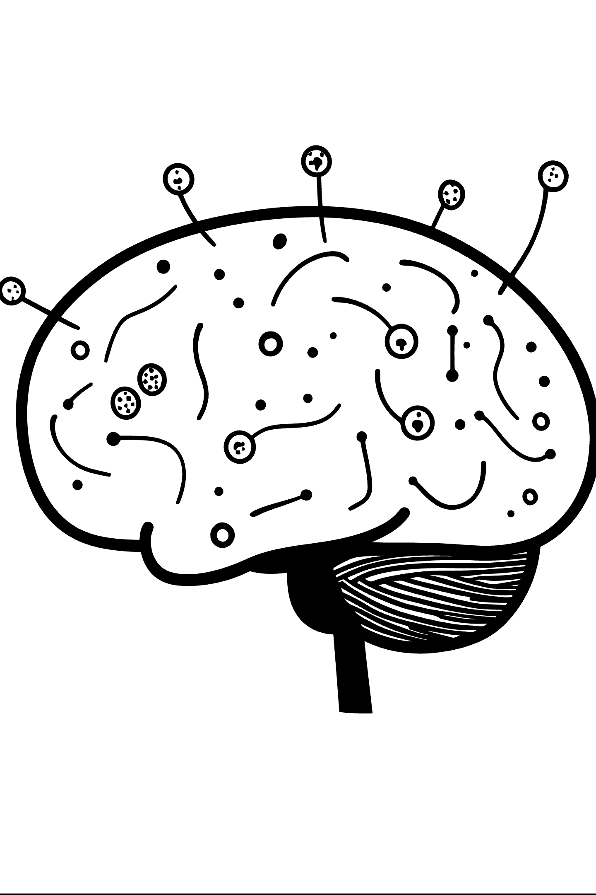

Stroke Risk Factor Analysis Using Patient Health Records
Salahuddin Shaikh · Roll No. 16014025056
Prateek Rai. Roll No.16014025054
Nisarg Sha. Roll No.16014025055
K. J. Somaiya School of Engineering
EXCP · S.Y. B.Tech · Semester III
Python Programming Laboratory · Academic year 2026–27
Statistical associations in an educational patient-record dataset
Notes:
This capstone examines associations between five patient characteristics and the recorded stroke label. The analysis uses a public benchmark and focuses on transparent statistical reasoning. It does not diagnose patients or estimate individual future stroke risk. Source: Stroke_Capstone_Report.pdf, pp. 1–2; Problem_Definition_and_Dataset.pdf, p. 1.

Slide 2
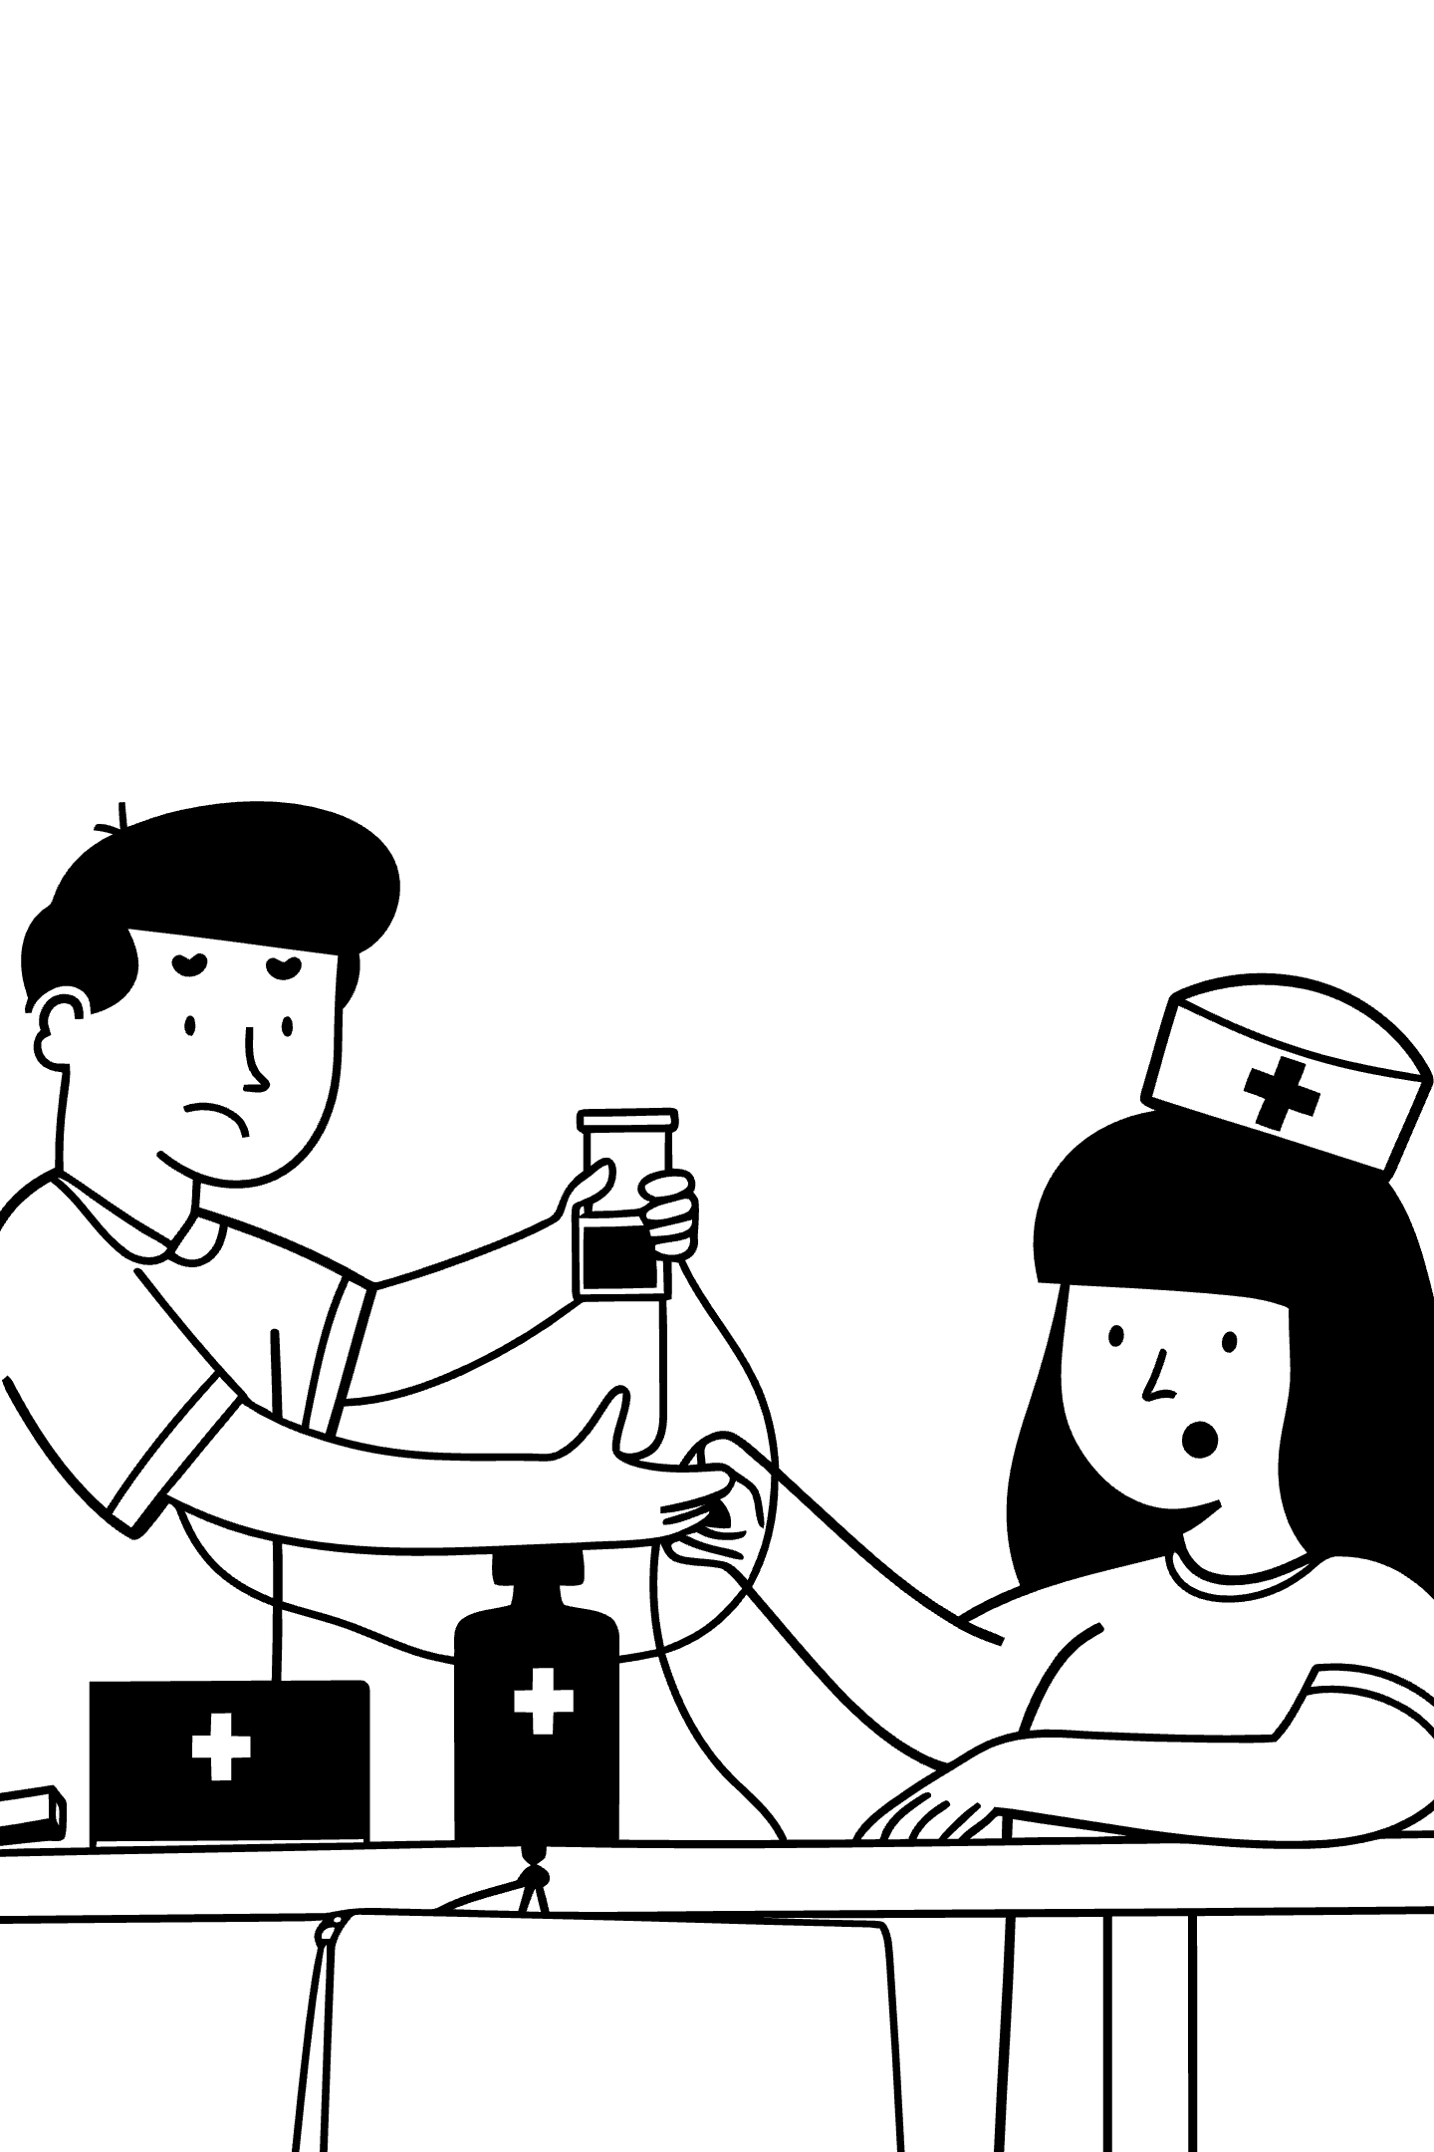
Introduction to Stroke and Health Records
What is a stroke?
Stroke occurs when blood flow to the brain is blocked or a blood vessel bursts.
Role of health records
Health records combine measurements, recorded conditions and patient history.
Comparing outcome groups
Comparing outcome groups helps us identify patterns for further study.
Dataset scope
This dataset records stroke status without follow-up dates.
Notes:
Stroke can involve blocked blood flow or bleeding in the brain. Health records allow researchers to compare patterns across people, but their usefulness depends on completeness and how the records were collected. Here, the outcome is an existing recorded label. Without measurement dates or follow-up, we cannot determine whether a factor came before stroke. Sources: National Institute of Neurological Disorders and Stroke, Stroke Overview, https://www.ninds.nih.gov/health-information/stroke/stroke-overview (accessed 5 October 2026); Stroke_Capstone_Report.pdf, pp. 2–3.

Slide 3
Problem Statement and Objectives
Question: How do five health factors differ by recorded stroke status?
Factors Under Study
Objectives
Age
Average glucose
BMI
Hypertension
Smoking status
Audit and clean the data, then compare the groups
Report effect sizes, uncertainty and sensitivity to analytic choices
Scope: association only, with no individual prediction
Notes:
The problem definition asks for statistical associations, not a causal explanation or a prediction system. The objectives are to validate the records, summarize the requested variables, apply suitable tests and explain the size and uncertainty of differences. Sensitivity checks test whether the conclusions depend on age restrictions or incomplete records. All comparisons are unadjusted for other variables. Sources: Problem_Definition_and_Dataset.pdf, p. 1; Stroke_Capstone_Report.pdf, p. 2.

Slide 4

Dataset Overview
5,110
249
4,861
Total Records
Stroke Records
No-Stroke Records
12 variables per record
4.87% of all records
Raw outcome count
Source: Kaggle Stroke Prediction Dataset, analyzed CSV from a public GitHub mirror. Educational benchmark with limited verified clinical provenance. The 4.87% is the fraction of records labeled stroke — not a population incidence estimate.
Data Dictionary
Variable | Unit / Type | Notes
Age | Years | Continuous
Average glucose | Recorded units, unverified | Continuous
BMI | kg/m² | Continuous
Hypertension | 0 / 1 | Binary
Smoking status | Never / Former / Current / Unknown | Categorical
Stroke | 0 / 1 | Outcome label
Notes:
The raw file contains 5,110 rows and 12 columns. The 12 fields are id, gender, age, hypertension, heart_disease, ever_married, work_type, Residence_type, avg_glucose_level, bmi, smoking_status and stroke. Only five factors form the primary test family. The ID serves traceability and is not a health measurement. The glucose protocol and unit were not independently verified. The 4.87% is the fraction of records labeled stroke, not a population incidence estimate. Sources: Stroke_Capstone_Report.pdf, pp. 3 and 5; Problem_Definition_and_Dataset.pdf, p. 1. Dataset landing page cited by both PDFs: https://www.kaggle.com/datasets/fedesoriano/stroke-prediction-dataset.

Slide 5
Data Cleaning and Analysis Population
Cleaning Steps
Population Flow
Validate types, categories, binary labels and duplicate IDs
No exact duplicates removed; retain valid unusual observations
Exclude 856 records aged under 18 from the primary analysis
Use observed BMI — keep Unknown smoking distinct from never smoked
Population | Records
Raw records | 5,110
Under 18 excluded | 856
Primary adults | 4,254
Adults with observed BMI | 4,073
Adults with known smoking | 3,392
Complete adults | 3,256
Adult missing BMI = 181 · Unknown smoking = 862 · Primary adults include 247 stroke and 4,007 no-stroke records. Test denominators vary by factor.
Notes:
Children remain in the raw data and in the all-age sensitivity analysis. The primary adult population includes 247 stroke and 4,007 no-stroke records. Test denominators vary: age and glucose use all adults, BMI uses 4,073 observed values, and smoking uses 3,392 known categories. Adults with both observed BMI and known smoking total 3,256 and form a sensitivity population. Unusual valid observations remain in the analysis. An optional median-filled BMI export is for teaching only and is not used for reported tests. Source: Stroke_Capstone_Report.pdf, pp. 4–6. Observed BMI total 4,073 is derived as 4,254 minus 181.

Slide 6
Methodology and Statistical Analysis Plan
Summarize outcome groups with suitable charts and descriptive statistics. Use five primary tests with Holm correction, adjusted p < 0.05. Report effect sizes and 95% confidence intervals. Check sensitivity with rank tests, all ages and complete adult records.
Factor | Test | Effect Size / Interval
Age, Glucose, BMI | Two-sided Welch t-tests | Mean difference, 95% CI, Hedges g
Hypertension | Pearson chi-square | Cramér V
Known smoking categories | Pearson chi-square | Cramér V
Proportion charts use pointwise 95% Wilson intervals. Python libraries: NumPy, Pandas, SciPy, Matplotlib, Seaborn.
Notes:
Welch tests compare outcome-group means while allowing unequal variances and sample sizes. Pearson chi-square tests examine independence of the stroke label and categorical factors. The smoking test excludes Unknown. Both chi-square tables meet the planned expected-count check. Holm correction applies to exactly five primary p-values. Confidence intervals and effect sizes remain pointwise and unadjusted for multiplicity. Supplementary Mann–Whitney tests help examine patterns when distributions are skewed. Independent records are assumed but cannot be verified from the source. A small p-value does not establish a large or causal effect. Source: Stroke_Capstone_Report.pdf, p. 6.

Slide 7
Key Finding 1: Age, Glucose and BMI
Age — Large Difference
Glucose — Moderate Difference
BMI — Inconclusive
Stroke records show older mean age. Hedges g = 1.108. Holm-adjusted p = 3.63×10⁻⁷⁴.
Observed adult BMI means are almost equal. Hedges g = 0.005. Holm-adjusted p = 0.9328.
Stroke records show higher mean glucose. Hedges g = 0.551. Holm-adjusted p = 1.08×10⁻⁹.
Factor | Stroke mean | No-stroke mean | Difference (95% CI)
Age (years) | 68.21 | 49.09 | 19.12 (17.58 to 20.67)
Glucose (recorded units) | 133.10 | 107.00 | 26.10 (18.22 to 33.98)
BMI (kg/m²) | 30.47 | 30.43 | 0.04 (−0.86 to 0.94)
Age/glucose: n = 247 vs 4,007. Observed BMI: n = 208 vs 3,865. All differences = stroke mean minus no-stroke mean. BMI confidence interval includes zero — analysis detects no adult mean difference. Glucose values in recorded units (measurement unit unverified).
Notes:
All differences equal stroke mean minus no-stroke mean. Age has Hedges g = 1.108 and Holm-adjusted p = 3.63×10^-74. Glucose has g = 0.551 and adjusted p = 1.08×10^-9. BMI has g = 0.005 and adjusted p = 0.9328. The BMI confidence interval includes zero, so the analysis detects no adult mean difference. This does not prove the absence of any BMI relationship. BMI availability differs by outcome and nonlinear patterns could exist. Glucose values remain in recorded units because the measurement unit is unverified. Source: Stroke_Capstone_Report.pdf, p. 7.

Slide 8

Key Finding 2: Hypertension and Stroke
Statistical Result
Holm-adjusted p = 1.37 × 10⁻¹³
Cramér V = 0.116
Recorded stroke proportion: 13.28% with hypertension vs 4.82% without
Age and other factors may explain part of this unadjusted association. This is an association in the dataset — not an independent predictor or causal effect. No multivariable adjustment was performed.
No hypertension: 181/3,757 · Hypertension: 66/497
Wilson 95% CI: 4.18–5.55% and 10.58–16.55%
Notes:
The bars show the proportion of adult records labeled stroke within each hypertension category. Their denominators differ, so compare percentages rather than stroke counts alone. The hypertension association remains statistically significant after Holm correction, but the effect size is modest and no multivariable adjustment was performed. This is an association in the dataset, not an independent predictor or causal effect. Source: Stroke_Capstone_Report.pdf, p. 8. Chart counts and Wilson intervals: corresponding project export outputs/tables/group_proportions.csv, hypertension rows, consistent with the report.

Slide 9

Key Finding 3: Smoking Status and Interpretation
Statistical Results
Known-status association: Cramér V = 0.054
Holm-adjusted p = 0.0143 (known-status adults)
Complete adult records: adjusted p = 0.1888
Former smokers are older (median age 58 vs 49 never, 47 current)
Missingness and age composition affect interpretation
These results do not show that current smoking is protective or that quitting increases risk. Smoking dose, duration and timing are unavailable.
Former: 70/860 · Never: 90/1,752 · Current: 42/780 · Unknown: 45/862 (gray — excluded from primary test)
Notes:
The primary smoking test compares formerly smoked, never smoked and smokes among 3,392 adults with known status. Unknown is shown for transparency but omitted from that test. Median ages are 58 for former, 49 for never, 47 for current and 48 for Unknown. These age differences complicate simple comparisons. With observed BMI and known smoking required together, the adjusted p-value rises to 0.1888, about 0.189, and crosses the prespecified 0.05 threshold. The analysis cannot establish that current smoking protects against stroke or that quitting causes risk. Smoking dose, duration and timing are unavailable. Source: Stroke_Capstone_Report.pdf, p. 9.

Slide 10
Sensitivity Checks and Correlations
Holm-Adjusted p-Values Across Populations
Spearman Correlation with Stroke (Available Pairs)
Factor | Primary adults | All ages | Complete adults
Age | 3.63e−74 | 1.06e−94 | 9.55e−51
Glucose | 1.08e−09 | 7.20e−11 | 1.14e−08
BMI | 0.9328 | 0.000668 | 0.7977
Hypertension | 1.37e−13 | 2.43e−19 | 5.93e−15
Smoking | 0.0143 | 0.0033 | 0.1888
Each sensitivity population uses its own Holm correction across the same five factor tests.
Correlation values are pairwise ranked associations — not probabilities of stroke or estimates of causal effects. Age, glucose and hypertension remain significant across all sensitivity checks. BMI sensitive to age composition; smoking sensitive to incomplete-record handling.
Notes:
Each sensitivity population uses its own Holm correction across the same five factor tests. BMI shows evidence in the all-age analysis but not in adults, indicating sensitivity to mixing children and adults. Smoking loses significance in the complete adult population. Age, glucose and hypertension retain significance in these checks. This does not resolve confounding or missingness bias. Spearman coefficients summarize pairwise ranked associations using available records for each pair. IDs and arbitrary nominal encodings are excluded. Correlation values are not probabilities of stroke or estimates of causal effects. Source: Stroke_Capstone_Report.pdf, p. 10. Exact correlations, rounded to three decimals, from companion project export outputs/tables/spearman_correlations.csv used for the report's Figure 7.

Slide 11


Limitations
Small Stroke Group
No Timing Information
Only 247 of 4,254 adults experienced a stroke — outcome groups are substantially unequal.
Without temporal data, the order of measurements relative to stroke cannot be determined.
BMI Missingness Differs
Unverified Study Design
15.79% missing in stroke adults vs 3.54% in no-stroke adults — this difference may bias BMI comparisons.
Hospital, geography, dates, sampling design, and outcome adjudication were not independently verified.
Unknown Smoking Status
Possible Confounding
862 adults have smoking status recorded as Unknown — a recorded category, not an empty field.
Unadjusted observational comparisons leave possible confounding. Complete-case checks do not prove missing-data bias has been removed.
Findings do not establish causation or individual future risk.
Notes:
The outcome groups are unequal. Missing BMI occurs in 39 of 247 stroke records and 142 of 4,007 no-stroke adult records. This difference may bias comparisons using observed BMI. Unknown smoking is a recorded category, not an empty CSV cell. Hospital, geography, dates, sampling and outcome adjudication were not independently verified. Without temporal information, we cannot determine the order of measurements and stroke. Complete-case checks do not prove that missing-data bias has been removed. Sources: Stroke_Capstone_Report.pdf, pp. 3–6 and 12; Problem_Definition_and_Dataset.pdf, p. 2.

Slide 12

Conclusion & Future Scope
Key Findings
Future Work
Consistent Associations
In this adult sample, stroke is associated with older age, higher glucose (recorded units), and hypertension.
Covariate-Adjusted Analysis
Apply logistic regression to examine associations while accounting for other factors simultaneously.
Inconclusive BMI
The adult BMI mean comparison is inconclusive — differential missingness limits interpretation.
Stronger Missing-Data Methods
Employ appropriate imputation or sensitivity analyses to address differential BMI and smoking missingness.
Sensitive Smoking Findings
Smoking findings depend on which records are included and should be interpreted with caution.
Separate Prediction Development
Individual prediction would require separate model development, suitable temporal data, and external validation.
An educational analysis of recorded associations — this presentation supports a student statistical-analysis exercise only.
Notes:
The strongest consistent findings concern age, glucose and hypertension. The project also reports uncertain or unstable findings for BMI and smoking, rather than forcing every factor into a positive-risk narrative. A future extension could use covariate-adjusted logistic regression to examine associations while accounting for other factors, alongside appropriate missing-data methods and better source information. Such a model would still require careful interpretation. If individual prediction becomes a goal, it would require separate development, suitable temporal data and external validation. This presentation supports a student statistical-analysis exercise only. Source: Stroke_Capstone_Report.pdf, p. 12; Problem_Definition_and_Dataset.pdf, pp. 1–2.

