Slide 1
Tuesday 1/30
COMS-3163

Slide 2
TypeScript
Advantages
Type Safety
Finds bugs at compile time (static typing)
Autocompletion
Editor can provide valid properties and methods at time of writing
Code Refactoring
Disadvantages
Learning Curve
Slower build times
Unavailable/Missing or Incomplete Type Definitions
Types not guaranteed at runtime

Slide 3
TypeScript
A superset of JavaScript
Statically typed
Typescript compiler (tsc) always generates JavaScript output (unless noEmitOnError)
Type is inferred but can be explicitly annotated
functions arguments require annotation (can't be inferred)

Slide 4
TypeScript
Type Inference Always on
The Any type assigned if can't assign a more specific type
Any type bypasses type system

Slide 5
TypeScript Statically Typed Example
JavaScript
TypeScript
JS Dynamically Typed
let p = {}
p.name = 'John' // name prop added
Statically Typed
let p = {} // p: any type
p.name = 'John' // error: name not defined on any type

Slide 6
Structural Typing
Types are defined by the collection of their properties and not the name of the type.
let person = { name: 'John' }
let product = { name: 'Phone' }
let company= { name: 'Acme LLC' }

Slide 7
Type Annotations
Annotations to help typescript understand what type is expected
const bob: Person = {…}
function add(a: number, b: number): number {}

Slide 8
Optional Properties (?)
type Person = {
lastName: string
firstName: string
middleName?: string // optional
}
let john = {
lastName: 'Doe',
firstName: 'John'
}

Slide 9
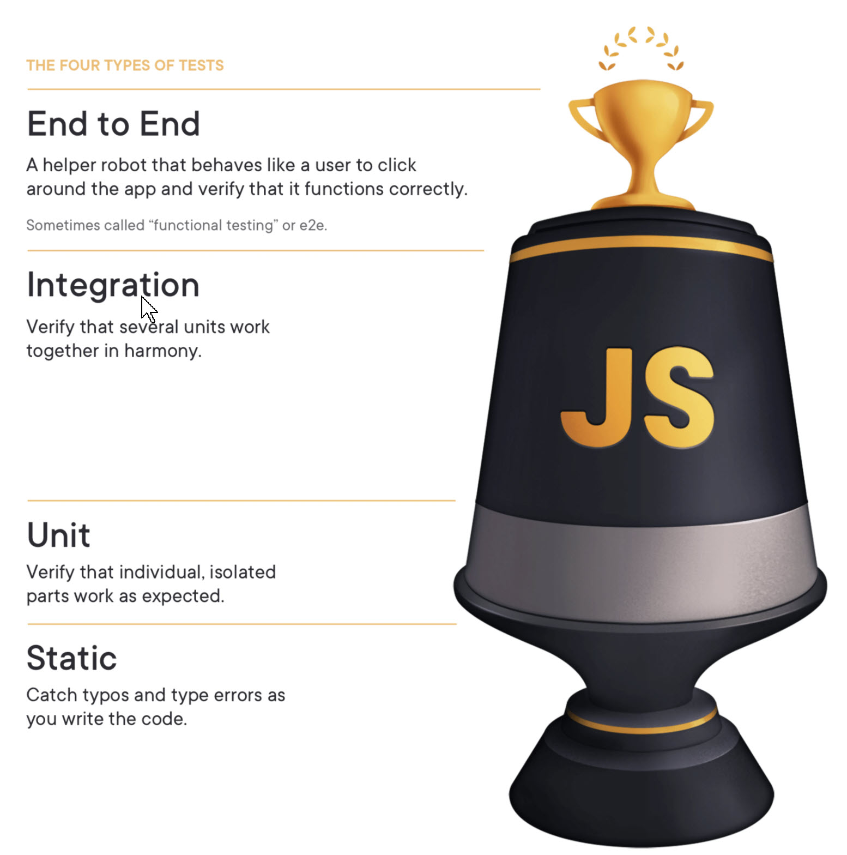
The Testing Trophy and Testing Classifications
Kent C. Dodds
https://kentcdodds.com/blog/the-testing-trophy-and-testing-classifications

Slide 10
Type Definitions
Some libraries include typescript definitions
Many libraries typescript definitions are available on Definitely Typed https://github.com/DefinitelyTyped/DefinitelyTyped/
If a library doesn’t have type definitions available, the typescript typecheck can be bypassed for that library

Slide 11
Generics
A feature allowing creation of reusable code when the type is not known at time of writing.
A restful API returns a Promise but what is the promise data
let result = http.get('/products') returns Promise<Products>
result isn't just a promise but Products. Editors can autocomplete Products methods

Slide 12
unknown, never
Unknown type
Typesafe version of any
Unknown can't be assigned to a known type
Never type
A type that should never be used. If never is inferred it errors
Used often is switch statement to prevent new values from being undefined condition/state

Slide 13
Type Narrowing
function Foo(a: any) {
if a === "Hello World" {
// a must be a string here
} elseif (typeof a === 'number') {
// must be a number here
}
}

Slide 14
TypeScript
ts-node
Execute typescript similar to javascript in node
node main.js -> ts-node main.ts
TypeScript config options
strict: true – turns on many flags making the type checking strict as possible
skipLibCheck: true – skip checking libraries (dependencies)
Can greatly improve compilation in large projects
Checking libraries with a newer version of typescript can produce some new warnings/errors
lib: additional built-in typescript type declarations to be included
https://www.typescriptlang.org/tsconfig#individual-library-components

Slide 15
Project
Build a quiz tool front-end now
Frameworks
Straight JavaScript, HTML, CSS
Angular
React
True/False question, Single Choice (A,B,C,D), Multiple Choice, Fill-in
Backend (later)
REST API
Login
List Quizzes
Create new Quiz
Take Quiz

