Slide 1
Tuesday 1/30
COMS-3163

Slide 2
Notes
Blackboard Ultra
GradeBook issue
Not sure you’re getting your grades
Remote Classes April 4 & April 9 (Eclipse)
Why learn git on command line?
Ask Questions

Slide 3
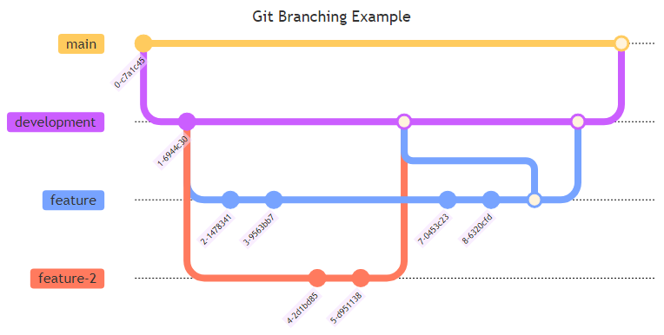
Git Workflow

Slide 4
console.log ( ('b' + 'a' + + 'a' + 'a').toLowerCase() )

Slide 5
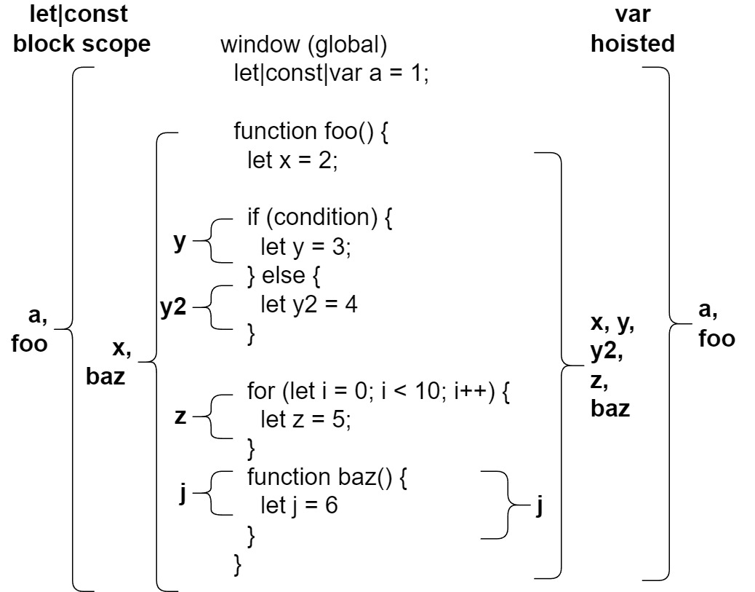
JavaScript Scope

Slide 6
console.log ( ('b' + 'a' + + 'a' + 'a').toLowerCase() )
Output: banana
console.log(+'a') // NaN
console.log('a' + +'a') // aNaN

Slide 7
Browsers
Chome, Firefox, Edge, Safari
Mobile
DevTools (Chrome)
Inspect
CSS
Console

Slide 8
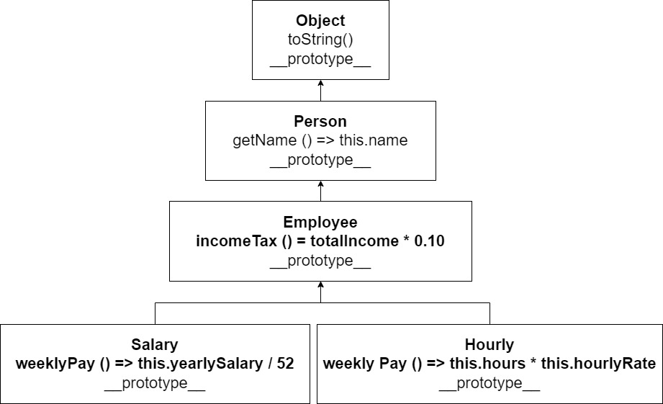
Prototypical Inheritance

Slide 9
JavaScript
Visualize Code
https://pythontutor.com/render.html#mode=display

Slide 10
Best Practices
Avoid using globals
Use strict
Use let & const instead of var
Initialize variables
Name variables and functions
Full names, be descriptive.
Read code 90%, write code 10%
Avoid branching if possible

