Slide 1

Slide 1
Ledger-ndary
Benjamin Albert, Giovanna Lemos Ribeiro, Sally Cao

Slide 2
Slide 10
INTRODUCTION
Mercado Libre
Our Analysis
Mercado Libre is an Argentine company that allows people and business buy and sell products online
Foundation: 1999
Share price: approximately US$ 347
Countries Argentina, Brazil, Bolivia, Chile, Colombia, Costa Rica, Dominic Republic, Ecuador, El Salvador, Guatemala, Honduras, Mexico, Nicaragua, Panama, Paraguay, Peru, Uruguay, Venezuela
Some competitors: Ebay, Amazon, OLX, Submarino, Enjoei
In our analysis of Mercado Libre, we use computational techniques to predict if the Mercado Libre shares have a greater probability of going up or down. The analysis is composed of two parts:
Use of machine learning classification to make the prediction. Those indicators are associated with both the financial strategies of the company and the internal processes.
We used concepts of Natural Language Processing to analyze the emotional contend of news related to the company.

Slide 3
Slide 9
MACHINE LEARNING ALGORITHM
IDENTIFICATION OF IMPORTANT
FACTORS
ALGORITHM BUILDING AND TRAINING
We created and trained a classification machine learning algorithm to predict if the stock price will go up or down according to the company’s business strategies.
Use of Balance Scorecard theory to identify the key measures that can predict the success of a company
GATHERING DATA
TESTING THE ALGORITHM
Using mainly the 10-K form, we gathered data about the business since 2009
We used part of our data to test if the algorithm’s predictions were accurate.
We reserved 2 years of data (2017-2018) for testing.

Slide 4
Slide 10
FINANTIAL DIMENTION
Growth – Includes data such as revenue and investments
Maintenance – Includes data such as indirect expenses and profitability of products
Harvest – Includes data such as unitary costs and return of investment
FACTORS OF ANALYSIS
INTERNAL PROCESSES
Clients – Includes data such as the market share
Innovation – Includes data such as the time of development
of a new generation of products
Operations – Includes data such as the time efficacy of the production process
After-Sale Services – Includes data such as the cost of resources
We used the theory of Balance Scorecard to create the machine learning algorithm. We analyzed Mercado Libre’s business strategy each year (starting in 2009) based on the following dimensions
LEARNING AND GROWTH – To Be Implemented
Employee Capacity – Employee satisfaction, retention, productivity
Information Systems – Includes data such as the % of processes with real time feedback
Empowerment – Includes data such as the number of suggestions per employee

Slide 5
Slide 2
MACHINE LEARNING CODE
We used a Support Vector Machine (SVM) with Radial Basis Function (RBF) Kernel for binary classification task: whether to invest or not invest.
Percentage of data used for training and for testing the algorithm
Accuracy of the algorithm: number of instances correctly and incorrectly classified during testing
Scores for: Precision-Recall Curve Area, Mathews Correlation Coefficient, and F-Score.

Slide 6
Slide 9
NATURAL LANGUAGE PROCESSING
NEWS SEARCH
STOCK VALUE ANALYSIS
Search of the top news about Mercado Libre in each half of the year since 2009 in three languages: English, Spanish and Portuguese
Comparison of the overall sentiment of the news with the rise and fall of the stock value of the company
LANGUAGE ANALYSIS
CORRELATION ANALYSIS
Comparison of the emotional content of the news by comparing it with a database of positive and negative words.
Analysis of the correlation of the overall positive tone of the news with the stock value of the company

Slide 7
Slide 8
NATURAL LANGUAGE PROCESSING
Correlation between the sentiment value of the news with the stock value of Mercado Libre

Slide 8
Slide 6
CONCLUSION
Machine Learning Code
Natural Language Processing
We were able to use the concepts of Balance Scorecard to create an algorithm that correctly predicts of Mercado Libre’s shares are going to rise or fall in price.
>85%
We were able to find a correlation between the emotional value of news about Mercado Libre and the stock value of the company. Although the correlation was not so strong, when coupled with the Machine Learning algorithm, this analysis could increase the accuracy of the prediction to above 85%
Accuracy
CONCLUSION: INVEST!
Both our analysis – the machine learning algorithm and the natural language processing code - predict an overall increase in the stock share value of Mercado Libre if it continues with the strategies reported in the latest 10-K form.

Slide 9
Slide 5
NEXT STEPS
USE METHOD FOR STRATEGIC PLANNING
GATHER MORE DATA
INCLUDE CORPUS SCORE
Improve the machine learning algorithm by including more detailed data on the internal processes of the company. Moreover, we can include data about the company’s main competitors
With more computational power, we could improve the natural language processing analysis by including more inputs. Moreover, we can include the corpus score on the machine learning code to improve the accuracy
Our methodology could be use to assist the strategic planning in companies, allowing business to simulate the outcome of their action before implementation
Your logo

Slide 10
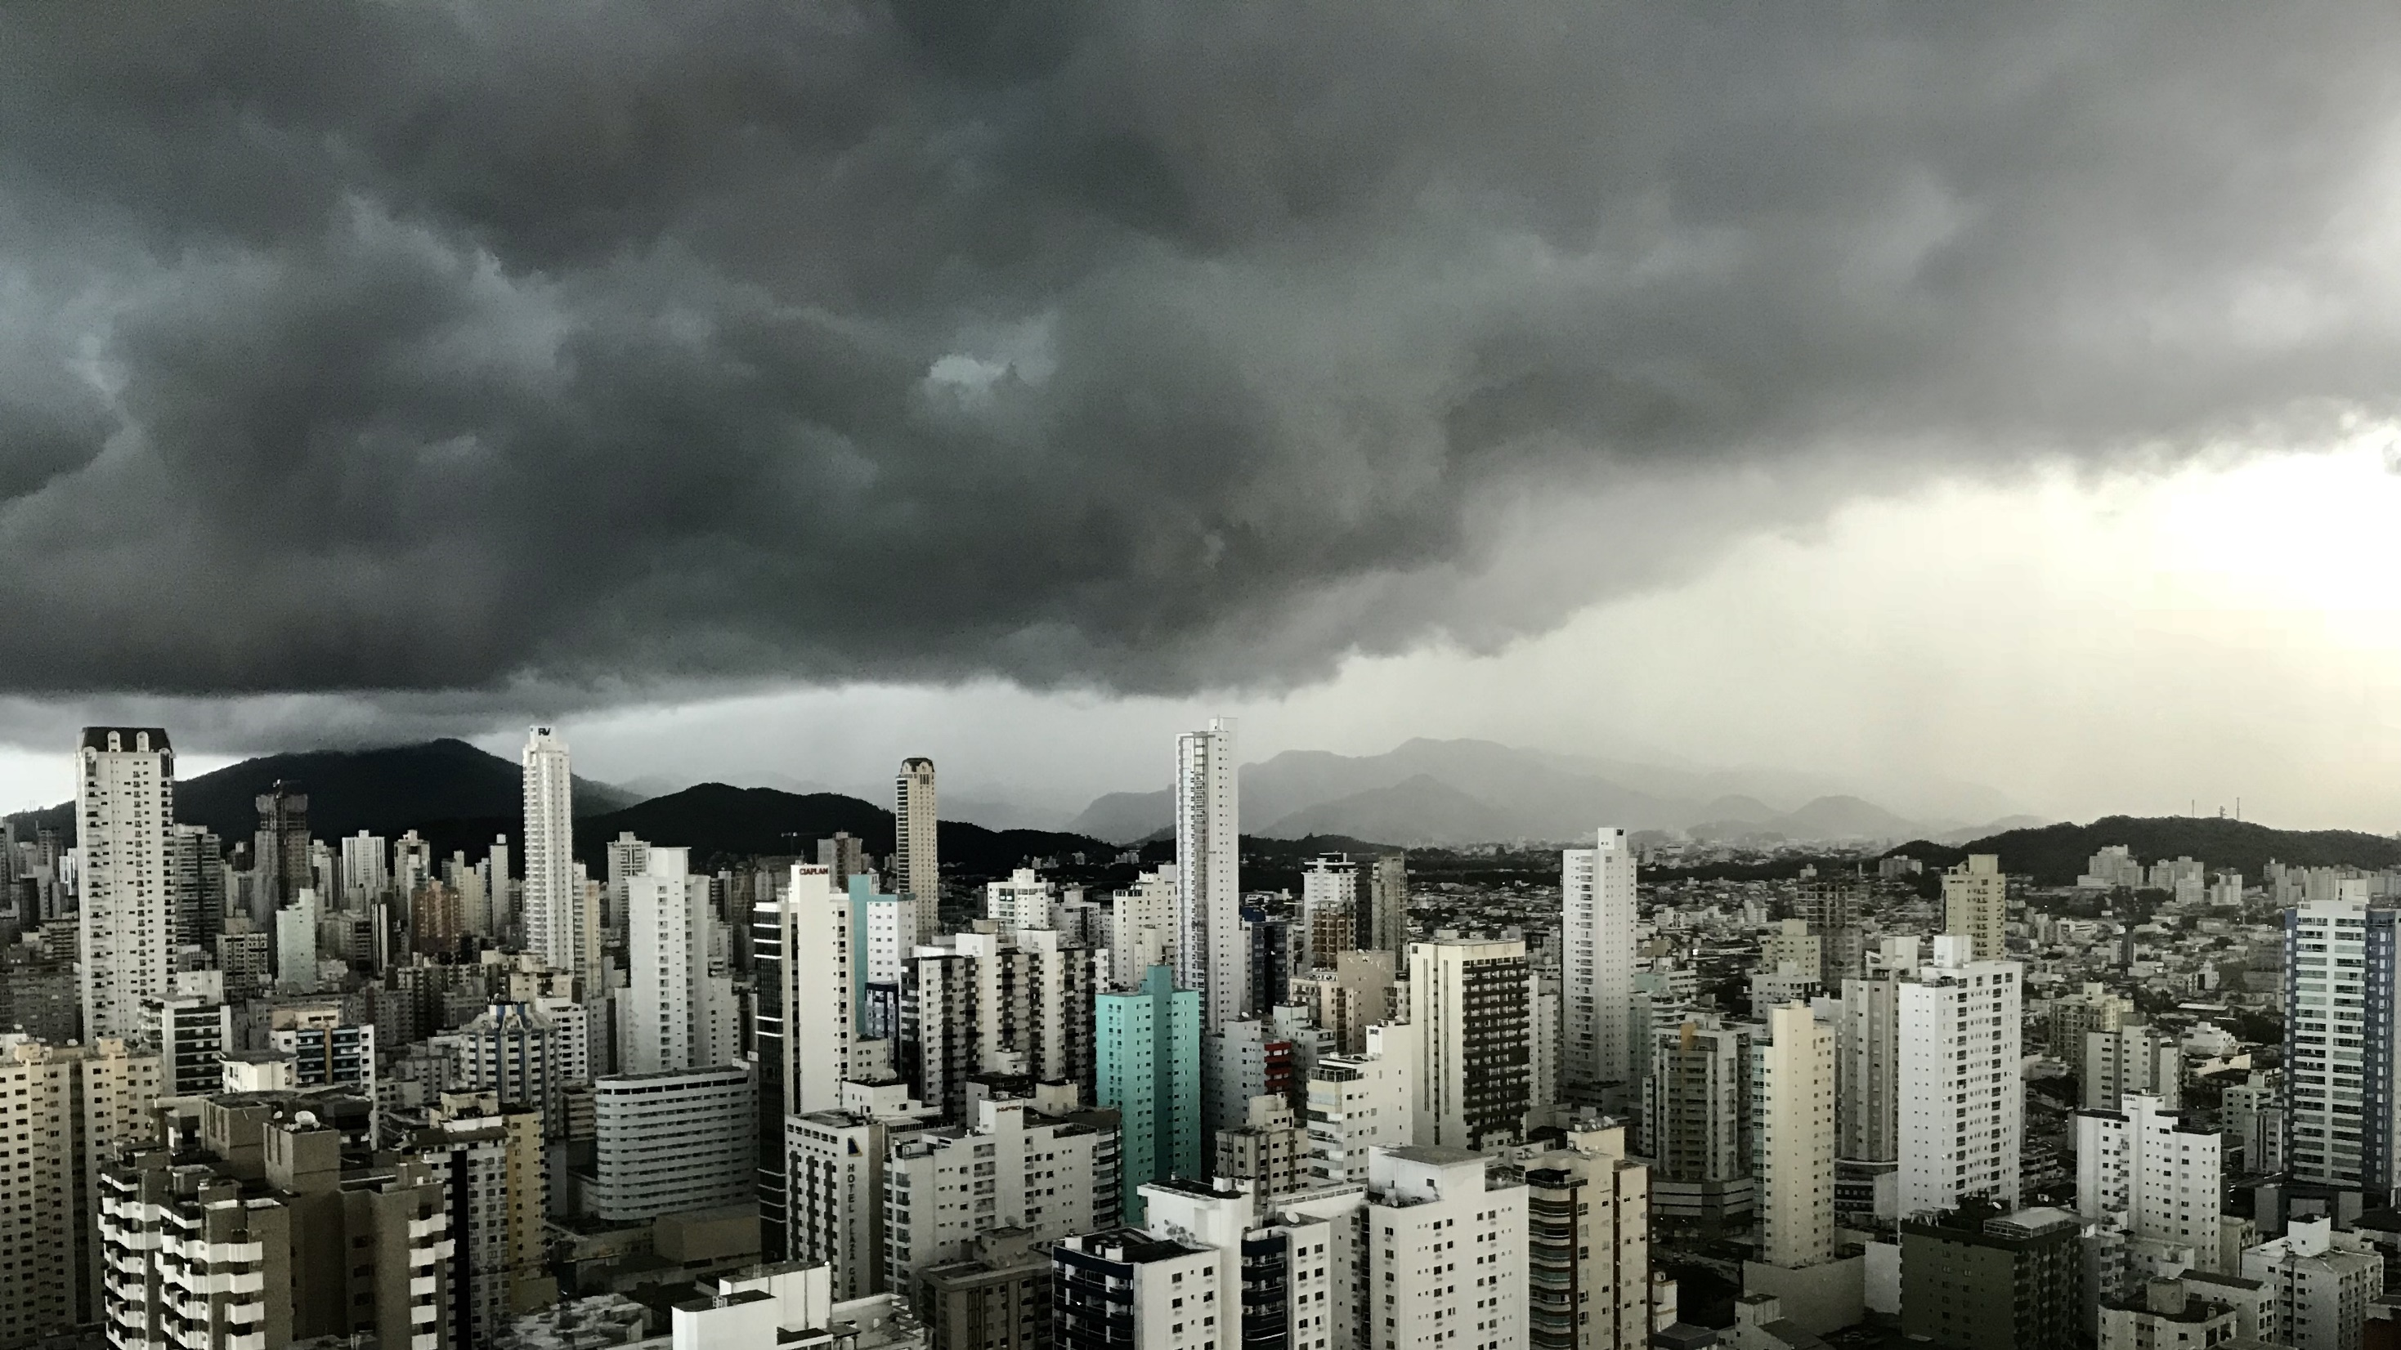
Slide 11
THANK YOU

