Slide 1
Expert System
Lecture # 3

Slide 2
(Exam style question)
Give a definition of “Expert System”.
In the context of Expert Systems, describe what the term “knowledge acquisition” covers.
Important Papers
A Review on Knowledge-based Expert System: Concept and Architecture
AN EXPERT SYSTEM FOR DIAGNOSING EYE DISEASES USING CLIPS
FUNDAMENTALS OF EXPERT SYSTEMS
Development of an Expert System for Distinguishing Headaches from Migraines

Slide 3
Pay your attention
Ready for candies?
Quick Quiz

Slide 4
………………is the implicit knowledge and skills of the expert that must be extracted and made explicit so that it can be encoded in an expert system.
Expertise
Knowledge acquisition facility
-------------------------- automatic way for the user to enter knowledge in the system bypassing the explicit coding by knowledge engineer.
Expert system
-------------------has the capability to explain how the decision was made.
Shell
------------------------a piece of software which contains “The user interface” , A format for declarative knowledge in the knowledge base and An inference engine
Domain
-----------------The area of knowledge addressed by the expert system
Knowledge acquisition facility
-----------------------------------Provides a convenient and efficient means of capturing and storing all components of the knowledge base

Slide 5
Pay your attention
Shell

Slide 6
Languages, Shells, and Tools
Shell - a piece of software which contains:
The user interface
A format for declarative knowledge in the knowledge base
An inference engine
Major advantage of a customized shell: the format of the knowledge base can be designed to facilitate the knowledge engineering process
Knowledge engineer and the system engineer might be the same person
Depending on the size of the project
One of the major bottlenecks - knowledge engineering process:
The coding of the expertise into the declarative rule format can be a difficult and tedious task
The semantic gap between the expert's representation of the knowledge and the representation in the knowledge base should be minimized
Expert system languages are post-third generation.
Procedural languages (e.g., C) focus on techniques to represent data.
More modern languages (e.g., Java) focus on data abstraction.
Expert system languages (e.g. CLIPS) focus on ways to represent knowledge.

Slide 7
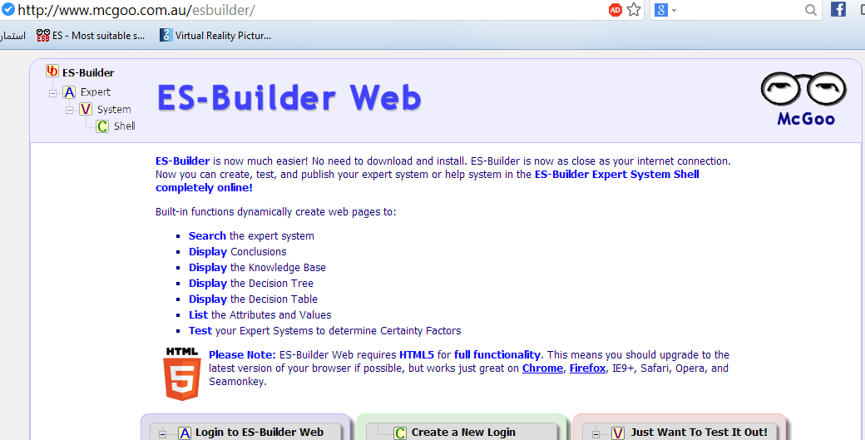
As we have talked about

Slide 8
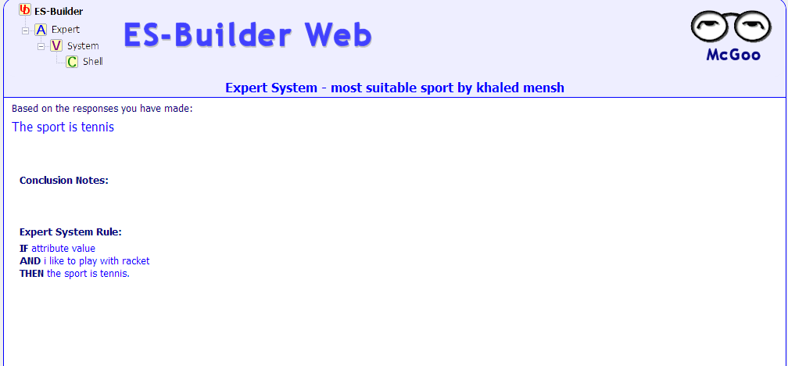

Slide 9
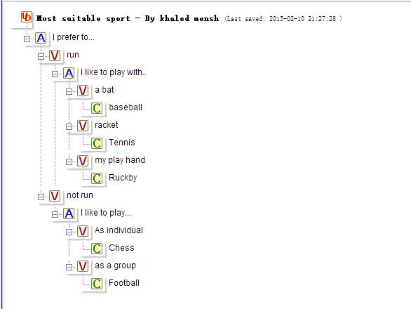
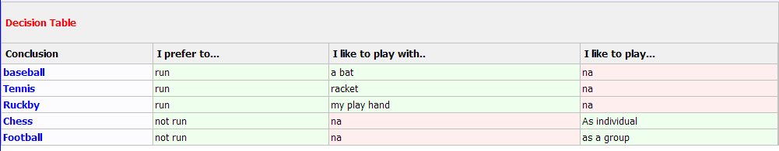

Slide 10
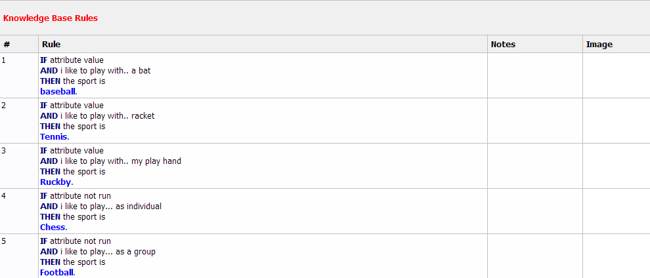

Slide 11
Representing the Knowledge
The knowledge of an expert system can be represented in a number of ways, including IF-THEN rules:
IF you are hungry THEN eat
A conclusion is the end product of a chain of reasoning, called inference when done according to formal rules.

Slide 12
Intro to CLIPS
CLIPS = C Language Integrated Production System
First of all I hope you will earn the good benefit from this lecture. Secondly you need to practice your hand to write code that is the best way to learn any Programming language
Download from http://clipsrules.sourceforge.net/
Knowledge-Based Systems, Paula Matuszek

Slide 13
What tools should I use for building Expert System with?
CLIPS : Is an expert system tool developed by the Software Technology Branch (STB) at the NASA/ B. Johnson Space Center. It was released in 1986.
JESS : Is a rule engine and scripting environment written entirely in Sun's Java language by Ernest Friedman-Hill at Sandia National Laboratories, it was first written in late 1995, its powerful scripting language give you the access to all of Java APIs. Website:
http://www.jessrules.com/
License: Closed Source – Public Domain
Jess 8.0 includes support for the Android platform.

Slide 14
CLIPS History
C was used as implementation language
(because of restricted availability of LISP compilers and problems of integration LISP-code with non-LISP applications)
Initial version: a production rule interpreter.
Extensions include
COOL: CLIPS Object-Oriented Language
JESS: Java Expert Systems Shell
Fuzzy Clips: Fuzzy logic, for capturing uncertainty
CLIPS is a type of computer language designed for writing expert systems applications.
Knowledge-Based Systems, Paula Matuszek

Slide 15
What is it?
Classic Rule-Based Expert System shell
Core is facts and rules
Inference is forward chaining using the RETE algorithm
Multiple conflict resolution strategies
Advantages:
Written in C; portable, embeddable, fast
Public domain, readily available
Easy to set up, low initial effort
Knowledge-Based Systems, Paula Matuszek

Slide 16
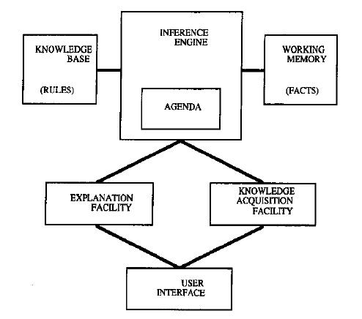

Elements of an Expert System
Working memory – global database of facts used by rules.
Knowledge acquisition facility – automatic way for the user to enter knowledge in the system bypassing the explicit coding by knowledge engineer.
Inference engine – makes inferences deciding which rules are satisfied and prioritizing.
Exploration facility – explains reasoning of expert system to user.
Agenda – a prioritized list of rules created by the inference engine, whose patterns are satisfied by facts or objects in working memory.
User interface – mechanism by which user and system communicate.

Slide 17
CLIPS Components
A basic CLIPS program has three primary components:
Facts
Rules
Agenda
Facts represent information about the state of the world.
Rules represent things to do with/about facts.
Knowledge-Based Systems, Paula Matuszek

Slide 18

Starting CLIPS
CLIPS can be run directly from the command line of a terminal window, but for Windows and Mac OS X there is a simple IDE which is preferable
Windows: CLIPSWin.exe
Mac: CLIPS IDE.app
When you start it, the CLIPS prompt will appear:
CLIPS>
At that point you are at the CLIPS interpreter and can enter commands.
Everything in CLIPS is surrounded by ( )
Knowledge-Based Systems, Paula Matuszek

Slide 19
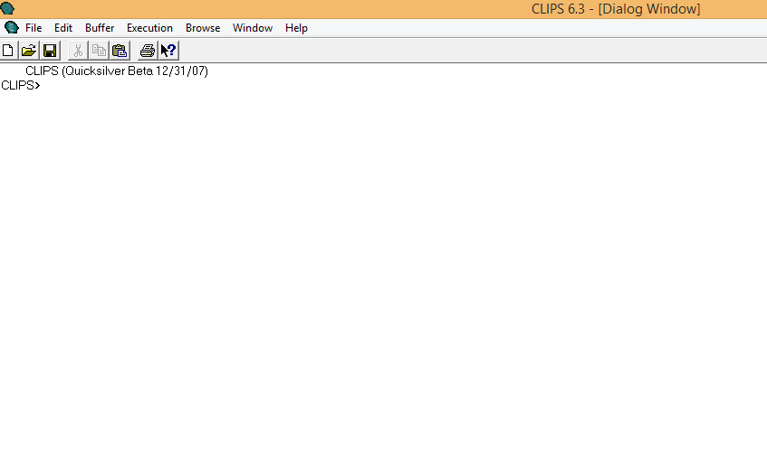
Versions of CLIPS
CLIPS is written in C => CLIPS is portable => there are different versions that run on different platforms: mac, unix, windows.
Latest released version 6.24 can be downloaded from the CLIPS web site for Windows and OS X.
There is a beta version 6.30
Knowledge-Based Systems, Paula Matuszek

Slide 20
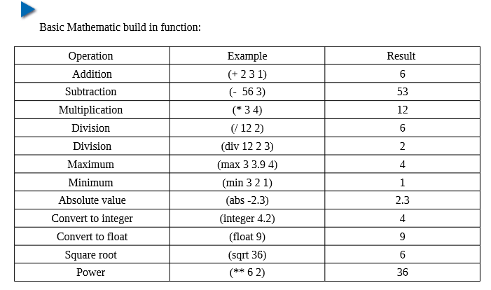
Basic Mathematics

Slide 21
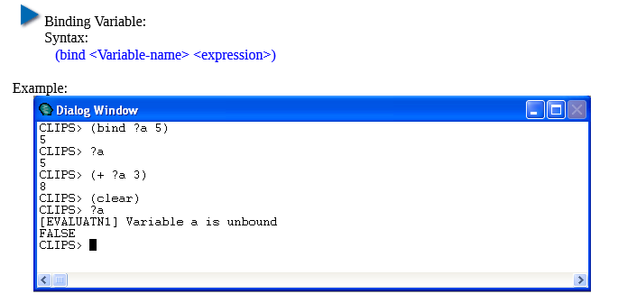

Slide 22
CLIPS: Notation
Symbols and characters: Anything not enclosed by the character pairs < >, [ ], or { } should be entered exactly as shown:
e.g. (example)
This syntax description means that (example) should be entered as shown.
Square brackets, [ ], indicate that the contents of the brackets are optional.
e.g. (example [1])
Indicates that the 1 found within the brackets is optional. So the following would both be consistent with the syntax:
(example) OR (example 1)

Slide 23
CLIPS: Notation
Another notation is the * following a description. This indicates that the description can be replaced with zero or more occurrences of the value specified. Spaces should be placed after each occurrence of a value.
e.g. <integer> * could be replaced with
1
1 2
1 2 3
or with any number of integers, or with nothing at all

Slide 24
CLIPS: Notation
A description followed by a + indicates that one or more of the values specified by the description should be used in placed of the syntax description.
e.g. <integer>+ is equivalent to:
<integer> <integer> *
A vertical bar, | , indicates a choice among one or more of the items separated by the bars.
e.g. all | none | some could be replaced with:
all
none
some

Slide 25
CLIPS: Notation
Numeric fields: numbers.
two types:
integers: any number consisting of an optional sign followed by only digits is stored as an integer.
e.g.
1
+3
-1
65
floats: all other numbers
e.g.
1.5
1.0
0.7
9e+1
3.5e10
Three parts of numeric fields:
sign: either + or -
value: contains one or more digits with a single optional decimal point contained with the digits.
exponent: consists of the letter e or E followed by an optional + or - followed by one or more digits.

Slide 26
CLIPS: Symbols
symbol: a field that starts with a printable ASCII character and is followed by zero or more characters.
The end of a symbol is reached when a delimiter is encountered.
Symbols cannot contain delimiters (with the exception of < which may be the first character in a symbol).
The ? and $? sequence cannot be placed at the beginning of a symbol since these are used to denote variables.
A sequence of characters which doesn’t follow the numeric format is treated as a symbol.

Slide 27
CLIPS: Delimiters
delimiter: includes any nonprintable ASCII character e.g. spaces, tabs, carriage returns, line feeds, the “ , ( , ) , ; , &, | , ~ , and < characters.

Slide 28
Examples of valid symbols:
Space-Station
February
fire
activate_sprinkler_system
notify-fire-department
!?#^*
345B
**note: underscore _ and hyphen - characters should be used to tie symbols together to make them a single field.

Slide 29
CLIPS Facts
Facts are what CLIPS believes to be true.
The simplest form of a fact is a single string.
(snowing)
(“January 11”)
An ordered fact is a list of one or more strings:
(snowing “January 11”)
CLIPS> (assert (duck))
The terms f-0 and f-1 are the fact identifier assigned to each fact by CLIPS. Every fact inserted
into the fact-list is assigned a unique fact identifier starting with the letter “f ” and followed by an integer called the fact-index.
You will see the response
<Fact-1>
its argument.
Notice that the (assert) command and its (duck) argument are surrounded by parentheses.

Slide 30
Valid Facts
Examples of valid ordered facts
(single-field)
(two fields)
(speed 38 mph)
(cost 78 dollars 23 cents)
(name “John Doe”)
here is an override command, set-fact-duplication, which will allow duplicate fact entry.
What happens if you try to put a second duck into the fact-list?
CLIPS> (assert (duck))
FALSE
The FALSE message is returned by CLIPS to indicate that it was not possible to perform this command.

Slide 31
Adding Facts
Putting facts into the CLIPS fact base is done by asserting.
CLIPS> (assert(snowing))
<Fact-1> This is the fact index.
CLIPS> (assert(snowing Jan11))
<Fact-2>
You can also ask CLIPS what facts it knows.
CLIPS> (facts)
f-0 (initial-fact)
f-1 (snowing)
f-2 (snowing Jan11)
For a total of 3 facts.
CLIPS>

Slide 32
Initial-fact
CLIPS has a special fact, initial-fact.
It is asserted by the system and can be used to initiate inference when no other facts are known.
A rule with no specified LHS will activate when initial-fact is true.
01/12/2011
Knowledge-Based Systems, Paula Matuszek

Slide 33


KNOWLEDGE REPRESENTATION
FACTS: deffacts constructs, assert a list of facts.
Syntax: (deffacts <deffacts-name> [<comment>]
<RHS-pattern>*)
Example (deffacts home “This is facts about home”
(door is open) )
after writing the facts we would like to Execute the program to execute we must use the following command.
(reset)
(run)

Slide 34
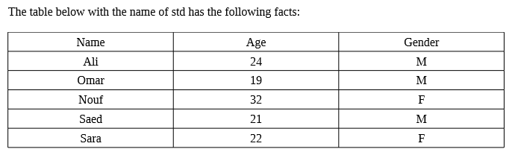
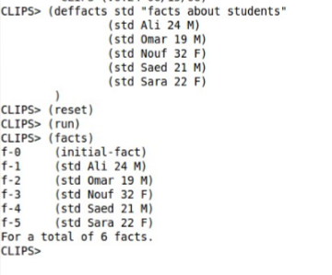
Define Facts

Slide 35
Retracting Facts
Facts can be removed using retract
(retract <fact-index>)
CLIPS> (retract 1)
CLIPS> (facts)
f-0 (initial-fact)
f-2 (snowing Jan11)
For a total of 2 facts.
CLIPS>
Retract can be used for more than one fact
CLIPS> (retract 0 2)
CLIPS> (facts)
CLIPS>
Knowledge-Based Systems, Paula Matuszek

Slide 36
Rules
One of the primary method to represents knowledge in CLIPS is a rule, A rule is a collection of condition and action to be taken if the condition met.
Rules in CLIPS are forward chaining production rules.
LHS = Left Hand Side = IF = triggers
RHS = Right Hand side = THEN = actions
So a rule has a set of triggers; when they are true that rule is activated.
When a rule is fired the actions take place.
Conflict resolution determines which of the activated rules actually fires.

Slide 37
Rules Format
LHS => RHS
(defrule <rule-name> [<comment>] [<declaration>] ; Rule Properties
<patterns>* ;LHS, premises, patterns, ;conditions, antecedent
=>
<actions>*) ;RHS, actions, consequent
Rule properties could have any name
Knowledge-Based Systems, Paula Matuszek

Slide 38
Rules Example
(defrule snowing (snowing hard) => (assert(cancel class)))
Rules can have more than one pattern/premise: (defrule travel-bad (SEPTA no) (traffic horrible) => (assert(cancel class)))
01/12/2011
Knowledge-Based Systems, Paula Matuszek

Slide 39
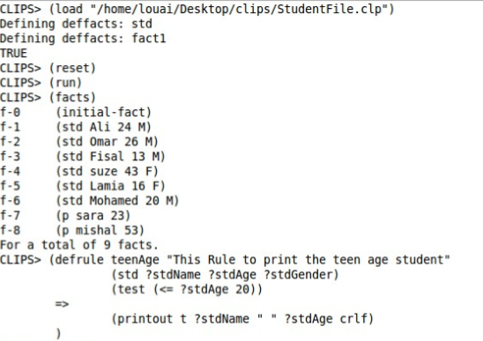



Slide 40
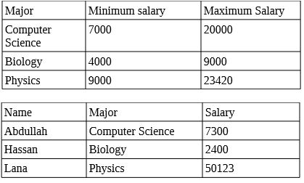
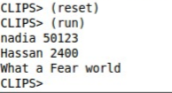
Example : Represents the below facts in Knowledge base and find out how miss the rage of the salary according to employee major.
Who has more or less than regular salary
the output should be look like this

Slide 41


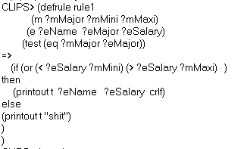
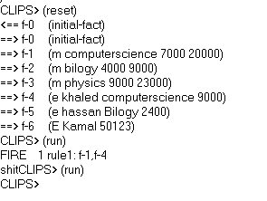
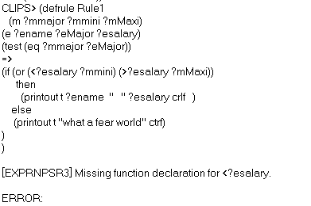

Slide 42
The reset
-------------------command is used to assert the facts in a deffacts statement.
A conclusion
------------------------is the end product of a chain of reasoning, called inference when done according to formal rules.
Facts
Rules
A basic CLIPS program has three primary components ____________,_____________
____________________
Agenda
Keyword defrule
The header of the rule consists of three parts:---------------------
Name of the rule
Optional comment string
-------------------------------and ------------------------------

Slide 43
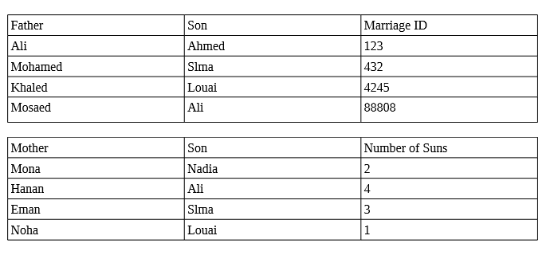
Example:
The following table has the relation between each father and his son lets call this table M, and the table next table F has relation between Mother and her son. If we supposed that sons in both table are same could you figure out whom married whom. ?

Slide 44
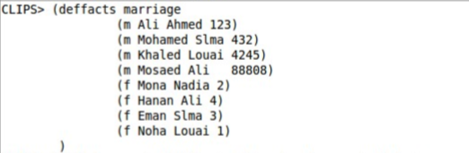
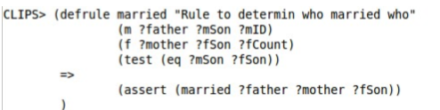
1- Represents the facts in table.
2- show the facts using (facts) command.
3- add Assert to add facts.

Slide 45
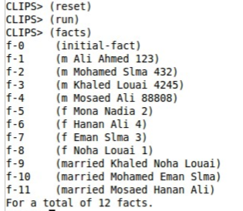
The reset command is used to assert the facts in a deffacts statement.

Slide 46
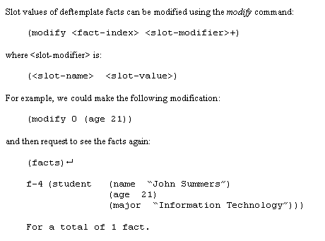
Modifying Facts
Slot values of deftemplate facts can be modified using the modify command:
A new fact index is generated because when a fact is modified:
The original fact is retracted
The modified fact is asserted

Slide 47
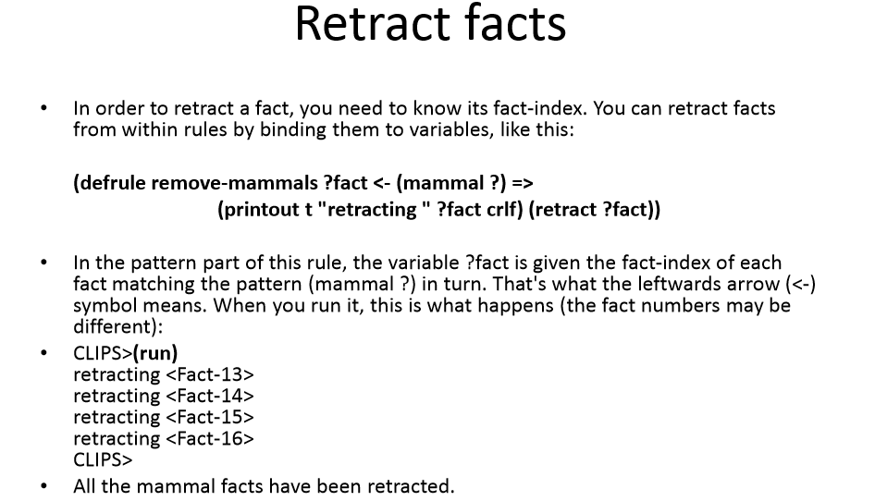

Slide 48
To retract multiple facts, just list the fact-id numbers in the (retract) command. You can just use (retract *) to retract all the facts, where the “*” indicates all .
Watch that Fact
Help you debug programs. One command allows you to continuously watch facts being asserted and retracted. This is more convenient than having to type in a (facts) command over and over again and trying to ﬁgureout what’s changed in the fact-list
CLIPS> (clear) CLIPS> (watch facts) CLIPS> (assert (animal-is duck)) ==> f-1 (animal-is duck) <Fact-1> CLIPS>
The right double arrow symbol, ==>, means that a fact is entering memory while the left double arrow indicates a fact is leaving memory, as shown following.

Slide 49
CLIPS> (reset)
<== f-0 (initial-fact)
<== f-1 (animal-is duck)
==> f-0 (initial-fact)
CLIPS> (assert (animal-is duck))
==> f-1 (animal-is duck)
<Fact-1>
CLIPS> (retract 1)
<== f-1 (animal-is duck)
CLIPS> (facts)
f-0 (initial-fact)
For a total of 1 fact.
CLIPS>

Slide 50
CLIPS> (assert (animal-is walrus))
<Fact-1>
CLIPS> (assert ( animal-is walrus ))
FALSE
CLIPS> (assert ( animal-is walrus ))
FALSE
CLIPS> (facts)
f-0 (initial-fact)
f-1 (animal-is walrus)
For a total of 2 facts.
Since spaces are used to separate multiple ﬁelds, it follows that spaces cannot simply be included in facts.
CLIPS> (clear)
CLIPS> (assert (animal-is "duck"))
<Fact-1>
CLIPS> (assert (animal-is "duck "))
<Fact-2>
CLIPS> (assert (animal-is " duck"))
<Fact-3>
CLIPS> (assert (animal-is " duck "))
<Fact-4>

Slide 51
f-0 (initial-fact) f-1 (animal-is "duck") f-2 (animal-is "duck ") f-3 (animal-is " duck") f-4 (animal-is " duck ") For a total of 5 facts. CLIPS>
What if you want to include the double quotes in a ﬁeld? The correct way to put double quotes in a fact is with the backslash, “\”, as the following example shows.
CLIPS> (clear) CLIPS> (assert (single-quote "duck")) <Fact-1> CLIPS> (assert (double-quote "\"duck\"")) <Fact-2> CLIPS> (facts) f-0 (initial-fact) f-1 (single-quote "duck") f-2 (double-quote ""duck"") For a total of 3 facts. CLIPS>

Slide 52
It is good rule-based programming style to use the first fields of a fact to describe the relationship of the following fields . When used this way, the first fields is called a relation. The remaining fields of the fact are used for speciﬁc values.
An example is (grocery-list ice-cream cookies candy fudgesauce).
(animal-is duck)
(animal-is horse)
(animal-is cow)
(animals duck horse cow)
The explicit relations, animal-is and animals, make more sense to a person than the implicit meaning of (duck), (horse), and (cow).

Slide 53
Stop And Go
Suppose you wanted to write an expert system to determine how a mobile robot should respond to a trafﬁc light. It is best to write this type of problem using multiple rules. For example, the rules for the red and green light situations can be written as follows. (defrule red-light
(light red)
=>
(printout t "Stop" crlf))
(defrule green-light
(light green)
=>
(printout t "Go" crlf))
After the rules have been entered into CLIPS, assert a fact (light red) and run. You’ll see “Stop” printed. Now assert a (light green) fact and run. You should see “Go” printed.

Slide 54
The Agenda
More than one rule may be activated at one time; CLIPS keeps all activated rules on an agenda. Conflict resolution chooses which to fire.
In each cycle one rule will be chosen to fire
The agenda can be listed:
CLIPS> (agenda)
Knowledge-Based Systems, Paula Matuszek

Slide 55
Agenda Example
CLIPS> (defrule snowing
(snowing hard) => (assert(cancel class)))
CLIPS> (agenda)
CLIPS> (defrule snowing2
(snowing hard) => (assert(alert maintenance)))
CLIPS> (agenda)
CLIPS> (assert(snowing hard))
<Fact-0>
CLIPS> (agenda)
0 snowing: f-0
0 snowing2: f-0
For a total of 2 activations.
Knowledge-Based Systems, Paula Matuszek

Slide 56
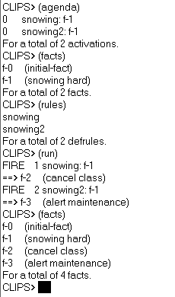

Slide 57
Some Basic CLIPS Commands
(exit) to exit from CLIPS
(clear) to clear the environment from facts, rules, and other active definitions
(reset) to set the fact base to its initial state (clears existing facts; sets (initial-fact), and all (deffacts) constructs in the program). Perform (reset) before each program run!
(run) executes a program currently loaded into the CLIPS interpreter against currently defined rule- and fact-bases.
Knowledge-Based Systems, Paula Matuszek

Slide 58
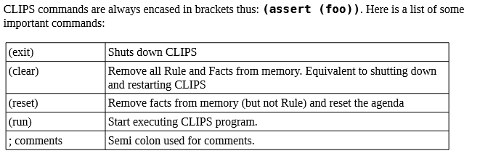
CLIPS>
The mode in which you are entering direct commands is called the top-level.
Save File: If the file saved successfully then the function return TRUE otherwise return FALSE and might some explain log .
Syntax: (save <file-name>)

Slide 59
More Basic CLIPS Commands
(load “filename.clp”) to load CLIPS program into the interpreter from the file named filename.clp . This also does syntax check and defines constructs in the file. In some cases you may omit quotes in the name.
(facts) to display a list of currently active facts in the fact base.
(rules) to display a set of rules currently in the rule base.
Knowledge-Based Systems, Paula Matuszek

Slide 60
“Hello World” in CLIPS
(defrule start
(initial-fact)
=>
(printout t “Hello, world!” crlf))

Slide 61
To Make It Run
The usual method of working in CLIPS is:
Type the code in a file, save it (e.g. hello-world.clp)
Start CLIPS
Do: File -> Load (in XCLIPS) or type
(load hello-world.clp)
When the file is loaded CLIPS will display:
(load hello-world.clp)
defining defrule start +j
TRUE

Slide 62
To Make It Run
Type (reset)
Type (run)
Tip: You can also use the menu
To exit CLIPS use the menu or (exit)

Slide 63
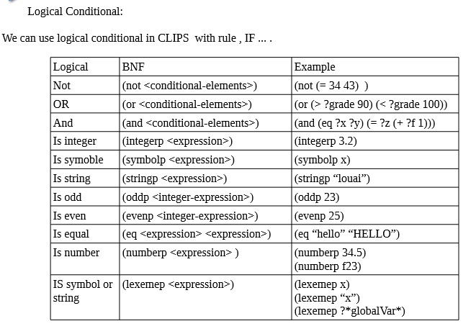
User define Function: deffunction constructs , define a user function like any other language, There is two way to define function in CLIPS:
Syntax: (deffunction <function-name> [<comment>]
(<regular-parameter> [<wildcard-parameter>] ) ; parameter
<action>* ; one or steps of actions )

Slide 64
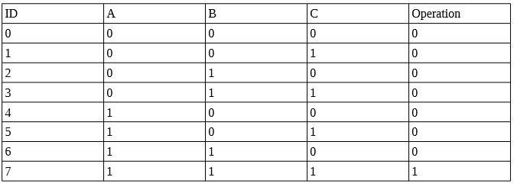
Example: Suppose that we have a below facts in the Truth Table, Write a program that assert a facts from existing ones facts about which facts operation represent Logical AND GATE.

Slide 65
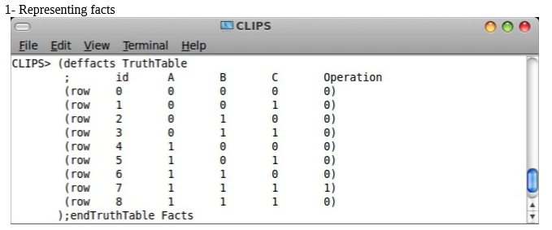
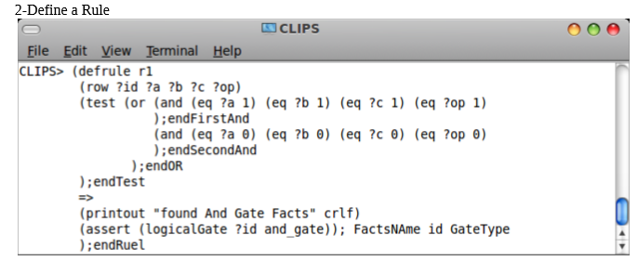

Slide 66
IDE
The IDE includes a fairly simple editor.
The open command in the file menu loads a file into the edit buffer.
The new command creates an empty buffer.
From the IDE you can load the buffer directly into CLIPS
This is easier if you are making and testing a lot of small changes.
Knowledge-Based Systems, Paula Matuszek

Slide 67
SNOW Example
The file snow1.clp contains a program for deciding whether I will cancel class.
Its input is provided by directly asserting the current conditions.
If it concludes that class should be cancelled it will output a message.
Knowledge-Based Systems, Paula Matuszek

