Slide 1

What if the way we lead is making it harder
to do the work that matters?
GOVERNMENT RESULTS
UPDATE
IPPs
REPORT CARDS
APPROVE
SUBMIT
VERIFY
PARENT
COMMUNICATION
FORMS
EDUCATION PLAN
TRACK
STUDENT TEACHER
CODING
DATA ENTRY
DEADLINES
DOCUMENTATION
ASSESSMENT
RE-ENTER
When the processes fill the space, people become harder to see.
Notes:
Silent sequence. Automatic advance enabled.

Slide 2
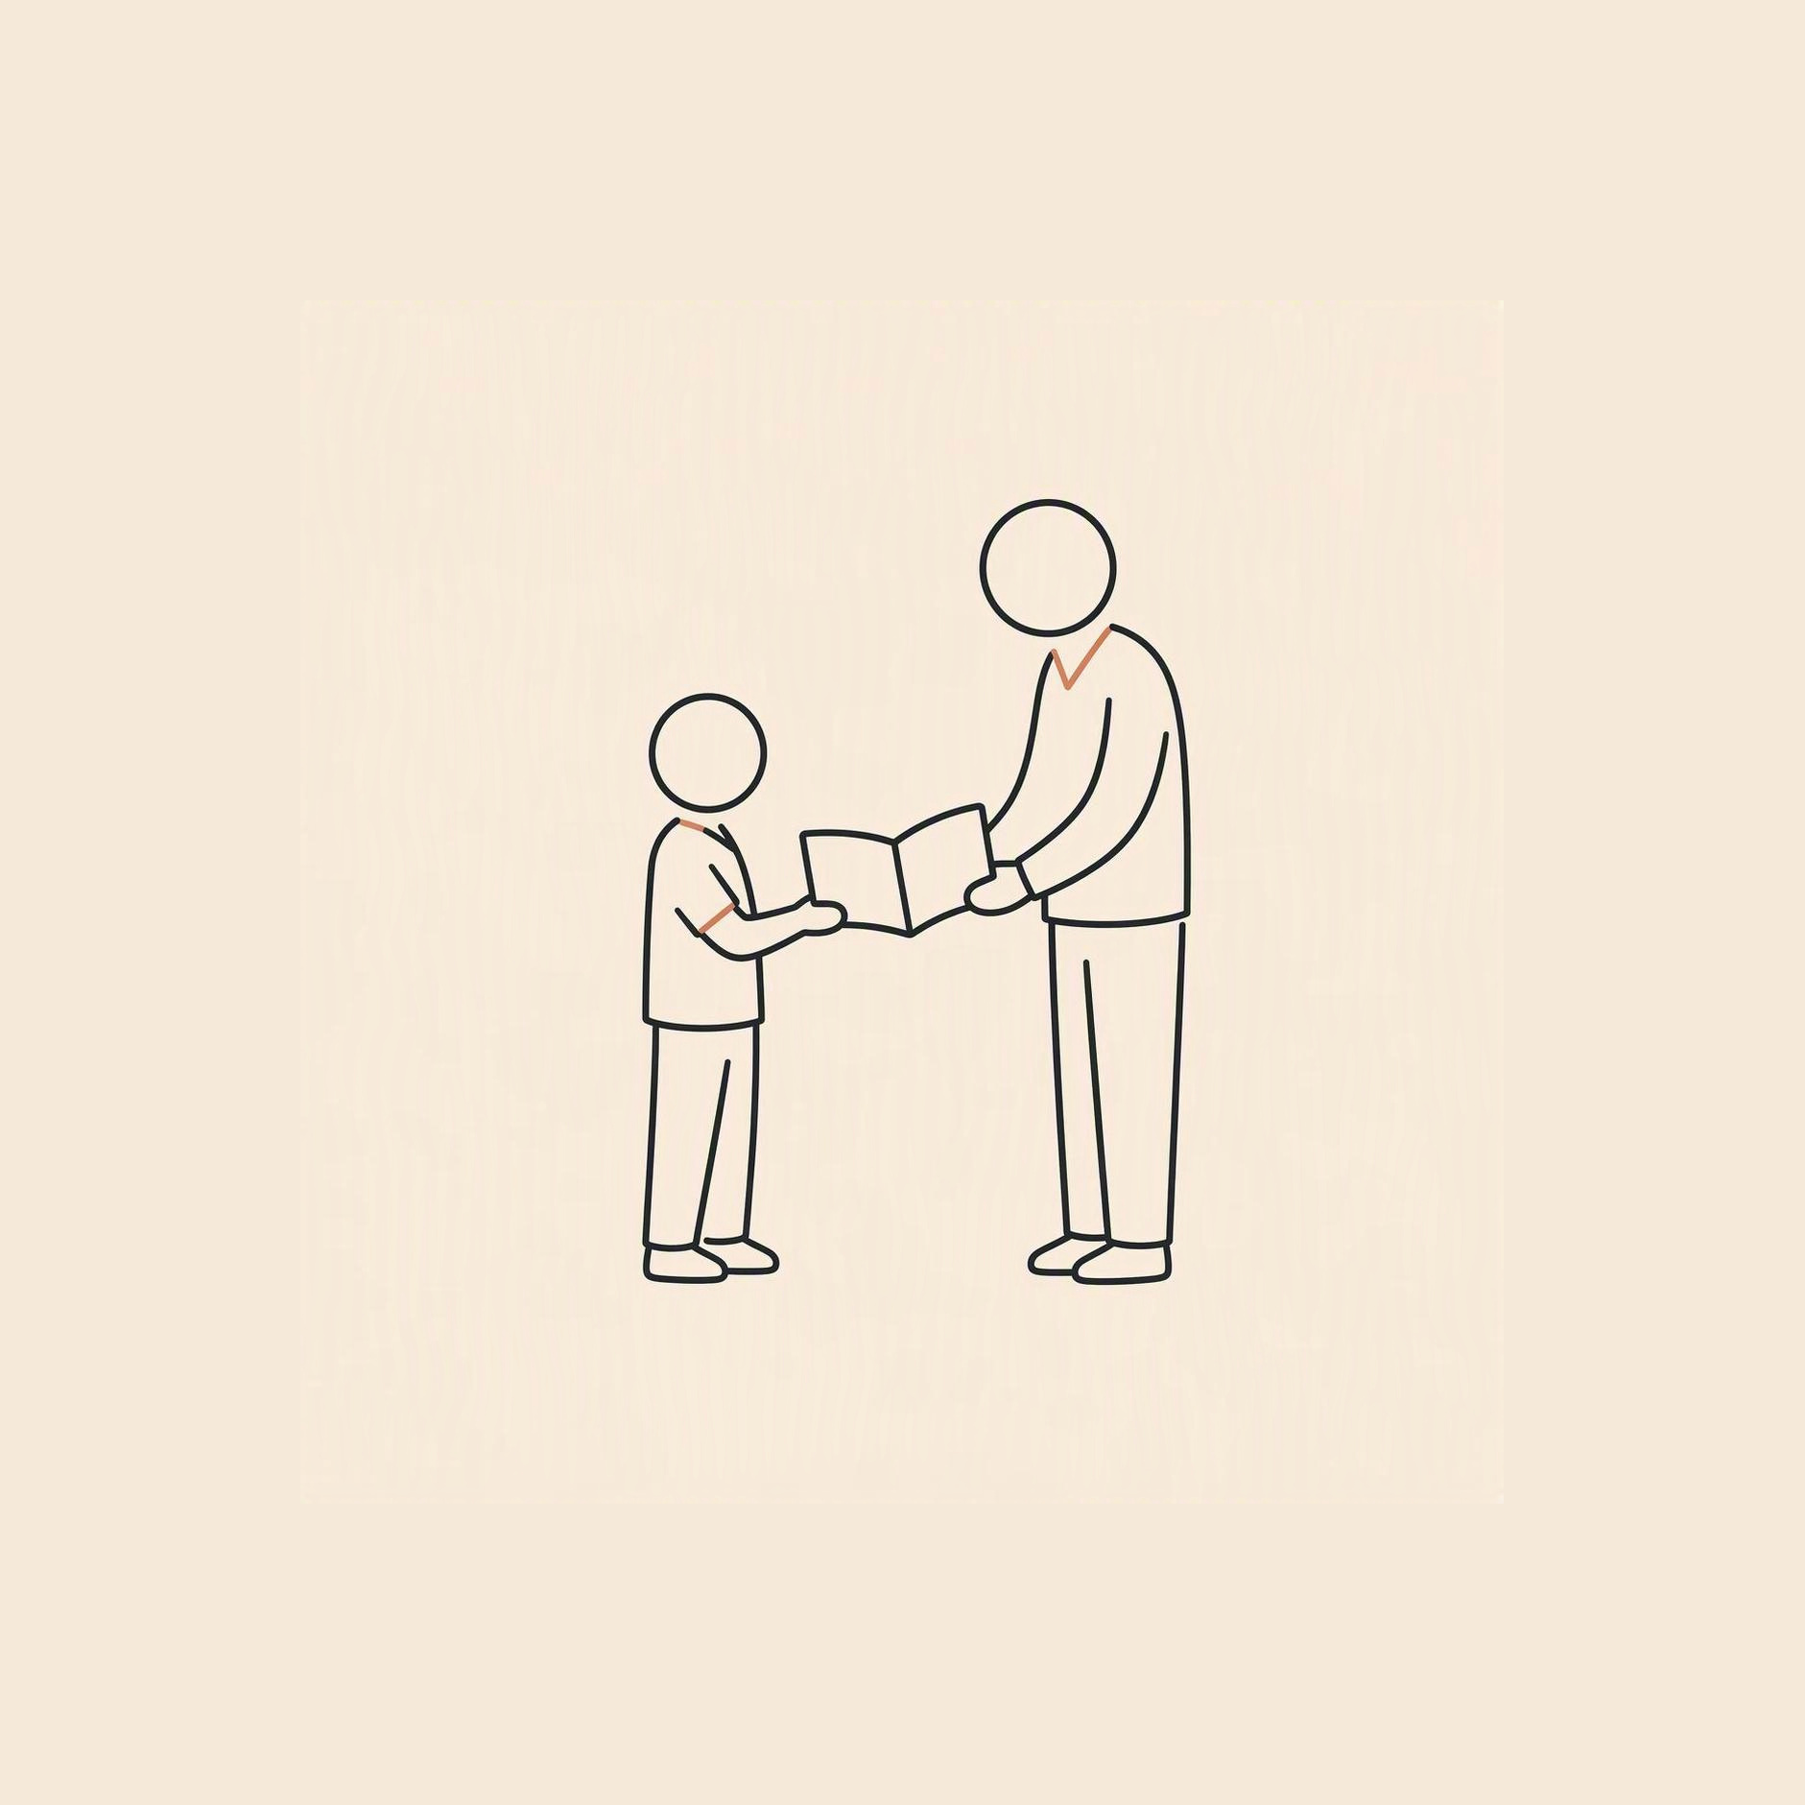
IPPs, report cards, plans and processes
were created to support the work.
GOVERNMENT RESULTS
UPDATE
IPPs
REPORT CARDS
APPROVE
VERIFY
SUBMIT
PARENT
COMMUNICATION
FORMS
EDUCATION PLAN
TRACK
CODING
DATA ENTRY
STUDENT TEACHER
DEADLINES
DOCUMENTATION
ASSESSMENT
RE-ENTER
The purpose is human. The processes should be here to help.
Notes:
Silent sequence. Automatic advance enabled.

Slide 3
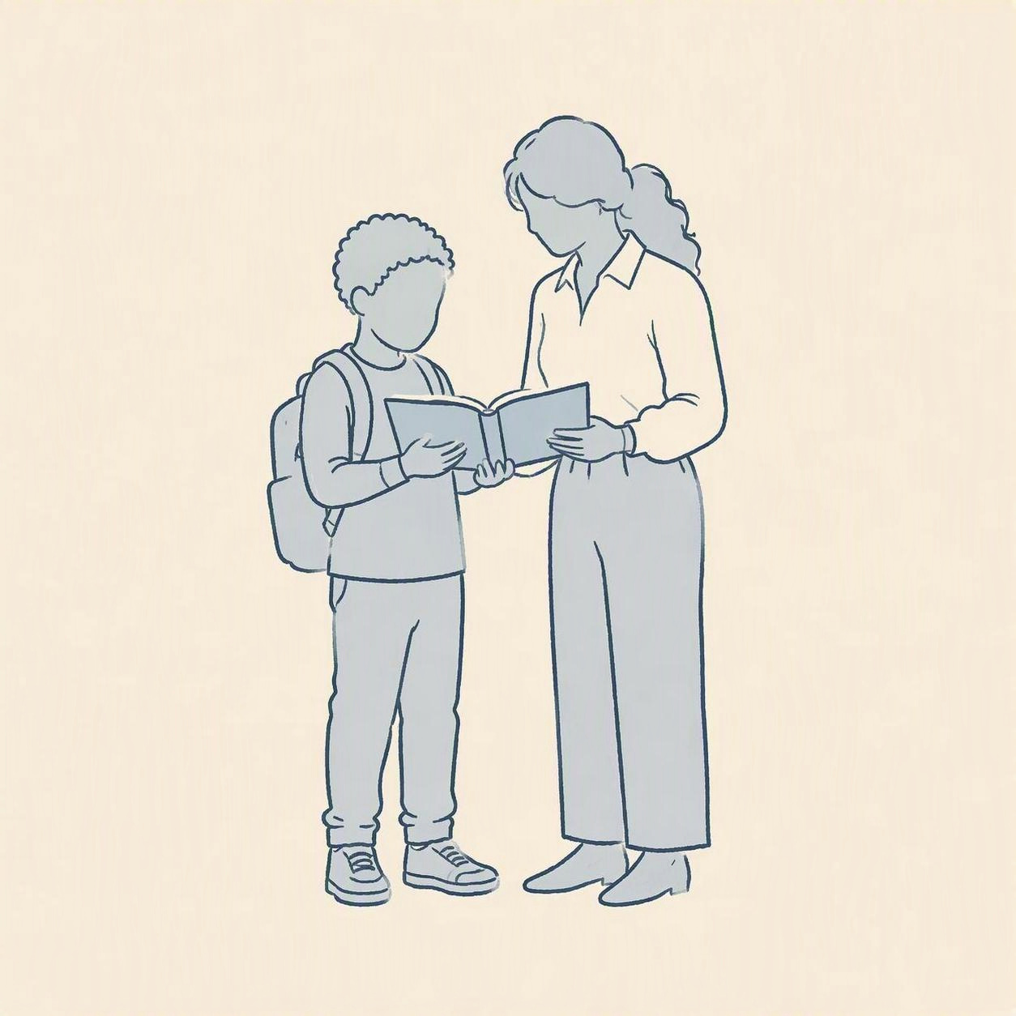
When maintaining the systems takes the space,
the support becomes the work.
Government Results
IPPs
tracking
report cards
approvals
submissions
verification
assessment plans
forms
Education Plan
updates
compliance
data entry
evidence
goals
deadlines
documentation
Assessment
re-entering information
Notes:
Silent sequence. Automatic advance enabled.
[Sources]
AI-generated conceptual illustration. Not a photograph of real people or a real school.
[/Sources]
AI-assisted continuity edit of the existing conceptual illustration.

Slide 4
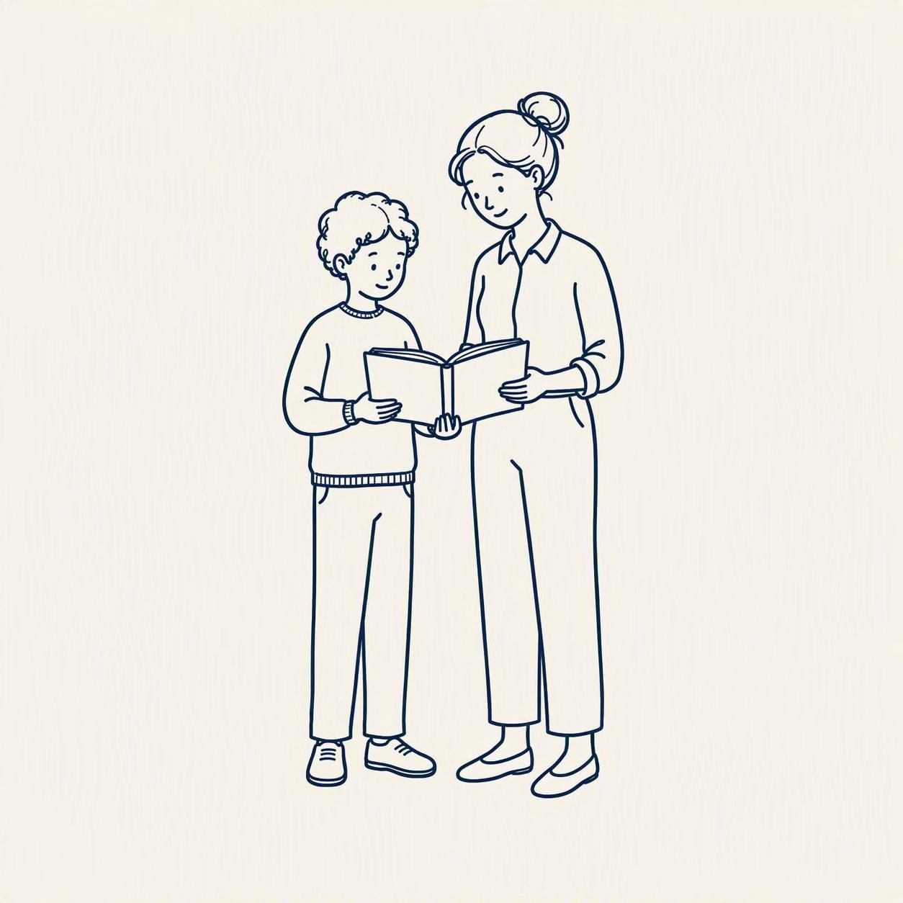
How much complexity have we passed on
to the people we lead?
Government Results
tracking
IPPs
report cards
approvals
submissions
verification
assessment plans
forms
Education Plan
updates
compliance
data entry
evidence
goals
deadlines
documentation
Assessment
re-entering information
Accountability matters. Not every burden belongs with schools.
Notes:
Silent sequence. Automatic advance enabled.
[Sources]
AI-generated conceptual illustration. Not a photograph of real people or a real school.
[/Sources]
[Sources]
AI-generated conceptual hand-drawn illustration. Not a depiction of actual people or a real school.
[/Sources]
AI-assisted continuity edit of the existing conceptual illustration.
Reporting, documentation and accountability may be legitimate. That does not mean every burden belongs with schools.

Slide 5
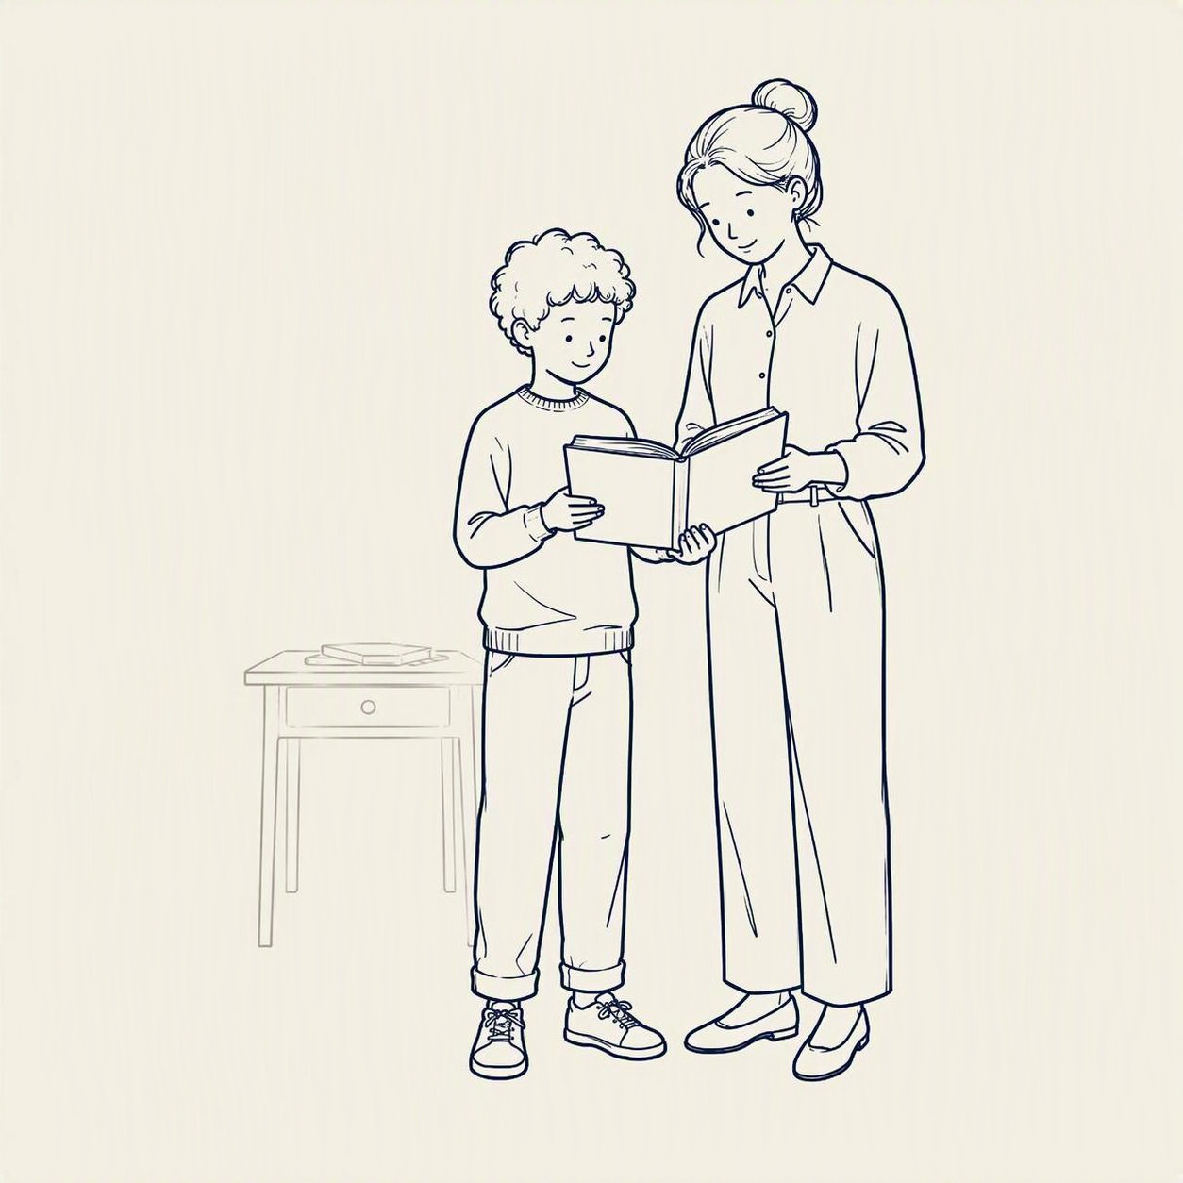
As leaders, we can absorb, remove and simplify.
IPPs
tracking
report cards
approvals
assessment plans
compliance
data entry
verification
documentation
submissions
evidence
updates
forms
goals
deadlines
Assessment
re-entering information
Education Plan
Government Results
Protect teachers’ capacity for the work only people can do.
Notes:
Silent sequence. Automatic advance enabled.
[Sources]
AI-generated conceptual illustration. Not a photograph of real people or a real school.
[/Sources]
[Sources]
AI-generated conceptual hand-drawn illustration. Not a depiction of actual people or a real school.
[/Sources]
AI-assisted continuity edit of the existing conceptual illustration.

Slide 6
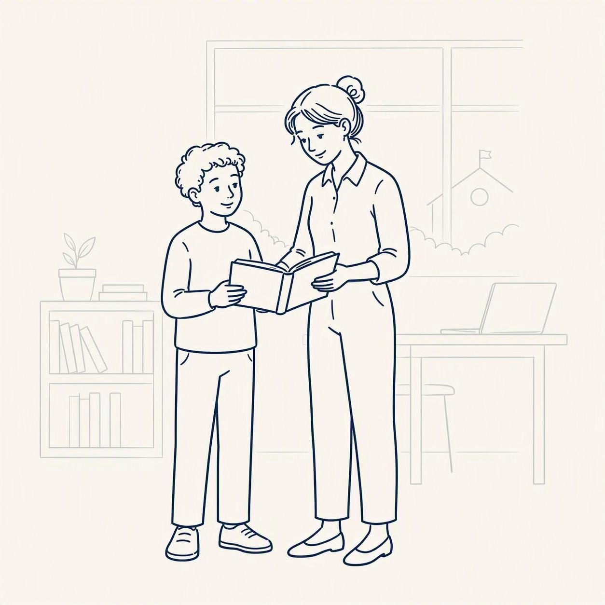
The system remains. It simply stops shouting.
IPPs
tracking
report cards
approvals
assessment plans
compliance
data entry
verification
documentation
submissions
evidence
updates
forms
goals
deadlines
Assessment
re-entering information
Education Plan
Government Results
Notice
Listen
Understand
Leadership is not the hero. Leadership shapes the conditions.
Notes:
Silent sequence. Automatic advance enabled.
[Sources]
AI-generated conceptual illustration. Not a photograph of real people or a real school.
[/Sources]
[Sources]
AI-generated conceptual hand-drawn illustration. Not a depiction of actual people or a real school.
[/Sources]
AI-assisted continuity edit of the existing conceptual illustration.

Slide 7

In education, our work is human.
IPPs
report cards
assessment plans
data entry
documentation
evidence
forms
goals
tracking
approvals
Notice
Listen
Understand
Encourage
Adapt
Connect
Create
Exercise judgment
Build belonging
compliance
verification
submissions
updates
deadlines
re-entering information
Assessment
Education Plan
Government Results
Our systems should make room for it.
Notes:
Silent sequence. Automatic advance enabled.
[Sources]
AI-generated conceptual illustration. Not a photograph of real people or a real school.
[/Sources]
Leadership’s responsibility is to shape the conditions in which teachers and students can flourish. Buildings, resources, systems and technology support the human purpose of education.
[Sources]
AI-generated conceptual hand-drawn illustration. Not a depiction of actual people or a real school.
[/Sources]
AI-assisted colour edit of existing conceptual illustration; line-art composition preserved.
Our success is judged on the humans we help to develop. Buildings, resources, systems and technology remain meaningful supports for human learning.

Slide 8
What if the way we lead is making it harder
to do the work that matters?
Leadership makes room for human work
UPDATE
GOVERNMENT RESULTS
IPPs
The burden
Systems created to help can crowd out
relationships, judgment and learning.
REPORT CARDS
Leadership
APPROVE
SUBMIT
VERIFY
PARENT
COMMUNICATION
FORMS
The responsibility
Absorb. Remove. Simplify.
Protect teachers’ capacity.
EDUCATION PLAN
TRACK
STUDENT TEACHER
The purpose
Keep buildings, resources and technology
working in support of people.
CODING
DATA ENTRY
DEADLINES
The system remains.
It simply stops shouting.
DOCUMENTATION
ASSESSMENT
RE-ENTER
What can we take off schools’ shoulders?
When the processes fill the space, people become harder to see.
Notes:
Interactive recap for live PowerPoint use. Four clicks reveal: burden, leadership responsibility, human purpose, and a reflective question. Slides 1–7 form the silent-video sequence. Export only slides 1–7 for LinkedIn. This summary intentionally reuses the final scene from the same story. AI-generated conceptual illustration.

