Slide 1
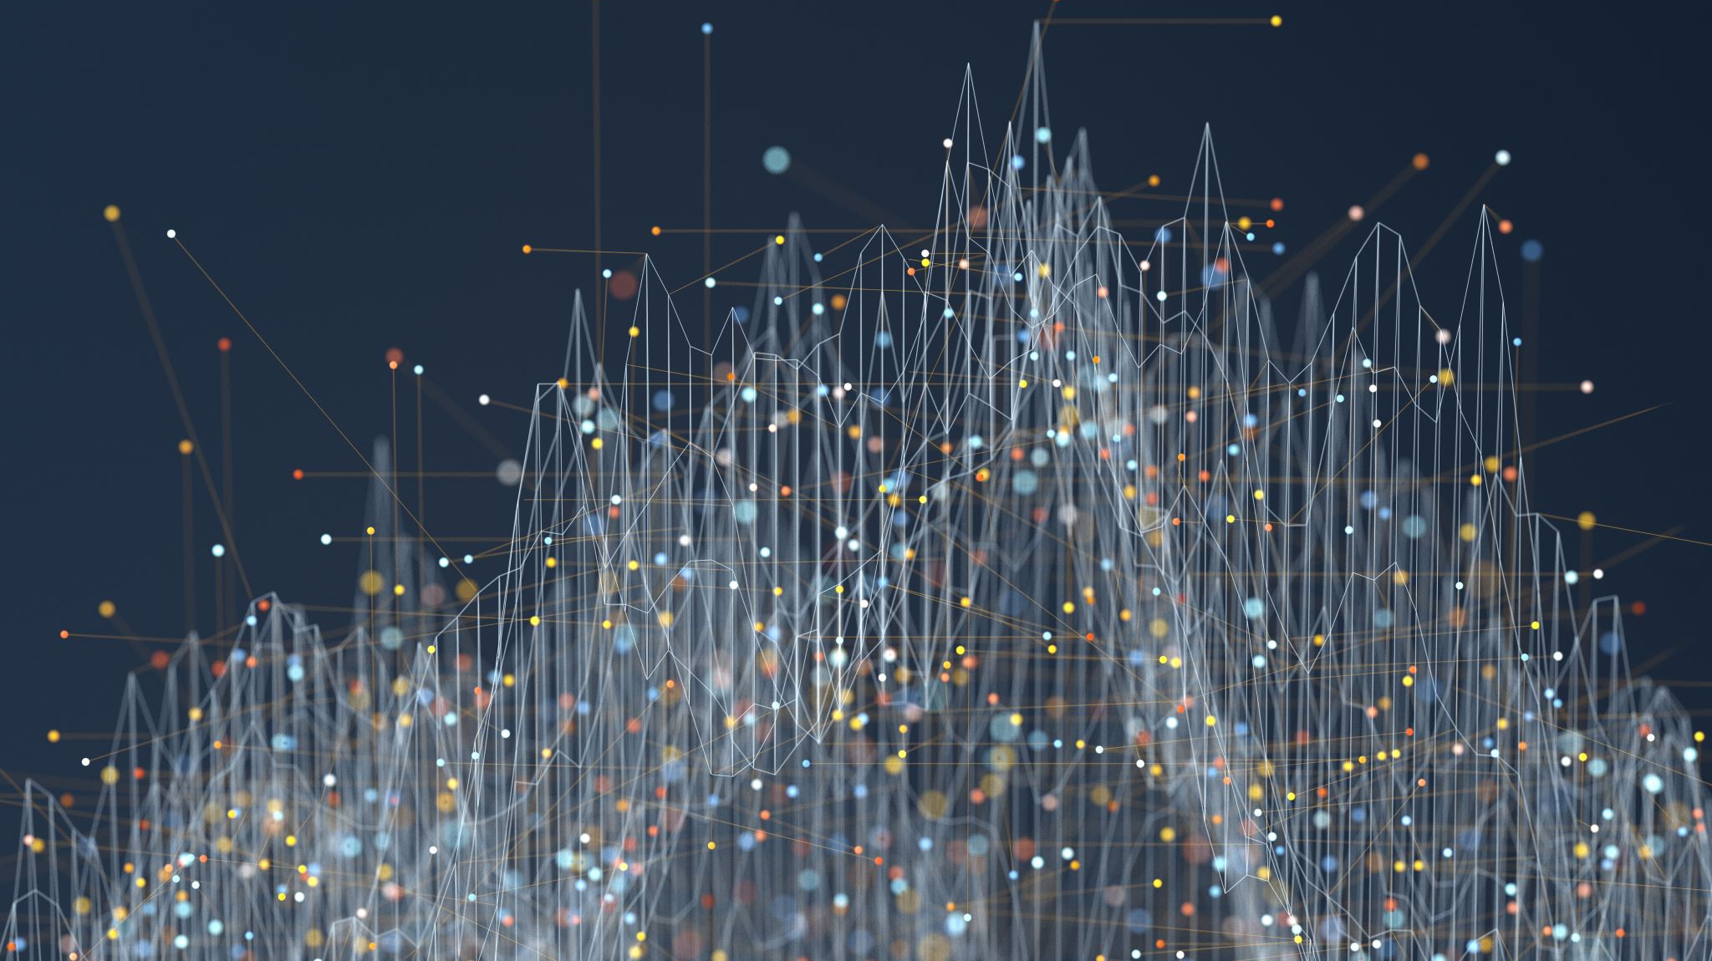
People’s App
“People’s app from the people to the people”

Slide 2
Problems
The government buildings are crowded
Bribe
The citizens will go to the government building several times
The citizen will go to many government buildings to get one paper
The paper cost

Slide 3
Normal cycle
Home
Transports
Government building
The citizen faces many problems to access to the government building

Slide 4
With People’s App
Home
From home or any place you can access all the data you want

