Slide 1

Quality of Life in Canada
An Analytical Power BI Report | 2019–2023
Salma Babiker April 2026

Slide 2
Project Overview & Structure
About This Report
Report Structure
Data sourced from Statistics Canada Web Data Service (WDS) API, modeled and visualized in Microsoft Power BI. Covers five Quality of Life dimensions across all Canadian provinces from 2019 to 2023.
Page 2 — Summary Dashboard
Aggregate KPIs & cross-dimensional findings
Pages 3–7 — Dimension Reports
Page 8 — Conclusion
Society · Prosperity · Governance · Environment · Health
Key takeaways & policy implications
Society
Prosperity
Governance
Environment
Health

Slide 3
SUMMARY DASHBOARD
Uneven Progress: Growth Without Equal Gains in Well-being
8.53M
61.5
139K
Aggregate Income
Health Life Expectancy
Natural Areas
144K
141K
Number of Persons
Number with Income
Key Findings
Key Insight
Total persons grew from 27K (2019) to 31K (2023) driven by immigration policy
Number_with_Income closely tracks population — broad but unequal participation
Toronto (Ontario) + British Columbia = over 48% of provincial population
Health-adjusted life expectancy declining from pre-pandemic baseline
Aggregate income concentrated in few provinces
"Despite rising aggregate income, median income and health outcomes lag behind — indicating unequal wealth distribution and limited governance impact on overall quality of life."

Slide 4
SOCIETY
Society Growth & Distribution Insight
2.63K
5.97K
677
Avg Society Population
Max Society
Min Society
144K
40K
Total Population
Society Score
Population grew consistently 2019–2023, driven by federal immigration targets
Society growth rate rose from 1% (2020) to 4% (2023) — accelerating pressure on housing and services
Interactive slicer by Year, Province, and Age enables sub-population drill-down
Min 677 vs Max 5.97K reveals deep regional inequality across provinces
Key Insight
"Positive growth trajectory alongside significant distribution disparity — deep regional inequality may require targeted social investment."

Slide 5
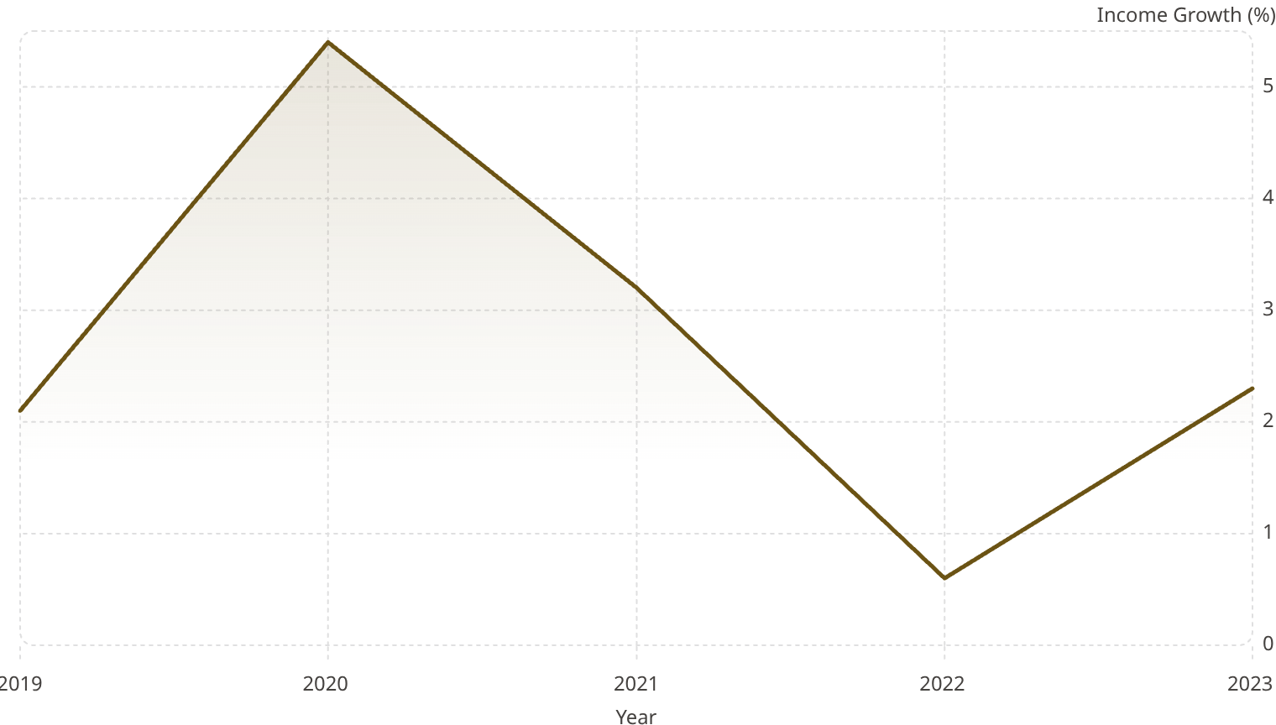
PROSPERITY
Per Capita Income by Province — 2019–2023
31M
2M
Total Value
Max Value
673
90K
Min Value
Avg Per Capita Income
Ontario leads all provinces in total income value
Avg Per Capita Income line is relatively flat — income gap driven by population size, not per-person earnings alone
Income growth peaked at 5.4% in 2020 (CERB pandemic transfers), dropped to 0.6% in 2022 due to inflation, partially recovering to 2.3% in 2023
5.4
3.2
2.1
2.3
0.6
"Ontario leads in per capita income. Total values rising steadily, but growth rate declining since 2020 — real purchasing power needs continued monitoring."

Slide 6
GOVERNANCE
Race & Ethnicity Dominate Hate Crime Trends
9K
2K
962
Total Cases
Race/Ethnicity
Religion-Motivated
559
60
Sexual Orientation
Language-Motivated
Race/Ethnicity is the dominant hate crime motivation across all target groups
Religion is the second-most prevalent motivation province-wide
Targets include: Age groups, Immigrants & Newcomers, Language communities
Both quarterly and year-to-date data confirm a consistent pattern
Key Insight
"Race/Ethnicity-motivated hate crimes account for the largest share (~9K cases). This pattern is consistent across all target groups — signaling urgent need for anti-discrimination policy."

Slide 7
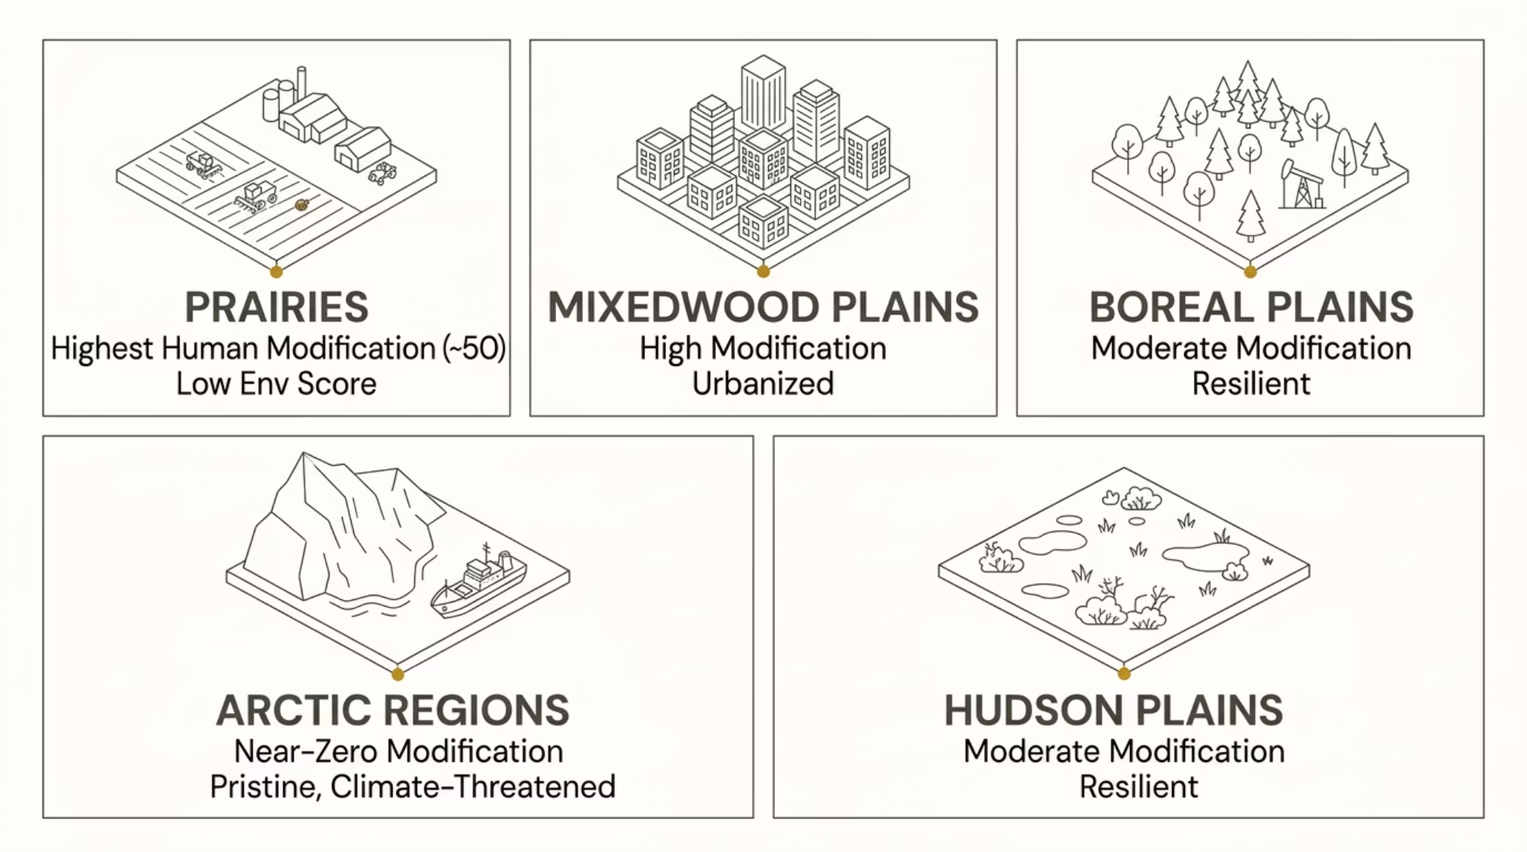


ENVIRONMENT
Environmental Conditions & Human Impact Analysis
4.54K
16.52
Avg Patch Size
Human Landscape Modification
139K
46.64K
Natural Areas
Overall Env. Score
Prairies ecozone = highest human modification score (~50)
Mixedwood Plains and Atlantic Maritime are most heavily farmed and urbanized
Arctic ecozones show near-zero modification — remote and undisturbed
Clear negative correlation: higher modification → lower environment score
"Higher human landscape modification is directly associated with lower environmental quality. Prairie ecozones most at risk — Arctic regions pristine but face emerging climate-driven threats."

Slide 8
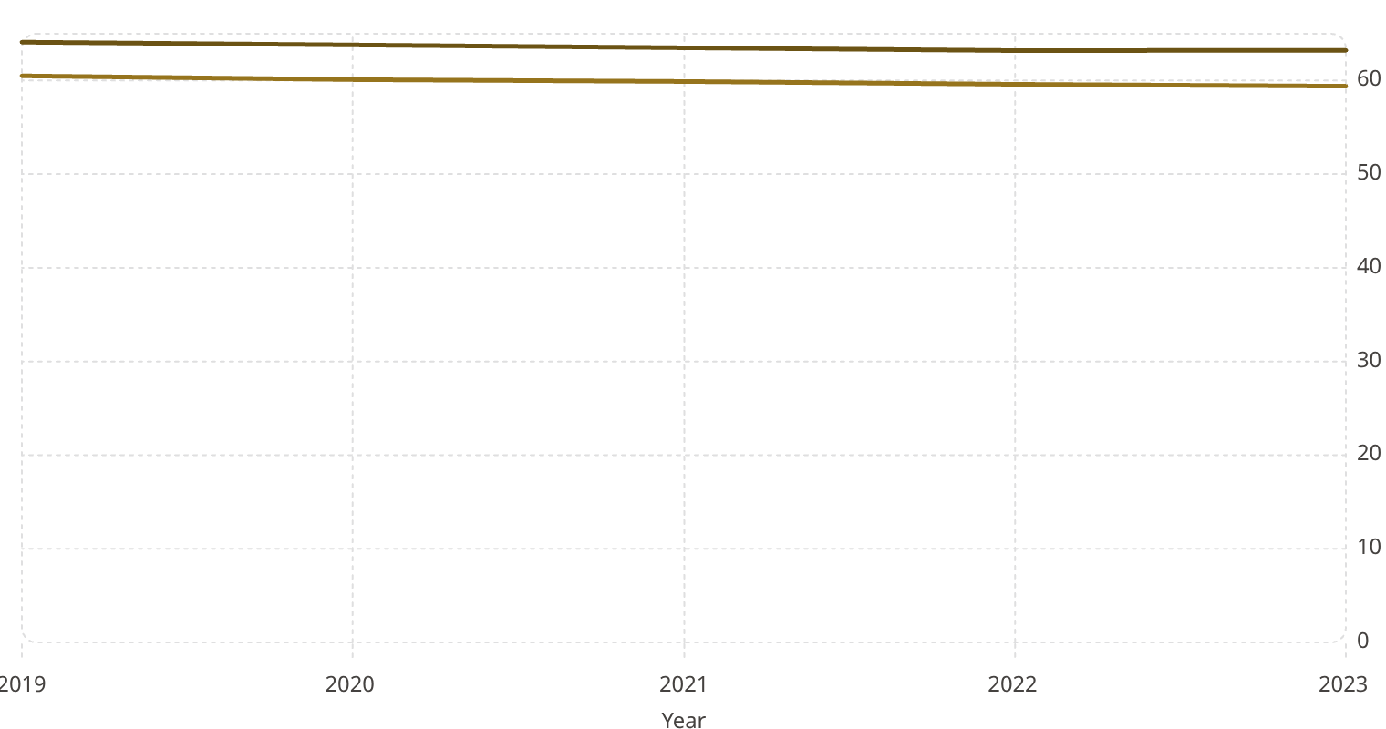

HEALTH
Health-Adjusted Life Expectancy: Trends & Disparities
61.48
3.84
59.10
Avg HALE
Gender Gap (yrs)
Latest HALE
63.23
59.39
Female Health Exp.
Male Health Exp.
Male HALE
Female HALE
British Columbia leads in HALE; Manitoba records the lowest values
All provinces show a declining HALE trend 2019–2023
Females outlive males in healthy years by ~3.84 years consistently
Decline driven by: COVID-19 long-term effects, chronic disease, mental health burden
64.1
63.8
63.5
63.2
63.2
60.5
60.1
59.9
59.6
59.4
"HALE is gradually declining across Canada. Provincial disparities correlate with socioeconomic and environmental quality indicators."

Slide 9
Conclusion & Key Takeaways
1
2
3
Growth Without Equity
Environmental Trade-Off
Declining Health Baseline
Canada's population and income have grown, but benefits are unevenly distributed across provinces and demographics. Rising aggregates mask persistent gaps in median income and social services access.
Economic development zones show measurably worse environmental quality, highlighting the real cost of urbanization and industrial activity on Canada's natural landscape.
HALE is falling across all provinces, signaling a health system under sustained post-pandemic pressure. Provincial disparities persist despite universal healthcare coverage.
References
Statistics Canada. QoL Hub. https://www160.statcan.gc.ca
Statistics Canada. WDS User Guide. https://www.statcan.gc.ca/en/developers/wds/user-guide
Iteration Insights. How to Use Statistics Canada Data in Power BI. https://iterationinsights.com
Microsoft. Power BI Documentation. https://learn.microsoft.com/en-us/power-bi/
Few, S. (2012). Show Me the Numbers. Analytics Press.
Knaflic, C. N. (2015). Storytelling with Data. Wiley.
Salma Babiker | April 2026

