Slide 1
The main topic of our project is to create (Hypermarket without human assistance or crowding ,Easy fast shopping ,You don’t need your wallet to purchase groceries and Easy useable application).
To build this market it will be a saver for you to buy electronic devices (like sensors, cameras, and launching an application) one time rather than pay monthly to a human employees for years.

Slide 2
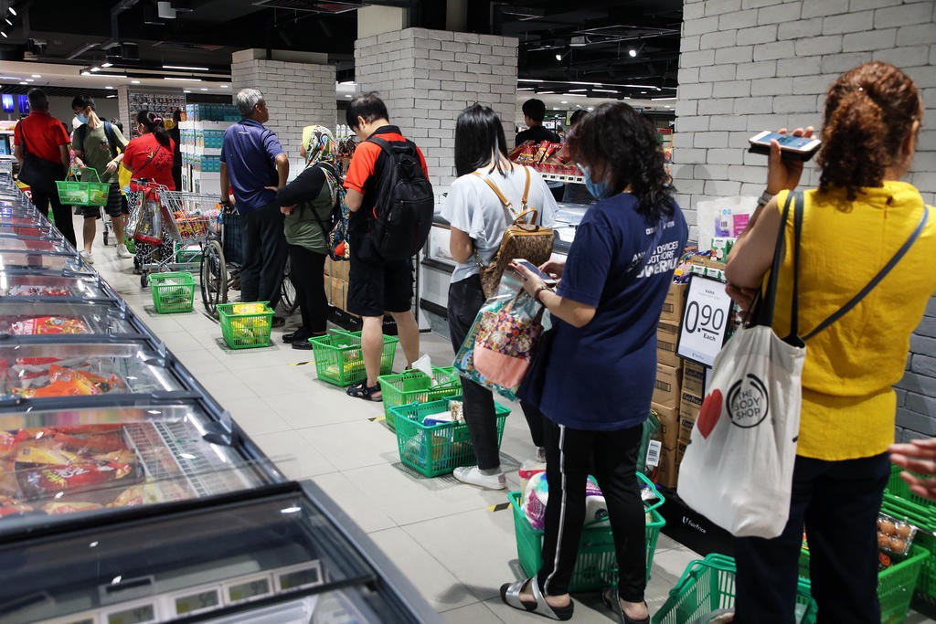
Crowding in the supermarket and long rows on the casher is one of the unlovely problems nowadays.
Imagine that you have to wait in this row to just buy a can of soda

Slide 3
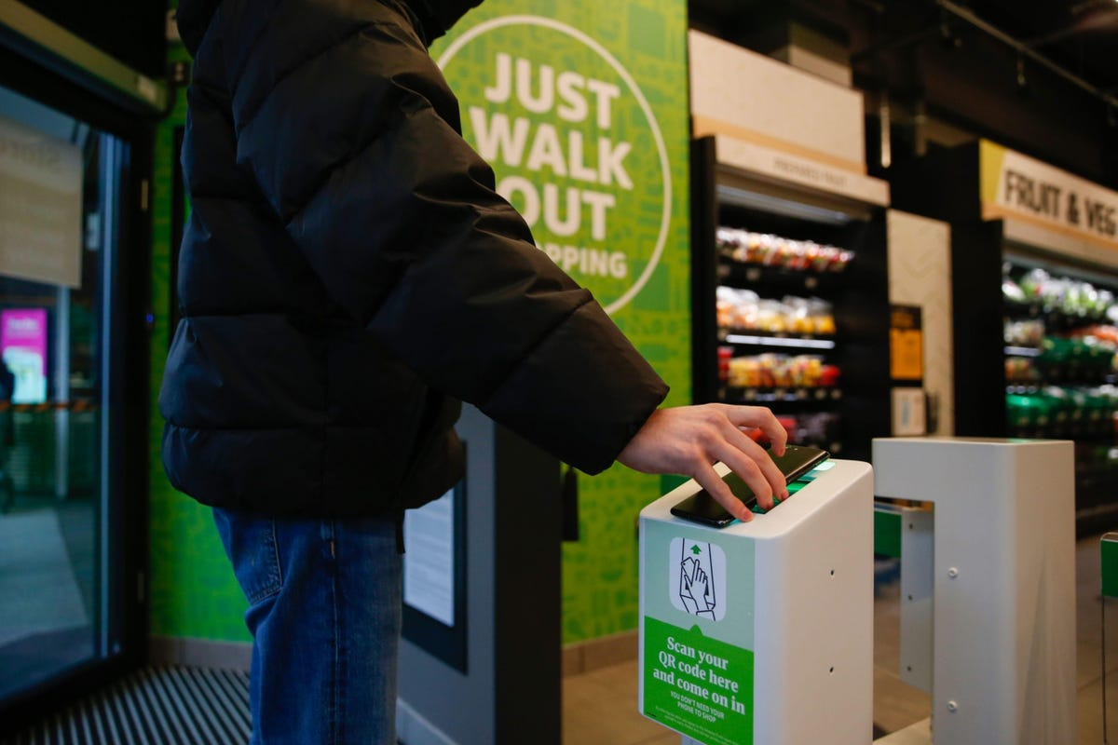
The application allows the user to scan a QR code and enter the supermarket

Slide 4
You just need to scan the QR code on any cart after your entrance and take anything you want from the shelves and put it in your cart and just in the way getting out of the supermarket confirm the purchases on what you took on the cart’s screen and get out and the purchases will be paid by his visa which is linked to the application and he will receive notifications of the receipt of his purchases.

Slide 5
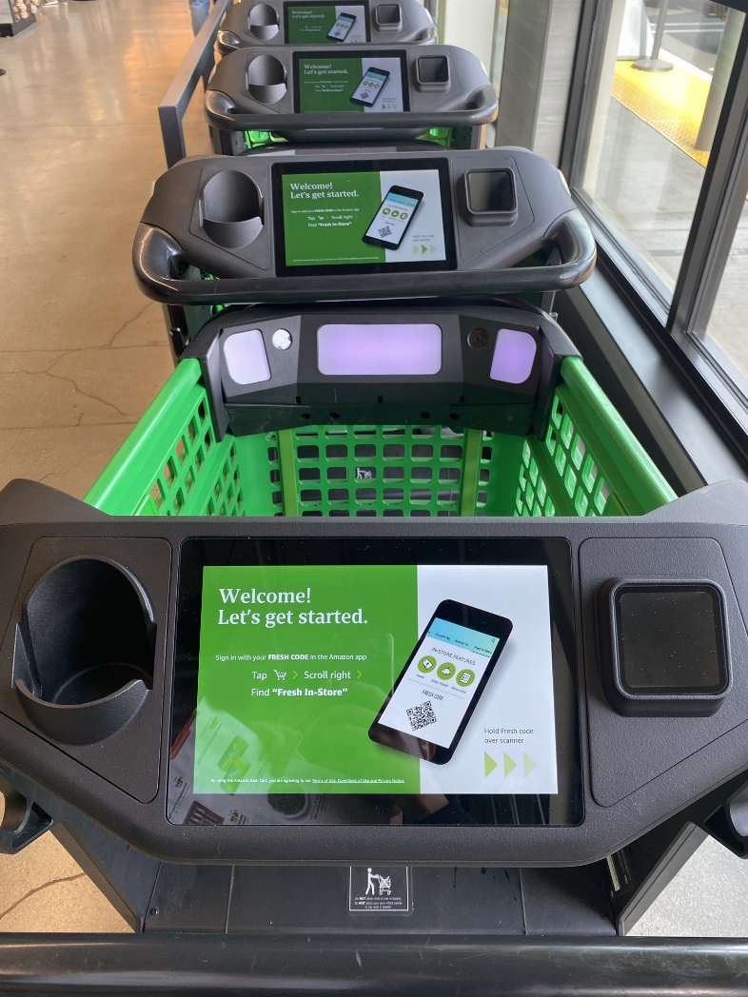

Slide 6
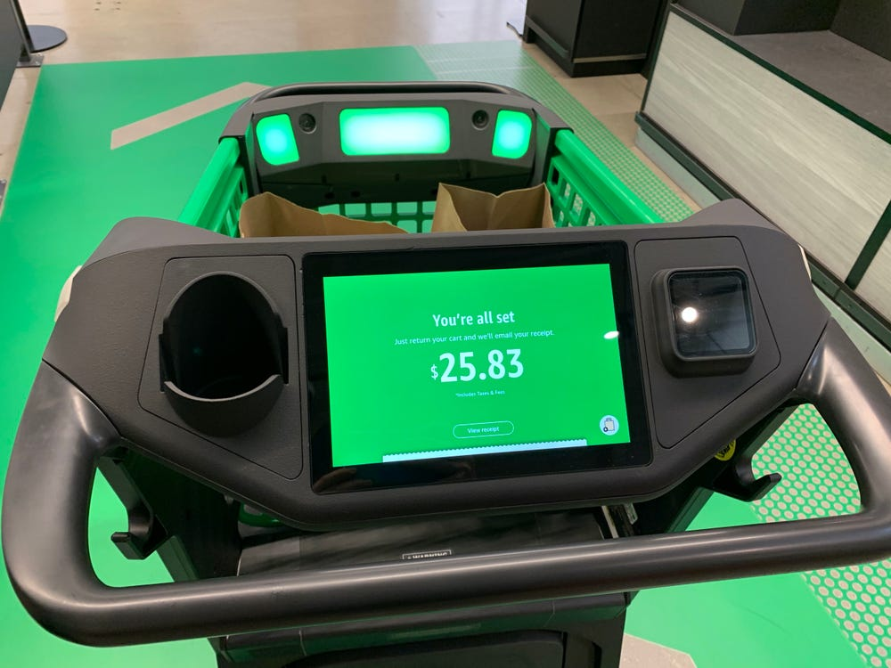

Slide 7
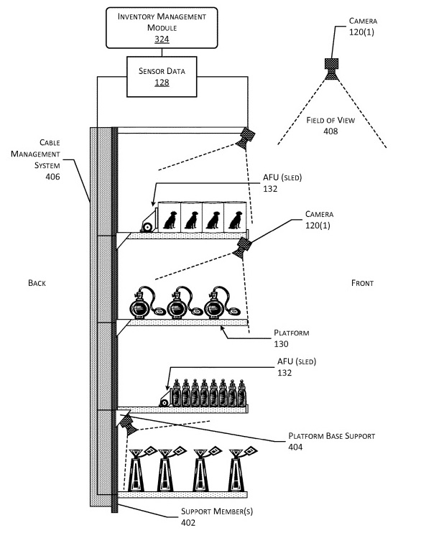
This picture show that how the products will be checked from the shelves to the cart

Slide 8
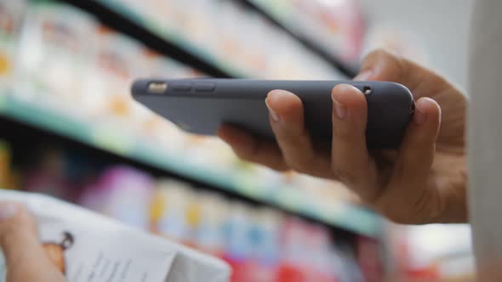
There will be a feature on the app that makes you able to scan the products from the phone and buy it without using any carts

Slide 9
There will be three teams responsible for the market:
Team1: will be responsible for market design
Team2: will be responsible for sensors and cameras
Team3: will be responsible for the software of the application

Slide 10
The project will be ready after 4 months with Budget: 200,000$:
For Two months, the market will be built and designed
For Two weeks, a team of technical engineers will set the sensors and the cameras.
For Two weeks, a team of programmers will make the mobile application.
The project is being tested for 3 weeks.

Slide 11
Assumption:
The project does not take more than 4 months.
The cost no more 200,000$
Constraints:
You must link your visa to the application
You must have your phone when you enter the market
The project must not exceed 200,000 $.
The project must take time less than 4 months.
The App is for this market only
High level risks:
Increase in the cost.
Not to satisfy the users.
Problems in application’s system.
Electricity failure
Security Hack

Slide 12
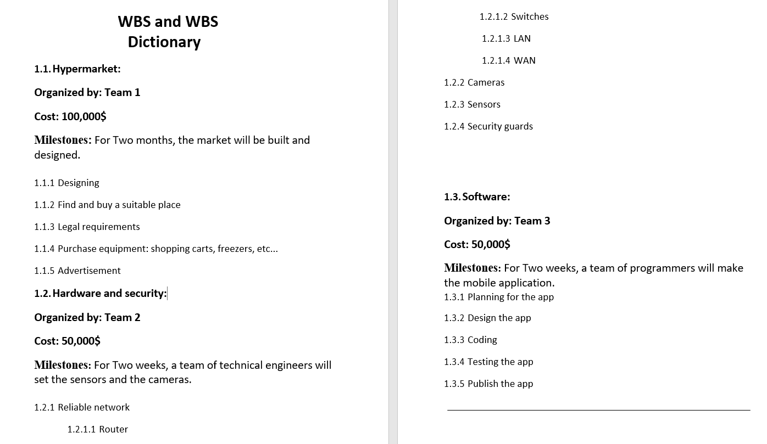

Slide 13
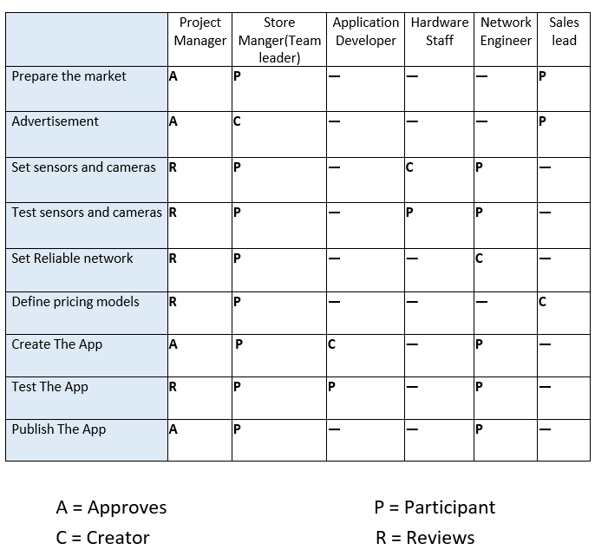
Responsability Matrix:

Slide 14
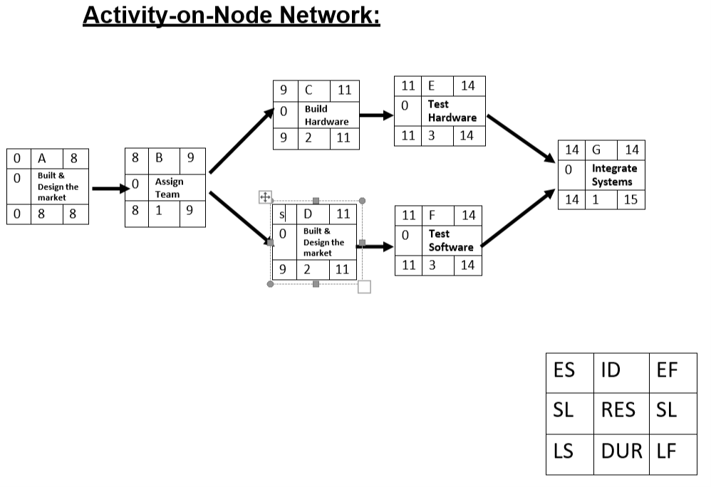
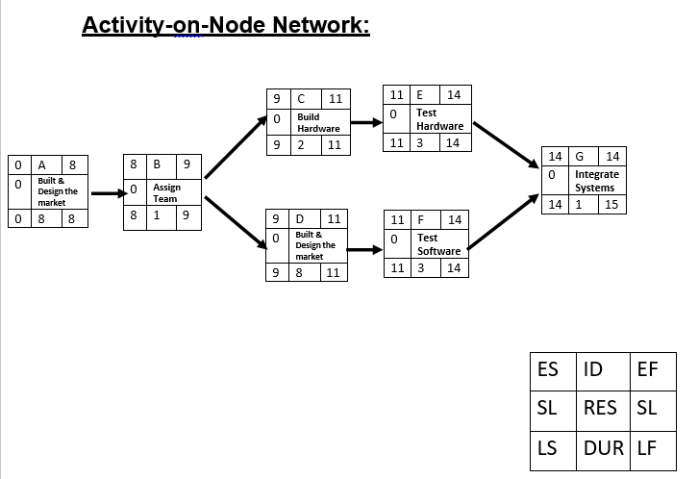
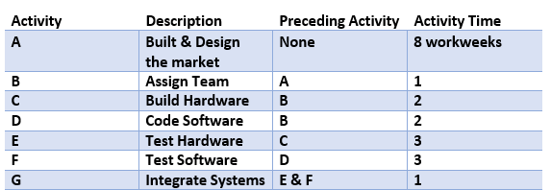
Project Network

Slide 15
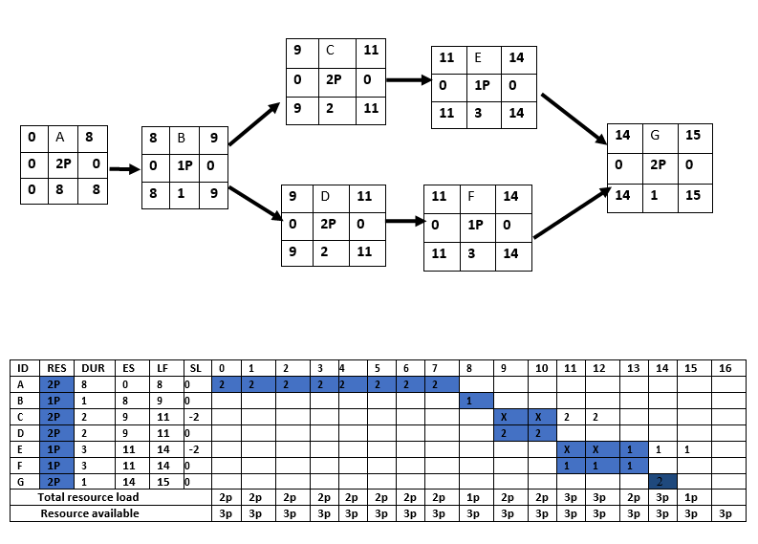
Resource Constrained

Slide 16
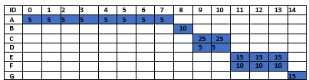
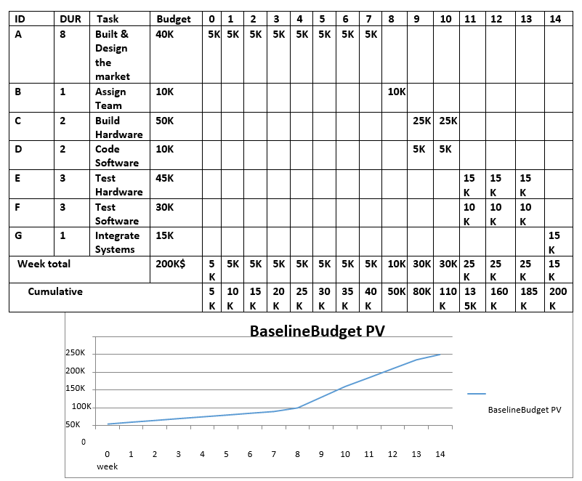
Budget Baseline

Slide 17
Risk Management
The risks That can face our project:
Increase in the cost.
Not to satisfy the users of product.
Problems in application’s system.
Electricity failure.
Security Hack.
How to deal with these risks?
Increase in the cost→ Reducing costs and using less expensive materials.
Not to satisfy the users of produce→ Create feedback on the application to hear customer issues and try to solve them and make offers and discounts.
Problems in application’s system→ Hiring Technician team to ensure that the application runs well.
Electricity failure→ Providing electricity generators.
Security Hack→ Improve the security of the app and use encryption.
Monitor the project:
Creating milestones.
Set realistic, clear and measurable goals.
Meet regularly with team and stakeholders.
Have clear deadlines.
Track Key Performance.

