Slide 1
Big Data Tasks - SIC
Big Data
Done By : Salma Mamdoh

Slide 2



Task 1 Sqoop + HDFS

Slide 3
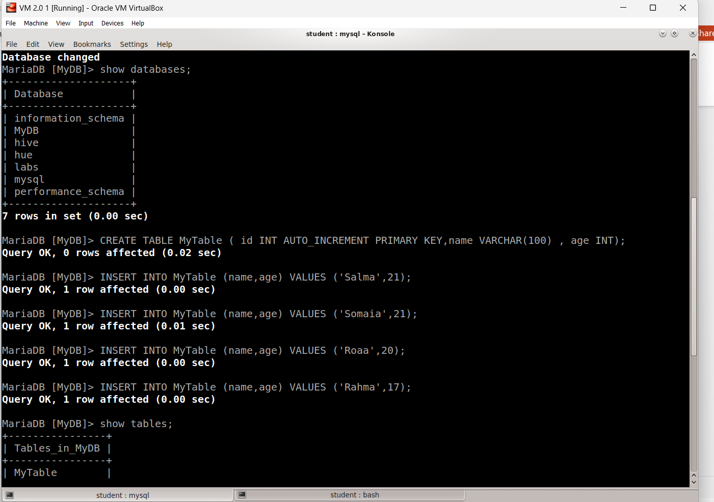
Creating Database

Slide 4
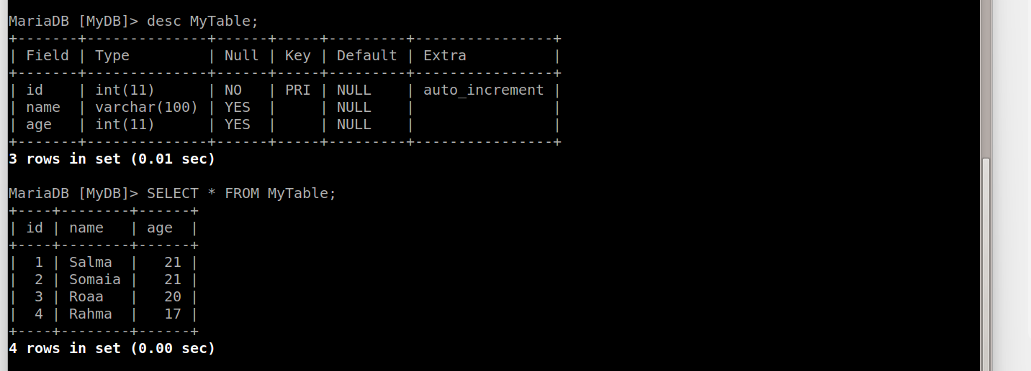
The Schema and the Populated data of the Created Table

Slide 5
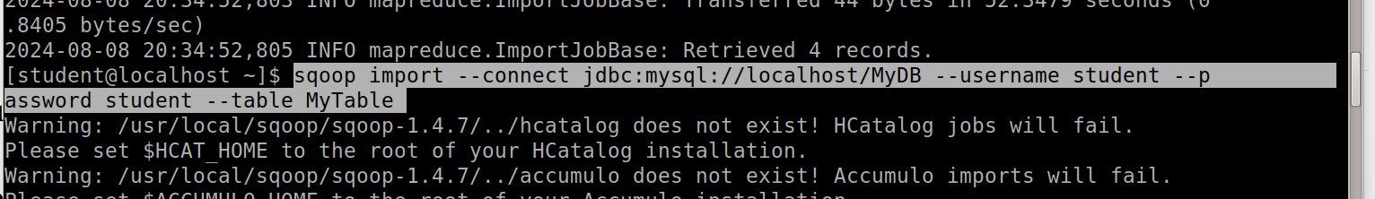
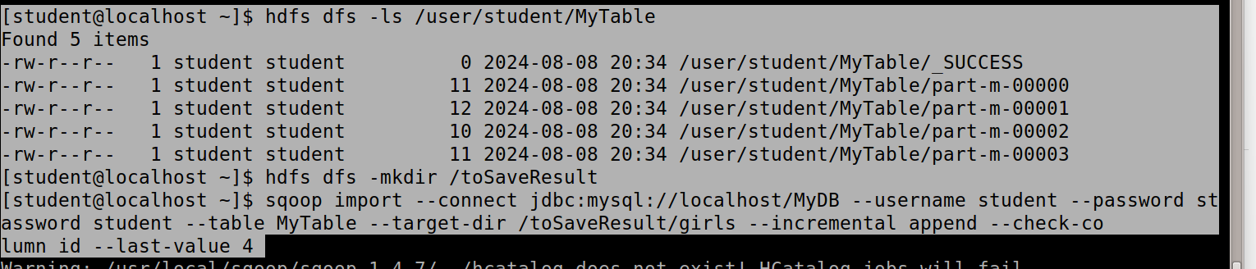
Importing Data in incremental mode using Sqoop

Slide 6
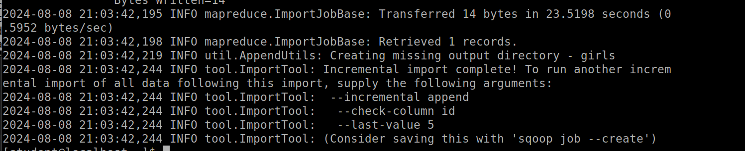
Importing data using incremental mode method

Slide 7
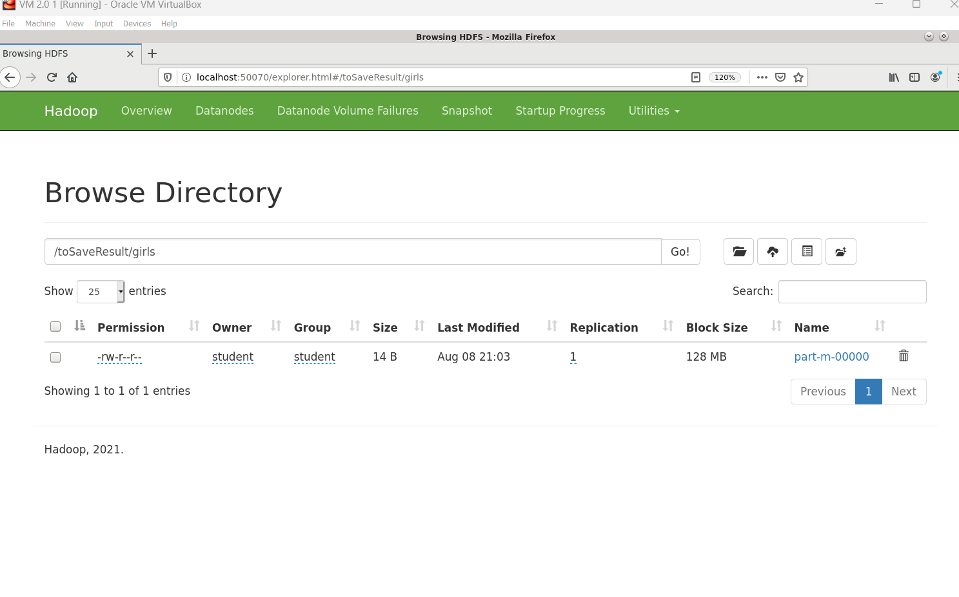
Exploring the imported data in HDFS

Slide 8



Task 2 Flume + Kafka

Slide 9
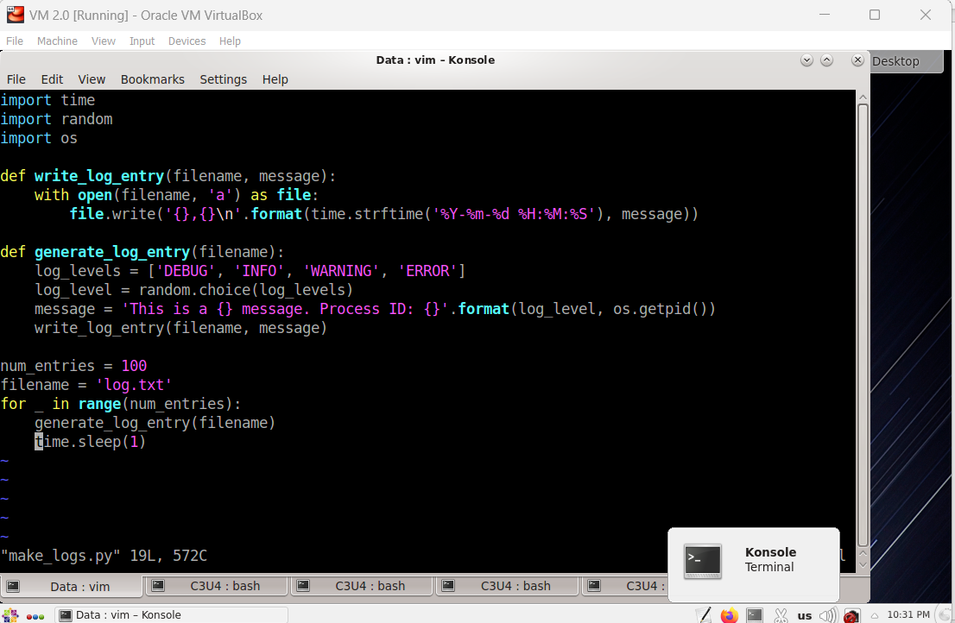
Creating logs By Python Script command used : vim make_logs.py

Slide 10
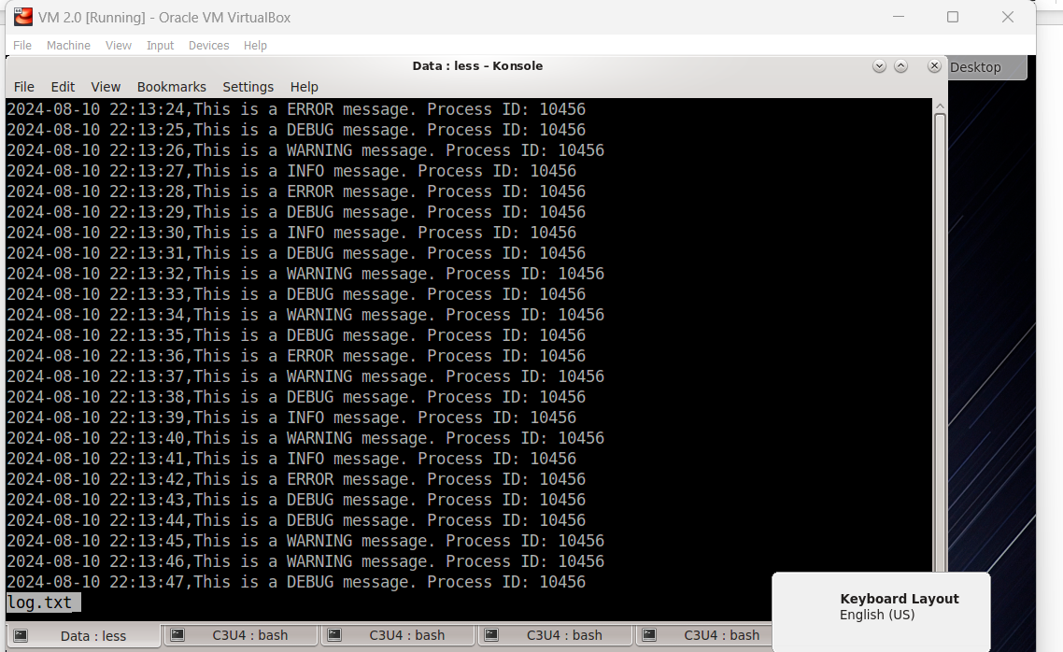
The generated log command to run python_Script : python make_logs.py , to see content of file: less log .txt

Slide 11
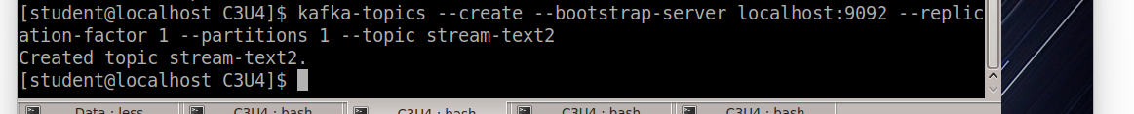
Create Kafka Topic command used : kafka-topics --create --bootstrap-server localhost:9092 --replication-factor 1 --partitions 1 --topic stream-text2 Created topic stream-text2.

Slide 12
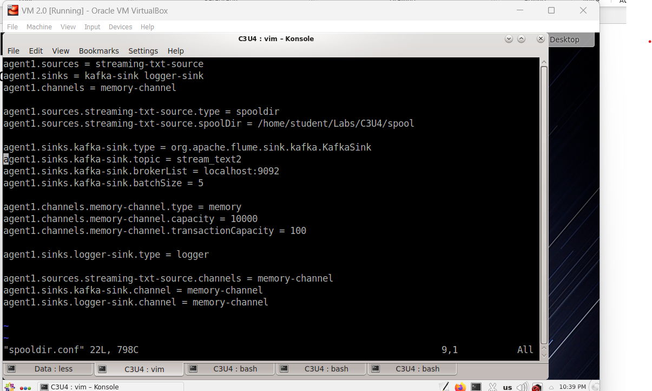
Flume Config File commands used : vi spooldir.conf

Slide 13
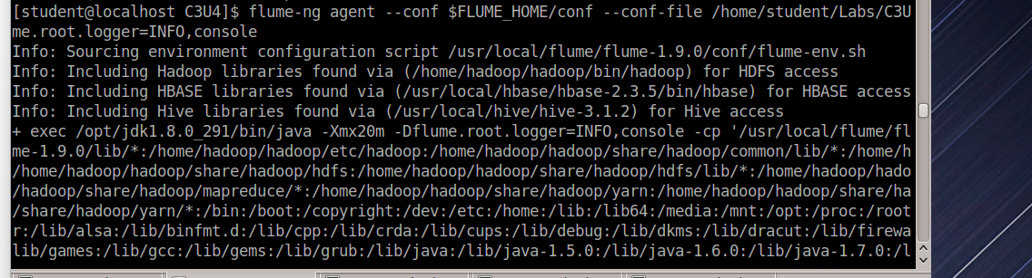
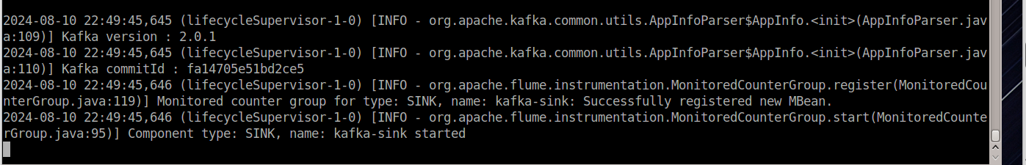
Start Flume commads used : rm –rf ./spool ( to delete any previous data ) mkdir spool ( to store the result data) start flume : flume-ng agent --conf $FLUME_HOME/conf \ --conf-file /home/student/Labs/C3U4/spooldir.conf \ --name agent1 -Dflume.root.logger=INFO,console

Slide 14
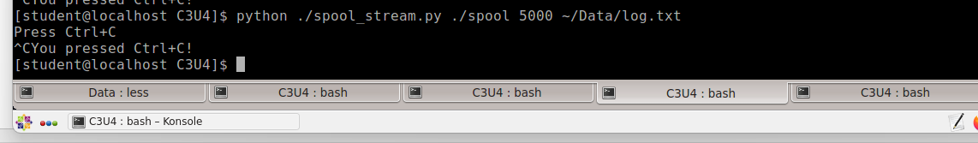
Python Script for Data Streaming command used : python ./spool_stream.py ./spool 5000 ~/Data/log.txt

Slide 15
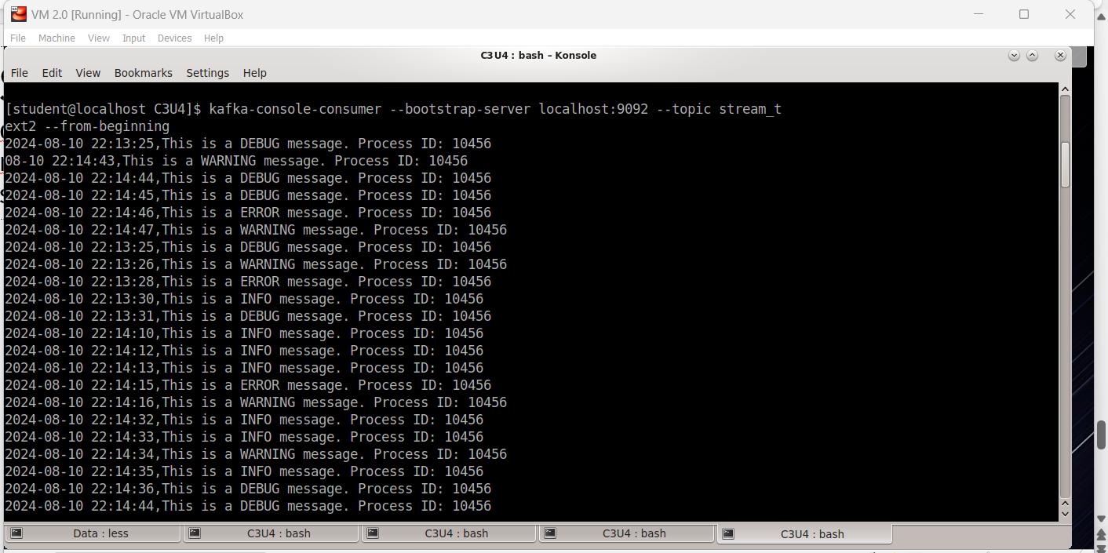
THE FINAL REAULT command used : kafka-topics --create --bootstrap-server localhost:9092 --replication-factor 1 --partitions 1 --topic stream_text

Slide 16
