Slide 1
In Depth Analysis of Adventureworks
Done By: Salma Mamdoh

Slide 2
Introduction
I utilized the AdventureWorks database to implement a comprehensive ETL (Extract, Transform, Load) process using SQL Server Integration Services (SSIS) and performed data analysis with Power BI.

Slide 3
01
ETL
Using SSIS

Slide 4
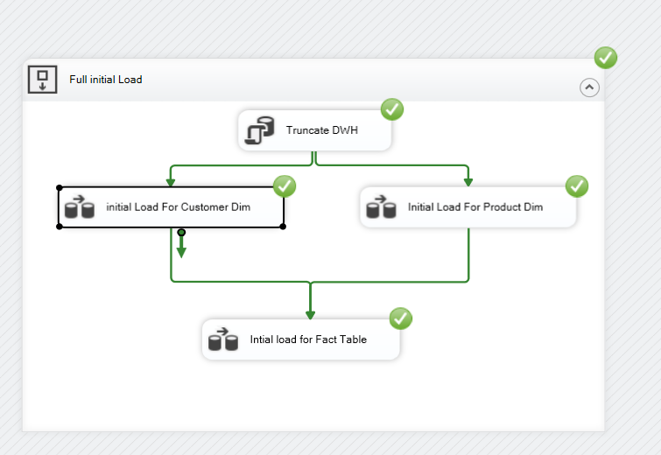
Control Flow

Slide 5
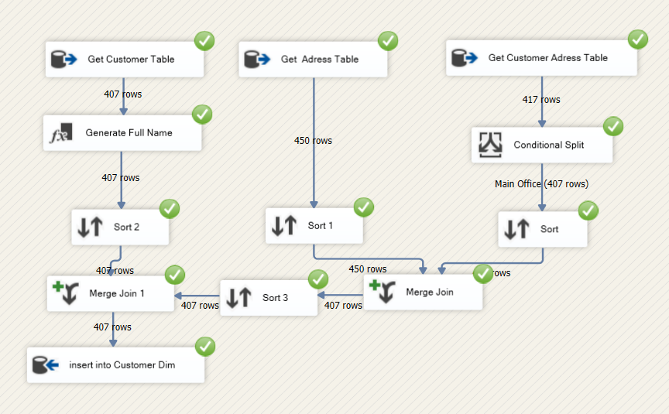
Customer Dimension Population

Slide 6
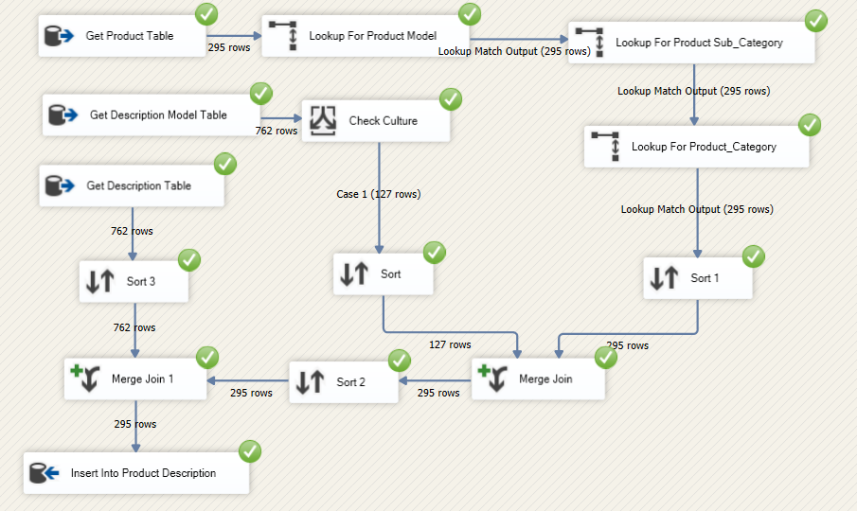
Product Dimension Population

Slide 7
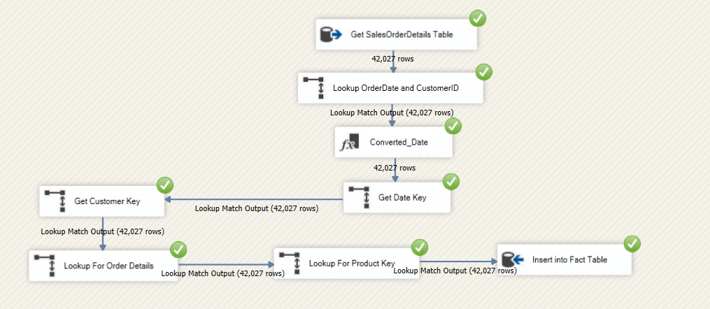
Fact Sales Population

Slide 8
02
Analysis
Using Power BI

Slide 9
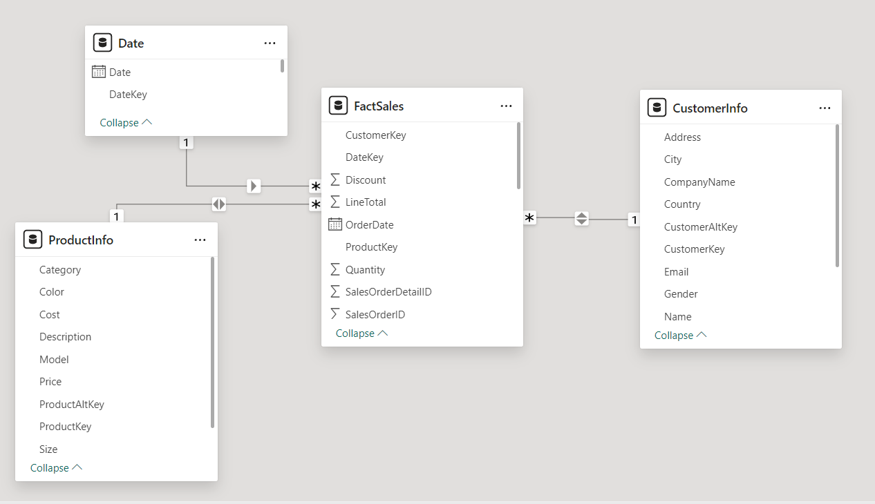
Data Model in Power BI

Slide 10
Customer Page Key Elements
Customer Count: indicating the size of their customer based on country and time slicer.
Total Revenue: The Total Revenue Based on chosen country and date , reflecting overall financial performance.
Order Volume: The number of orders done by this number of customers in this country in specified period of time , showing business activity and demand.
Geographical Distribution: A pie chart displays the distribution of customers by country, helping identify market concentration and expansion opportunities.
Revenue by Customer: A line chart shows the revenue generated by each customer, highlighting variability in spending and aiding in segmentation strategies.
City-Level Data: A table provides metrics like total orders and revenue at the city level, useful for pinpointing high-performing regions for targeted sales and marketing efforts.

Slide 11
Average Order Price: The average order price based on customer country and date, reflecting the typical value of each customer transaction.
Revenue Trends: A line chart shows total revenue over time, broken down by year, quarter, and customer gender, helping analyze revenue trends, seasonal patterns, and gender-based spending differences.
Gender Distribution: A pie chart reveals the customer gender distribution based on the country , providing insight into customer demographics and potential for targeted marketing.
Customer Distribution: A world map shows customer locations with high concentrations in the United States, Canada, and the United Kingdom, illustrating the global reach and geographical distribution of the customer base.

Slide 12
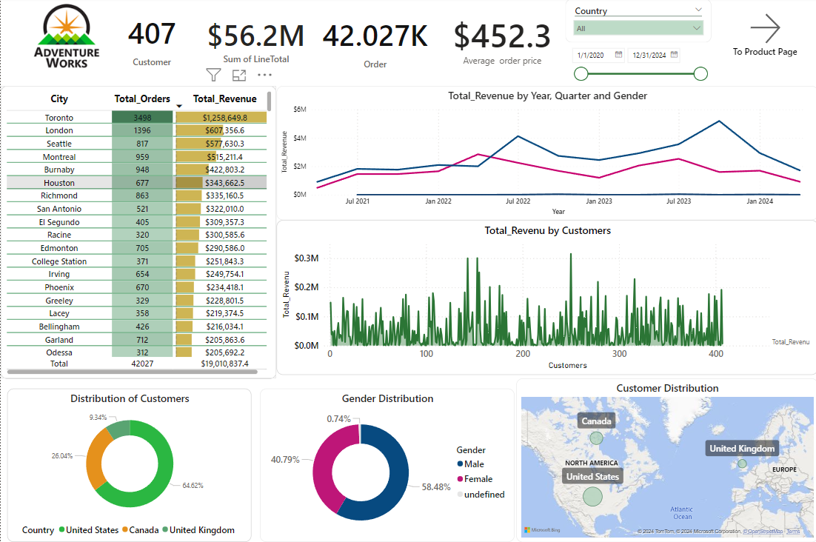

Slide 13
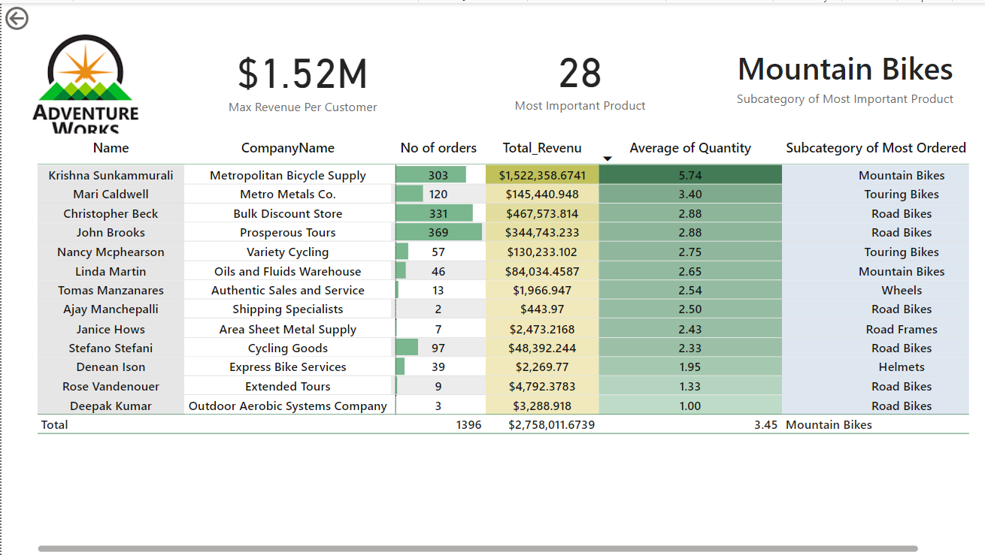
Customer Details in London

Slide 14
Product Page Key Elements
Number of Products: giving an overview of the company's product portfolio based on the country and date selected .
Number of Orders: indicating the volume of customer transactions.
Total Revenue: reflecting the overall financial performance from product sales.
Product Details: A table breaks down top-selling product models by total orders and revenue. This helps identify the most popular and profitable products.
Total Orders by Category: A stacked bar chart displays order volumes across main product categories (Bikes, Components, Clothing). This visualization helps understand sales distribution and focus efforts on the most successful categories.
Number of Orders by Sub-Category:A bar chart provides detailed order volumes for sub-categories (e.g., Mountain Frames, Road Frames, Jerseys, Helmets). This detail supports optimization of product mix and inventory management by highlighting which sub-categories perform best.

Slide 15
Average Selling Quantity: indicating the typical number of items purchased per transaction. This helps understand order size and customer purchasing behavior.
Average Selling Price: reflecting the average price of products. This metric is essential for assessing pricing strategies and revenue potential.
Average Revenue by Year and Quarter: A line chart shows trends in average revenue over time, broken down by year and quarter. This helps identify seasonal patterns and track revenue performance changes.
Total Revenue by Category: A pie chart displays revenue contributions from product categories (Bikes, Components, Clothing, Accessories). This helps understand the sales mix and relative importance of each category.
Average Units Sold by Category and Country: A stacked bar chart shows the average number of units sold per order for each product category, segmented by country (Canada, United Kingdom, United States). This data aids in tailoring marketing efforts and inventory management based on regional preferences and buying behaviors.

Slide 16
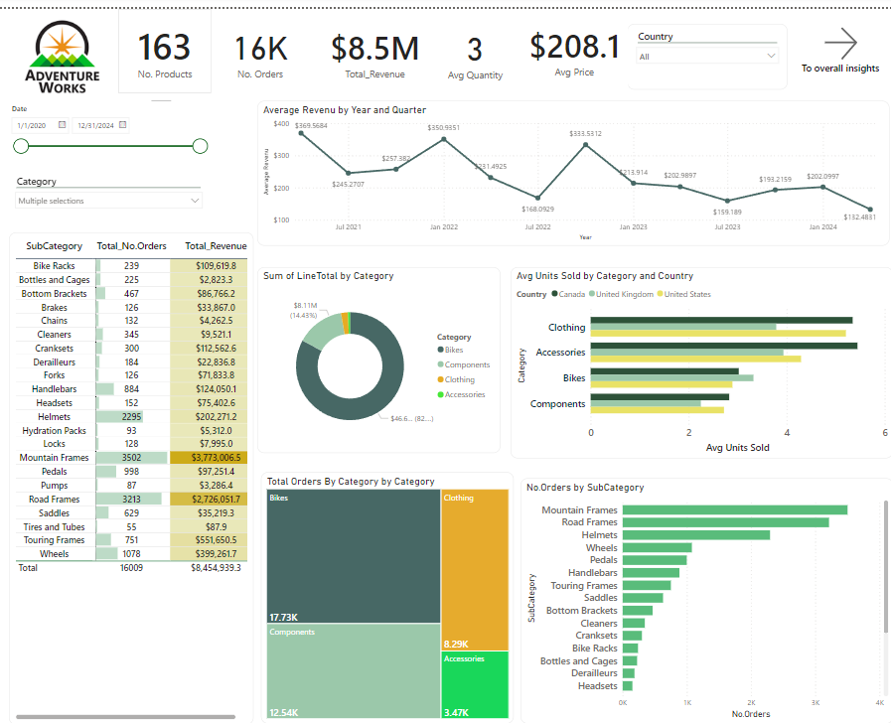

Slide 17
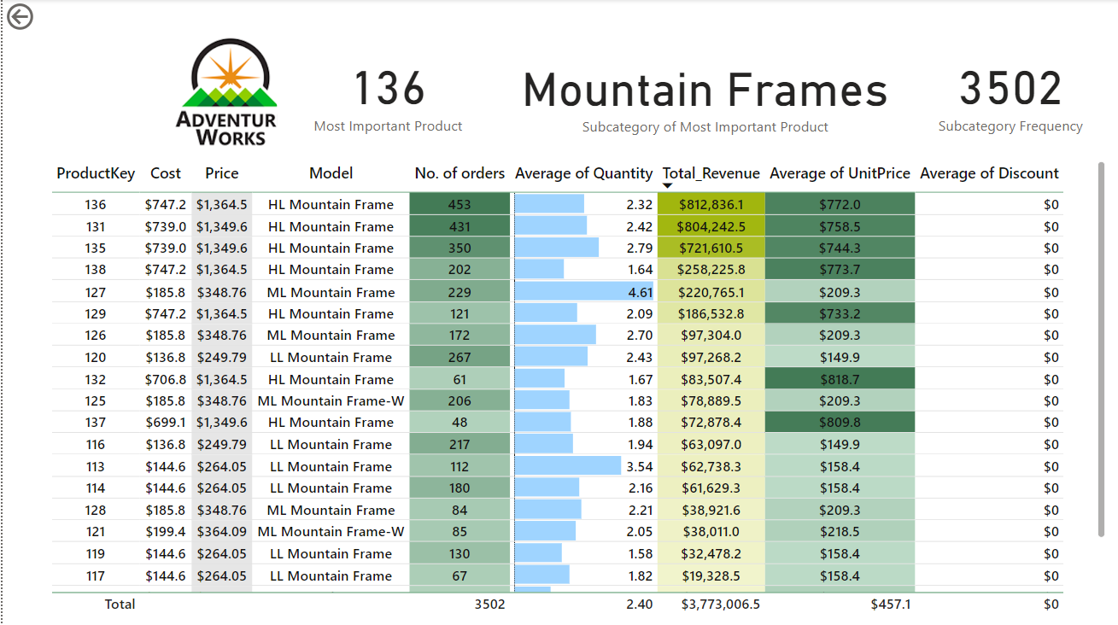
Product Details in Mountain Frame Subcategory

Slide 18
Overall insights Page Elements
Max Revenue by Category: $46.63 million in revenue from the Bikes category, indicating it is the highest-grossing category for Adventure Works.
Total Revenue by Country: The United States is the largest market, generating **$56.25 million** in revenue, highlighting its significance to the company.
Count of CustomerKey: 407 unique customer accounts, reflecting the total number of distinct customers in the system.
Mountain Bikes as the Top Subcategory: Within the Bikes category, Mountain Bikes is the leading subcategory in terms of revenue.
United States as the Most Important Country: The United States is the top market for Adventure Works, contributing the highest revenue compared to other countries.
Total Revenue by Country : This visualization helps identify key markets and opportunities for expansion or targeted marketing efforts.
Total Revenue by Subcategory : The chart reveals that Road Bikes, Mountain Bikes, and Touring Bikes are the highest revenue-generating subcategories within the Bikes category.

Slide 19
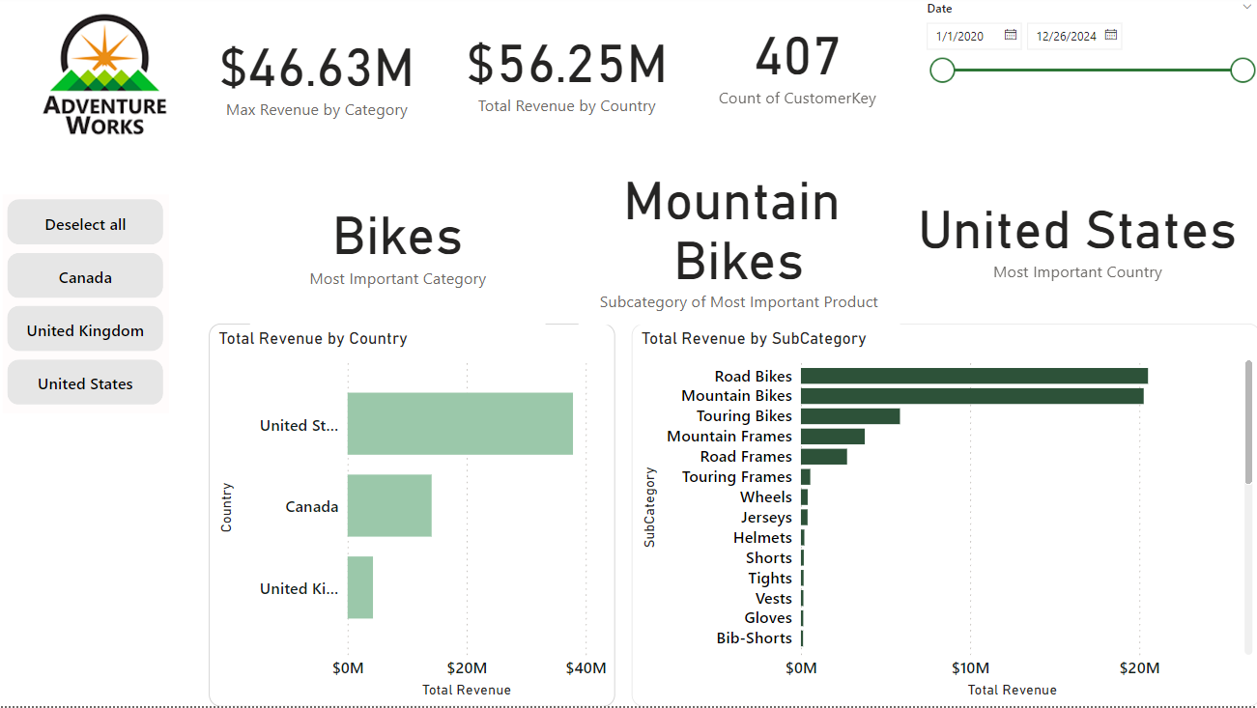

Slide 20
Thanks!

