Slide 1

New York Stock Exchange Analysis

Slide 2
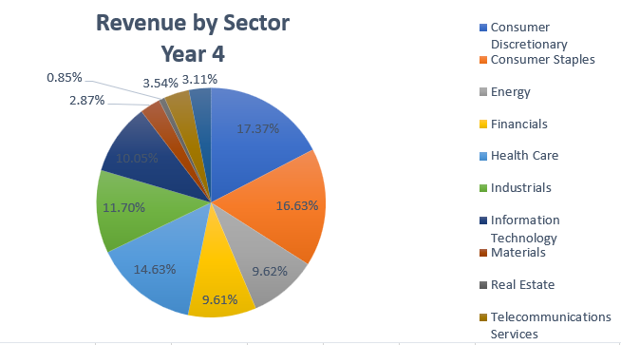
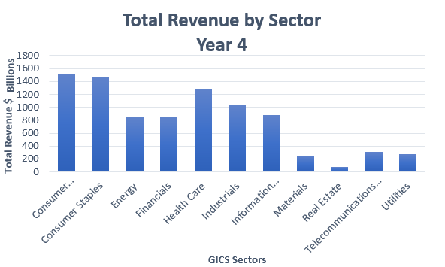
Which Sector generated the highest revenue in Year 4 and How does it Compare to other sectors?
The total revenue was about 8.78 trillion in Year 4.
Consumer Discretionary and Consumer Staples had the highest revenue in .
Consumer Discretionary generated 17.37% of the revenue about 1.52 trillion, the highest revenue of the sectors while Consumer Staples generated 16.63% of the revenue about 1.45 trillion, the second highest revenue of other sectors.

Slide 3
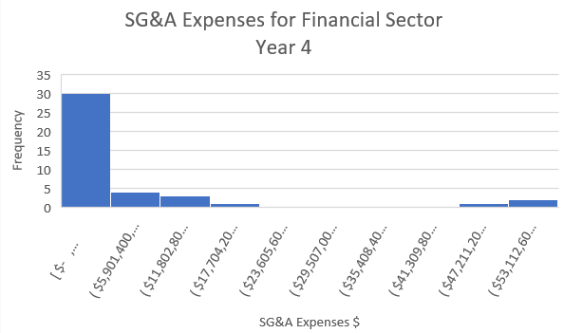
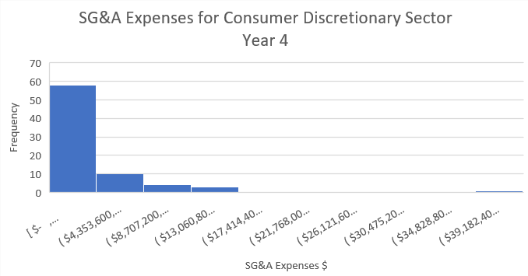
What are the top 2 Sectors with the highest SG&A expenses in Year 4?
Here are histograms for SG&A for GICS Sectors for Year 4. Both distributions are right-skewed or positively skewed. That means the mean for each is more than the median.
The mean for Financial is about 7.55 billion and for Consumer Discretionary is slightly lower it is about 3.90 billion.
However, the median for Financial is about 2.27 billion while the median for Consumer Discretionary is about 1.87 billion.
The Standard Deviation is slightly higher it is 14.40 billion for Financial and 5.82 billion for Consumer Discretionary.
The Range for Financial is about 59.0 billion, indicating a wider spread in values, while the Range in Consumer Discretionary is about 43.5 billion, suggesting a narrower spread to compare to Financials.
That means the variability in SG&A Expenses in Financial is higher.

Slide 4
Thank You Salma Gamal

