Slide 1

Guided By:
Dr. Kankanala Srinivas
Assistant Professor,
School of Electronics Engineering
Single Image Dehazing using Classical Image Processing
Baseline Paper Reproduction and Improved Method
Submitted By:
Salma SK -23BCE20344
B.Tech CSE (AI & ML)
Notes:
1

Slide 2
Problem Statement
Haze significantly degrades image quality, leading to reduced visibility, diminished contrast, and altered color perception. This atmospheric interference poses substantial challenges for various applications, including autonomous driving, surveillance systems, and remote sensing, where clear visual data is crucial for precise analysis and informed decision-making. Developing effective dehazing techniques is therefore essential to mitigate these limitations and enhance visual clarity.
Notes:
2

Slide 3




Problem Statement
Hazy and foggy images degrade visual information, posing challenges for both human perception and machine vision systems. The goal is to recover a clear image from a single hazy input using classical image processing techniques — without deep learning.
Low Contrast
Poor Visibility
Haze scatters light, flattening the tonal range across the scene.
Distant objects become indistinguishable, reducing scene depth.
Colour Fading
Loss of Detail
Atmospheric scattering washes out saturation and hue fidelity.
Fine structures and edges are obscured, hampering object recognition.
Notes:
3

Slide 4






Base Paper Method: Dark Channel Prior
The baseline dehazing pipeline is grounded in He et al.'s Dark Channel Prior (DCP), which exploits the statistical observation that most local patches in haze-free images contain pixels with very low intensity in at least one colour channel.
Input
Dark Channel
Atmospheric Light
Transmission Map
Radiance
Each stage is implemented in Python using OpenCV and NumPy, faithfully reproducing the original algorithm before introducing targeted improvements.
Notes:
4

Slide 5

Baseline Implementation
Core Techniques
Dark Channel Prior
Atmospheric Light Estimation
Estimates haze density via minimum-channel filtering over local patches.
Top 0.1% brightest pixels in the dark channel used as airlight proxy.
Transmission Recovery
Libraries: OpenCV & NumPy
Transmission map refined via soft matting to preserve scene depth.
Efficient matrix operations for real-time-compatible processing.
Baseline Performance
10.77
0.58
PSNR (dB)
SSIM
Peak Signal-to-Noise Ratio — measures reconstruction fidelity.
Structural Similarity Index — measures perceptual quality.
Notes:
5

Slide 6

Proposed Improvements
Five targeted modifications were introduced iteratively to the baseline DCP pipeline, each addressing a specific weakness in the original method.
Improved Airlight Estimation
1
Brightest candidate pixels selected more robustly, reducing overestimation artefacts.
Tuned Transmission Coefficient
2
Omega parameter adjusted to balance haze removal and naturalness.
Lower-Bound Clipping
3
Minimum transmission threshold applied to suppress noise in dense-haze regions.
Gamma Correction
4
Non-linear brightness adjustment restores perceptual luminance balance.
Mild Sharpening
5
Unsharp masking applied post-recovery to enhance edge clarity.
Notes:
6

Slide 7
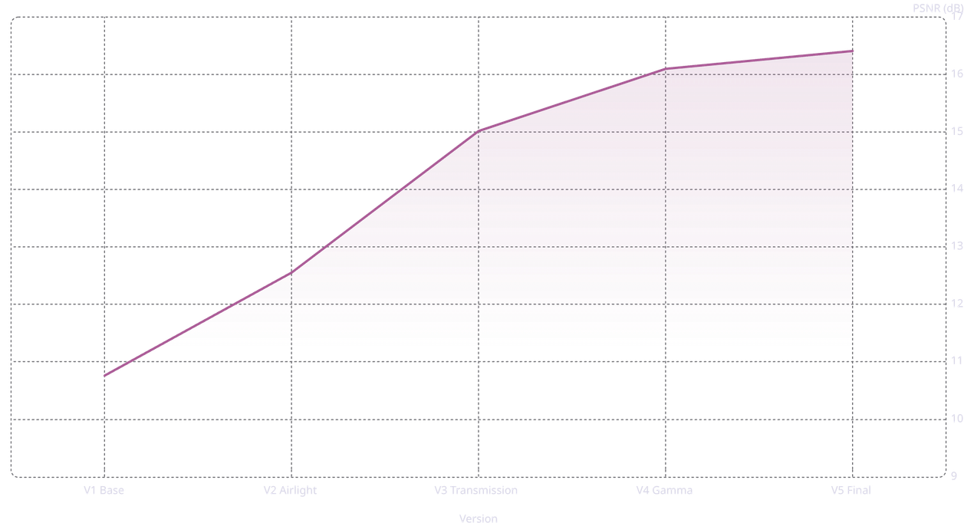
Checkpoint Evolution: PSNR Progression
Iterative Gains
16.1
16.4
+1.79 dB
15
V1 → V2: Better airlight estimation
12.6
+2.46 dB
V2 → V3: Transmission tuning
10.8
+1.08 dB
V3 → V4: Gamma correction
+0.31 dB
V4 → V5: Final sharpening
Notes:
7

Slide 8
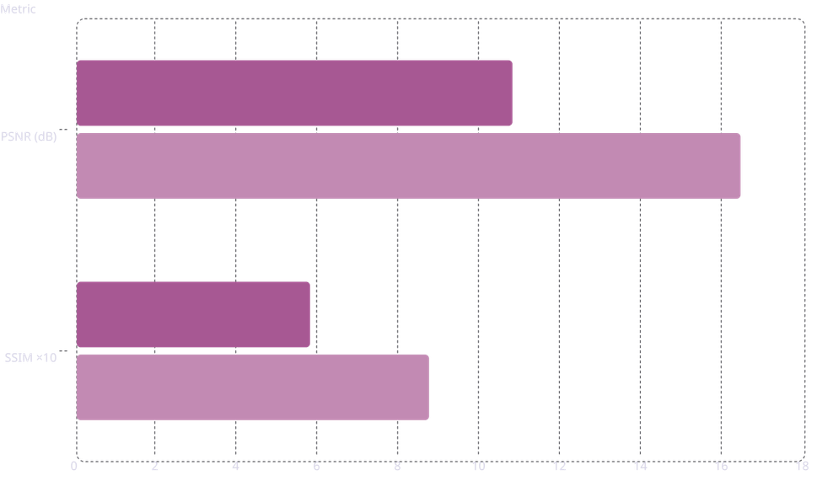

Final Performance Comparison
Metric
Baseline
Improved
Gain
Baseline
Improved
10.8
PSNR (dB)
10.77
16.41
+5.64 dB
16.4
SSIM
0.5768
0.8708
+0.2940
5.77
The improved method achieves a 52% increase in PSNR and a 51% increase in SSIM over the baseline — a substantial gain using purely classical techniques.
8.71
Notes:
8

Slide 9
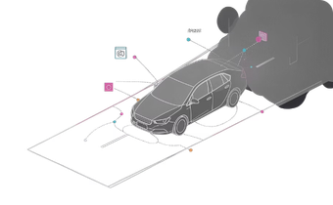
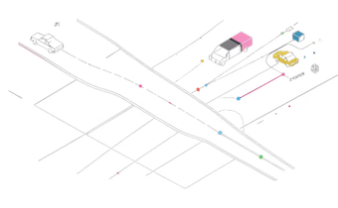
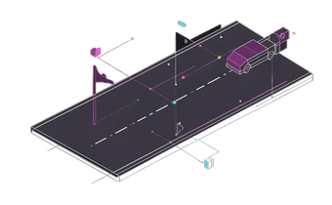
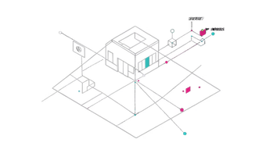
Output Image Comparison
Hazy Input
Baseline Output
Improved Output
Ground Truth
Original degraded image with low contrast and poor visibility.
DCP baseline recovers some detail but shows residual haze and colour imbalance.
Enhanced pipeline yields superior clarity, contrast, and structural fidelity.
Reference haze-free image used for PSNR and SSIM evaluation.
The improved method produces a visually cleaner result with markedly higher structural similarity to ground truth.
Notes:
9

Slide 10





Advantages of the Proposed Method
Better Visibility Restoration
Higher PSNR & SSIM
Low Computational Complexity
Quantitative metrics confirm significant quality improvement over the baseline.
Iterative refinements recover fine detail and natural colour balance effectively.
Entirely matrix-based; runs efficiently on standard hardware without a GPU.
No Deep Learning Required
Real-Time Compatible
Suitable for deployment in resource-constrained or embedded vision systems.
Fully interpretable and explainable — no training data or model inference needed.
Notes:
10

Slide 11
Conclusion & Future Work
Key Achievements
Future Directions
1
Baseline Reproduced
CNN-Based Dehazing
GAN Frameworks
Faithful re-implementation of the Dark Channel Prior method validated against published results.
Adversarial training for perceptually realistic restoration.
Leverage learned priors for complex haze distributions.
2
Improved Method Developed
Five targeted enhancements yielded a 52% PSNR gain (10.77 → 16.41 dB) and 51% SSIM gain (0.5768 → 0.8708).
Transformer Models
3
Classical Approach Validated
Attention mechanisms for global context in dense-haze scenes.
Demonstrated that principled, interpretable methods remain competitive for single-image dehazing.
Thank you
Notes:
11

