Slide 1
Multi-threading & Multi-processing
Name: Salman Al-Harbi

Slide 2
TABLE OF CONTENTS
01
02
03
04
Introduction
Concurrency
& Parallelism
multi-threading & multi-processing in python
Wrap-up

Slide 3

INTRODUCTION
Multi-threading & multi-processing are very important concepts in computer science world ,because it allows the modern computers to be more time efficient and do multiple tasks at the same instance of time and.

Slide 4
INTRODUCTION
Program: and executable file which consists of a set of instructions (not executed yet).
Process: an executed program.
Thread: the unit of execution within a process.

Slide 5
INTRODUCTION
multithreading: a technique where multiple threads are spawned by a process to do different tasks
multiprocessing: a technique where parallelism in its truest form is achieved. Multiple processes are run across multiple CPU cores

Slide 6
02
Concurrency & Parallelism

Slide 7
concurrent != parallel
Before we dive into the fun part, we must clarify the meaing of two different important terms
Concurrency and parallelism

Slide 8
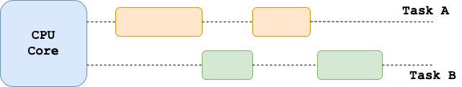
Concurrency
The following figure shows us a single CPU core handling two tasks concurrently but not simultaneously, the CPU core switches repeatedly between the two tasks.
Concurrent but not parallel!

Slide 9
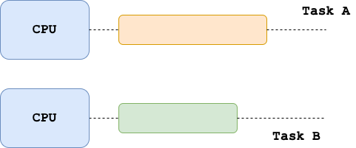
Parallelism
The following figure shows us a Two CPU core each one handling a single task/thread in parallel/simultaneously, Which means there is a progress in both tasks/threads in the same instance of time.
Parallel but not Concurrent!

Slide 10

Concurrency & Parallelism
Concurrency
parallelism
a property of a system or program and refers to how a single CPU core can make progress on multiple tasks seemingly at the same time
the actual run-time behavior of executing at least two tasks literally at the same time, in parallel
Can’t we have them both ?

Slide 11
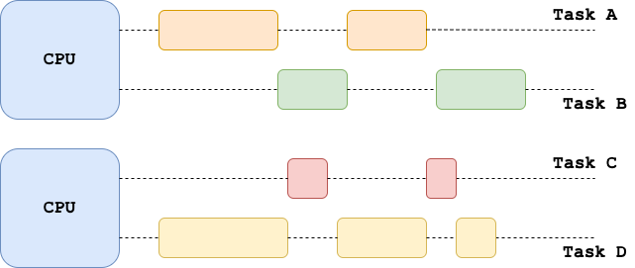
Concurrency & Parallelism
Yes, We can, In modern days CPUs Concurrency & Parallelism is a most, The following figure shows us a Two CPU core each one handling multiple tasks/threads Concurrently and in parallel/simultaneously.
Concurrent and parallel!

Slide 12
03
multi-threading & multi-processing in python

Slide 13
multi-threading & multi-processing in python
Multi-processing in python might not work as expected For people who comes from other programing languages.
Because python process cannot run multiple threads in parallel, but it can run them concurrently.
This limitation is enforced by GIL. The Python Global Interpreter Lock (GIL) prevents threads within the same process to be executed at the same time.
So, we will have to come up with a way to overcome this limitation.

Slide 14
multi-threading & multi-processing in python
Now let's go to the fun part.
If you want to follow me, you can clone this repo.
https://github.com/Salma7577/multiThreading_and_multiProcessing

Slide 15
multi-threading & multi-processing in python
Now let's go to the fun part.
If you want to follow me, you can clone this repo.
https://github.com/Salma7577/multiThreading_and_multiProcessing

Slide 16
04
Wrap-up

Slide 17
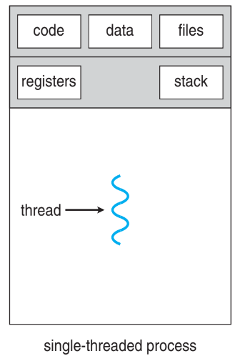
multi-threading & multi-processing in python

Slide 18
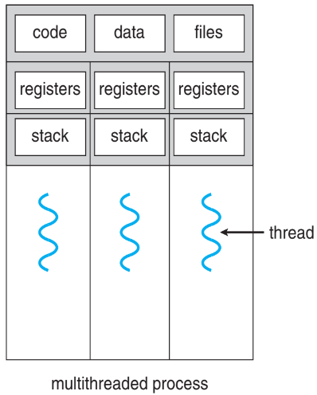
multi-threading & multi-processing in python

Slide 19
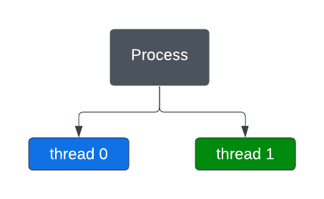

multi-threading & multi-processing in python

Slide 20
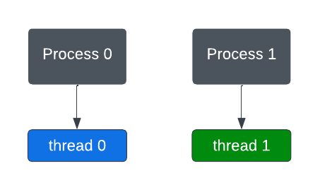

multi-threading & multi-processing in python

Slide 21
RESOURCES
https://www.toptal.com/python/beginners-guide-to-concurrency-and-parallelism-in-python
https://towardsdatascience.com/multithreading-multiprocessing-python-180d0975ab29
https://www.geeksforgeeks.org/difference-between-multithreading-vs-multiprocessing-in-python/

Slide 22
THANKS!
Do you have any questions?

