Slide 1
Chapter 1: Introduction to computer architecture
Subject Code: 352CCS-5

Slide 2
Introduction to microprocessors Organization & architecture of 8086 Microprocessor
8086 Microprocessor is an enhanced version of 8085Microprocessor that was designed by Intel in 1976. It is a 16-bit Microprocessor having 20 address lines and16 data lines that provides up to 1MB storage. It consists of powerful instruction set, which provides operations like multiplication and division easily.
It supports two modes of operation, i.e. Maximum mode and Minimum mode. Maximum mode is suitable for system having multiple processors and Minimum mode is suitable for system having a single processor.

Slide 3
Features of 8086
The most prominent features of a 8086 microprocessor are as follows −
It has an instruction queue, which is capable of storing six instruction bytes from the memory resulting in faster processing.
It was the first 16-bit processor having 16-bit ALU, 16-bit registers, internal data bus, and 16-bit external data bus resulting in faster processing.
It is available in 3 versions based on the frequency of operation −
8086 → 5MHz
8086-2 → 8MHz
(c)8086-1 → 10 MHz

Slide 4
Cont..
It uses two stages of pipelining, i.e. Fetch Stage and Execute Stage, which improves performance.
Fetch stage can prefetch up to 6 bytes of instructions and stores them in the queue.
Execute stage executes these instructions.
It has 256 vectored interrupts.
It consists of 29,000 transistors.

Slide 5
Comparison between 8085 & 8086 Microprocessor
Size − 8085 is 8-bit microprocessor, whereas 8086 is 16-bit microprocessor.
Address Bus − 8085 has 16-bit address bus while 8086 has 20-bit address bus.
Memory − 8085 can access up to 64Kb, whereas 8086 can access up to 1 Mb of memory.
Instruction − 8085 doesn’t have an instruction queue, whereas 8086 has an instruction queue.
Pipelining − 8085 doesn’t support a pipelined architecture while 8086 supports a pipelined architecture.
I/O − 8085 can address 2^8 = 256 I/O's, whereas 8086 can access 2^16 = 65,536 I/O's.
Cost − The cost of 8085 is low whereas that of 8086 is high.

Slide 6
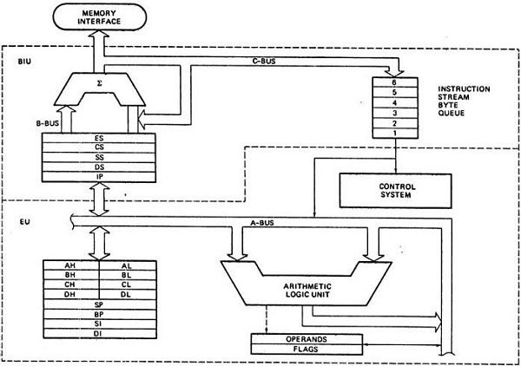
Architecture of 8086

Slide 7
Functional Block Diagram of 8086 Microprocessor
The 8086 is a 16-bit microprocessor. The term 16 bit implies that its arithmetic logic unit, its internal registers, and most of its instructions are intended to work with 16 bit binary data. The 8086 has a 16 bit data bus, so it can read data from or write data to memory and ports either 16 bits or 8 bits at a time. The 8086 has a 20 bit address bus, so it can address any one of 220, or 1,048,576 memory locations.
8086 CPU is divided into 2 independent functional parts to speed up the processing namely BIU (Bus interface unit) & EU (execution unit).

Slide 8
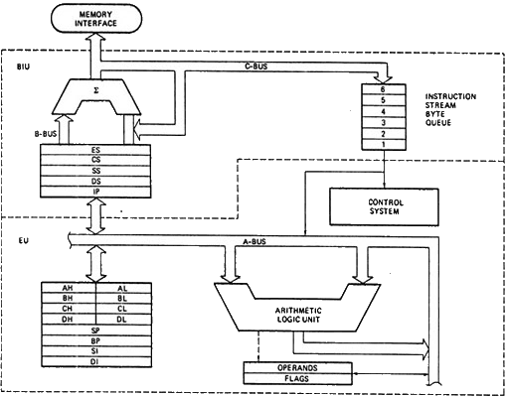
Fig: Functional Block Diagram of Intel 8086 microprocessor

Slide 9
Cont..
BIU: It handles all transfers of data and addresses on the buses for the execution unit.
Sends out addresses
Fetches instructions from memory.
Read / write data from/to ports and memory i.e. handles all transfers of data and addresses on the busses
EU
Tells BIU where to fetch instructions or data from
Decodes instructions
Executes instructions

Slide 10
Instruction Decoder & ALU:
Decoder in the EU translates instructions fetched from the memory into a series of actions which the EU carries out.16-bit ALU in the EU performs actions such as AND, OR, XOR, increment, decrement etc.
FLAG Register:
It is a 16-bit register. 9-bit are used as different flags, remaining bits unused
Fig: 16-bit flag register
 |  |  |  | OF | DF | IF | TF | SF | ZF |  | AF |  | PF |  | CF

Slide 11
Cont..
Out of 9-flags, 6 are conditional (status) flags and three are control flags
Conditional flags:
These are set or reset by the EU on the basis of the results of some arithmetic or logic operation. 8086 instructions check these flags to determine which of two alternative actions should be done in executing the instructions.
OF (Overflow flag): is set if there is an arithmetic overflow, i.e. the size of the result exceeds the capacity of the destination location.
SF (Sign flag): is set if the MSB of the result is 1
ZF (Zero flag): is set if the result is zero

Slide 12
Cont..
AF (Auxiliary carry flag): is set if there is carry from lower nibble to upper nibble or from lower byte to upper byte
PF (Parity flag): is set if the result has even parity
CF (Carry flag): is set if there is carry from addition or borrow from subtraction

Slide 13
Control flags:
They are set using certain instructions. They are used to control certain operations of the processor.
TF (Trap flag): for single stepping through the program
IF (Interrupt flag): to allow or prohibit the interruption of a program
DF (Direction flag): Used with string instructions

Slide 14
General purpose Registers (GPRs):
8 GPRs AH, AL (Accumulator), BH, BL, CH, CL, DH, DL are used to store 8 bit data.
AL register is also called the accumulator
Used individually for the temporary storage of data
GPRs can be used together (as register pair) to store 16-bit data words. Acceptable register pairs are:

Slide 15
Cont..
AH-AL pair AX register
BH-BL pair BX register (to store the 16-bit data as well as the base address of the memory location)
CH-CL pair CX register (to store 16-bit data and can be used as counter register for some instructions like loop)
DH-DL pair DX register (to store 16-bit data and also used to hold the result of 16-bit data multiplication and division operation)

Slide 16
Cont..
Pointer and Index registers: SP (Stack Pointer), BP (Base pointer), SI (Source Index), DI (Destination index)
Pointer Registers:
The two pointer registers, SP and BP are used to access data in the stack segment. The SP is used as offset from current Stack Segment during execution of instruction that involve stack. SP is automatically updated. BP contains offset address and is utilized in based addressing mode. Overall, these are used to hold the offset address of the stack address.

Slide 17
Cont..
Index Registers:
EU also contains a 16-bit source index (SI) register and 16-bit destination index (DI) register. These registers can be used for temporary storage of data similarly as the general purpose registers. However they are specially to hold the 16-bit offset of the data word. SI and DI are used to hold the offset address of the data segment and extra segment memory respectively.

Slide 18
ALU: Arithmetic and Logic Unit
An arithmetic-logic unit is the part of a central processing unit that carries out arithmetic and logic operations on the operands in computer instruction words.
In some processors, the ALU is divided into two units: an arithmetic unit (AU) and a logic unit (LU). Some processors contain more than one AU -- for example, one for fixed-point operations and another for floating-point operations.
ALUs serve as a combinational digital circuit that performs arithmetic and bitwise operations on binary numbers. This is a foundational building block of arithmetic logic circuits for numerous types of control units and computing circuits including central processing units (CPUs)

Slide 19
ALU cont..
The following are a few examples of bitwise logical operations and basic arithmetic operations supported by ALUs:
Addition. Adds A and B with carry-in or carry-out sum at Y.
Subtraction. Subtracts B from A or vice versa with the difference at Y and carry-in or carry-out.
Increment. Where A or B is increased by one and Y represents the new value.
Decrement. Where A or B is decreased by one and Y represents the new value.
AND. The bitwise logic AND of A and B is represented by Y.
OR. The bitwise logic OR of A and B is represented by Y.
Exclusive-OR. The bitwise logic XOR of A and B is represented by Y.

Slide 20
8086 SYSTEM BUS STRUCTURE
The 8086 Microprocessor is a 16-bit CPU available in 3 clock rates, i.e.
5, 8 and 10MHz
The 8086 Microprocessor operates in single processor or multiprocessor configurations to achieve high performance
The System Bus A bus is collection of signal wires which connect between the components of the computer systems – the fi gure shows that the CPU is connected to the memory as well as I/O through the system bus, but only one at a time – if the memory and I/O wants to use the bus at the same time, there is a confl ict, as there is only one system bus. Th e system bus comprises of the address bus, data bus and the control bus.

Slide 21
The Data Bus
Th e set of lines used to transfer data is called the data bus. It is a bidirectional bus, as data has to be sent from the CPU to memory and I/O, and has to be received as well by the CPU. Th e width of the data bus determines the data transfer rate, size of the internal registers of the CPU and the processing capability of the CPU. In short, it is a reflection of the complexity of the processor. As we see, the 8086 has a data bus width of 16 bits, while the 80486 has a 32-bit bus width. Th us the 80486 can process data of 32 bits at a time while the 8086 can only handle 16 bits.

Slide 22
The Address Bus
Th e address bus width determines the maximum size of the physical memory that the CPU can access. With an address bus width of 20 bits, the 8086 can address 220 different locations. It can use a memory size of 220 bytes or 1 MB. For Pentium with an address bus width of 32 bits, the corresponding numbers are 232 bytes i.e., 4 GB. When a particular memory location is to be accessed, the corresponding address is placed on the address bus by the CPU. I/O devices also have addresses. In both cases, it is the CPU which supplies the address, and as such, the address bus is unidirectional.

Slide 23
The Control Bus
Th e control bus is a set of control signals which needs to be activated for activities like writing/reading to/from memory/I/O, or special activities of the CPU like interrupts and DMA. Th us, we see signals like Memory Read, I/O Read, Memory Write and Interrupt Acknowledge as part of the control bus. Th ese control signals dictate the actions taking place on the system bus that involve communications with devices like memory or I/O. For example, the Memory Read signal will be asserted for reading from memory. It is sent to memory from the processor. A signal such as ‘Interrupt’ is received by the processor from an I/O device. Hence in the control bus, we have signals traveling in either direction. Some control lines may be bidirectional too.

Slide 24
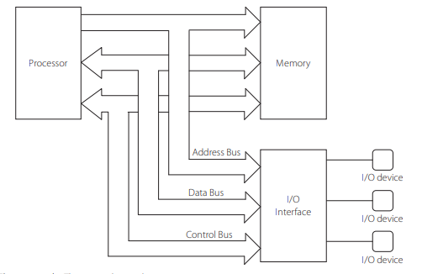
The system bus and its components

Slide 25
Timing
The 8086/8088 microprocessors use the memory and I/O in periods called bus cycles. Each bus cycle equals four system-clocking periods (T states). Newer microprocessors divide the bus cycle into as few as two clocking periods. If the clock is operated at 5 MHz (the basic operating frequency for these two microprocessors), one 8086/8088 bus cycle is complete in 800 ns. This means that the microprocessor reads or writes data between itself and memory or I/O at a maximum rate of 1.25 million times a second. (Because of the internal queue, the 8086/8088 can execute 2.5 million instructions per second [MIPS] in bursts.) Other available versions of these microprocessors operate at much higher transfer rates due to higher clock frequencies.

Slide 26
Control Signals:
When Address latch enable (ALE) is logic 1 it signals that a valid address is on the bus. This address can be latched in external circuitry on the 1-to-0 edge of the pulse at ALE.
M/IO (memory/IO) tells external circuitry whether a memory or I/O transfer is taking place over the bus. Logic 1 signals a memory operation and logic 0 signals an I/O operation.
DT/R (data transmit/receive) signals the direction of data transfer over the bus. Logic 1 indicates that the bus is in the transmit mode (i.e., data are either written into memory or to an I/O device). Logic 0 signals that the bus is in the receive mode (i.e., reading data from memory or from an input port).

Slide 27
Cont..
The bank high enable (BHE) signal is used as a memory enable signal for the most significant byte half of the data bus, D8 through D15.
WR (write) is switched to logic 0 to signal external devices that valid output data are on the bus.
RD (read) indicates that the MPU is performing a read of data off the bus. During read operations, one other control signal, DEN (data enable), is also supplied. It enables external devices to supply data to the microprocessor.
The READY signal can be used to insert wait states into the bus cycle so that it is extended by a number of clock periods. This signal is supplied by a slow memory or I/O subsystem to signal the MPU when it is ready to permit the data transfer to be completed.

