Slide 1
Chapter 4:
Addressing Modes for the 80x86:

Slide 2
Content
1. Instruction forms
2. Addressing Modes:
Register addressing mode, Immediate addressing mode, Direct addressing mode, Register Indirect addressing mode, Base plus index addressing mode, Register Relative addressing mode, Base Relative Plus Index addressing mode.
3. Translating assembly program into machine code.

Slide 3
1. Instruction forms
For every instruction that is executed in the 8086 microprocessor, an instruction format is available that is the binary representation of that instruction.
This instruction format can be coded from 1 to 6 bytes depending upon the addressing modes used for instructions.
The general Instruction format that most of the instructions of the 8086 microprocessor follow is:

Slide 4
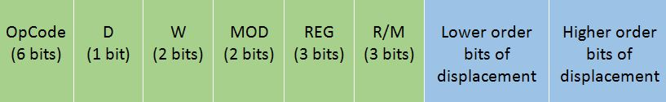
The Opcode stands for Operation Code. Every Instruction has a unique 6-bit opcode. For example, the opcode for MOV is 100010.
D stands for direction If D=0, then the direction is from the register If D=1, then the direction is to the register
W stands for word If W=0, then only a byte is being transferred, i.e. 8 bits If W=1, them a whole word is being transferred, i.e. 16 bits
The MOD and R/M together is calculated based upon the addressing mode and register being used in it. This is calculated as follows:

Slide 5
R/M | 0 0 (Memory Mode with no displacement) | 0 1 (Memory mode with 8 bit displacement) | 1 0 (Memory Mode with 16 bit displacement) | 1 1 (Register Mode)
000 | [BX] + [SI] | [BX] + [SI] + d8 | [BX] + [SI] + d16 | AL AX
001 | [BX] + [DI] | [BX] + [DI] + d8 | [BX] + [DI] + d16 | CL CX
010 | [BP] + [SI] | [BP] + [SI] + d8 | [BP] + [SI] + d16 | DL DX
011 | [BP] + [DI] | [BP] + [DI] + d8 | [BP] + [DI] + d16 | BL BX
100 | [SI] | [SI] + d8 | [SI] + d16 | AH SP
101 | [DI] | [DI] + d8 | [DI] + d16 | CH BP
110 | d16 (direct) | [BP] + d8 | [BP] + d16 | DH SI
111 | [BX] | [BX] + d8 | [BX] + d16 | BH DI

Slide 6
REG stands for register selected. It is a 3-bit code which is calculated as follows:
REG Code | Register Selected
0 0 0 | AL AX
0 0 1 | CL CX
0 1 0 | DL DX
0 1 1 | BL BX
1 0 0 | AH SP
1 0 1 | CH BP
1 1 0 | DH SI
1 1 1 | BH DI

Slide 7
The 80x86 memory addressing modes provide flexible access to memory, allowing the programmer to easily access variables, arrays, records, pointers, and other complex data types.
Computer instructions are made up of an operation code (opcode) and a set of operands. The op-code identifies the action to be taken; the operands identify the source and destination of the data operated on. Op-codes are usually written in an abbreviated form called a mnemonic. Move, for example, becomes MOV, increment is INC, jump becomes JMP, and so on. The operands identify CPU registers, memory locations, or I/O ports. The complete form of an instruction is:
op-code destination operand, source operand
For example the instruction Mov AL,BL is thus interpreted as moving a copy of register BL into register AL.
80x86 processors may have as few as zero operands, and as many as three. Here are a few examples

Slide 8
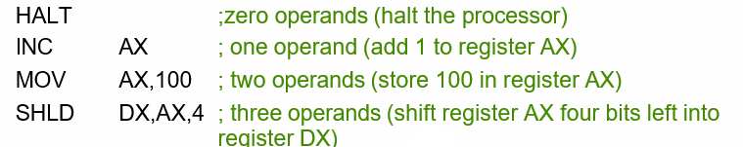
The instruction set of the 8086 microprocessor integrates instructions of different types with one, two, three, . . . operands as listed below:
Note that each instruction has an op-code that indicates the action to be taken (halt, increment, move, or shift left) and a set of operands that identifies the source of the data operated on and its destination. Sometimes there is no data to operate on (HLT), and sometimes the source and destination are the same (INC AX).

Slide 9
The CPU can access operands (data) in various ways, called addressing modes. The number of addressing modes is determined when the microprocessor is designed and cannot be changed. The 8086 provides a total of seven distinct addressing modes:
Register addressing mode
Immediate addressing mode
Direct addressing mode
Register indirect addressing mode
Based relative addressing mode
Indexed relative addressing mode
Based indexed relative addressing mode,

Slide 10
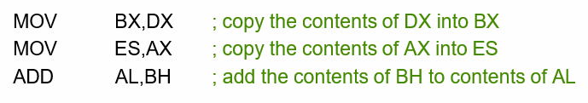
Register Addressing Mode
The register Addressing Mode involve the use of registers to hold the data to be manipulated.
Memory is not access when this addressing mode is executed; therefore, it is relatively fast.
Examples of register addressing mode follow:
The source and destination registers must match in size. Coding MOV CL,AX will give ERROR, since the source is a 16 bits register and the destination is an 8-bits register
Never mix an 8-bit register with a 16-bit register because this is not allowed by the microprocessor and results in an error when assembled.
It is also important to note that none of the MOV instructions affect the flag bits.

Slide 11
Register Addressing Mode –Cont’d–
A segment-to-segment register MOV instruction is about the only type of register MOV instruction not allowed. Note that the code segment register is not normally changed by a MOV instruction because the address of the next instruction is found in both IP and CS. If only CS were changed, the address of the next instruction would be unpredictable. Therefore, changing the CS register with a MOV instruction is not allowed.
The figure shows the operation of the MOV BX,CX instruction. Note that the source register’s contents do not change, but the destination register’s contents do change. The instruction moves (copies) a 1234H from register CX into register BX. This erases the old contents (76AFH) of register BX, but the contents of CX remain unchanged.

Slide 12
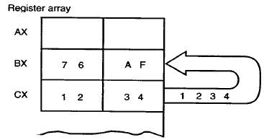
Register Addressing Mode –Cont’d–
Figure 1: The effect of executing the MOV BX,CX instruction at the point just before BX register changes.

Slide 13
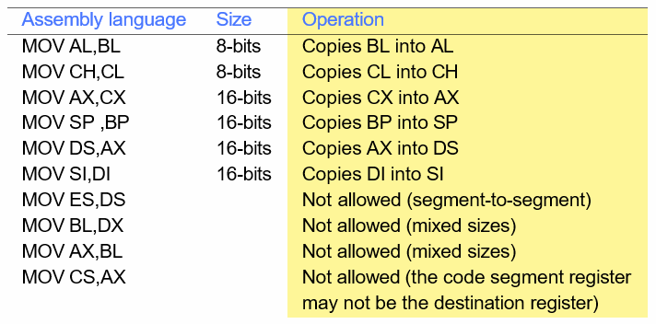
Register Addressing Mode –Cont’d–

Slide 14
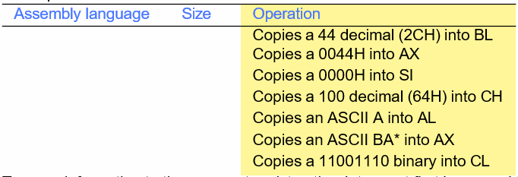
Immediate Addressing Mode
In the immediate addressing mode, the source operand is a constant.
In immediate addressing mode, as the name implies, when the instruction is assembled, the operand comes immediately after the opcode.
Immediate addressing mode can be used to load data into any of the registers excepts the segment registers and flags register.
Example:

Slide 15
Immediate Addressing Mode cont’d-
To move information to the segment register, the data must first be moved to a general purpose register and then to the segment register.
Example
MOV AX,2550h ; move 2550h into AX
MOV DS,AX ; Copy the content of AX into register segment DS

Slide 16
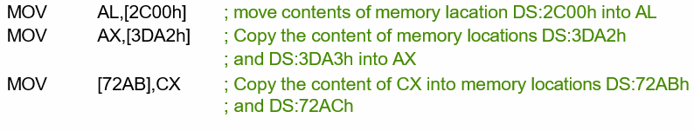
Direct addressing mode
In the direct addressing mode the data is in some memory location(s) and the address of the data in memory comes immediately after the instruction.
This address is the offset address and one can calculate the physical address by shifting left the DS register and adding it to the offset:
Example

Slide 17
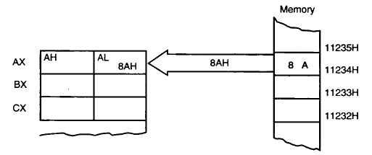
Direct addressing mode cont’d-
Figure 2: The operation of MOV AL,[1234H] instruction when

Slide 18
Direct addressing mode cont’d-
Example:
Find the physical address of the memory location and its contents after the execution of the following, assuming that DS=1512H
MOV AL,99H
MOV [3518],AL
Solution
First AL is initialized to 99H, then in line two, the contents of AL are moved to logical address DS:3518 which is 1512:3518. Shifting DS left and adding it to the offset gives the physical address of 18638H (15120H+3518H=18638H). That means after the execution of the second instruction, the memory location with address 18638H will contain the value 99H.

Slide 19
Register Indirect addressing mode
The address of the memory location where the operand resides is held by a register.
The registers used for this purpose are SI, DI and BX.
If these three registers are used as pointers, that is, if they hold the offset of the memory location, they must be combined with DS in order to generate the 20-bits physical address.
MOV AL,[BX] ; moves into AL the contents of the memory location
; pointed to by DS:BX.
Note that BX is in brackets. In the absence of brackets, it is interpreted as an instruction moving the contents of register BX to AL (which give an error because source and destination do not match)

Slide 20
Register Indirect addressing mode –Cont’d–
Example: Assume that DS=1120, SI=2498, and AX=17FE. Show the contents of memory locations after the execution of MOV [SI],AX
Solution:
The contents of AX are moved into memory locations with logical address DS:SI (physical address: 13698) and DS:SI+1 (physical address: 13699).

Slide 21
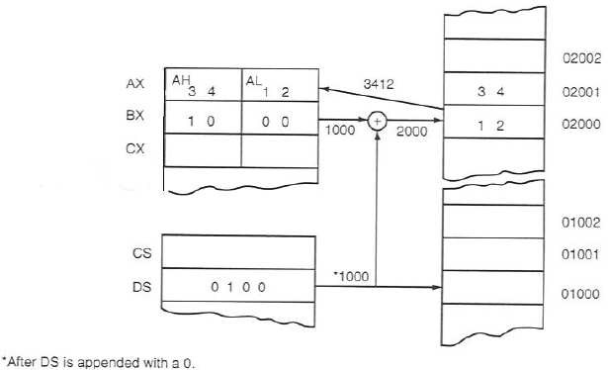
Register Indirect addressing mode –Cont’d–
Figure 3: The operation of the MOV AX,[BX] instruction when BX=1000H and DS=0100H. Note that this instruction is shown after the contents of memory are transferred to AX.

Slide 22
Register Indirect addressing mode –Cont’d–
If we write in the memory, the data size should be specified
If the size is 8 bits: byte ptr is used
If the size is 16 bits: word ptr is used
Example 1: Write the value 0065H at the address pointed by DS:BX
MOV BX,1200H
MOV word ptr [BX],65H
Example 2: Transfer the byte from AL to the address pointed by DS:1202H
MOV byte ptr [1202H],AL

Slide 23
Base relative addressing mode
In the base relative addressing mode, base registers BX and BP, as well as a displacement value, are used to calculate what is called the effective address.
The default segments used for the calculation of the physical address (PA) are DS for BX and SS for BP.
Example 1:
MOV CX,[BX]+10 ; move DS:BX+10 and DS:BX+10+1 into CX
; PA=DS (shifted left) + BX + 10
Alternative coding are MOV CX,[BX+10] or MOV CX,10[BX]
The low address contents will go into CL and the high address contents into CH.

Slide 24
Base relative addressing mode cont’d
Example 2:
MOV AL,[BP]+5 ; PA=SS (shifted left) + BP + 5
Alternative codings are MOV AL,[BP+5] or MOV AL,5[BP]
In MOV AL,[BP+5], BP + 5 is called the effective address used in Intel literature.

Slide 25
Indexed Relative addressing mode
The indexed relative addressing mode works the same as the base relative addressing mode, except that registers DI and SI hold the offset address. Example 1:
MOV DX,[SI]+5 ; PA=DS (shifted left) + SI + 5
MOV CL,[DI]+20 ; PA=DS (shifted left) + DI + 20

Slide 26
Example 2:
Assume that DS=4500, SS=2000, BX=2100, SI=1486, DI=8500, BP=7814, and AX=2512.
Show the exact physical memory location where AX is stored in each of the following. All values are hex.
MOV [BX]+20,AX
MOV [SI]+10,AX
MOV [DI]+4,AX
MOV [BP]+12,AX
Solution:
In each case, PA=segment register (shifted left) + offset register + displacement
DS:BX+20 ; location 47120=(12) and 47121=(25)
DS:SI+10 ; location 46496=(12) and 46497=(25)
DS:DI+4 ; location 4D504=(12) and 4D505=(25)
SS:BP+20 ; location 27826=(12) and 27827=(25)

Slide 27
Base indexed addressing mode
By combining based and indexed addressing modes, a new addressing mode is derived called the based indexed addressing mode.
In this mode, one base register and one index register are used.
Example:
MOV CL,[BX][DI]+8 ; PA=DS (shifted left) +BX+ DI + 8
MOV CH,[BX][SI]+20 ; PA=DS (shifted left) + BX+SI + 20
MOV AH,[BP][DI]+12 ; PA=SS (shifted left) + BP+DI + 12
MOV AH,[BP][SI]+29 ; PA=SS (shifted left) + BP+SI + 29
The coding of the instructions above can vary; for example, the last example could have been written
MOV AH,[BP+SI+29
Or
MOV AH,[SI+BP+29] ; The register order does not matter

Slide 28
Note that in the previous examples, the MOV instruction was used for the sake of clarity, even though one can used any instruction as long as the instruction supports the addressing mode.
Example: ADD DL,[BX] would add the contents of the memory location pointed at by DS:BX to the contents of register DL.

Slide 29
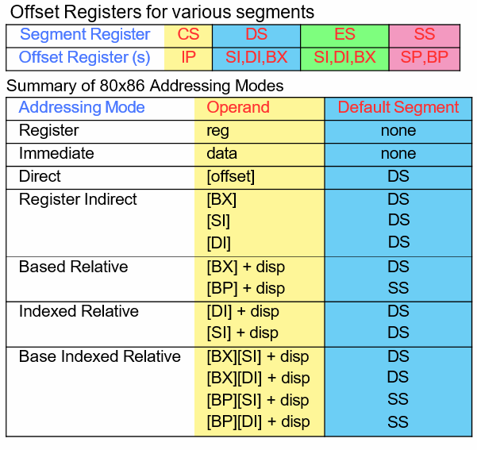
Addressing mode summary

Slide 30
3. Translating assembly program into machine code.
Everything in a computer is a binary value. Numbers are binary, characters are binary, and even the instructions to run a program are binary. Therefore the assembly language that has been presented cannot be what the computer understands.
This assembly code must be converted to binary values. These binary values are called machine code. This topic will explain how to convert the assembly instructions that have been covered so far into machine code.

Slide 31
This section will translate the following add instruction to machine code.
add $t0, $t1, $t2
The MIPS Greensheet specifies the add instruction as an R-format instruction and the op- code/function for the add as 0/20. The op-code/function field is made up of two numbers, the first is the op-code, and the second is the function. Note that the function is used only for R format instructions. If the instruction has a function, the number to the left of the "/" is the op- code, and the number to the right of the "/" is the function. If there is only one number with no "/", it is the op-code, and there is no function.

Slide 32
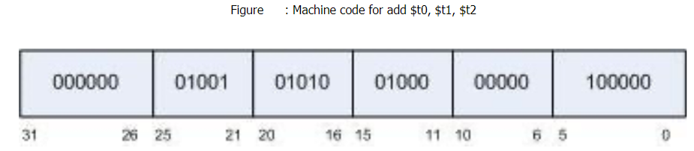
Both the op-code and the function are 6 bits, divided into a 2 bit number and a 4 bit number. So the first number in the op-code and function is 0..3, and the second is 0..f. Both are generally called hex values, so this text will do so as well. So the 6 bits for the op-code translate to 00 0000, and the 6 bits for the function translate to 10 0000. These are placed into the op-code and function fields of the R format instruction shown in figure below.

Slide 33
Register Rd is $t0. $t0 is also register $8, or 01000, so 01000 is placed in the Rd field.
Register Rs is $t1. $t1 is also register $9, or 01001, so 01001 is placed in the Rs field
Register Rt is $t2. $t2 is also register $10, or 01010, so 01010 is placed in the Rt field.
The shamt is 00000 as there are no bits being shifted.
The result is the following R-format instruction.

Slide 34
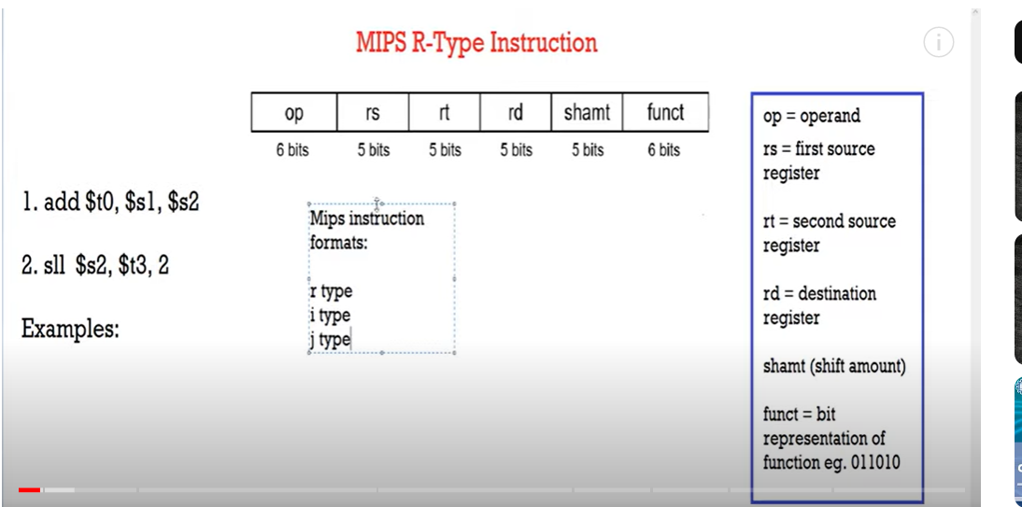

Slide 35
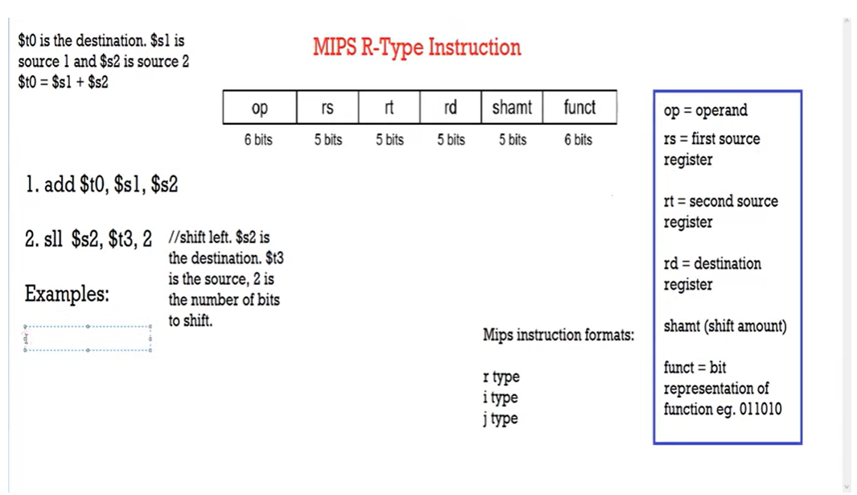

Slide 36
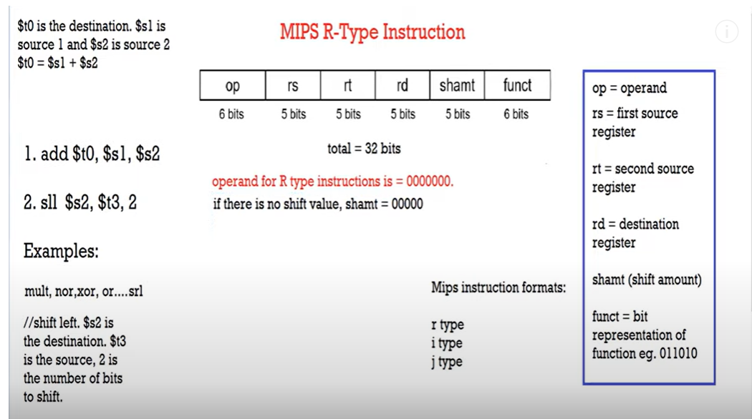

Slide 37
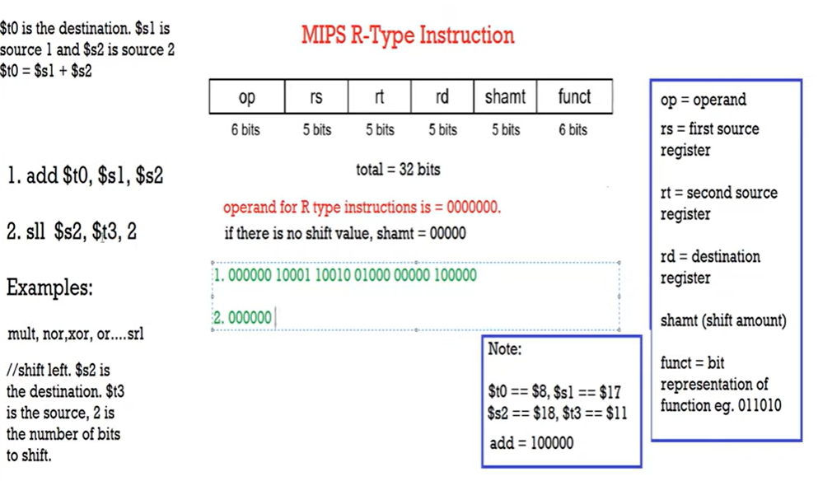

Slide 38
