Slide 1
Knowledge-Based Agents
361CCS
CHAPTER 7, 8
Prepared by Dr. Aliya Aleryani

Slide 2

A knowledge-based agent includes a knowledge base and an inference system.
A knowledge base is a set of representations of facts of the world.
Each individual representation is called a sentence.
The sentences are expressed in a knowledge representation language.
Axiom
When the sentence is taken as being given without being derived from other sentences
The agent operates as follows:
  1. It TELLs the knowledge base what it perceives.
  2. It ASKs the knowledge base what action it should perform.
  3. It performs the chosen action.

Slide 3

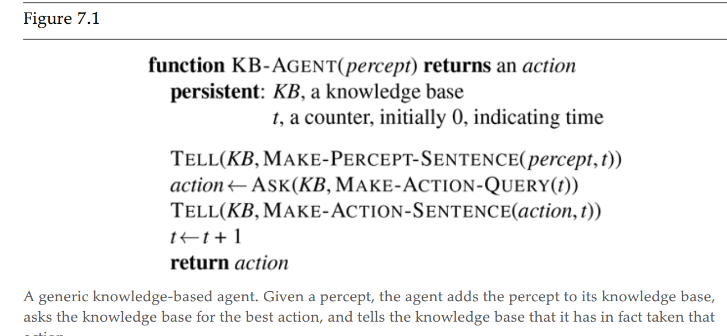
MAKE-PERCEPT-SENTENCE
MAKE-ACTION-QUERY
MAKE-ACTIONSENTENCE

Slide 4

Knowledge Level.
  The most abstract level: describe agent by saying what it knows.
  Example: A taxi agent might know that the Golden Gate Bridge connects San Francisco with the Marin County.
Logical Level.
  The level at which the knowledge is encoded into sentences.
  Example: Links(GoldenGateBridge, SanFrancisco, MarinCounty).
Implementation Level.
  The physical representation of the sentences in the logical level.
  Example: ‘(links goldengatebridge sanfrancisco marincounty)

Slide 5

Declarative Approach of Agent
Starting with an empty knowledge base, the agent designer can TELL sentences one by one until the agent knows how to operate in its environment
Procedural Approach of Agent
The procedural approach encodes desired behaviors directly as program code.
The successful agent=Combines of Declarative and Procedural
knowledge-based agent Learns it self, autonomous

Slide 6

The Wumpus computer game
The agent explores a cave consisting of rooms connected by passageways.
Lurking somewhere in the cave is the Wumpus, a beast that eats any agent that enters its room.
Some rooms contain bottomless pits that trap any agent that wanders into the room.
Occasionally, there is a heap of gold in a room.
The goal is to collect the gold and exit the world without being eaten

Slide 7

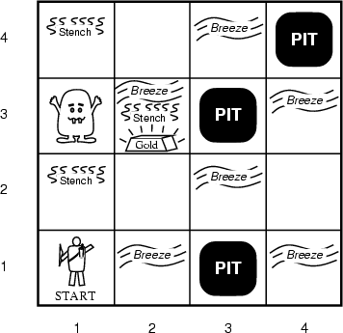
The agent always starts in the field [1,1].
The task of the agent is to find the gold, return to the field [1,1] and climb out of the cave.

Slide 8

The agent perceives
  a stench in the square containing the wumpus and in the adjacent squares (not diagonally)
  a breeze in the squares adjacent to a pit
  a glitter in the square where the gold is
  a bump, if it walks into a wall
  a woeful scream everywhere in the cave, if the wumpus is killed
The percepts are given as a five-symbol list. If there is a stench and a breeze, but no glitter, no bump, and no scream, the percept is
  [Stench, Breeze, None, None, None]

Slide 9

go forward
turn right 90 degrees
turn left 90 degrees
grab: Pick up an object that is in the same square as the agent
shoot: Fire an arrow in a straight line in the direction the agent is facing. The arrow continues until it either hits and kills the wumpus or hits the outer wall. The agent has only one arrow, so only the first Shoot action has any effect
climb is used to leave the cave. This action is only effective in the start square
die: This action automatically and irretrievably happens if the agent enters a square with a pit or a live wumpus

Slide 10

The agent’s goal is to find the gold and bring it back to the start square as quickly as possible, without getting killed
  1000 points reward for climbing out of the cave with the gold
  1 point deducted for every action taken
  10000 points penalty for getting killed

Slide 11

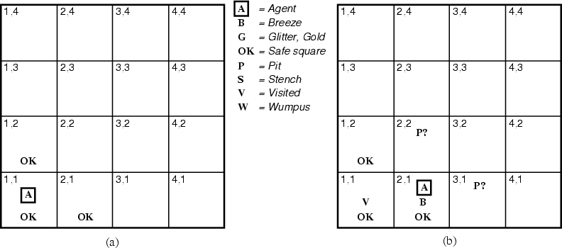
¬W
¬W

Slide 12

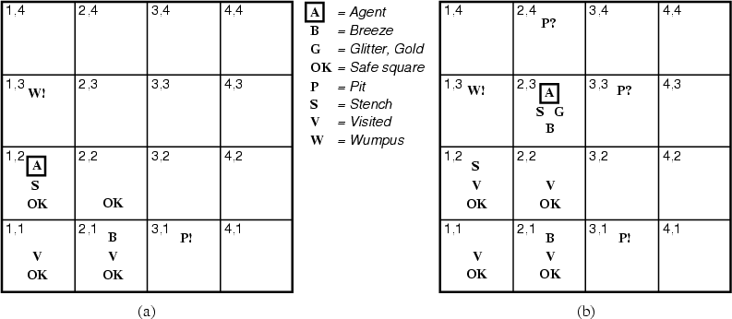
¬W
¬W
¬P
¬P
¬W
¬W

Slide 13


Slide 14

The object of knowledge representation is to express knowledge in a computer-tractable form, so that agents can perform well.
A knowledge representation language is defined by:
  its syntax, which defines all possible sequences of symbols that constitute sentences of the language.
    Examples: Sentences in a book, bit patterns in computer memory.
  its semantics, which determines the facts in the world to which the sentences refer.
    Each sentence makes a claim about the world.
    An agent is said to believe a sentence about the world.

Slide 15

In each case for which the agent draws a conclusion from the available information, that conclusion is guaranteed to be correct if the available information is correct.

Slide 16

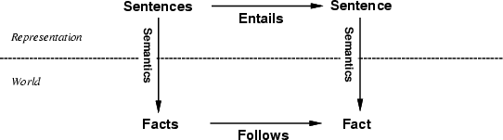
Semantics maps sentences in logic to facts in the world.
The property of one fact following from another is mirrored
by the property of one sentence being entailed by another.

Slide 17
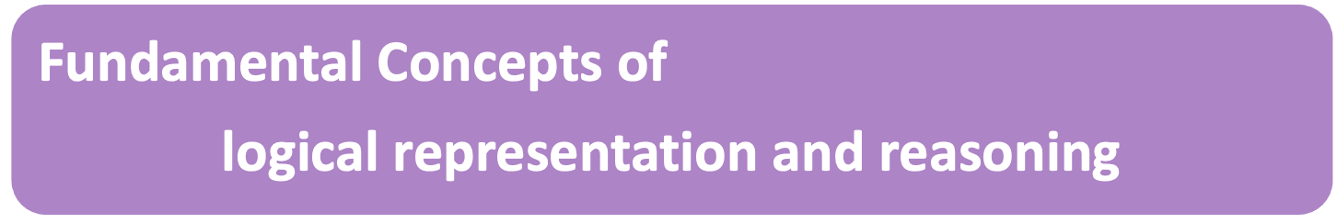
Information is represented in sentences, which must have correct syntax
  ( 1 + 2 ) * 7 = 21 vs. 2 ) + 7 = * ( 1 21
The semantics of a sentence defines its truth with respect to each possible world – an interpretation assigning T or F to all propositions
W is a model of S means that sentence S is true under interpretation W
[What do the following mean?]
  X |= Y
  X entails Y
  Y logically follows from X

Slide 18

{Man, Man → Mortal} |= Mortal
{Raining,Dog→ Mammal} |= Mammal
{Raining,Raining → Wet} |= Wet
{Smoke, Fire → Smoke} |= Fire
{Tall ^ Silly} |= Tall
{Tall v Silly} |= Silly
{Tall, Silly} |= Tall ^ Silly
[Wumpus world EG illustrating possible worlds and entailment]

Slide 19

A |= B
Under all interpretations in which A is true, B is true as well
All models of A are models of B
Whenever A is true, B is true as well
A entails B
B logically follows from A

Slide 20
Soundness and completeness
A sound inference method derives only entailed sentences.
Analogous to the property of completeness in search, a complete inference method can derive any sentence that is entailed.

Slide 21
Logic as a KR language
Multi-valued
Logic
Modal
Temporal
Non-monotonic
Logic
Higher Order
Probabilistic
Logic
First Order
Propositional Logic
Fuzzy
Logic

Slide 22
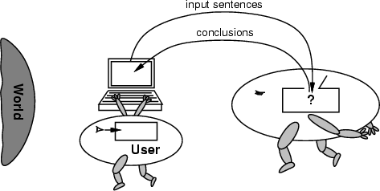
No independent access to the world
The reasoning agent often gets its knowledge about the facts of the world as a sequence of logical sentences and must draw conclusions only from them without independent access to the world.
Thus it is very important that the agent’s reasoning is sound!

Slide 23


Slide 24

Logic is a great knowledge representation language for many AI problems
Propositional logic is the simple foundation and fine for some AI problems
First order logic (FOL) is much more expressive as a KR language and more commonly used in AI
There are many variations: horn logic, higher order logic, three-valued logic, probabilistic logics, etc.

Slide 25

Logical constants: true, false
Propositional symbols: P, Q,... (atomic sentences)
Wrapping parentheses: ( … )
Sentences are combined by connectives:
  ∧and [conjunction]
  ∨ or [disjunction]
  ⇒ implies [implication / conditional]
  ⇔ is equivalent [biconditional]
  ¬ not [negation]
Literal: atomic sentence or negated atomic sentence
  P, ¬ P

Slide 26

(P ∧ Q) → R
  “If it is hot and humid, then it is raining”
Q → P
  “If it is humid, then it is hot”
Q
  “It is humid.”
We’re free to choose better symbols, btw:
  Ho = “It is hot”
  Hu = “It is humid”
  R = “It is raining”

Slide 27

Simple language for showing key ideas and definitions
User defines set of propositional symbols, like P and Q
User defines semantics of each propositional symbol:
  P means “It is hot”, Q means “It is humid”, etc.
A sentence (well formed formula) is defined as follows:
  A symbol is a sentence
  If S is a sentence, then ¬S is a sentence
  If S is a sentence, then (S) is a sentence
  If S and T are sentences, then (S ∨ T), (S ∧ T), (S → T), and (S ↔ T) are sentences
  A sentence results from a finite number of applications of the rules

Slide 28

The meaning or semantics of a sentence determines its interpretation
Given the truth values of all symbols in a sentence, it can be “evaluated” to determine its truth value (True or False)
A model for a KB is a possible world – an assignment of truth values to propositional symbols that makes each sentence in the KB True

Slide 29

Let the KB be [P∧Q→R, Q → P]
What are the possible models? Consider all possible assignments of T|F to P, Q and R and check truth tables
  FFF: OK
  FFT: OK
  FTF: NO
  FTT: NO
  TFF: OK
  TFT: OK
  TTF: NO
  TTT: OK
  If KB is [P∧Q→R, Q → P, Q], then the only model is TTT
P: it’s hot
Q: it’s humid
R: it’s raining

Slide 30

A valid sentence or tautology is a sentence that is True under all interpretations, no matter what the world is actually like or what the semantics is. Example: “It’s raining or it’s not raining”
An inconsistent sentence or contradiction is a sentence that is False under all interpretations. The world is never like what it describes, as in “It’s raining and it’s not raining.”
P entails Q, written P |= Q, means that whenever P is True, so is Q. In other words, all models of P are also models of Q.

Slide 31

A sentence is a tautology if it is true for any setting of its propositional symbols
P | Q | P OR Q | NOT(P) AND NOT(Q) | (P OR Q) OR (NOT(P) AND NOT(Q))
false | false | false | true | true
false | true | true | false | true
true | false | true | false | true
true | true | true | false | true
(P OR Q) OR (NOT(P) AND NOT(Q)) is a tautology

Slide 32



Truth tables are used to define logical connectives and to determine when a complex sentence is true given the values of the symbols in it.
Truth tables for the five logical connectives
Example of a truth table used for a complex sentence

Slide 33

Note that → is a logical connective
So P→Q is a logical sentence and has a truth value, i.e., is either true or false
If we add this sentence to the KB, it can be used by an inference rule, Modes Ponens, to derive/infer/prove Q if P is also in the KB
Given a KB where P=True and Q=True, we can also derive/infer/prove that P→Q is True

Slide 34

When is P→Q true? Check all that apply
  P=Q=true
  P=Q=false
  P=true, Q=false
  P=false, Q=true

Slide 35

When is P→Q true? Check all that apply
  P=Q=true
  P=Q=false
  P=true, Q=false
  P=false, Q=true
We can get this from the truth table for →
Note: in FOL it’s much harder to prove that a conditional true.
  Consider proving prime(x) → odd(x)
✔
✔
✔

Slide 36

Logical inference creates new sentences that logically follow from a set of sentences (KB)
An inference rule is sound if every sentence X it produces when operating on a KB logically follows from the KB
  i.e., inference rule creates no contradictions
An inference rule is complete if it can produce every expression that logically follows from (is entailed by) the KB.
  Note analogy to complete search algorithms

Slide 37

Here are some examples of sound rules of inference
Each can be shown to be sound using a truth table
  RULE PREMISE CONCLUSION
  Modus Ponens A, A → B B
  And Introduction A, B A ∧ B
  And Elimination A ∧ B A
  Double Negation ¬¬A A
  Unit Resolution A ∨ B, ¬B A
  Resolution A ∨ B, ¬B ∨ C A ∨ C

Slide 38

A | B | A → B | OK?
True | True | True | √
True | False | False | √
False | True | True | √
False | False | True | √

Slide 39

Resolution is a valid inference rule producing a new clause implied by two clauses containing complementary literals
  A literal is an atomic symbol or its negation, i.e., P, ~P
Amazingly, this is the only interference rule you need to build a sound and complete theorem prover
  Based on proof by contradiction and usually called resolution refutation
The resolution rule was discovered by Alan Robinson (CS, U. of Syracuse) in the mid 60s

Slide 40
A KB is actually a set of sentences all of which are true, i.e., a conjunction of sentences.
To use resolution, put KB into conjunctive normal form (CNF), where each sentence written as a disjunction of (one or more) literals
Example
  KB: [P→Q , Q→R∧S]
  KB in CNF: [~P∨Q , ~Q∨R , ~Q∨S]
  Resolve KB(1) and KB(2) producing: ~P∨R (i.e., P→R)
  Resolve KB(1) and KB(3) producing: ~P∨S (i.e., P→S)
  New KB: [~P∨Q , ~Q∨~R∨~S , ~P∨R , ~P∨S]
Tautologies
(A→B)↔(~A∨B)
(A∨(B∧C)) ↔(A∨B)∧(A∨C)

Slide 41

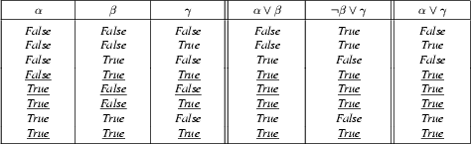
From the rightmost three columns of this truth table, we can see that
    (α ∨ β) ∧ (β ∨ γ) ↔ (α ∨ γ)
is valid (i.e., always true regardless of the truth values assigned to α, β and γ

Slide 42

A proof is a sequence of sentences, where each is a premise or is derived from earlier sentences in the proof by an inference rule
The last sentence is the theorem (also called goal or query) that we want to prove
Example for the “weather problem”
  1 Hu premise “It’s humid”
  2 Hu→Ho premise “If it’s humid, it’s hot”
  3 Ho modus ponens(1,2) “It’s hot”
  4 (Ho∧Hu)→R premise “If it’s hot & humid, it’s raining”
  5 Ho∧Hu and introduction(1,3) “It’s hot and humid”
  6 R modus ponens(4,5) “It’s raining”

Slide 43

Advantages
  Simple KR language sufficient for some problems
  Lays the foundation for higher logics (e.g., FOL)
  Reasoning is decidable, though NP complete, and efficient techniques exist for many problems
Disadvantages
  Not expressive enough for most problems
  Even when it is, it can very “un-concise”

Slide 44

Hard to identify “individuals” (e.g., Mary, 3)
Can’t directly talk about properties of individuals or relations between individuals (e.g., “Bill is tall”)
Generalizations, patterns, regularities can’t easily be represented (e.g., “all triangles have 3 sides”)
First-Order Logic (FOL) is expressive enough to represent this kind of information using relations, variables and quantifiers, e.g.,
    Every elephant is gray: ∀ x (elephant(x) → gray(x))
    There is a white alligator: ∃ x (alligator(X) ^ white(X))

Slide 45

First-order logic (FOL) models the world in terms of
  Objects, which are things with individual identities
  Properties of objects that distinguish them from other objects
  Relations that hold among sets of objects
  Functions, which are a subset of relations where there is only one “value” for any given “input”
Examples:
  Objects: Students, lectures, companies, cars ...
  Relations: Brother-of, bigger-than, outside, part-of, has-color, occurs-after, owns, visits, precedes, ...
  Properties: blue, oval, even, large, ...
  Functions: father-of, best-friend, second-half, one-more-than ...

Slide 46

Constant symbols, which represent individuals in the world
  Mary
  3
  Green
Function symbols, which map individuals to individuals
  father-of(Mary) = John
  color-of(Sky) = Blue
Predicate symbols, which map individuals to truth values
  greater(5,3)
  green(Grass)
  color(Grass, Green)

Slide 47

Variable symbols
  E.g., x, y, foo
Connectives
  Same as in PL: not (¬), and (∧), or (∨), implies (→), if and only if (biconditional ↔)
Quantifiers
  Universal ∀x or (Ax)
  Existential ∃x or (Ex)

Slide 48

A term (denoting a real-world individual) is a constant symbol, a variable symbol, or an n-place function of n terms.
  x and f(x₁, ..., x_{n}) are terms, where each x_{i} is a term.
  A term with no variables is a ground term
An atomic sentence (which has value true or false) is an n-place predicate of n terms
A complex sentence is formed from atomic sentences connected by the logical connectives:
  ¬P, P∨Q, P∧Q, P→Q, P↔Q where P and Q are sentences
A quantified sentence adds quantifiers ∀ and ∃
A well-formed formula (wff) is a sentence containing no “free” variables. That is, all variables are “bound” by universal or existential quantifiers.
  (∀x)P(x,y) has x bound as a universally quantified variable, but y is free.

Slide 49

Universal quantification
  (∀x)P(x) means that P holds for all values of x in the domain associated with that variable
  E.g., (∀x) dolphin(x) → mammal(x)
Existential quantification
  (∃ x)P(x) means that P holds for some value of x in the domain associated with that variable
  E.g., (∃ x) mammal(x) ∧ lays-eggs(x)
  Permits one to make a statement about some object without naming it

Slide 50

Universal quantifiers are often used with “implies” to form “rules”:
  (∀x) student(x) → smart(x) means “All students are smart”
Universal quantification is rarely used to make blanket statements about every individual in the world:
  (∀x)student(x)∧smart(x) means “Everyone in the world is a student and is smart”
Existential quantifiers are usually used with “and” to specify a list of properties about an individual:
  (∃x) student(x) ∧ smart(x) means “There is a student who is smart”
A common mistake is to represent this English sentence as the FOL sentence:
  (∃x) student(x) → smart(x)
  But what happens when there is a person who is not a student?

Slide 51
Some Examples
Brother(Richard, John). Richard is the brother of John
Married(Father(Richard),Mother(John)): Richard the Lionheart’s father is married
to King John’s mother
∀x King(x) ⇒ Person(x) : All kings are persons
∀x ∀y Brother(x,y) ⇒ Sibling(x,y) Brothers are siblings
∀x ∃ y Loves(x,y) Everybody loves somebody
∀x ¬Likes(x,Parsnips) = ¬∃ x Likes(x,Parsnips)
∀x Likes(x,IceCream) is equivalent to ¬∃ x ¬Likes(x,IceCream)

Slide 52
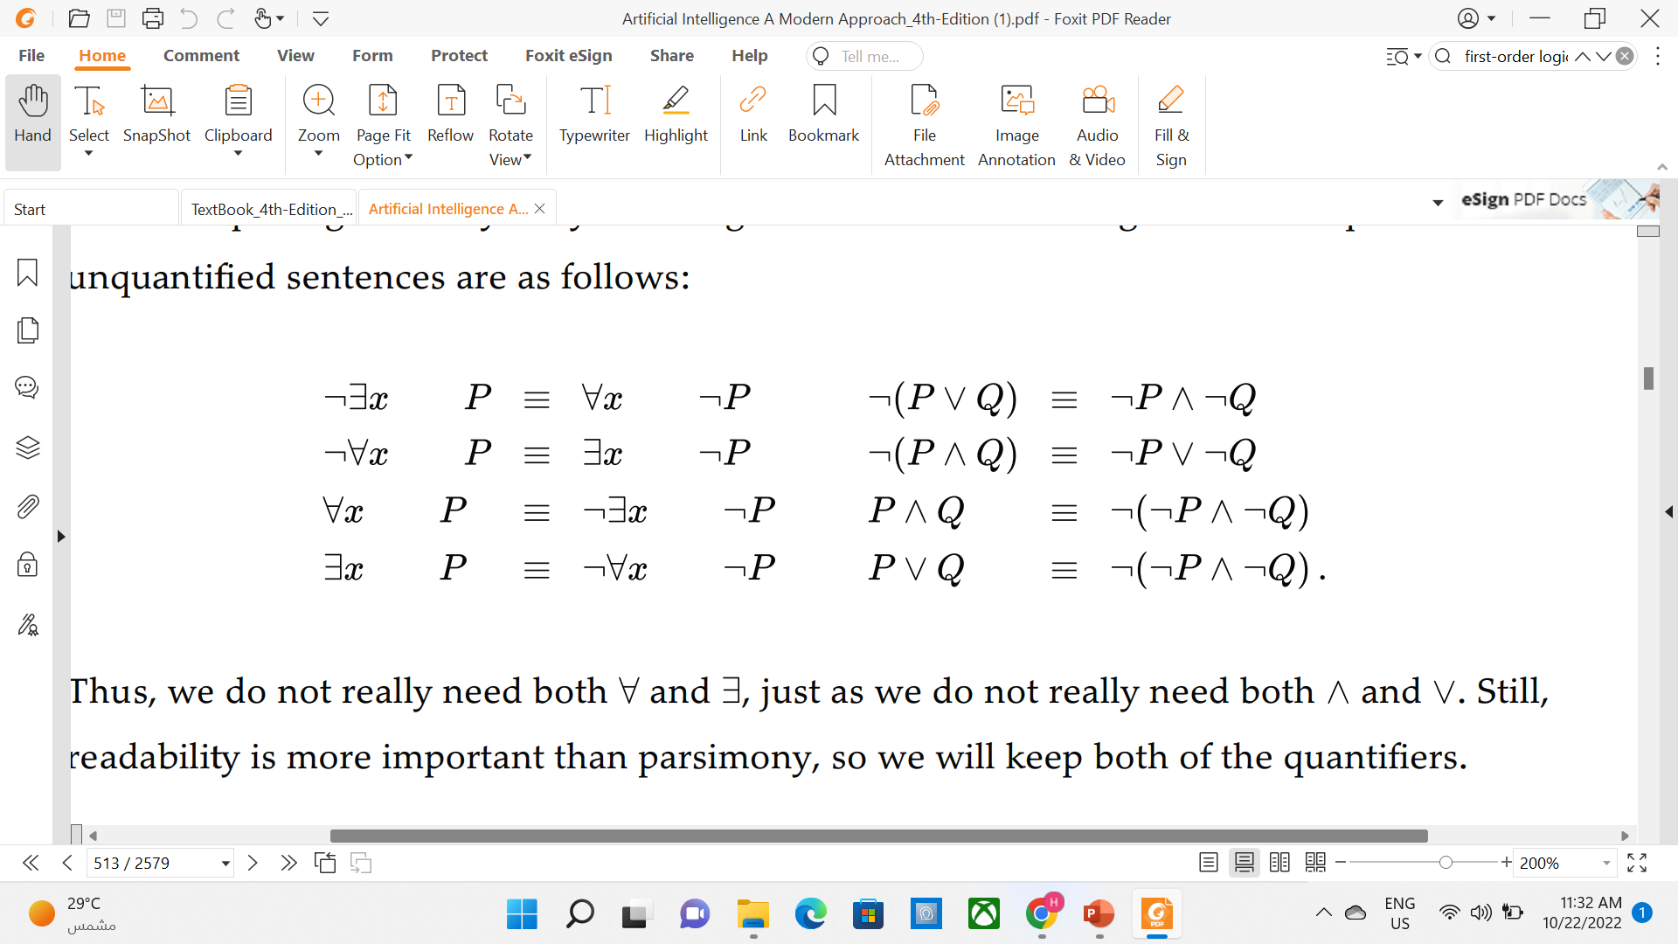
The De Morgan rules for quantified and unquantified sentences
        Prove the following by using Truth table:

Slide 53

Inference is the process of deriving new sentences from old
  Sound inference derives true conclusions given true premises
  Complete inference derives all true conclusions from a set of premises
A valid sentence is true in all worlds under all interpretations
If an implication sentence can be shown to be valid, then—given its premise—its consequent can be derived
Different logics make different commitments about what the world is made of and what kind of beliefs we can have
Propositional logic commits only to the existence of facts that may or may not be the case in the world being represented
  Simple syntax and semantics suffices to illustrate the process of inference
  Propositional logic can become impractical, even for very small worlds

Slide 54

Intelligent agents need knowledge about the world for making good decisions.
The knowledge of an agent is stored in a knowledge base in the form of sentences in a knowledge representation language.
A knowledge-based agent needs a knowledge base and an inference mechanism. It operates by storing sentences in its knowledge base, inferring new sentences with the inference mechanism, and using them to deduce which actions to take.
A representation language is defined by its syntax and semantics, which specify the structure of sentences and how they relate to the facts of the world.
The interpretation of a sentence is the fact to which it refers. If this fact is part of the actual world, then the sentence is true.

