Slide 1
Chapter12 Quantifying Uncertainty

Slide 2

Topics
Acting under Uncertainty
Random Variables
Joint and Marginal Distributions
Conditional Distribution
Bayes’ Rule
Inference
Notes:
Like “sort this list” or “add these two numbers”

Slide 3
Acting under Uncertainty
Uncertainty arises because of both laziness and ignorance. It is inescapable in complex, nondeterministic, or partially observable environments.
General situation:
Observed variables (evidence): Agent knows certain things about the state of the world (e.g., sensor readings or symptoms)
Unobserved variables: Agent needs to reason about other aspects (e.g. where an object is or what disease is present)
Model: Agent knows something about how the known variables relate to the unknown variables
Probabilistic reasoning gives us a framework for managing our beliefs and knowledge

Slide 4
Random Variables
A random variable is some aspect of the world about which we (may) have uncertainty
R = Is it raining?
T = Is it hot or cold?
D = How long will it take to drive to work?
L = Where is the ghost?
We denote random variables with capital letters
Like variables in a CSP, random variables have domains
R in {true, false} (often write as {+r, -r})
T in {hot, cold}
D in [0, ∞)
L in possible locations, maybe {(0,0), (0,1), …}

Slide 5
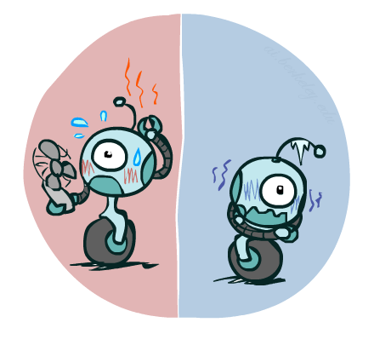

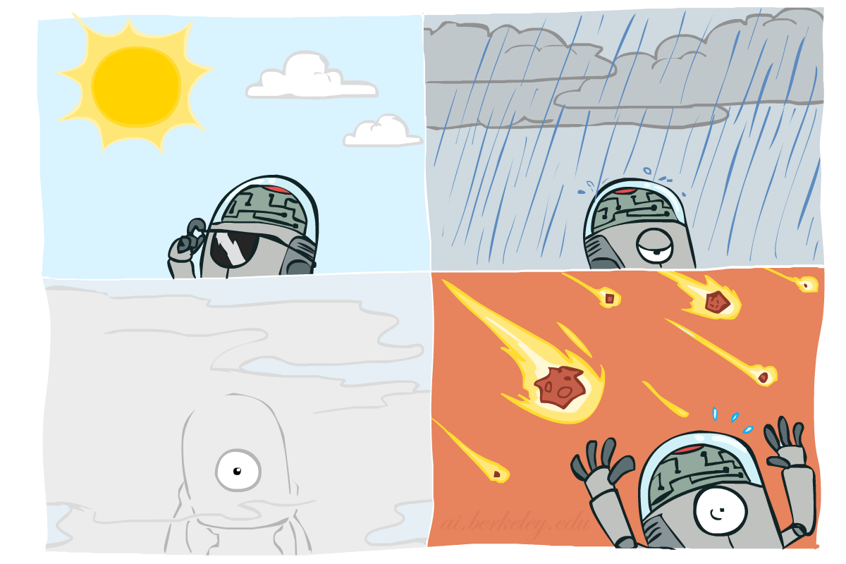

Probability Distributions
Associate a probability with each value
Temperature:
Weather:
W | P
sun | 0.6
rain | 0.1
fog | 0.3
meteor | 0.0
T | P
hot | 0.5
cold | 0.5

Slide 6


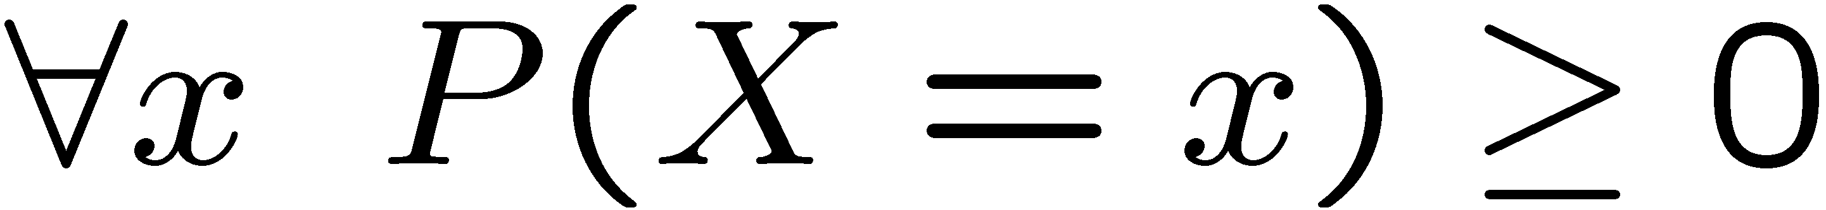
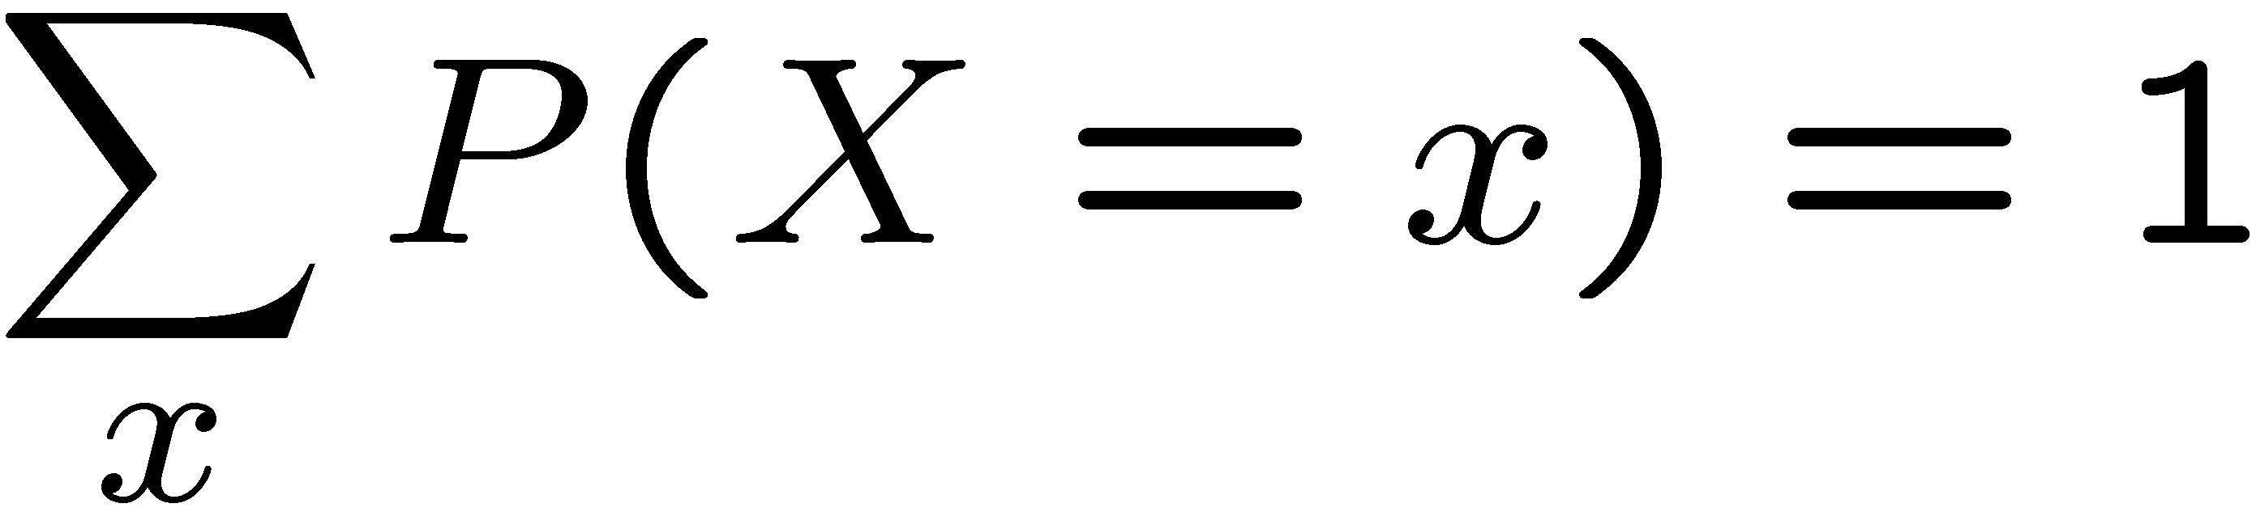
Probability Distributions
Unobserved random variables have distributions
A distribution is a TABLE of probabilities of values
A probability (lower case value) is a single number
Must have: and
Shorthand notation:
OK if all domain entries are unique
T | P
hot | 0.5
cold | 0.5
W | P
sun | 0.6
rain | 0.1
fog | 0.3
meteor | 0.0

Slide 7




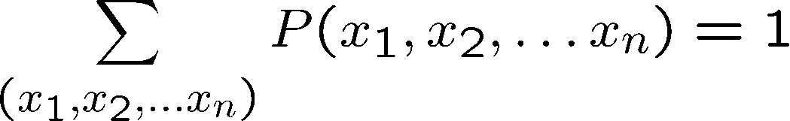
Joint Distributions
A joint distribution over a set of random variables:
specifies a real number for each assignment (or outcome):
Must obey:
Size of distribution if n variables with domain sizes d?
For all but the smallest distributions, impractical to write out!
T | W | P
hot | sun | 0.4
hot | rain | 0.1
cold | sun | 0.2
cold | rain | 0.3

Slide 8
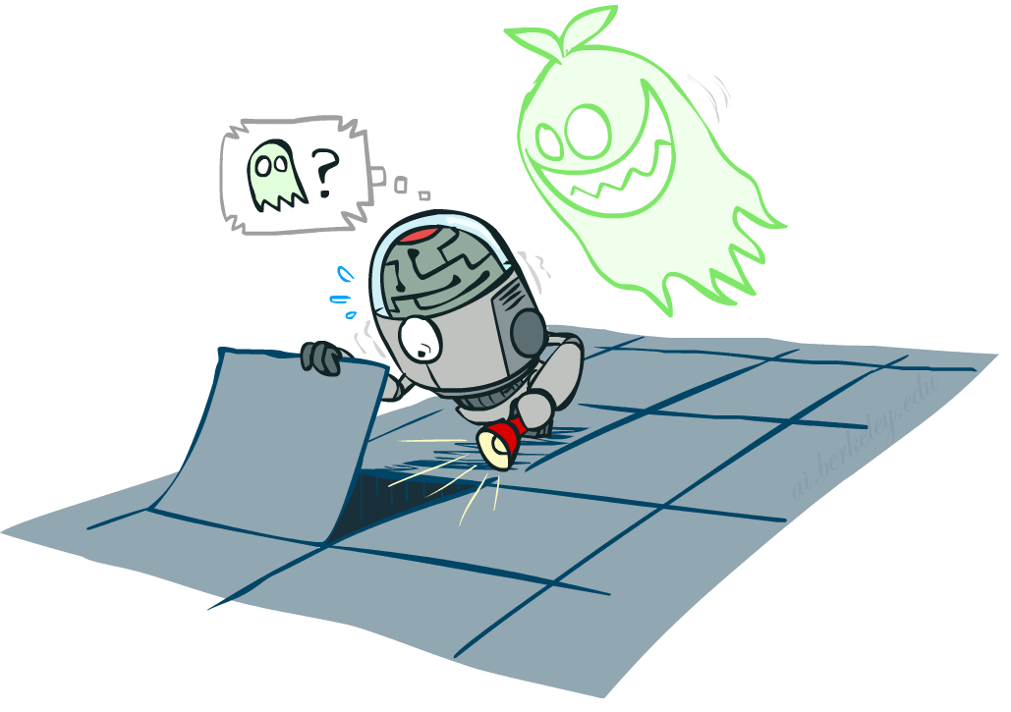

Probabilistic Models
Distribution over T,W
A probabilistic model is a joint distribution over a set of random variables
Probabilistic models:
(Random) variables with domains
Assignments are called outcomes
Joint distributions: say whether assignments (outcomes) are likely
Normalized: sum to 1.0
Ideally: only certain variables directly interact
Constraint satisfaction problems:
Variables with domains
Constraints: state whether assignments are possible
Ideally: only certain variables directly interact
T | W | P
hot | sun | 0.4
hot | rain | 0.1
cold | sun | 0.2
cold | rain | 0.3
Constraint over T,W
T | W | P
hot | sun | T
hot | rain | F
cold | sun | F
cold | rain | T

Slide 9
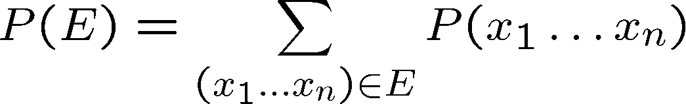
Events
An event is a set E of outcomes
From a joint distribution, we can calculate the probability of any event
Probability that it’s hot AND sunny?
Probability that it’s hot?
Probability that it’s hot OR sunny?
Typically, the events we care about are partial assignments, like P(T=hot)
T | W | P
hot | sun | 0.4
hot | rain | 0.1
cold | sun | 0.2
cold | rain | 0.3

Slide 10
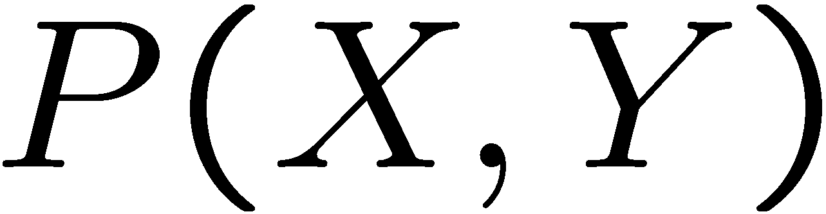
Quiz: Events
P(+x, +y) ?
P(+x) ?
P(-y OR +x) ?
X | Y | P
+x | +y | 0.2
+x | -y | 0.3
-x | +y | 0.4
-x | -y | 0.1

Slide 11
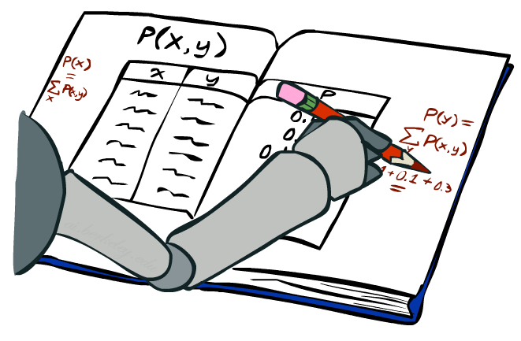
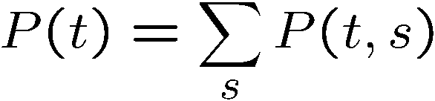
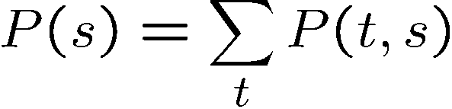
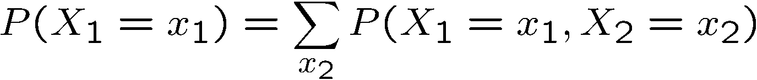
Marginal Distributions
Marginal distributions are sub-tables which eliminate variables
Marginalization (summing out): Combine collapsed rows by adding
T | P
hot | 0.5
cold | 0.5
T | W | P
hot | sun | 0.4
hot | rain | 0.1
cold | sun | 0.2
cold | rain | 0.3
W | P
sun | 0.6
rain | 0.4

Slide 12
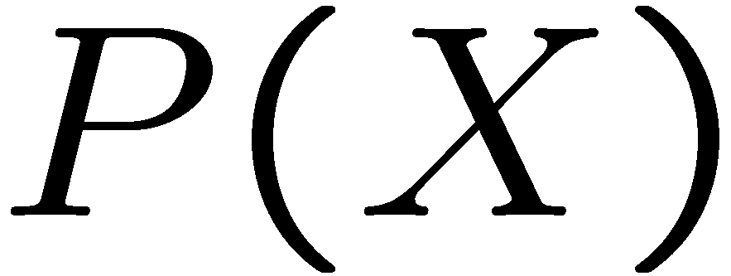
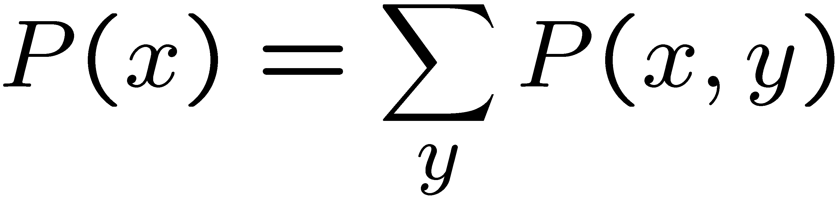
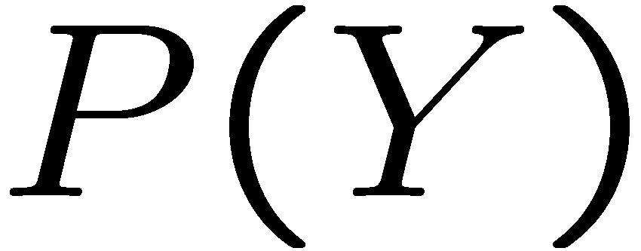
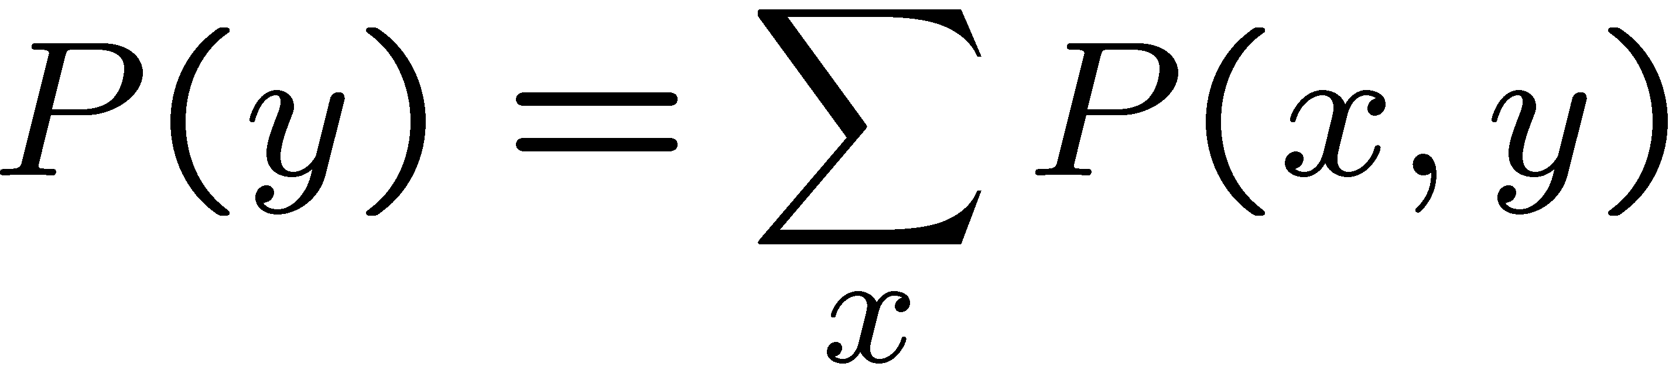
Quiz: Marginal Distributions
X | P
+x
-x
X | Y | P
+x | +y | 0.2
+x | -y | 0.3
-x | +y | 0.4
-x | -y | 0.1
Y | P
+y
-y

Slide 13
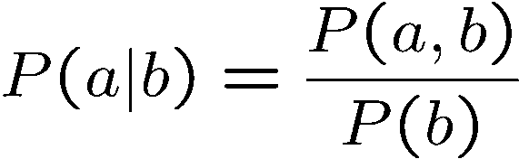
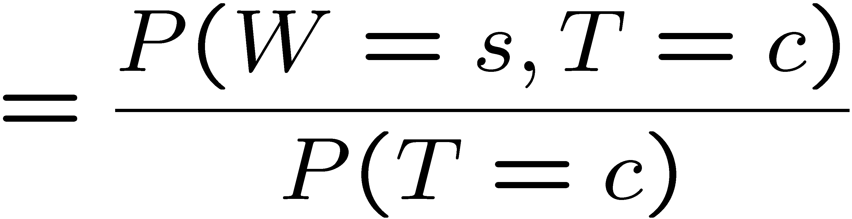
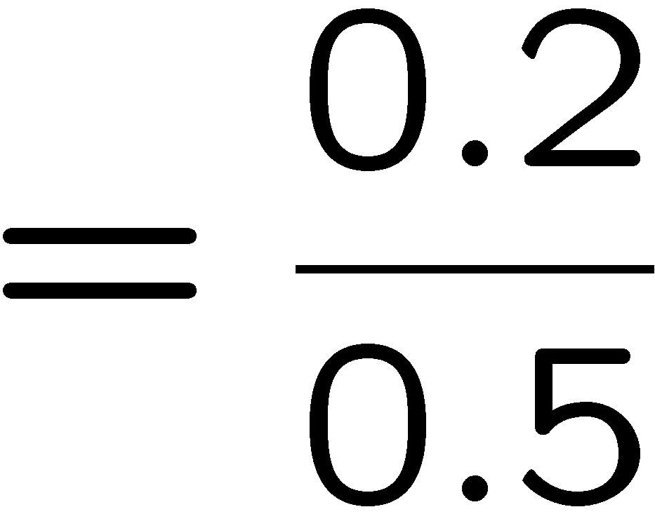



Conditional Probabilities
A simple relation between joint and conditional probabilities
In fact, this is taken as the definition of a conditional probability
P(a,b)
P(a)
P(b)
T | W | P
hot | sun | 0.4
hot | rain | 0.1
cold | sun | 0.2
cold | rain | 0.3

Slide 14
Quiz: Conditional Probabilities
P(+x | +y) ?
P(-x | +y) ?
P(-y | +x) ?
X | Y | P
+x | +y | 0.2
+x | -y | 0.3
-x | +y | 0.4
-x | -y | 0.1

Slide 15



Conditional Distributions
Conditional distributions are probability distributions over some variables given fixed values of others
Conditional Distributions
Joint Distribution
W | P
sun | 0.8
rain | 0.2
T | W | P
hot | sun | 0.4
hot | rain | 0.1
cold | sun | 0.2
cold | rain | 0.3
W | P
sun | 0.4
rain | 0.6

Slide 16

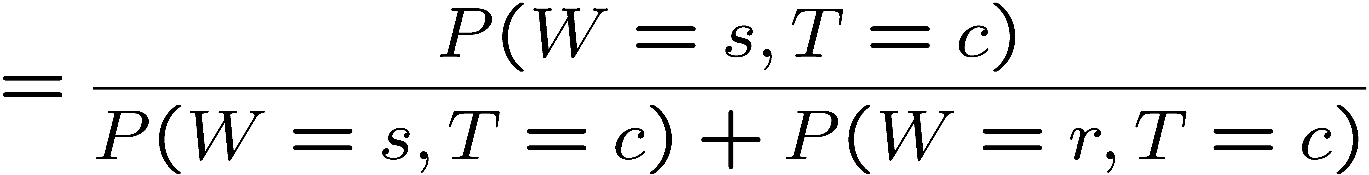
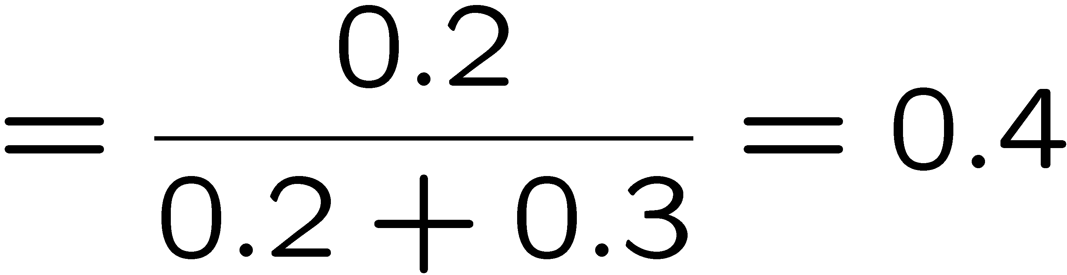
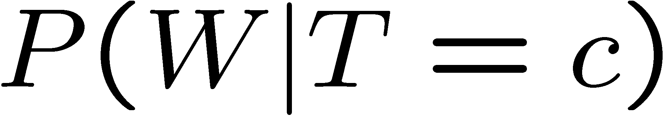
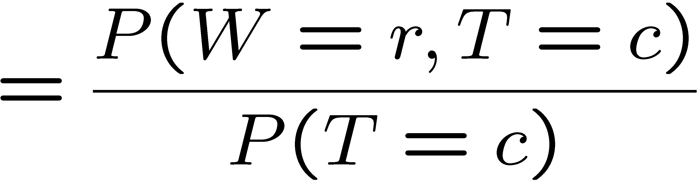

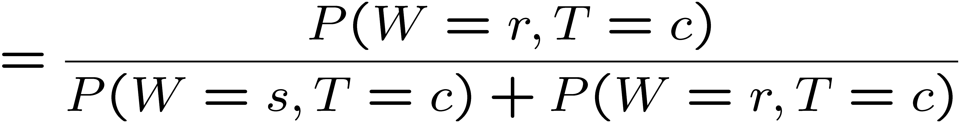
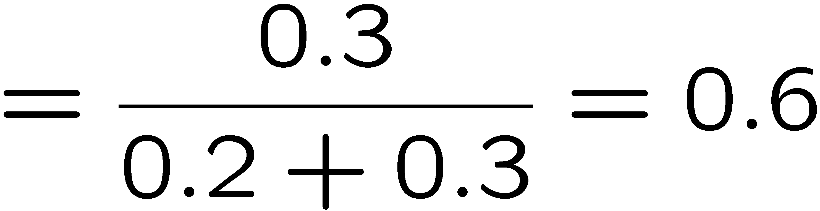
Normalization Trick
T | W | P
hot | sun | 0.4
hot | rain | 0.1
cold | sun | 0.2
cold | rain | 0.3
W | P
sun | 0.4
rain | 0.6

Slide 17
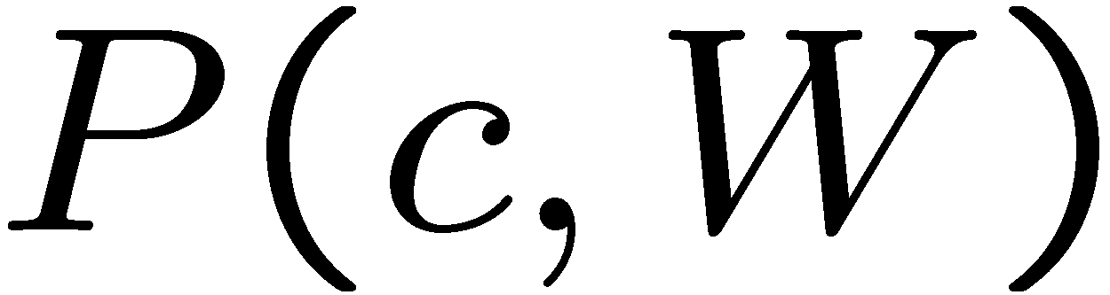
Normalization Trick
SELECT the joint probabilities matching the evidence
NORMALIZE the selection
(make it sum to one)
T | W | P
hot | sun | 0.4
hot | rain | 0.1
cold | sun | 0.2
cold | rain | 0.3
T | W | P
cold | sun | 0.2
cold | rain | 0.3
W | P
sun | 0.4
rain | 0.6

Slide 18
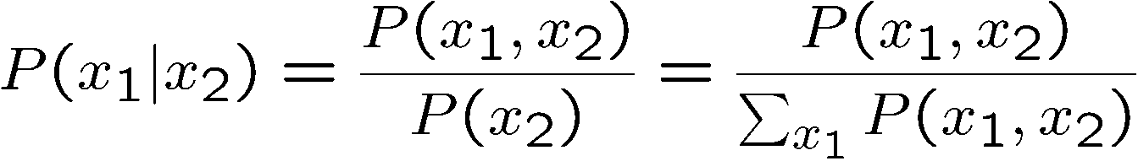
Normalization Trick
SELECT the joint probabilities matching the evidence
NORMALIZE the selection
(make it sum to one)
T | W | P
hot | sun | 0.4
hot | rain | 0.1
cold | sun | 0.2
cold | rain | 0.3
T | W | P
cold | sun | 0.2
cold | rain | 0.3
W | P
sun | 0.4
rain | 0.6
Why does this work? Sum of selection is P(evidence)! (P(T=c), here)

Slide 19
Quiz: Normalization Trick
P(X | Y=-y) ?
SELECT the joint probabilities matching the evidence
NORMALIZE the selection
(make it sum to one)
X | Y | P
+x | +y | 0.2
+x | -y | 0.3
-x | +y | 0.4
-x | -y | 0.1

Slide 20
To Normalize
(Dictionary) To bring or restore to a normal condition
Procedure:
Step 1: Compute Z = sum over all entries
Step 2: Divide every entry by Z
Example 1
All entries sum to ONE
Example 2
W | P
sun | 0.2
rain | 0.3
Normalize
W | P
sun | 0.4
rain | 0.6
T | W | P
hot | sun | 20
hot | rain | 5
cold | sun | 10
cold | rain | 15
T | W | P
hot | sun | 0.4
hot | rain | 0.1
cold | sun | 0.2
cold | rain | 0.3
Normalize
Z = 0.5
Z = 50

Slide 21
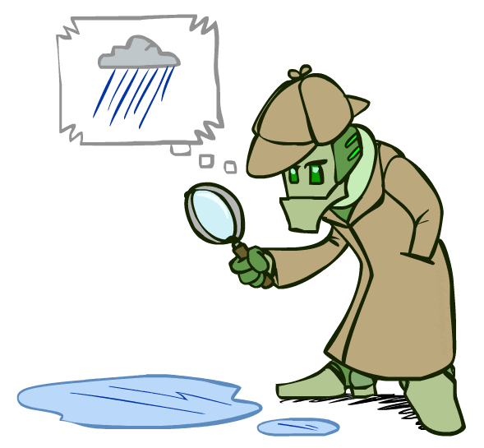
Probabilistic Inference
Probabilistic inference: compute a desired probability from other known probabilities (e.g. conditional from joint)
We generally compute conditional probabilities
P(on time | no reported accidents) = 0.90
These represent the agent’s beliefs given the evidence
Probabilities change with new evidence:
P(on time | no accidents, 5 a.m.) = 0.95
P(on time | no accidents, 5 a.m., raining) = 0.80
Observing new evidence causes beliefs to be updated

Slide 22





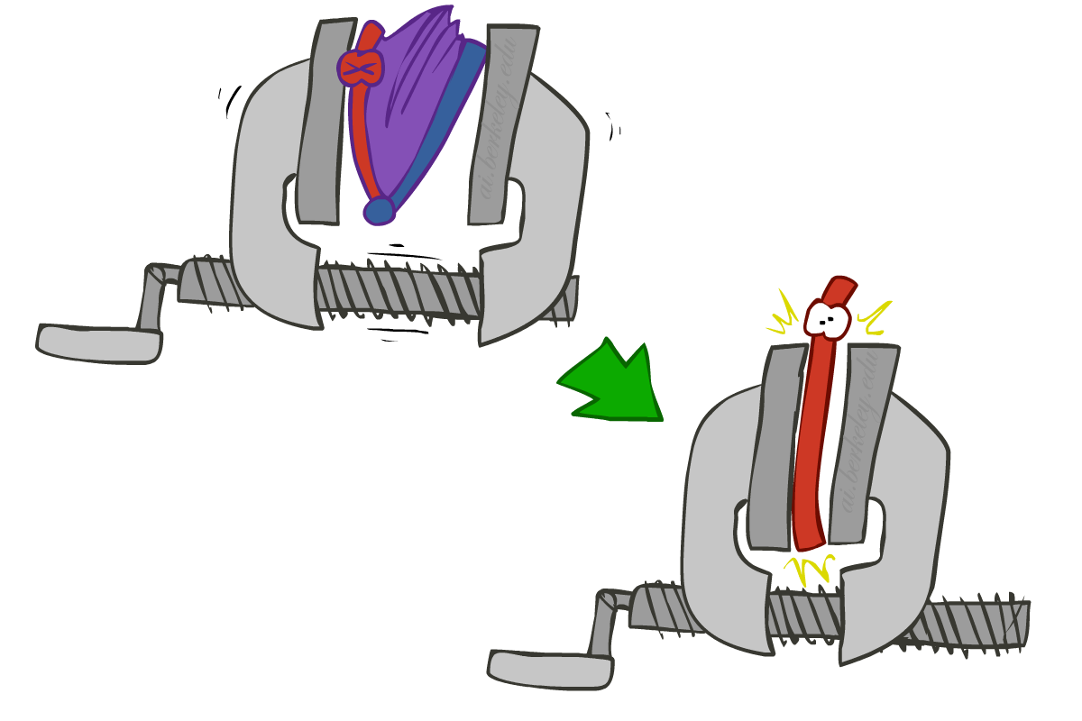
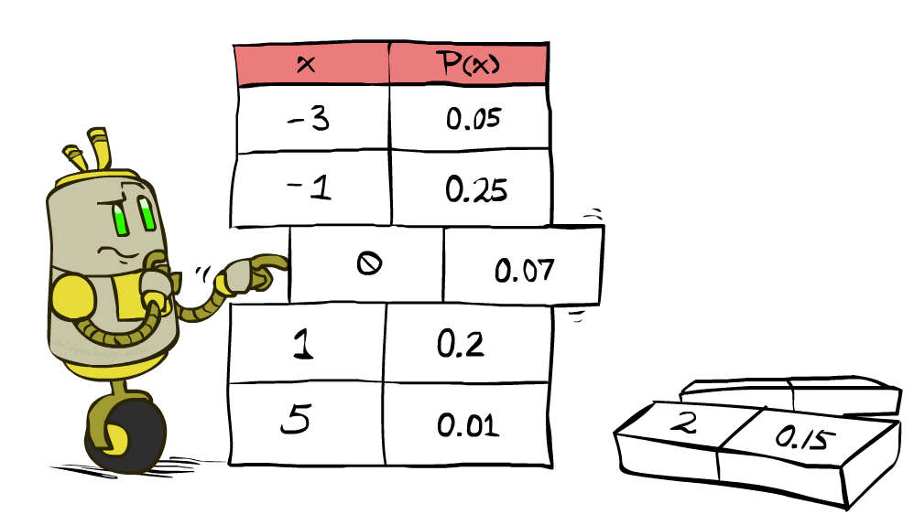


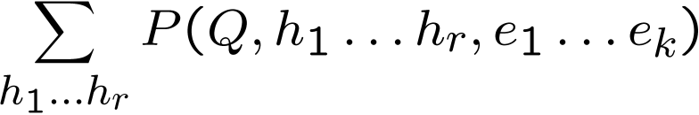
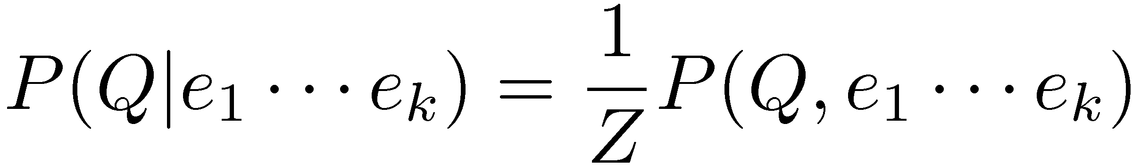
Inference by Enumeration
* Works fine with multiple query variables, too
General case:
Evidence variables:
Query* variable:
Hidden variables:
We want:
All variables
Step 1: Select the entries consistent with the evidence
Step 2: Sum out H to get joint of Query and evidence
Step 3: Normalize

Slide 23
Inference by Enumeration
P(W)?
P(W | winter)?
P(W | winter, hot)?
S | T | W | P
summer | hot | sun | 0.30
summer | hot | rain | 0.05
summer | cold | sun | 0.10
summer | cold | rain | 0.05
winter | hot | sun | 0.10
winter | hot | rain | 0.05
winter | cold | sun | 0.15
winter | cold | rain | 0.20

Slide 24
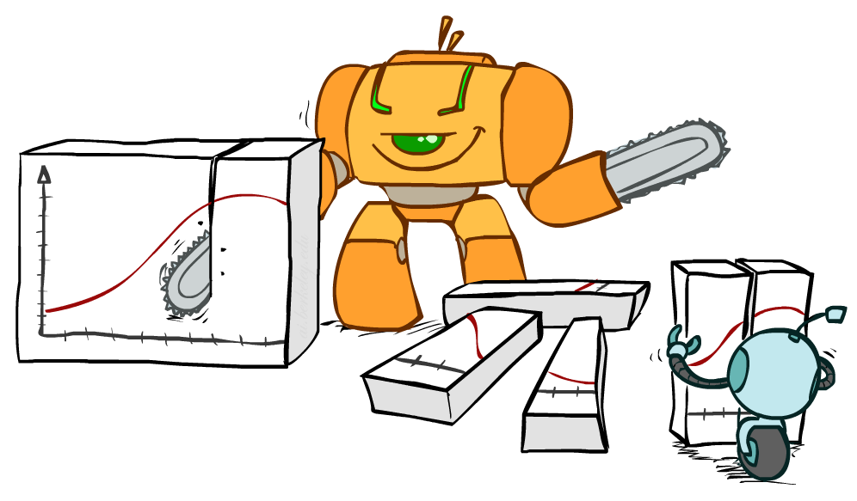
Bayes Rule

Slide 25


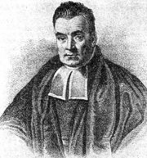
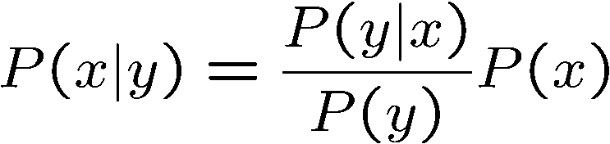
Bayes’ Rule
Two ways to factor a joint distribution over two variables:
Dividing, we get:
Why is this at all helpful?
Lets us build one conditional from its reverse
Often one conditional is tricky but the other one is simple
Foundation of many systems we’ll see later (e.g. ASR, MT)
In the running for most important AI equation!
That’s my rule!

Slide 26
Inference with Bayes’ Rule
Example: Diagnostic probability from causal probability:
Example:
A doctor knows that the disease meningitis causes a patient to have a stiff neck,
say, 70% of the time. The doctor also knows some unconditional facts: the prior probability that any patient has meningitis is 1/50,000 and the prior probability that any patient has a stiff neck is 1%.

Slide 27
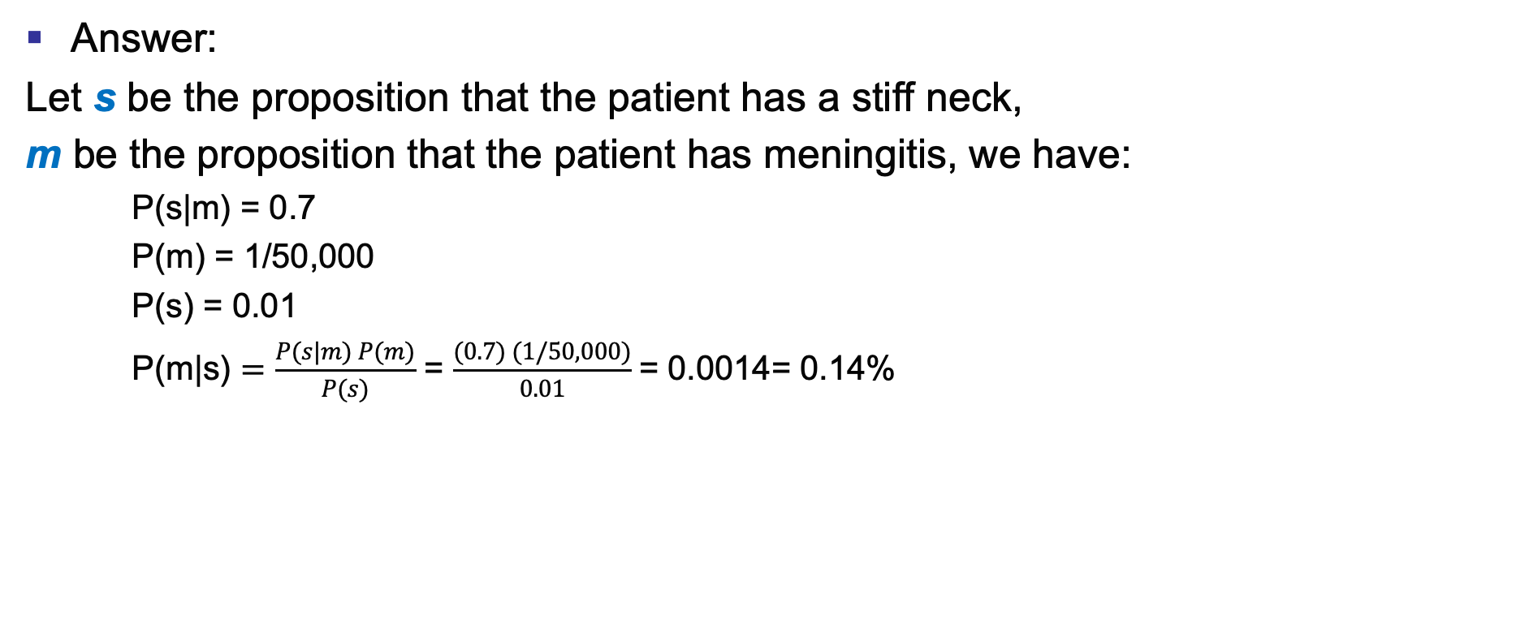
Inference with Bayes’ Rule
Answer:
Let s be the proposition that the patient has a stiff neck,
m be the proposition that the patient has meningitis, we have:
P(s|m) = 0.7
P(m) = 1/50,000
P(s) = 0.01
P(m|s) $=\frac{P(s|m) P(m)}{P(s)}$ = $\frac{(0.7) (1/50,000)}{0.01}$= 0.0014= 0.14%

Slide 28

Quiz: Bayes’ Rule
Given:
What is P(W | dry) ?
D | W | P
wet | sun | 0.1
dry | sun | 0.9
wet | rain | 0.7
dry | rain | 0.3
R | P
sun | 0.8
rain | 0.2

Slide 29
Summary
Probabilities express the agent’s inability to reach a definite decision regarding the truth of a sentence.
Probabilities summarize the agent’s beliefs relative to the evidence.
The full joint probability distribution specifies the probability of each complete assignment of values to random variables.
Bayes’ rule allows unknown probabilities to be computed from known conditional probabilities, usually in the causal direction.

